Slide 1

Standards-based
Engineering Frameworks
(Excerpts and updates based on Section 1.3 of http://eislab.gatech.edu/pubs/seminars-etc/2002-04-shinshu-peak/)
Russell Peak
Senior Researcher
Manufacturing Research Center
Georgia Tech
Plus other contributors as noted …
Excerpt Version
2003-08-12

Slide 2
Engineering Frameworks Interest Group (EFWIG)
A PDES Inc. Systems Engineering Subproject http://eislab.gatech.edu/efwig/
  The Engineering Frameworks Interest Group (EFWIG) is a cooperative team aimed at furthering standards-based collaborative engineering environments (CEEs). In this context, similar terminology¹ includes engineering information and knowledge systems, interoperability technology, repository architectures, and integration frameworks.
The emphasis is on techniques and tools to achieve open, standards-based EFWs. We are showing how existing and emerging standards like ISO 10303 (STEP), OMG CAD Services, and W3C SOAP can work together to enable plug-and-play EFWs. We are also working with similar groups to identify gaps, develop solutions, and promote standardization of such solutions.
The initial scope is oriented towards electro-mechanical systems design (e.g., STEP AP210), systems engineering (e.g., AP233), systems software, and engineering analysis (e.g., AP209) . Cross-cutting aspects like PDM/PxM, engineering information technology, and knowledge representation are also considered. The target end user context is engineering work groups and departments developing in-process designs.
Another way to think of EFWIG is as an "implementers forum" or "users group“; however, here the thing being implemented and used is not a single standard or a vendor tool, but EFWs within particular organizations (which include components like people, their models, their tools, and enabling standards). Thus groups like the NASA/JPL Design Hub that provide CAx capabilities across an organization are natural EFWIG stakeholders.
1 - Related terms include systems for product data/lifecycle/information/knowledge management (PxM) and collaborative product commerce (CPC).
Source: http://eislab.gatech.edu/efwig/ - 2002-05-21 - Russell Peak - Georgia Tech

Slide 3
Contents
Introductory Definitions
Gaps Addressed
Example Standards-Based Engineering Framework
(NASA JPL work by GIT et al. using AP210 & AP233)
Benefits

Slide 4
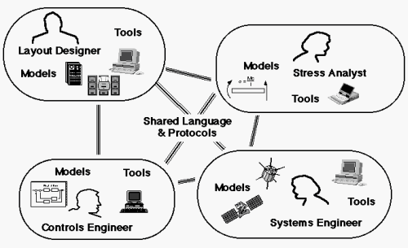
Engineering Framework
As Defined by a Question
“How do we connect people, their models, and their tools?”
[Olsen, 1994]
Similar terms: information system, knowledge-based system,
advanced / collaborative engineering environment (AEE/CEE), …

Slide 5
Engineering Framework
Components & Views
Some EFW “components” …
  Computing - networks, machines, software (tools)
  Content - information representation (models)
  Communication - content access protocols (interoperability)
  Control - work flow & business processes
  People - including their specific skills and roles
Some views of an EFW …
  Computer Network View
  Software Tool Organization View
  Product Model Content View
  Tool-Product Model Relationships View
Various Standards
Required

Slide 6
Framework Aspects
Components
  Tool/Service Communication - how to provide model inputs to a tool and request model outputs.
  Information Representation - how to represent models in a computer-processable manner for sharing among tools.
  Control - how to manage sequencing of multiple tools, coordination of multiple users, consistency of shared information, etc.
Spectrum of Applicability
  Intra-group connections ↔
  International virtual enterprise connections
Standards
Required

Slide 7
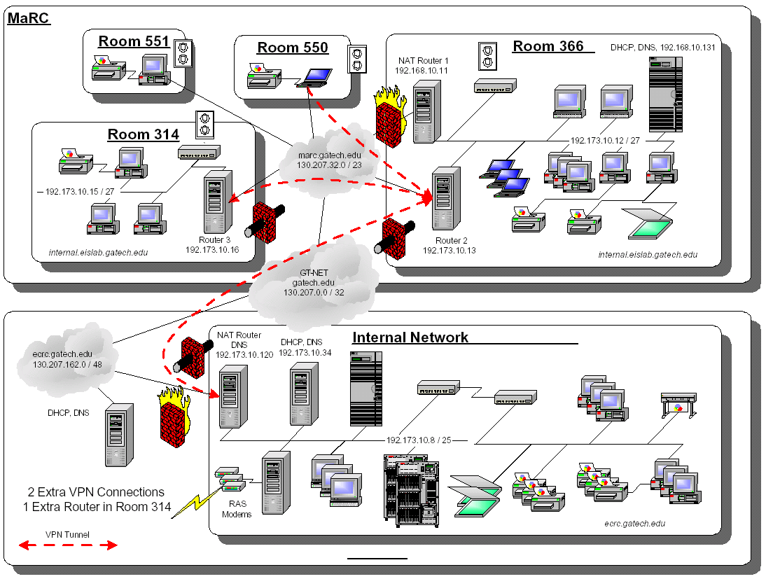
Example EFW: Computer Network View
Georgia Tech ECRC & EIS Lab (sanitized)
Adapted from 2000-07 - Chien Hsiung, Georgia Tech

Slide 8









Example EFW: Software Tool Organization View
Customers
JPL Projects and Technical Divisions
Soap
Sat Took Kit SDK
Doors
ApGen
Fast Flight
Ansoft
HPEE Sof
Sonnet
Mentor Graphics
Cadence
Mathworks Matlab
Synopsys
Synplicity
Ilogix Statemate
Orcad
AutoCad
Relex
Avant!
Place & Route
- Actel
- Xilinx
- Atmel
(and many more)
PTC Computer Vision
PTC Pro-E
SDRC Ideas
SDRC Femap
Solid Works
Cosmos
NASTRAN
Adams
Sinda/Fluent
PDMS -
EDMG
SDRC Metaphase
Sherpa
Visual ToolSets
Cool Jex
Perceps
Rational Rose
Ruify
Harlequin LISP
I-Logix Rhapsody
Code V
LensView
TracePro
Zemax
Software Tools
CAE Cost Centers
System
CAE
RF & EM
CAE
Electronics
CAE
Mechanical
CAE
Software
CAE
Optical
CAE
DIVISION 31
DIVISION 33
DIVISION 34
DIVISION 35
DIVISION 36
DIVISION 38
M-CAE Toolsmiths
and Workstations
Holding Account
Billing & Payable
E-CAE Toolsmiths and Workstations
Toolsmiths
Workstations
Servers & Sys Admin
M-CAE Servers
& Sys Admin
TMOD Severs
Servers & SA
DNP Operations
* Not DNP Operations
Management and Administration
Robin Moncada
Design, Build, Assembly, Test (DBAT) Process
Source: Adapted from “Computer Aided Engineering Tool Service at JPL” - 2001-07-22 - Mike Dickerson -NASA-JPL

Slide 9
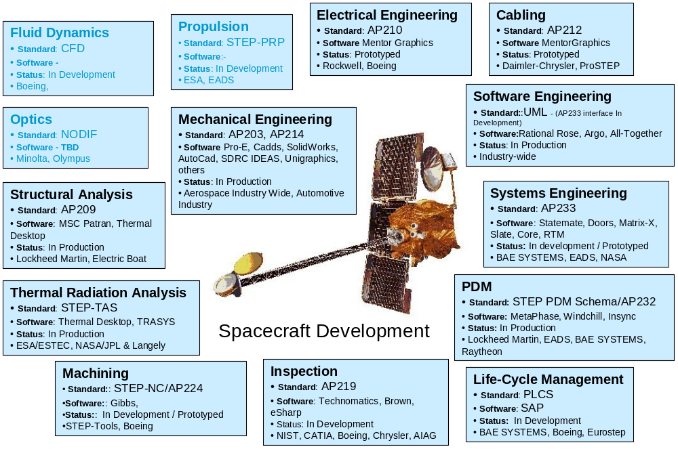
EFW View: Specific Product Model Content
A composition of standard and custom information models
Adapted from 2001-12-16 - Jim U’Ren, NASA-JPL

Slide 10
EFW View:
Tool-Product Model Relationships
Electrical
CAD Tools
Mechanical
CAD Tools
Systems Engineering
Tools
Traditional
Tools
Eagle
Pro/E
Doors
Mentor
Graphics
CATIA
Slate
…
AP210
AP203, AP214
AP233
Smart Product Model
Building Blocks
Models & meta-models
  International standards
  Industry specs
  Corporate standards
  Local customizations
Modeling technologies:
  Express, UML, XML, COBs, …
AP210
AP2xx
XaiTools
PWA-B
LKSoft, …
STEP-Book AP210,
SDAI-Edit,
STI AP210 Viewer, ...
Gap-Filling
Tools
XaiTools
PWA-B
pgef
EPM, LKSoft,
STI, …
PWB Stackup Tool,
…
Engineering
Framework Tool
Instance Browser/Editor

Slide 11
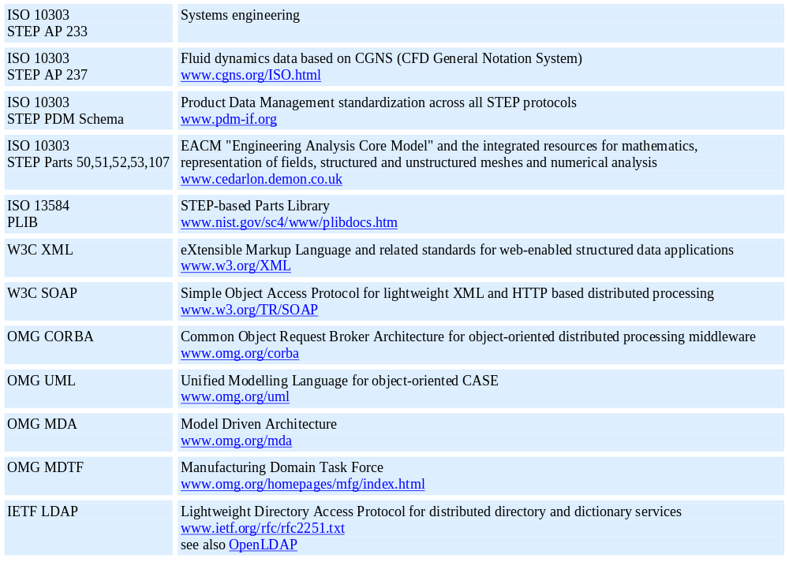
Partial “Parts Library” of
Relevant EFW Standards
From http://www.estec.esa.nl/conferences/aerospace-pde-2002/relevant_standards.htm as of 2/2002

Slide 12
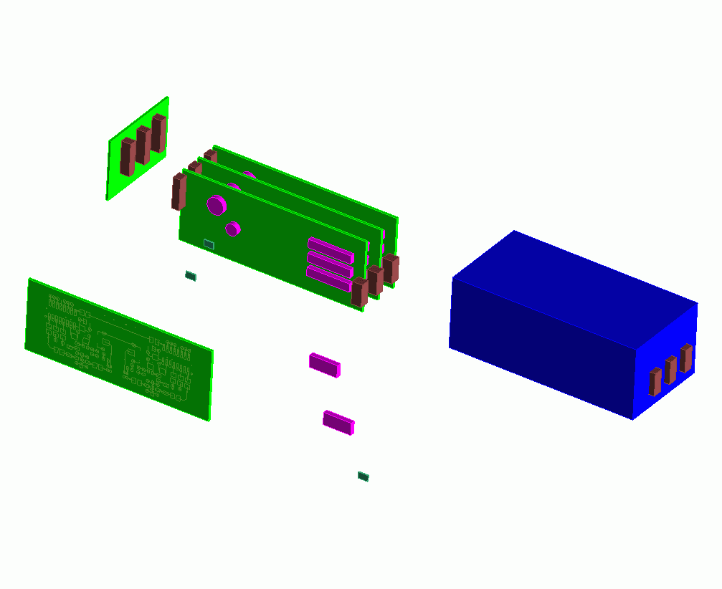

EFW Analogy with Electronic Systems
A “system of systems”: parts, assemblies, technologies, configuration mgt., …
Repository Architecture
EFW Subsystems
Interconnect
Assembly
CAx Tool xyz
An EFW
at Company XYZ
Printed Circuit Assemblies
(PCAs/PWAs)
Product Enclosure
Die/Chip
Packaged Part
Printed Circuit
Substrate (PCBs/PWBs)
Die/Chip
Package
External Interfaces
AP233, AP210, …
SOAP, CORBA, …
2002-04 - Russell Peak, Georgia Tech. Adapted from AP210 figure by Tom Thurman, Rockwell-Collins

Slide 13
Contents
Introductory Definitions
Gaps Addressed
Example Standards-Based Engineering Framework
(NASA JPL work by GIT et al. using AP210 & AP233)
Benefits

Slide 14
Challenges in Today's
Engineering Frameworks
Highly dynamic & complex “objects”:
    users, models, relationships, tools, machines, virtual resources, …
  Frequent changes, including technology evolution
  Large quantities
  Version & configuration management issues
  Maintaining commonality takes time, resources, & hard work
EFW structure & operation not well-defined
  Little central knowledge or control
Interoperability not typical vendor intent
  Primary CAx tools designed for stand-alone mode
  “Integration” = “single vendor can do-it-all” tendency
  Capacitor mfg. turned supercomputer mfg. analogy
Inherent humans limits
  Communications bandwidth (Tower of Babel)
  Time, space, language, motivation (money/politics/human nature)

Slide 15
Specific Gaps Being Addressed by EFWIG
Content coverage gaps
Content semantic gaps
  Ancillary information, including “dumb” figures & notes
Fine-grained associativity gaps

Slide 16
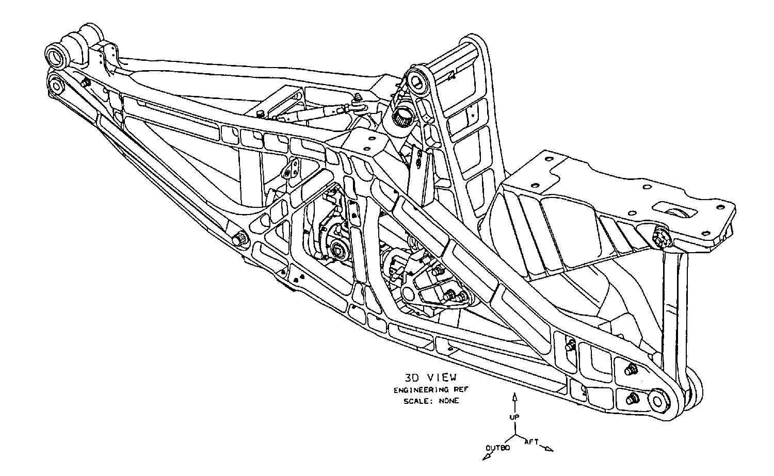
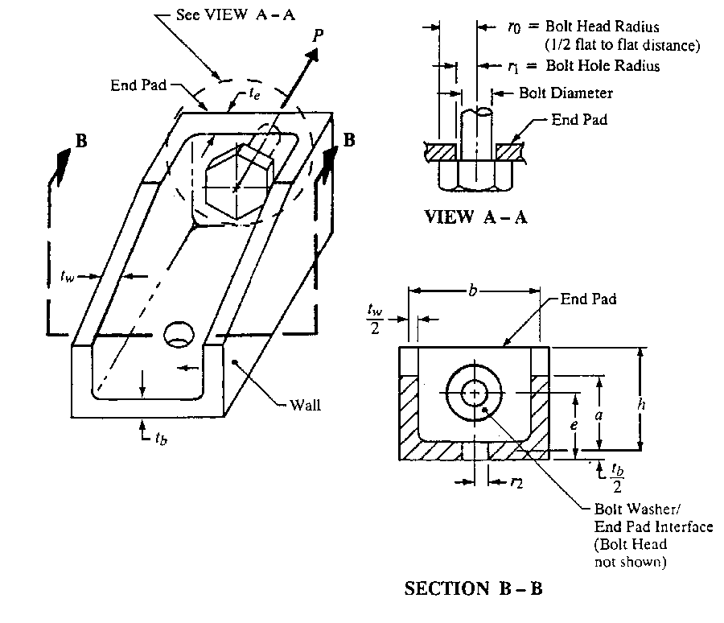
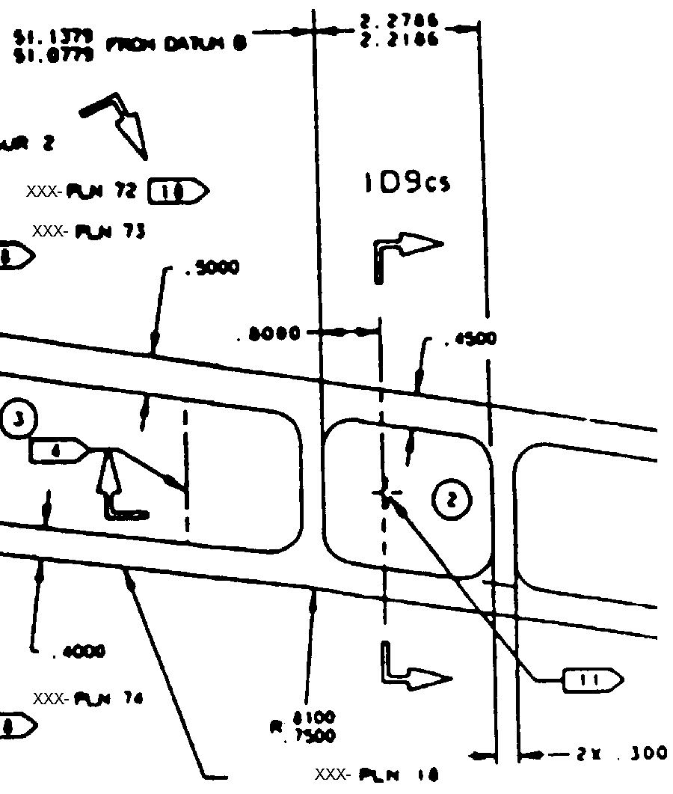
Interoperability Gap:
Lack of Fine-Grained Associativity design model-analysis model example
Detailed Design Model
Γ₁ : b = cavity3.inner_width + rib8.thickness/2
+ rib9.thickness/2
...
Analysis Model
(with Idealized Features)
No explicit
fine-grained
CAD-CAE
associativity
Γ
K
3
=
f
(
r
,
b
,
h
)
1
f
se
=
P
f
be
=
C
1
P
Idealizations
2
π
r
t
ht
2
0
e
e
Channel Fitting Analysis
“It is no secret that CAD models are driving more of today’s product development processes ... With the growing number of design tools on the market, however, the interoperability gap with downstream applications, such as finite element analysis, is a very real problem. As a result, CAD models are being recreated at unprecedented levels.” Ansys/ITI press Release, July 6 1999
http://www.ansys.com/webdocs/VisitAnsys/CorpInfo/PR/pr-060799.html

Slide 17
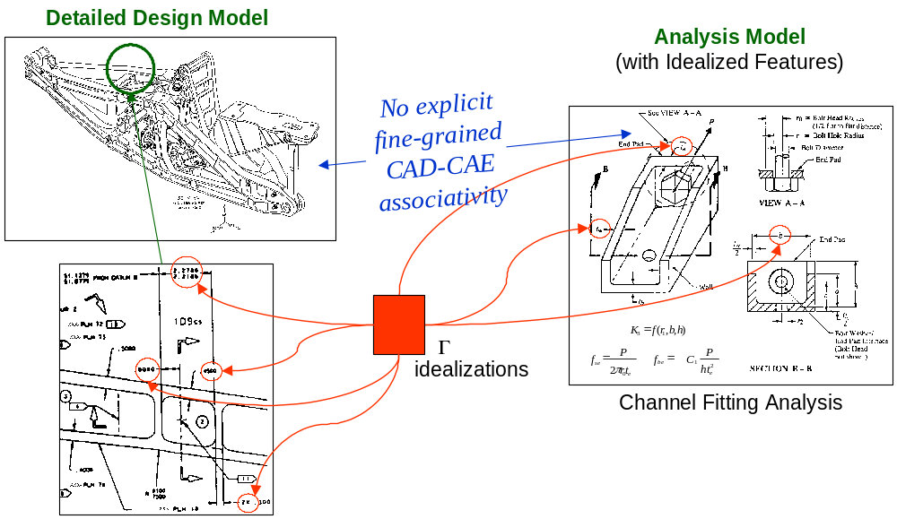
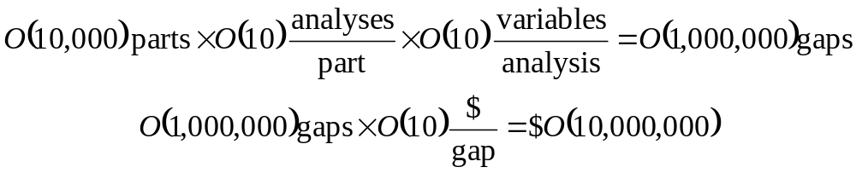
Cost of Associativity Gaps http://eislab.gatech.edu/pubs/reports/EL004/
Categories of Gap Costs
Associativity time & labor
- Manual maintenance
- Little re-use
- Lost knowledge
Inconsistencies
Limited analysis usage
- Fewer parts analyzed
- Fewer iterations per part
“Wrong” values
- Too conservative:
Extra part costs and
performance inefficiencies
- Too loose:
Re-work, failures, law suits
Initial Cost Estimate per Complex Product (only for manual maintenance costs of structural analysis problems)

Slide 18
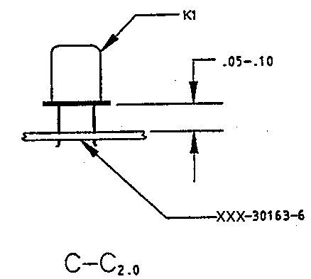
Information Capture Gaps:
Content Coverage and Semantics
Existing Tools
Tool A₁
...
Tool A_{n}
Legend
Content
Coverage Gaps
“dumb” information capture
(only human-sensible,
I.e., not computer-sensible)
Smart Product Model
Building Blocks
Models & meta-models
  International standards
  Industry specs
  Corporate standards
  Local customizations
Modeling technologies:
  Express, UML, XML, COBs, …
Content
Semantic Gaps
Example “dumb” figures

Slide 19
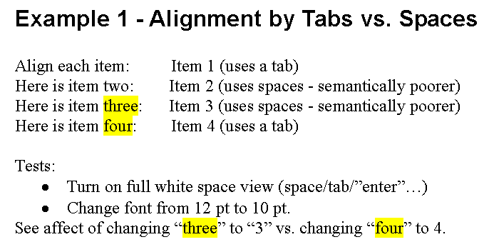
On Semantic Gaps wysiNwyg examples in MS Word
(WYSIWYG drawbacks: What You See is NOT always What You Get!)

Slide 20
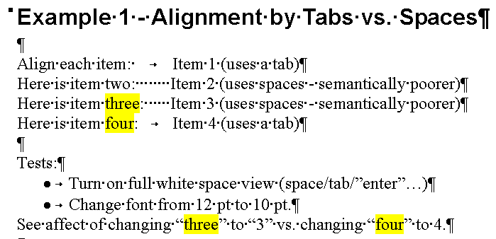
On Semantic Gaps (cont.)
Higher fidelity view of your “model” (your document)
Next slide

Slide 21
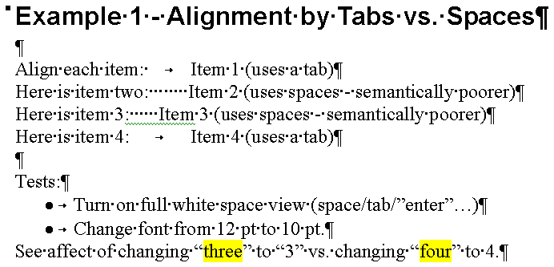
On Semantic Gaps (cont.)
Adverse effect of change on semantically poorer model content

Slide 22
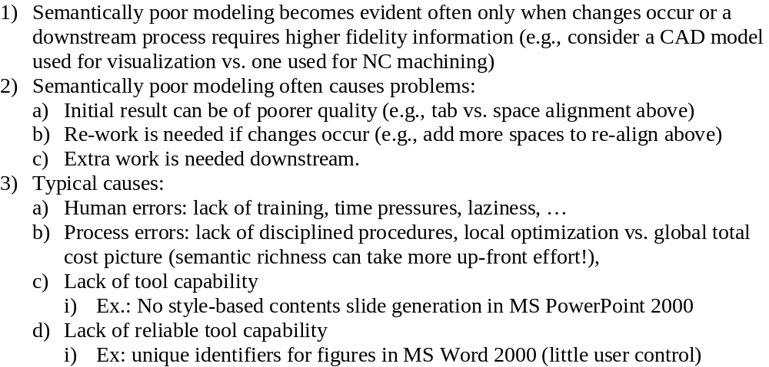
Observations about Semantic Gaps
Problems are compounded in engineering tools …

Slide 23
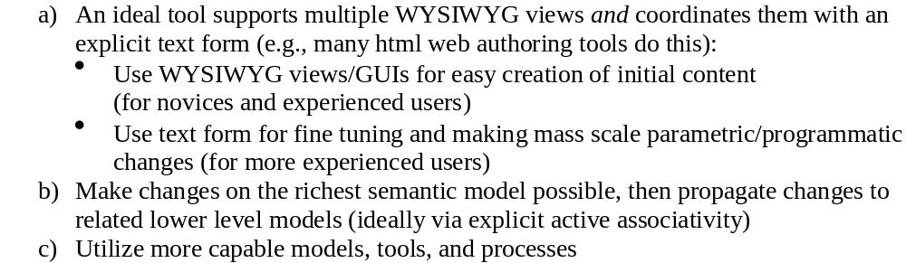
Addressing Semantic Gaps

Slide 24
Contents
Introductory Definitions
Gaps Addressed
Example Standards-Based Engineering Framework
(NASA JPL work by GIT et al. using AP210 & AP233)
Benefits

Slide 25

Development of Advanced
Collaborative Engineering Environments (CEEs)
Phase 2: Standards-Based Infrastructure and Applications for PWA/B Requirements and Design
Phase 2 Final Review
September 20, 2002
JPL • Pasadena, California
Highlights from
Full Slide Set
Georgia Tech Contact:
Russell.Peak@marc.gatech.edu
http://eislab.gatech.edu/projects/
v3 November 12, 2002

Slide 26
Tool-Product Model Schema Relationships in a
Standards-Based Engineering Framework
Electrical
CAD Tools
Systems Engineering
Tools
Traditional
Tools
Eagle
Doors
- Eurostep AP233 Demonstrator
- XaiTools AP233
Mentor
Graphics
Slate
AP210
AP233
Product Model
Components
AP210
AP233
PDM Schema
XaiTools
PWA-B
LKSoft, …
STEP-Book AP210,
SDAI-Edit,
STI AP210 Viewer, ...
Gap-Filling
Tools
XaiTools
PWA-B
pgpdm
LKSoft, …
PWB Stackup Tool,
…
Core
PDM Tool
Instance Browser/Editor

Slide 27
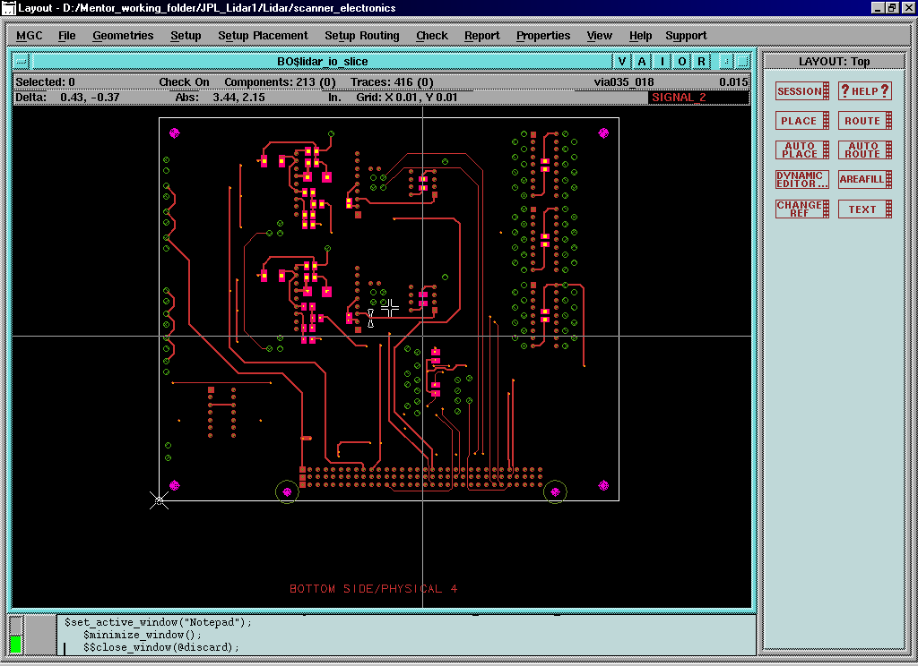
Example PCB Layout in MGC BoardStation

Slide 28
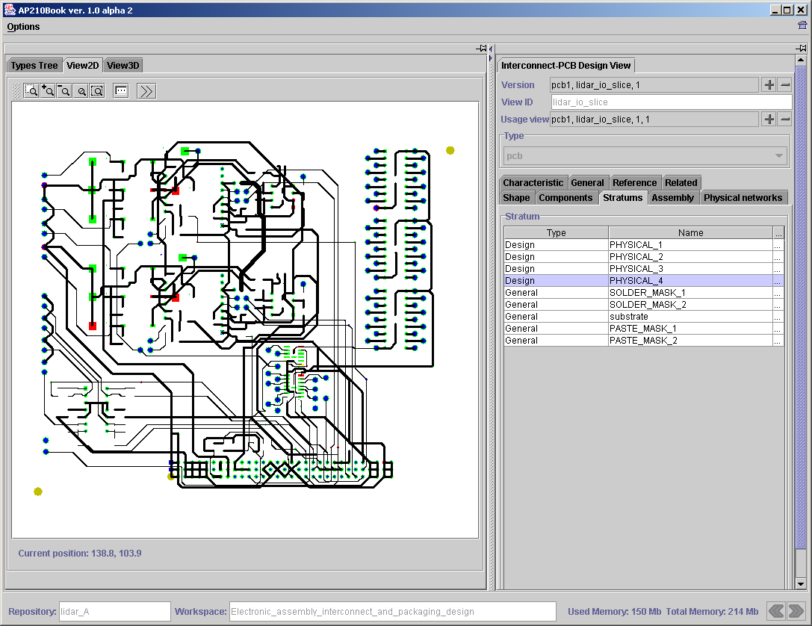
Example PCB Layout in STEP-Book AP210

Slide 29
Tool-Product Model Schema Relationships in a
Standards-Based Engineering Framework
Electrical
CAD Tools
Systems Engineering
Tools
Traditional
Tools
Eagle
Doors
- Eurostep AP233 Demonstrator
- XaiTools AP233
Mentor
Graphics
Slate
AP210
AP233
Product Model
Components
AP210
AP233
PDM Schema
XaiTools
PWA-B
LKSoft, …
STEP-Book AP210,
SDAI-Edit,
STI AP210 Viewer, ...
Gap-Filling
Tools
XaiTools
PWA-B
pgpdm
LKSoft, …
PWB Stackup Tool,
…
Core
PDM Tool
Instance Browser/Editor

Slide 30
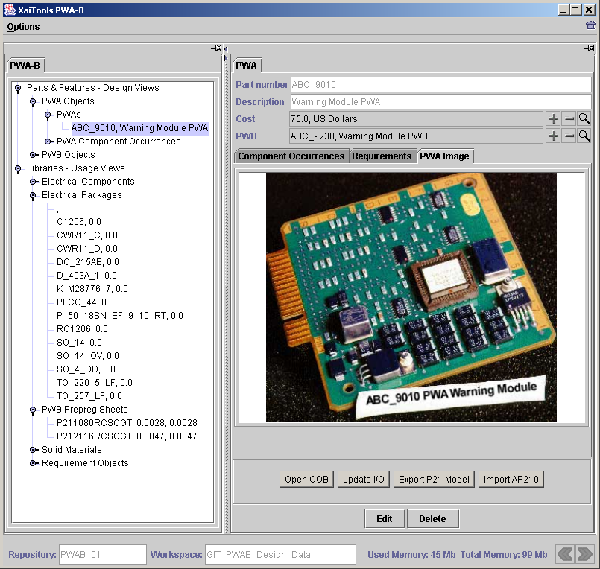
Example PWA Design

Slide 31
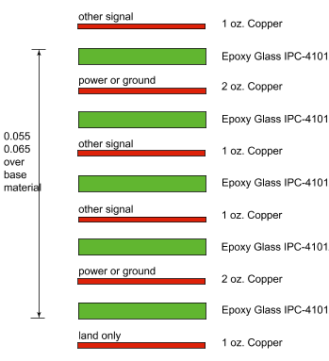
Stackup Design Tool
End User Scenario - Target 1.0 (Phase 2 results)
Board Station v8
ICX
Mentor
Graphics
Mentor
Graphics
Interoperability levels:
Repository (SDAI)
File exchange
Native file(s)
ap210.exp
(IS CC24)
Requirement Libraries & Tools
- Eurostep AP233 Demonstrator
- XaiTools AP233
mg-ap210
pwb_stackup.step
Translator
v1 - OEM spec
AP233
stackup spec (OEM view)
(1)
my_pwb_model.exp
Document view
html, xml, svg
(2), (4)
Stackup
Tool
my_pwb_stackup.step
XaiTools PWA-B
stackup spec (OEM view) viewing & editing
Other Libraries
- PWB building blocks (laminates …)
- Electrical components
- Component package styles
- Materials
Custom STEP, (later AP210, …)

Slide 32
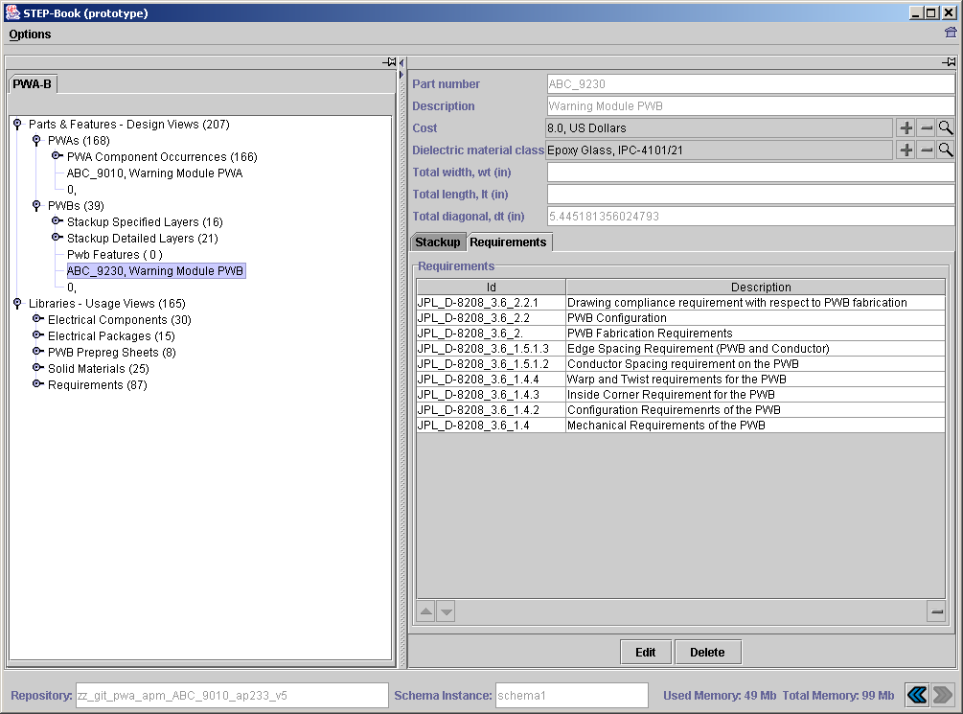
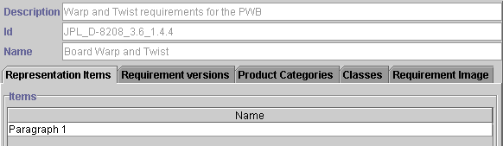

Part Level-Specific Usage of AP233 Requirements Library (TBRs)
PWB Level (bare board) - Multi-Schema Usage: AP210, AP233, …

Slide 33
Stackup Design Tool
End User Scenario - Target 1.0 (Phase 2 results)
Board Station v8
ICX
Mentor
Graphics
Mentor
Graphics
Interoperability levels:
Repository (SDAI)
File exchange
Native file(s)
ap210.exp
(IS CC24)
Requirement Libraries & Tools
- Eurostep AP233 Demonstrator
- XaiTools AP233
mg-ap210
pwb_stackup.step
Translator
v1 - OEM spec
AP233
stackup spec (OEM view)
(1)
my_pwb_model.exp
Document view
html, xml, svg
(2), (4)
Stackup
Tool
my_pwb_stackup.step
XaiTools PWA-B
stackup spec (OEM view) viewing & editing
Other Libraries
- PWB building blocks (laminates …)
- Electrical components
- Component package styles
- Materials
Custom STEP, (later AP210, …)

Slide 34
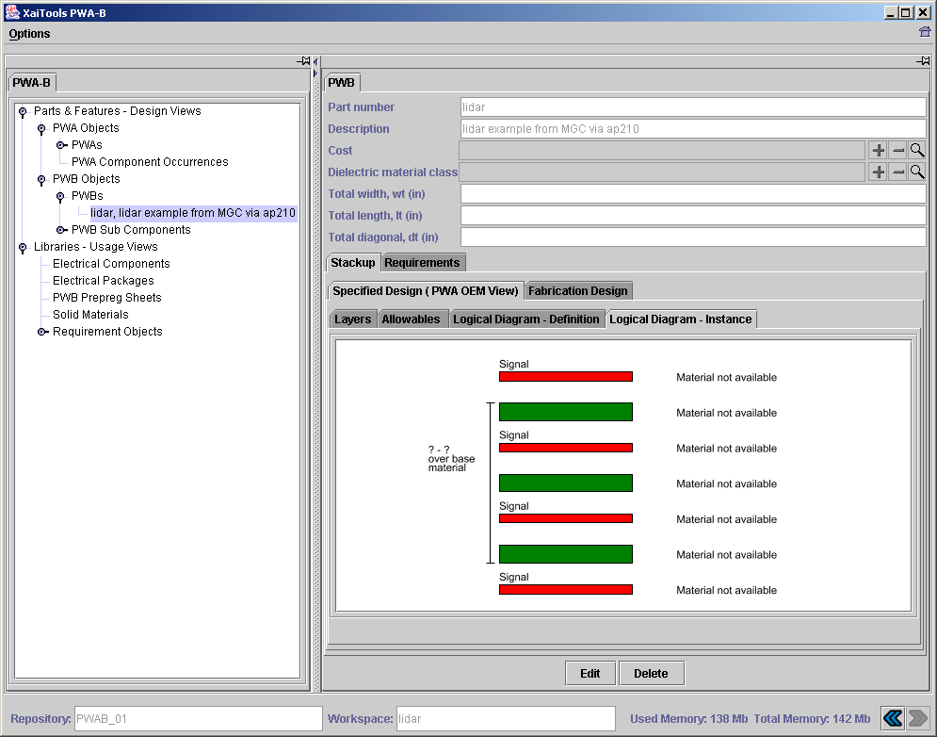
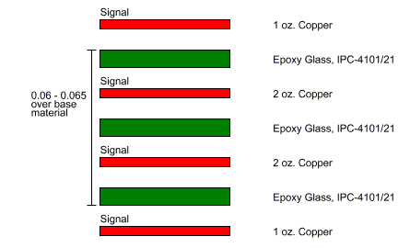
Production Test Case:
MGC to AP210 to XaiTools for Stackup Design
1. In MGC BoardStation:
2. In XaiTools … (via AP210)
2.a - as-imported
Status (2002-10-10)
- Initial testing completed
- End user testing underway
- Setting up next sub-phase to
achieve production release
2.b - after specifying PWB design

Slide 35
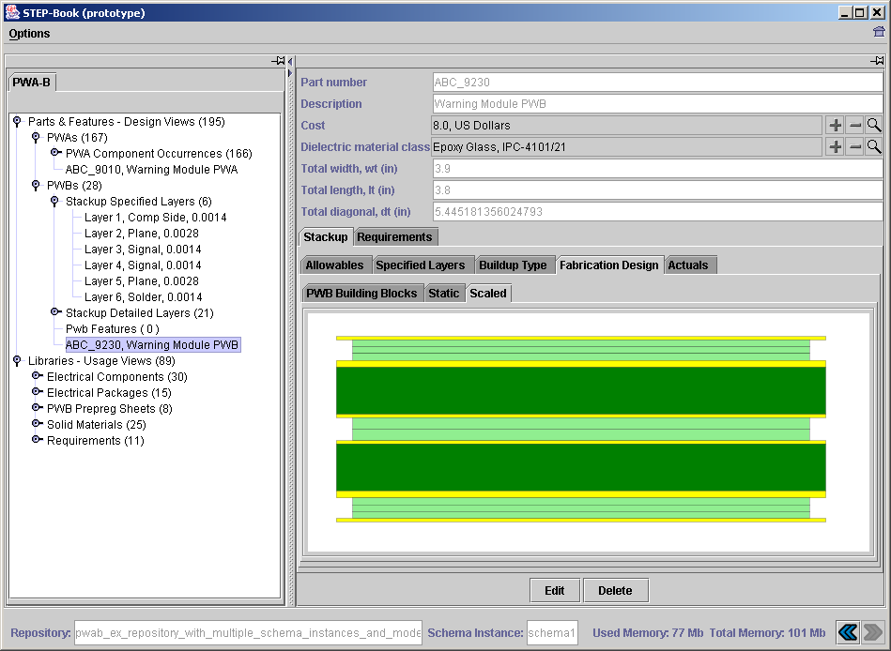
Detailed Stackup Design
(PWB fabricator view)

Slide 36
Problems Addressed
Electrical
CAD Tools
Systems Engineering
Tools
Traditional
Tools
Eagle
Doors
- Eurostep AP233 Demonstrator
- XaiTools AP233
Mentor
Graphics
Slate
AP210
AP233
Product Model
Components
AP210
AP233
PDM Schema
Problems Addressed:
- Semantic Gaps
- Coverage Gaps
XaiTools
PWA-B
LKSoft, …
STEP-Book AP210,
SDAI-Edit,
STI AP210 Viewer, ...
Gap-Filling
Tools
XaiTools
PWA-B
pgpdm
LKSoft, …
PWB Stackup Tool,
…
Core
PDM Tool
Instance Browser/Editor

Slide 37
Contents
Introductory Definitions
Gaps Addressed
Example Standards-Based Engineering Framework
(NASA JPL work by GIT et al. using AP210 & AP233)
Benefits

Slide 38
Benefits of
Standards-based Engineering Frameworks
Specific techniques:
  Gap-filling techniques and tools (example usage of AP210)
  “Better, faster, cheaper”
    Increased product model completeness
    Reduced downstream errors
    Increased automation
    Increased knowledge retention
Overall EFWIG emphasis: Improving daily end user world
    Engineering work group/dept. focus
    Grass roots involvement
    Provides momentum and pull
    Gives guidance vs. re-invention & ad-hoc approaches
Leveraging team effort

