Slide 1

Towards Standards-based Engineering Frameworks in the Electronics Domain
April 22, 2002
Russell Peak
Senior Researcher
Manufacturing Research Center
Georgia Tech
Plus other contributors as noted …

Slide 2
Contents
Motivation
Intro to ISO 10303-210 (STEP AP210)
  Example Organizations and Their Activities
  Example Applications & Vendor Tools
  Hands-On Exercises
  Usage in the Product Development Process
Summary & Recommended Approach

Slide 3
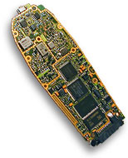
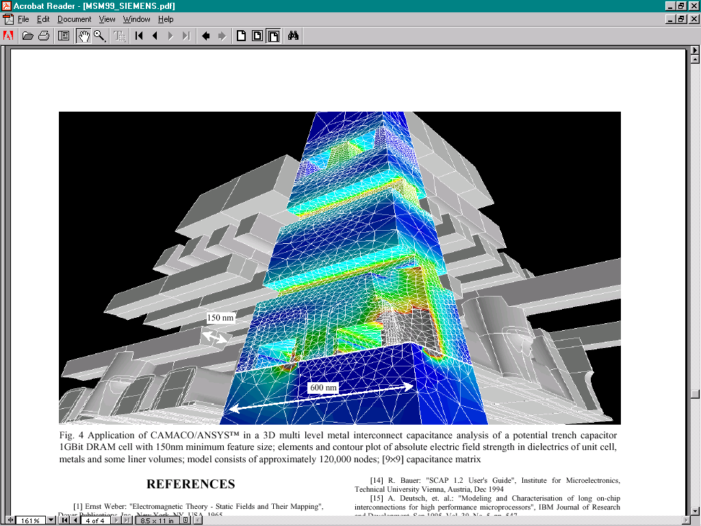
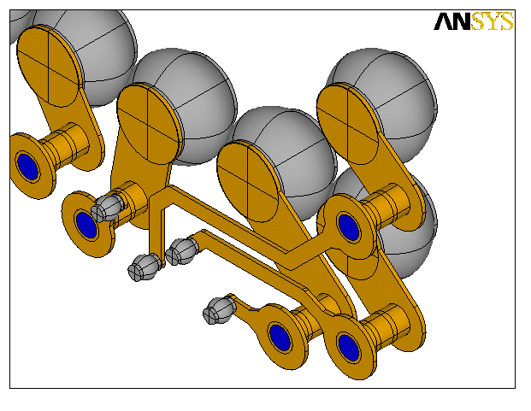
Motivation: Product Challenges
Trend towards complex multi-disciplinary systems
Demanding End User Applications
MEMS devices
http://www.zuken.com/solutions_board.asp
3D interconnects
Source: www.ansys.com

Slide 4
Motivation: Engineering Tool Challenges
2001 International Technology Roadmap for Semiconductors (ITRS) http://public.itrs.net/Files/2001ITRS/Home.htm
Design Sharing and Reuse
  Tool interoperability
  Standard IC information model
  Integration of multi-vendor and internal design technology
  Reduction of integration cost
Simulation module integration
  Seamless integration of simulation modules
  Interplay of modules to enhance design effectiveness

Slide 5
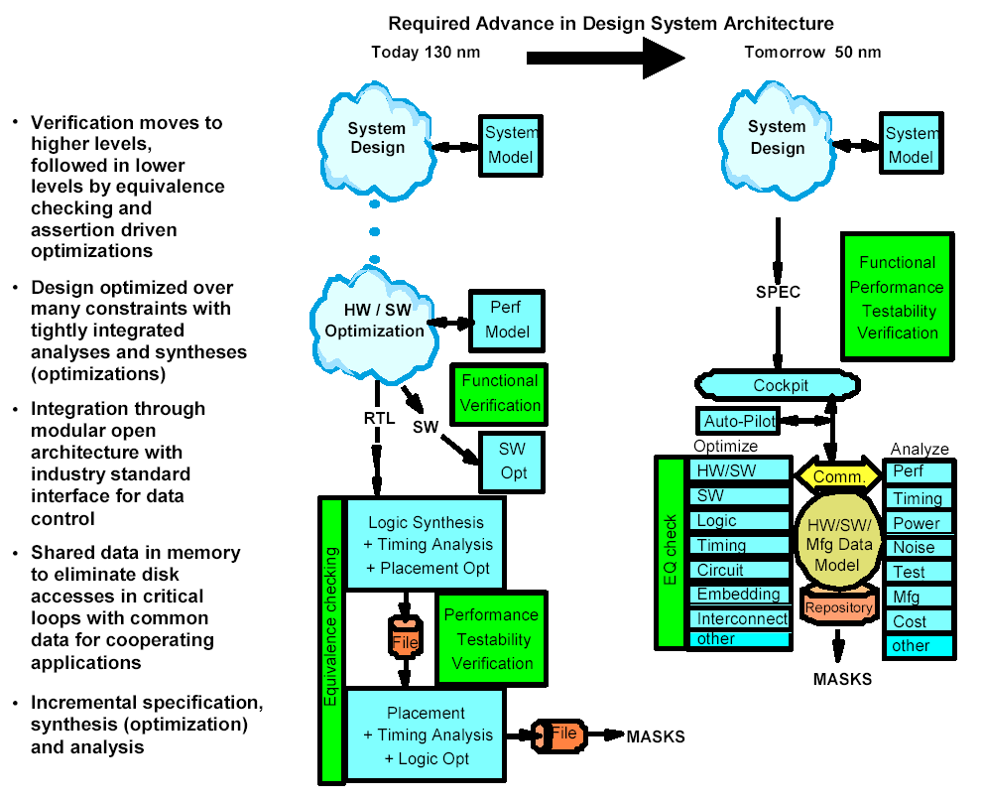
Advances Needed in Engineering Frameworks
2001 International Technology Roadmap for Semiconductors (ITRS) http://public.itrs.net/Files/2001ITRS/Home.htm

Slide 6
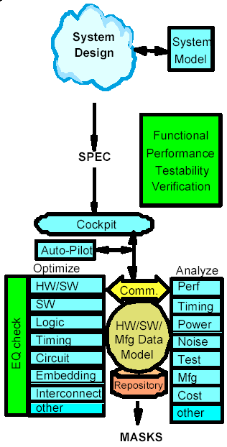
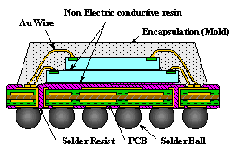
Analogy
Physical Integration Modules ↔ Model Integration Frameworks
Design System Architecture
Stacked Fine-Pitch BGA
www.shinko.co.jp
System-On-a-Package (SOP)
Wafer Level Packaging
RF, Digital, Analog, Optical, MEMS
www.prc.gatech.edu
2001 ITRS
Multidisciplinary challenges require innovative solution approaches

Slide 7
Interoperability
Seamless communication between people, their models, and their tools.
Requires techniques beyond traditional engineering
  Information models
    Abstract data types
    Object-oriented languages (UML, STEP Express, …)
  Knowledge representation
    Constraint graphs, rules, …
  Web/Internet computing
    Middleware, agents, mobility, …
Emerging field: engineering information methods
  Analogous to CAD and FEA methods

Slide 8
Contents
Motivation
Introduction to ISO 10303-210 (STEP AP210)
  Example Organizations and Their Activities
  Example Applications & Vendor Tools
  Hands-On Exercises
  Usage in the Product Development Process
Summary & Recommended Approach

Slide 9
Intro to ISO 10303-210 (STEP AP210)
Business driver example
  Rockwell Collins - Jack Harris (2001 AFEI Expo)
Content of AP210
  Tom Thurman, et al.
Status and example implementations
  PDES Inc. Electromechanical Pilot Update - Greg Smith
Vendor examples
  LKSoft - Lothar Klein
  STEP-Book AP210 Usage Overview with Hands-on Exercises - Russell Peak
See separate file
See separate file
See separate file

Slide 10

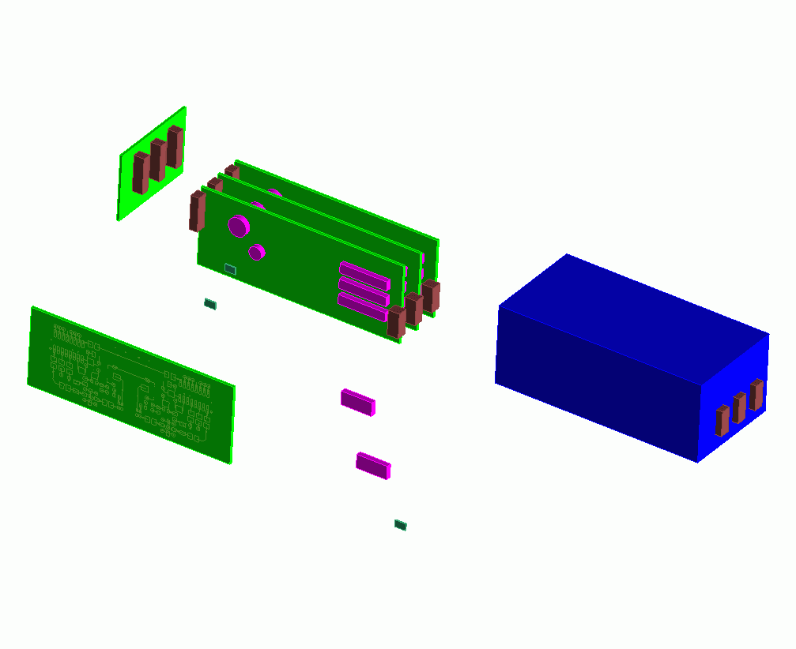

STEP AP 210 (ISO 10303-210)
Domain: Electronics Design
R
~800 standardized concepts (many applicable to other domains)
Development investment: O(100 man-years) over ~10 years
Configuration Controlled Design of Electronic Assemblies,
their Interconnection and Packaging
Interconnect
Assembly
Printed Circuit Assemblies
(PCAs/PWAs)
Product Enclosure
Die/Chip
Packaged Part
Printed Circuit
Substrate (PCBs/PWBs)
Die/Chip
Package
External Interfaces
Adapted from 2002-04 - Tom Thurman, Rockwell-Collins

Slide 11
STEP AP210 Scope
R
Scope is “As-Required” & “As-Designed” Product Information
  Design “In Process” & “Release”
  Design views (white boxes) & usage views (black boxes)
  Design at individual or multiple levels:
  microsystems, packages, PCAs, units, …
Sharing Partners:
  Engineering Domains
  Design / Analysis
  Manufacturing / Analysis
Sharing Across Several Levels of Supply Base
Notes:
3

Slide 12
STEP AP210 Models
R
Functional Models
Requirements Models
Component / Part Models
Functional Unit
Interface Declaration
Network Listing
Simulation Models
Signals
Design
Constraints
Interface
Allocation
Analysis Support
Package
Material Product
Properties
“White Box”/ “Black Box”
Pin Mapping
Assembly Models
User View
Design View
Component Placement
Material product
Complex Assemblies with Multiple Interconnect
Interconnect Models
User View
Design View
Bare Board Design
Layout templates
Layers
  planar
  non-planar
conductive
non-conductive
Configuration Mgmt
Identification
Authority
Effectivity
Control
Net Change
GD & T Model
Datum Reference Frame
Tolerances
Notes:
5

Slide 13
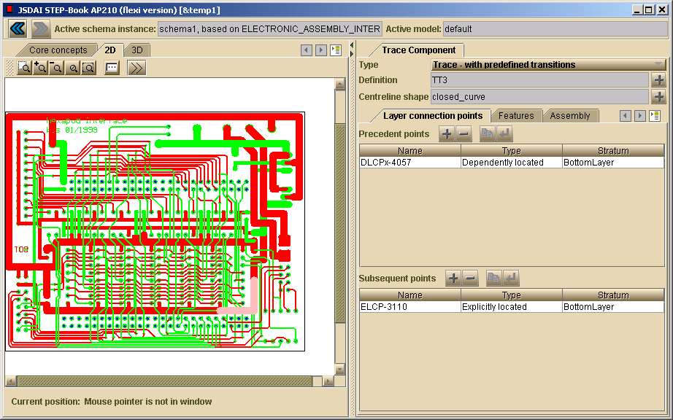
Rich Features in AP210: PWB traces
AP210 STEP-Book Viewer - www.lksoft.com

Slide 14
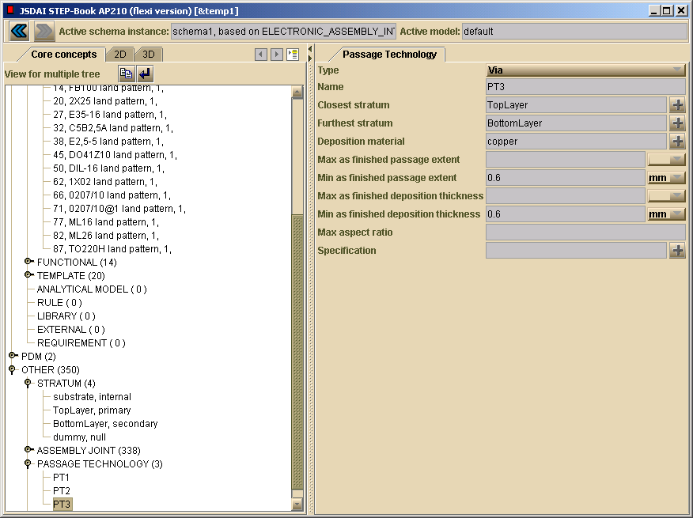
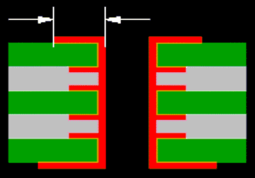
Rich Features in AP210: Via/Plated Through Hole
Z-dimension details …

Slide 15
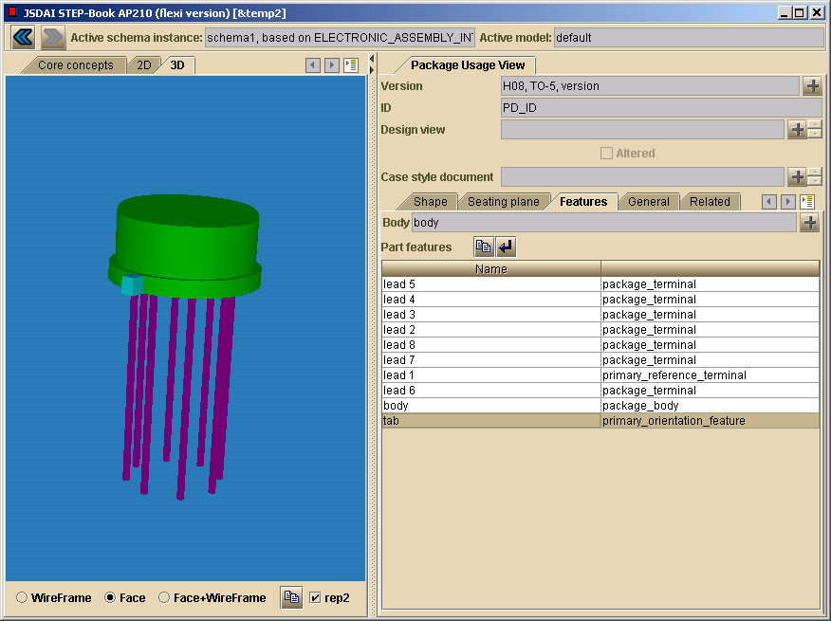
Rich Features in AP210: Electrical Component
The 3D shape is generated from these “smart features” which have electrical functional knowledge. Thus, the AP210-based model is much richer than a typical 3D MCAD package model.
210 can also support the detailed design of a package itself (its insides, including electrical functions and physical behaviors).

Slide 16
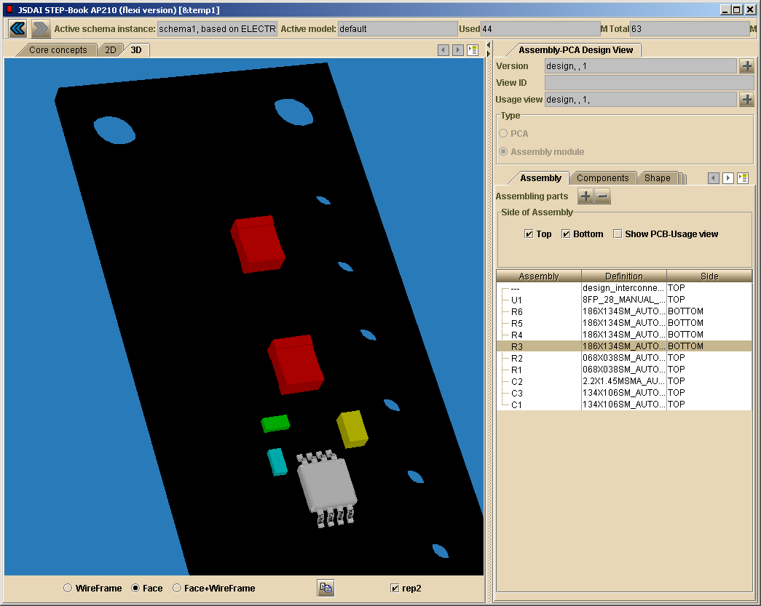
Rich Features in AP210: 3D PCB Assembly
AP210 STEP-Book Viewer - www.lksoft.com

Slide 17
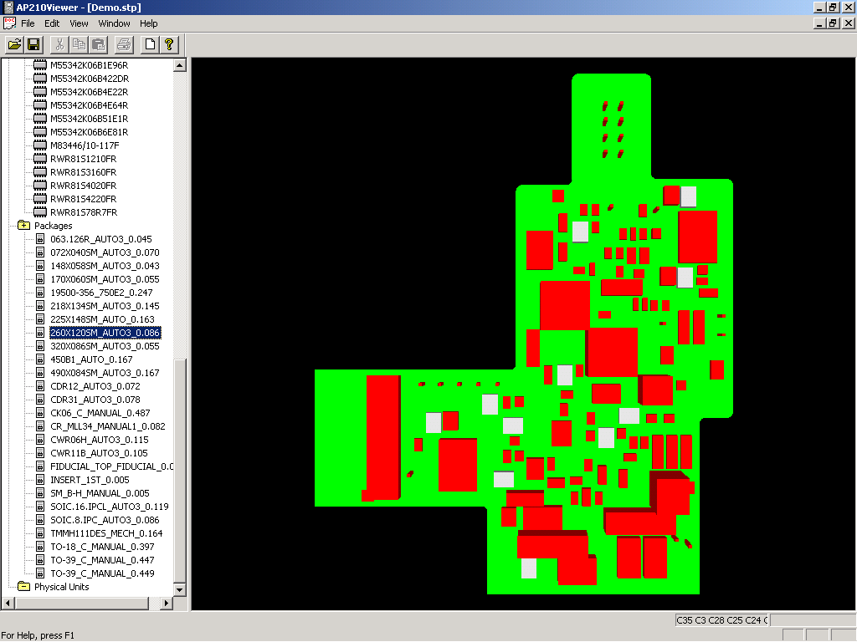
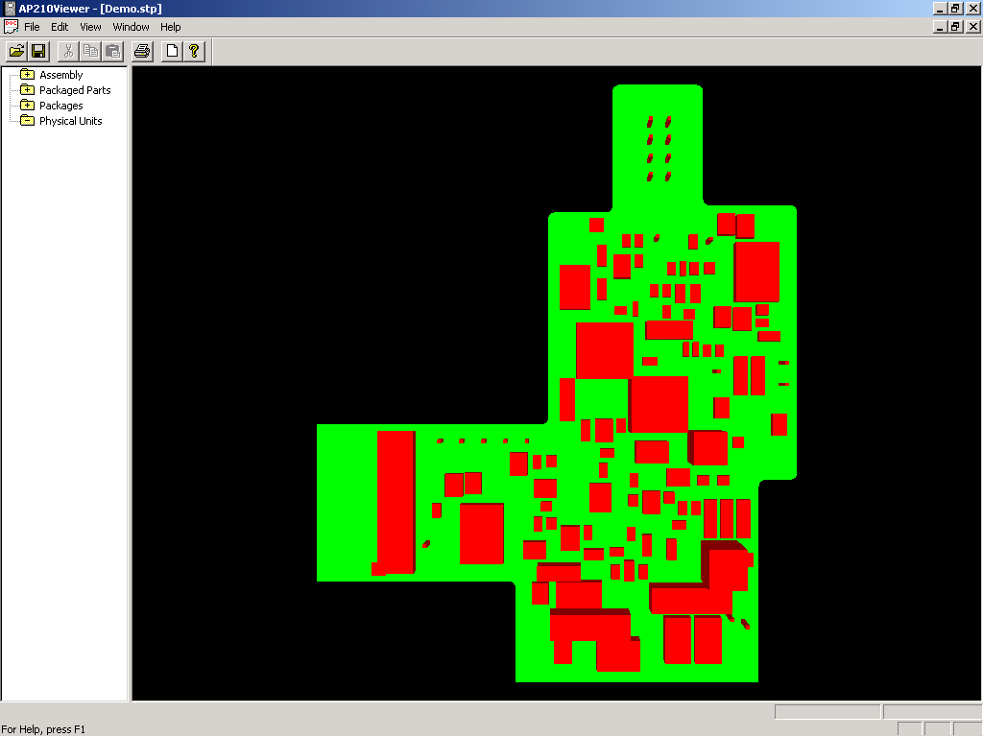
Another AP210 Viewer
Boeing/PDES Inc.
2002-03 - Mike Keenan, Boeing

Slide 18
Intro to ISO 10303-210 (STEP AP210)
Business driver example
  Rockwell Collins - Jack Harris (2001 AFEI Expo)
Content of AP210
  Tom Thurman, et al.
Status and example implementations
  PDES Inc. Electromechanical Pilot Update - Greg Smith
Vendor examples
  LKSoft - Lothar Klein
  STEP-Book AP210 Usage Overview with Hands-on Exercises - Russell Peak
See separate file
See separate file
See separate file

Slide 19
Selected STEP for Electronics Activities
STEP Electro-Mechanical Activities
Standards Development and Deployment
Company Activities
Related Activities
Producibility Analysis (DFM) (B)
Manufacturing Simulation (R)
AP210, AP220, AP233
AP212
Wiring Harnesses, etc.
www.ecad-if.de
IDF/AP210 Conversion (R/B/N)
AP203/AP210 Conversion (N, T)
Advocacy
Implementation
AP210 Viewers
(B, STI)
STEP Repository (GT/N/B)
Marketing
Zuken AP210 Translation (R/L/AT)
Company Legend
B – Boeing
N – NASA
GT – Georgia Tech
A – U.S.Army
R – Rockwell-Collins
GM – General Motors
L – LK Software
T - Theorem Solutions
AT - ATI/PDES Inc.
STI - STEP Tools Inc.
Mentor AP210 Translation (B/N/L/AT)
Education
AP210 Book (L)
PWA/PWB Stackup (GT/N)
Eagle AP210 Translator (L)
AP210 Primer (A)
Analysis Templates (GT)
2002-03 - Adapted from Greg Smith, Boeing

Slide 20
PDES, Inc. Electro-Mechanical Pilot
Primary Participants
  ATI, Boeing, Georgia Tech, LKSoft,
  NASA (JPL and Goddard), Rockwell-Collins, U.S.Army
Support the implementation of STEP for Electronics within the US and the world.
Series of activities worked by individual companies and teams of companies.
Activities include:
  Interface/Translator development and marketing
  Standards publicity
  Tool development
  Standard development/refinement (AP210, AP220, AP233)
    Test cases, recommended practices

Slide 21
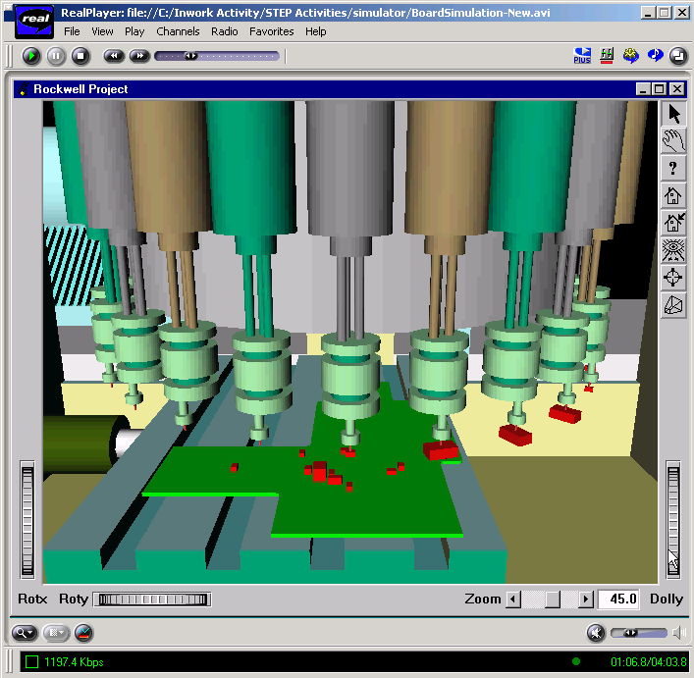
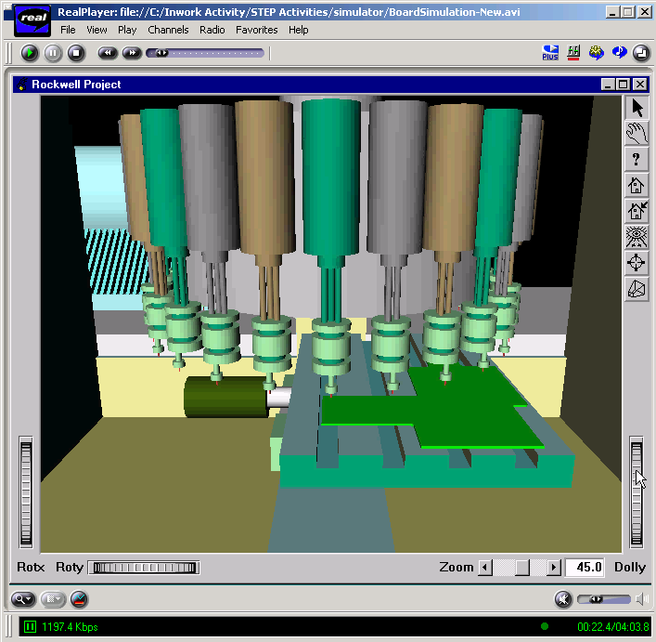
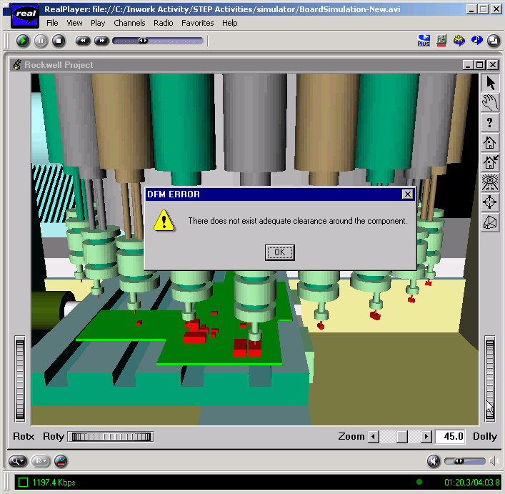
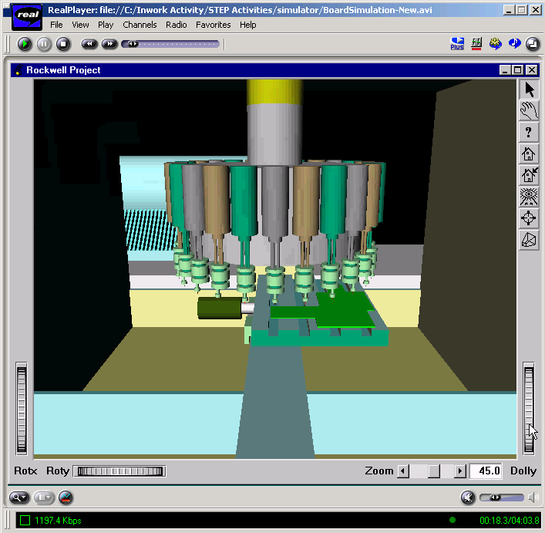
PWA/PWB Assembly Simulation using AP210
User Alerted on Exceptions to Producibility
Guidelines
Rules (From
Definition
Facility)
Generic Manufacturing Equipment Definitions
Specific
Manufacturing Equipment Used
2002-03 - Tom Thurman, Rockwell-Collins

Slide 22
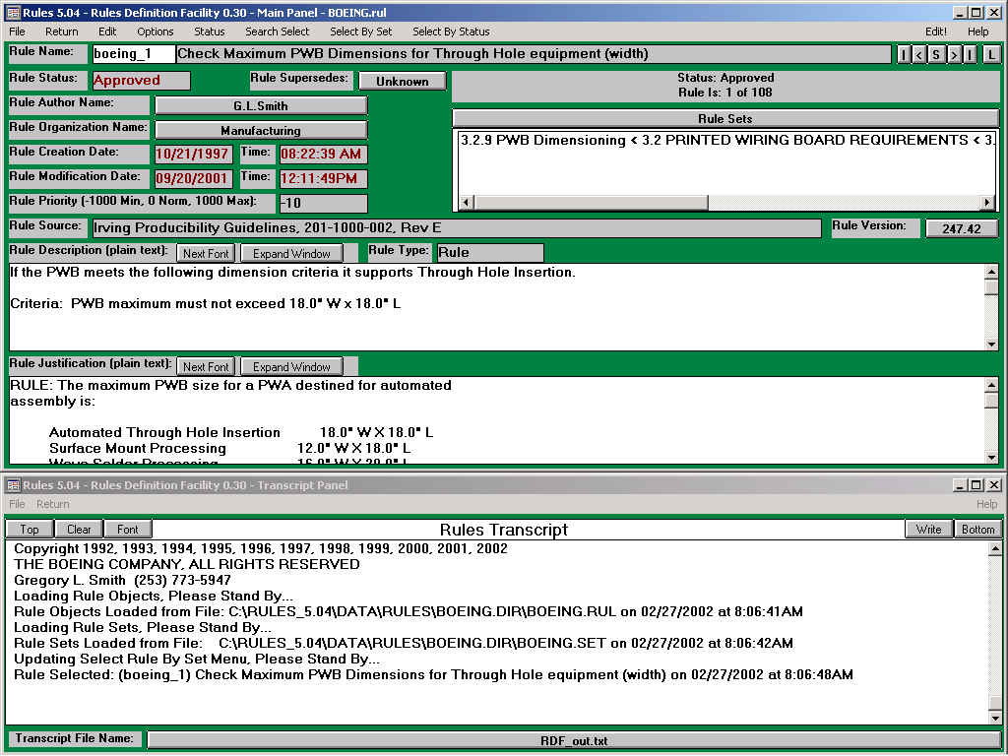
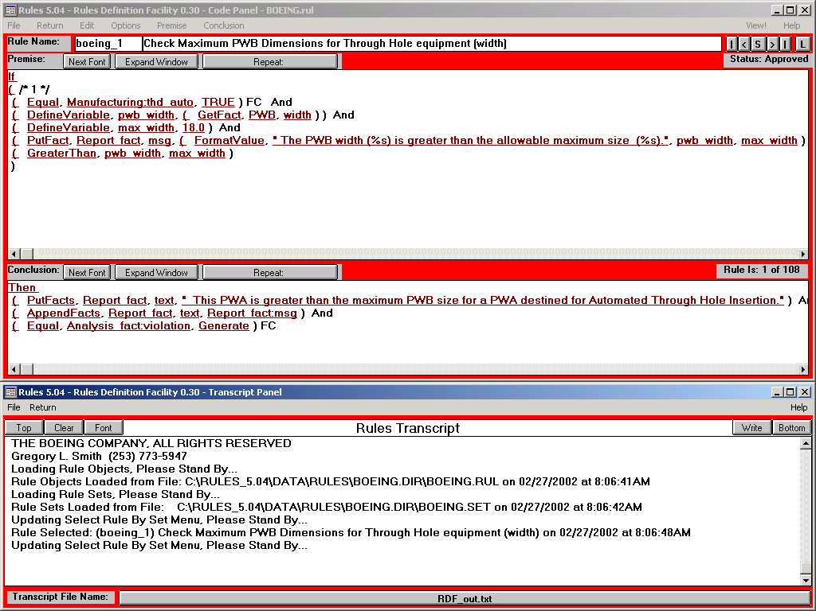

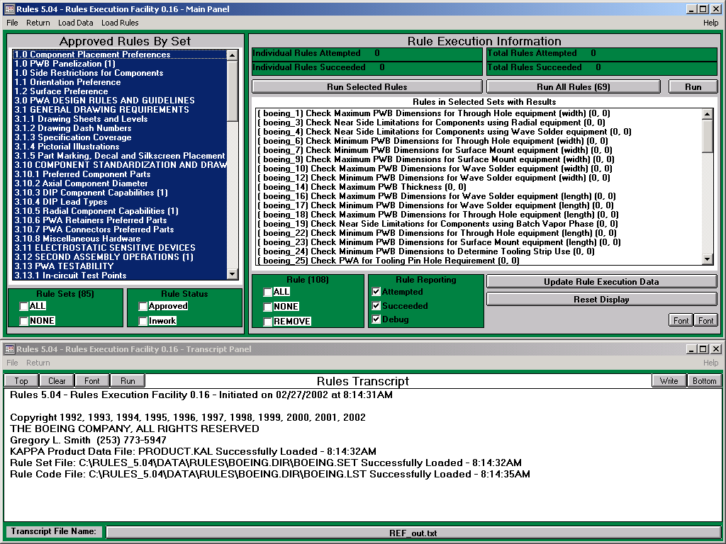
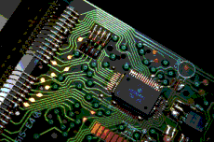
PWA/PWB Producibility Analysis using AP210
Codification of
Guidelines
(Rules Definition)
Company PWA/PWB
Guidelines
Manufacturing Capabilities
STEP AP220
Rules
STEP AP210
Producibility
Analysis
Report
Comparison of Rules
Against Product Data
(Rules Execution)
PWA/PWB Captured in Mentor Design Tools
2002-03 - Greg Smith, Boeing

Slide 23
PWA/PWB Producibility Analysis using AP210
Producibility Analysis Report
Boeing PWA Analysis Completed - Generating Summary, Please Stand By...
During this Analysis:
14 Administration Checks were Executed.
40 Data Collection Checks were Executed.
52 Analysis Checks were Executed.
-----------------------------------------------------------------------
106 Checks Total were Executed.
The Analysis on PWA: B169-78762-4,
resulted in the possible violation of 5 rule(s) and 5 guideline(s).
The following (5) rules may have been violated by this design:
IPG Sec 3.3.4 Check PWA support for Surface Mount Automation (Check175 Ver248.25)
IPG Sec 3.3.2 Check PWA Requirement for In-Circuit Test (Check176 Ver241.29)
IPG Sec 3.2.9 Check Minimum PWB Dimensions for Wave Solder equipment (length) (Check17 Ver16.3)
IPG Sec 3.5.5 Check Surface Mount Device Test Keep Out Zone - Minimum Edge (Components) (Check185 Ver296.12)
IPG Sec 3.5.3 Check Wave Solder & Vibration Test Keep Out Zone - Minimum Edge (Components) (Check184 Ver531.9)
The following (5) guidelines may have been violated by this design:
IPG Sec 3.10 Check PWA support for Mixed Technology (Check58 Ver310.28)
IPG Sec 3.6.2 Check Common Surface Mount Component Orientation (Modulo 180) (primary) (Check34 Ver35.2)
IPG Sec 3.10.5 Check Radial Component Lead Span (Check157 Ver914.57)
IPG Sec 3.2.1 Check Maximum PWB Thickness (Check14 Ver245.8)
IPG Sec 3.10 Check PWA support for Mixed Technology (2) (Check70 Ver255.26)
***** Analysis Completed on 02/27/2002 at 8:20:03AM
2002-03 - Greg Smith, Boeing

Slide 24
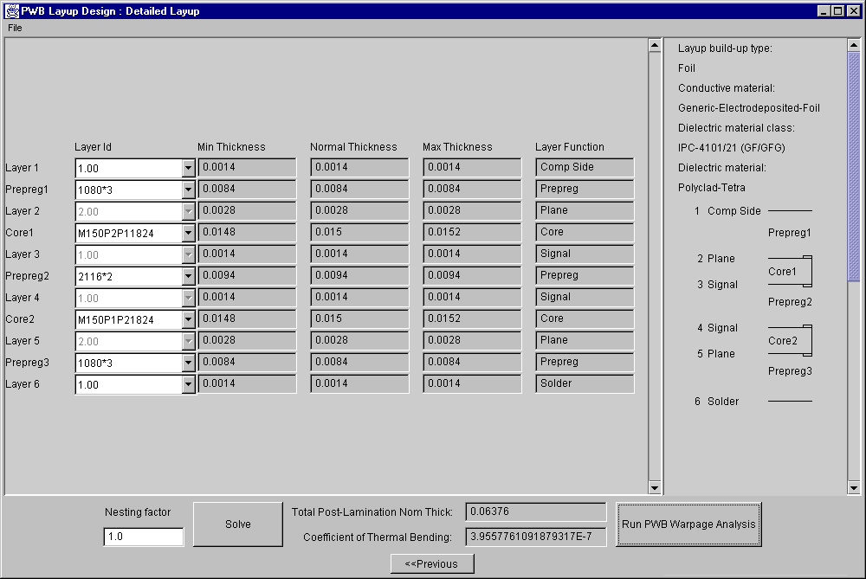
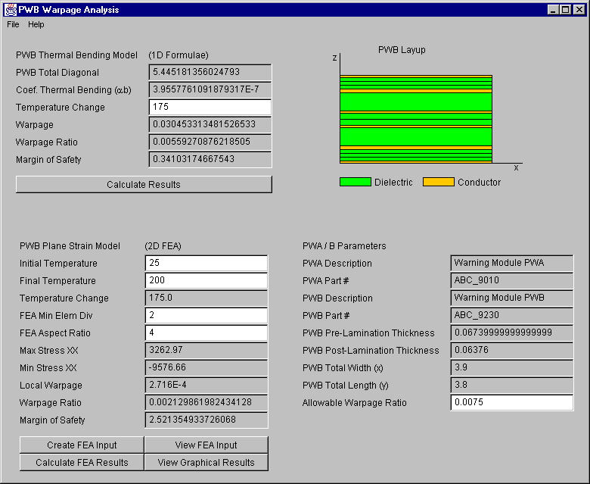
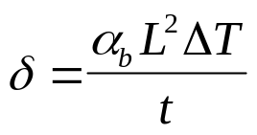
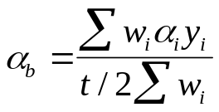
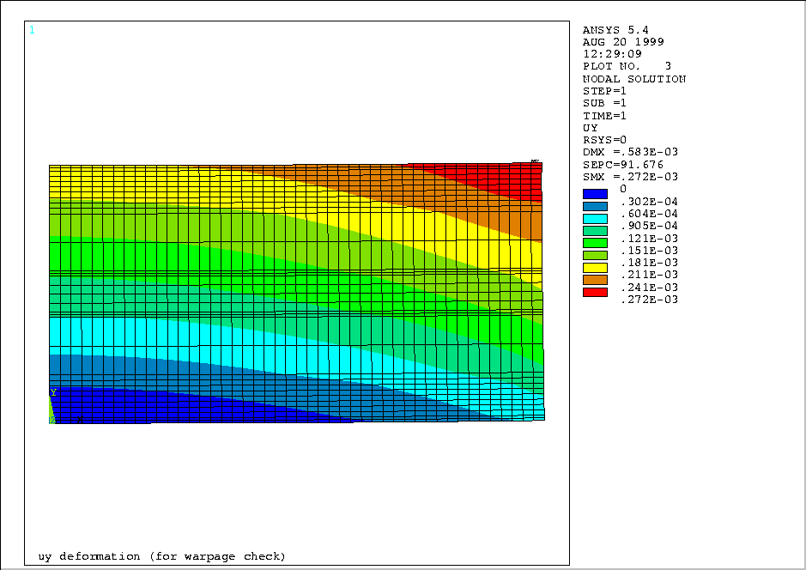
Product Model-Driven Analysis
Iterative PWB Stackup Design & Warpage Analysis
Pro AM
Analysis Template Methodology
http://eislab.gatech.edu/projects/
PWB Stackup Design Tool
1D Thermal Bending Model
Quick Formula-based Check
Layup
Re-design
PWB Warpage Modules
AP210
Analyzable
Product Model
2D Plane Strain Model
Detailed FEA Check
3 x 1080
1 Oz. Cu
Tetra GF
2 Oz. Cu
2 x 2116
1 Oz. Cu
Tetra GF
1 Oz. Cu
3 x 1080
2 Oz. Cu
1 Oz. Cu

Slide 25
Intro to ISO 10303-210 (STEP AP210)
Business driver example
  Rockwell Collins - Jack Harris (2001 AFEI Expo)
Content of AP210
  Tom Thurman, et al.
Status and example implementations
  PDES Inc. Electromechanical Pilot Update - Greg Smith
Vendor examples
  LKSoft - Lothar Klein
  STEP-Book AP210 Usage Overview with Hands-on Exercises - Russell Peak
See separate file
See separate file
See separate file

Slide 26
Contents
Motivation
Introduction to ISO 10303-210 (STEP AP210)
  Example Organizations and Their Activities
  Example Applications & Vendor Tools
  Hands-On Exercises
  Usage in the Product Development Process
Summary & Recommended Approach

Slide 27







AP210 Usage
Supply Chain
System Engineer
Package Data
Supplier
Simulation Model
Supplier
Requirements
Design Team
Configuration Managed
Corporate Data
Process (PDM/Library)
Customer
ECAD
MCAD
Device
Supplier
Assembly & Fabrication
Vendor(s)
2002-03 - Tom Thurman, Rockwell-Collins
Notes:
6

Slide 28
AP210 Usage
Multidisciplinary Engineering Interaction
System Engineer
EE
Vendor Web Site
Final
Data Package
Stored in
Repository
Initial Task
Negotiation
and data dump
to EE
Sys Eng
Gets More
Data
Sys Eng
sends data
to EE
EE Performs
Task
EE
Transmits
Data to Sys
Eng
2002-03 - Tom Thurman, Rockwell-Collins

Slide 29
Electro-Mechanical Design Flow Vision
System Engineering
Circuit Board
Assembly
Electrical
Iterate
Iterate
Manufacturing
STEP Data
for Exchange
AP 233
AP 210
PWI 220
Quality
Product
Iterate
Iterate
Manufacturing
Multi-Card
Module
Mechanical
2002-03 - Tom Thurman, Rockwell-Collins

Slide 30
Multidisciplinary Design Issues
Typical Resulting Errors Today
Connector off by 2 mm
Signal off by 1 pin
Design change caused electromagnetic problem
Manufacturing change caused interference problem
Thermal source moved causing drift problem
Physical pin name doesn’t match simulation model port name
Problems: Error-prone manually maintained associativity (and/or gaps)
between disciplinary models!
Adapted from 2002-04 - Tom Thurman, Rockwell-Collins

Slide 31
Multidisciplinary Design Issues
Typical Process Gaps Today
Engineering Properties Data Sources for Material Queries Exist
  Internet/Intranet Query/Response Capability
  May or May not be Accurate
  May need Interpretation
On-line Engineering ECAD/MCAD Models to Support Synthesis are Needed but on-line Detailed Packaging Definitions are “dumb” images (e.g. pdf files or low-level CAD models)
Problem: Semantically poor upstream models
Adapted from 2002-04 - Tom Thurman, Rockwell-Collins

Slide 32
Multidisciplinary Design Needs
Design Requires: system, s/w, electrical, mechanical, manufacturing, logistics, analysis
Synthesis-Based Design
  Synthesis
    Relates a Construct Extracted from a Discipline Specific Library to a Design Structure and Establishes Intentional Connections Between the Constructs in that Structure
  Analysis
    Evaluate (Discipline Specific) Design Structure for Compliance with Requirements
Adapted from 2002-04 - Tom Thurman, Rockwell-Collins

Slide 33
Multidisciplinary Design Needs (cont.)
Discipline Library
  Validated Only Within the Context of that Discipline
  May Include Multiple Product Definitions that are Related at Detailed Level
  May be Obtained From Another Organization
  May need Interpretation
Discipline Product Definition
  The Synthesis Result
  Tied to a Product Version in PDM with one Relationship -- Discipline View
Adapted from 2002-04 - Tom Thurman, Rockwell-Collins

Slide 34
AP 210 Approach to Enable Multidisciplinary Design
Focus on Interfaces! (associativity between models)
  Formal Mapping Technology Based on Explicit Instance Relationships (I.e., not based on names)
  Relationships may be simple or based on algorithm
  Relationships allow Data Verification
  Use Generic External Mechanism for purely Behavioral Property Data (I.e., resistance, rise time)
Maintain Key Relationships and Data
  Provide a Standard Way to Describe Structural Relationships Connecting Discipline Views
  Relationships are Implemented in Library
Adapted from 2002-04 - Tom Thurman, Rockwell-Collins

Slide 35
AP210-based Multidisciplinary Model Associativity
Ex. Application: Requirements & Functions Allocation Traceability
Requirements
Functions (Design Intent)
Parts
Assemblies
Assembly Backbones (e.g., PCB)
Requirements
Decomposition
Functional
Decomposition
(Network)
Each column is a typical “stovepipe” (a CAx tool island of automation)
Physical
Unit
Network
Physical
Assembly
Decomposition
Physical
Interconnect
Decomposition
Requirement
To Function
Requirement
To Assembly
Requirement
occurrence
Requirement
To Interconnect
Function
Occurrence
Functional
Path Subset
To Assembly
Physical
Occurrence
Layout
Occurrence
Requirement
Verification
Model
Functional
Path
Subset
(Single
Node)
Function to
Physical
Map
Physical Unit
Network
Subset
(Single Node)
Assembly to
Interconnect
Layout
Network
Subset to
Implement
Node
Function to
Layout
“Design”
“Library”
Function
Definition
Each yellow bubble is a typical associativity gap (problem area)
Physical Macro &
Component
Definition
Layout
Macro &Template
Definition
Omitted for Clarity:
1. Details of recursive definition
2. “Pin Mapping” in library
3. Simulation model library and associativity aspects.
Simulation
Model
Definition
Adapted from 2002-03 - Tom Thurman, Rockwell-Collins
Notes:
Color Key:
Light Pink: Requirement decomposition
Violet: Product decompositions
Yellow: Requirement allocations
Green: Network subsets in the scope of the referenced decomposition
Dark Pink: Simulation model Library
References to Simulation models from Design/Decomposition levels and from components omitted for clarity.
Inclusion of decomposition relationships in library omitted for clarity.
Some details of relationships omitted for clarity.
Requirements may be allocated to a total design or to a component or between network subsets.
Functional Decomposition forms a requirement for Assembly.
Assembly forms a requirement for Interconnect. (these two are for the case where not all requirements are explicitly detailed using other mechanisms.
AP 210 for instance does not fully map all the assembly details into a separate requirements tree to avoid data explosion.

Slide 36
Contents
Motivation
Introduction to ISO 10303-210 (STEP AP210)
  Example Organizations and Their Activities
  Example Applications & Vendor Tools
  Hands-On Exercises
  Usage in the Product Development Process
Summary & Recommended Approach

Slide 37
Status
2002-04
AP210 standard release 1 done
Much ready for deployment
Interfaces to other vendor ECAD tools underway
  Following EAGLE example - see www.ap210.org
Need more international involvement
  Build momentum for widespread 210 usage
    Collaboration among intra-company groups
    Collaboration among external partners
    Format for rich standards-based component info

Slide 38
Analogy
Physical Integration Modules ↔ Model Integration Frameworks
Design System Architecture
Stacked Fine-Pitch BGA
www.shinko.co.jp
System-On-a-Package (SOP)
Wafer Level Packaging
Challenge:
Integrating
Diverse
Technologies
RF, Digital, Analog, Optical, MEMS
www.prc.gatech.edu
2001 ITRS

Slide 39
Recommended Approach
Philosophy: Consider engineering design environments as analogous to physical systems like electronic packaging
  A system composed of “components” (software tools, hardware, methods, standards, …)
Leverage international collaboration with other industries
  Contribute personnel and/or funding
    Develop standards, test cases and scenarios
    Perform collaborative pilots to test, improve, and learn
  Learn by doing and interacting with others
  Example: Join PDES Inc. and/or sponsor projects

Slide 40
Recommended Approach (cont.)
Follow systems engineering approach
  Decompose problem into subsystems
    Architectures, components, techniques, …
  Identify & define gaps
  Identify existing solutions where feasible
  Define solution paths
    Identify who will “supply”/develop these “components”
  Develop & prototype solutions
  Advocate solution standardization and vendor support
  Test in pilots
  Deploy in production usage

Slide 41
Where to Get More Information
www.ap210.org
ap210.aticorp.org
step.nasa.gov
www.tc184-sc4.org
www.ecad-if.de

