Slide 1


Enhancing Design-for-Manufacturability
Using the ISO 10303 Standard for Electronics Design: AP210
2003 Aerospace Product Data Exchange (APDE) Workshop
April 7-9, 2003
NIST • Gaithersburg, Maryland
Presenter:
Russell.Peak@marc.gatech.edu
http://itimes.marc.gatech.edu/
http://eislab.gatech.edu/projects/
Russell.Peak@InterCAX.com
http://www.InterCAX.com/

Slide 2
Authors and Abstract
Conference Series Archive: http://step.nasa.gov/
Enhancing Design-for-Manufacturability
Using the ISO 10303 Standard for Electronics Design: AP210
Georgia Tech (GIT): Russell Peak (presenter), Manas Bajaj, Miyako Wilson, Injoong Kim
Rockwell Collins (RCI): Tom Thurman, Mike Benda, M. C. Jothishankar
U. Illinois (UIUC): Placid Ferreira, Jami Stori, Deepkishore Mukhopadhyay, Dong Tang
LKSoft: Giedrius Liutkus, Lothar Klein
This presentation overviews recent work to deploy AP210 within Rockwell Collins to enhance the printed circuit assembly (PCA) design-for-manufacturability (DFM) process. PCA design models in the form of AP210 are created here by combining information from Zuken Visula electrical CAD models with other product model sources. The resulting AP210 models are then checked against corporate DFM guidelines implemented in a rule-based expert system.
This work illustrates the challenges and benefits of addressing common engineering framework gaps, including gathering information from various sources, managing different levels of abstraction, and addressing semantic mismatches.
X = design, mfg., sustainment, and other lifecycle phases.

Slide 3
Primary GIT Technical Team in Phase 1
Mfg. Research Center (MARC)
  Russell Peak† - Project mgt., architecture, use cases, STEP
  Miyako Wilson† - Lead s/w developer, STEP, schema customization, RDD Model Creator (AP210-to-Kappa) development via java/jsdai
Engineering Information Systems Lab (EIS Lab)
  Manas Bajaj‡ - Rules implementation (Kappa); RDD Model Creator dev. assistance; verification & validation testing
  Injoong Kim‡ - Oracle DBMS setup & interaction (CIM Library); RDD Model Creator dev. assistance; rules implementation; testing
iTIMES Center - information technology for engineering
†Full-time R&D staff ‡Graduate student

Slide 4
Primary Technical Team in Phase 1
RCI - end user context & support; AP210 support
GIT - architecture; rules implementation; AP210 & DBMS interfaces
LKSoft/InterCAX - Zuken CADIF-AP210 translator; STEP toolkit
CAM-I Simulation for Flexible Mfg. (SFM) project &
PDES Inc. Electromechanical (EM) Pilot
  RCI - project mgt. & teaming coordination
  UIUC - DFX analysis results visualization; pkg. modeler
  Boeing - rules framework support; AP210 support
  ASU - next-gen. knowledge-based systems survey
SFM = Simulation for Flexible Mfg. RCI - Rockwell Collins Inc. GIT - Georgia Tech UIUC - U. Illinois ASU - Arizona State University

Slide 5
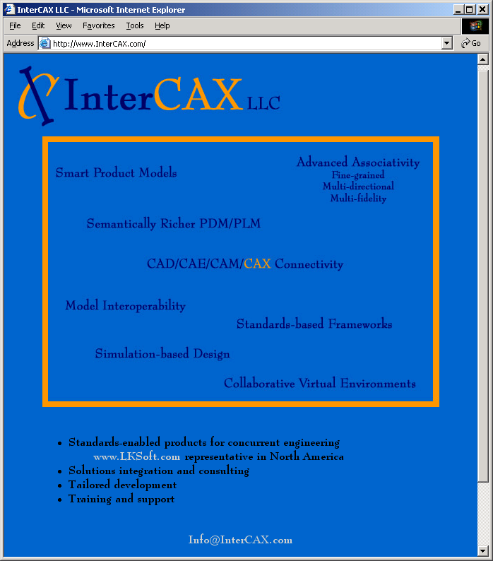
www.InterCAX.com
LKSoft
U.S.-based representative
for North America
Status: Open for business
Received business licenses etc. January, 2003
North American sales, project contracts, technical support, etc.
Close interactions with LKSoft European offices
(e.g. for AP210 converter development & support)
Technology Director
Mike.Dickerson@InterCAX.com
Research Director
Russell.Peak@InterCAX.com
Managing Director
Dirk.Zwemer@InterCAX.com

Slide 6
Other External Collaborators re: related technology …
PDES Inc. Teams
  Electromechanical (EM) Pilot
    Boeing, LKSoft, NASA, Rockwell Collins, US Army, …
  Engineering Frameworks Interest Group (EFWIG)
    ~Above plus ATI, GM, NIST, …
  Systems Engineering (SE)
    ~Above plus Eurostep (AP233 Demonstrator), LMCO, …
CAX Vendors
  Zuken, Mentor Graphics, Ansys, …

Slide 7
Contents
Context
SFM DFX Checker overview
  AP210 context
  System walk-through
  System development architecture
Verification & validation
Challenges
Summary & next steps
SFM = Simulation for Flexible Mfg. DFX = Design-for-Manufacturability, -Reliability, -Test, -Maintenance, …

Slide 8

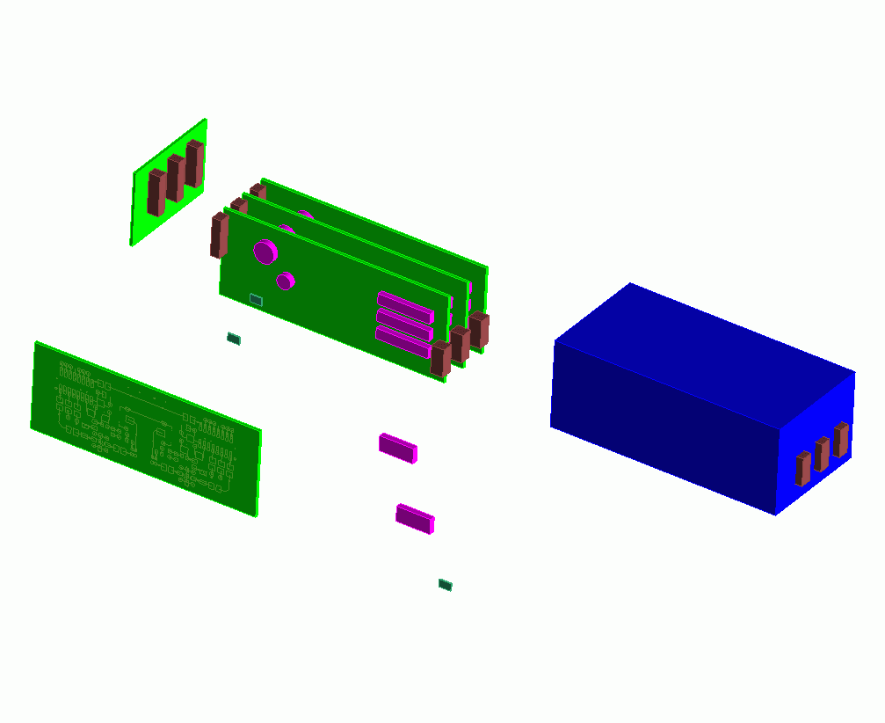

STEP AP210 (ISO 10303-210)
Domain: Electronics Design
R
~950 standardized concepts (many applicable to other domains)
Development investment: O(100 man-years) over ~10 years
Configuration Controlled Design of Electronic Assemblies,
their Interconnection and Packaging
Interconnect
Assembly
Printed Circuit Assemblies
(PCAs/PWAs)
Product Enclosure
Die/Chip
Packaged Part
Printed Circuit
Substrate (PCBs/PWBs)
Die/Chip
Package
External Interfaces
2003-04 - Adapted from 2002-04 version by Tom Thurman, Rockwell-Collins

Slide 9
STEP AP210 Models
R
Functional Models
Requirements Models
Component / Part Models
Functional Unit
Interface Declaration
Network Listing
Simulation Models
Signals
Design
Constraints
Interface
Allocation
Analysis Support
Package
Material Product
Properties
“White Box”/ “Black Box”
Pin Mapping
Assembly Models
User View
Design View
Component Placement
Material product
Complex Assemblies with Multiple Interconnect
Interconnect Models
User View
Design View
Bare Board Design
Layout templates
Layers
  planar
  non-planar
conductive
non-conductive
Configuration Mgmt
Identification
Authority
Effectivity
Control
Net Change
GD & T Model
Datum Reference Frame
Tolerances
Notes:
5

Slide 10
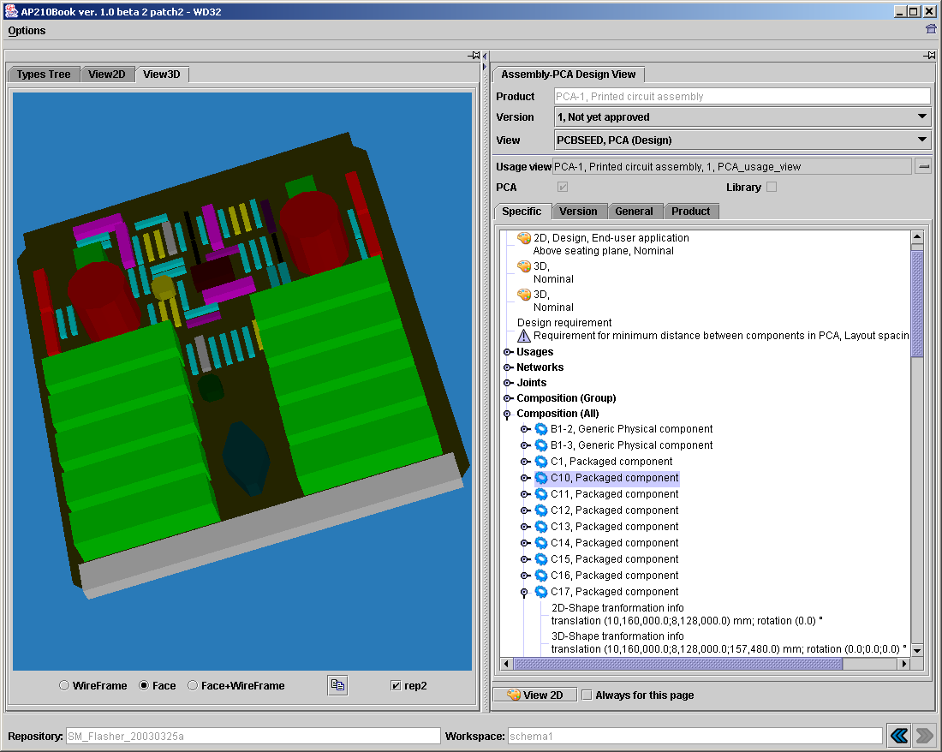
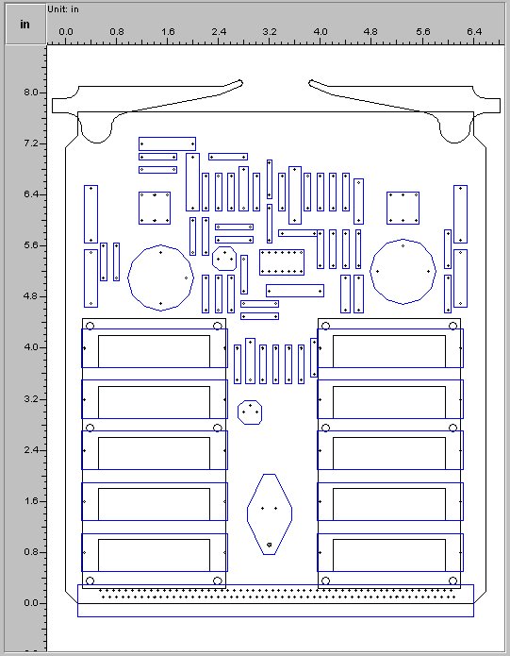
Rich Features in AP210: PCB Assembly - 3D & 2D
STEP-Book AP210 Browser - www.lksoft.com
PDES Inc. EM Pilot
Test Case:
Cable Order Wire
(COW) Board

Slide 11
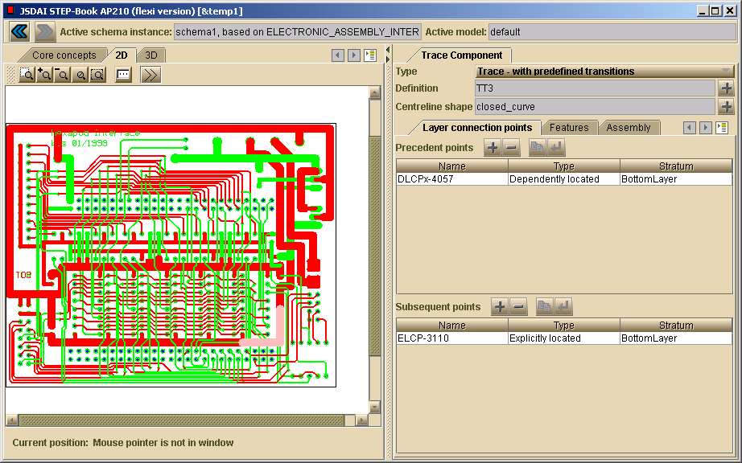
Rich Features in AP210: PWB traces
AP210 STEP-Book Viewer - www.lksoft.com

Slide 12
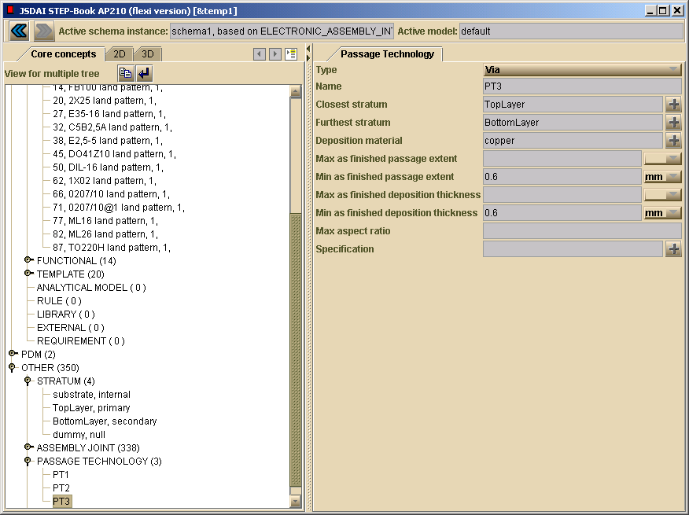
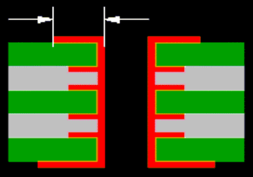
Rich Features in AP210: Via/Plated Through Hole
Z-dimension details …

Slide 13
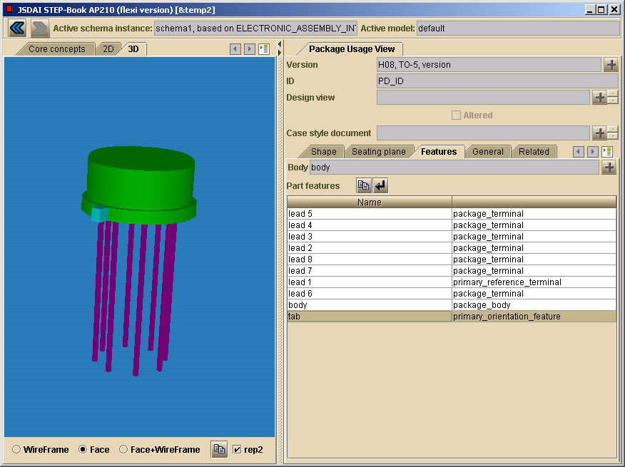
Rich Features in AP210: Electrical Component
The 3D shape is generated from these “smart features” which have electrical functional knowledge. Thus, the AP210-based model is much richer than a typical 3D MCAD package model.
210 can also support the detailed design of a package itself (its insides, including electrical functions and physical behaviors).

Slide 14
Envisioned Standards-based “Data Bus”
System Engineering
Circuit Board
Assembly
Electrical
Iterate
Iterate
Manufacturing
STEP Data
for Exchange
AP 233
AP 210
PWI 220
Quality
Product
Iterate
Iterate
Manufacturing
Multi-Card
Module
Mechanical
2002-03 - Tom Thurman, Rockwell-Collins

Slide 15
Contents
Context
SFM DFX Checker overview
  AP210 context
  System walk-through
  System development architecture
Verification & validation
Challenges
Summary & next steps
SFM = Simulation for Flexible Mfg. DFX = Design-for-Manufacturability, -Reliability, -Test, -Maintenance, …

Slide 16

AP210-Based DFX Analysis Process
Rockwell Collins (RCI) SFM Project
Design
Evaluation
Intended
Design Changes
CAD/E/M/X Tools
Model
Information
Automated
DFX Checking
DFX
Analysis Results
STEP AP210
DFX
Guidelines
Other Design Verification
Analysis & Simulation
SFM Project Focus:
High-value rules
not supported
by typical CAD tools
DFX = Design-for-Manufacturability, -Reliability, -Test, -Maintenance, … SFM = Simulation for Flexible Mfg.

Slide 17
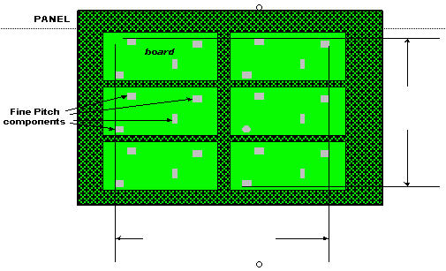
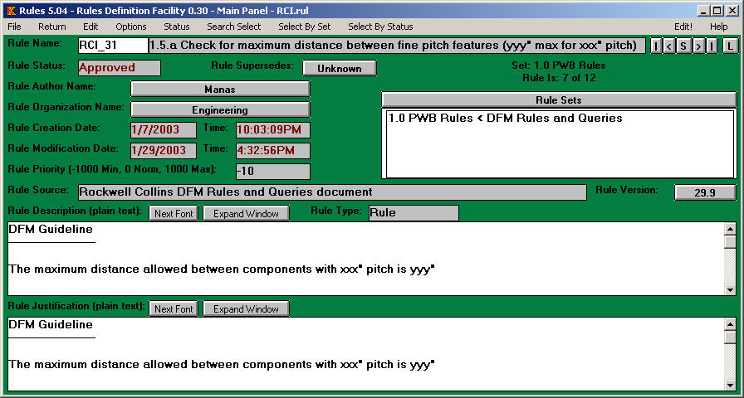
Example DFM Rule and Implementation
DFM Document
(human-sensible)
Boeing Rules Definition Facility (RDF):
Rule Meta-Data (computer-sensible)

Slide 18
AP210-Based DFX Analysis Process
Rockwell Collins (RCI) SFM Project
Design
Evaluation
Intended
Design Changes
CAD/E/M/X Tools
Model
Information
Automated
DFX Checking
DFX
Analysis Results
STEP AP210
DFX
Guidelines
Other Design Verification
Analysis & Simulation
DFX = Design-for-Manufacturability, -Reliability, -Test, -Maintenance, … SFM = Simulation for Flexible Mfg.

Slide 19
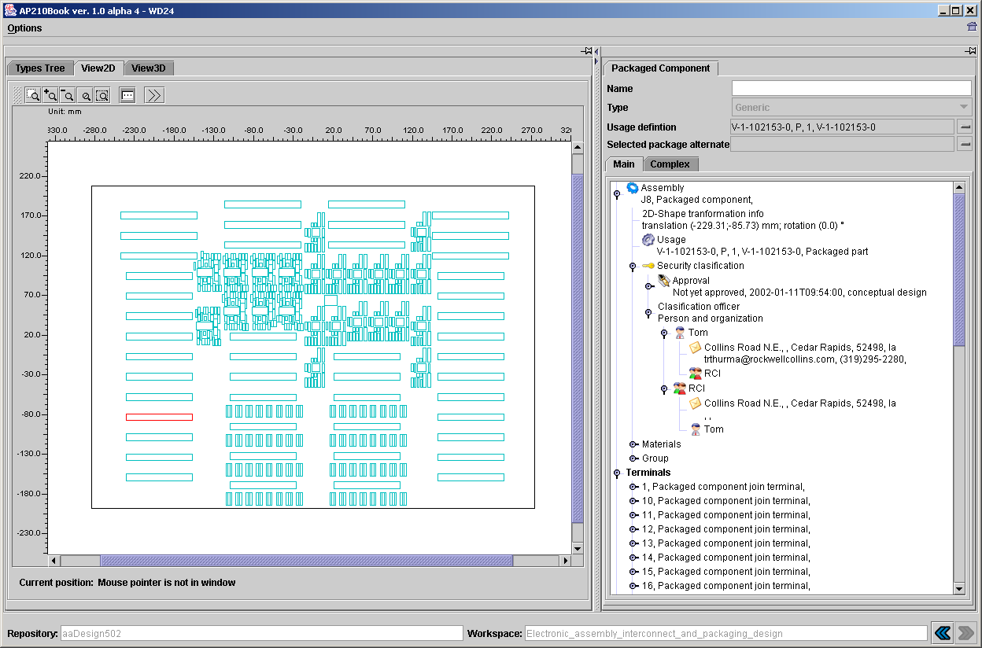
RCI Design -502 in STEP Book AP210
Production design: -502
728 components; 6 layer stackup
Notes:
Note: this is from the STEP-Book version included with the a6 release of the LKSoft CADIF-210 translator. The design model is from the translator plus manual edits by RCI to include additional information.

Slide 20
AP210-Based DFX Analysis Process
Rockwell Collins (RCI) SFM Project
Design
Evaluation
Intended
Design Changes
CAD/E/M/X Tools
Model
Information
Automated
DFX Checking
DFX
Analysis Results
STEP AP210
DFX
Guidelines
Other Design Verification
Analysis & Simulation
DFX = Design-for-Manufacturability, -Reliability, -Test, -Maintenance, … SFM = Simulation for Flexible Mfg.

Slide 21
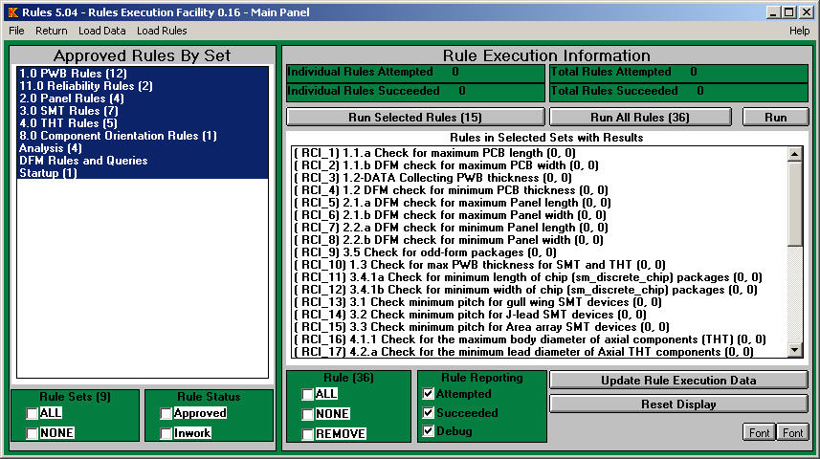
AP210 Design Input &
Rule Checker Execution
AP210 Design Input
(in LKSoft STEP-Book via CADIF Converter)
Rule Checker Execution
(in Boeing REF Tool)

Slide 22
AP210-Based DFX Analysis Process
Rockwell Collins (RCI) SFM Project
Design
Evaluation
Intended
Design Changes
CAD/E/M/X Tools
Model
Information
Automated
DFX Checking
DFX
Analysis Results
STEP AP210
DFX
Guidelines
Other Design Verification
Analysis & Simulation
DFX = Design-for-Manufacturability, -Reliability, -Test, -Maintenance, … SFM = Simulation for Flexible Mfg.

Slide 23
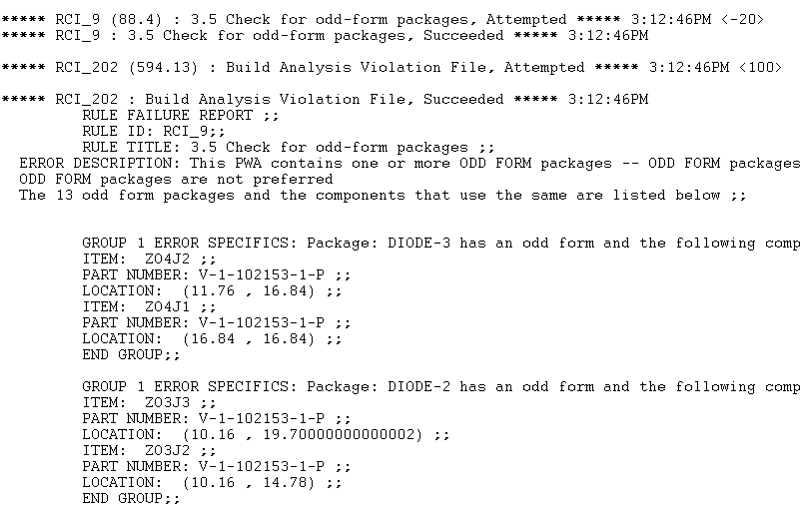
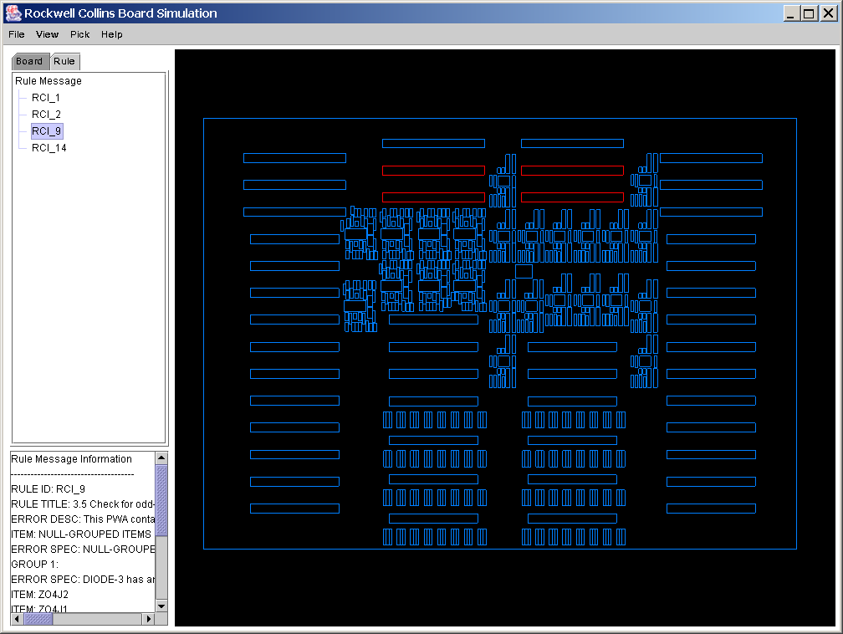
UIUC DFX Results Viewer
RCI Design Rule Violation Example
Results Log
(from SFM DFX Checker)
Results Browser
(highlighted features
have DFX violations)

Slide 24
AP210-based SFM DFX Checker
(see PDES Inc. Electromechanical Pilot slides)
Status at Rockwell Collins - Rules Set 1
Jan ’03 - Pre-production testing
Mar ‘03 - Pilot production testing
Spring ’03 - Full production release
Design
Evaluation
Intended
Design Changes
CAD/E/M/X Tools
Model
Information
Automated
DFX Checking
DFX
Analysis Results
STEP AP210
DFX
Guidelines
DFX = Design-for-Manufacturability, -Reliability, -Test, -Maintenance, …
SFM = Simulation for Flexible Mfg.

Slide 25
Contents
Context
SFM DFX Checker overview
  AP210 context
  System walk-through
  System development architecture
Verification & validation
Challenges
Summary & next steps
SFM = Simulation for Flexible Mfg. DFX = Design-for-Manufacturability, -Reliability, -Test, -Maintenance, …

Slide 26

SFM DFX Checker (SDC) Architecture
End User Views: DFX Librarians & Design Analysts SDC v1.0.b03+
ECAD Tool
Design
Information
Model
Transformer
Stds.-based
Design Model
Visula
CADIF
Design Aux File
CADIF-AP210
Converter
Other CAD/E/X
Tools
Zuken
STEP AP210
PWA/B
Properties
LKSoft
DTI
Informix DBMS
dti (text)
Model
Transformer
Augmented
Design/Mfg. Model
RDD = intermediate design & mfg info model
(custom application-oriented model)
Component
Mfg.-related Info.
RDD Model
Creator
(SDC-RMC)
Component Library Files (.csv)
Auto & Manual Generation
RDD model (.kal)
Design/Mfg.
Model Mgt.
GIT
Simulation/Analysis
Library Mgt.
Simulation/Analysis
Model Execution & Mgt.
DFX Librarian
Design Analyst
RCI DFX
Guidelines
RCI DFX
Rules Library
Analysis Tool
DFX
Analysis Results
Reviewer Tool
Feedback for Design
Readiness / Changes
Authoring Tool
Rules Definition
Facility (RDF)
Rules Execution
Facility (REF)
Results Mgr.
(SDC-RM)
Boeing
RDF
REF_log.txt
Boeing
GIT
Boeing
GIT
UIUC
Version: 2003-03-25
RCI - Rockwell Collins Inc. GIT - Georgia Tech UIUC - U. Illinois

Slide 27
SFM DFX Checker (SDC) Architecture
System Composition View: Development & Deployment SDC v1.0.b03+
ECAD Tool
Design
Information
Model
Transformer
Stds.-based
Design Model
Visula
CADIF
Design Aux File
CADIF-AP210
Converter
Other CAD/E/X
Tools
Zuken
STEP AP210
PWA/B
Properties
LKSoft
DTI
Informix DBMS
dti (text)
Model
Transformer
Augmented
Design/Mfg. Model
Component
Mfg.-related Info.
RDD Model
Creator
(SDC-RMC)
RDD = intermediate design & mfg info model
(custom application-oriented model)
Component Library Files (.csv)
Auto & Manual Generation
RDD model (.kal)
GIT
SFM DFX Checker (SDC)
SDC Rules Tool (SDC-RT)
Boeing Rules System (BRS = Kappa + RDF + REF)
RCI DFX
Guidelines
RCI DFX
Rules Library
Analysis Tool
DFX
Analysis Results
Reviewer Tool
Feedback for Design
Readiness / Changes
Authoring Tool
Rules Definition
Facility (RDF)
Rules Execution
Facility (REF)
Results Mgr.
(SDC-RM)
Boeing
RDF
REF_log.txt
Boeing
GIT
Boeing
GIT
UIUC
Version: 2003-03-25
RCI - Rockwell Collins Inc. GIT - Georgia Tech UIUC - U. Illinois

Slide 28
Engineering Standards-Based
Client-Server Architecture - LKSoft
Remote Repositories
Using commercial LKSoft tools (www.lksoft.com)
Applications
JSDAI - SQL
Bridge
End Users
SQL
WebAdmin
AP210 Interfaces (ECAD):
EAGLE / CadSoft
CircuitCAM / LPKF
VHDL
BoardStation / Mentor
Visula / Zuken
STEP-Book AP210
Oracle
Local Repositories
AP214 Interfaces (MCAD):
EDAG / eMatrix (PDM)
DXF
MicroStation-J
eM-Planner / Tecnomatix
STEP-Book AP214
High-level API
Multiple
Schemas
& Models
JSDAI API
STEP - p22
ARM
Early binding
AIM
Late binding
Model Exchange
STEP - p27
STEP-Book AP203 (MCAD)
Custom STEP-Book-based
Applications
XML File
STEP-p28
Classic
STEP File
STEP-p21
Express
Compiler
Developers
Dictionary
STEP-Book Toolkit
GUI widgets
(lists, 2d/3d viewers, …)
Wizards
Mapping
(ARM-AIM)
Mapping
Compiler
Web-based
Workstations
Meta-Data
SdaiEdit
AimToArmAnalysis
pXX / APyyy = ISO 10303 part XX / APyyy (in STEP standard series)
Source: LKSoft with GIT updates 2002-10

Slide 29
Contents
Context
SFM DFX Checker overview
  AP210 context
  System walk-through
  System development architecture
Verification & validation
Challenges
Summary & next steps
SFM = Simulation for Flexible Mfg. DFX = Design-for-Manufacturability, -Reliability, -Test, -Maintenance, …

Slide 30
Verification & Validation
RCI designs & cases (for primary V&V)
  ~10 production designs
  ~8 V&V test case designs
    Exercise specific DFM rules for V&V
Unit test cases (manually created kappa models
to aid rules development process)
  Type A: for full intended passing
  (ensure no false negatives)
  Type B: for selectively induced violations
  (ensure no false positives when have all needed data)
  Type C: for checking if design model has insufficient data
  (ensure no false positives when have insufficient data)

Slide 31
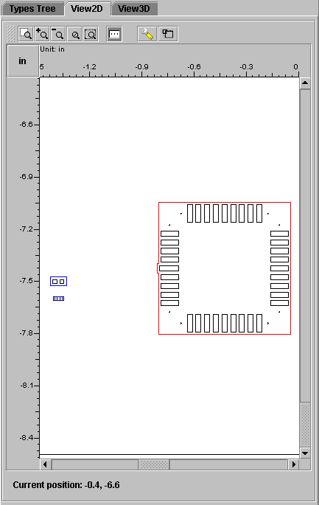
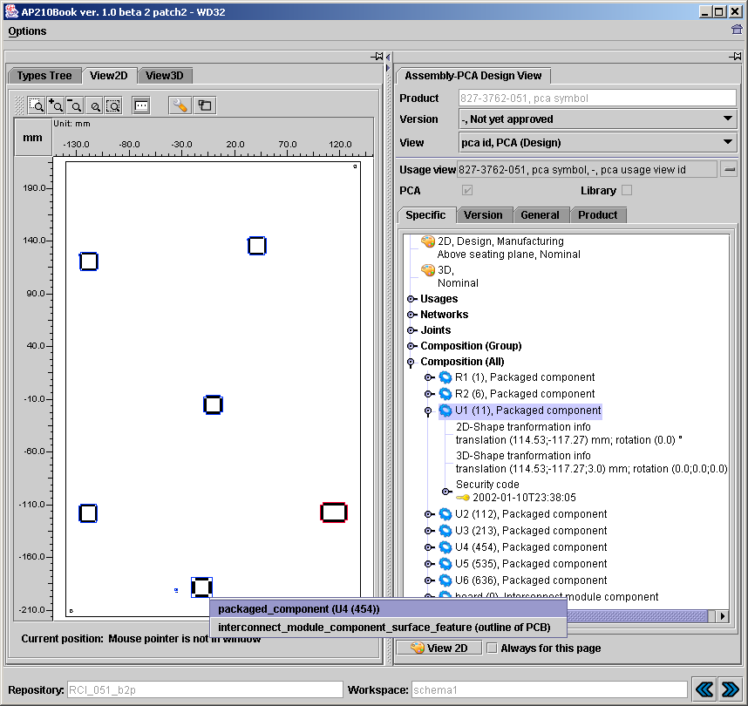
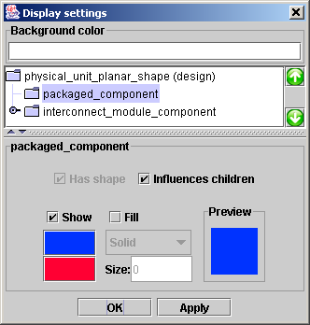
RCI V&V Case -051 in STEP Book AP210

Slide 32
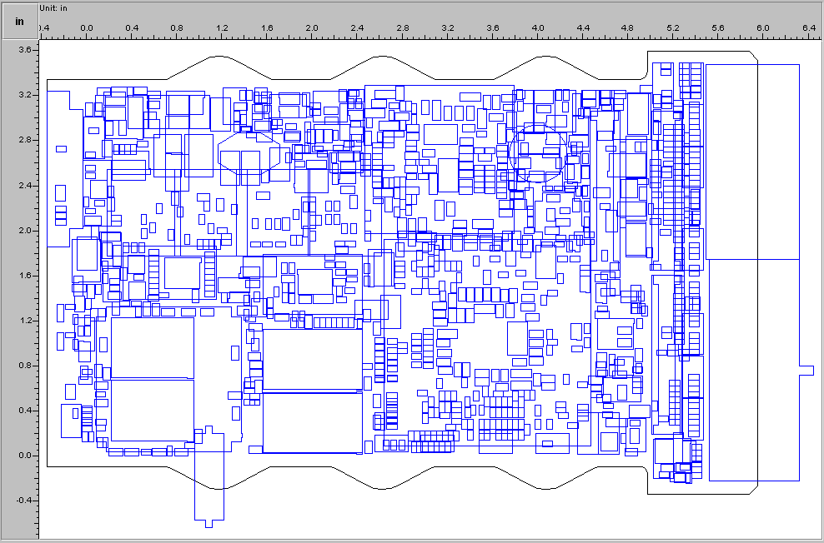
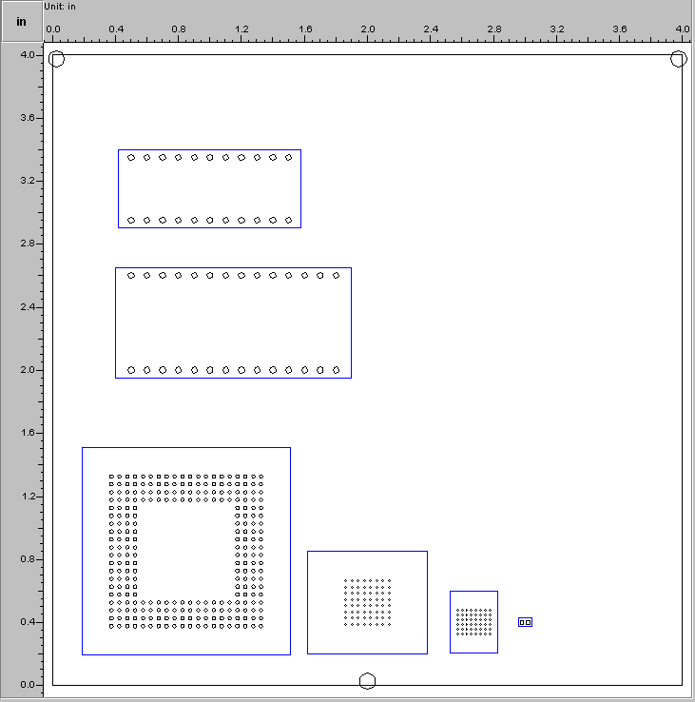
RCI Test Cases -053 and -503 in STEP Book AP210
Production design: -503
1043 components; 20 layer stackup
V&V design: -053
fiducials test;16 layer stackup

Slide 33
Contents
Context
SFM DFX Checker overview
Verification & validation status
Challenges
Summary & next steps
SFM = Simulation for Flexible Mfg. DFX = Design-for-Manufacturability, -Reliability, -Test, -Maintenance, …

Slide 34
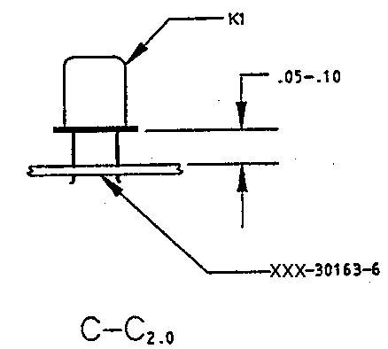
Information Capture Gaps:
Content Coverage and Semantics
Existing Tools
Tool A₁
...
Tool A_{n}
Legend
Content
Coverage Gaps
“dumb” information capture
(only human-sensible,
I.e., not computer-sensible)
Smart Product Model
Building Blocks
Models & meta-models
  International standards
  Industry specs
  Corporate standards
  Local customizations
Modeling technologies:
  Express, UML, XML, COBs, …
Content
Semantic Gaps
Example “dumb” figures

Slide 35
Contents
Context
SFM DFX Checker overview
Verification & validation
Challenges
Summary & next steps
SFM = Simulation for Flexible Mfg. DFX = Design-for-Manufacturability, -Reliability, -Test, -Maintenance, …

Slide 36
Summary
Phase 1 Accomplishments
Established methodology and team approach
Refined system architecture
  Component library approach
Addressed challenges
  Information gaps
  Multiple updates to requirements, tools, standards
Implemented higher value rules (plus other rules)
  Validation & verification ~complete
  Higher priority rules ready for RCI pilot production usage
  On-track for full production usage (~Spring 2003)

