Slide 1
AP 210 Testcases
AP 210 Implementers Forum
CalTech Athenaeum
January 20, 2001

Slide 2
Why have Testcases?
Required for Formal Test Spec for AP 210.
Provide “Qualified” files to use in testing implementations.
Provide concrete examples of concepts covered in recommended practices.
Provide Incremental Implementation Examples
Provide achievable challenges for implementers

Slide 3
Testcase validation criteria
Identifies the Scope & Specific Purpose
  Identify UoFs that are Addressed
  Identify UoF Subset that is Addressed
  Describe Use Cases Supported
Conforms to AP 210
  As a minimum, within the scope
  Ideally will conform completely
  Identifies non-conformance (Violated Rules/Ips)

Slide 4
Testcase validation criteria
Pedigree of the files provided.
  History
  Change History
  Issues against the file
  Issues against AP 210 the file illustrates
  Version of the AIM it is tested against.
  Version of the AIM it was built against.

Slide 5
Types of Testcases
Simple with a limited implementation scope.
  Examples:
    Simple Rectangle
    Multi product
    Component Orientation

Slide 6
Types of Testcases (cont.)
Complex with a scope that covers a particular usage scenerio or design type.
  Examples:
    Thru Hole PCB design
    Surface mount PCA design
    Double Sided Surface Mount PCA design
    Requirement Specification
    Design Change Sequence

Slide 7
Types of Testcases (cont.)
What about ARM data vs AIM data
  Needed for Formal Documentation of test purposes?

Slide 8
Legacy Testcases
Cabledb
Thru Hole Flasher
Surface Mount Flasher
HO8 Package

Slide 9
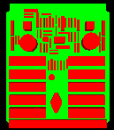
Cabledb
Testcase Purpose
A real design available to share.
Test History:
Filename: cable_db.stp
Author: Paul Monson
Design Source: Mentor Graphics
Translator: ITI Version 1.2
Post Processing: None

Slide 10

Thru Hole Flasher
Testcase Purpose
A real design available to share.
Test History:
Filename: flasherthruhole.stp
Author: Paul Monson
Design Source: Mentor Graphics
Translator: ITI Version 1.2
Post Processing: None

Slide 11
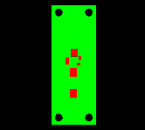
Surface Mount Flasher
Testcase Purpose
A real design available to share.
Test History:
Filename: flasher.210
Author: Kevin Cline
Design Source: IDF Version 2.0
Translator: IDF to AP210
Post Processing: None

Slide 12
H08 Package
Testcase Purpose
Provide a 3D model of an AP210 package.
Test History:
Filename: ??
Author: Craig Lanning
Design Source: AP203
Translator: None
Post Processing: Hand built

Slide 13
In-Process AP 210 Testcases
Rockwell Collins EM Integration Effort
  Bare PCBs -- rectangular board, {rectangular corners, rounded corners}, circular board, rectangular bezel board with rounded corners
  PCAs -- based on PCBs above
  Packaged Parts -- 9 parts in Recprac

Slide 14
Existing AP 210 Testcases
Component_placement_restriction_
assignment Requirements
Drilled Hole
Modified MRA Boundary
Multi Product
Component Orientation
PCB
Simple Rectangle
Circular Arcs
Annex K examples

Slide 15

Component Placement Restriction
Testcase Purpose:
To test the function of the ARM concept of component_
placement_restriction_
assignment requirements
Test History:
The file MGC_CGA.brd includes the ROUTE_OUTLINE and PLACE_OUTLINE outlines that where required in order to create a board geometry in Mentor Graphics tools.
Filename: CRA.210
Author: Mike Keenan
Design Source: ATX subset
Translator: IDF to AP210 11/13/00
Post Processing: None

Slide 16

Drilled Hole
Testcase Purpose
Provide simple drilled hole example.
Test History:
Filename: DrilledHole.210
Author: Mike Keenan
Design Source: ATX Version 2.01
Translator:IDF to AP210 11/13/00
Post Processing: None

Slide 17
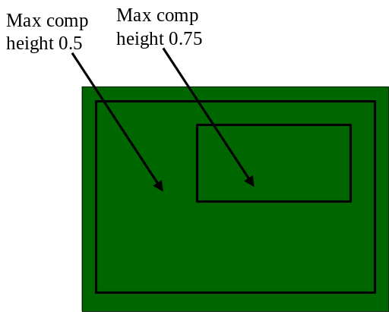

Mounting Restriction Area Boundaries
Testcase Purpose
Test a mounting_restriction_area with both an external and internal boundary.
Test History:
Filename: ModifiedMRABoundary.210
Author: Mike Keenan
Design Source: MRABoundary.brd
Translator: IDF to AP210 11/13/00
Post Processing: Manual to add the cutout to the outer mounting_restriction_area.

Slide 18

Multi Assembly
Testcase Purpose
Test the results of giving a system a part21 file with two PWA assemblies in it.
?
Test History:
9/20/00 - AP210Viewer Version 1.2f Beta 1.0, displayed the single component annexk example. No indication of another design in the file.
Filename: MultiProduct.stp
Author: Mike Keenan
Design Source: Annex K examples for AP210 IS
Translator: N/A
Post Processing: Used StepMerge program to create a single part21 file for the two examples.

Slide 19
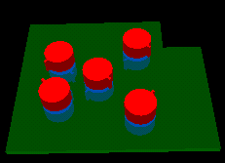
Component Orientation
Testcase Purpose
Test component placement and rotation on both sides of the board.
Test History:
Extensive testing during development of AP210 Viewer and IDF to AP210 translator.
Filename: Test_05.210
Author: Mike Keenan
Design Source: Test_05.brd
Translator: IDF to AP210
Post Processing: None

Slide 20
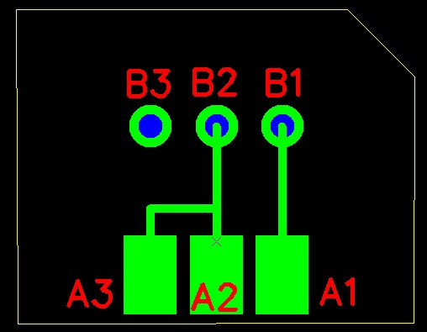
PCB
Testcase Purpose
Test History:
Tested using Expresso.
Extensive, ask Tom and Lothar
Filename: ap210_pcb1.stp
Author: Giedrius Liutkus
Design Source: Circuit Cam
Translator: Circuit Cam
Post Processing: Manual, being incorporated into tool

Slide 21
McKee/Evans Test Suite
Describes a set of testcases that increase in complexity

Slide 22
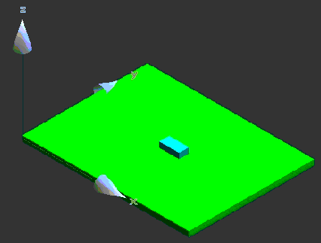
Simple Rectangle
Testcase Purpose
Simple rectangular board with one component
Test History:
A direct translation using TLDi Software PCBto3D from IDF to Solid Edge.
Translate IDF files to STEP AP203 file format. Rename resulting STEP file from tidf.step to tidf.stp. Inport STEP file into Solid Edge
Filename: tidf-A.brd
Author:Jim Evans
Design Source:IDF Data
Translator: Many
Post Processing: None

Slide 23
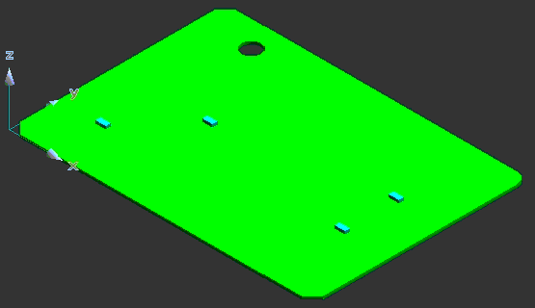
Circular Arcs
Testcase Purpose
Test circular arcs in outlines and multiple placement of single part.
Test History:
A direct translation using TLDi Software PCBto3D from IDF to Solid Edge.
Translate IDF files to STEP AP203 file format. Rename resulting STEP file from tidf.step to tidf.stp. Inport STEP file into Solid Edge
Filename: tidf-B.brd
Author: Jim Evans
Design Source: IDF Data
Translator: Many
Post Processing: None

Slide 24
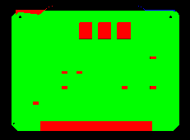
AnnexK Assembly
Testcase Purpose
Test History:
Filename: annexk_assembly.stp
Author: Kevin Cline
Design Source: IDF Version 2.0
Translator: IDF to AP210
Post Processing: None

Slide 25

AnnexK Component
Testcase Purpose
Test History:
Filename: annexk_component.stp
Author: Kevin Cline
Design Source: IDF Version 2.0
Translator: IDF to AP210
Post Processing: None

Slide 26
Proposed AP210 Testcases
Complete 2D Geometry

Slide 27

Interface Drawing
Testcase Purpose
Provide an example of the “interface drawing” for a PWA.
Test History:
Filename: Atx.210
Author: Mike Keenan
Design Source: ATX Spec. 2.01
Translator: IDF to AP210
Post Processing: Expected

Slide 28
Complete 2D Geometry
Testcase Purpose
Validate that all 2-D geometry types are handled.
Description: Contains a board outline and only a board outline with all allowed 2-D geometry types.
Test History:
Filename:
Author: TBD
Design Source:
Translator:
Post Processing:

Slide 29
Where we are today
Have an incomplete list of the testcases we need.
Have a very informal testcase process.
Only one testcase (PCB) has been checked for AP210 conformance,

Slide 30
Where we need to go
Identify the types of testcases we need
Establish a testcase process.

Slide 31
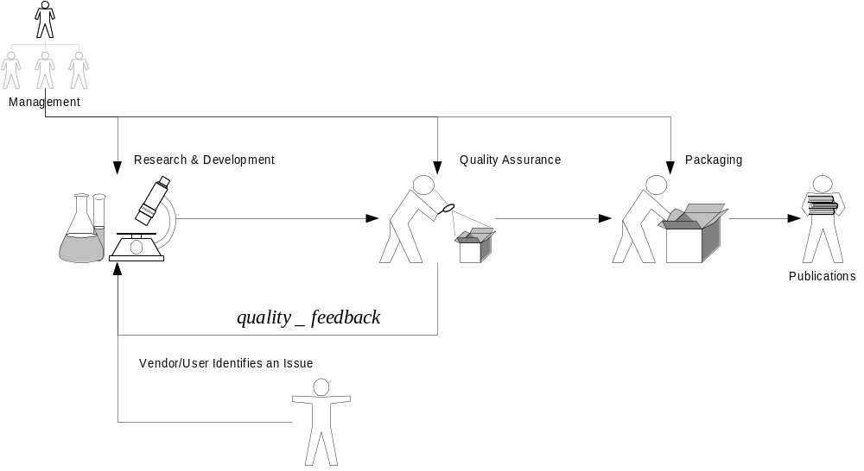
Proposed Testcase Process

