Slide 1
Problem Introduction
Wheatstone Bridge Design

Slide 2
Problem Introduction
Design Flow
Circuit Board
Assembly
ECAD
Quality
Product
Requirements
STEP Data for Exchange AP 210
Product
Package
MCAD
  The EM Pilot uses AP 210 to integrate electrical and mechanical design processes
Notes:
Here is a typical design flow. Those who are familiar with EM Pilot see that I’ve stolen our favorite slide and reused it. Primarily I will talk about ECAD part because we are focusing on connectivity.

Slide 3
Problem Introduction
Design Flow
Systems Engineering creates requirements
  Functional Requirement
    Diagram
    Resistance Range
    Accuracy
    Resolution
    Voltage & Current Limits
  Functional Interface Requirement
    Communication & Control Interfaces
Notes:
System engineering creates a set of requirements. There is a functional requirement. The purpose of a wheatstone bridge is to measure resistance values in products typically known as resistors. So there’s range, accuracy (for wheatstone bridges they are good, usually better than .01%, so you get six digits of accuracy), resolution, voltage and current limits, within which the wheatstone bridge would work if you ran a 100 RAMs through a wheatstone bridge.

Slide 4
Problem Introduction
Design Flow
Systems Engineering creates requirements (cont.)
  Physical Requirement
    Temperature
    Humidity
    Mass
    Volume
  Physical Interface Requirement (ICD – Interface Control Definition)
  Safety, …
AP 210 Conformance Classes 4, 5, 31, 32
Notes:
In functional interface requirement there are some communication and control interfaces. In physical requirements there are some operational conditions. If the wheatstone bridge weighs 400 kg, even if there are 6 digits of accuracy, it probably doesn’t satisfy the requirement. Then there is physical interface requirement also known as an Interface Control Definition (ICD).
We identified some conformance classes that might give some assistance looking into AP 210.

Slide 5
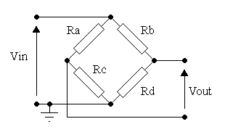
Diagram
Notes:
label this as typical(?) view to point out the difference in ambiguity between this representation and AP 210 capabilities.
I would leave this slide back here to avoid the diatribe about the levels of abstraction.

Slide 6
Functional Requirement
Insert Battery into Battery Clips
Attach Unknown Resistor to Input Connectors
Attach Voltmeter to Output Connectors
Adjust Knob until Voltage reading is Zero
Record Value on Dial Indicator on Knob
Notes:
Functional requirement defines the main purpose of a wheatstone bridge. You have to insert the battery into battery clips, attach an unknown resistor to input connectors, attach a voltmeter to output connectors, adjust the knob until voltage reading in the voltmeter is zero, then record the value on as dial indicator on a knob.

Slide 7
Functional Questions
URL http://www.dwiarda.com/scientific/Bridge.html
Questions:
Which of Ra—Rd are Unknown, Pot, and which are the two fixed resistors?
Eventually:: Ra is Unknown, Rd is Pot, Rb is fixed, Rc is fixed.

Slide 8
Functional Interface Requirement
WB1
X1
X4
X2
X3
+
-
Notes:
The bright blue rectangle in the center is a wheatstone bridge, on the right there’s a voltmeter, down there is a battery and there’s an unknown resistor up here. This is the way you will connect various items for making the measurement into the wheatstone bridge.

Slide 9
Physical Requirement
    Temperature:
      operating 25 deg C +/- 10 deg C (2 hour startup minimum)
      Non-operating -25 deg C to 55 deg C
    Humidity
      Operating 50% (+30 – 50%)
      Non-operating 0-100 %
    Mass
      Less than 2 Kilograms
    Volume
      Less than 1 Liter
Notes:
Here we have operating temperature. As it is a high precision instrument, we’ve given some time to stabilize the instrument before evaluating whether it is performing right. Other factors included are mass, humidity and volume.

Slide 10
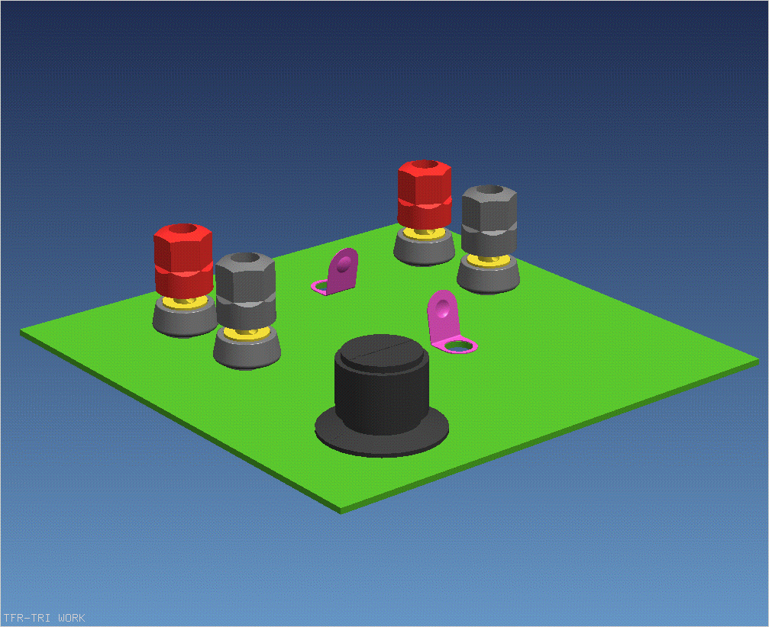
Physical Interface Requirement
Notes:
Here is a set of 75 pages textual descriptions. In the picture we have banana jacks for the input resistor, banana jacks for the voltmeter, a couple of battery clips and a knob.

Slide 11
Problem Introduction
Design Flow
Electrical Design Receives requirements
Mechanical Design Receives requirements
Design has Available:
  Schematic Symbols and Related Function Definitions
  Electrical Simulation Models
  Thermal Simulation Models
  Mechanical Piece Part Models
  Manufacturing capabilities and quality manuals
CC 2, 3, 12
Notes:
Electrical design receives requirements, mechanical design also receives requirements. The design organization here has a library, on which they spent a lot of money and a lot of care, and they have symbols and functions and simulation models, thermal simulation models, mechanical piece part models and they know what their manufacturing capabilities are. Here are also some conformance classes that will help with this situation.

Slide 12
Problem Introduction
Design Flow
Electrical Design (Schematic)
  Draws schematic
    Specifies one new part to add to component library data base
  Specifies element values and tolerances --
  Saves functional netlist
  Selects parts:
    that meet the values and tolerances
    that have Application constraints satisfied by the design
  Executes packaging application that marries the part to the schematic element
  Saves packaged netlist and sends to PC Design
CC 35, 36
Notes:
We decided that we need to add one new part to the component library database in the electrical design flow. Electrical design specifies element values and tolerances – saves functional netlist and selects parts that meet the values and tolerances and also look to see that those parts have Application constraints that are satisfied by the design. In some cases they put sensor arrays down the bottom of the well that is 350 degrees. They don’t use the same kind of parts that we do in aerospace and automotive because those parts would melt within a few minutes down there. So in this case they make sure there’s a drift coefficient over the temperature range and lifetime required. One of the impacts might be that in 10 years the using organization may come back and complain to the designer because over the lifetime of this bridge this thing has drifted and now have to calibrate it every 10 minutes. The designer would go back to the system engineer and say there was no spec. for how often it has to be recalibrated.
Then we execute packaging application that marries the part to the schematic element. Afterwards we save packaged netlist and send to PC design.
Conformance classes 35 and 36 might have this kind of information.

Slide 13
Problem Introduction
Design Flow
Mechanical Design (Assembly)
  Selects connectors
  Defines board outline, thickness, material, Tolerances
  Refines External User Interface Approach
  Validates that Part Application Constraints are met
Notes:
Mechanical design selects the connectors, defines board outline, thickness, material and tolerances, refines external user interface approach, e.g. we have a particular person on cock-pit instruments. When we went from toggle switches on airplane panels to push-button switches, he had the official firm that was engaged in the heads of push-button switches for pilots with gloves on to be able to switch.
They also run various analysis to verify that things don’t get to hot or don’t get too cold.

Slide 14
Problem Introduction
Design Flow
Printed Circuit (PC) Design (Layout)
  Receives packaged netlist
  Receives library data for new part
  Receives board outline,
  Lays out board based on:
    Mechanical constraints
    Design & producibility rules
  Routes board based on same constraints plus electrical constraints
  Saves board data; sends to mechanical for fit check/top level simulation
  Verifies producibility
Mechanical design changes a connector orientation; recycle
Notes:
The PC design department gets the packaged lists, library data, the board outline. They are integrating 3 different pieces of data. They get the netlist from the electrical side, library data from the library and board outline from mechanical department. We have mechanical constraints and design and producibility rules. In all these constraints PC designer route the board, save the board data, send it back to mechanical for fit-check and environmental simulation and verify the producibility. After all this is done the mechanical design changes the connector and then everything is done all over again

