Slide 1








Progress on Standards-Based
Engineering Frameworks that include STEP AP210 (Avionics), PDM Schema, and AP233 (Systems)
An Engineering Framework Interest Group (EFWIG) Overview
2002 NASA-ESA Workshop on
Aerospace Product Data Exchange
ESA/ESTEC, Noordwijk (ZH), The Netherlands
April 9-12, 2002
Russell Peak - Georgia Tech, Atlanta GA, USA
Mike Dickerson - JPL/NASA, Pasadena CA, USA
Lothar Klein - LKSoft, Kuenzell, Germany
Steve Waterbury - NASA-Goddard, Greenbelt MD, USA
Greg Smith - Boeing, Seattle WA, USA
Tom Thurman - Rockwell Collins, Cedar Rapids IA, USA
Jim U'Ren - JPL/NASA, Pasadena CA, USA
Ken Buchanan - ATI/PDES Inc., Charleston SC, USA
v2 - 2002-04-23

Slide 2
Abstract http://www.estec.esa.int/conferences/aerospace-pde-2002
Progress on Standards-Based Engineering Frameworks
that include STEP AP210 (Avionics), PDM Schema, and AP233 (Systems)
This presentation overviews progress towards standards-based engineering frameworks for in-progress design collaboration at the department/workgroup level. Engineering frameworks (EFWs) are themselves viewed as a system of subsystems.
We describe how content representation standards like STEP AP210, PDM Schema, and AP233 are subsystems in an EFW and discuss their combined role. Content access standards like SDAI, CORBA, and PDM Enablers are another element in EFWs that enable finer-grained interoperability than monolithic file exchange. Tools and architectures that leverage these two levels of standards are discussed, including experience to date with specific EFWs.

Slide 3
Engineering Framework Interest Group (EFWIG)
A PDES Inc. Systems Engineering Subproject http://eislab.gatech.edu/efwig/
The Engineering Frameworks Interest Group (EFWIG) is a cooperative team aimed at furthering standards-based collaborative engineering environments. In this context, similar terminology includes engineering information systems, interoperability technology, repository architectures, and integration frameworks.
The emphasis is on techniques and tools to achieve open, standards-based EFWs. We are showing how existing and emerging standards like STEP and SOAP fit within an EFW. We are also identifying gaps, developing solutions, and promoting standardization of such solutions.
The current domain orientation is towards electro-mechanical systems design (e.g., STEP AP210), including considerations for PDM/PLM, systems engineering (e.g., AP233), systems software, and engineering analysis (e.g., AP209) . The target end user level is engineering work groups and departments for in-process designs.
Another way to think of EFWIG is as an "implementers forum" or "users group", where the thing being implemented/used is not a standard or a vendor tool, but EFWs within particular organizations. Thus CAx organizations like the JPL Design Hub and its constituents are natural participants in EFWIG.

Slide 4
Contents
Definitions & Scope
Example Gaps Being Addressed
Solution Approach
Example Progress
Summary

Slide 5
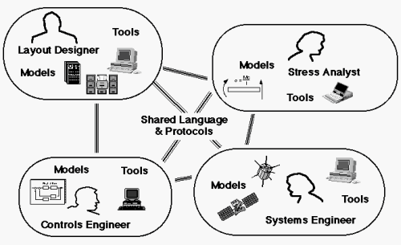
Engineering Framework
As Defined by a Question
“How do we connect people, their models, and their tools?”
[Olsen, 1994]

Slide 6
Engineering Framework
Components & Views
Some EFW “components” …
  Computing - networks, machines, software (tools)
  Content - information representation (models)
  Communication - content access protocols (interoperability)
  Control - work flow & business processes
  People - including their specific skills and roles
Some views of an EFW …
  Computer Network View
  Software Tool Organization View
  Product Model Content View
  Tool-Product Model Relationships View
Various Standards
Required

Slide 7
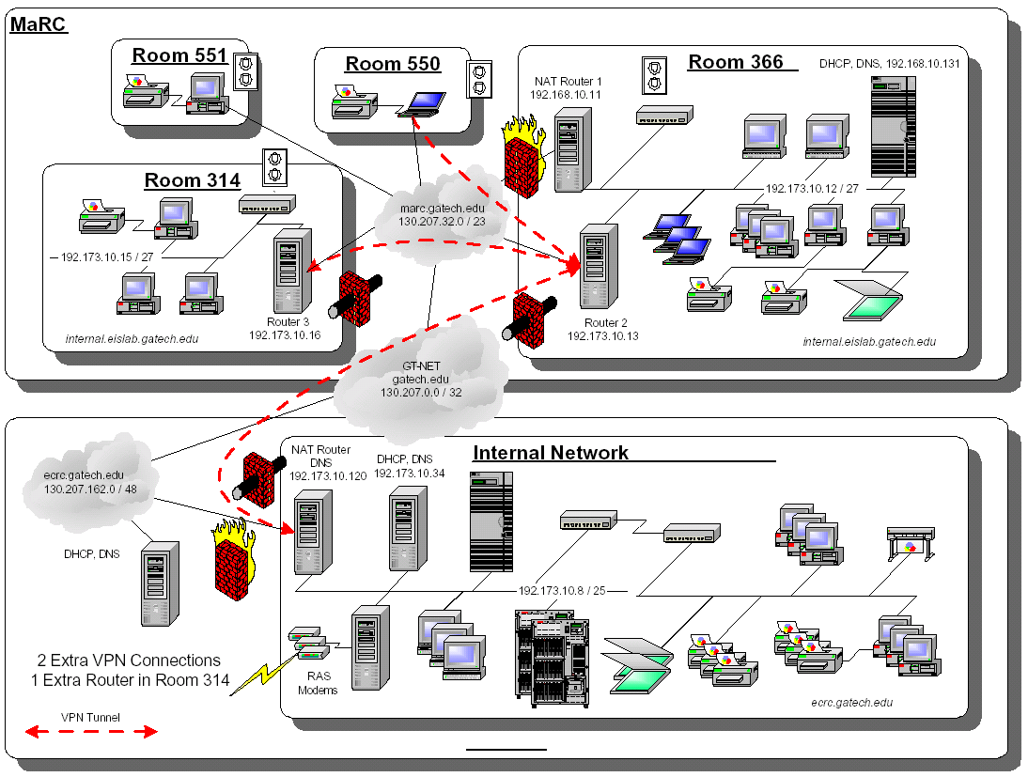
Example EFW: Computer Network View
Georgia Tech ECRC & EIS Lab (sanitized)
Adapted from 2000-07 - Chien Hsiung, Georgia Tech

Slide 8









Example EFW: Software Tool Organization View
Customers
JPL Projects and Technical Divisions
Soap
Sat Took Kit SDK
Doors
ApGen
Fast Flight
Ansoft
HPEE Sof
Sonnet
Mentor Graphics
Cadence
Mathworks Matlab
Synopsys
Synplicity
Ilogix Statemate
Orcad
AutoCad
Relex
Avant!
Place & Route
- Actel
- Xilinx
- Atmel
(and many more)
PTC Computer Vision
PTC Pro-E
SDRC Ideas
SDRC Femap
Solid Works
Cosmos
NASTRAN
Adams
Sinda/Fluent
PDMS -
EDMG
SDRC Metaphase
Sherpa
Visual ToolSets
Cool Jex
Perceps
Rational Rose
Ruify
Harlequin LISP
I-Logix Rhapsody
Code V
LensView
TracePro
Zemax
Software Tools
CAE Cost Centers
System
CAE
RF & EM
CAE
Electronics
CAE
Mechanical
CAE
Software
CAE
Optical
CAE
DIVISION 31
DIVISION 33
DIVISION 34
DIVISION 35
DIVISION 36
DIVISION 38
M-CAE Toolsmiths
and Workstations
Holding Account
Billing & Payable
E-CAE Toolsmiths and Workstations
Toolsmiths
Workstations
Servers & Sys Admin
M-CAE Servers
& Sys Admin
TMOD Severs
Servers & SA
DNP Operations
* Not DNP Operations
Management and Administration
Robin Moncada
Design, Build, Assembly, Test (DBAT) Process
Adapted from “Computer Aided Engineering Tool Service at JPL” - 2001-07-22 - Mike Dickerson -NASA-JPL

Slide 9
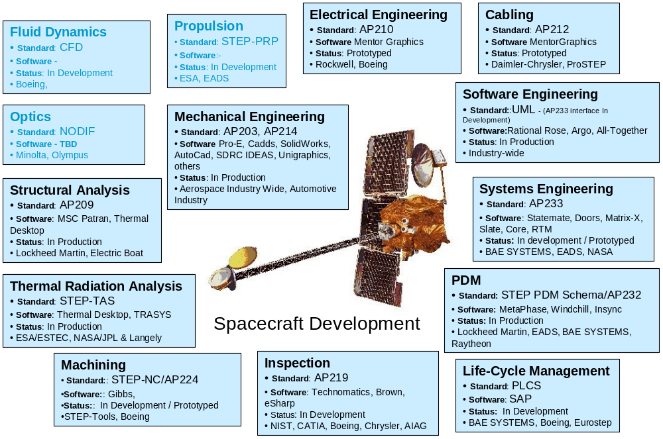
EFW View: Specific Product Model Content
A composition of standard and custom information models
Adapted from 2001-12-16 - Jim U’Ren, NASA-JPL

Slide 10
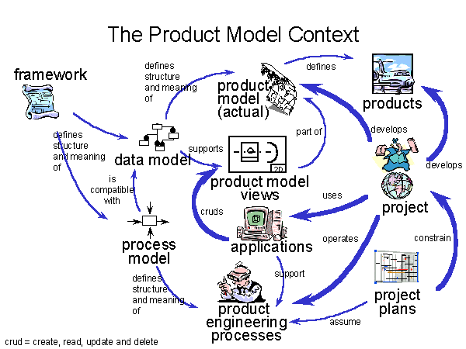
EFW View: Generic Product Model Content
Generic product development aspects
Source: SC4 Industrial Data Framework - ISO TC184 document SC4N1167 - 2001-08-01

Slide 11
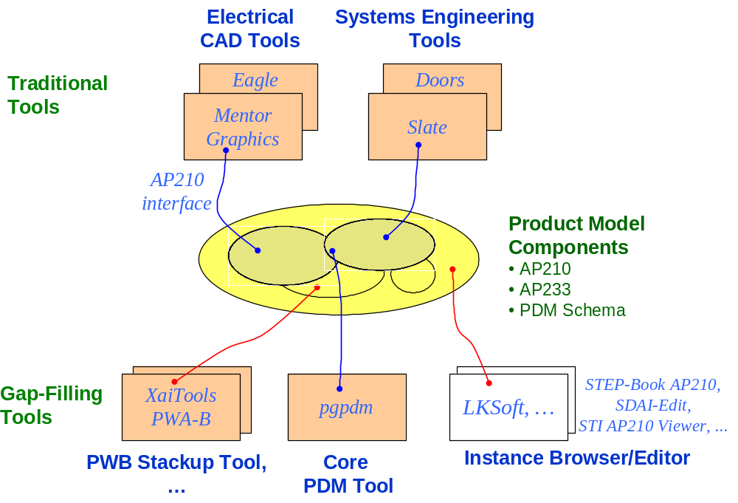
EFW View:
Tool-Product Model Relationships

Slide 12
Target Situation
Collaborative Engineering Environment with Advanced Interoperability
Longer Term Vision for a Standards-based Architecture
PDM
Schema
System
Engineering
Schema
Mechanical
Schema
(AP203)
Electrical
Schema
(AP210)
Analysis
Schema
(AP209)
Catalog &
View
Schemas
Mfg.
Capabilities
(AP220)
(Express)
(UML)
Repository Schema Generator
Application Access/Translation Layer
Documentation Facilities
(Text, XML,
SGML, etc.)
Data Views and PDM
Requirements Design & Analysis
(STEP)
Objects
Entities,
Relations &
Attributes
Request
Broker
Or
Remote
Access
Mech.
Data Viewers
(STEP, XML)
Object Oriented or
Object Relational
DBMS
Cross Domain Analysis
(STEP)
Domain Specific Analysis
(STEP)
Negotiation/
Communications
Agents
Analysis
Agents
CAx Applications and PDMs
(STEP)
Model Development and Interactive Environment
Data Dictionary Facilities
2000-02 - Greg Smith, Boeing

Slide 13
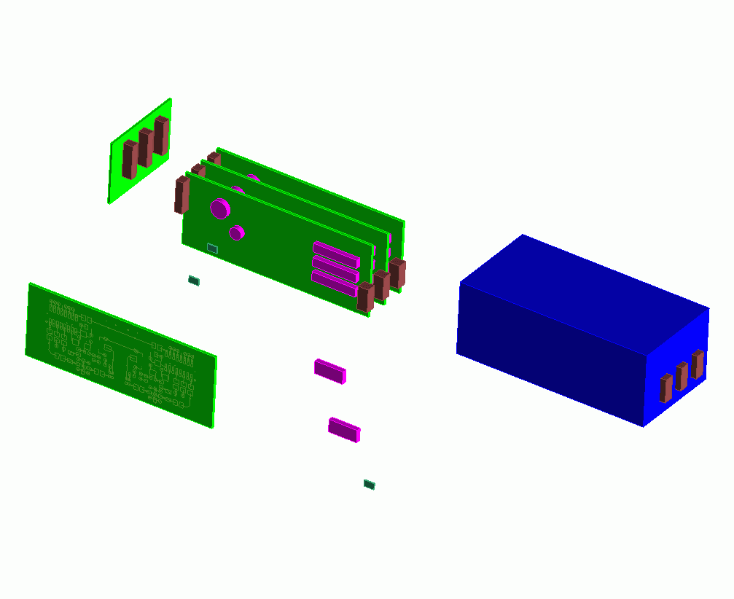

EFW Analogy with Electronic Systems
A “system of systems”: parts, assemblies, technologies, configuration mgt., …
Repository Architecture
EFW Subsystems
Interconnect
Assembly
CAx Tool xyz
An EFW
at Company XYZ
Printed Circuit Assemblies
(PCAs/PWAs)
Product Enclosure
Die/Chip
Packaged Part
Printed Circuit
Substrate (PCBs/PWBs)
Die/Chip
Package
External Interfaces
AP233, AP210, …
SOAP, CORBA, …
2002-04 - Russell Peak, Georgia Tech. Adapted from AP210 figure by Tom Thurman, Rockwell-Collins

Slide 14
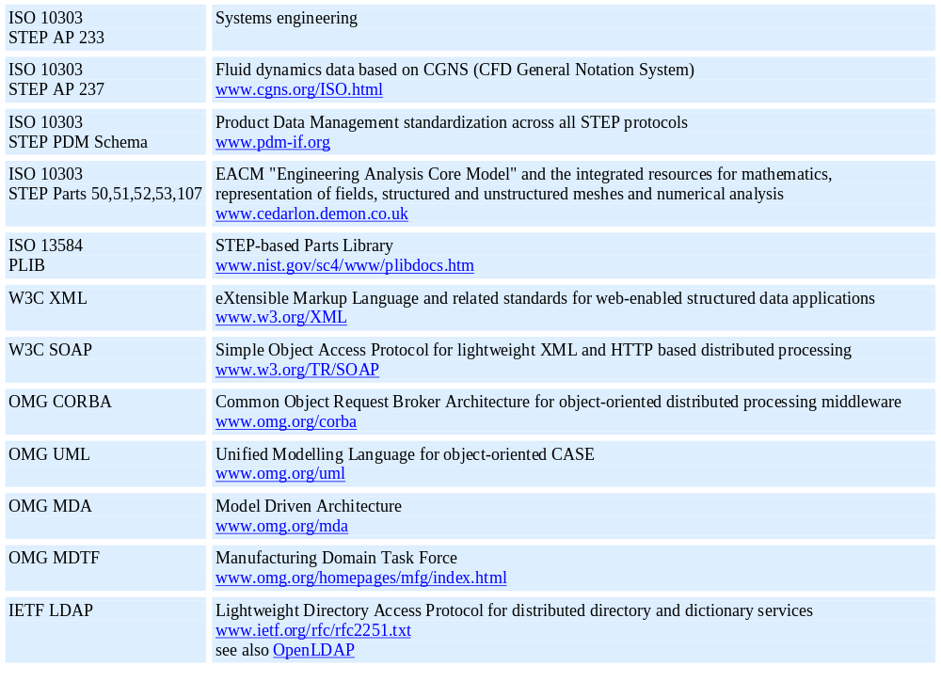
Partial “Parts Library” of
Relevant EFW Standards
From http://www.estec.esa.nl/conferences/aerospace-pde-2002/relevant_standards.htm as of 2/2002

Slide 15
Scope of Engineering Framework
Interest Group (EFWIG)
Interoperability in multi-disciplinary engineering development environments
  Emphasis dimensions:
    Organizational Level: engineering group/department
    Domains: systems & s/w engineering, electromechanical, analysis
    Design stages: WIP designs at concept, preliminary, and detailed stages
  Awareness of design interfaces to other life cycle phases:
    pursuit & order capture, mfg., operation/service, and disposal

Slide 16
Contents
Definitions & Scope
Example Gaps Being Addressed
Solution Approach
Example Progress
Summary

Slide 17
Challenges in Today's
Engineering Frameworks
Highly dynamic & complex “objects”:
    users, models, relationships, tools, machines, virtual resources, …
  Frequent changes, including technology evolution
  Large quantities
  Version & configuration management issues
  Maintaining commonality takes time, resources, & hard work
EFW structure & operation not well-defined
  Little central knowledge or control
Interoperability not typical vendor intent
  Primary CAx tools designed for stand-alone mode
  “Integration” = “single vendor can do-it-all” tendency
  Capacitor mfg. turned supercomputer mfg. analogy
Inherent humans limits
  Communications bandwidth (Tower of Babel)
  Time, space, language, motivation (money/politics/human nature)

Slide 18
Specific Gaps Being Addressed by EFWIG
Content coverage gaps
Content semantic gaps
  Ancillary information, including “dumb” figures & notes
Fine-grained associativity gaps

Slide 19
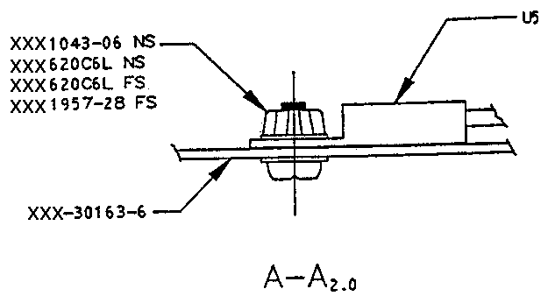
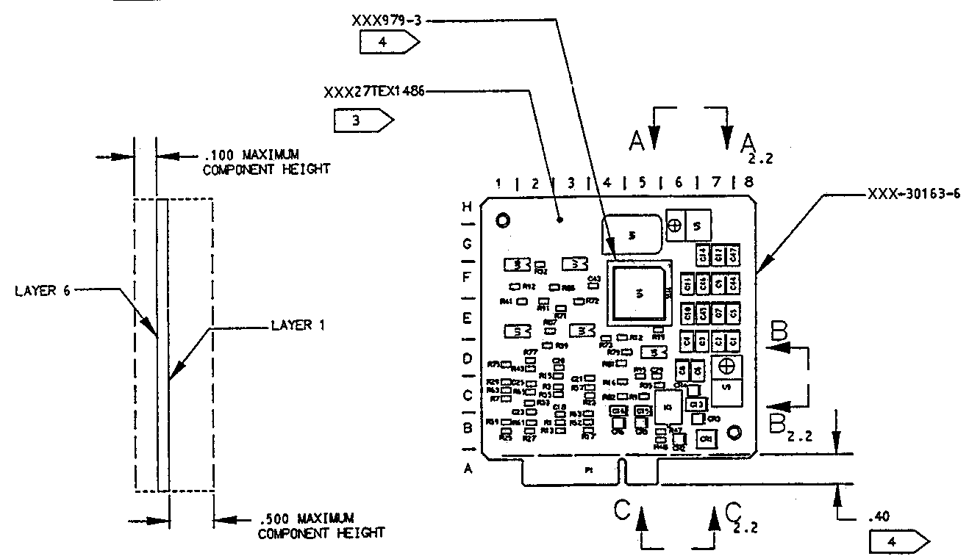
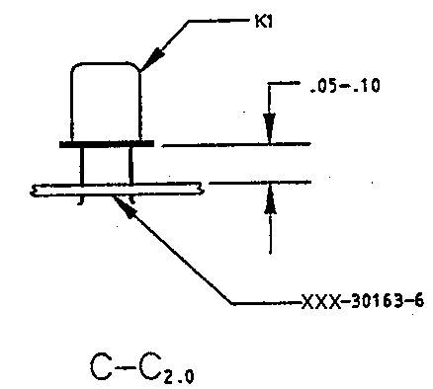
Example PWA Ancillary Information
“Dumb” figures & notes
PWA = printed wiring assembly
PWB = printed wiring board
Maximum Height
Restrictions
Conformal Coating
Restrictions
Component Assembly
Instructions
Stackup Notes

Slide 20
Information Capture Gaps:
Content Coverage and Semantics
Existing Tools
Tool A₁
...
Tool A_{n}
Legend
Content
Coverage Gaps
“dumb” information capture
(only human-sensible,
I.e., not computer-sensible)
Product Model
Components
AP210
AP233
PDM Schema
Content
Semantic Gaps

Slide 21
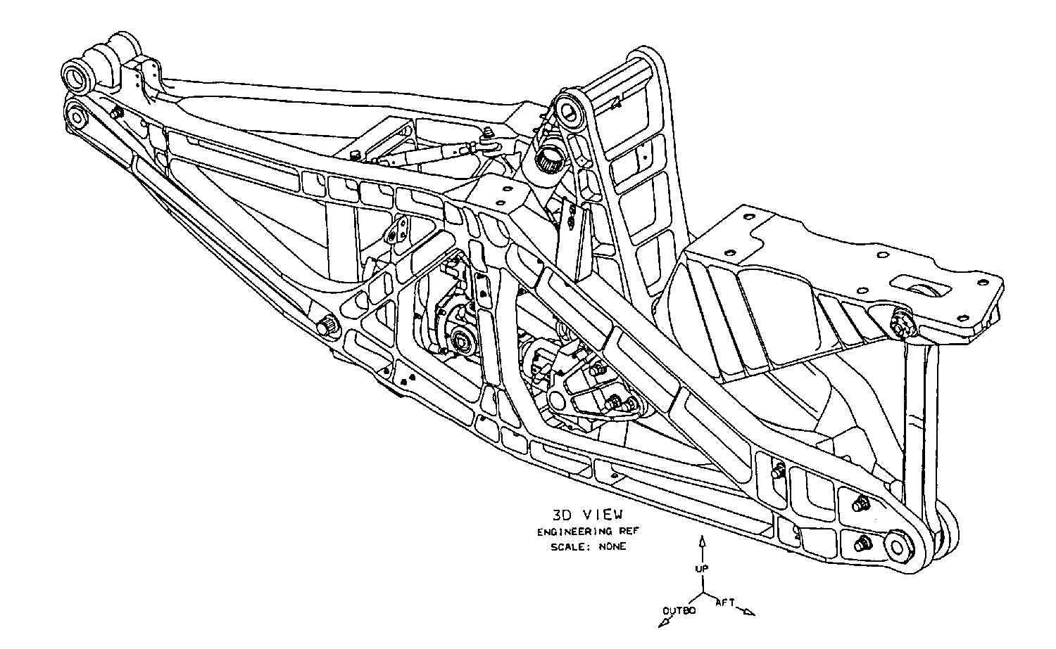
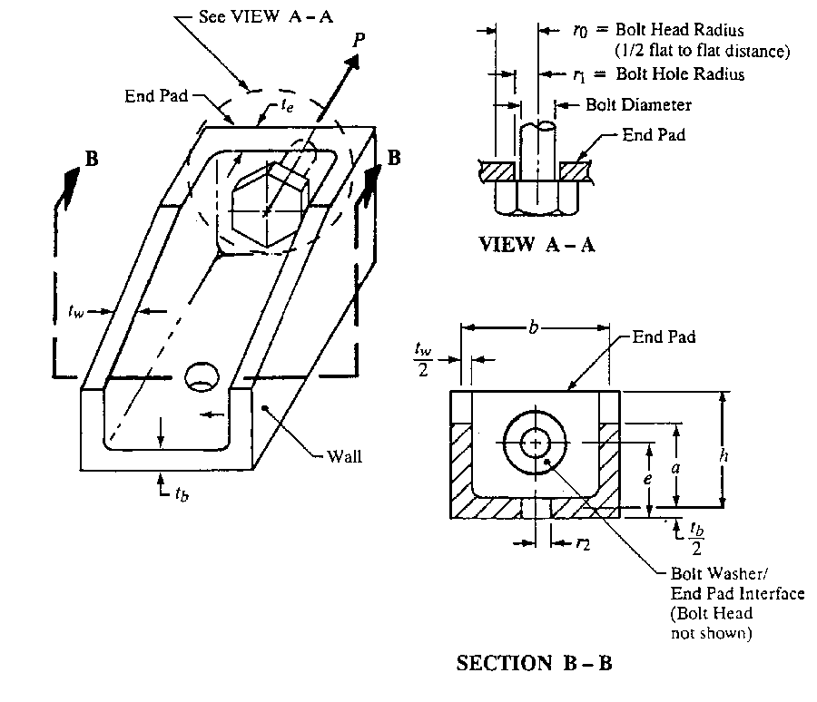
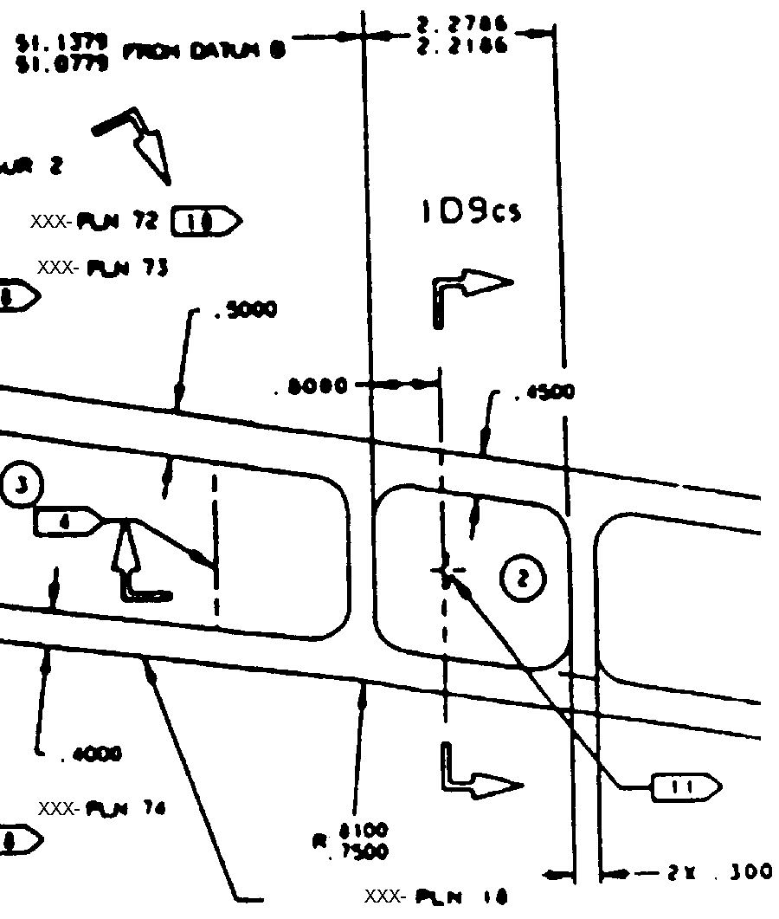
Interoperability Gap:
Lack of Fine-Grained Associativity design model-analysis model example
Detailed Design Model
Γ₁ : b = cavity3.inner_width + rib8.thickness/2
+ rib9.thickness/2
...
Analysis Model
(with Idealized Features)
No explicit
fine-grained
CAD-CAE
associativity
Γ
K
3
=
f
(
r
,
b
,
h
)
1
f
se
=
P
f
be
=
C
1
P
Idealizations
2
π
r
t
ht
2
0
e
e
Channel Fitting Analysis
“It is no secret that CAD models are driving more of today’s product development processes ... With the growing number of design tools on the market, however, the interoperability gap with downstream applications, such as finite element analysis, is a very real problem. As a result, CAD models are being recreated at unprecedented levels.” Ansys/ITI press Release, July 6 1999
http://www.ansys.com/webdocs/VisitAnsys/CorpInfo/PR/pr-060799.html

Slide 22
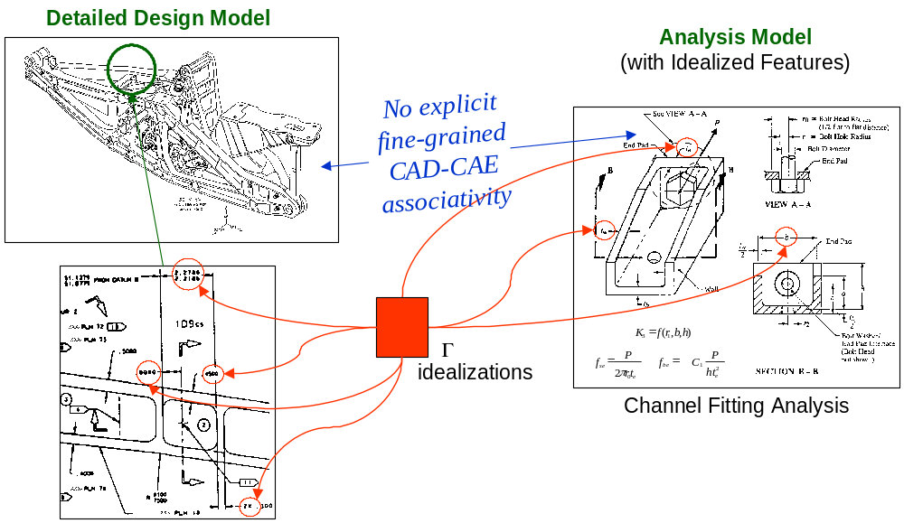
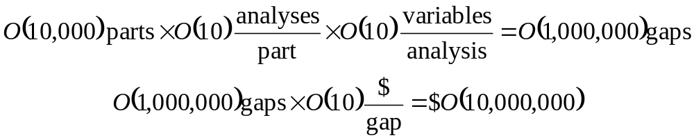
Cost of Associativity Gaps
Categories of Gap Costs
Associativity time & labor
  Manual maintenance
  Little re-use
  Lost knowledge
Inconsistencies
Limited analysis usage
  Fewer parts analyzed
  Fewer iterations/part
“Wrong” values
  Too conservative:
  Extra costs, inefficiencies
  Too loose:
  Re-work, failures, law suits
Rough Cost Estimate per Complex Product

Slide 23
Contents
Definitions & Scope
Example Gaps Being Addressed
Solution Approach
Example Progress
Summary

Slide 24
EFWIG Teamwork Approach
Twice monthly telecons
Regular working sessions
  At SC4 meetings, PDES Inc. offsites, …
Team website & virtual workspace
Other organizations are welcome to get involved!

Slide 25
EFWIG Solution Approach
Philosophy: Consider engineering computing environments
and EFWIG deliverables as “products” themselves
Follow systems engineering approach for EFWIG itself
  Decompose problem into subsystems
    Architectures, components (stds., tools, …), and techniques
  Identify existing solutions where feasible
  Identify & define gaps
  Define solution paths
    Identify team members and/or other groups
    who will “supply”/develop these subsystems
  Develop & prototype solutions
  Advocate solution standardization and vendor support
  Test in pilots
  Deploy in production usage

Slide 26
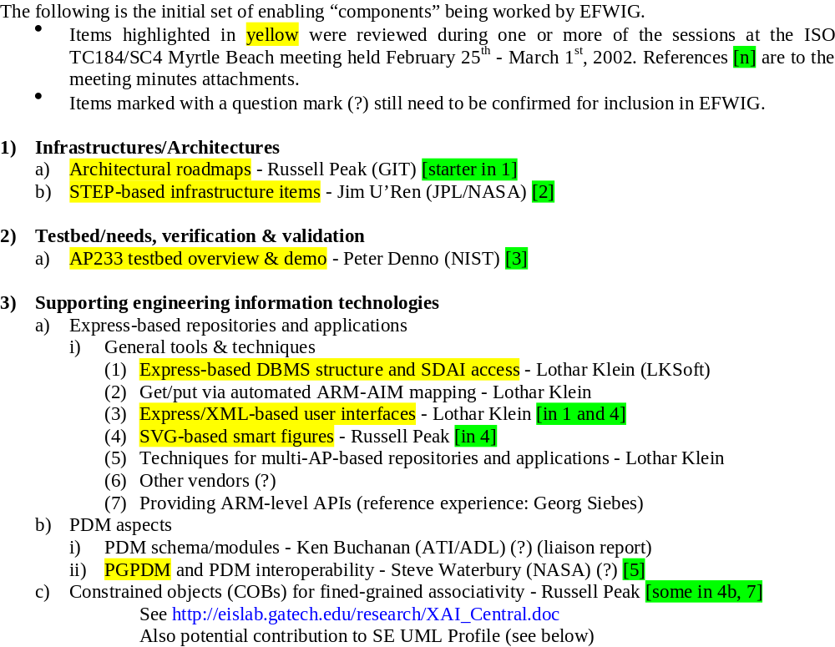



EFWIG “Subsystems” Work In-Progress
(page 1 of 2 - working list)
Other participants are welcome!

Slide 27
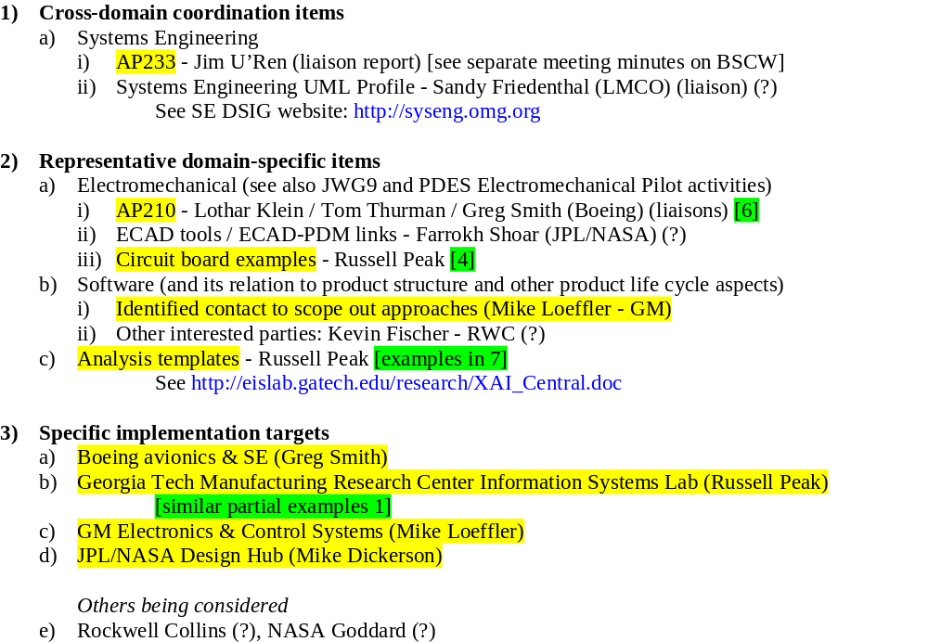
EFWIG “Subsystems” Work In-Progress
(page 2 of 2)
Other participants are welcome!

Slide 28
Contents
Definitions & Scope
Example Gaps Being Addressed
Solution Approach
Example Progress
Summary

Slide 29
EFWIG “Subsystems” Work In-Progress
(page 1 of 2 - working list)
Other participants are welcome!

Slide 30
Another “System of Subsystems” Analogy:
An EFW is like a 24/7 Automobile Assembly Factory …
Each is a unique “facility”
  Built from standard & custom components
  Include organization-specific business practices
Near-continuous operation
  Facility usage to create “products”
  Business critical facility!
Frequent “live/hot-swap” maintenance and upgrades
Periodic major overhauls
  To support new product types
  To install major new technologies

Slide 31
Example Approach in JPL/NASA Effort
Typical Current Multi-PDM Architecture for Larger Organizations
(components and interfaces)
Level 1: Domain-Level PDM
Interactive WIP design collaboration: main tools
Tight Integration w/ major domain-specific CAD tools
Level 2: Workgroup-Level PDM
Interactive WIP design collaboration
Focus on inter-tool information interoperability
Oracle
MGC Board Station
MGC DMS
Basic Objects & Relations
ECAD Bound Design
ECAD- Oriented PDM
DBMS
Software and
Person-ware (manual) glue
____________
Native Files
…
Gaps:
Content coverage and semantics
Fine-grained associativity
  Even within a native file
  Esp. between attributes in monolithic native files
Dynamic interactivity vs. batch releases
Oracle
PTC Pro/Engineer 2001
PTC ProjectLink
MCAD Bound Design
MCAD- Oriented PDM
DBMS
____________
Native Files
Oracle
Level 3: Enterprise-Level PDM
Major Releases (to manufacturer, to supplier, …)
Long Term Archiving
EDS Metaphase
Plus other enterprise resources:
Document Mgt. Systems
(e.g., DocuShare), …
Enterprise PDM
DBMS
____________
Native Files

Slide 32
Example Approach in JPL/NASA Effort
Target Standards-Based Multi-PDM Architecture for Larger Organizations
(components and interfaces)
Level 1: Domain-Level PDM
Interactive WIP design collaboration: main tools
Tight Integration w/ major domain-specific CAD tools
Level 2: Workgroup-Level PDM
Interactive WIP design collaboration: gap filler tools
Focus on inter-tool information interoperability
Oracle
Type 2a
Oracle or MySQL
MGC Board Station
MGC DMS
Basic Objects & Relations
LKSoft & XaiTools
ECAD Bound Design
ECAD- Oriented PDM
DBMS
Object Manager
SDAI
____________
Native Files
…
LKSoft & XaiTools
Fine-Grained Objects &
Advanced Relations
w/ Multi-Schema
STEP-Based Models:
233, 203, 209, 210, …
Standard & Custom Templates
Oracle
Statemate, Ansys, Matlab, Materials DB, …
PTC Pro/Engineer 2001
PTC ProjectLink
Other CAD/CAE Tools
MCAD Bound Design
MCAD- Oriented PDM
DBMS
CORBA, SOAP
Type 2b
PostgreSQL
OMG PDM Enablers Protocol
(for inter-PDM/repository communication)
____________
Native Files
PGPDM
SOAP
Product Structure and Native File Manager
PDM Schema Context
OMG CAD Services Protocol
(for automatic usage
of geometry processing, …)
____________
Native Files
Oracle
Level 3: Enterprise-Level PDM
Major Releases (to manufacturer, to supplier, …)
Long Term Archiving
EDS Metaphase
Plus other enterprise resources:
Document Mgt. Systems
(e.g., DocuShare), …
Enterprise PDM
DBMS
____________
Native Files

Slide 33
Tool-Product Model Schema Relationships in a
Standards-Based Engineering Framework
Version 1 Target for Workgroup-level Product Development
Electrical
CAD Tools
Systems Engineering
Tools
Traditional
Tools
Eagle
Doors
Mentor
Graphics
Slate
AP210
interface
Product Model
Components
AP210
AP233
PDM Schema
XaiTools
PWA-B
LKSoft, …
STEP-Book AP210,
SDAI-Edit,
STI AP210 Viewer, ...
Gap-Filling
Tools
XaiTools
PWA-B
pgpdm
LKSoft, …
PWB Stackup Tool,
…
Core
PDM Tool
Instance Browser/Editor

Slide 34
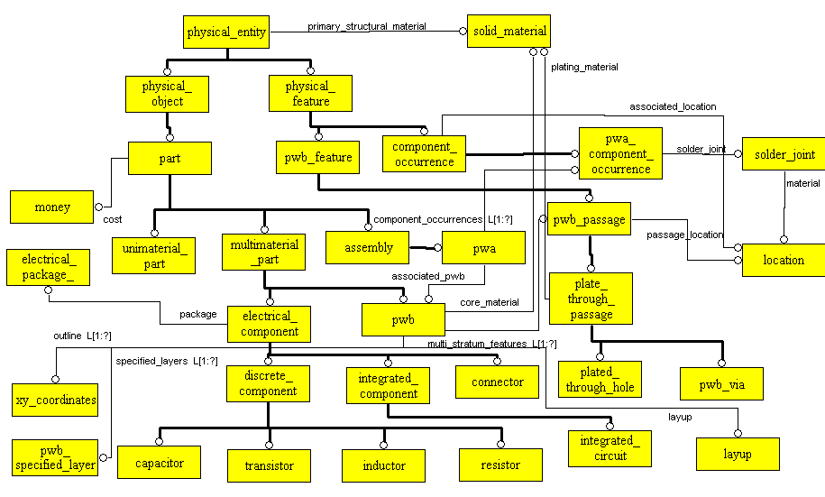
Application-Oriented
Custom Schema: git_pwa.exp
Based on TIGER/ProAM/JPL Phase 1
Focused to support stackup design, analysis, etc.
Has mapping with AP210 stackup data

Slide 35
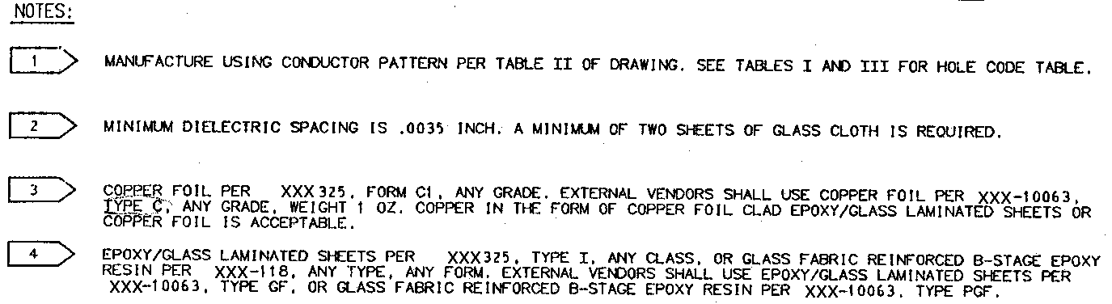
Example PWB Ancillary Information
Stackup Specs
Outline Detail
Stackup Notes

Slide 36
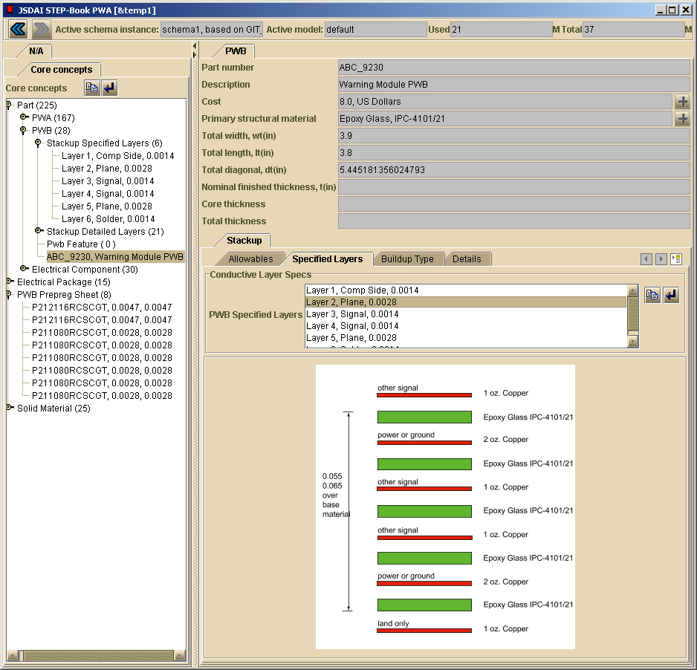
Next Gen. Gap-Filler Application
(In-Progress):
PWB Stackup Design & Analysis Tool
Attributes captured in computer-sensible form
Original manually generated
“dumb” figure
Reference figure (static SVG - first prototype). Enhances end user understanding of above attributes

Slide 37
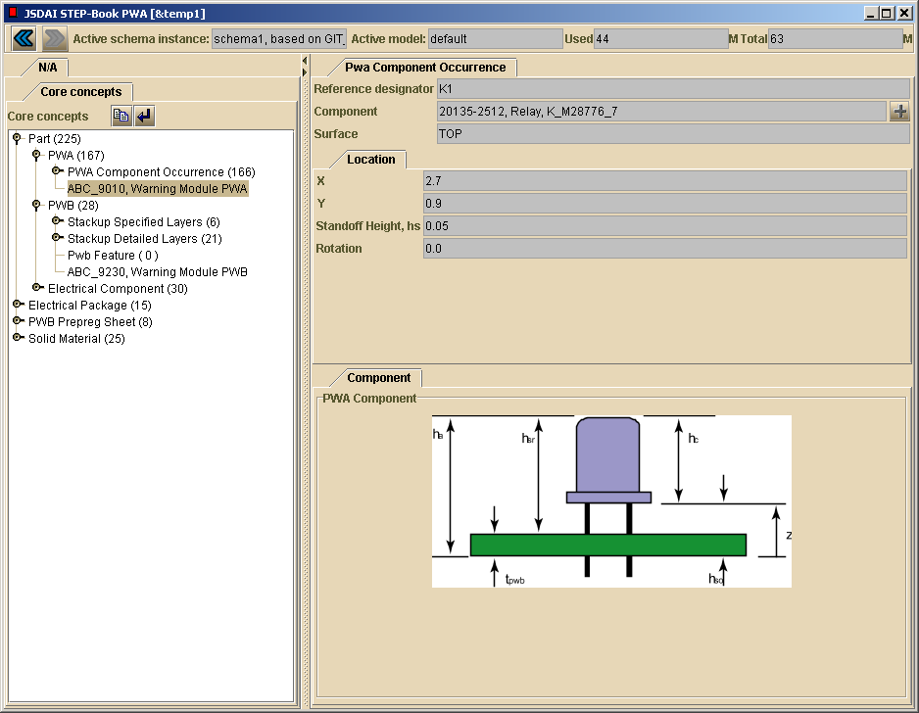
Attribute captured in computer-sensible form
Original “dumb” figure
with computer-insensible parameter: standoff height, hs
Reference figure (static SVG - first prototype). Enhances end user understanding of above attributes

Slide 38
EFWIG “Subsystems” Work In-Progress
(page 1 of 2 - working list)
Other participants are welcome!

Slide 39
Developing a Global STEP Usage Infrastructure:
Identifying and Defining Standard Services
Contact: Jim U’Ren, NASA/Jet Propulsion Laboratory
Long-Term Vision
Develop Infrastructure of Services supporting end-to-end, interdisciplinary data integration and data reuse
Bring STEP to the desktop with easy-to-use interfaces
Needed Services
Data Dictionary Services
Translation Services
Validation Services
Visualization Services
Tool Services
Part Library Services
Data Repository Services
Education/Training Services
Data Modeling Services
2002-01-28

Slide 40
EFWIG “Subsystems” Work In-Progress
(page 1 of 2 - working list)
Other participants are welcome!

Slide 41


Scope of the STEP PDM Schema
and PDM Implementers Forum Test Campaigns
(Status: March 2002)
Part Management
Alias
Identifi-
cation
Document Management
Part
Identification
Part
Classification
Document
Identification
File
Identification
Effec-
tivity
Confi-
guration
Part
Structure
Part Properties
Document
Structure
Document/
File
Properties
Authorization
Contract
and
Project
Work and
Change
Management
Geometry
Assignment
Person and
Organization
Date and Time
External
Geom. Model
Approval
Security
Classification
Transformation
performed
ongoing
upcoming

Slide 42
PDM Modules Used in AP 203 Edition 2 – Modular AP: Configuration Controlled 3D Design of Mechanical Parts and Assemblies
PDM Modules
Product Item Structure
Specifications
Product Identification
Definition
Version
Identification
Engineering Change
Work Order
Work Request
Configuration Effectivity
Effectivity
End Item Identification
Geometric Shapes
Constructive solid geometry
Advanced BREP Solids
3D Associative Text
Faceted BREP Solids
Solid Model Construction History
Manifold Surfaces with
Topology
Geometric Dimensioning and Tolerancing
Wireframe with Topology
Geometric Presentation
Colours, Layers & Groups
Wireframe with Topology
Geometrically Bounded
Surfaces and Wireframe
Geometric Validation Properties
2002 - PDES Inc.
Notes:
2

Slide 43
Pan-Galactic PDM (PGPDM)
STEP-based Intelligent PDM and
Systems Engineering Repository
Stephen C. Waterbury
NASA STEP Testbed
NASA / Goddard Space Flight Center
April 2002
Notes:
NASA’s Intelligent Synthesis Environment (ISE) initiative and its Collaborative Engineering Environment (CEE) will require sophisticated capabilities for the sharing and configuration management of engineering models. Engineers using these advanced environments will have state-of-the-art tools for Computer-Aided Design, Analysis, Simulation, Systems Engineering, Software Engineering, and other engineering disciplines.
Each of these discipline’s tools focuses on a view that is in some ways unique and separate from other engineering disciplines, and yet the design of a particular item often requires a collaboration between two or more disciplines -- for example, a printed circuit assembly must be designed and analyzed from the mechanical as well as the electrical point of view in order to meet all system requirements.
The engineering models on which the tools of different disciplines operate are unique in important ways, but if tools from different disciplines are brought to bear on a single product, it is important for data integrity that all tools work to a common underlying structure. This common underlying structure is contained in the STEP standard (ISO 10303), “STandard for the Exchange of Product model data”.
This presentation will discuss how STEP can be used to provide a common structure to which all engineering discipline models refer, so that data integrity and configuration management are maintained.

Slide 44
PGPDM Acronyms and Definitions
API ……….... Application Programming Interface
CAD ……….. Computer-Aided Design
CAE ……….. Computer-Aided Engineering
Express …… the STEP information modeling language
Express-X … language to map one Express model to another
OMG ……….. Object Management Group
PDM ………... Product Data Management
PDME ………. PDM Enablers (an API developed by the OMG)
PGPDMTM ….. Pan-Galactic PDM
SE .................. Systems Engineering
STEP ………... Standard for Exchange of Product Model Data
(ISO 10303)
2002-04 - Steve Waterbury, NASA-GSFC

Slide 45
Pan-Galactic PDM
Scope and Design Intent
  Standards-based PDM and Systems Engineering Repository Services
    Basic CM, Work Flow, CAX Model and Document Management Services
    CAX Model Integration and Transformation Services
    Parts Library Catalog, Global Search, and Federation Services
  Standard interfaces to engineering tools and systems
Implementation Approach
  Create PGPDM as Open Source, using Open Source technologies (Python, Express Engine, PostgreSQL, Apache, OpenCASCADE)
  Use standard information models (STEP)
  Use standard API's (OMG PDM Enablers and CAD Services, SOAP and Web Services Architecture, HTTP, SSL, etc.)
  Components:
    PGPDM Server (Repository and Services)
    PGPDM Client (Cross-Platform Desktop GUI Client)
2002-04 - Steve Waterbury, NASA-GSFC

Slide 46
PGPDM: Intelligent Model Managment
Master Model Integration Using STEP and OMG Standards
Mechanical
CAD
Tools
Analysis
(CAE)
Tools
Electronic
CAD
Tools
Systems
Engineering
Tools
PGPDM
Client
AP 203
AP 209
AP 210
AP 233
Instrument Y
Object
Express-X
Maps
Spacecraft X
Master Model
Instrument Y
Master Model
Integrated STEP
Master Model
Notes:
This diagram illustrates the concept of “Intelligent PDM”. The essential ingredients for Intelligent PDM are:
(1) a set of discipline-specific information models (the examples shown are the STEP Application Protocols 203 [MCAD], 209 [Finite-Element Analysis], 210 [ECAD], and 232 [Systems Engineering]);
(2) STEP translators for the discipline tools: since Intelligent PDM is based on STEP, each tool to participate in this environment must have a STEP import/export capability;
(3) a Product Master Model, which incorporates the STEP AP’s as subsets and represents each common object once. For example, the geometry of the product is a subset of the Product Master Model, and is “reflected” in the MCAD, ECAD, and Analysis models, in which it may have different projections (e.g., 2-D or “2.5”-D in an ECAD model) or transformations to lower fidelity. The Product Master Model could be thought of as a “union” or “superset” of all the discipline models of the product.
(4) mappings between the discipline-specific views of the product (the STEP AP’s) and the Product Master Model. These mappings are being developed using the EXPRESS-X mapping language, a new part of the STEP standard.
The diagram depicts the discipline tools feeding their models through the STEP AP’s and mappings into the Master Models for Spacecraft X and Instrument Y. The Intelligent PDM system can then generate, through the reverse mappings, the changed versions of the other discipline models.

Slide 47
Prototype
PGPDM Server
v1.0 Architecture
Transaction
and Search
Manager
Security,
Auth.,
and
Request
Routing
Services
Database:
PostgreSQL
Thick
Client
API
(for
PGPDM
Client
et al.)
Model
Integration and
Transformation
Services:
Express
Engine
CAD/CAE
Tools
File Vault
(STEP, proprietary, docs, etc.)

Slide 48
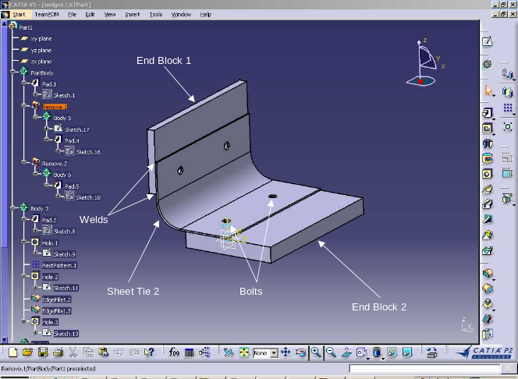
eWidget v1.2 Test Case – Product Structure
XYZ-440
Back plate Type 3
Main Assembly
XYZ-500
Bolt
XYZ-431
uses
XYZ-455
Backplate Type 6
XYZ-450
Corner Sheet 2
Parts
2002-03 - R Ludlow, R Peak, Georgia Tech

Slide 49
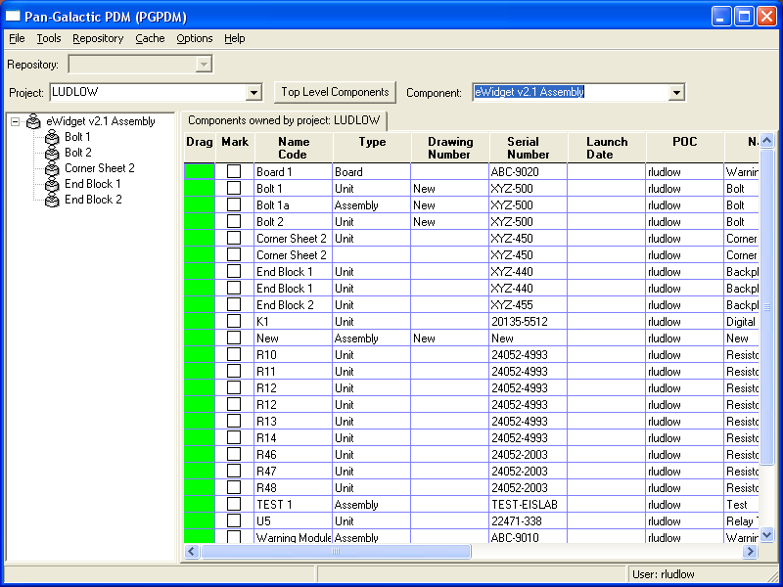
eWidget v1.2 Test Case – In PGPDM Client
2002-03 - R Ludlow, R Peak, Georgia Tech

Slide 50
PGPDM Server
System
API
(peer/peer,
federation,
global search)
Transaction
and Search
Manager
External
Systems
(PDM, etc.)
Database
PostgreSQL
(Master Model Repository)
Model
Integration and
Transformation
Services
(translate and
transform models,
generate views)
CAD/CAE
Tools
Security,
Auth.,
and
Request
Routing
Services
Thick
Client
API
Library
Services
File Vault
(STEP, proprietary files, docs, etc.)
Thin
Client
API
MetaServices
(Dictionaries,
MOF, CWM)
Web Browsers

Slide 51
EFWIG “Subsystems” In-Progress
(page 2 of 2)
(Others TBD)

Slide 52
What is the context of Systems Engineering?
User/Owner/Operator
User/Owner/Operator
Management
Marketing
Acquisition Authority
Business Strategy
Concept
RFP
Proposal
Contract
Management Info
Systems Engineering
Management Info
Specifications
Digital
Maintenance
Logistics
STEP
ISO SC4
UML
ISO SC7
Engineering
Disciplines
Chemical
Mechanical
Controls
Electrical
Software
Communications
Civil
Manufacture
2002-04 - Mike Dickerson, NASA-JPL

Slide 53
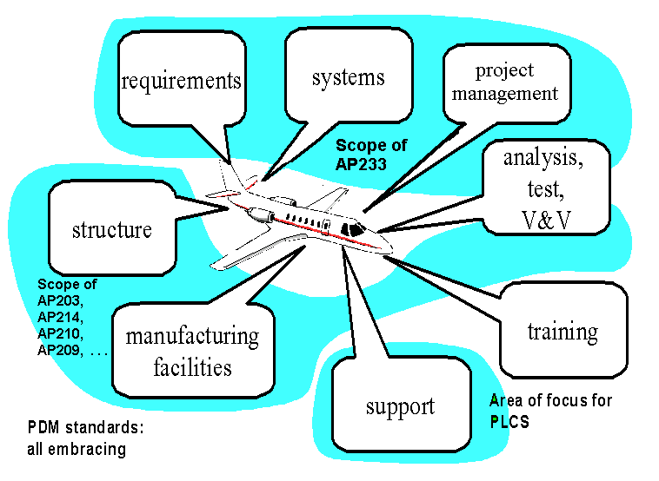
Scope of AP233 and Related APs
2002-04 - Jim U’Ren, NASA-JPL

Slide 54
A
P
2
3
3
-
W
h
a
t
i
s
i
n
S
y
s
t
e
m
E
n
g
i
n
e
e
r
i
n
g
S
E
M
a
n
a
g
e
m
e
n
t
C
r
e
a
t
i
o
n
R
e
q
t
'
s
T
e
x
t
M
o
d
e
l
i
n
g
O
r
g
W
B
S
S
t
r
u
c
t
u
r
e
S
c
h
e
d
u
l
i
n
g
A
l
l
o
c
a
t
i
o
n
B
e
h
a
v
i
o
r
S
t
r
u
c
t
u
r
e
t
e
x
t
t
e
x
t
R
o
l
e
T
r
a
c
a
b
i
l
i
t
y
C
M
P
e
o
p
l
e
C
h
a
n
g
e
C
t
e
x
t
S
t
a
t
e
o
n
t
r
o
l
D
e
r
i
v
e
d
C
h
a
r
t
C
o
n
t
i
n
e
o
u
s
O
p
t
i
m
a
z
a
t
i
o
n
PLCS
C
a
l
c
u
l
a
t
e
P
e
r
f
o
t
e
x
t
r
m
a
n
c
e
P
D
M
E
A
C
M
L
i
b
r
a
r
y
N
o
t
i
n
A
P
2
3
3
U
M
L
A
P
2
1
0
2002-03 - Mike Dickerson, NASA-JPL

Slide 55
EFWIG “Subsystems” Work In-Progress
(page 2 of 2)

Slide 56
AP210 Roles in EFWIG
Traditional role:
  Use for design of electronics
Additional multidisciplinary roles:
  Recognize generic capabilities:
    PDM, inter-model associativity, requirements, supply chain, …
  Use as starting point for needs in other product domains
    Ex. Systems Engineering (AP233) reuse of AP210 concepts

Slide 57

STEP AP 210 (ISO 10303-210)
Domain: Electronics Design
R
~800 standardized concepts (many applicable to other domains)
Development investment: O(100 man-years) over ~10 years
Interconnect
Assembly
Printed Circuit Assemblies
(PCAs/PWAs)
Product Enclosure
Die/Chip
Packaged Part
Printed Circuit
Substrate (PCBs/PWBs)
Die/Chip
Package
External Interfaces
Adapted from 2002-04 - Tom Thurman, Rockwell-Collins

Slide 58
Summary of Ongoing Activities
Related to STEP for Electronics
STEP Electro-Mechanical Activities
Standards Development and Deployment
Company Activities
Related Activities
Producibility Analysis (DFM) (B)
Manufacturing Simulation (R)
AP210, AP210, AP233
IDF/AP210 Conversion (R/B/N)
AP203/AP210 Conversion (N)
Advocacy
Implementation
AP210 Viewers
(B, STI)
STEP Repository (GT/N/B)
Marketing
Zuken AP210 Translation (R/L/AT)
Mentor AP210 Translation (B/N/L/AT)
Company Legend
B – Boeing
N – NASA
GT – Georgia Tech
A – U.S.Army
R – Rockwell-Collins
GM – General Motors
L – LK Software
AT - ATI/PDES Inc.
STI - STEP Tools Inc.
Education
AP210 Book (L)
PWA/PWB Stackup (GT/N)
Eagle AP210 Translator (L)
AP210 Primer (A)
Analysis Templates (GT)
2002-03 - Greg Smith, Boeing

Slide 59
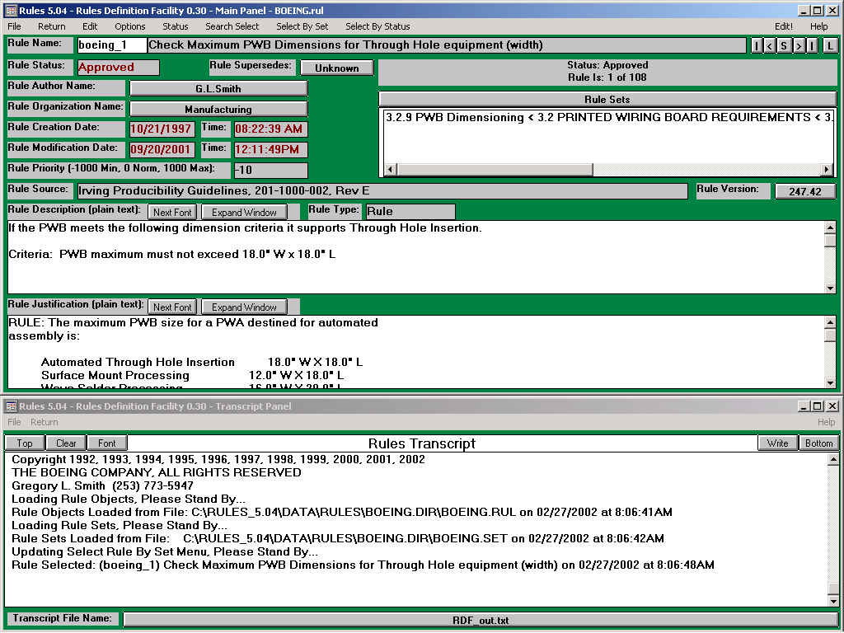
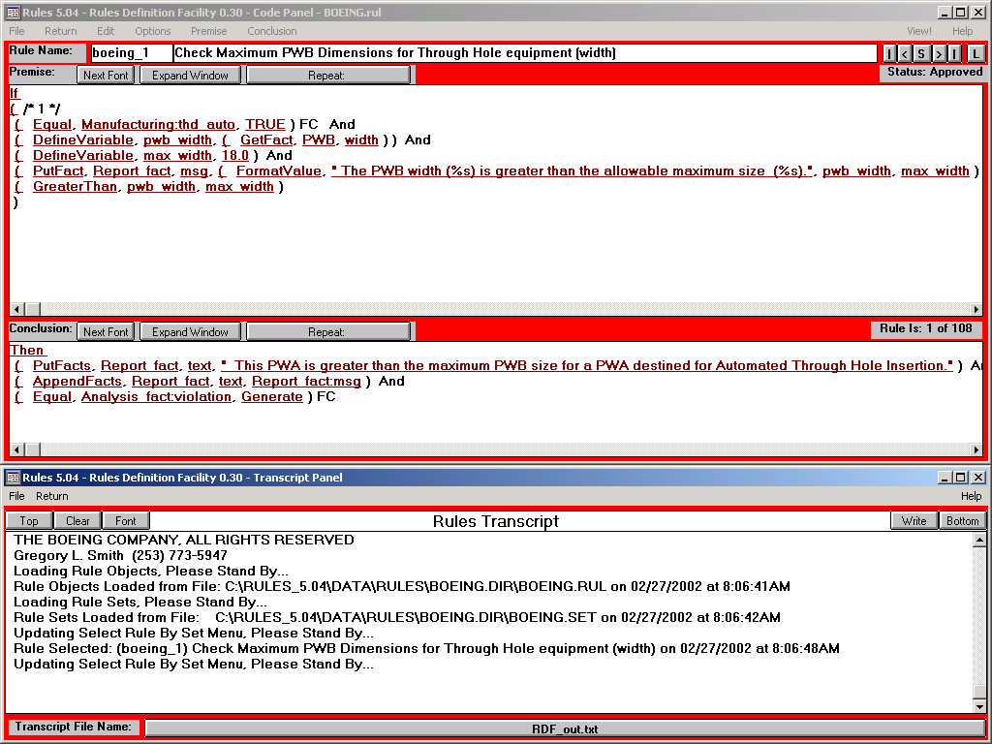

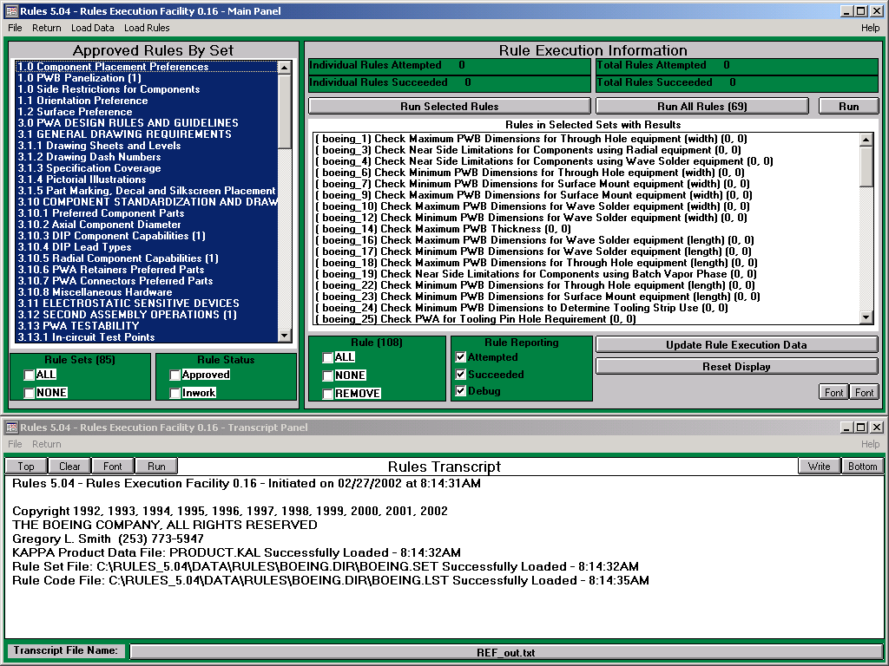
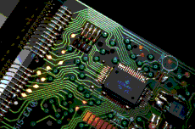
PWA/PWB Producibility Analysis using AP210
Codification of
Guidelines
(Rules Definition)
Company PWA/PWB
Guidelines
Manufacturing Capabilities
STEP AP220
Rules
STEP AP210
Producibility
Analysis
Report
Comparison of Rules
Against Product Data
(Rules Execution)
PWA/PWB Captured in Mentor Design Tools
2002-03 - Greg Smith, Boeing

Slide 60
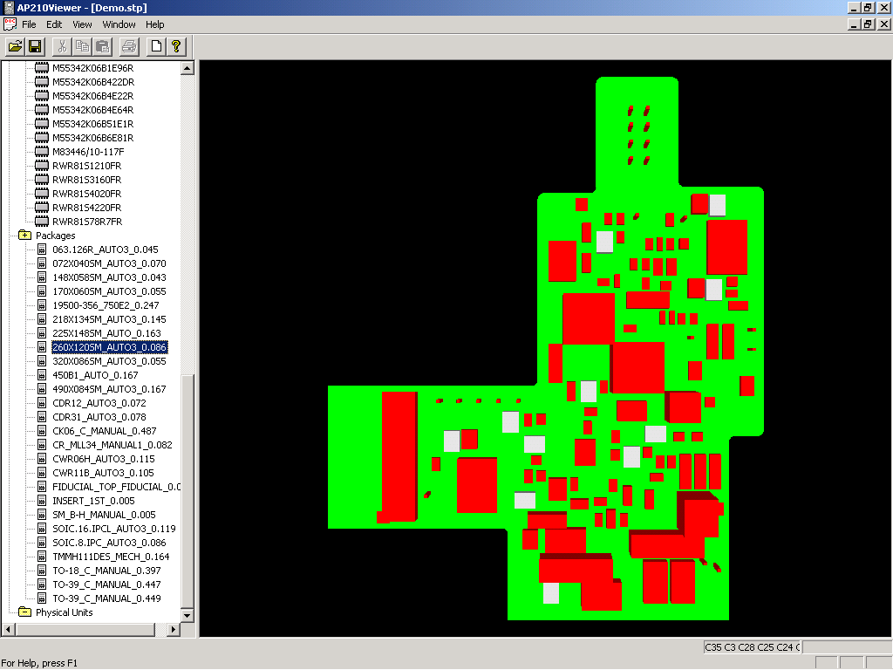
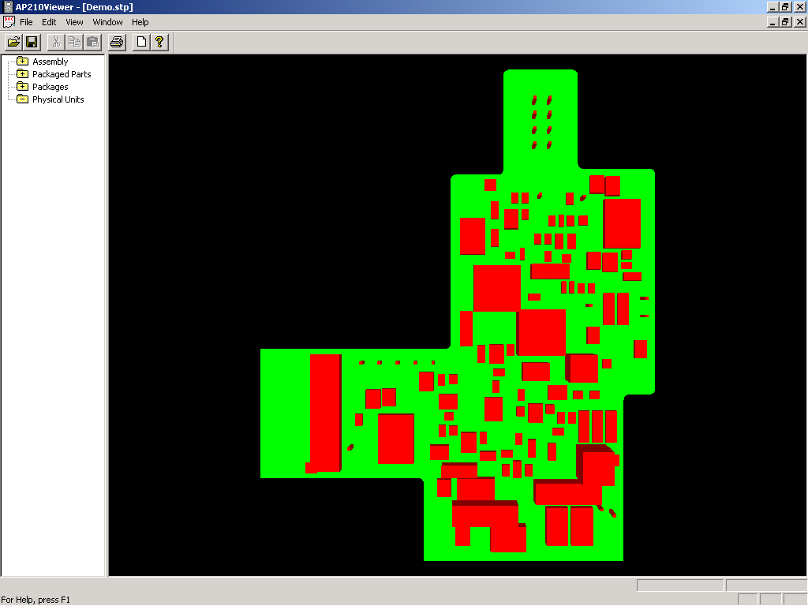
AP210 Viewer
Boeing/PDES Inc.
2002-03 - Mike Keenan, Boeing

Slide 61
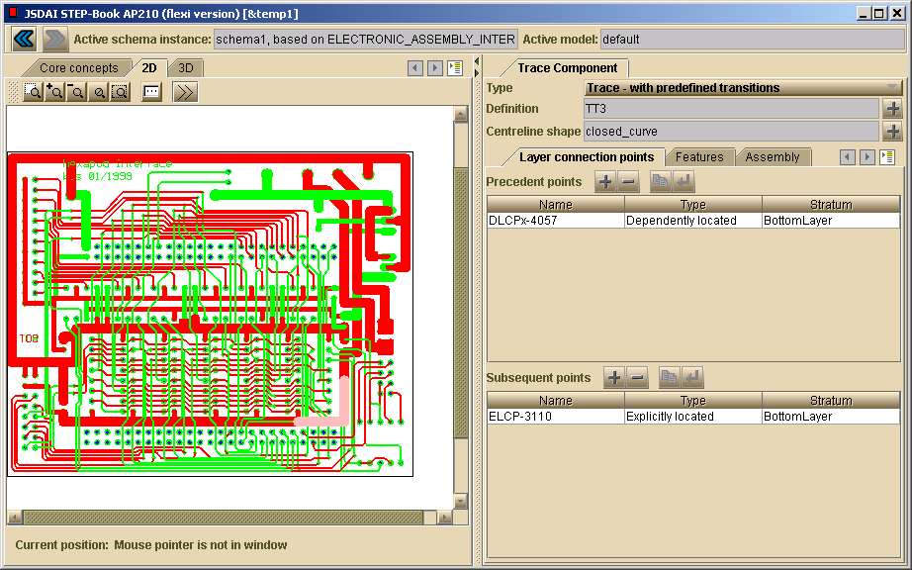
Rich Features in AP210: PWB traces
AP210 STEP-Book Viewer - www.lksoft.com

Slide 62
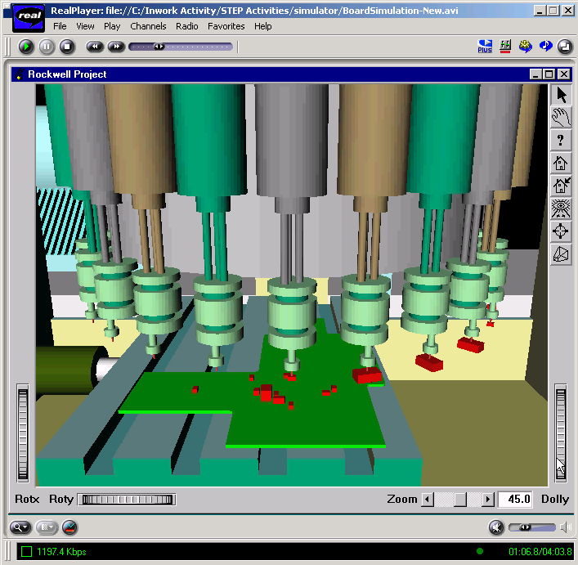
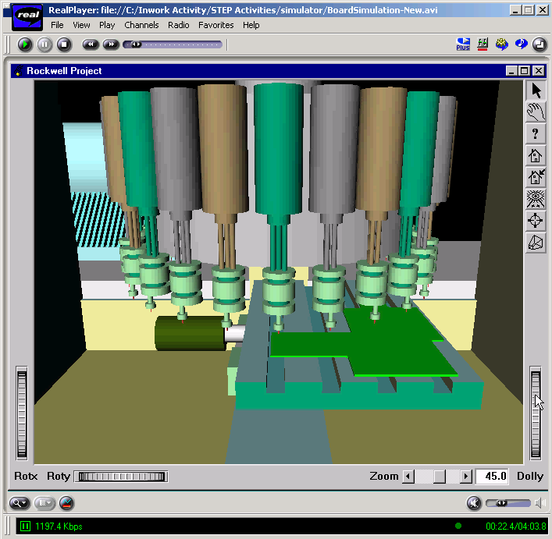
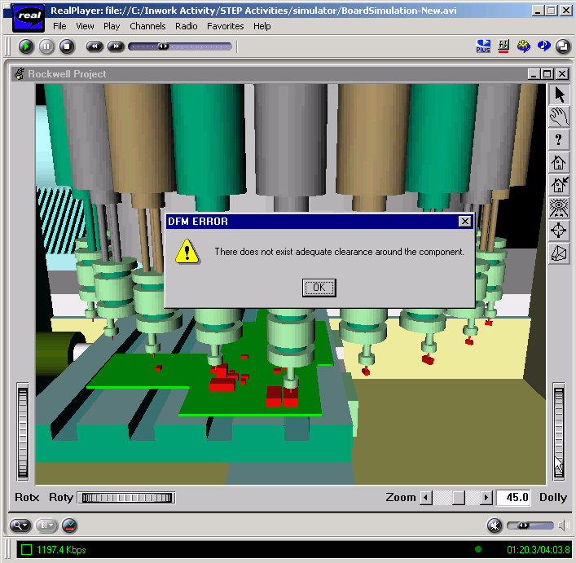
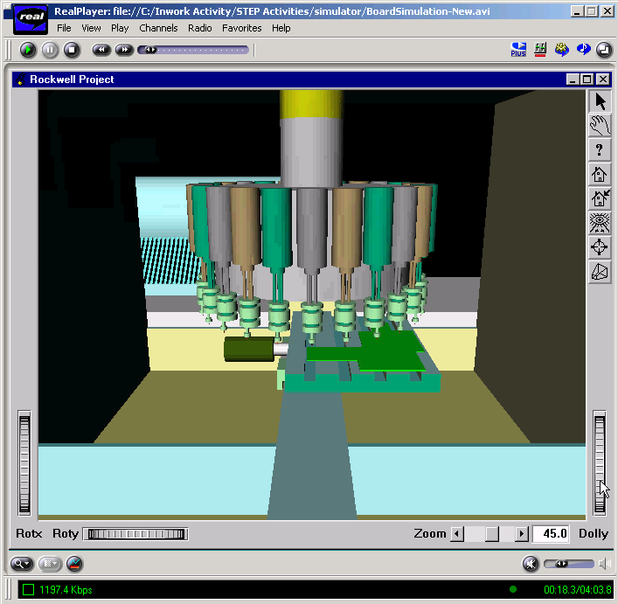
PWA/PWB Assembly Simulation using AP210
User Alerted on Exceptions to Producibility
Guidelines
Rules (From
Definition
Facility)
Generic Manufacturing Equipment Definitions
Specific
Manufacturing Equipment Used
2002-03 - Tom Thurman, Rockwell-Collins

Slide 63
AP210 Scope in EFWIG
Traditional scope:
  Use for design of electronics
Additional scope:
  Recognize generic capabilities:
    PDM, inter-model associativity, requirements, supply chain, …
  Use as starting point for needs in other product domains
    Ex. Systems Engineering (AP233) reuse of AP210 concepts

Slide 64



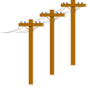
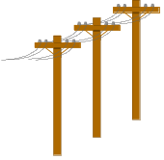

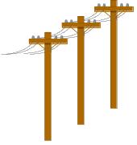
AP210 Usage
Supply Chain
System Engineer
Package Data
Supplier
Simulation Model
Supplier
Requirements
Design Team
Configuration Managed
Corporate Data
Process (PDM/Library)
Customer
ECAD
MCAD
Device
Supplier
Assembly & Fabrication
Vendor(s)
2002-03 - Tom Thurman, Rockwell-Collins
Notes:
6

Slide 65
AP210 Usage
Multidisciplinary Engineering Interaction
System Engineer
EE
Vendor Web Site
Final
Data Package
Stored in
Repository
Initial Task
Negotiation
and data dump
to EE
Sys Eng
Gets More
Data
Sys Eng
sends data
to EE
EE Performs
Task
EE
Transmits
Data to Sys
Eng
2002-03 - Tom Thurman, Rockwell-Collins

Slide 66
AP210-based Multidisciplinary Model Associativity
Ex. Application: Requirements & Functions Allocation Traceability
Requirements
Functions (Design Intent)
Parts
Assemblies
Assembly Backbones (e.g., PCB)
Requirements
Decomposition
Functional
Decomposition
(Network)
Each column is a typical “stovepipe” (a CAx tool island of automation)
Physical
Unit
Network
Physical
Assembly
Decomposition
Physical
Interconnect
Decomposition
Requirement
To Function
Requirement
To Assembly
Requirement
occurrence
Requirement
To Interconnect
Function
Occurrence
Functional
Path Subset
To Assembly
Physical
Occurrence
Layout
Occurrence
Requirement
Verification
Model
Functional
Path
Subset
(Single
Node)
Function to
Physical
Map
Physical Unit
Network
Subset
(Single Node)
Assembly to
Interconnect
Layout
Network
Subset to
Implement
Node
Function to
Layout
“Design”
“Library”
Function
Definition
Each yellow bubble is a typical associativity gap (problem area)
Physical Macro &
Component
Definition
Layout
Macro &Template
Definition
Omitted for Clarity:
1. Details of recursive definition
2. “Pin Mapping” in library
3. Simulation model library and associativity aspects.
Simulation
Model
Definition
Adapted from 2002-03 - Tom Thurman, Rockwell-Collins
Notes:
Color Key:
Light Pink: Requirement decomposition
Violet: Product decompositions
Yellow: Requirement allocations
Green: Network subsets in the scope of the referenced decomposition
Dark Pink: Simulation model Library
References to Simulation models from Design/Decomposition levels and from components omitted for clarity.
Inclusion of decomposition relationships in library omitted for clarity.
Some details of relationships omitted for clarity.
Requirements may be allocated to a total design or to a component or between network subsets.
Functional Decomposition forms a requirement for Assembly.
Assembly forms a requirement for Interconnect. (these two are for the case where not all requirements are explicitly detailed using other mechanisms.
AP 210 for instance does not fully map all the assembly details into a separate requirements tree to avoid data explosion.

Slide 67
EFWIG “Subsystems” Work In-Progress
(page 1 of 2 - working list)
See also other presentations at APDE 2002
Workshop
Other participants are welcome!

Slide 68
EFWIG “Subsystems” Work In-Progress
(page 2 of 2)
Other participants are welcome!

Slide 69
2002 ESA-NASA APDE Workshop
Presentations with Direct EFWIG Involvement
An Overview of the STEP Systems Engineering Project (AP233)
  U'Ren
A Modular Application Protocol for Systems Engineering
  Bailey and U'Ren
Progress on Standards-Based Engineering Frameworks that include STEP AP210 (Avionics), PDM Schema, and AP233 (Systems)
  Peak, Dickerson, Klein, Waterbury, Smith, Thurman, U'Ren, and Buchanan
Standards Based Collaborative System Design across the Life Cycle
  Dickerson
Creating Gap-Filling Applications Using STEP Express, XML, and SVG-based Smart Figures - An Avionics Example
  Peak, Wilson, Kim, Udoyen, Bajaj, Mocko, Liutkus, Klein, Dickerson
AP210 Converters and Applications
  Liutkus and Klein
Developing a Distributed Data Dictionary Service
  U'Ren and Crichton

Slide 70
Summary of Progress
Engineering Framework Interest Group (EFWIG)
Defined philosophical foundation:
An EFW as a “product” itself - a “system of systems”
  Enables using similar engineering techniques and tools to address gaps
    Problem decomposition, “make/buy”,
    configuration mgt., versioning, maturity/TRL, …
Specific gaps addressed:
  Content coverage & semantic gaps
  Fine-grained associativity gaps
Example “components” in-progress:
  Multi-level architecture
  Global STEP services infrastructure
  PGPDM: standards-based open source PDM system
  Leveraging AP210 capabilities in other areas (e.g. AP233)

