Slide 1
Physical Product Structure
July 8-10, 2003
Cedar Rapids, IA

Slide 2
Physical Product Structure
A Physical Product Definition Consists of:
  Interface Definition
    Physical Interface Can use GD&T Principles
  Optionally, An Assembly or Layout Definition
  Optionally, A Simulation Model with Parameters
  Optionally, Shape Data (Several Purposes)
A Physical Product Definition is a view of a specific Product Version.

Slide 3
Physical Product Structure
A Physical Product Definition IS a view of a Physical Product
Application objects: Physical_unit_usage_view, Physical_unit_design_view, Ee_product_definition, Ee_product_version, Ee_product, Physical_unit_3d_shape, Shape_element

Slide 4
Physical Product Structure
Explicit
Usage
terminal
Views
definition
usually
usage view
have
Usage View
is required
Design View
terminals
Packaged
part
Package
Assembly
Assembly
module
Connector
Bare Die

Slide 5
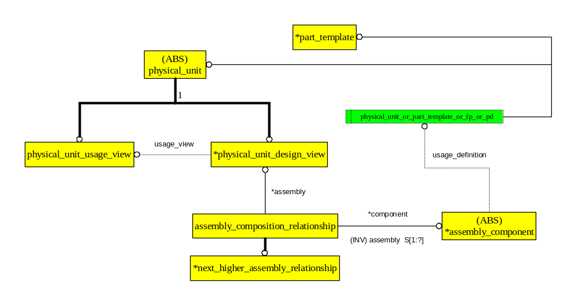
Physical Product Structure

