Slide 1
ISO 10303-210 ed2 test case status
February 14, 2007
Updated December 31, 2019
This file is provided in support of
TC 184/SC 4 WG 3 N2608

Slide 2
Contents
Discussion
Test case quad charts

Slide 3
Discussion
AP 203 files from the AP 210 recommended practices are not integrated with AP 210 versions.
NIST has many test case files for AP 210 ed2 that are not incorporated into a comprehensive repository.
Public/private dichotomy
The completed Intercax test case V and V project summary is provided herein.

Slide 4
Recommended Practice AP203 Test Cases
AP203 models of figures from recommended practices
Created in UGS
All are included in database
Footprint definitions may need to be added.

Slide 5
NIST Test Cases
Multiple NIST test cases exist for Edition 2 of the standard
A repository needs to be identified and files uploaded and links to the repository provided.

Slide 6
Public/Private dichotomy
Some of the publicly available test cases are not up to date
Private Test Cases are up to date but
They are real designs;
They are proprietary;
They will not be released into the public domain.

Slide 7
Intercax results
Cabledb, Surface mount flasher, design0, preview and flasher successfully passed AP 210 ed2.
All others in this (originally PDES) repository were at AP 210 ed1 ARM or AIM. Does not include the NIST data sets.
For details, contact Manas Bajaj at www.intercax.com

Slide 8
Test Case Provenance and results
Pedigree of the files provided.
CAD Source identification if applicable
History
Change History
Issues against the file
Issues against AP 210 the file illustrates
Version of the AIM it is tested against.
Version of the AIM it was built against.

Slide 9
Types of Test Cases
Simple with a limited implementation scope.
Examples:
Simple Rectangle
Multi product
Component Orientation

Slide 10
Types of Test Cases (cont.)
Complex with a scope that covers a particular usage scenerio.
Examples:
Thru Hole PCB design
Surface mount PCA design
Double Sided Surface Mount PCA design
Requirement Specification
Design Change Sequence

Slide 11
Test Case Quad Charts

Slide 12
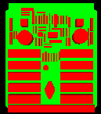
Cabledb ECAD View
Test Case Purpose
A real design available to share.
Test History:
Filename: cable_db.stp
Author: Paul Monson
Design Source: Mentor Graphics
Translator: ITI Version 1.2
Post Processing: None

Slide 13
Cabledb MCAD View
Test Case Purpose
A real design available to share.
Test History:
3D model created in UGS to support
MCAD View. UG Part and AP203
Models available for assembly and
Piece parts and maybe the PWB.
Filename:
Author: Tom Thurman
Design Source: UGS
Translator: Unknown
Post Processing: None

Slide 14

Thru Hole Flasher
Test Case Purpose
A real design available to share.
Test History:
Filename: flasherthruhole.stp
Author: Paul Monson
Design Source: Mentor Graphics
Translator: ITI Version 1.2
Post Processing: None

Slide 15
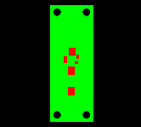
Surface Mount Flasher
Test Case Purpose
A real design available to share.
Test History:
Needs more work. There are Mentor
Board station source as well as CADIF
Source as well as (maybe) UG source
Filename: flasher.210
Author: Kevin Cline
Design Source: IDF Version 2.0
Translator: IDF to AP210
Post Processing: None

Slide 16
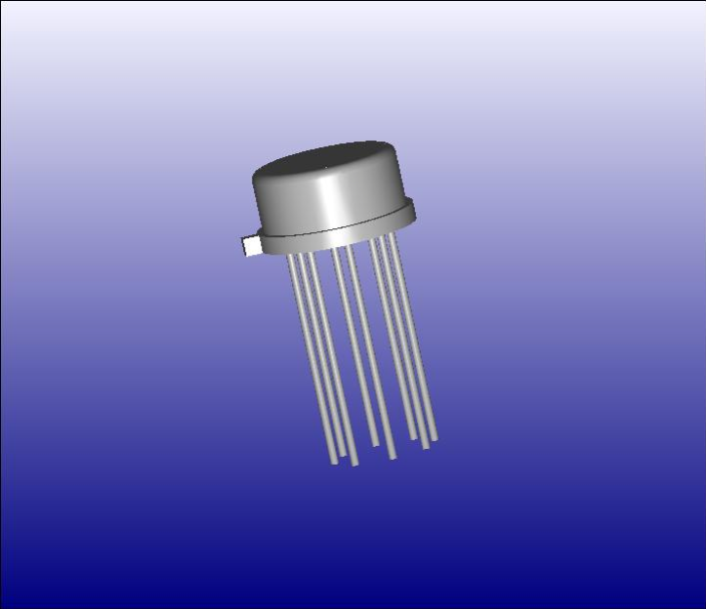
H08 Package
Test Case Purpose
Provide a 3D model of an electronic package in both AP203 and in AP210 for comparison purposes for implementors.
Test History:
The current file is against the DIS
Version and therefore needs updating.
Filename: H08.2xx
Author: Craig Lanning
Design Source: AP203
Translator: None
Post Processing: Hand built

Slide 17

Component Placement Restriction
Test Case Purpose:
To test the function of the ARM concept of component_
placement_restriction_
assignment requirements
Test History:
The file MGC_CGA.brd includes the ROUTE_OUTLINE and PLACE_OUTLINE outlines that where required in order to create a board geometry in Mentor Graphics tools.
Filename: CRA.210
Author: Mike Keenan
Design Source: ATX subset
Translator: IDF to AP210 11/13/00
Post Processing: None

Slide 18

Drilled Hole
Test Case Purpose
Provide simple drilled hole example.
Test History:
Filename: DrilledHole.210
Author: Mike Keenan
Design Source: ATX Version 2.01
Translator:IDF to AP210 11/13/00
Post Processing: None

Slide 19
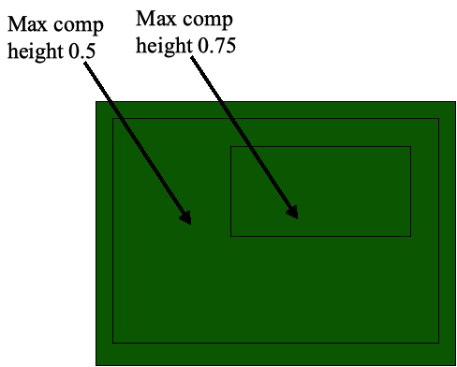

Mounting Restriction Area Boundaries
Test Case Purpose
Test a mounting_restriction_area with both an external and internal boundary.
Test History:
Filename: ModifiedMRABoundary.210
Author: Mike Keenan
Design Source: MRABoundary.brd
Translator: IDF to AP210 11/13/00
Post Processing: Manual to add the cutout to the outer mounting_restriction_area.

Slide 20

Multi Assembly
Test Case Purpose
Test the results of giving a system a part21 file with two PWA assemblies in it.
?
Test History:
9/20/00 - AP210Viewer Version 1.2f Beta 1.0, displayed the single component annexk example. No indication of another design in the file.
Filename: MultiProduct.stp
Author: Mike Keenan
Design Source: Annex K examples for AP210 IS
Translator: N/A
Post Processing: Used StepMerge program to create a single part21 file for the two examples.

Slide 21
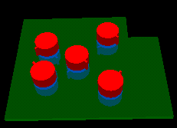
Component Orientation
Test Case Purpose
Test component placement and rotation on both sides of the board.
Test History:
Extensive testing during development of AP210 Viewer and IDF to AP210 translator.
Filename: Test_05.210
Author: Mike Keenan
Design Source: Test_05.brd
Translator: IDF to AP210
Post Processing: None

Slide 22
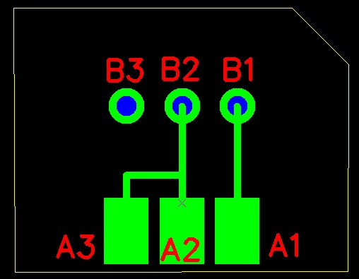
PCB
Test Case Purpose
Test History:
Tested using Expresso.
Extensive, ask Tom and Lothar
Filename: ap210_pcb1.stp
Author: Giedrius Liutkus
Design Source: Circuit Cam
Translator: Circuit Cam
Post Processing: Manual, being incorporated into tool

Slide 23
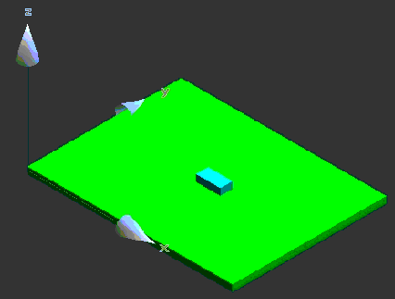
Simple Rectangle
Test Case Purpose
Simple rectangular board with one component
Test History:
A direct translation using TLDi Software PCBto3D from IDF to Solid Edge.
Translate IDF files to STEP AP203 file format. Rename resulting STEP file from tidf.step to tidf.stp. Inport STEP file into Solid Edge
Filename: tidf-A.brd
Author:Jim Evans
Design Source:IDF Data
Translator: Many
Post Processing: None

Slide 24
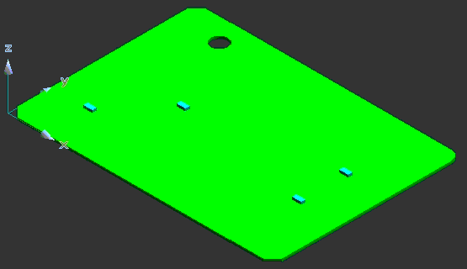
Circular Arcs
Test Case Purpose
Test circular arcs in outlines and multiple placement of single part.
Test History:
A direct translation using TLDi Software PCBto3D from IDF to Solid Edge.
Translate IDF files to STEP AP203 file format. Rename resulting STEP file from tidf.step to tidf.stp. Inport STEP file into Solid Edge
Filename: tidf-B.brd
Author: Jim Evans
Design Source: IDF Data
Translator: Many
Post Processing: None

Slide 25

AnnexK Assembly
Test Case Purpose
Test History:
Filename: annexk_assembly.stp
Author: Kevin Cline
Design Source: IDF Version 2.0
Translator: IDF to AP210
Post Processing: None

Slide 26

AnnexK Component
Test Case Purpose
Test History:
Filename: annexk_component.stp
Author: Kevin Cline
Design Source: IDF Version 2.0
Translator: IDF to AP210
Post Processing: None

Slide 27

Interface Drawing
Test Case Purpose
Provide an example of the “interface drawing” for a PWA.
Test History:
Filename: Atx.210
Author: Mike Keenan
Design Source: ATX Spec. 2.01
Translator: IDF to AP210
Post Processing: Expected

