Slide 1
AP 210 Test Cases
  February 15, 2007
  Tom Thurman

Slide 2
History
  Updated from Original by
  Mike Keenan..thanks Mike!
  Integrated copies:
  sparkynet,
  ATI,
  RC internal
  TBD: Integrate copies from wikistep

Slide 3
Why have Test Cases?
Required by ISO TC184/SC4
Provide “Qualified” files to use in testing implementations.
Provide concrete examples of concepts covered in recommended practices.
Provide Incremental Implementation Examples
Provide achievable challenges for implementers

Slide 4
Where we are today
Have a Pile of Test Cases that are not up to date.
Have an incomplete list of the Test Cases we need.
Have No Test Case process.
Have not integrated the ap203 files from the recommended practices

Slide 5
What we need to do
Identify the Test Cases We will Identify to SC4 as 'official'.
Identify the types of Test Cases we need for development
Establish a Test Case process.
Pick critical test cases
Update the critical Test Cases to E2
Clean up names

Slide 6
Proposed Test Case Process

Slide 7
Test Case validation criteria
Identifies the Scope & Specific Purpose
  Identify Modules that are Addressed
  Identify Subset that is Addressed
  Describe Use Cases Supported

Slide 8
Test Case validation criteria(cont)
Conforms to AP 210
  Within the scope of the use case for the test case
  Identifies ARM AOs of Principal Interest
    (Test case may include other AOs for validity/ease of construction.)
  Identifies non-conformance
    Violated Rules
    Violated Attributes/Relationships
    Violated Ips
    Arm
    Aim

Slide 9
Test Case validation criteria(cont)
Use Case Provided (Data Flow Diagram)
Pedigree of the files provided.
  CAD Source identification if applicable
  History
  Change History
  Issues against the file
  Issues against AP 210 the file illustrates
  Version of the AIM it is tested against.
  Version of the AIM it was built against.

Slide 10
Types of Test Cases
Simple with a limited implementation scope.
  Examples:
    Simple Rectangle
    Component Orientation

Slide 11
Types of Test Cases (cont.)
Complex with a scope that covers a particular usage scenerio.
  Examples:
    Thru Hole PCB design
    Surface mount PCA design
    Double Sided Surface Mount PCA design
    Requirement Specification
    Design Change Sequence

Slide 12
The List of Test Cases
Analytical model
Annex K assembly
Annex K component
ap210_pcb1
ap210_pcb2
Atx
Cabledb
Circular Arcs
Component_placement_restriction_
assignment Requirements
CubeModule
Cylindrical Assembly
Dip-switch
Drilled Hole
HO8 Package
  JimsTestCase A
  MRA Boundary
  Multi Product
  Orientation
  PCB
  Recommended Practices
  Resistance Module
  Simple Rectangle
  Surface Mount Flasher
  Surface Mount Flasher LRU
  Thru Hole Flasher
  Tutor
  TutorCPU

Slide 13
These are available in the Repository
Analytical model
Annex K assembly
Annex K component
Atx
Cabledb
Circular Arcs
Component_placement_restriction_
assignment Requirements
CubeModule
Cylindrical Assembly
Dip-switch
Drilled Hole
HO8 Package
  JimsTestCase A
  MRA Boundary
  Multi Product
  Orientation
  PCB
  Recommended Practices
  Resistance Module
  SimpleRectangle
  Surface Mount Flasher
  Surface Mount Flasher LRU
  Thru Hole Flasher

Slide 14
These are on the www.wikistep.org site and in the Repository
Cable db
Surface mount flasher
Through hole flasher
NOTE: The repository and wikistep site may not be in sync.

Slide 15
These are on the www.ap210.org site and are NOT in the repository
ap210_pcb1
··ap210_pcb2
CPU board
Demo3
··Design 1
··Design 2
··Design 3
Singlesided board
··tutor
··tutorCPU

Slide 16
Test Case Quad Charts

Slide 17
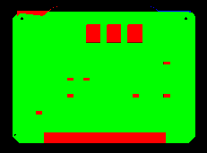
AnnexK Assembly
Test Case Purpose
Test History:
Filename: annexk_assembly.stp
Author: Kevin Cline
Design Source: IDF Version 2.0
Translator: IDF to AP210
Post Processing: None

Slide 18

AnnexK Component
Test Case Purpose
Test History:
Filename: annexk_component.stp
Author: Kevin Cline
Design Source: IDF Version 2.0
Translator: IDF to AP210
Post Processing: None

Slide 19
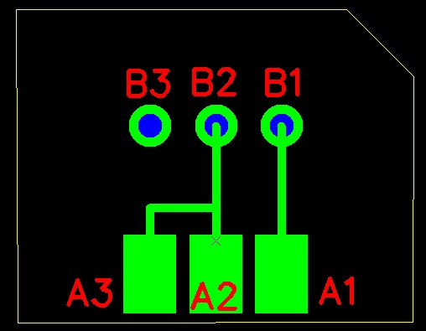
AP210_PCB1
Test Case Purpose
Test History:
Tested using Expresso.
Filename: ap210_pcb1.stp
Author: Giedrius Liutkus
Design Source: Circuit Cam
Translator: Circuit Cam
Post Processing: Manual, being incorporated into tool

Slide 20

Atx
Test Case Purpose
Provide an example of the “interface drawing” for a PWA.
Test History:
Filename: Atx.210
Author: Mike Keenan
Design Source: ATX Spec. 2.01
Translator: IDF to AP210
Post Processing: Expected

Slide 21
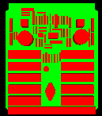
Cabledb ECAD View
Test Case Purpose
A real design available to share.
Test Case Status:
Test History:
Filename: cable_db.stp
Author: Paul Monson
Design Source: Mentor Graphics
Translator: LKSoft v???
Post Processing: None

Slide 22
Cabledb MCAD View
Test Case Purpose
A real design available to share.
Test History:
3D model created in UGS to support
MCAD View. UG Part and AP203
Models available for assembly and
Piece parts and maybe the PWB.
Filename:
Author: Tom Thurman
Design Source: UGS
Translator: Unknown
Post Processing: None

Slide 23
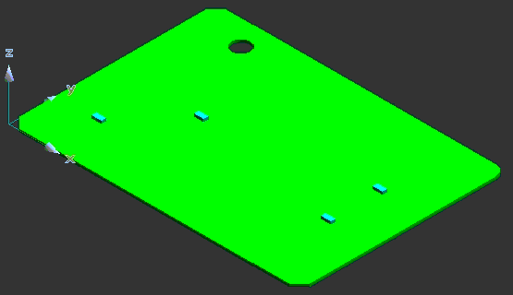
Circular Arcs
Test Case Purpose
Test circular arcs in outlines and multiple placement of single part.
Test History:
A direct translation using TLDi Software PCBto3D from IDF to Solid Edge.
Translate IDF files to STEP AP203 file format. Rename resulting STEP file from tidf.step to tidf.stp. Inport STEP file into Solid Edge
Filename: tidf-B.brd
Author: Jim Evans
Design Source: IDF Data
Translator: Many
Post Processing: None

Slide 24
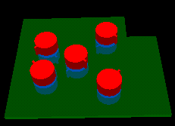
Component Orientation1
Test Case Purpose
Test component placement and rotation on both sides of the board.
Test History:
Extensive testing during development of AP210 Viewer and IDF to AP210 translator.
Filename: Test_05.210
Author: Mike Keenan
Design Source: Test_05.brd
Translator: IDF to AP210
Post Processing: None

Slide 25

Component Orientation2
Test Case Purpose
Simple board with one part placed 8 times to test multiple placements and orientations of a single part
Test History:
Extensive testing during development of AP210 Viewer and IDF to AP210 translator.
Includes AP210, IDF, VRML, and
CAD source
Filename: JimsTestCase_A.210
Author: James M. Evans
Design Source: Solid Edge Version 8
Translator: Source Translator
Post Processing: None

Slide 26

Component Placement Restriction
Test Case Purpose:
To test the function of the ARM concept of component_
placement_restriction_
assignment requirements
Test History:
The file MGC_CGA.brd includes the ROUTE_OUTLINE and PLACE_OUTLINE outlines that where required in order to create a board geometry in Mentor Graphics tools.
Filename: CRA.210
Author: Mike Keenan
Design Source: ATX subset
Translator: IDF to AP210 11/13/00
Post Processing: None

Slide 27
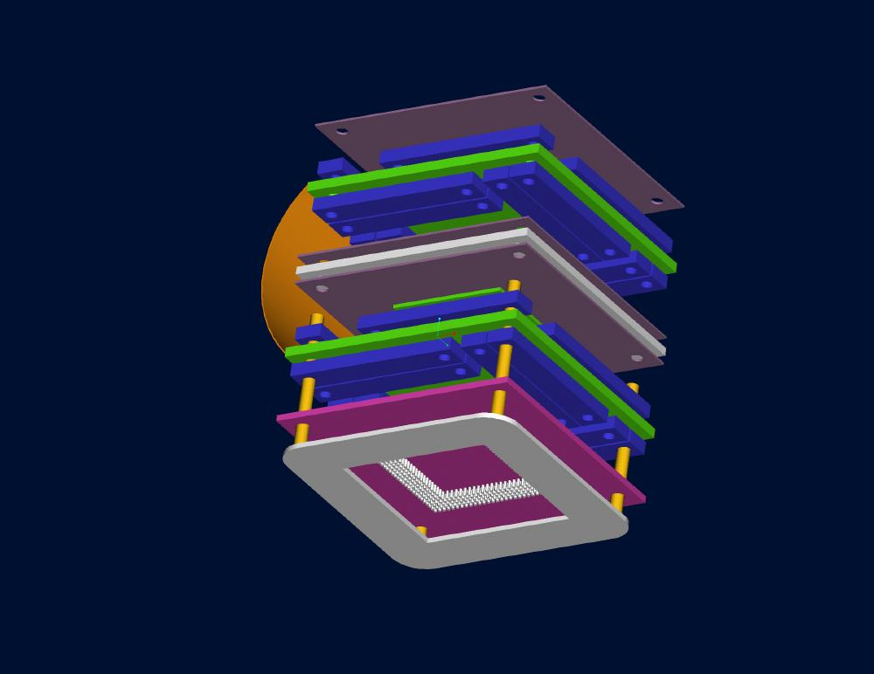
Cube Module
Test Case Purpose
Complex 3d assembly
Test History:
Filename: cube_module_562_ap203.stp
Author: Steve Waterbury
Design Source:
Translator:
Post Processing: None

Slide 28
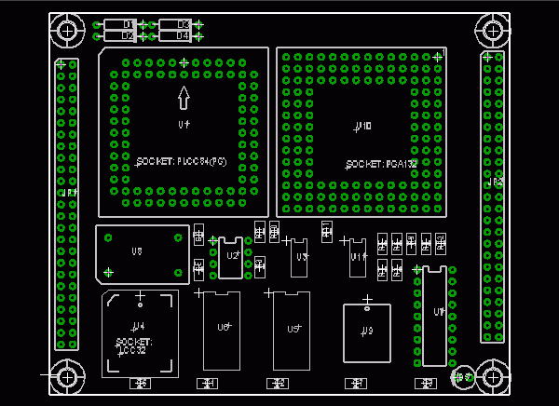
Eagle CPU Board
Cube Module
Test Case Purpose
Test History:
From AP210 Examples on www.ap210.org
Filename: CPU Board
Author:
Design Source: Eagle
Translator:
Post Processing: None
Test Case Purpose
Complex 3d assembly
Test History:
Filename: cube_module_562_ap203.stp
Author: Steve Waterbury
Design Source:
Translator:
Post Processing: None

Slide 29
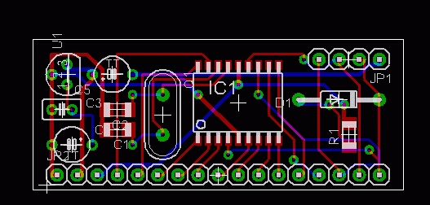
Eagle Demo 3
Test Case Purpose
Test History:
From AP210 Examples on www.ap210.org
Filename: eagle demo 3
Author:
Design Source: Eagle
Translator:
Post Processing: None

Slide 30
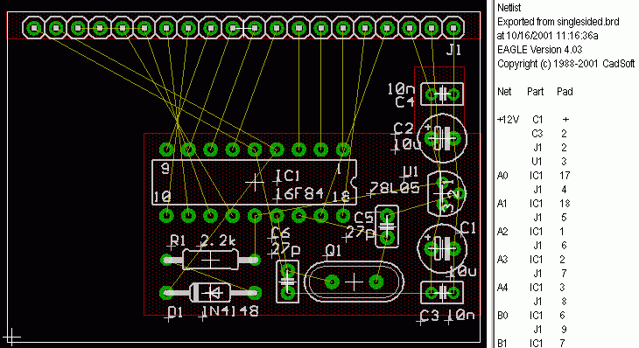
Eagle Single Sided + Netlist
Test Case Purpose
Test History:
From AP210 Examples on www.ap210.org
Filename: Single Sided + Netlist
Author:
Design Source: Eagle
Translator:
Post Processing: None

Slide 31
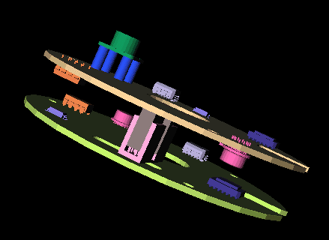
Cylindrical Assembly
Test Case Purpose
Complex 3d assembly
with simple 3d part shapes
including board-board
connectors
Test History:
Filename: cylindrical_assembly_demo.tar.Z
Author: Fred Tolmie
Design Source: UGS
Translator: Source Translator
Post Processing: None

Slide 32
Dip Switch
Test Case Purpose
Provide dip switch example.
Test History:
2007-02-15
Tried to load into
Step Tools viewer v10 and it locked up
Filename: dip-switchV6.step
Author: Craig Lanning
Design Source: by hand
Translator:none
Post Processing: None

Slide 33

Drilled Hole
Test Case Purpose
Provide simple drilled hole example.
Test History:
Filename: DrilledHole.210
Author: Mike Keenan
Design Source: ATX Version 2.01
Translator:IDF to AP210 11/13/00
Post Processing: None

Slide 34
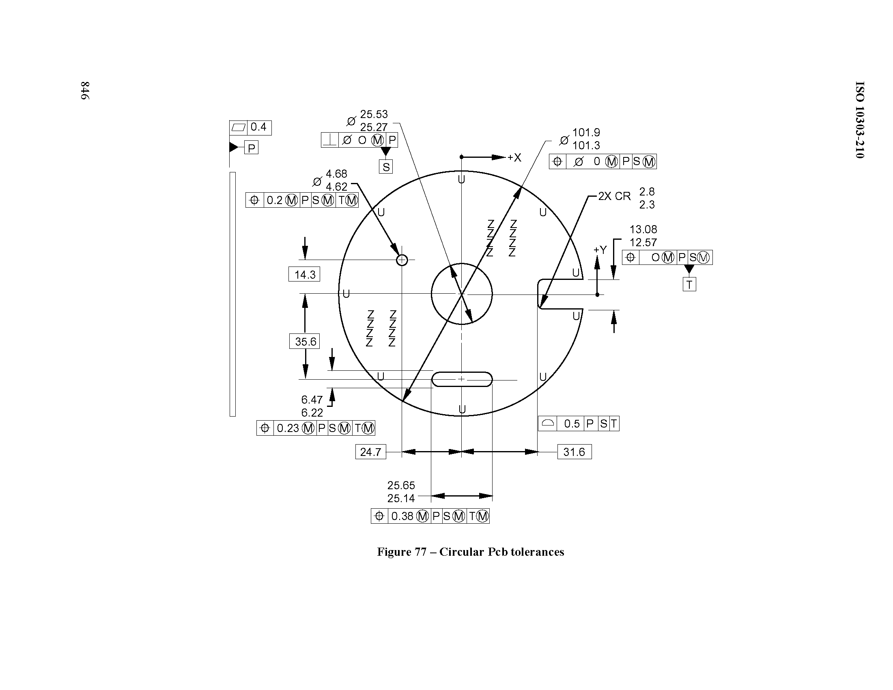
GDT1
Test Case Purpose
Provide a 1st GD&T model of a PWB
Test Case Status
Test History:
Provided the figure to Kevin Fischer
Filename: tbd
Author: tbd
Design Source: tbd
Translator: tbd
Post Processing: tbd

Slide 35
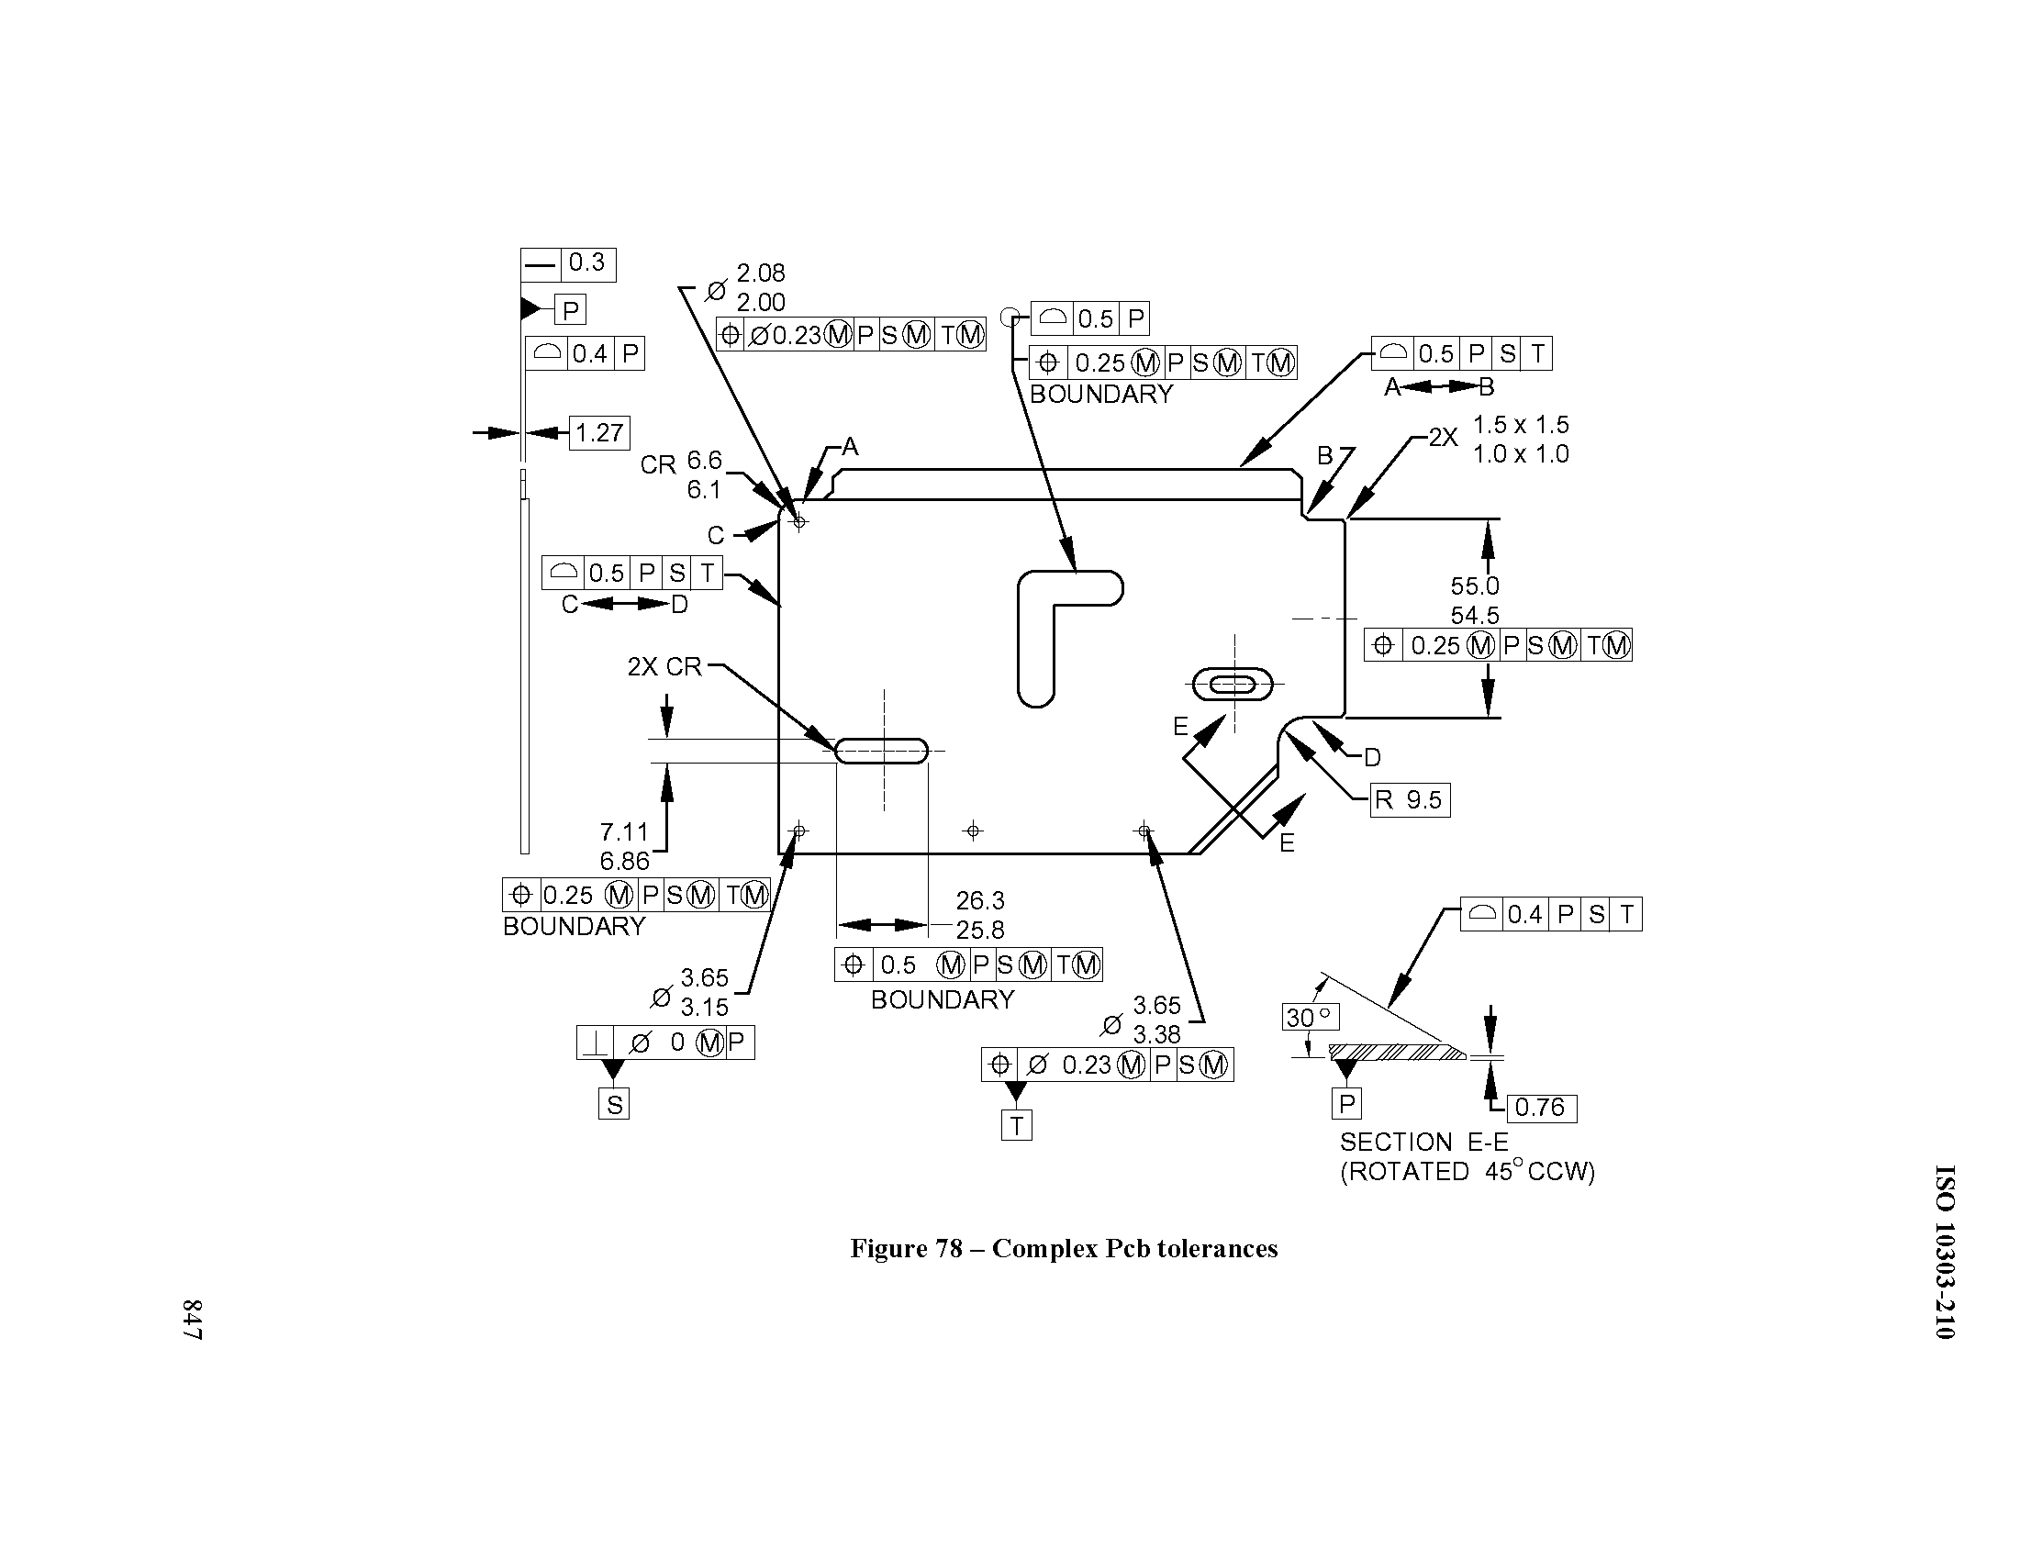
GDT2
Test Case Purpose
Provide a 2nd GD&T model of a PWB
Test Case Status
Test History:
Provided the figure to Kevin Fischer
Filename: tbd
Author: tbd
Design Source: tbd
Translator: tbd
Post Processing: tbd

Slide 36
H08 Package
Test Case Purpose
Provide a 3D model of an electronic package in both AP203 and in AP210 for comparison purposes for implementors.
Test Case Status
Test History:
The current file is against the DIS
Version and needs updating.
Filename: H08.2xx
Author: Craig Lanning
Design Source: AP203
Translator: None
Post Processing: Hand built

Slide 37

MRA Boundary
Test Case Purpose
Test a mounting_restriction_area with both an external and internal boundary.
Test History:
Filename: ModifiedMRABoundary.210
Author: Mike Keenan
Design Source: MRABoundary.brd
Translator: IDF to AP210 11/13/00
Post Processing: Manual to add the cutout to the outer mounting_restriction_area.

Slide 38

Multi Assembly
Test Case Purpose
Test the results of giving a system a part21 file with two PWA assemblies in it.
?
Test History:
9/20/00 - AP210Viewer Version 1.2f Beta 1.0, displayed the single component annexk example. No indication of another design in the file.
Filename: MultiProduct.stp
Author: Mike Keenan
Design Source: Annex K examples for AP210 IS
Translator: N/A
Post Processing: Used StepMerge program to create a single part21 file for the two examples.

Slide 39
Production Rules
Only the part 21 file is available at this time

Slide 40
Recommended Practice Test Cases
827-7362-070, 074, 078, 082, 086, 090, 091, 096, 101 are the main models.
Initially these are AP203 E1 models.
(Other models are supporting chunks.)

Slide 41
Resistance Module
Test Case Purpose
Provide electrical functional test case
Test History:
Used in training class
Filename: resistoru.210
Author: Tom Thurman
Design Source: By Hand
Translator: N/A
Post Processing:

Slide 42
2 Resistor Module
Test Case Purpose
Provide electrical functional test case with two resistors
Test History:
Used in training class
Filename: 2_resistor_module_testcase.210
Author: Tom Thurman
Design Source: By Hand
Translator: N/A
Post Processing:

Slide 43
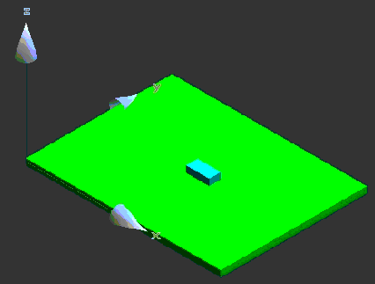
Simple Rectangle
Test Case Purpose
Simple rectangular board with one component
Test History:
A direct translation using TLDi Software PCBto3D from IDF to Solid Edge.
Translate IDF files to STEP AP203 file format. Rename resulting STEP file from tidf.step to tidf.stp. Inport STEP file into Solid Edge
Filename: tidf-A.brd
Author:Jim Evans
Design Source:IDF Data
Translator: Many
Post Processing: None

Slide 44
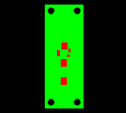
Surface Mount Flasher
Test Case Purpose
A real design available to share.
Test Case Status
Test History:
There are Mentor
Board station source as well as CADIF
Source as well as UG source
Filename: flasher.210
Author: Kevin Cline
Design Source: Various
Translator: Various
Post Processing: None

Slide 45
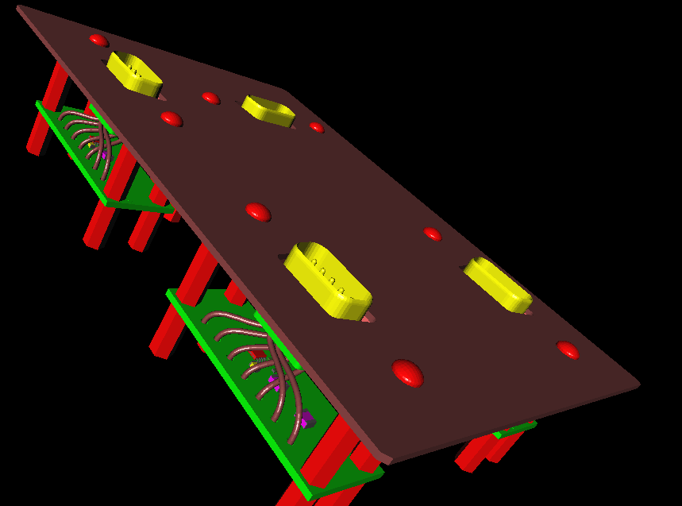
Surface Mount Flasher LRU
Test Case Purpose
A Multi-level design simulating a Black Box.
Test Case Status
Test History:
This design re-uses the surface mount
flasher circuit card
There are UG source and AP203 files
Filename:
Author: Tom Thurman
Design Source: Various
Translator: Various
Post Processing: None

Slide 46

Thru Hole Flasher
Test Case Purpose
A real design available to share.
Test History:
Filename: flasherthruhole.stp
Author: Paul Monson
Design Source: Mentor Graphics
Translator: ITI Version 1.2
Post Processing: None

Slide 47
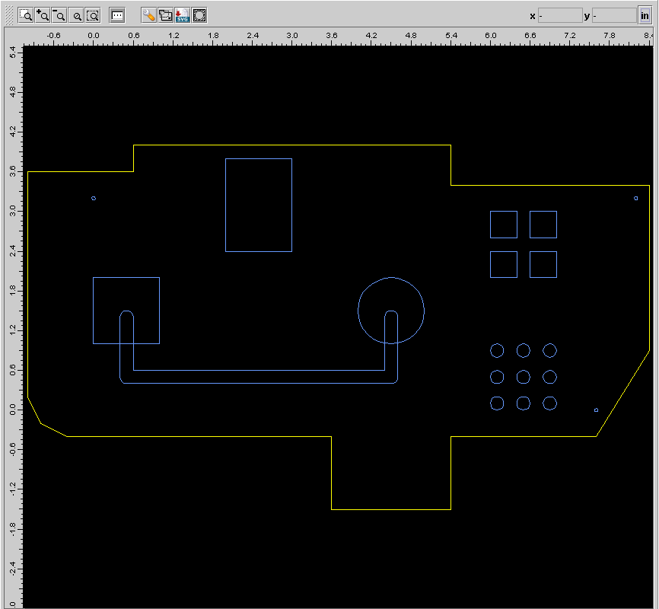
Warpage Test Case 020
Test Case Purpose
A synthetic test case to support area calculations.
Test History:
Filename: 827-3762-020-_v2-3-2-Beta_GPL_ARM-X.210
Author: Manas Bajaj
Design Source: Zuken CR5000-CADIF
Translator: LKSoft v2.3.2
Post Processing: None

Slide 48
Warpage Test Case 021
Test Case Purpose
A synthetic test case to support area calculations.
Test History:
Filename: 827-3762-021-_v2-3-2-Beta_GPL_ARM-X.210
Author: Manas Bajaj
Design Source: Zuken CR5000-CADIF
Translator: LKSoft v2.3.2
Post Processing: None

Slide 49
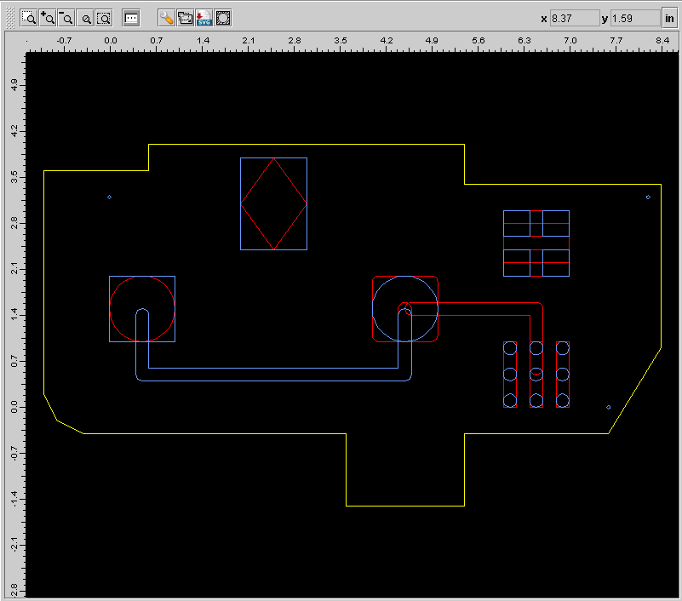
Warpage Test Case 022
Test Case Purpose
A synthetic test case to support area calculations.
Test History:
Filename: 827-3762-022-_v2-3-2-Beta_GPL_ARM-X.210
Author: Manas Bajaj
Design Source: Zuken CR5000-CADIF
Translator: LKSoft v2.3.2
Post Processing: None

Slide 50
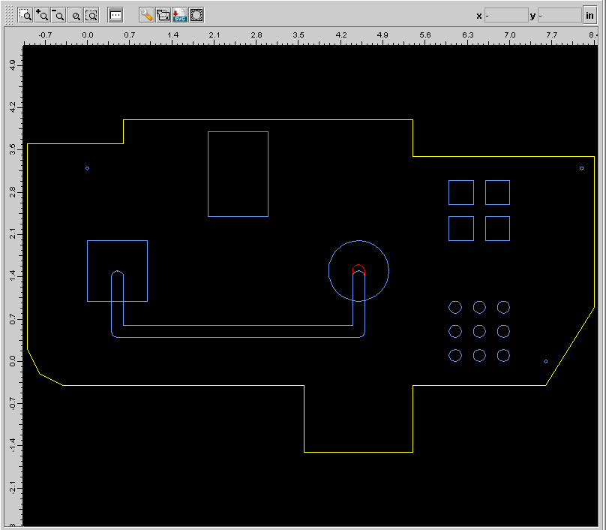
Warpage Test Case 023
Test Case Purpose
A synthetic test case to support area calculations.
Test History:
Filename: 827-3762-023-_v2-3-2-Beta_GPL_ARM-X.210
Author: Manas Bajaj
Design Source: Zuken CR5000-CADIF
Translator: LKSoft v2.3.2
Post Processing: None

Slide 51
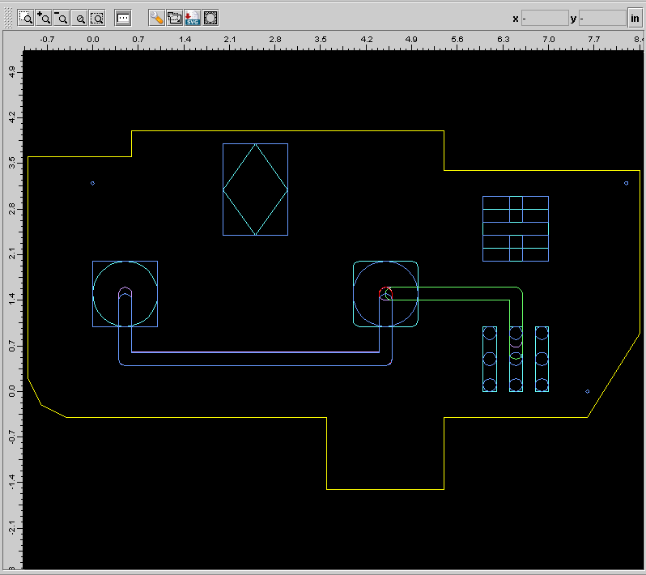
Warpage Test Case 024
Test Case Purpose
A synthetic test case to support area calculations.
Test History:
Filename: 827-3762-024-_v2-3-2-Beta_GPL_ARM-X.210
Author: Manas Bajaj
Design Source: Zuken CR5000-CADIF
Translator: LKSoft v2.3.2
Post Processing: None

Slide 52
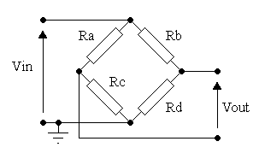
Wheatstone Bridge
Test Case Purpose
Provide multi-disciplinary test case
Test History:
Used in training class
Filename: Wheatstone_Bridge_TestBench.210
Author: Tom Thurman
Design Source: By Hand
Translator: N/A
Post Processing:

Slide 53
Proposed AP210 Test Cases
Complete 2D Geometry

Slide 54
Complete 2D Geometry
Description: Contains a board outline and only a board outline with all allowed 2-D geometry types.
Test Case Purpose
Validate that all 2-D geometry types are handled.
Test History:
Filename:
Author: TBD
Design Source:
Translator:
Post Processing:

