Slide 1
Rules Overview
Capturing Corporate Knowledge
This presentation was received from Greg Smith
of The Boeing Company on July 9, 2003
Gregory L. Smith
Gregory.L.Smith@Boeing.com
July 8, 2003
Modified to fit on bugzilla by T. Thurman
10-19-2005
Revised August 4, 2003 TT

Slide 2
Agenda
3 Rules Overview-Capturing Corporate Knowledge
4 Rules: A “Simple” Definition
5 Rules: A “Simple” Example
6 Knowledge Acquisition-Three Schema Architecture
7 Rules Discussion
8 COTS Rules Environment - Benefits
9 Generic Rules Environment - Challenges/Introduction of STEP data
11 Present/Future Data Exchange
12 Generic Rules Environment - Introduction of STEP data/Architecture
15 Rules Architecture - Data
17 PWA/PWB Producibility Analysis
21 Rule Execution Map
22 Rules Architecture - Data
23 PWA/PWB Producibility Analysis
24 Rule Life Cycle
25 Rule Sets
26 Generic Rule Template
31 Rules: Backus-Noir Form
33 Rules: Express
36 Future

Slide 3
Rules: A “Simple” Definition
A constraint, either conditional or unconditional, quite often levied via system requirements, physical limitations or environmental restrictions that may effect one, many or all of the life cycle processes (e.g. design, manufacture, disposal, recycle, etc.) for a given product or family of products.

Slide 4
Rules: A “Simple” Example
GUIDELINE: Components and hardware should not extend
below the bottom side of a PCA more than 0.175 inches.
RATIONALE: The depth of the flow solder wave is approx-
imately 0.200 inches. Approximately 0.025 inch of solder
mask is applied to all hardware and some components
prior to wave solder. Components or hardware that exceed
this value will get caught on the wave nozzle and be trapped
over the solder pot.
REFERENCE: Automated Flow Solder Machine, Electrovert
2000, Dual wave, finger conveyor computer controlled,
capable of handling boards up to 19.5 inches wide.
(Source: Boeing CAS-IO Producibility Guidelines, Section 3.4.1)

Slide 5
Rules Discussion
What problems are rules based systems best at solving?
  Configuration
  Analysis
    Design for X
      Producibility
      Manufacturability
    Data Verification
  Diagnostics
  Knowledge discovery
Notes:
EX systems being used for Income tax form analysis, font analysis (Adode)
EX tool vendors have been selling knowledge empty systems are 20 years
Most vendors are out of business or transitioning to other businesses

Slide 6
COTS Rules Environment - Benefits
Why should one consider a rules based systems approach?
  Functionality is localized
  Data validation & verification is localized
  Introducing additional functionality has minimum effect on existing functionality
  Information can be discovered / acted on
  Complexity can be managed
  System can be easily extended
Notes:
Problems with Conventional Software Applications
Computer Aided Design report, December 2000
Why are bugs winning?
Bugs creeping up in sections of code where nothing new had been added!
Ault lies in the method by which software are created
bad pointers
failure to free memory
bad data

Slide 7
Generic Rules Environment - Challenges
Each COTS Environment has:
  Its own subset and/or superset of code functions
    Logic, math, list, string, set, I/O, etc.
  Its own rule control strategies
    Backward chaining
    Forward chaining
    Exhaustive back tracking
    Assertive/ Non-Assertive execution
    Goal-based/ Non-Goal-based execution
  Timeline (COTS tool obsolescence)
Notes:
Longevity of vendors and their tools
Functions are different between vendors and tools
Control strategies different between vendors and tools

Slide 8
Generic Rules Environment - Architecture
Generic
Rules Definition
Environment
-----
Rules
Editing Facility
Syntax Checking
Rule Conversion
Rules Execution
Environment
-----
Rules
Selection Mechanism
Rule Agenda
Inference Mechanism
Rule Strategies
Initiation Mechanism
Trace Facility
Report Facility
Rules
Meta Data
Generic Rules
ProKAPPA
COTS
Rules
KAPPA-PC
CLIPS
J2EE (JAVA)

Slide 9
Generic Rules Environment - Architecture
Rules attributes
COTS
Rule
Attributes
  Identifier Name
  Priority Comments
  Sets Code
  Justification Description
  Versioning Supercede
  Free Form Code Timestamps
  Structured Code Organization
  Set Maintenance Source
  Code Meta Knowledge Notes
  Author Status
  Type
Additional
Generic
Rule
Attributes

Slide 10

Rules Architecture - Data
STEP Part 21/28
STEP Schema
STEP
Generation
Vendor Data
(e.g ECAD,
MCAD)
Fact Extraction
Application
ARM semantic data
Rules
Data
Files
Rules
Execution
Facility
Rule
Code
Rules
Results Files
STEP
Extraction
Utility
Fact Part 21/28
Fact Schema
Rules
Definition
Facility
Notes:
Input vendor information
Conversion to STEP
Refinement to ARM level information

Slide 11
Rules Architecture - Data
Create Design
Submit Design for Analysis
Design
Issue
Tracker
Design
Designer
Legend
-------------
Invocation
Mechanism
Producibility
Guidelines
Reviewer
Producibility
Analysis
Process
Issues
Manufacturing
Resources
Data
IPT
Producibility Analysis Server
Notes:
Input vendor information
Conversion to STEP
Refinement to ARM level information

Slide 12
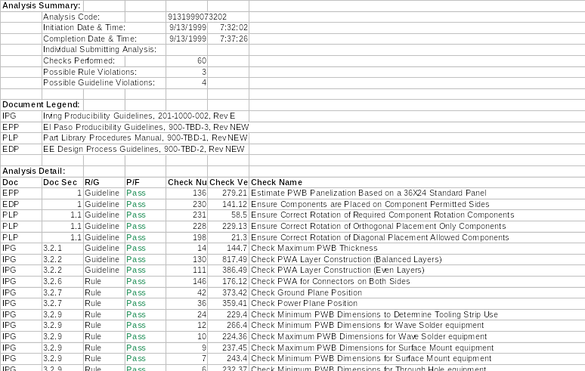

PWA/PWB Producibility Analysis
Producibility
Analysis
Report

Slide 13
Rule Execution Map
Rule47(10) -
Store Comp & Type
Count
Rule170(0) -
Initiate Producibility
Review
DataCapture_fact.status
=> Succeeded
Rule206(30) -
Add Inverse
Pointers
Rule169(20) -
Map Comp Inst to
Pkg Inst
Rule209(10) -
Store Pkg
Comp Style
Part_fact.status
=> Succeeded
Rule46(0) -
Initiate Core Rules
AP210_fact.status
=> Succeeded
No_fact.status
=> Succeeded
Rule77(10) -
Store Comp Surface
( Near / Far )
Rule44(10) -
Store Comp Ref
Des & Part Num
Rule214(10) -
Store Comp
Passive/
Active Status
Rule100(10) -
Find & store PCB
max & min X & Y
Rule190(10) -
Det & store PCB
Length & Width
Rule192(10) -
Det & store PCB
Preferred Orient
Rule177(20) -
Find & store product
meta info
Part2_fact.status
=> Succeeded
Part1_fact.status
=> Succeeded
PCB_fact.status
= Succeeded
PCB1_fact.status
= Succeeded
PCB2_fact.status
= Succeeded
Product_fact.status
= Succeeded
Rule78(10) -
Store Comp
Location & Rotation
Rule171(10) -
Map PCA Pkgs to
Mfg Pkg Types
Rule27(10) -
Store Pkg Heights
Rule119(10) -
Store Pkg Pin Cnt
Rule210(10) -
Store Mnt Type for
Pkg
Rule131(10) -
Store Pkg Pin Loc
Rule52(10) -
Store Pkg Extents
Type1_fact.status
=> Succeeded
Type3_fact.status
=> Succeeded
Type4_fact.status
=> Succeeded
Type2_fact.status
=> Succeeded
Part3_fact.status
=> Succeeded
Type_fact.status
=> Succeeded
Type6_fact.status
=> Succeeded
Rule172(10) -
Map Mfg part types
w/ PCA part types
Rule208(10) -
Store Surface
for Pkg
Rule153(10) -
Store Pol Comps
Rule182(10) -
Store NO Comps
Rule180(10) -
Store Pkg Pin Span
Rule53(5) -
Store Comp Extents
Type6_fact.status
=> Succeeded
Type7_fact.status
=> Succeeded
Type5_fact.status
=> Succeeded
Part4_fact.status
=> Succeeded
PartType_fact.status
=> Succeeded
Type6_fact.status
=> Succeeded
Rule29(10) -
Map Mfg part types
w/ part classes
Rule173(10) -
Count & store the
num of mfg types
Rule13(10) -
Det if PWA should use WS
Rule60(10) -
Store Any TH
Mfg_fact.ws = True
Rule41(10) -
Store Layers
PartType1_fact.status
=> Succeeded
Mfg_fact.status
=> Succeeded
Rule59(10) -
Store Any SMD
Rule215(10) -
Store Any Top/
Bottom SMD
Layer_fact.status
= Succeeded

Slide 14
Rule Execution Map
DataCapture_fact.status
=> Succeeded
Rule21(-10) -
Check Common TH Comp Orient
(Modulo 180)
Rule170(0) -
Initiate Producibility Review
Rule19(-10) -
Check Near Side Limits for
Comps using Batch Vapor Phase
Rule49(-100) -
Summarize Producibility Review
Rule12(-10) -
Check Min PWB Dims for WS equipment
Rule10(-10) -
Check Max PWB Dims for WS equipment
Rule9(-10) -
Check Max PWB Dims for SMT equipment
Rule7(-10) -
Check Min PWB Dims for SMT equipment
Rule6(-10) -
Check Min PWB Dim for TH
Rule4(-10) -
Check Near Side Limits for Comps for WS Equip
Rule3(-10) -
Check Near Side Limits for Comps for Radial Equip
Rule1(-10) -
Check Max PWB Dim for TH equipment

Slide 15
Rules Architecture - Data
ECAD Tool
Design
Information
Model
Transformers
Standards-based
Repository
STEP AP210,
STEP AP233,
Internal Schemas,etc.
Zuken
Visula
CADIF
LKSoft
CADIF-AP210
Other Design Tools
Component
Pkg. Modeler
Model
Transformer
Augmented
Design/Mfg. Model
Mfg. Tools
Mfg.
Information
Process
Planner
GIT
RDD Model
Creator*
Design/Mfg.
Model Mgt.
Kappa model (.kal)
Simulation/Analysis
Library Mgt.
Simulation/Analysis
Model Execution & Mgt.
RCI DFX
Guidelines
Rules Definition
Tool
Rules
Library
Rules Execution
Tool
DFX
Analysis Results
DFX Results
Reviewer
Feedback
for Design
Readiness /
Changes
Boeing
RDF
Boeing
REF
UIUC
Browser
REF_log. txt
RCI - Rockwell Collins Inc.
GIT - Georgia Tech
UIUC - U. Illinois
Notes:
Input vendor information
Conversion to STEP
Refinement to ARM level information

Slide 16
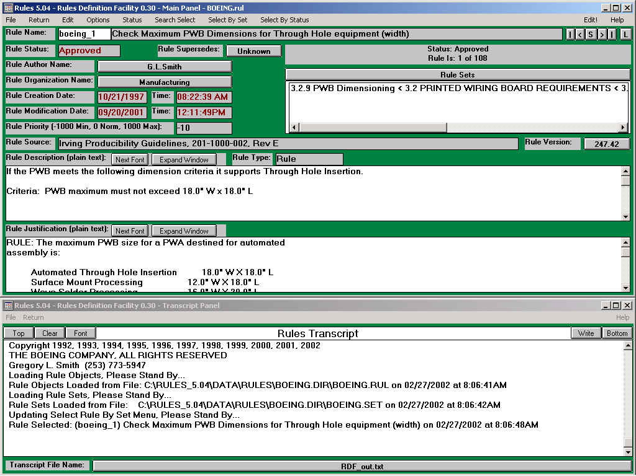
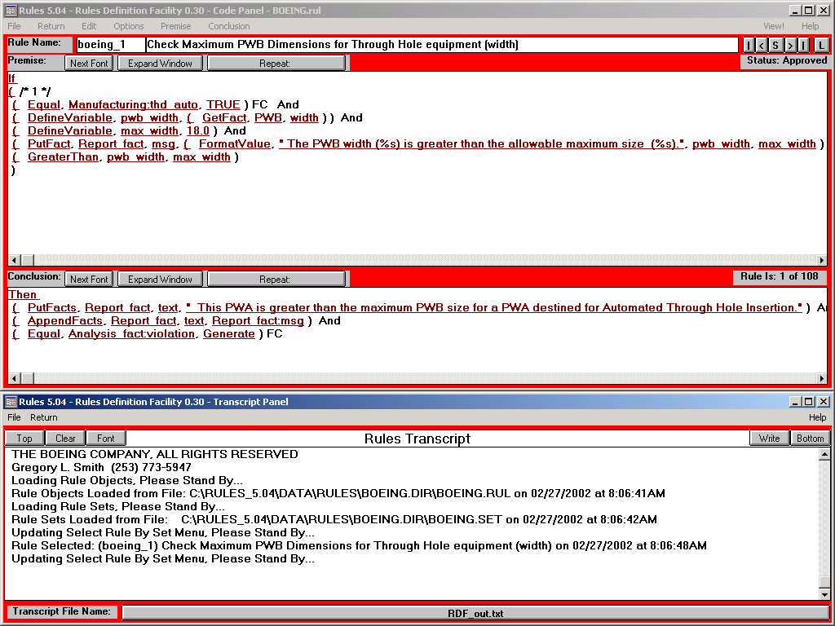

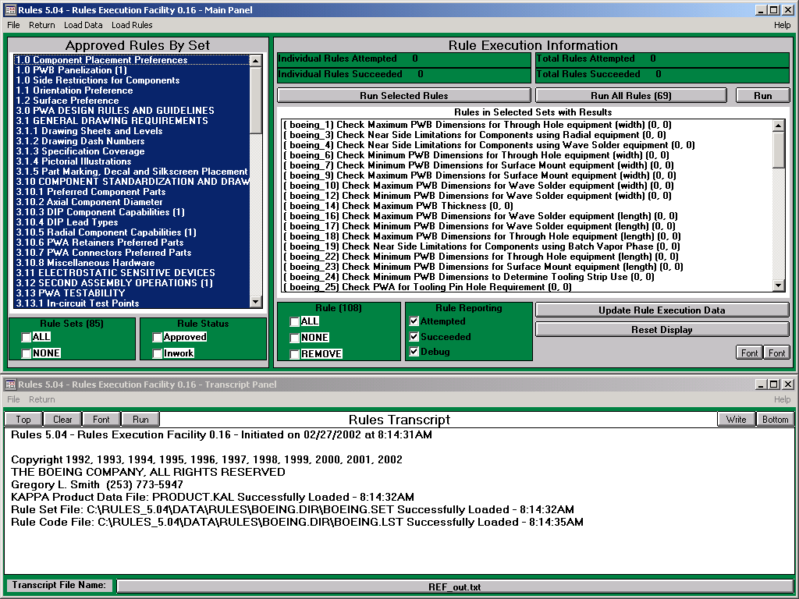
PWA/PWB Producibility Analysis
Codification of
Guidelines
(Rules Definition)
Company PWA/PWB
Guidelines
Manufacturing Capabilities
STEP AP220
Rules
STEP AP210
Producibility
Analysis
Report
PWA/PWB Captured in Mentor Design Tools
Comparison of Rules
Against Product Data
(Rules Execution)
Notes:
Provide an analysis capability for the manufacturing entity to determine the producibility of the PWA/PWB.
Developed by Boeing
Prototyped and tested at Irving
Responses were excellent, identified areas not caught by M&P
Requested to extend coverage
Usage halted due to problems with ITI translator
Provided to Rockwell-Collins
Supplied in conjunction with Boeing-Rockwell data exchange project
Performed extensive testing and added Rockwell rules
Presenting supporting limited production use
Provided to Consortium for Advanced Manufacturing – International
Supplied to support Boeing membership
Part of Model-Based Manufacturing program
General Electric planning on implementing resulting applications

Slide 17
Rule Life Cycle
Submit Inwork Rule
Create Rule/Copy Rule
Inwork
Submitted
Accept Proposed Rule
Proposed
Approve Submitted Rule
Reject Proposed Rule
Disapprove Submitted Rule
Approved
Rejected
Disapproved
New Rule Identifies Rule
Any rule can be demoted to Proposed
Proposed rules can be deleted
Proposed & Inwork rules can be edited
Approved & Inwork rules can be executed
to be Superseded
Superseded

Slide 18
Rule Sets
Testability
Manufacturability
Design for X (CAx)
Reliability
Methods for rule categorization.
Goal: provide the end user with a view of a subset of rules.
Maintainability
Producibility
Thermal
Physical Property
Chemical
G.L.Smith
EMI / HIRF
R.Peak
Author
Source
Test
Rule Set
Organization
Manufacturing
Commercial Specification
Engineering
Quality Assurance
Design Rule Check Tool
Schematic Capture
PCA Layout
Shock
Water Incursion
Environment
Humidity
Military Specification
Mil-2000
Temperature
Atmosphere
Design
Vibration
Design State
Package
Assembly

Slide 19
Generic Rule Template
Dfx Rule
Scope
Premise
Conclusion

Slide 20
Generic Rule Template
Dfx Rule
Scope
Premise
Conclusion
(And)
Simple Scope
Variable
Feature

Slide 21
Generic Rule Template
Dfx Rule
Scope
Premise
Conclusion
(Or)
Complex Premise
(And)
Simple Premise
(0, 1, N)
Function
Parameter

Slide 22
Generic Rule Template
Dfx Rule
Scope
Premise
Conclusion
(And)
Simple Conclusion
(0, 1, N)
Function
Parameter

Slide 23
Generic Rule Template
Dfx Rule
Scope
Premise
Conclusion
(And)
(Or)
(And)
Simple Scope
Complex Premise
Simple Conclusion
(And)
(0, 1, N)
Variable
Feature
Simple Premise
Function
Parameter
(0, 1, N)
Function
Parameter
Where: Parameter can be: a constant, a database attribute,
function, or scope variable.← Recursive!

Slide 24
Rules: Backus-Noir Form
<rule> ::= <scope> <premise> <conclusion>
<scope> ::= { <variable> <feature> }+
<premise> ::= <complex premise> { Or <complex premise> }*
<complex premise> ::= <simple premise> { And <simple premise> }*
<simple premise> ::= <system function> <premise parameter>*
<premise parameter> ::= <simple premise> | <constant> | <variable>
<conclusion> ::= <simple conclusion> { And <simple conclusion> }*
<simple conclusion> ::= <system function> <conclusion parameter>
<conclusion parameter> ::= <simple conclusion> | <constant> | <variable>

Slide 25
Rules: Backus-Noir Form
<variable> - alphanumeric pattern instantiated as feature object when rule
        Is fired (e.g., component1, layer2, net3).
<feature> - Data class or instance (e.g., Factory, Equipment, Component).
<constant> - Number, Integer or Floating Point
<system function>
- Any system provided function that a. returns a value for
        testing or comparison (e.g., logical, math) or b. sets attributes
        or alters the environment.
Note: This Backus-Naur Form has been extended using the Kleene cross + depicting a sequence of one or more and the Kleene Star * depicting a sequence of zero or more.

Slide 26
Rules: Express
managed_design_object
ee_rule_definition
SUBTYPE OF (ee_product_definition)
defined_versioned_rule
identifier
rule_definition_premise
rule_definition_conclusion
ee_rule_function
identifier
parameter (model parameter)
reference_document
source_code
model_parameter
type_name
unit_of_measure
reference_document
parameter_type
valid_range
default_value

Slide 27
Rules: Express
ee_rule_definition
SUBTYPE OF (ee_product_definition);
SELF\ee_product_definition.version : ee_rule_version;
identifier : STRING ;
INVERSE
premise : ee_rule_premise_definition FOR rule_definition;
conclusion : ee_rule_conclusion_definition FOR rule_definition;
UNIQUE
UR1 : defined_versioned_rule, identifier
ee_rule_premise_definition
SUBTYPE OF (managed_design_object);
rule_definition : ee_rule_definition;
identifier : STRING ;
disjunctive_content : SET [1:?] OF ee_rule_complex_clause;
UNIQUE
UR1 : rule_definition, identifier;
Revised to reflect BNF

Slide 28
Rules: Express
ee_rule_conclusion_definition
SUBTYPE OF (managed_design_object);
rule_definition : ee_rule_definition;
identifier : STRING;
conjunctive_content : SET[1:?] OF ee_rule_simple_clause;
UNIQUE ur1 : rule_definition, identifier;
END_ENTITY; -- ee_rule_conclusion_definition
Revised to reflect BNF

Slide 29
Rules: Express
ee_rule_complex_clause
SUBTYPE OF (managed_design_object);
conjunctive_content : SET [1:?] OF ee_rule_simple_clause;
identifier : STRING ;
UNIQUE
UR1 : identifier;
The latest corrections to the model (recursive function) have Not been incorporated into this EXPRESS.
ee_rule_simple_clause
SUBTYPE OF (managed_design_object);
rule_function : ee_rule_function;
parameter : SET [1:?] OF parameter_assignment;← Add recursion here.
identifier : STRING ;
UNIQUE
UR1 : identifier;
WHERE
valid_assignment : the parameters assigned values shall be declared in the function header;
Revised to reflect BNF

Slide 30
More on BNF
BNF is one of the most commonly used metasyntactic notations for specifying the syntax of programming languages, command sets, and the like. It is widely used for language descriptions but seldom documented anywhere (how do you document a metasyntax?), so that it must usually be learned by osmosis (but see RFC 2234).
Consider this BNF for a US postal address:
<postal-address> ::= <name-part> <street-address> <zip-part>
<personal-part> ::= <name> | <initial> "."
<name-part> ::= <personal-part> <last-name> [<jr-part>] <EOL> |
<personal-part> <name-part>
<street-address> ::= [<apt>] <house-num> <street-name> <EOL>
<zip-part> ::= <town-name> "," <state-code> <ZIP-code> <EOL>
This translates into English as:
"A postal-address consists of a name-part,
followed by a street-address part,
followed by a zip-code part.
A personal-part consists of either a first name or an initial followed by a dot.
A name-part consists of either: a personal-part followed by a last name
followed by an optional "jr-part" (Jr., Sr., or dynastic number) and end-of-line,
or a personal part followed by a name part
(this rule illustrates the use of recursion in BNFs,
covering the case of people who use multiple first and middle names and/or
initials).
A street address consists of an optional apartment specifier,
followed by a street number, followed by a street name.
A zip-part consists of a town-name, followed by a comma, followed by a state code,
followed by a ZIP-code followed by an end-of-line."
Note that many things (such as the format of a personal-part, apartment specifier, or ZIP-code) are left unspecified. These lexical details are presumed to be obvious from context or specified somewhere nearby.

