Slide 1
Overview of Information Modeling Using STEP EXPRESS, EXPRESS-G, and Part 21 Models
Authors: Diego Tamburini and Russell Peak
eislab.gatech.edu
www.marc.gatech.edu
Based on Graduate Course Lectures
Georgia Tech
COA/CS/ME 6754
April 22, 2002

Slide 2
Version History and Known Caveats
Version History
~5/97 - Diego Tamburini: Initial version
10/30/00 - Russell Peak: Minor corrections
2/7/01 - Russell Peak: Updates
4/22/02 - Russell Peak: Updates including more examples
Known Caveats
- Beware: length and end are Express keywords (better: point1, point2, length12 etc.) - also the TYPE DATE example
gives problems in some STEP processing tools
- More explanation and proper usage of INVERSE is needed (when to use INVERSE vs. aggregates)

Slide 3
STEP Information Modeling Languages
Included in ISO 10303-xx series of standards
Geared towards design & engineering information systems for product life cycle
Schemas Instances
Lexical (Text) Forms: Express Part 21 (ISO 10303-21),
(computer-sensible) Language bindings,
Express-I
Graphical Forms: Express-G
(human-sensible)

Slide 4
EXPRESS: Overview
Textual conceptual schema language.
Object-Oriented flavor.
Defined in ISO 10303-11.
Used to specify STEP integrated resources and APs.
Human-readable and computer-processable.
It is not a traditional programming language (e.g., no I/O).
It is not a data manipulation language.

Slide 5
EXPRESS Elements
Main Elements:
  Schema
  Type
  Entity
  Rule
Other Elements
  Constants
  Functions and procedures
  Executable statements
Notes:
Schema: “container” or “wrapper” of constructs
Types used to represent value domains.
Built-in: real, integer, strings, etc.
User-defined: built on top of the built-in ones.
Entities: the “meat: of EXPRESS. Things, concepts of interest.
Rules:
Local rules: uniqueness, domain
Global rules: apply to only a part of a population of entities, or to more than one population.

Slide 6
Example 1: Lines & Points
Schema
Express
Express-G
SCHEMA example1;
ENTITY point;
x : REAL;
y : REAL;
END_ENTITY;
ENTITY line;
end1 : point;
end2 : point;
END_ENTITY;
END_SCHEMA;
REAL
Primitive attributes
x
point
y
end1
line
Complex attributes
end2

Slide 7
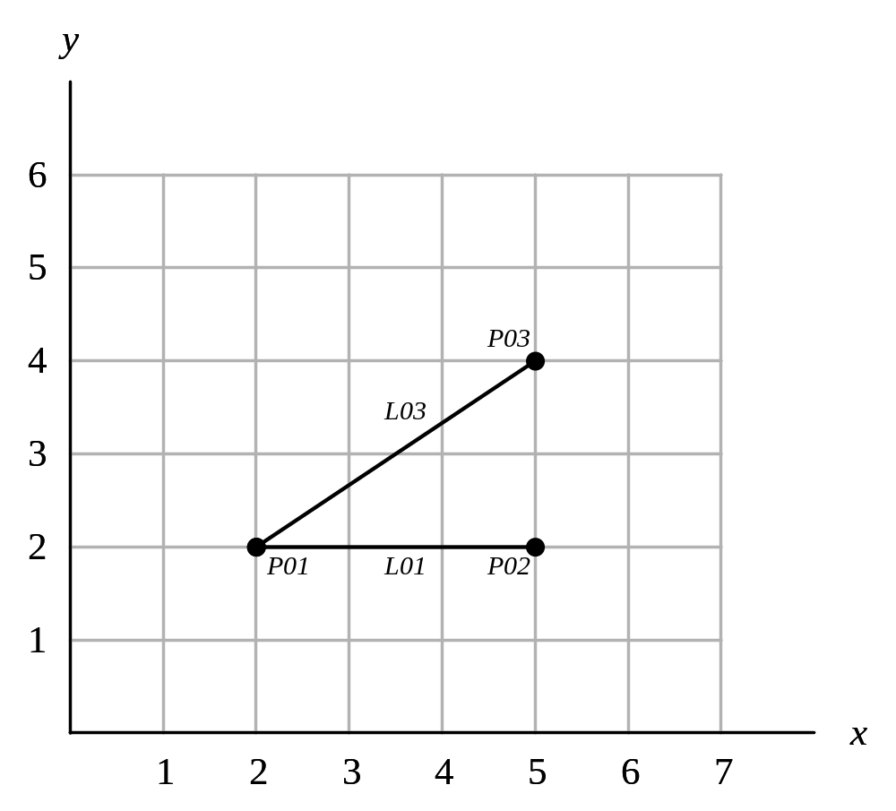
Example 1: Lines & Points (cont.)
Instances 1.a for the example1 schema
Instance Model Fragment
Part 21 (p21) format
Instance identifier (arbitrary number within a given p21 model)
Attribute values (in order as given in schema)
#10 = POINT (2.0, 2.0);
#20 = POINT (5.0, 2.0);
#30 = POINT (5.0, 4.0);
#110 = LINE (#10, #20);
#150 = LINE (#10, #30);
Reference to another instance

Slide 8
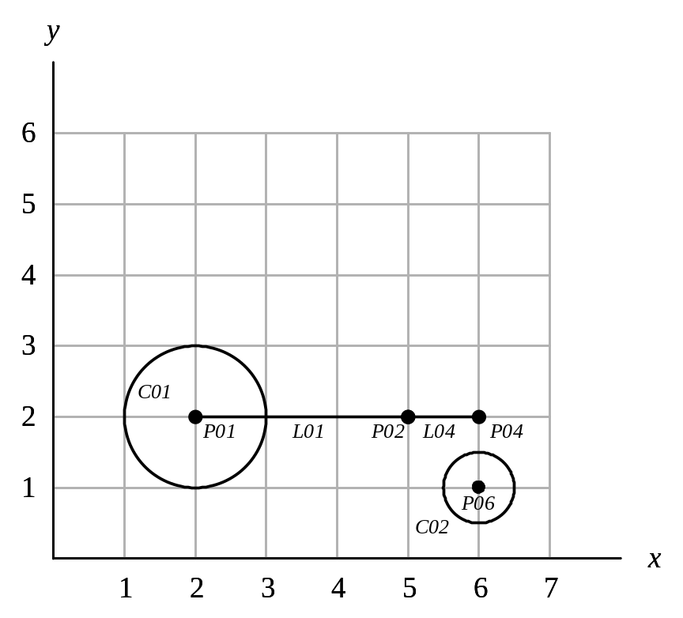
Example 2: Circles, Lines, Points
Add a “circle” entity to the Express schema
Draw the new Express-G model
Create a Part 21 model of the following drawing:

Slide 9
Schema
SCHEMA YourSchemaName;
[type declarations]
[entity declarations]
[rule declarations]
[functions]
END_SCHEMA;

Slide 10
Types (basic)
Simple (built-in) types:
  BINARY, BOOLEAN, INTEGER, LOGICAL, NUMBER, REAL, STRING
Collection types:
  Array (fixed size, position relevant)
  Bag (variable size, position not relevant)
  Set (like bag but without duplicates)
  List (variable size, position relevant)
Enumeration type
Select type

Slide 11
Types (user-defined )
TYPE distance = REAL;
END_TYPE;
TYPE positive_integer = INTEGER;
WHERE NotNegative : SELF >= 0;
END_TYPE;
TYPE trafficLightColor = ENUMERATION OF (Red, Amber, Green);
END_TYPE;
TYPE vehicle = SELECT( car, boat, plane );
END_TYPE;

Slide 12
Entities
ENTITY point;
x : REAL;
y : REAL;
END_ENTITY;
ENTITY line;
end1 : point;
end2 : point;
length : distance;
END_ENTITY;
ENTITY polyline;
lines : LIST[ 1 : ? ] OF line;
END_ENTITY;

Slide 13
Types vs. Entities
Type Entity
N Y - Can have instances:
Y Y - Can be used as an entity attribute

Slide 14
Entities: DERIVE and OPTIONAL
ENTITY line;
start : point;
end : point;
DERIVE
length : distance:=SQRT((end.xcoord - start.xcoord)**2
+ (end.ycoord - start.ycoord)**2);
END_ENTITY;
ENTITY person;
first_name : STRING;
last_name : STRING;
nickname : OPTIONAL STRING;
END_ENTITY;

Slide 15
Entities: INVERSE
ENTITY employee;
name : person_name;
END_ENTITY;
employee
person_name
ENTITY person_name;
last_name : STRING;
first_name : STRING;
INVERSE
link : employee FOR name;
END_ENTITY
Notes:
A person_name cannot exist unless there is exactly one value of employee that has an attribute named name whose value is Self.

Slide 16
Relationships and Cardinality
Rule 1: If an entity has [1:1] cardinality with respect to another, then the other entity should be an attribute value of the first entity.
Rule 2: A cardinality that requires another entity takes precedence over the one that does not.
Rule 3: The default inverse cardinality ([0:?]) should not be made explicit.

Slide 17
Relationships and Cardinality
ENTITY one;
ref : two;
END_ENTITY;
ENTITY two;
INVERSE
inv : one FOR ref;
END_ENTITY;
ENTITY two;
INVERSE
inv : SET[1:?] OF one FOR ref;
END_ENTITY;
one
two
one
two
ENTITY two;
INVERSE
inv : SET[0:1] OF one FOR ref;
END_ENTITY;
ENTITY two;
END_ENTITY;
one
two
one
two
Notes:
EXPRESS does not support cardinality in the same manner as ER (where entities and relationships are modeled by different constructs).
In EXPRESS the declaration of an attribute in one entity explicitly defines a relationship between the two.

Slide 18
Relationships and Cardinality
ENTITY one;
ref : SET[1:?] OF two;
END_ENTITY;
ENTITY two;
INVERSE
inv : one FOR ref;
END_ENTITY;
ENTITY two;
INVERSE
inv : SET[1:?] OF one FOR ref;
END_ENTITY;
Rule
1
one
two
one
two
ENTITY two;
INVERSE
inv : SET[0:1] OF one FOR ref;
END_ENTITY;
ENTITY two;
END_ENTITY;
one
two
one
two

Slide 19
Relationships and Cardinality
ENTITY one
INVERSE
ref : SET[1:?] of two FOR inv;
END_ENTITY;
ENTITY two;
inv : one;
END_ENTITY;
O.K.
one
two
O.K.
O.K.

Slide 20
Relationships and Cardinality
ENTITY one;
ref : SET[0:?] OF two;
END_ENTITY;
ENTITY two;
INVERSE
inv : one FOR ref;
END_ENTITY;
ENTITY two;
INVERSE
inv : SET[1:?] OF one FOR ref;
END_ENTITY;
Rules
1 & 3
Rules
2 & 3
one
two
one
two
ENTITY two;
INVERSE
inv : SET[0:1] OF one FOR ref;
END_ENTITY;
Rules
2 & 3
ENTITY two;
END_ENTITY;
one
two
one
two

Slide 21
Relationships and Cardinality
ENTITY one;
END_ENTITY;
ENTITY two;
inv : one;
END_ENTITY;
ENTITY two;
inv : SET[1:?] OF one;
END_ENTITY;
one
two
one
two
ENTITY two;
inv : OPTIONAL one;
END_ENTITY;
O.K.
one
two

Slide 22
Relationships and Cardinality
ENTITY one;
ref : OPTIONAL two;
END_ENTITY;
ENTITY two;
INVERSE
inv : one FOR ref;
END_ENTITY;
ENTITY two;
INVERSE
inv : SET[1:?] OF one FOR ref;
END_ENTITY;
Rule
2
Rule
2
one
two
one
two
ENTITY two;
INVERSE
inv : SET[0:1] OF one FOR ref;
END_ENTITY;
ENTITY two;
END_ENTITY;
one
two
one
two

Slide 23
Relationships and Cardinality
ENTITY one;
INVERSE
ref : SET[0:1] OF two FOR inv;
END_ENTITY;
ENTITY two;
inv : one;
END_ENTITY;
ENTITY one;
INVERSE
ref : SET[0:?] OF two FOR inv;
END_ENTITY;
ENTITY two;
inv : SET[1:?] OF one;
END_ENTITY;
one
two
one
two
O.K.
O.K.

Slide 24
ENTITIES: Local Rules
ENTITY student;
first_name : STRING;
last_name : STRING;
ssn : STRING;
UNIQUE
unique_ssn_rule : ssn;
END_ENTITY;
ENTITY unit_vector;
a,b,c : REAL;
WHERE
unit_length_rule : a**2+b**2+c**2 = 1.0;
END_ENTITY;

Slide 25
Subtypes/Supertypes (OneOf)
mammal
1
human
dog
cat
ENTITY mammal
ABSTRACT SUPERTYPE OF (OneOf(human,dog,cat));
weight : REAL;
END_ENTITY;
ENTITY human
SUBTYPE OF (mammal);
(* human attributes *)
END_ENTITY;
ENTITY dog
SUBTYPE OF (mammal);
(* dog attributes *)
END_ENTITY;
ENTITY cat
SUBTYPE OF (mammal);
(* cat attributes *)
END_ENTITY;

Slide 26
Example 3: Drawings, Lines, Points
Schema
Complete and compare to Example 1.
Express
Express-G
SCHEMA example2;
ENTITY drawing;
elements : SET [1:?] OF shape;
name : STRING;
END_ENTITY;
ENTITY shape;
label : STRING;
END_ENTITY;
ENTITY point SUB_TYPE OF (shape);
x : REAL;
y : REAL;
END_ENTITY;
ENTITY line SUB_TYPE OF (shape);
end1 : point;
end2 : point;
END_ENTITY;
END_SCHEMA;
Note: Another way for handling part-of relationships rather than SET as above is to use INVERSE as introduced earlier.

Slide 27
Example 3: Drawings, Lines, Points (cont.)
Instances 2.a
Instance Model Fragment
(Part 21 format)

Slide 28
Subtypes/Supertypes (AndOr)
person
student
employee
business
owner
ENTITY person
ssn : STRING;
END_ENTITY;
ENTITY student
SUBTYPE OF (person);
(*student attributes*)
END_ENTITY;
ENTITY employee
SUBTYPE OF (person);
(*employee attributes*)
END_ENTITY;
ENTITY business_owner
SUBTYPE OF (person);
(*business_owner atts*)
END_ENTITY;

Slide 29
Attribute Redeclaration
ENTITY closed_planar_curve
ABSTRACT SUPERTYPE;
area : REAL;
END_ENTITY;
ENTITY circle
SUBTYPE OF (closed_planar_curve);
center : point;
radius : REAL;
DERIVE
SELF\closed_planar_curve.area : REAL := PI*radius**2;
END_ENTITY;

Slide 30
Global Rules
RULE rule_name FOR (entity_type_1,…, entity_type_N);
(* executable statements *)
WHERE
(* some expression that returns TRUE or FALSE *)
END_RULE;
RULE max_number_of_students FOR (student);
WHERE
max_is_40 : SIZEOF(student) <= 40;
END_RULE;

Slide 31
Functions
FUNCTION days_between( d1 : date, d2 : date ) : INTEGER;
(* returns the number of days between the two
input dates. If d1 is earlier than d2, a positive
number is returned *)
END_FUNCTION;
ENTITY destroyed_part;
production_date : date;
destruction_date : date;
WHERE
dates_ok :
days_between(production_date,destruction_date) >=0;
END_ENTITY;

Slide 32
EXPRESS-G
Symbol Definitions
Simple types symbols
BOOLEAN
LOGICAL
BINARY
NUMBER
INTEGER
REAL
STRING
Type definition symbols
userDefinedType
anEnumeration
aSelect

Slide 33
EXPRESS-G
Symbol Definitions (cont.)
Entity symbol
Relationship line styles
attribute
Optional attribute
subtype-supertype

Slide 34
EXPRESS-G
Person Example
EXPRESS
EXPRESS-G
SCHEMA example;
TYPE date = ARRAY [1:3] OF INTEGER; END_TYPE;
TYPE hair_type = ENUMERATION OF (bald,dyed,natural,wig);
END_TYPE;
ENTITY person
SUPERTYPE OF(ONEOF(female,male));
first_name, last_name : STRING;
nickname : OPTIONAL STRING;
birthdate : date;
children : SET[0:?] OF person;
hair : hair_type;
DERIVE
age : INTEGER:=years(birthdate);
INVERSE
parents : SET[0:2] OF person FOR children;
END_ENTITY;
ENTITY female
SUBTYPE OF (person);
maiden_name : OPTIONAL STRING;
END_ENTITY;
ENTITY male
SUBTYPE OF (person);
END_ENTITY;
ENTITY married;
husband : male;
wife : female;
UNIQUE
no_polyandry : husband;
no_polygamy : wife;
END_ENTITY;
FUNCTION years(aDate:date) : INTEGER;
(* returns the number of years between aDate and today *)
END_FUNCTION;
END_SCHEMA;
hair
hair_type
person
birthdate
date
first_name
A[1:3]
last_name
STRING
nickname
(DER) age
INTEGER
1
male
female
maiden_name
STRING
*wife
*husband
married

Slide 35
Modeling Method - Car Example
Identify basic entities
owner
manufacturers
car
car model
dealership
person
group
history
transfer

Slide 36
Modeling Method - Car Example Subtyping
owner
1
manufacturer
car
car model
dealership
person
group
history
transfer

Slide 37
Modeling Method - Car Example Attributes/relationships
registration_no
owner
owned_by
mnfg_no
STRING
1
destruction_date
date
mfg_name
manufacturer
model
fuel_consumption
car
car_model
model_name
production_year
STRING
INTEGER
dealership
person_name
person
members
group
REAL
dealership_name
SET[1:?]
STRING
car
transferred_by
transeferred_car
history
made_by
transferred_to
transfer
transfers L[0:?]
(INV) must_be_in_history
transfer_date
date

Slide 38
Modeling Method - Car Example EXPRESS-G diagram
transferred_by
transfer
transfers L[0:?]
history
transfer_date
(INV) must_be_in_history
date
car
transferred_to
registration_no
mnfg_no
transeferred_car
STRING
destruction_date
model
fuel_consumption
date
car
car_model
REAL
model_name
production_year
STRING
INTEGER
owned_by
made_by
owner
1
mfg_name
manufacturer
dealership
person
members
group
dealership_name
SET[1:?]
STRING
person_name

Slide 39
Modeling Method - Car Example Corresponding EXPRESS
SCHEMA example;
ENTITY date;
day,month,year : INTEGER;
END_ENTITY;
ENTITY transfer;
transferred_car : car
transfer_date : date;
trasferred_by, transferred_to : owner;
INVERSE
must_be_in_history : history FOR transfers;
END_ENTITY;
ENTITY history;
car : car;
transfers : LIST[0:?] OF transfer;
END_ENTITY;
ENTITY car;
mnfg_no : STRING;
registration_no : STRING;
model : car_model;
destruction_date : date;
production_year : INTEGER;
owned_by : owner;
END_ENTITY;
ENTITY car_model;
model_name : STRING;
fuel_consumption : REAL;
made_by : manufacturer;
END_ENTITY;
ENTITY owner
ABSTRACT SUPERTYPE OF
(ONEOF(manufacturer,dealership,person,group));
END_ENTITY;
ENTITY manufacturer
SUBTYPE OF (owner);
mfg_name : STRING;
END_ENTITY;
ENTITY dealership
SUBTYPE OF (owner);
dealership_name : STRING;
END_ENTITY;
ENTITY person
SUBTYPE OF (owner);
person_name : STRING;
END_ENTITY;
ENTITY group
SUBTYPE OF (owner);
members : SET[1:?] OF person;
END_ENTITY;
END_SCHEMA;

Slide 40
Modeling Method - Car Example
Model Refinement: New types
TYPE name = STRING;
END_TYPE;
TYPE identification_no = STRING;
END_TYPE;
TYPE fuel_consumption = REAL;
WHERE
range : {4.0 <= SELF <= 25.0};
END_TYPE;
TYPE months = ENUMERATION OF
{ January , February , March,
April , May , June,
July , August , September,
October , November , December);
END_TYPE;

Slide 41
Modeling Method - Car Example
Model Refinement: Subtypes revisited
car
ENTITY destroyed_car
SUBTYPE OF (car);
destroyed_on : date;
WHERE
dates_ok : days_between(production_date,destroyed_on)>=0;
END_ENTITY;
destroyed_
car
destroyed_on
date
owner
ENTITY owner
ABSTRACT SUPERTYPE OF(ONEOF(named_owner, group));
END_ENTITY;
ENTITY named_owner
ABSTRACT SUPERTYPE OF(ONEOF(manufacturer,
dealership,
person))
SUBTYPE OF (owner);
called : name;
UNIQUE
name_must_be_unique : called;
END_ENTITY;
ENTITY authorized_manufacturer
SUBTYPE OF (manufacturer);
END_ENTITY;
1
named_owner
group
1
manufacturer
dealership
person
authorized_
manufacturer

Slide 42
Modeling Method - Car Example
Model Refinement: Constraints
ENTITY date;
day : INTEGER;
month : months;
year : INTEGER;
WHERE
days_ok : {1<=day<=31};
year_ok : year > 0;
date_ok : valid_date(SELF);
END_ENTITY;
ENTITY transfer;
transferred_car : car
transfer_date : date;
trasferred_by, transferred_to : owner;
INVERSE
must_be_in_history : history FOR transfers;
END_ENTITY;
WHERE
wr1 :
NOT(‘EXAMPLE.MANUFACTURER’ IN TYPEOF(transferred_to));
wr2 :
(NOT (‘EXAMPLE.MANUFACTURER’ IN TYPEOF(transferred_by)))
XOR
(‘EXAMPLE.MANUFACTURER’ IN TYPEOF(transferred_by)
AND
‘EXAMPLE.DEALERSHIP’ IN TYPEOF(transferred_to));
wr3 :
(NOT (‘EXAMPLE.DEALERSHIP’ IN TYPEOF(transferred_by)))
XOR
(‘EXAMPLE.DEALERSHIP’ IN TYPEOF(transferred_by)
AND
(‘EXAMPLE.PERSON’ IN TYPEOF(transferred_to)
XOR
‘EXAMPLE.GROUP’ IN TYPEOF(transferred_to)));
not_destroyed :
(NOT (‘EXAMPLE.DESTROYED_CAR’ IN TYPEOF(transferred_car))
XOR
((‘EXAMPLE.DESTROYED_CAR’ IN TYPEOF(transferred_car))
AND
days_between(transfer_date, transferred_car.destruction_date)>0);
END_ENTITY;
ENTITY car;
mnfg_no : identification_no;
registration_no : identification_no;
model : car_model;
destruction_date : date;
production_date : date;
production_year : INTEGER;
owned_by : owner;
UNIQUE
unique_serial : serial_number;
WHERE
jan_prod :
(production_year = production_date.year)
XOR
(production_date.month = January
AND
(production_year = production_date.year-1));
END_ENTITY;
Notes:
wr1: a car cannot be transferred to a manufacturer
wr2: a manufacturer can only transfer a car or a dealership
wr3: a dealership can only transfer to a person or a group
not_destroyed: if a car is a destroyed car then the date of transfer must be before the date of destruction.
A XOR B = if one is TRUE then the other must be FALSE for A XOR B to be TRUE.
TRUE XOR TRUE = FALSE
FALSE XOR FALSE = FALSE
TRUE XOR FALSE = TRUE
FALSE XOR TRUE = TRUE

Slide 43
Modeling Method - Car Example
Model Refinement: Constraints
ENTITY car_model;
model_name : name;
fuel_consumption : REAL;
made_by : manufacturer;
UNIQUE
unique_model_name : model_name;
END_ENTITY;
ENTITY history;
car : car;
transfers : LIST[0:?] OF UNIQUE transfer;
UNIQUE
unique_car : car;
END_ENTITY;
RULE max_number FOR (authorized_manufacturer);
WHERE
max_is_5 : SIZEOF(authorized_manufacturer) <= 5;
END_RULE;

Slide 44
Modeling Method - Car Example
Model Refinement: Functions
FUNCTION exchange_ok( aTransfer : LIST OF transfer ) : BOOLEAN;
(* returns TRUE if the “transferred_to” owner in the N’th transfer
of a car is the “transferred_by” of the N+1’th transfer *)
END_FUNCTION;
FUNCTION single_car( aHistory : history ) : BOOLEAN;
(* returns TRUE if a history is of a single car *)
END_FUNCTION;
FUNCTION valid_date( aDate : date ) : BOOLEAN;
(* returns FALSE if aDate is not a valid date *)
END_FUNCTION;
FUNCTION days_between( d1 : date, d2 : date ) : INTEGER;
(* returns the number of days between the two
input dates. If d1 is earlier than d2, a positive
number is returned *)
END_FUNCTION;

Slide 45
Modeling Method - Car Example
Final refined model
SCHEMA example;
TYPE name = STRING;
END_TYPE;
TYPE serial_number = STRING;
END_TYPE;
TYPE fuel_consumption = REAL;
WHERE
range : {4.0 <= SELF <= 25.0};
END_TYPE;
TYPE months = ENUMERATION OF
{ January , February , March,
April , May , June,
July , August , September,
October , November , December);
END_TYPE;
ENTITY date;
day : INTEGER;
month : months;
year : INTEGER;
WHERE
days_ok : {1<=day<=31};
year_ok : year > 0;
date_ok : valid_date(SELF);
END_ENTITY;
ENTITY transfer;
transferred_car : car
transfer_date : date;
trasferred_by, transferred_to : owner;
INVERSE
must_be_in_history : history FOR transfers;
END_ENTITY;
WHERE
(* wr1, wr2, wr3, not_destroyed rules
not shown for space *)
END_ENTITY;
ENTITY history;
car : car;
transfers : LIST[0:?] OF UNIQUE transfer;
UNIQUE
unique_car : car;
END_ENTITY;
ENTITY car;
mnfg_no : identification_no;
registration_no : identification_no;
model : car_model;
destruction_date : date;
production_date : date;
production_year : INTEGER;
owned_by : owner;
UNIQUE
unique_serial : serial_number;
WHERE
jan_prod :
(production_year = production_date.year)
XOR
(production_date.month = January
AND
(production_year = production_date.year-1));
END_ENTITY;
ENTITY car_model;
model_name : name;
fuel_consumption : REAL;
made_by : manufacturer;
UNIQUE
unique_model_name : model_name;
END_ENTITY;
ENTITY destroyed_car
SUBTYPE OF (car);
destroyed_on : date;
WHERE
dates_ok : days_between(production_date,destroyed_on)>=0;
END_ENTITY;

Slide 46
Modeling Method - Car Example
Final refined model (cont.)
ENTITY owner
ABSTRACT SUPERTYPE OF(ONEOF(named_owner,
group));
END_ENTITY;
ENTITY named_owner
ABSTRACT SUPERTYPE OF(ONEOF(
manufacturer, dealership,person))
SUBTYPE OF (owner);
called : name;
UNIQUE
name_must_be_unique : called;
END_ENTITY;
ENTITY manufacturer
SUBTYPE OF (named_owner);
END_ENTITY;
ENTITY authorized_manufacturer
SUBTYPE OF (manufacturer);
END_ENTITY;
ENTITY dealership
SUBTYPE OF (named_owner);
END_ENTITY;
ENTITY person
SUBTYPE OF (named_owner);
END_ENTITY;
ENTITY group
SUBTYPE OF (owner);
members : SET[1:?] OF person;
END_ENTITY;
RULE max_number FOR (authorized_manufacturer);
WHERE
max_is_5 : SIZEOF(authorized_manufacturer) <= 5;
END_RULE;
FUNCTION exchange_ok( aTransfer : LIST OF transfer ) : BOOLEAN;
END_FUNCTION;
FUNCTION single_car( aHistory : history ) : BOOLEAN;
END_FUNCTION;
FUNCTION valid_date( aDate : date ) : BOOLEAN;
END_FUNCTION;
FUNCTION days_between(
d1 : date, d2 : date ) : INTEGER;
END_FUNCTION;
END_SCHEMA;

Slide 47
Modeling Method - Car Example
Model Refinement: Behavior - Transfer History
“A transfer history must be kept until the end of the second calendar year following the
destruction of the car”
ENTITY history;
[…]
DERIVE
to_be_deleted : BOOLEAN := too_old(SELF);
WHERE
[…]
END_ENTITY;
FUNCTION too_old( aHistory : history ) : BOOLEAN;
(* returns TRUE if the input history is outdated. That is, if it is of a car
that was destroyed more than 2 years ago *)
IF ‘EXAMPLE.DESTROYED_CAR’ IN TYPEOF( aHistory.car ) THEN
IF current_date.year - aHistory.car.destruction_date.year >= 2 THEN
RETURN(TRUE);
END_IF;
END_IF;
RETURN(FALSE);
END_FUNCTION;

Slide 48
Modeling Method - Car Example
Model Refinement: Behavior - Registration Authority
“The Registration Authority should send a message to each manufacturer whose average fuel
consumption exceed certain limit”
ENTITY send_message;
max_consumption : fuel_consumption;
year : INTEGER;
makers : SET[0:?] of authorized_manufacturer;
DERIVE
excessives : SET[0:?] OF manufacturer := guzzlers(SELF);
END_ENTITY;
FUNCTION guzzlers( aMessage : send_message ) : SET OF manufacturer;
LOCAL
result : SET OF manufacturer := [];
mnfs : SET OF manufacturer := aMessage.makers;
limit : fuel_consumption := aMessage.max_consumption;
time : INTEGER := aMessage.year;
END_LOCAL;
REPEAT i := 1 to SIZEOF(mnfs);
IF(mnfg_average_consumption(mnfs[i],time) > limit) THEN
result := result + mnfs[i];
END_IF;
END_REPEAT;
RETURN(result);
END_FUNCTION;

Slide 49
Part 21 Files
SCHEMA example;
TYPE date = ARRAY [1:3] OF INTEGER; END_TYPE;
TYPE hair_type = ENUMERATION OF (bald,dyed,natural,wig);
END_TYPE;
ENTITY person
SUPERTYPE OF(ONEOF(female,male));
first_name, last_name : STRING;
nickname : OPTIONAL STRING;
birthdate : date;
children : SET[0:?] OF person;
hair : hair_type;
DERIVE
age : INTEGER:=years(birthdate);
INVERSE
parents : SET[0:2] OF person FOR children;
END_ENTITY;
ENTITY female
SUBTYPE OF (person);
maiden_name : OPTIONAL STRING;
END_ENTITY;
ENTITY male
SUBTYPE OF (person);
END_ENTITY;
ENTITY married;
husband : male;
wife : female;
UNIQUE
no_polyandry : husband;
no_polygamy : wife;
END_ENTITY;
FUNCTION years(aDate:date) : INTEGER;
(* returns the number of years between aDate and today *)
END_FUNCTION;
END_SCHEMA;
Part 21 File Fragment
(instances of data):
#10 = FEMALE( ‘Georgina’, ‘Burdell’, $, #20, (#30,#40), .DYED., ‘Jones’);
#20 = DATE((5,25,66));
#30 = PERSON(‘James’, ‘Burdell’, ‘Jimmy’, #50, ( ), .NATURAL.);
#40 = PERSON(‘Elizabeth’, ‘Burdell’, ‘Lisa’, #60, ( ), .NATURAL., $);
#50 = DATE((7,2,89));
#60 = DATE((10,29,90));
#70 = MALE( ‘George’, ‘Burdell’, $, #80, (#30,#40), .NATURAL.);
#80 = DATE((6,10,65));
#90 = MARRIED( #80, #10 );

Slide 50
Comparisons:
Shortcomings of the Relational Model
Simple Boundary Representation Data Model:
polyeder
poly_id
N
hull
M
faces
face_id
N
boundaries
M
edges
edge_id
N
start-end
M
vertices
vertex_id

Slide 51
Shortcomings of the Relational Model
polyeder
poly_id
volume
...
hull
...
...
...
poly_id
face_id
1.- Data segmentation.
2.- Identifier attributes.
3.- Lack of data abstraction.
4.- Only built-in types.
5.- Behavior divorced from structure.
6.- Programming language interfaces
are not integrated with the model.
“cube#5”
1000.00
...
...
...
...
...
...
“cube#5”
“f1”
“cube#5”
“f2”
faces
...
...
face_id
perimeter
...
“cube#5”
“f6”
...
...
...
“f1”
40.00
...
boundaries
“f2”
40.00
...
face_id
edge_id
...
...
...
...
...
“f6”
40.00
...
“f1”
“e1”
edges
“f1”
“e2”
face_id
length
...
“f1”
“e3”
...
...
...
“f1”
“e4”
...
...
“e1”
10.00
...
“f6”
...
“e2”
10.00
...
...
...
...
...
...
start-end
“e12”
10.00
...
edge_id
vertex_id
vertices
...
...
vertex_id
X
Y
Z
“e1”
“v1”
...
...
...
...
“e1”
“v2”
“v1”
0.00
0.00
0.00
“e2”
“v2”
“v2”
10.00
0.00
0.00
“e2”
“v3”
...
...
...
...
...
...
“e12”
...
“v8”
...
...
...
...
...
Notes:
Segmentation:
Object “cube#5” is decomposed into many information pieces that are segmented over seven different relations.
Not modeled as a coherent unit that it is.
Disassociation between external objects and database-internal objects that model the external objects.
For many operations on the data one wants to abstract the subparts to one logical unit (e.g., rotate, scale, delete “cube#5”). This is not supported by the relational model. One has to explicitly reconstruct a complex application object from the segments distributed over the relational schema. This often results in unnaturally complex queries with highly redundant results.
“Find the poly_id and the X, Y, and Z coordinates of all bounding vertices of polyeders whose volume is greater than 10”
select distinct p.poly_id, v.vertex_id, v.X , v.Y , v.Z
from polyeder p,
hull h,
boundaries b,
start-end s,
vertices v
where p.volume > 10 and
p.poly_id = h.poly_id and
h.face_id = b.face_id and
b.edge_id = s.edge_id and
s.vertex_id = v.vertex_id
Identifier Attributes:
Consider choice of X,Y,Z as the key for vertices. If a geometric transformation results in the modification if the coordinates, it would assign a new identity to the vertex. Thus, all references to the vertex become invalid
Lack of data abstraction
Engineering objects have a more heterogeneous structure. Need for more sophisticated abstraction mechanisms such as aggregation and generalization and specialization.
Only built-in data types
e.g., not possible to define a type vector consisting of three components.
Modeling Object Behavior
In relational can only model the structure of the data. The behavior (valid operations applicable to the individual objects) is entirely missing. E.g., scaling, translation, rotation.
The behavioral characteristics of an object have to be represented in application programs that interface with the relational DBMS. The behavioral dimension is divorced from the representation.
The database system cannot serve as a repository fir the operations. This makes the sharing of application-specific operations among different applications difficult.

Slide 52
Object-Oriented Data Model
volume
perimeter
start
x
polyeder
hull
face
boundary
edge
end
vertex
y
REAL
LIST[1:?]
LIST[1:?]
z
length
OBJECTS (
…
( POLYEDER
-> volume = 1000.00;
-> hull = ( FACE
-> perimeter = 40.00;
-> boundary = ( EDGE
-> length = 10.00;
-> start = ( VERTEX
-> x: 0.0
-> y: 0.0
-> z: 0.0);
-> end = ( VERTEX
->x: 10.0
-> y: 0.0
-> z: 0.0);
),
( EDGE …) ,
( EDGE …) ,
… ,
( EDGE …);
),
( FACE ...) ,
… ,
( FACE: …);
) ,
… ,
(POLYEDER … );
);
POLYEDER
Object Name
volume : REAL
hull : LIST[1:?] OF face
Attributes
rotate( pivot , degrees )
scale( factor )
weight( )
volume( )
translate( origin , dest )
Operations
Notes:
Data about physical objects is modeled in a way that is closer to the way these objects exist in the real world.
Instead of representing the information about the objects in several fragmented tables, data is encapsulated in independent modeling units called objects.
Modelling objects (simmilar to real objects) have attributes that defines their state.
When we model objects we also model the operations that can be performed on this object (protocol).
Objects of the same class share the same attributes and operations.
Objects are instances of classes.
Classes a.k.a entities, object type.
Objects a.k.a class instance.

Slide 53
STEP-based Information Modeling References
Web:
  ISO work site: http://www.tc184-sc4.org/
  EPM Technology: http://www.epmtech.jotne.com/
    Has online tutorials covering Express etc. in more depth
  STEP tool vendors (for tools to create and manage Express-based models)
Suggested Reading:
  Information Modeling the EXPRESS Way - Schenk & Wilson, 1994
  Developing High Quality Data Models - West & Fowler, 1996
  http://www.stepcom.ncl.ac.uk/epistle/data/mdlgdocs.htm
  Building Product Models - Eastman, 1999 (architecture/engr./construction)
    Chapter 5 overviews Express etc.
See also references in the next STEP-related lecture segment:
The Structure and Usage of the STEP Family of Standards

