Slide 1

ISO 10303-209 Implementation and Processor Validation
Keith Hunten, P.E.
Lockheed Martin Aeronautics
April, 2002 ESA-NASA Workshop
http://www.estec.esa.int/conferences/aerospace-pde-2002/

Slide 2

Overview
Enterprise Design and Analysis Information Integration with ISO 10303-209:2001
AP209 – Concepts and Overview
Scenario for Design and Analysis Integration in a PDM Context
PDES, Inc. Engineering Analysis AP209 Validation Efforts
NAFEMS Test Problem Documentation in AP209 Format
Conclusions

Slide 3
Enterprise Design and Analysis Information Integration with ISO 10303-209
PDM
Enables sharing of PDM
controlled composite and
metallic design, analysis,
material properties/specs information
Enables automated, electronic feedback of product shape, performance, and property analyses to CAD with respect to PDM product structure and versioning
Platform to extend engineering analysis STEP coverage into other analysis disciplines such as Fluid Dynamics
Provides a long term, potentially growing, repository crucial to many industries and vendors
  Neutral format for PDM/CAD/CAE
CAD
CAE
AP209

Slide 4
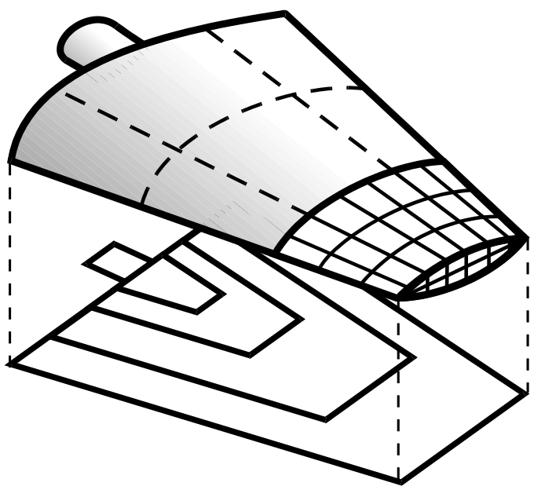
AP209: Composite & Metallic
Structural Analysis & Related Design
Analysis Discipline Product Definitions
Finite Element Analysis
  Model (Nodes, Elements, Properties,...)
  Controls (Loads, Boundary Constraints,...)
  Results (Displacements, Stresses,...)
Analysis Report
Information Shared Between Analysis & Design
3D Shape Representations
Composite Constituents
Material Specifications & Properties
Part Definitions
Composite Constituents
Ply Boundaries, Surfaces
Laminate Stacking Tables
Reinforcement Orientation
Design Discipline Product Definition
Shape Representations
Assemblies
Configuration Control, Approvals
Part, product definitions
Finite element analysis model, controls, and results
Material Specifications & Properties
Composites
Homogeneous (metallics)
3D Shape Representation
AP202/203 Commonality Plus Composite Specific 3D Shapes
  Advanced B-Representation
  Faceted B-Representation
  Manifold Surfaces With Topology
  Wireframe & Surface without Topology
  Wireframe Geometry with Topology
  Composite Constituent Shape Representation

Slide 5
Scenario for Design and Analysis Integration in a PDM Context
Theorem
CATIA AP209
Translator
CATIA
AP209
Others
CATIA
AP209
CATIA DB
Data and
PDM Access
Services
XML Product
Structure
AP209
Product
Data
Manager
(Merge/Split)
PDM
API Link
AP209 Shape
AP209
AP209 FEM
PATRAN
CATIA
AP209
XYZ123-101,A
AP209
Translator
PATRAN
PATRAN
PATRAN
Files in
PDM
Vault
AP209
PATRAN DB
CATIA

Slide 6
Standard PDM Design Information Management
Next Higher Assembly / Version
Indentured list of assemblies and components
Configuration and revision management
Associated data management
  Design shape model(s)
  Other related design information
Part / Version
Part / Version
Design Documents
Nominal Design Shape File

Slide 7
Critical AP209-Based PDM Concepts
Allow Analysis to Revise Independently of Related Design
Next Higher Assembly / Version
Separate, Versioned Analysis
Part / Version
Analysis Design Version Relationship
Part / Version
Analysis / Version
Design Documents
Three Classes of Shape
Analysis Documents
Nominal Design Shape File
Idealized Analysis Shape File
Analysis Shape (FEM) and Report File(s)
Same as AP203/214 Geometry

Slide 8
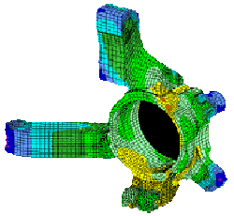
PDES, Inc. Engineering Analysis Team
Objectives
Accelerate the deployment of STEP support for EA applications in member companies
Validate AP209 capabilities in an industry setting
  Extensive multi-company exchanges have been completed
Demonstrate the extended coverage of enterprise PDM exchanges that AP209 provides
Establish a pilot framework for extending STEP capabilities in EA leading to the CAx-IF testing forum
  Initial CAx-IF testing underway

Slide 9
PDES, Inc. Engineering Analysis Team
Participants
Users
  Boeing
  GD/Electric Boat
  Lockheed Martin
  EADS/Airbus
  NAFEMS
Vendors/Developers
  MSC.Software
  Theorem Solutions
  NIST
Supporters
  NASA
  NIST

Slide 10
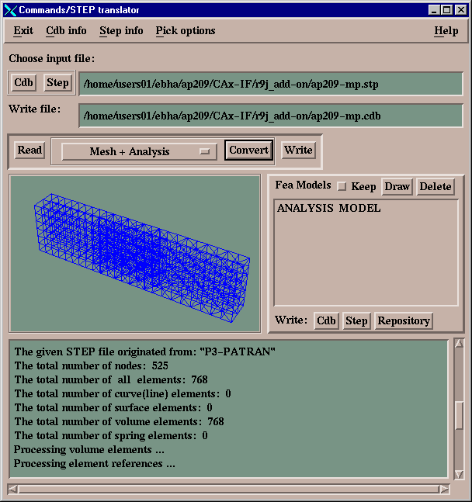
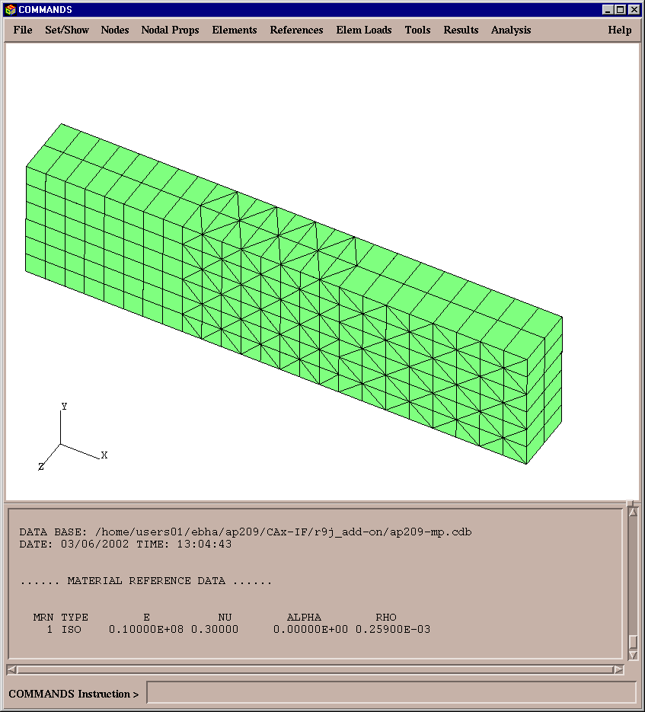
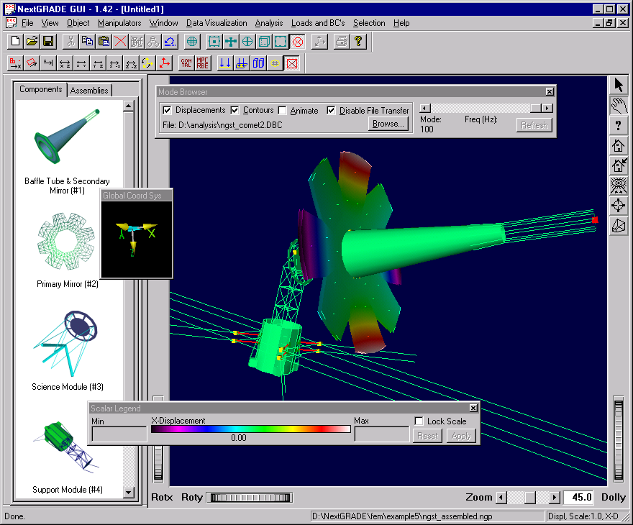
Extensive Multi-Company Exchanges have been Completed
PAS-C, TACOM, and PDES, Inc demos 1995 - 2000
12 Abstract Test Suite (ATS) files that cover minimum capabilities
Big production files at GD/EB and LM Aero
CATIA V4 test files
ARA/NASA AP209-based NextGRADE large multi-model management system

Slide 11
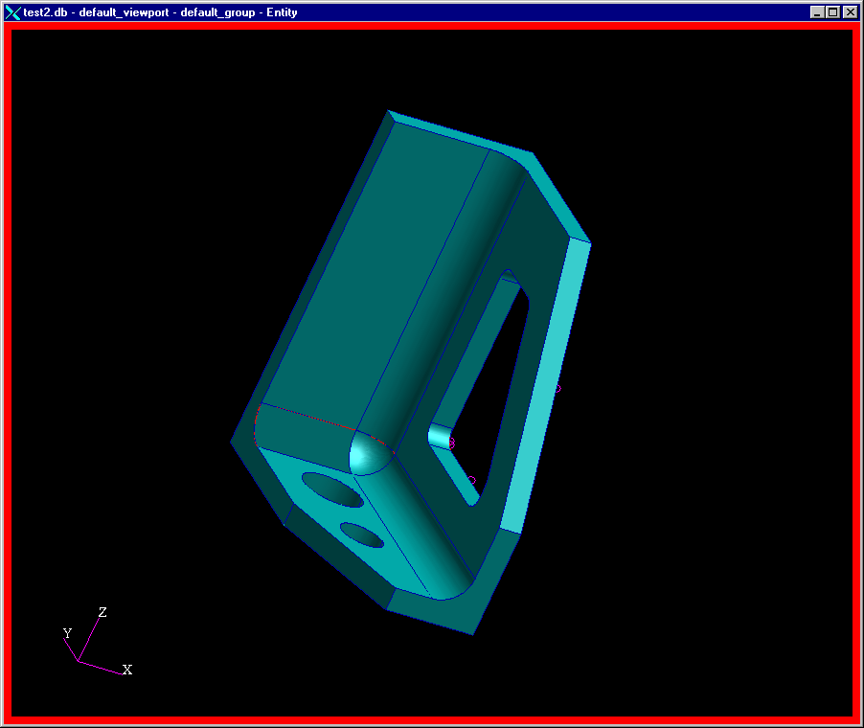
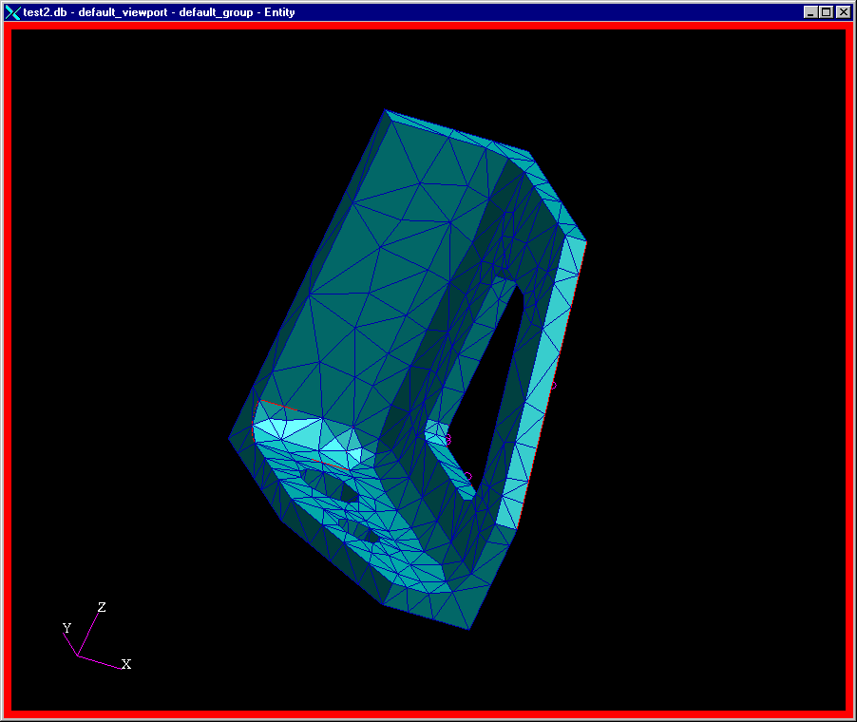
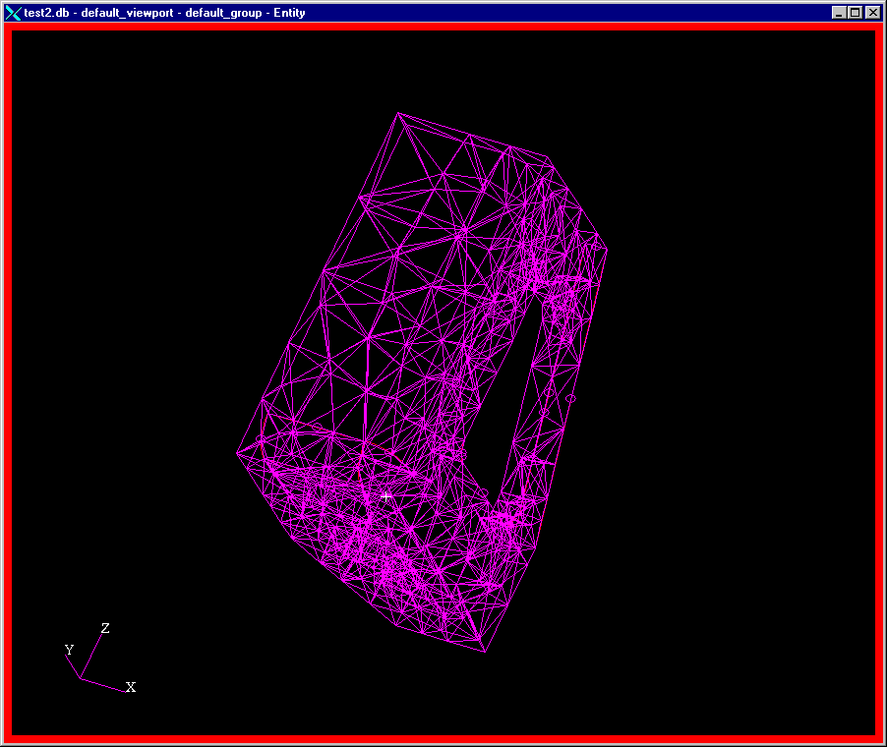
CAx-IF (PDES. Inc./Pro-STEP Testing Forum)
AP209 Initial Test File has been Submitted
CATIA V4 AP209 File ap209-td.stp as Imported into MSC.PATRAN
Six Vendors have signed up to Post-Process the ap209-td.stp file in CAx-IF Round 9J

Slide 12
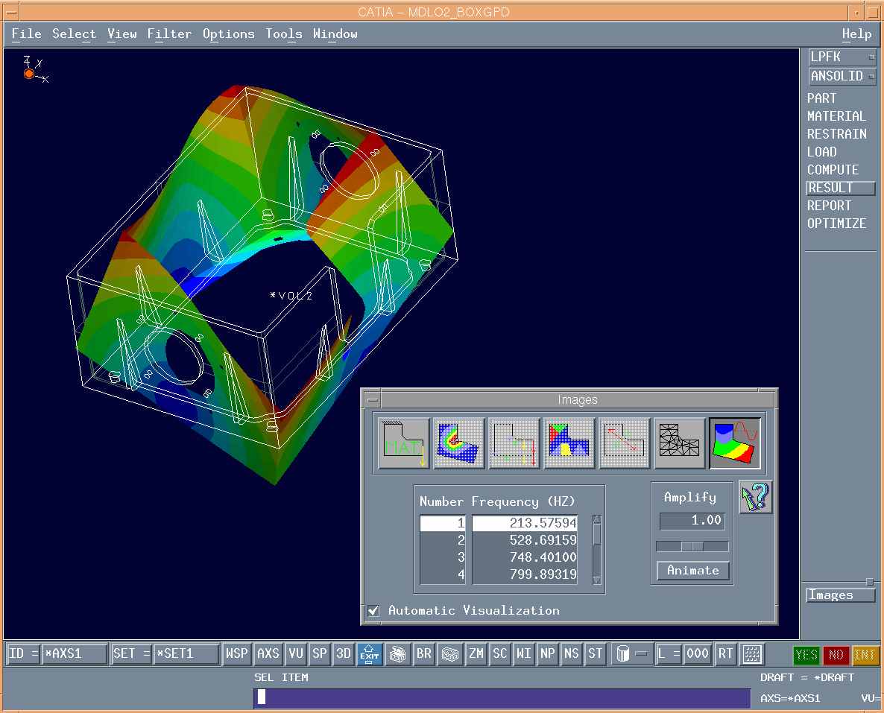
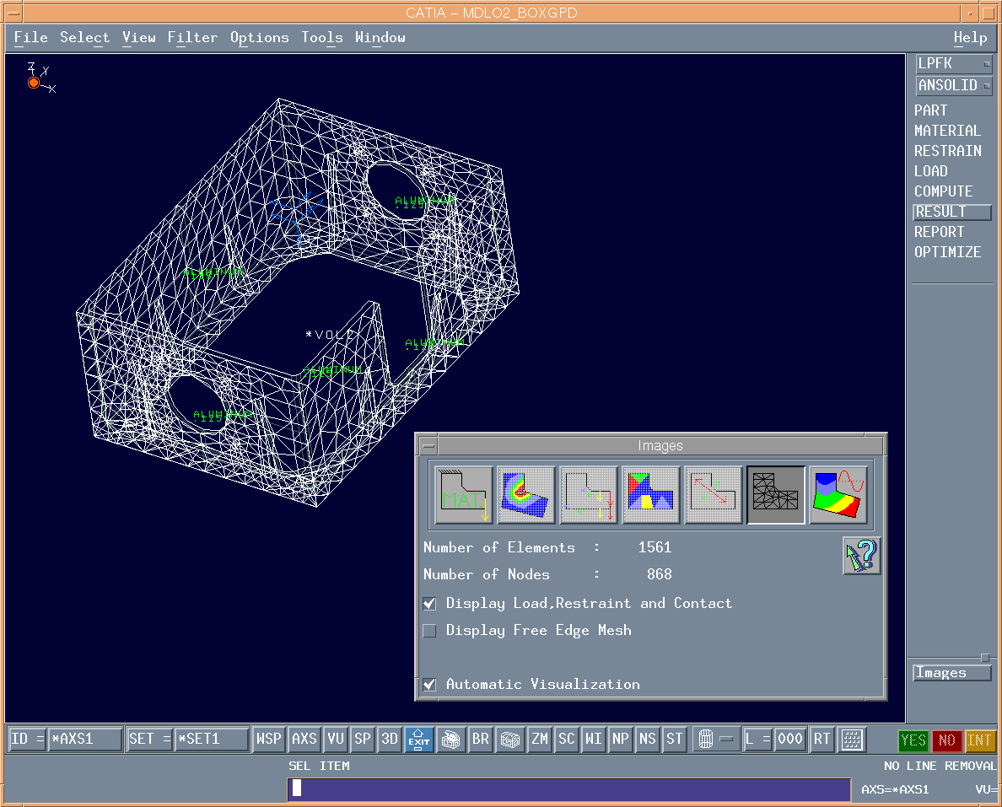
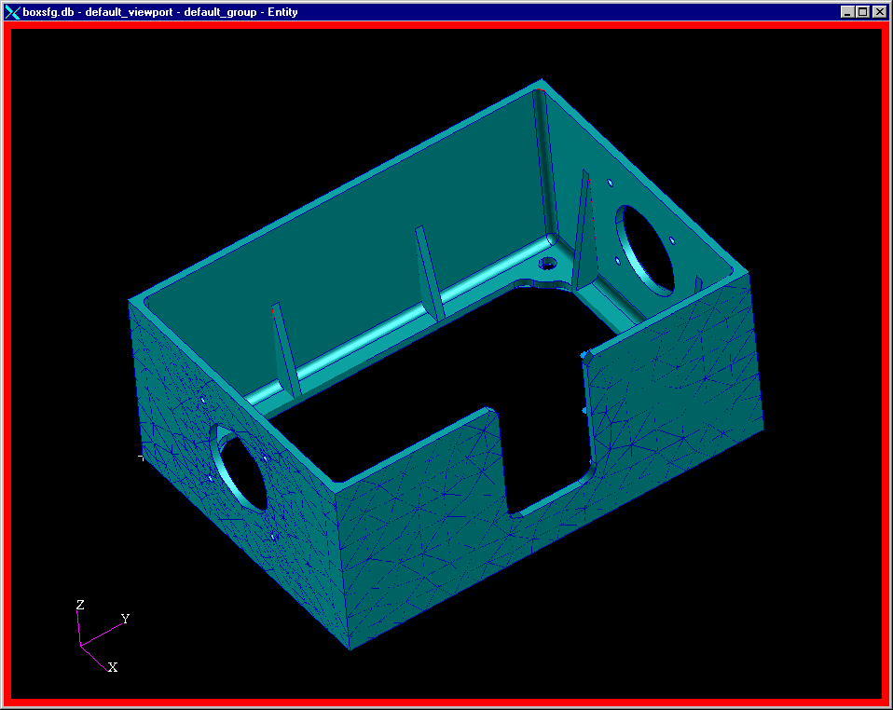
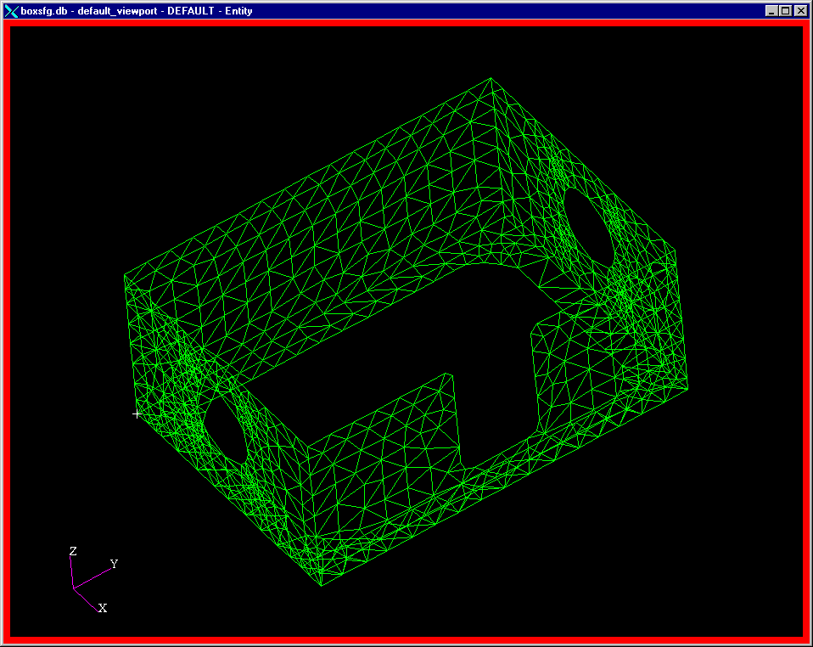
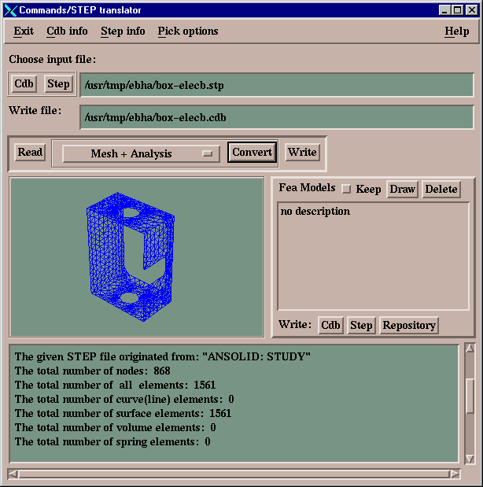
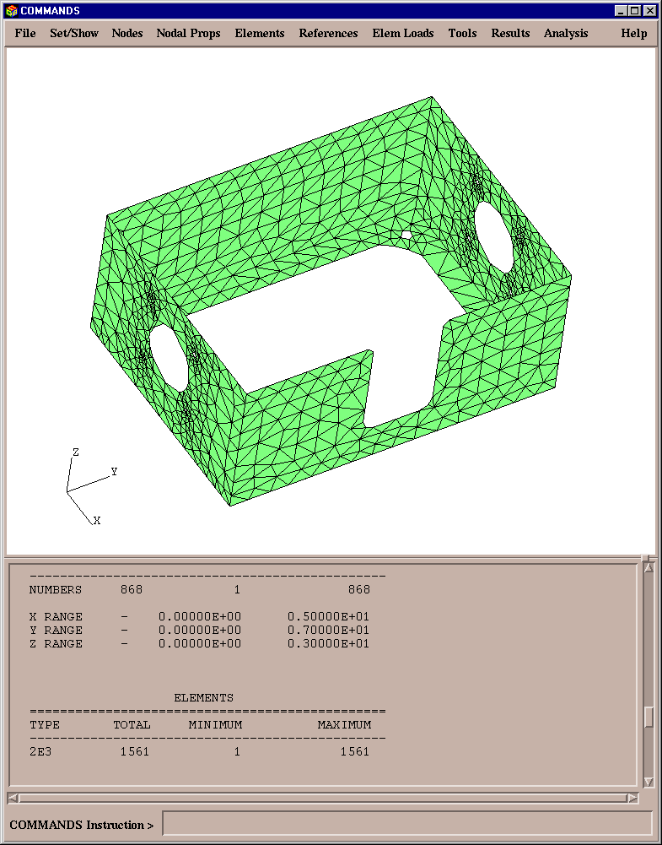
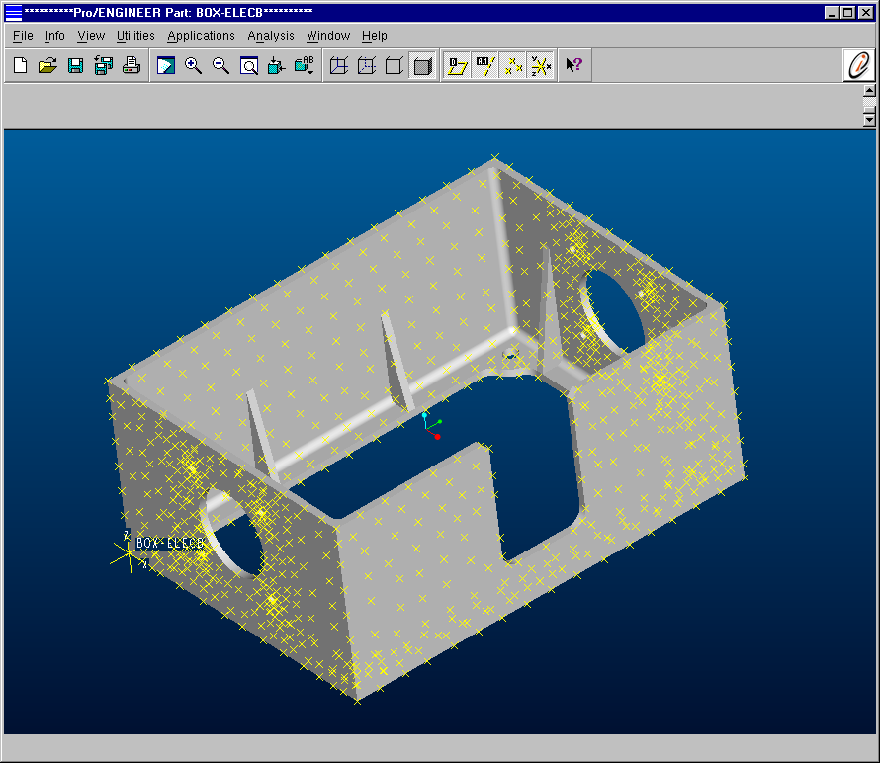
AP209 Testing Example
MSC / PATRAN
CATIA V4
Theorem /
CADverter
AP209
STEP File
CAx-IF Testing
Spring ‘02 PDES Offsite, Asheville, NC
Pro/E
EB / COMMANDS

Slide 13
Frequency &Mode Shape Analysis in CATIA using GPD
Outer surfaces used for thin-walled shell model
Original Box Model (Solid Brep) in CATIA V4

Slide 14
AP209 File Imported into GD/EB’s COMMANDS

Slide 15
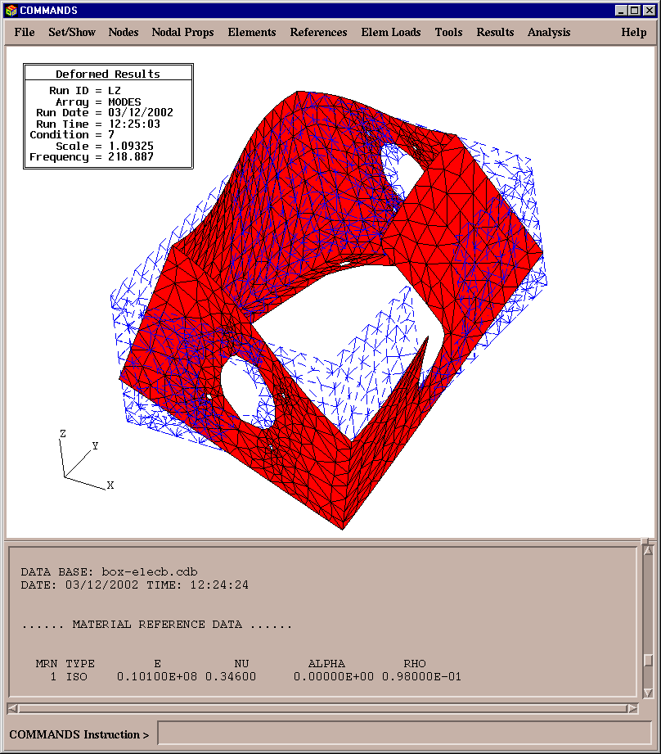
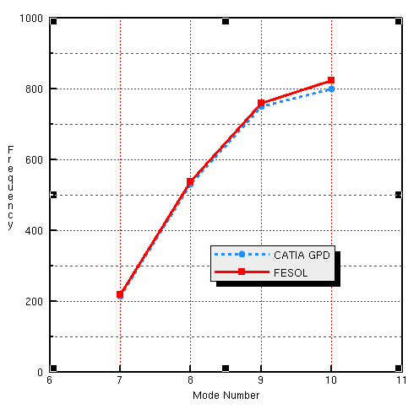
Re-Analysis of Model in GD/EB’s
COMMANDS/FESOL Matches Well
AP209 File Imported into EB’s COMMANDS and Create Data Base [30 Seconds]
Execute FESOL (Lanczos Eigenvalue Extraction) from within COMMANDS [2 minutes and 30 seconds]
No changes to model
as imported.

Slide 16
Same AP209 File Imported into MSC.PATRAN

Slide 17
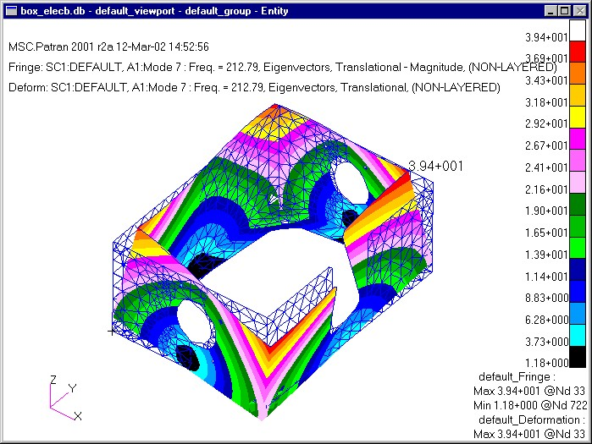
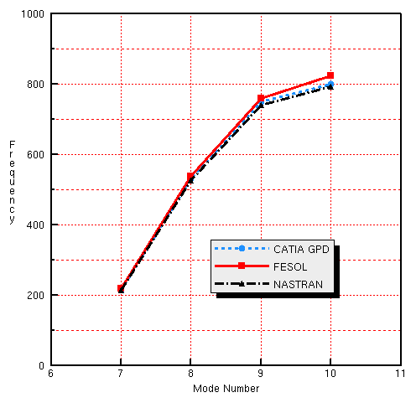
Re-Analysis of Model in MSC.NASTRAN
Matches CATIA and FESOL Well
Conclusion: Comparisons show a geometrically complex model can be shared in an AP209 Standardized manner and still match analyses extremely well

Slide 18
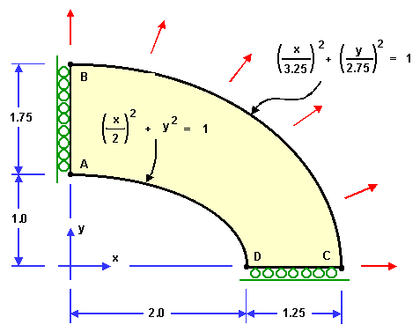
NAFEMS Test Problem Documentation
Piloted in AP209 Format
Many NAFEMS Linear Static and Dynamic Test Problems piloted in AP209 format
  Test Problems are used to document
  known solutions
  AP209 files include:
    Geometry
    FEM
    Exact solution
    FEM solution(s)
NAFEMS Benchmark Article – Oct. 2001 by David Leal
  Open systems for Engineering Analysis - made possible by a standard

Slide 19
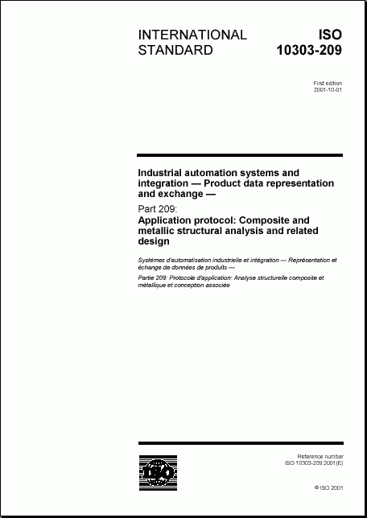
ISO 10303-209:2001 is now the International Standard for CAD/CAE/PDM Integration
ISO 10303-209 (AP209) was published as an International Standard October 2001
Extensive testing has proved functionality and capability
Two commercial ISO 10303-209 implementations are nearing Production status
  MSC.PATRAN translator is now commercially available
  Theorem Solutions’ CATIA V4 translator is nearing completion
  Several internal implementations now in place

