Slide 1
Wheatstone Bridge Testcase
July 8-10, 2003
Cedar Rapids, IA

Slide 2
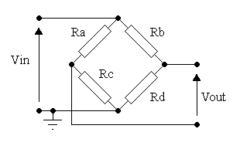
Classic Wheatstone Bridge
Notes:
label this as typical(?) view to point out the difference in ambiguity between this representation and AP 210 capabilities.
I would leave this slide back here to avoid the diatribe about the levels of abstraction.

Slide 3
Sub Topic One
First we talk about the Externals of the Wheatstone Bridge

Slide 4
Wheatstone Bridge
Functional Unit Usage View
WB
X1
X4
X2
X3
Notes:
The ee_function of the Wheatstone Bridge is WB

Slide 5
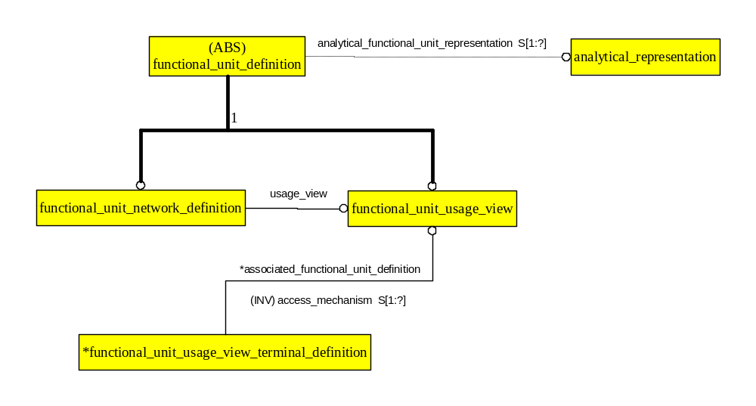
ARM Functional Unit Usage View

Slide 6
ARM Functional Unit Usage View Instances
#110 Ee_product_version
versioned_item
#111 Ee_product
version
product_nomenclature
WB
#2 Functional_unit_usage_view
associated_functional_unit_definition
associated_functional_unit_definition
#3 Functional_unit_usage_view
_terminal_definition
#4 Functional_unit_usage_view
_terminal_definition
signal_name
signal_name
X1
X2

Slide 7
Functional Specification
Environmental Conditions,
Battery Voltage…
Wheatstone
Bridge
?
+
-
Notes:
This introduces the key concept of Functional Specification
Functional Specification is similar to the Simulation paradigm of “test bench”.

Slide 8
Functional Specification
Test Bench Composition
  Function being analyzed
  Stimulus Blocks
  Measurement Blocks
  Signals present in Experiment
Test Requirement Occurrence
  Accuracy vs. Battery Voltage
Test Requirement Allocation

Slide 9
ARM Functional Specification Diagram
(ABS)
*functional_unit_definition
1
definition
functional_unit_usage_view
usage_view
*associated_functional_unit_definition
*composed_network
functional_unit_network_definition
(INV) access_mechanism S[1:?]
functional_unit
functional_unit_usage_view_terminal_definition
Functional_specification_definition
definition
characterizing_functional_unit
characterization_network
measurement_access_mechanism
*functional_unit_terminal
reference_access_mechanism
signal_specification
minimum_characteristic
maximum_characteristic
signal_property
characterizing_functional_unit
reference_signal
measurement_condition
test_specification
characterizing_signal
associated_definition
characteristic_category
external_definition
*functional_specification
Notes:
Specifies the function by characterizing the functional_unit, by referencing signals. This forms part of the functional specification.
Also note that Functional_specification is only for single input single output at present.
Mapping would not change to allow multiple input, multiple output semantics.
We added functional_specification_definition as a Ee_product_definition subtype for the test bench.

Slide 10
ARM Functional Specification Diagram (Test Bench Network)
definition
(ABS)
functional_unit_definition
1
usage_view
functional_unit_usage_view
functional_unit_network_definition
*associated_functional_unit_definition
*composed_network
(INV) access_mechanism S[1:?]
functional_unit
*associated_functional_unit_definition
functional_unit_usage_view_terminal_definition
accessed_functional_unit
functional_unit_network_node_definition
*connected_terminal
(INV) access_mechanisms S[1:?]
(INV) node_assignment S[0:1]
definition
functional_unit_terminal
*composed_node
*composed_node
*connected_terminal
(INV) external_node_access S[0:1]
(INV) node_assignment S[0:1]
functional_unit_terminal_node_assignment
functional_unit_network_terminal_definition_node_assignment

Slide 11
Wheatstone Bridge Functional Specification Test Bench Schematic
Functional_unit_terminal
Functional_unit
Functional
_unit
(Circuit Under Test
WB1)
WB1
X1
+
X4
X2
1
-
Functional_unit
X3
(Null
Indicator
VM1)
(R_unknown)
2
+
-
(Indicates
Node in the test bench
“Tbn-1” through “Tbn-4”)
Functional_unit
(Battery B1)
Notes:
This is the test bench for the Wheatstone Bridge, not for the unknown resistor

Slide 12
ARM Functional_specification
Test Bench Network Instances
“wheatstone bridge testbench”
product_nomenclature
#102 Ee_product
versioned_item
#101 Ee_product_version
version
version
usage_view
Tbn1
#1 Functional_unit
_network_definition
#2 Functional_unit
_usage_view
functional_unit_network
_node_name
composed_network
associated_functional
_unit_definition
definition
#12 Functional_unit
_usage_view
#7 Functional_unit_network
_node_definition
#11 Functional_unit
accessed_functional_unit
associated
_functional
_unit_definition
#25 Functional_unit_terminal
definition
connected_terminal
#3 Functional_unit
_usage_view
_terminal_definition
composed_node
#36 Functional_unit
_terminal_node_assignment
Notes:
Add ee_function to the new slide.
For a test bench, the Functional_unit_usage_view_terminal_definition may sometimes be ignored as we will often consider the test bench a “closed system”.
For this case, any reasonable name can be used for the Fuuvtd.

Slide 13
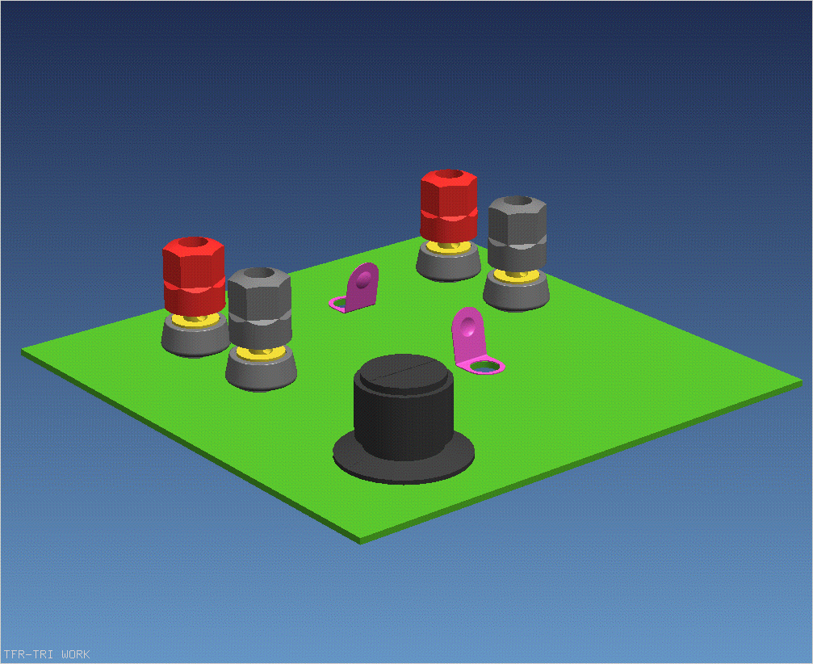
Physical Specification
Notes:
Note that for the purposes of the training, we are ignoring the mechanical input/visual output of the knob rotation and the visual readout on the knob dial.
Our perogative since we are focusing on connectivity, not industrial design.
The industrial designers obviously haven’t seen this mockup.

Slide 14
Sub Topic Two
Now we move to the Design of the Wheatstone Bridge

Slide 15
Wheatstone Bridge Schematic
X1
Functional_unit_network_definition
N1
Functional_unit
R1
R2
Functional_unit_terminal
N2
X2
Functional_usage_view_terminal_definition
X4
N4
Functional_unit_network_terminal
_definition_node_assignment
R3
N3
Functional_unit_network_node_definition
X3

Slide 16
ARM Functional_unit_network_definition Instances
product_nomenclature
versioned_item
WB
#110 Ee_product
#111 Ee_product_version
version
#200 Functional_unit
_network_definition
usage_view
#2 Functional_unit
_usage_view
N1
functional_unit_network
_node_name
composed_network
associated_functional
_unit_definition
definition
#213 Functional_unit_network
_node_definition
#210 Functional_unit
accessed_functional_unit
associated
_functional
_unit_definition
#211 Functional_unit_terminal
definition
#3 Functional_unit
_usage_view
_terminal_definition
Signal_name
connected_terminal
composed_node
#212 Functional_unit
_terminal_node_assignment
composed_node
connected_terminal
X1
#214 Functional_unit_network
_terminal_definition_node_assignment

Slide 17
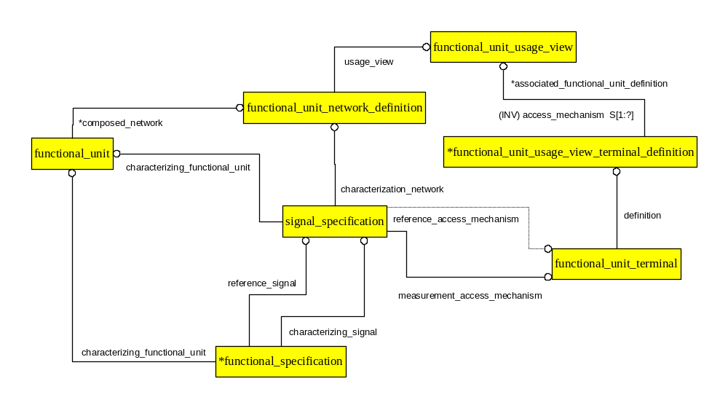
ARM Functional_specification Signal Requirement Instances

