Slide 1
Ajax Architecture - Goals
Attempt to Reduce bandwidth 40%-60%
Full Ajax – No browser requests
SEO Support
Minimal development effort/costs
Back/Front button support
Deep linking
Low learning curve
Downgradable
Multiple update types (Windows, Table Rows, etc.)
Unobtrusive JavaScript
HTML5 Compliant
Web Server Agnostic

Slide 2
On-Demand Partial Updates Unobtrusive JavaScript w/ HTML Metadata
<div id="login" data-update=“window" data-title="Login">
<form method="post" action="/User/Login">
<label>Username or Email</label>
<input id="Identity" type="text" name="Identity" />
<label>Password</label>
<input id="Password" type="password" name="Password" />
<input type="submit" value="Login" />
<input type="button" data-close="window" value="Cancel" />
</form>
</div>
data-my-value=“123” → data.myValue == 123

Slide 3
Implementing in ASP.NET MVC
Initialize Plugin
Adaptively Render Views
Wrap Views with Updates

Slide 4
Step 1 – Initialize Plugin (One time in _Layout.cshtml, Init.js)
<script type="text/javascript" src="/_Libs/jQuery.Updater.js")"></script>
<script type="text/javascript">
$(function () {
$.updater.init({
autoEvents: true,
autoCorrectLinks: true,
contentId: "main-body",
progressId: "progress",
progressText: "One Moment...",
progressCss: "progress",
pageTitlePrefix: "",
placeholder: ".placeholder",
onRequest: function (url, sender, formData) { },
onSuccess: function (result) { },
onBeforeUpdate: function (update, meta) { },
onAfterUpdate: function (update, meta) { },
onComplete: function (navKey) { },
onError: function (result) { }
});
});
</script>

Slide 5
Step 2 – Adaptive Rendering (One time in _ViewStart.cshtml)
@if (!IsAjax)
{
Layout = "~/Views/Shared/_ThreeColumnLayout.cshtml";
}

Slide 6
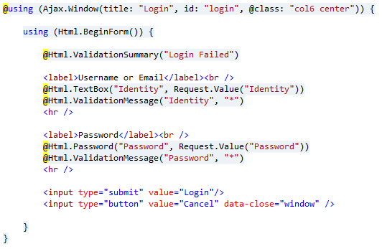
Step 3 – Wrap Views with Updates

Slide 7
Gotcha – No Redirects (not necessarily a disadvantage)
return Redirect("/Home/Index");
return RedirectToAction("Index", "Home");
Response.Redirect("/Home/Index");
Must Use Transfers
return new TransferResult("/Home/Index");
return new TransferResult("Index", "Home");
Server.Transfer("/Home/Index");

Slide 8
Downsides
Requires some rework/refactoring
Must integrate with existing scripts
Might need to remove some scripts
Doesn’t work with WebForms
Not as efficient as pure JSON-based Ajax

Slide 9
Future Development – JSON / Templating
Full Page – Non-Ajax Requests / Search Engines
<!DOCTYPE html>
<html>
<head>
<title>My HTML Page</title>
<link href="/Icon.ico" rel="shortcut icon" type="image/x-icon">
<link rel="stylesheet" type="text/css" href=“…"/>
<script type="text/javascript" src=“…"></script>
</head>
<body>
<div id=“header“>[Header]</div>
<div id=“content“>[Content]</div>
<div id=“footer“>[Footer]</div>
</body>
</html>
return AdaptiveResult("Index", "Home“, model);
AdaptiveResult
Partial HTML (Template) – First request to view
<div id=“content“ data-update=“content” >[Content]</div>
JSON – All subsequent requests to view
{“content”:”[Content]”}

Slide 10
HTML Minification Reduce bandwidth 10-30%
Add to config: <host factoryType=“MinifyHtmlWebRazorHostFactory" />
<!--Some Html comments-->
<div id="login" data-update="window" data-title="Login">
<form method="post" action="/User/Login">
<label>Username or Email</label>
<input id="Identity" type="text" name="Identity" />
<label>Password</label>
<input id="Password" type="password" name="Password" />
<input type="submit" value="Login" />
<input type="button" data-close="window" value="Cancel" />
</form>
</div>
Before: 515b
<div id="login" data-update="window" data-title="Login“><form method="post" action="/User/Login“><label>Username or Email</label> <input id="Identity" type="text" name="Identity”/> <label>Password</label> <input id="Password" type="password" name="Password" /> <input type="submit" value="Login”/> <input type="button" data-close="window" value="Cancel”/></form></div>
After: 370b
38% Reduction

