Slide 1
Step 5. Infrastructure as a Code

Slide 2
Agenda
Terraform
Ansible

Slide 3
Terraform

Slide 4
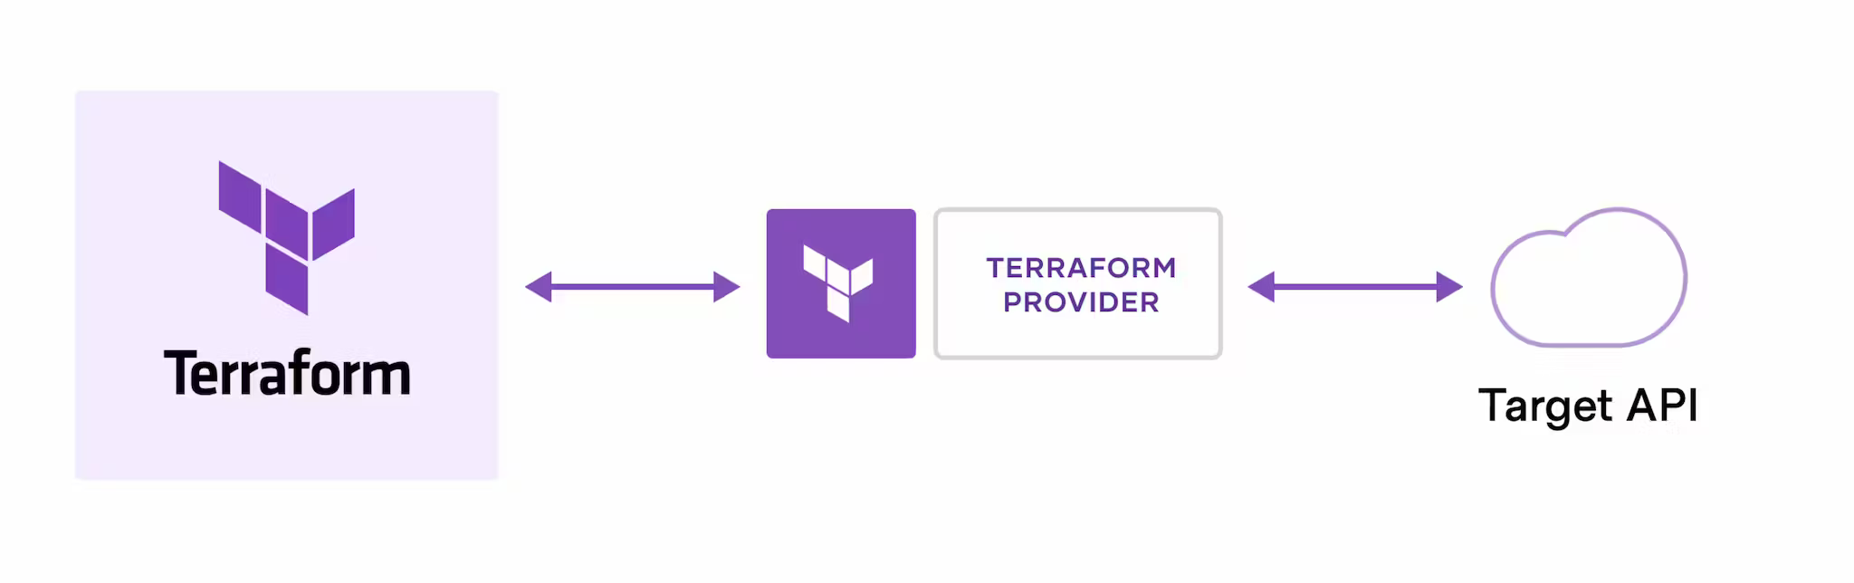
How does Terraform work?

Slide 5
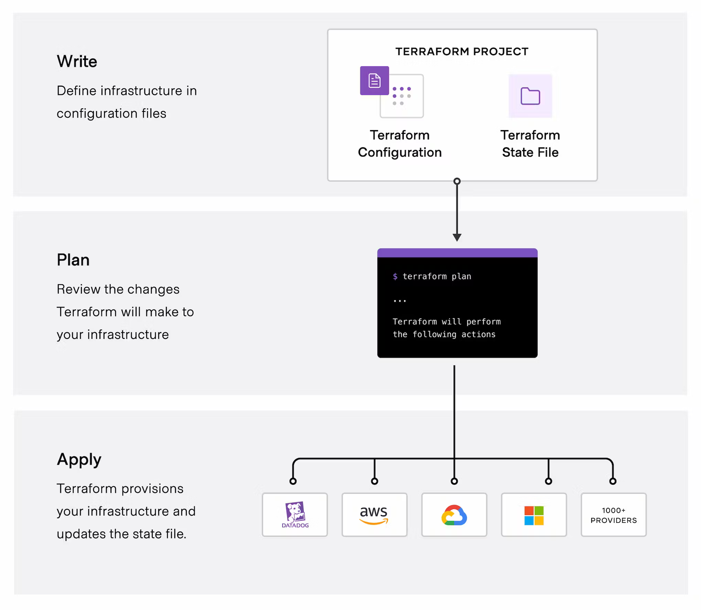
Terraform workflow

Slide 6
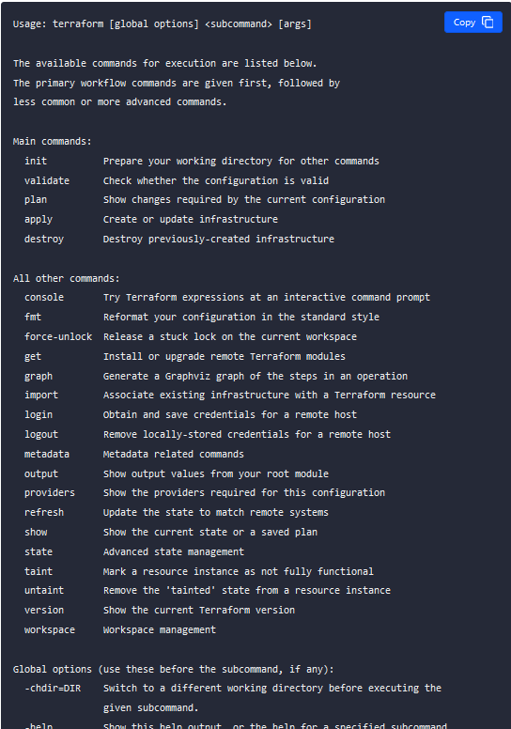
Terraform - Basic CLI Features

Slide 7
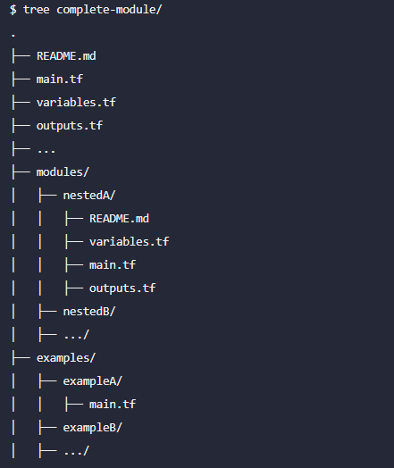
Terraform - Initializing Working Directories

Slide 8
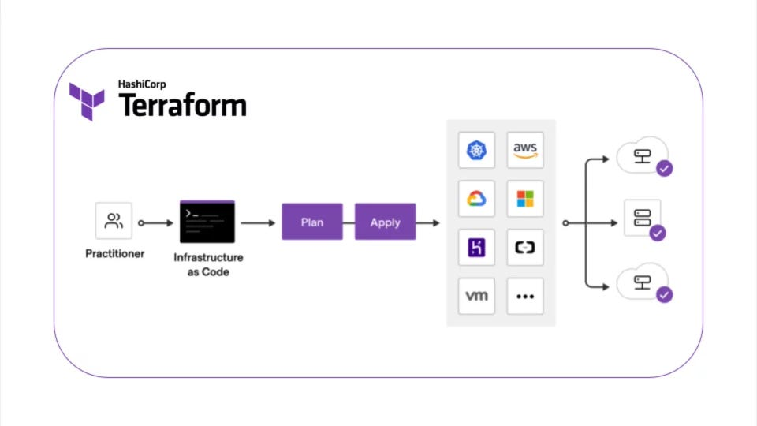
Provisioning Infrastructure with Terraform

Slide 9
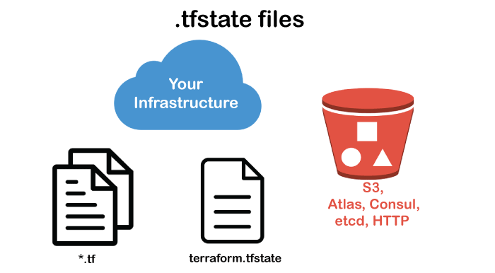
Manipulating Terraform State

Slide 10
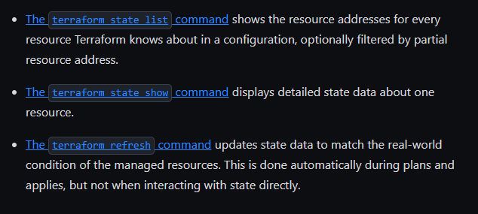
Terraform - Inspecting Infrastructure

Slide 11
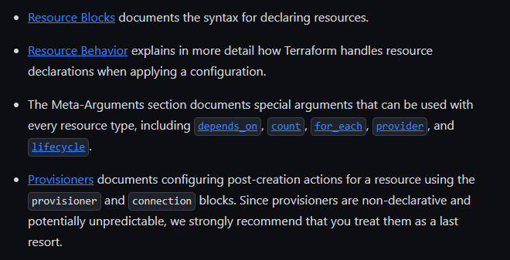
Terraform – Elements: Resources

Slide 12
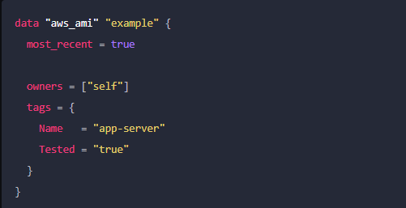
Terraform – Elements: Data Sources

Slide 13
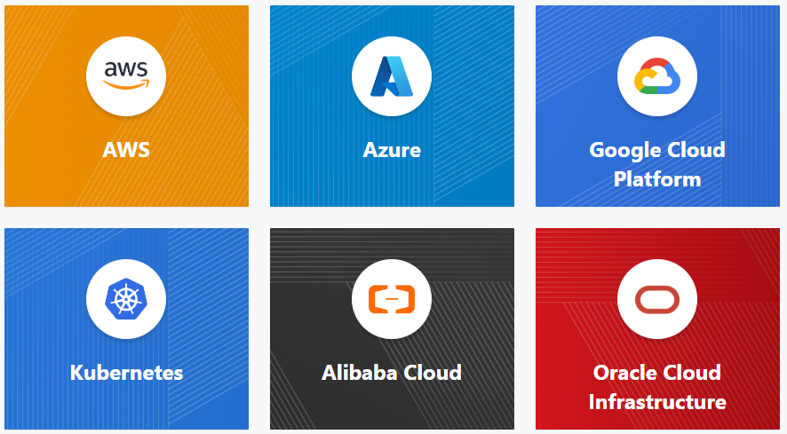
Terraform – Elements: Providers

Slide 14
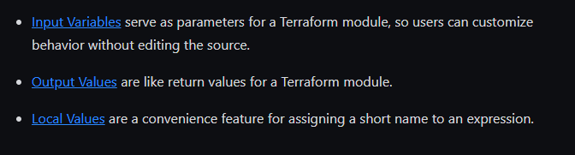
Terraform – Elements: Variables and Outputs

Slide 15
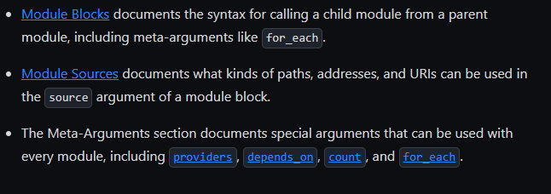
Terraform – Modules

Slide 16
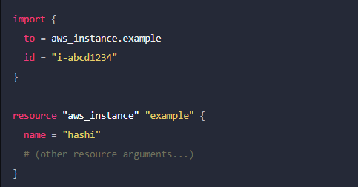
Terraform – Import

Slide 17
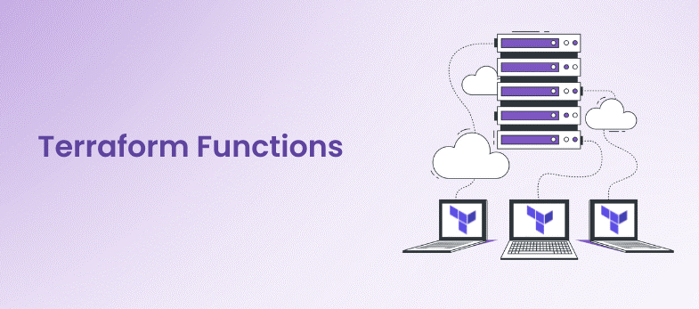
Terraform – Expressions/Functions

Slide 18
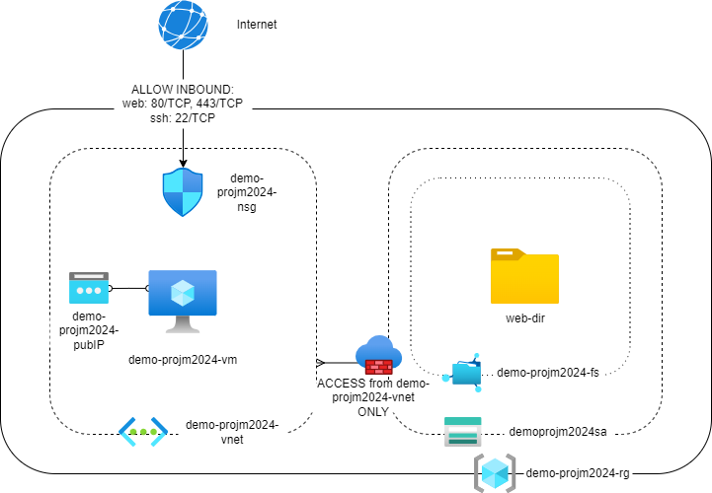
Terraform – Demo

Slide 19
Ansible

Slide 20
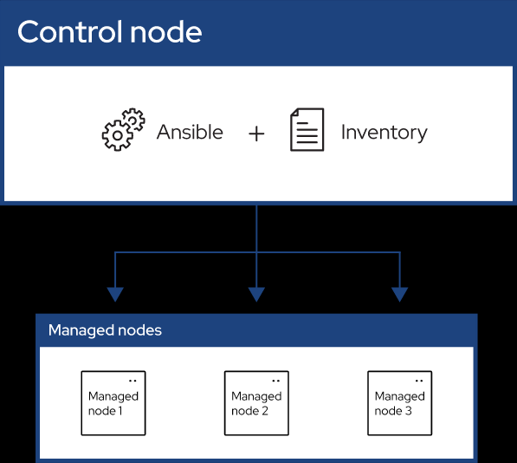
What Is Ansible?

Slide 21
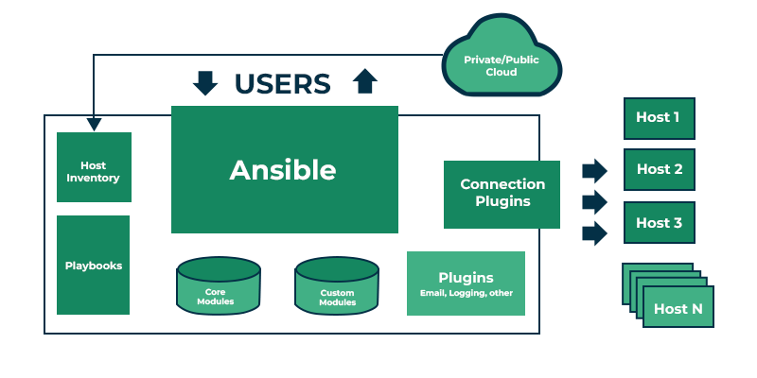
Ansible Architecture

Slide 22
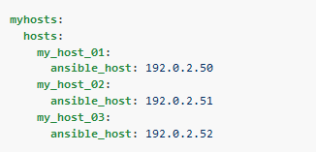
Ansible - Building an inventory

Slide 23
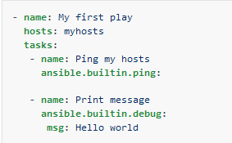
Ansible - Creating a playbook

Slide 24

Ansible Roles

Slide 25

Ansible - Demo

