Slide 1
Step 7. Containerization

Slide 2
Agenda
Containers
Docker

Slide 3
Containerization

Slide 4
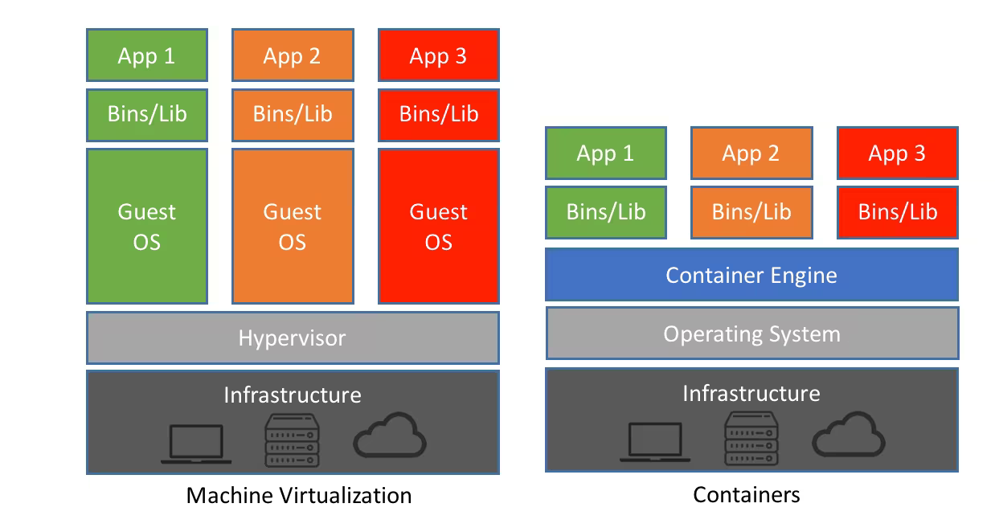
Virtualization vs. Containerization

Slide 5
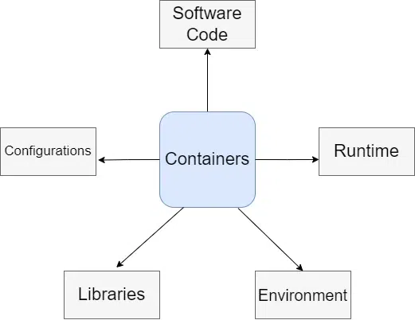
What is a Container?

Slide 6
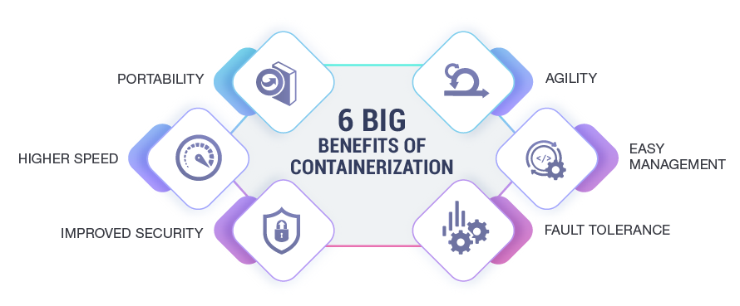
Benefits of using containers

Slide 7
Docker

Slide 8
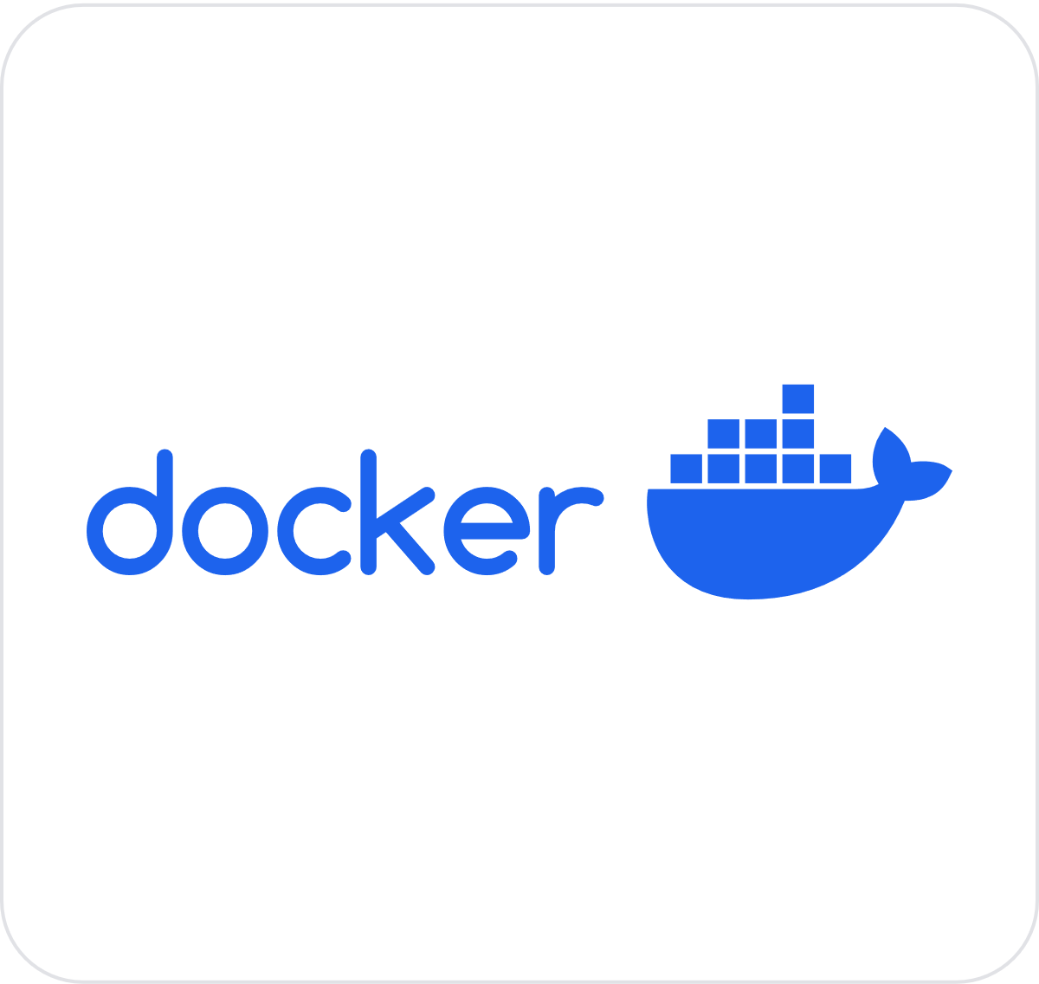
What is Docker?

Slide 9
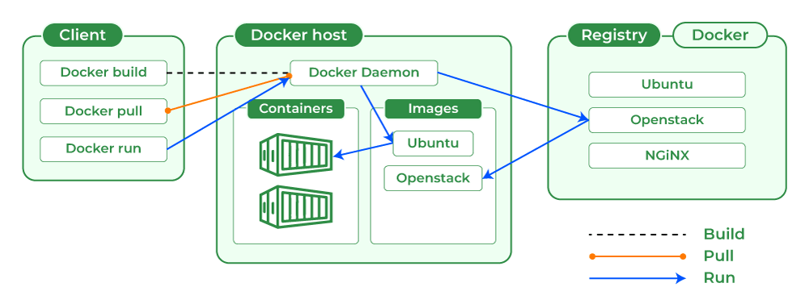
How Docker Works

Slide 10
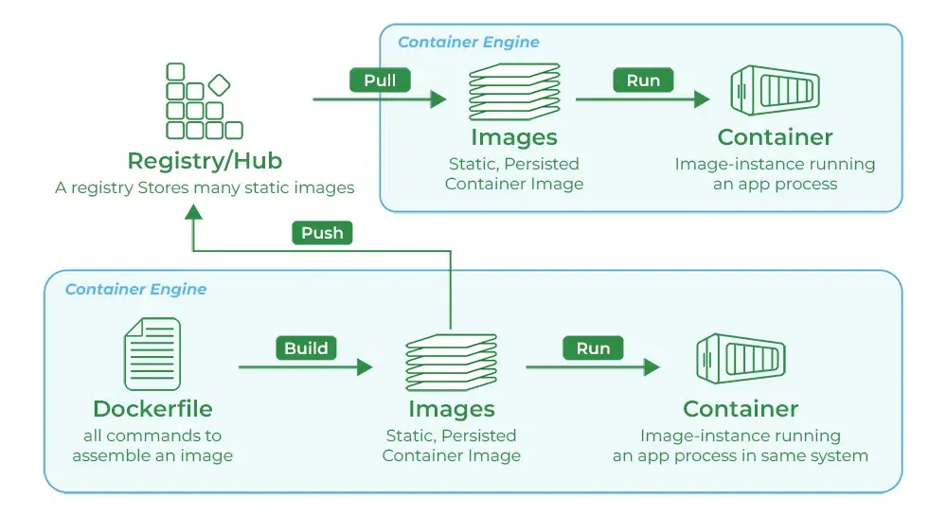
What is Docker Registry?

Slide 11
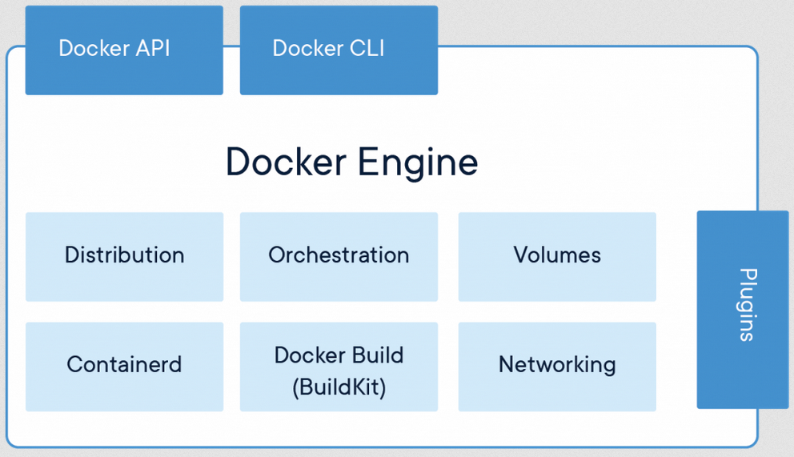
Docker Engine

Slide 12
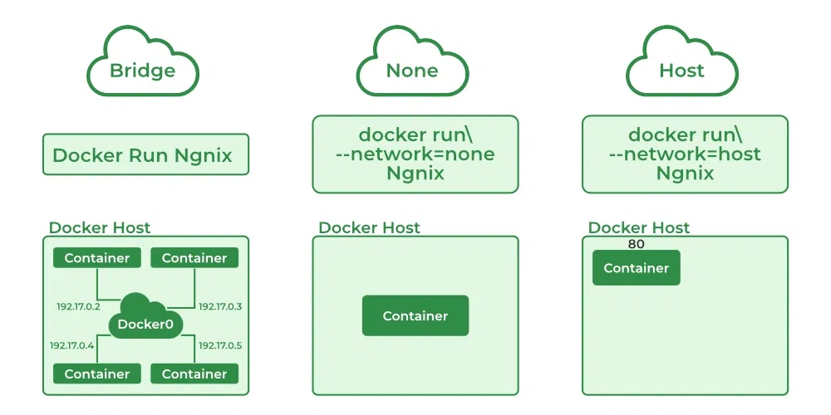
Docker Networking

Slide 13

Docker Networking – Port Expose

Slide 14
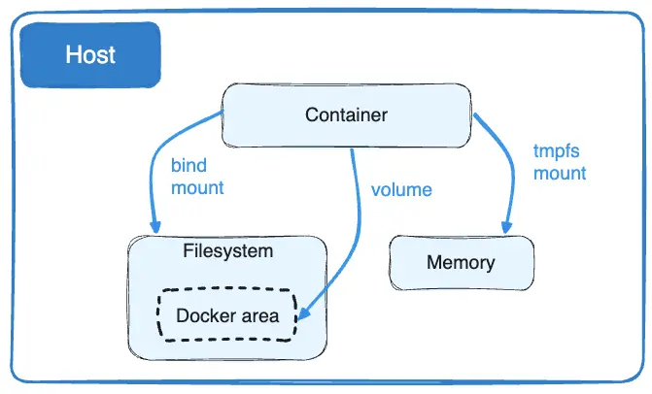
Data Storage in Docker

Slide 15
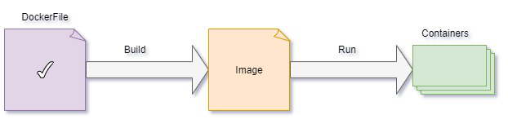
What is Docker Image?

Slide 16
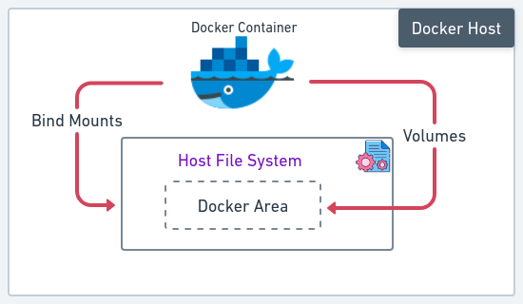
What is Docker Container?

Slide 17
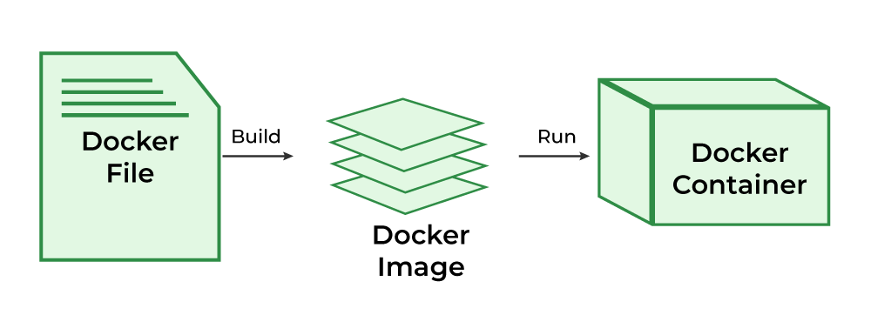
What is Dockerfile?

Slide 18
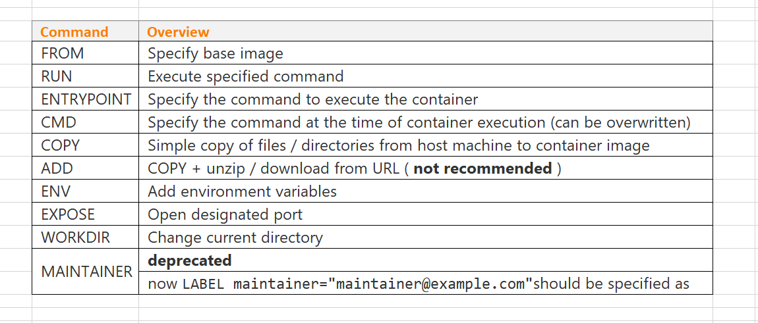
Dockerfile Syntax

Slide 19
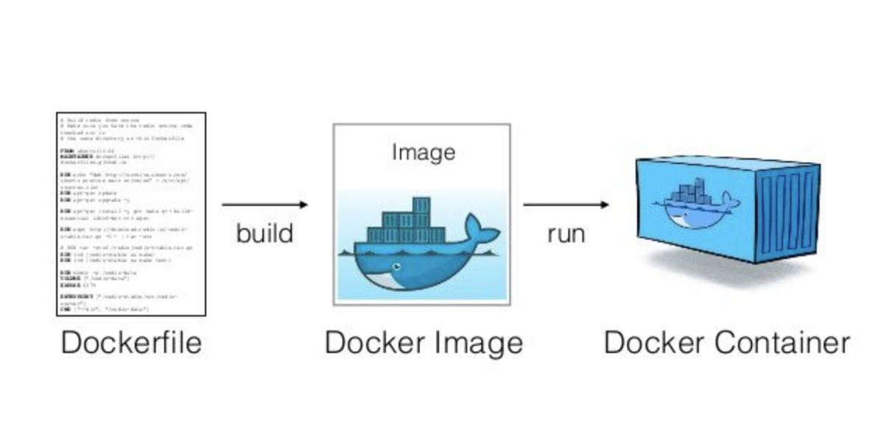
Dockerignore

Slide 20
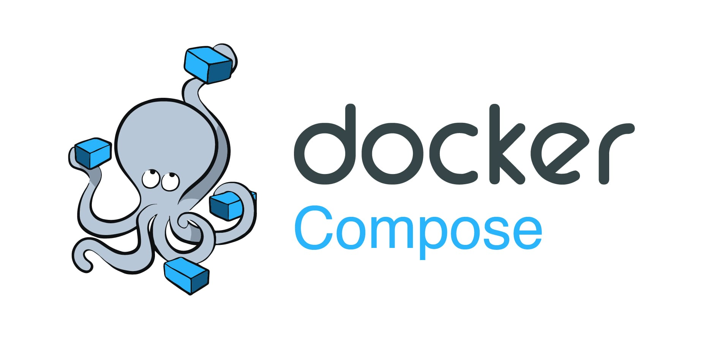
Docker Compose

Slide 21
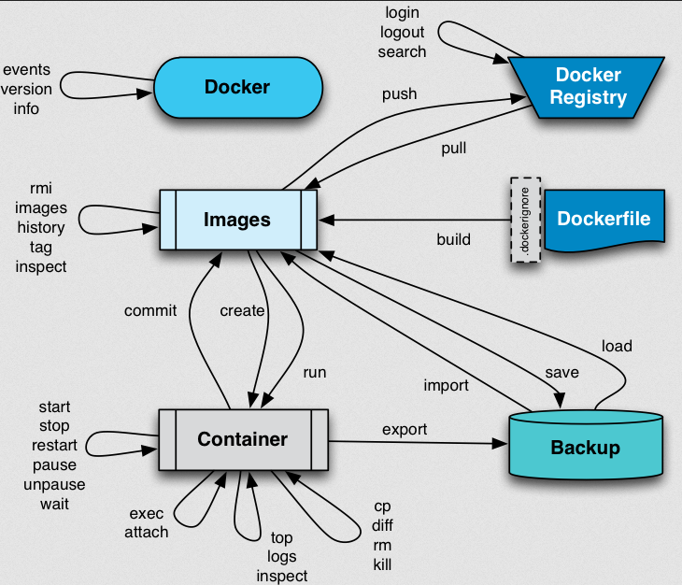
Docker Compose

Slide 22
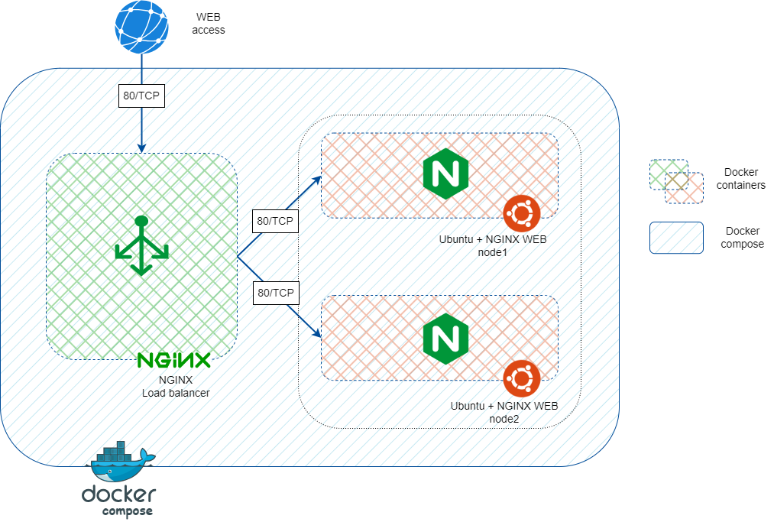
Docker Demo

