Slide 1
Step 3. Deployment Automatization

Slide 2
Agenda
GitHub DevOps
Azure DevOps

Slide 3
GitHub DevOps

Slide 4
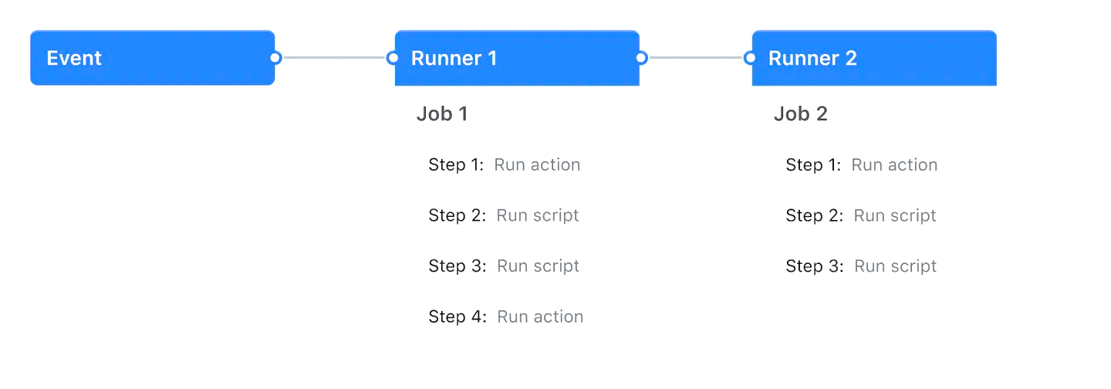
GitHub Actions

Slide 5

GitHub Actions (workflows)

Slide 6
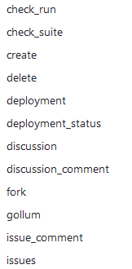
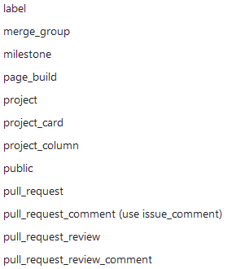
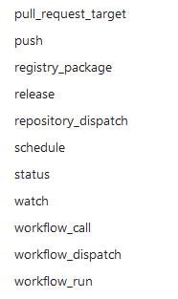
GitHub Actions (events)

Slide 7
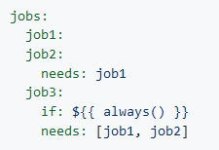
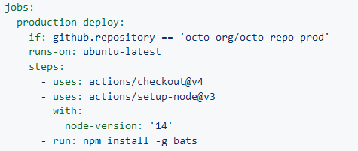
GitHub Actions (jobs)

Slide 8

GitHub Actions (actions)

Slide 9

GitHub Actions (runners)

Slide 10
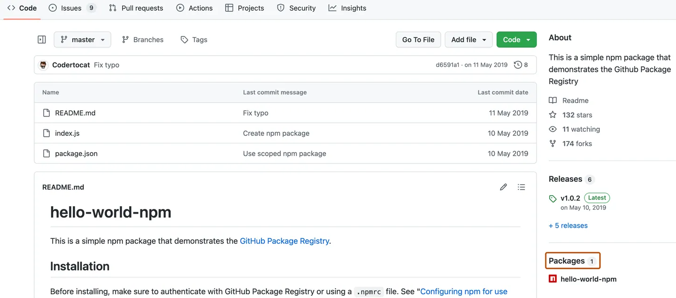
GitHub Packages

Slide 11
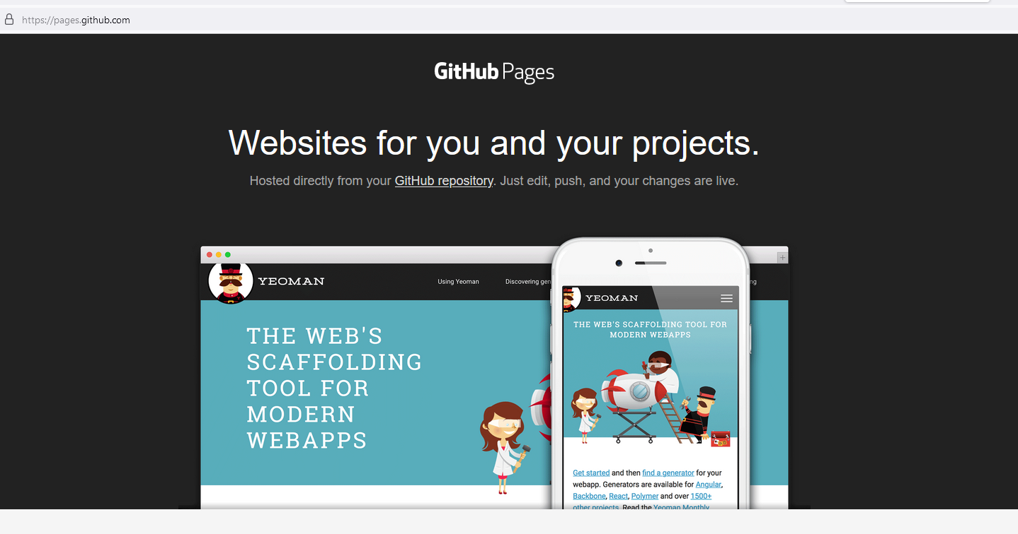
GitHub Pages

Slide 12
Azure DevOps

Slide 13
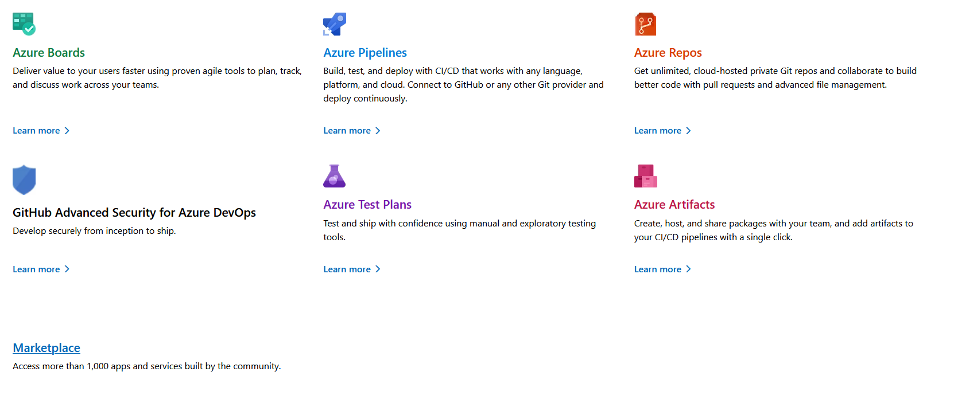
Azure DevOps Services

Slide 14
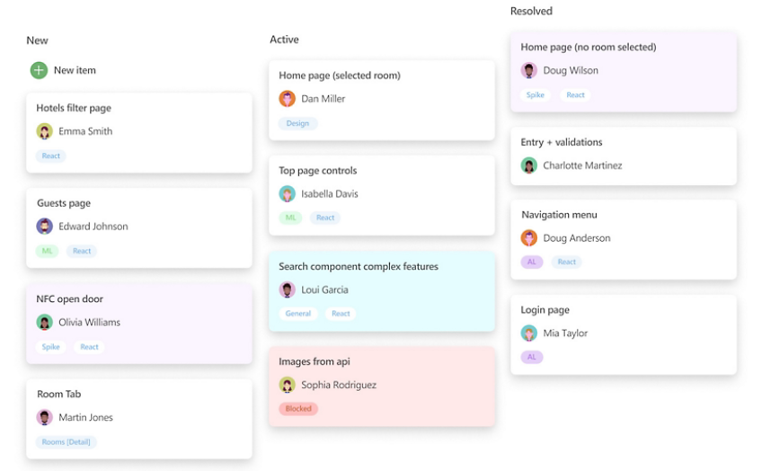
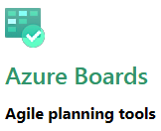
Azure Boards

Slide 15
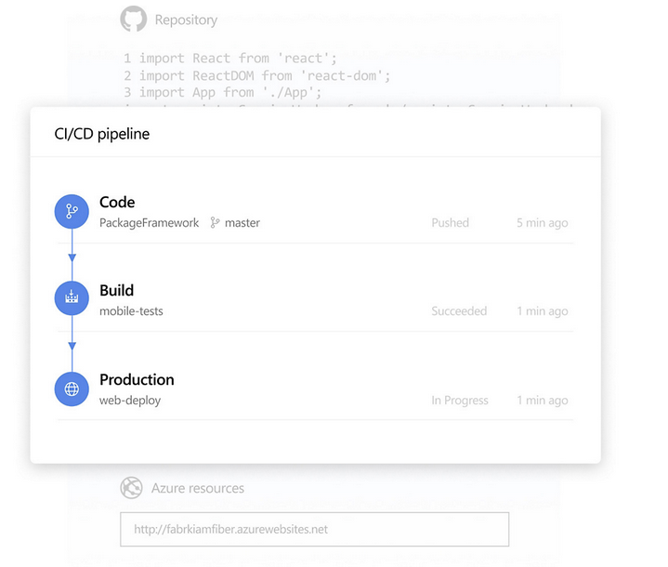
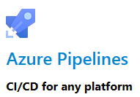
Azure Pipeline

Slide 16
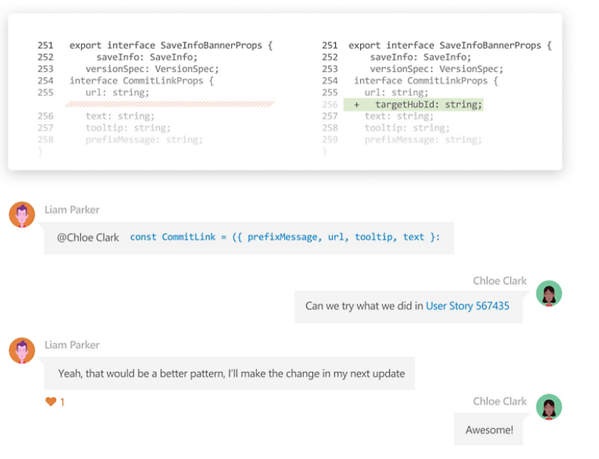
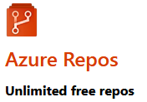
Azure Repos

Slide 17
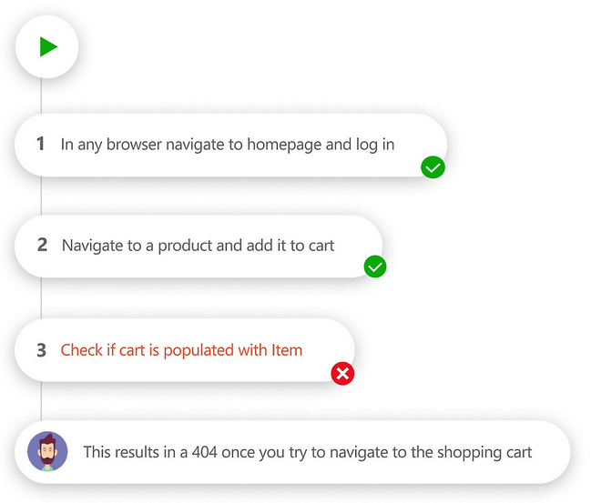
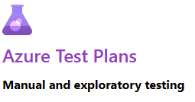
Azure Test Plans

Slide 18
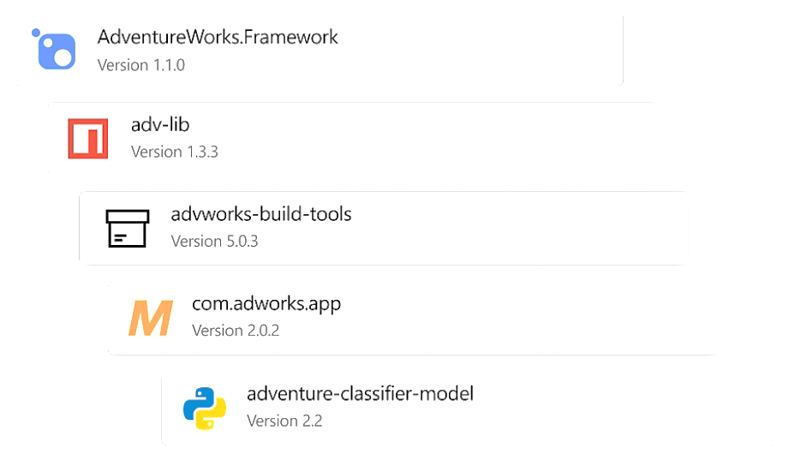
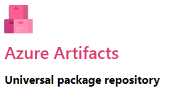
Azure Artifacts

Slide 19
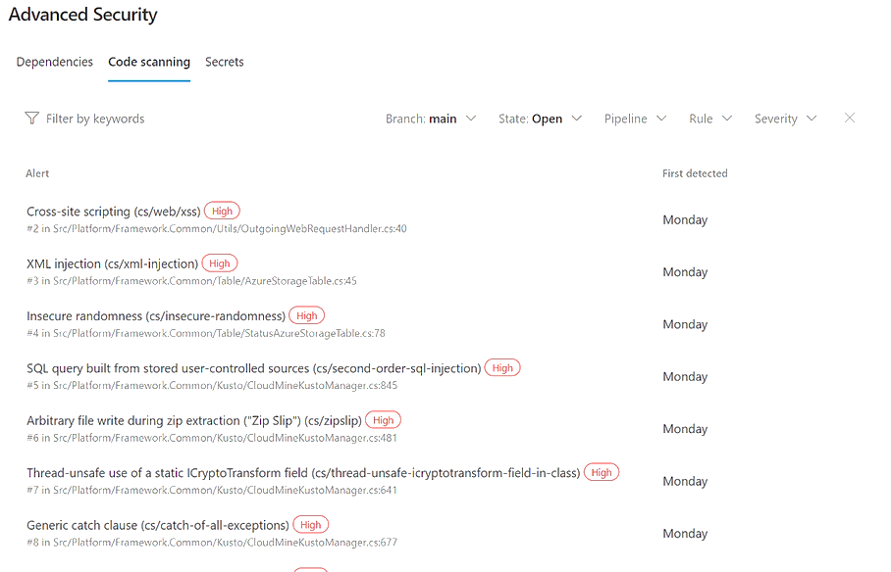

Azure Advanced Security

Slide 20
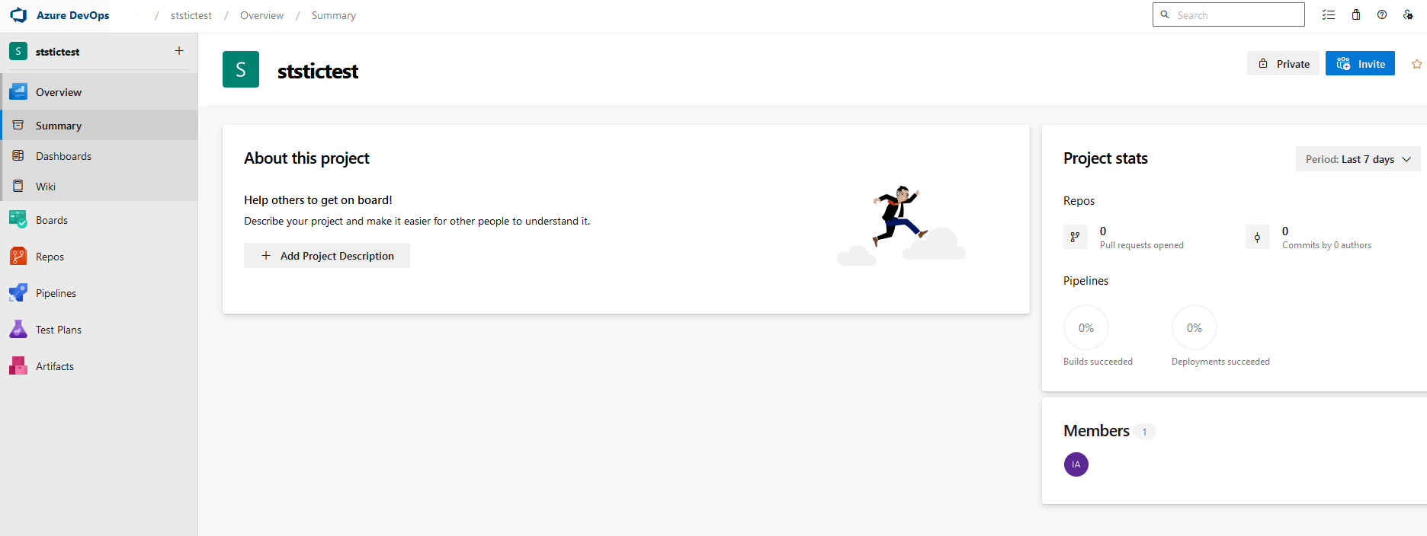
Azure DevOps (getting started)

Slide 21
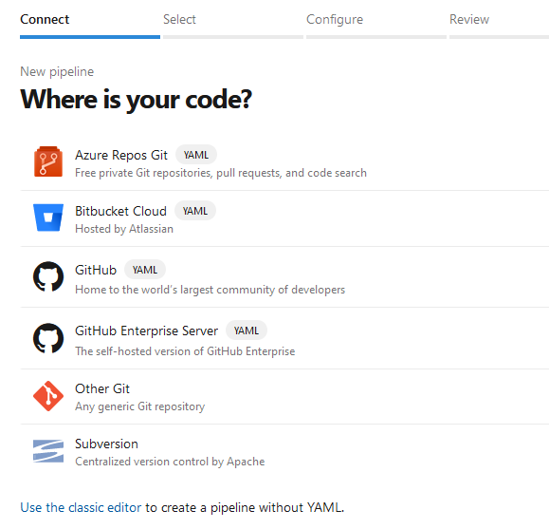
Azure Pipeline (in use)

Slide 22
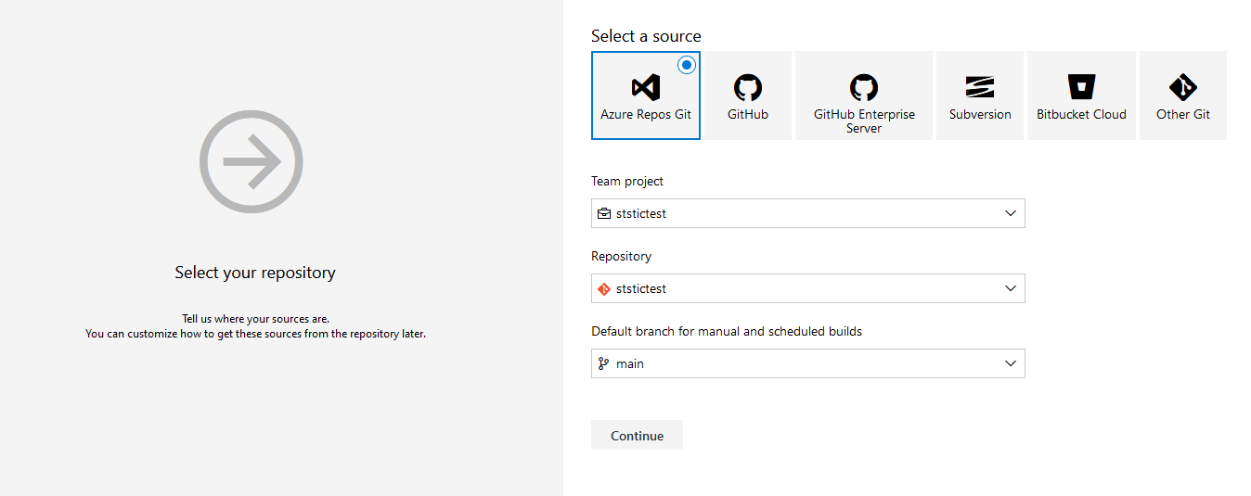
Azure Pipeline (in use)

Slide 23

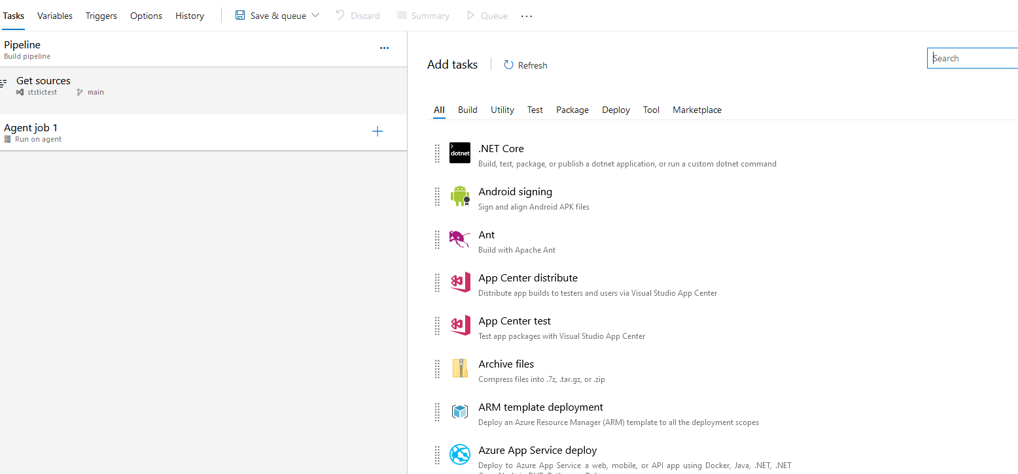
Azure Pipeline (in use)

Slide 24
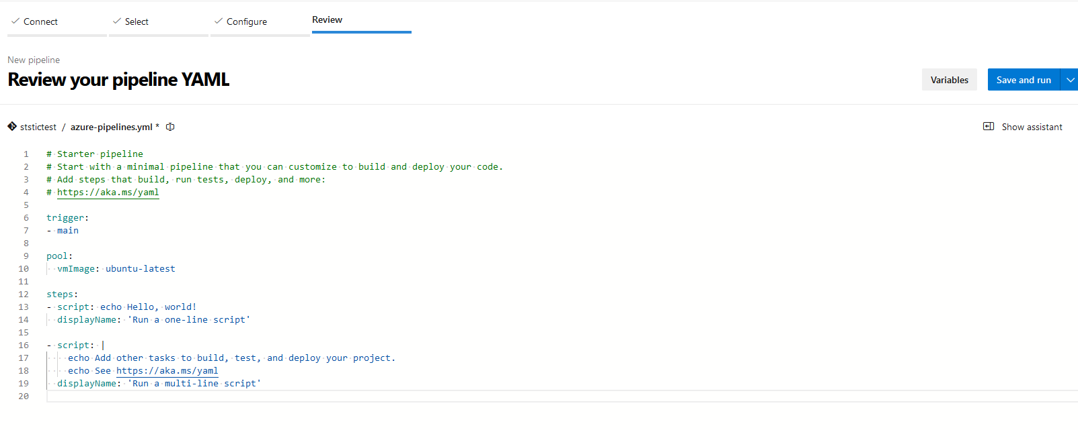
Azure Pipeline (in use)

