Slide 1
Step 6. Version Control Systems

Slide 2
Agenda
VCS
Git

Slide 3
Version Control Systems

Slide 4
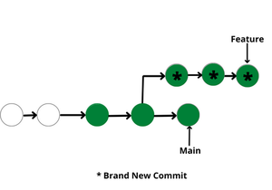
What is it?

Slide 5
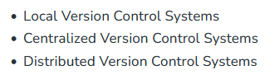
Types of Version Control Systems

Slide 6
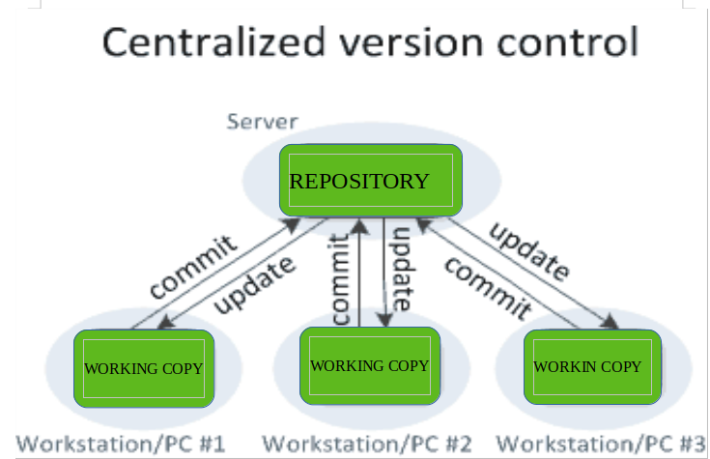
Centralized Version Control Systems

Slide 7
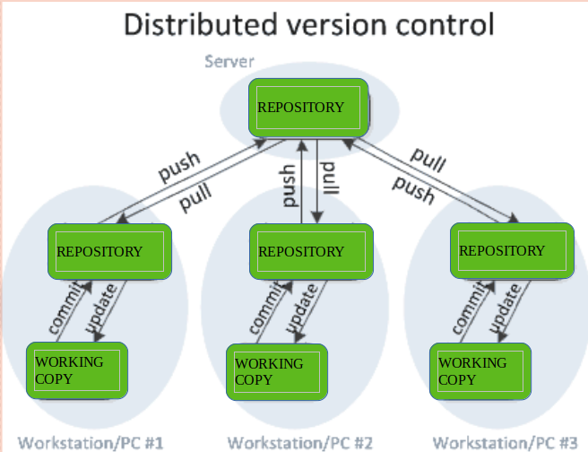
Distributed Version Control Systems

Slide 8
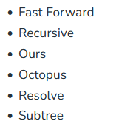
Merge Strategies

Slide 9
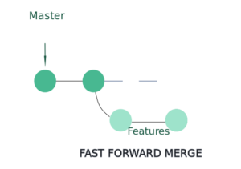
Fast Forward Merge

Slide 10
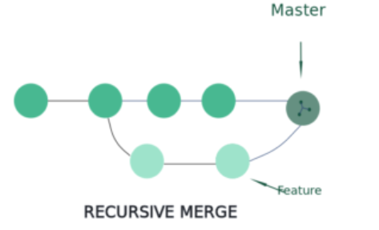
Fast Forward Merge

Slide 11
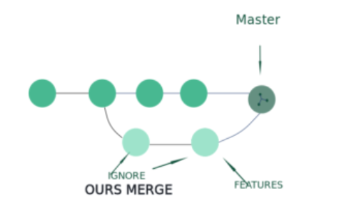
Ours Merge

Slide 12
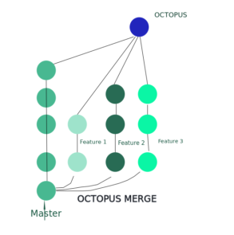
Octopus Merge

Slide 13
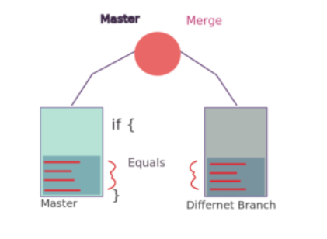
Resolve Merge

Slide 14
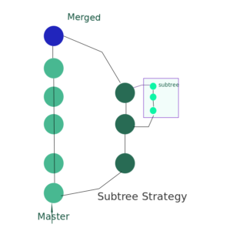
Subtree Merge

Slide 15
Git

Slide 16

What is Git?

Slide 17
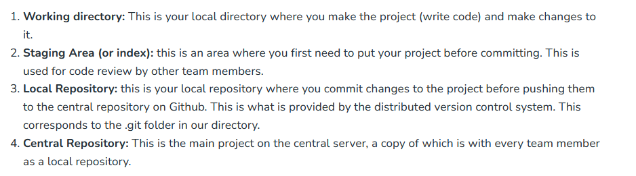
Introduction: Git Repository Structure

Slide 18
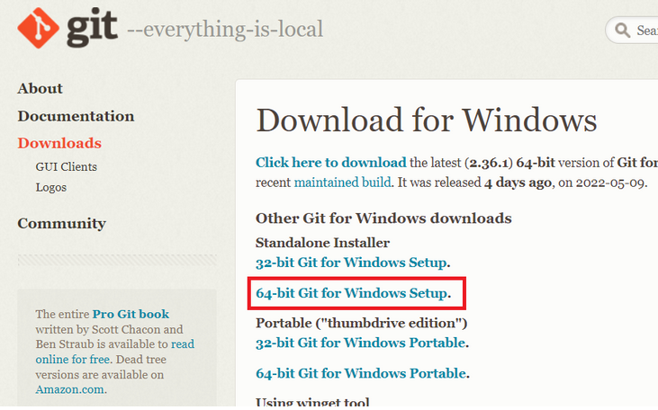

Git: Install and config

Slide 19
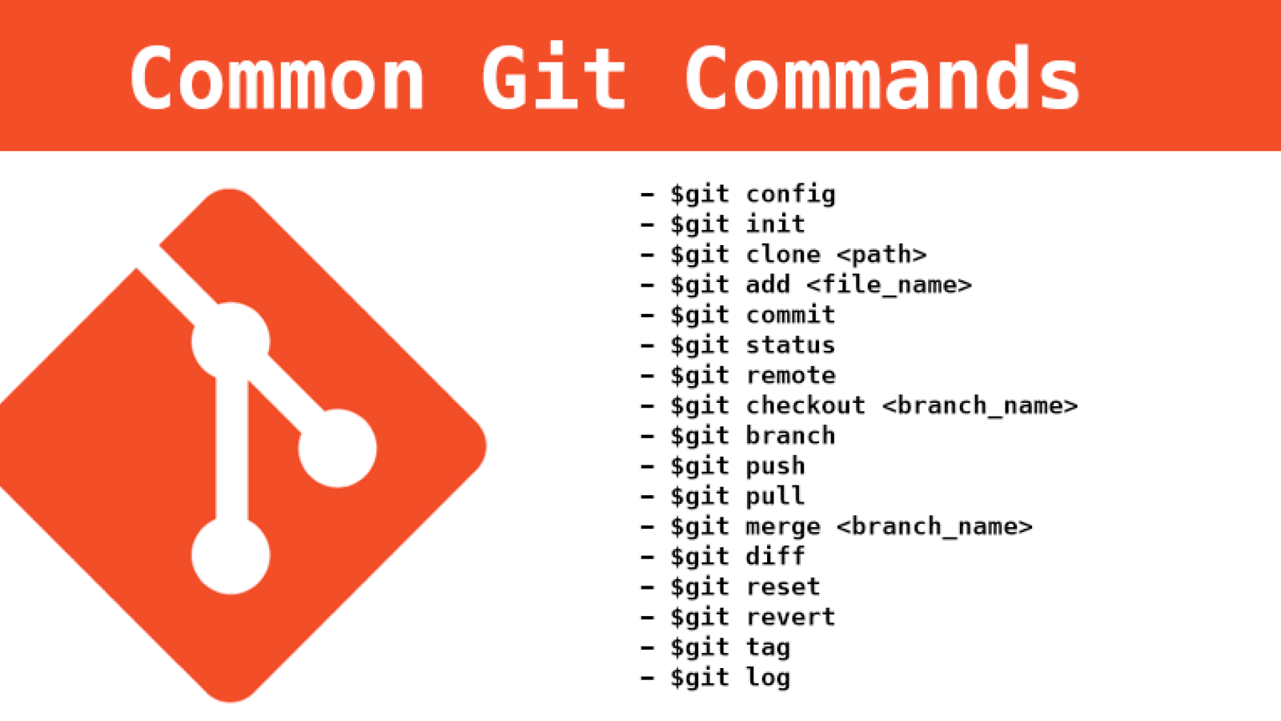
Git: Basic commands

Slide 20
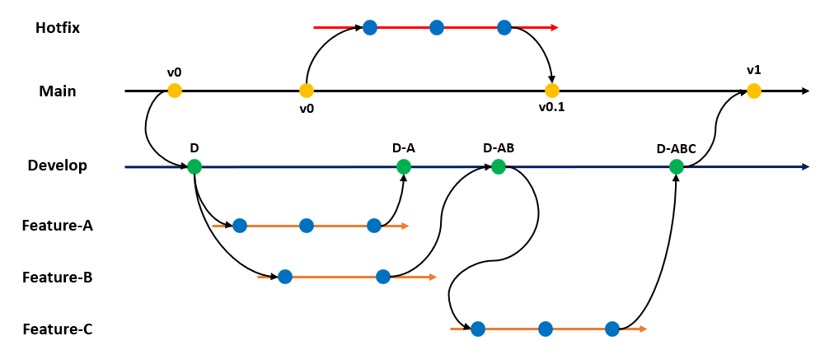
Git: Branching

Slide 21
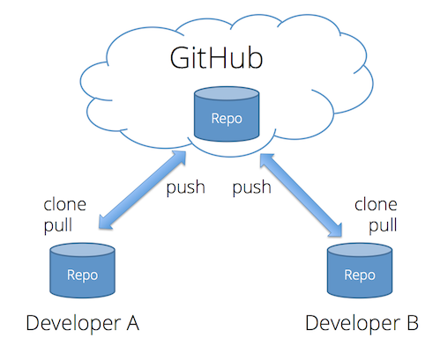
Git: Remote Repositories

Slide 22
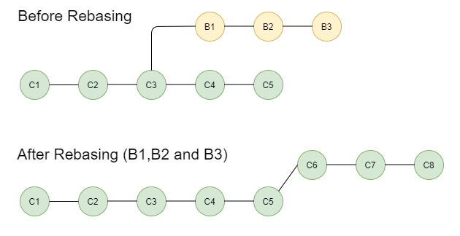
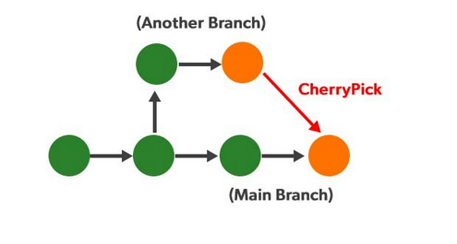
Git: Advanced

Slide 23

Git: Best practice: commit

Slide 24

Git: Best practice: git-ignore

