Slide 1
Step 10. Monitoring

Slide 2
Agenda
Azure Monitoring
AWS Monitoring

Slide 3
Azure Monitoring

Slide 4
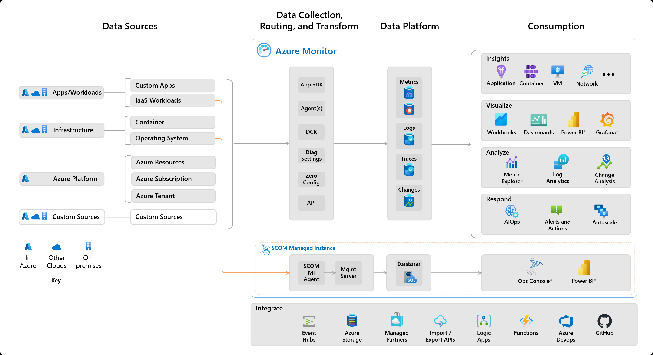
High level architecture

Slide 5
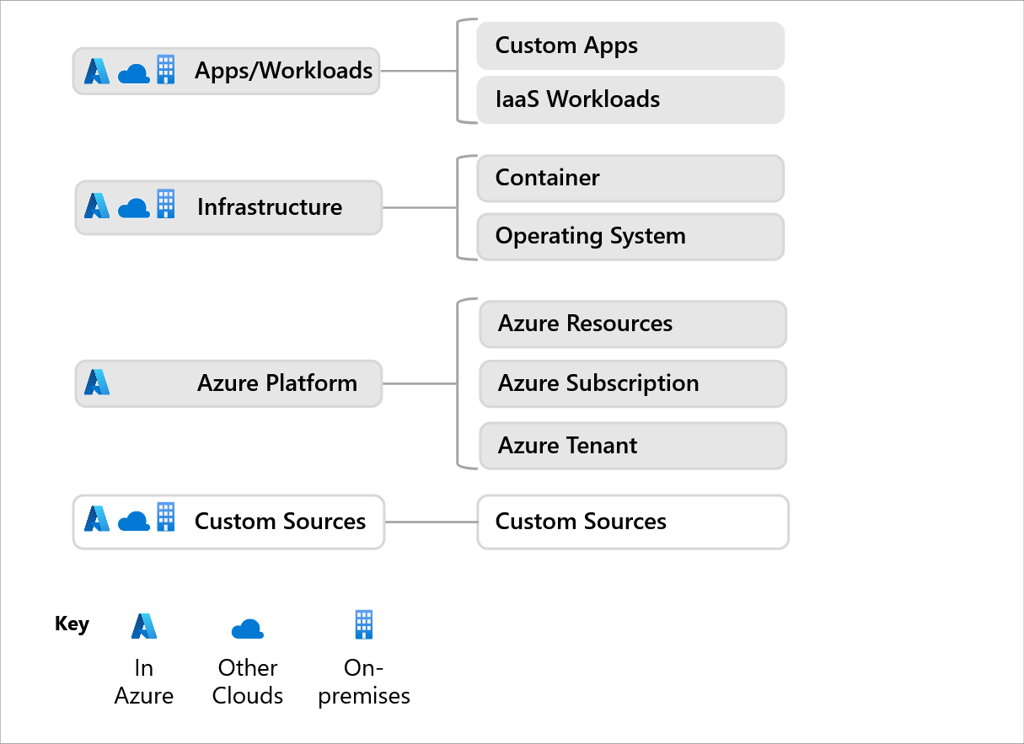
Data sources

Slide 6
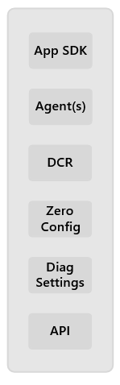
Data collection and routing

Slide 7
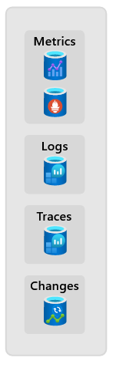
Data platform

Slide 8
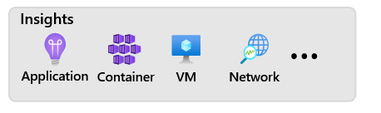
Consumption: Insights

Slide 9
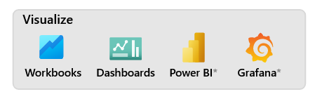
Consumption: Visualize

Slide 10
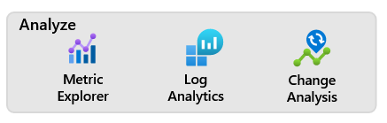
Consumption: Analyze

Slide 11
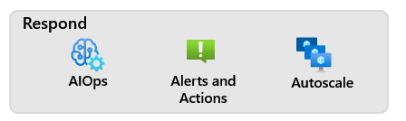
Consumption: Respond

Slide 12
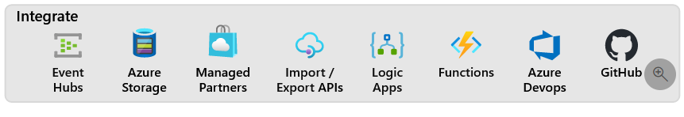
Integrate

Slide 13
AWS Monitoring

Slide 14
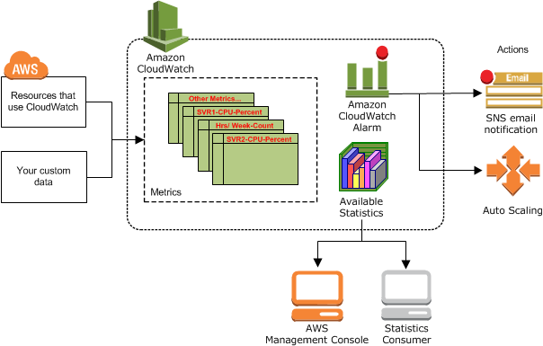
AWS CloudWatch

Slide 15
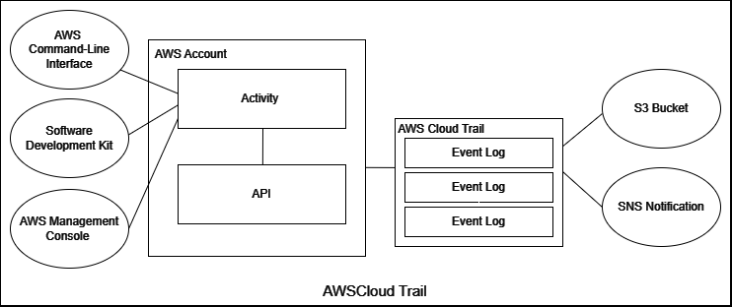
AWS CloudTrail

