Slide 1
Step 5. Infrastructure as a Code

Slide 2
Agenda
Terraform
Ansible

Slide 3
Terraform
HashiCorp Terraform is an infrastructure as code tool that lets you define both cloud and on-prem resources in human-readable configuration files that you can version, reuse, and share. You can then use a consistent workflow to provision and manage all of your infrastructure throughout its lifecycle. Terraform can manage low-level components like compute, storage, and networking resources, as well as high-level components like DNS entries and SaaS features.
https://developer.hashicorp.com/terraform/intro

Slide 4
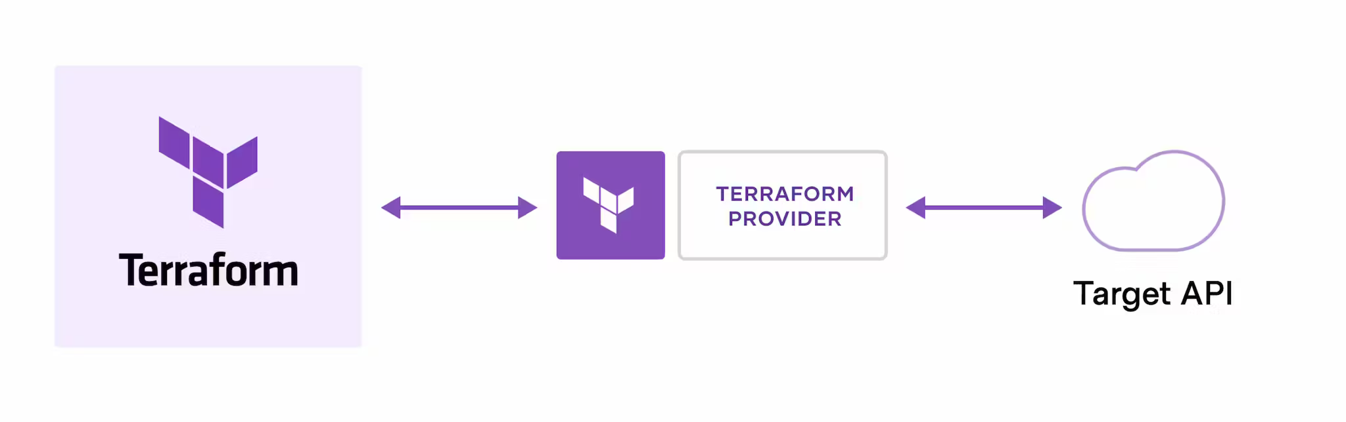
How does Terraform work?
Terraform creates and manages resources on cloud platforms and other services through their application programming interfaces (APIs). Providers enable Terraform to work with virtually any platform or service with an accessible API.
HashiCorp and the Terraform community have already written thousands of providers to manage many different types of resources and services. You can find all publicly available providers on the Terraform Registry, including Amazon Web Services (AWS), Azure, Google Cloud Platform (GCP), Kubernetes, Helm, GitHub, Splunk, DataDog, and many more.

Slide 5
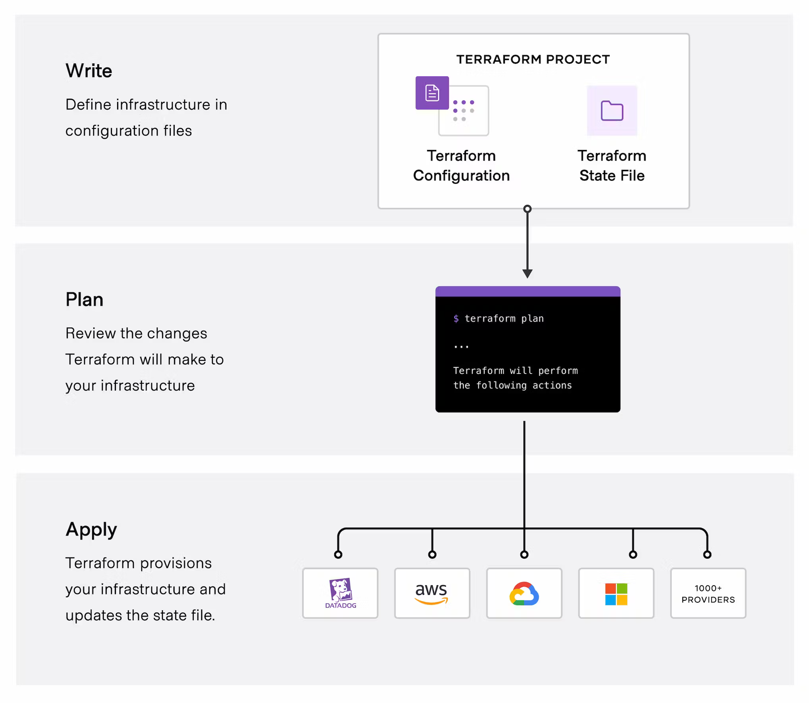
Terraform workflow
HashiCorp and the Terraform community have already written thousands of providers to manage many different types of resources and services. You can find all publicly available providers on the Terraform Registry, including Amazon Web Services (AWS), Azure, Google Cloud Platform (GCP), Kubernetes, Helm, GitHub, Splunk, DataDog, and many more.
The core Terraform workflow consists of three stages:
Write: You define resources, which may be across multiple cloud providers and services. For example, you might create a configuration to deploy an application on virtual machines in a Virtual Private Cloud (VPC) network with security groups and a load balancer.
Plan: Terraform creates an execution plan describing the infrastructure it will create, update, or destroy based on the existing infrastructure and your configuration.
Apply: On approval, Terraform performs the proposed operations in the correct order, respecting any resource dependencies. For example, if you update the properties of a VPC and change the number of virtual machines in that VPC, Terraform will recreate the VPC before scaling the virtual machines.

Slide 6
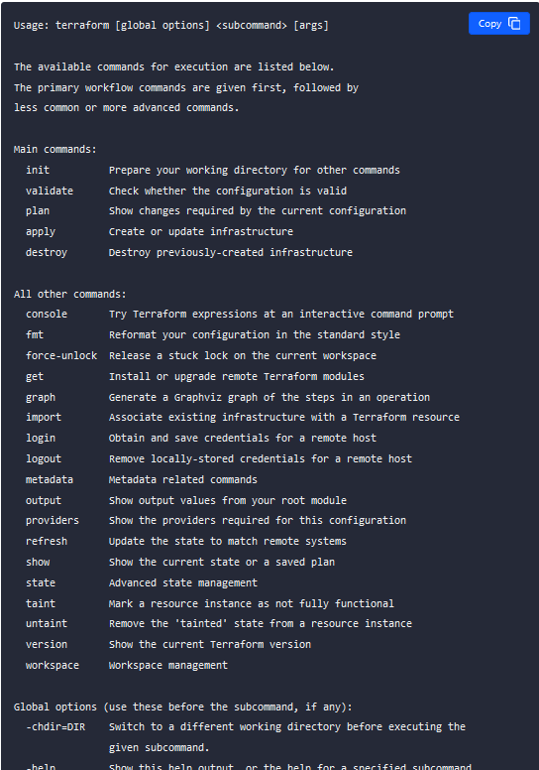
Terraform - Basic CLI Features
The command line interface to Terraform is the terraform command, which accepts a variety of subcommands such as terraform init or terraform plan.
We refer to the terraform command line tool as "Terraform CLI" elsewhere in the documentation. This terminology is often used to distinguish it from other components you might use in the Terraform product family, such as Terraform Cloud or the various Terraform providers, which are developed and released separately from Terraform CLI.
https://developer.hashicorp.com/terraform/cli/commands

Slide 7
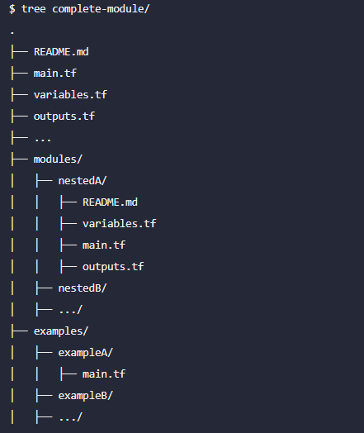
Terraform - Initializing Working Directories
Working Directory Contents
A Terraform working directory typically contains:
A Terraform configuration describing resources Terraform should manage. This configuration is expected to change over time.
A hidden .terraform directory, which Terraform uses to manage cached provider plugins and modules, record which workspace is currently active, and record the last known backend configuration in case it needs to migrate state on the next run. This directory is automatically managed by Terraform, and is created during initialization.
State data, if the configuration uses the default local backend. This is managed by Terraform in a terraform.tfstate file (if the directory only uses the default workspace) or a terraform.tfstate.d directory (if the directory uses multiple workspaces).
https://developer.hashicorp.com/terraform/cli/init

Slide 8
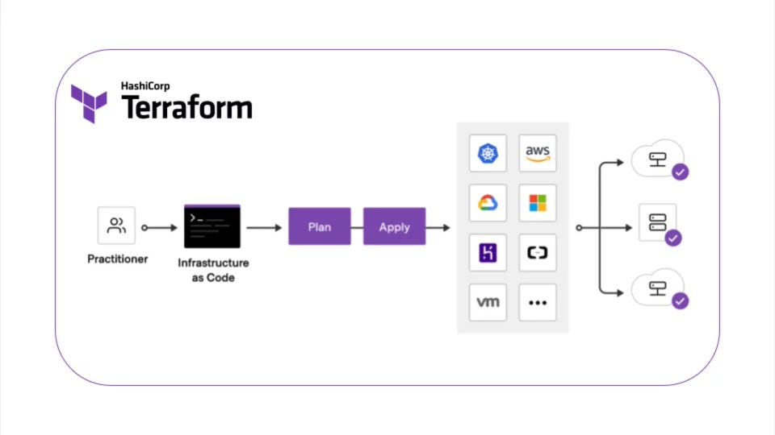
Provisioning Infrastructure with Terraform
Terraform's primary function is to create, modify, and destroy infrastructure resources to match the desired state described in a Terraform configuration.
When people refer to "running Terraform," they generally mean performing these provisioning actions in order to affect real infrastructure objects. The Terraform binary has many other subcommands for a wide variety of administrative actions, but these basic provisioning tasks are the core of Terraform.
Terraform's provisioning workflow relies on three commands: plan, apply, and destroy. All of these commands require an initialized working directory, and all of them act only upon the currently selected workspace.
https://developer.hashicorp.com/terraform/cli/run

Slide 9
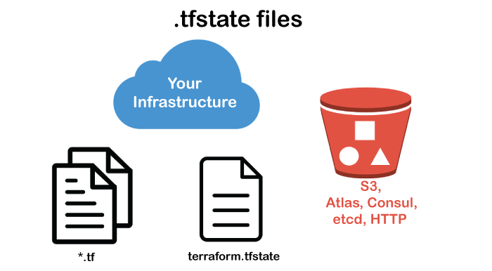
Manipulating Terraform State
Terraform uses state data to remember which real-world object corresponds to each resource in the configuration; this allows it to modify an existing object when its resource declaration changes.
Terraform updates state automatically during plans and applies. However, it's sometimes necessary to make deliberate adjustments to Terraform's state data, usually to compensate for changes to the configuration or the real managed infrastructure.
Terraform CLI supports several workflows for interacting with state:
Inspecting State
Forcing Re-creation
Moving Resources
Importing Pre-existing Resources (documented in the Importing Infrastructure section)
Disaster Recovery
https://developer.hashicorp.com/terraform/cli/state

Slide 10
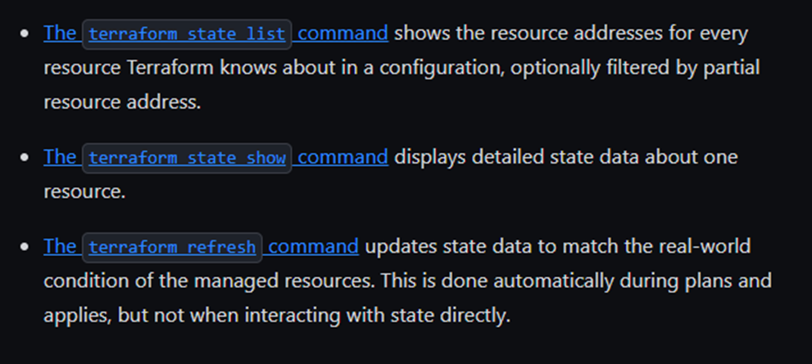
Terraform - Inspecting Infrastructure
Terraform configurations and state data include some highly structured information about the resources they manage; this includes dependency information, outputs (which are pieces of generated or discovered data that the configuration's author considers important enough to surface to users), and more.
Terraform CLI includes some commands for inspecting or transforming this data. You can use these to integrate other tools with Terraform's infrastructure data, or just to gain a deeper or more holistic understanding of your infrastructure.
The terraform graph command creates a visual representation of a configuration or a set of planned changes.
The terraform output command can get the values for the top-level output values of a configuration, which are often helpful when making use of the infrastructure Terraform has provisioned.
The terraform show command can generate human-readable versions of a state file or plan file, or generate machine-readable versions that can be integrated with other tools.
The terraform state list command can list the resources being managed by the current working directory and workspace, providing a complete or filtered list.
The terraform state show command can print all of the attributes of a given resource being managed by the current working directory and workspace, including generated read-only attributes like the unique ID assigned by the cloud provider.
https://developer.hashicorp.com/terraform/cli/inspect

Slide 11
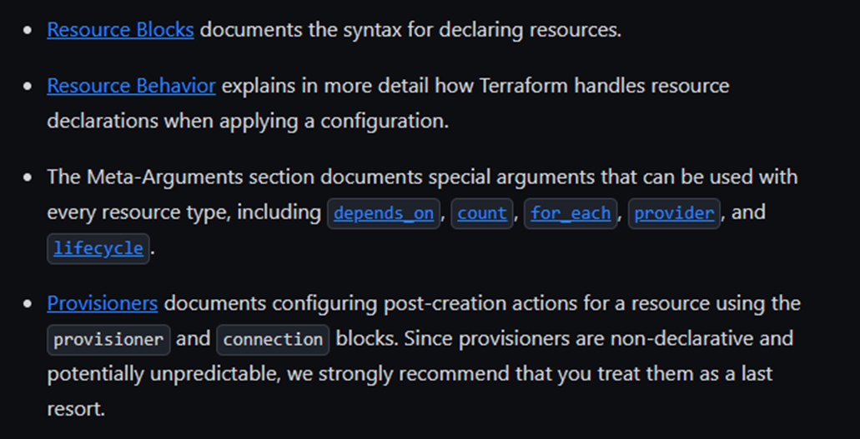
Terraform – Elements: Resources
Resources are the most important element in the Terraform language. Each resource block describes one or more infrastructure objects, such as virtual networks, compute instances, or higher-level components such as DNS records.
Resource Blocks documents the syntax for declaring resources.
Resource Behavior explains in more detail how Terraform handles resource declarations when applying a configuration.
The Meta-Arguments section documents special arguments that can be used with every resource type, including depends_on, count, for_each, provider, and lifecycle.
Provisioners documents configuring post-creation actions for a resource using the provisioner and connection blocks. Since provisioners are non-declarative and potentially unpredictable, we strongly recommend that you treat them as a last resort.
https://developer.hashicorp.com/terraform/language/resources

Slide 12
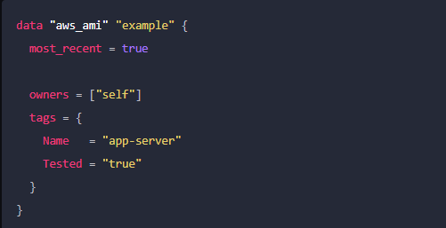
Terraform – Elements: Data Sources
Data sources allow Terraform to use information defined outside of Terraform, defined by another separate Terraform configuration, or modified by functions.
A data block requests that Terraform read from a given data source ("aws_ami") and export the result under the given local name ("example"). The name is used to refer to this resource from elsewhere in the same Terraform module, but has no significance outside of the scope of a module.
The data source and name together serve as an identifier for a given resource and so must be unique within a module.
https://developer.hashicorp.com/terraform/language/data-sources

Slide 13
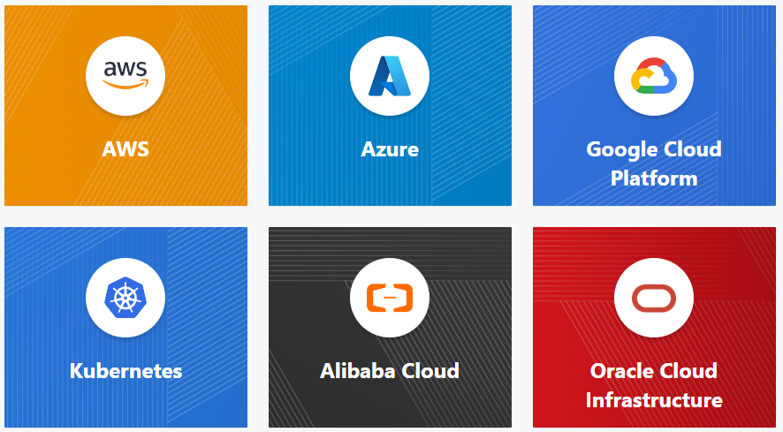
Terraform – Elements: Providers
Terraform relies on plugins called providers to interact with cloud providers, SaaS providers, and other APIs.
Terraform configurations must declare which providers they require so that Terraform can install and use them. Additionally, some providers require configuration (like endpoint URLs or cloud regions) before they can be used.
Each provider adds a set of resource types and/or data sources that Terraform can manage.
Every resource type is implemented by a provider; without providers, Terraform can't manage any kind of infrastructure.
Most providers configure a specific infrastructure platform (either cloud or self-hosted). Providers can also offer local utilities for tasks like generating random numbers for unique resource names.
https://developer.hashicorp.com/terraform/language/providers

Slide 14
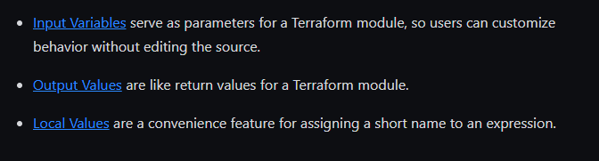
Terraform – Elements: Variables and Outputs
The Terraform language includes a few kinds of blocks for requesting or publishing named values.
Input Variables serve as parameters for a Terraform module, so users can customize behavior without editing the source.
Output Values are like return values for a Terraform module.
Local Values are a convenience feature for assigning a short name to an expression.
https://developer.hashicorp.com/terraform/language/values

Slide 15
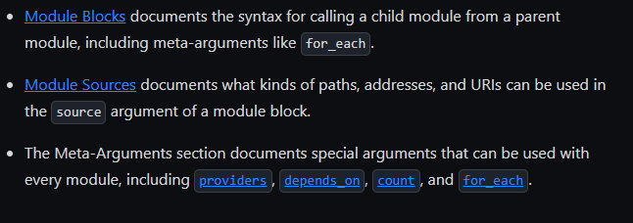
Terraform – Modules
Modules are containers for multiple resources that are used together. A module consists of a collection of .tf and/or .tf.json files kept together in a directory.
Modules are the main way to package and reuse resource configurations with Terraform.
The Root Module
Every Terraform configuration has at least one module, known as its root module, which consists of the resources defined in the .tf files in the main working directory.
Child Modules
A Terraform module (usually the root module of a configuration) can call other modules to include their resources into the configuration. A module that has been called by another module is often referred to as a child module.
Child modules can be called multiple times within the same configuration, and multiple configurations can use the same child module.
Published Modules
In addition to modules from the local filesystem, Terraform can load modules from a public or private registry. This makes it possible to publish modules for others to use, and to use modules that others have published.
https://developer.hashicorp.com/terraform/language/modules

Slide 16
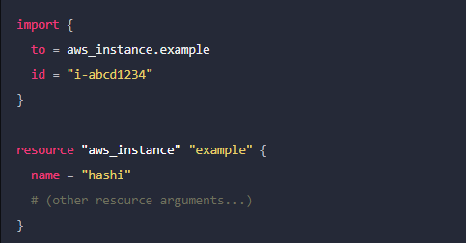
Terraform – Import
Use the import block to import existing infrastructure resources into Terraform, bringing them under Terraform's management. Unlike the terraform import command, configuration-driven import using import blocks is predictable, works with CICD pipelines, and lets you preview an import operation before modifying state.
Once imported, Terraform tracks the resource in your state file. You can then manage the imported resource like any other, updating its attributes and destroying it as part of a standard resource lifecycle.
The import block records that Terraform imported the resource and did not create it. After importing, you can optionally remove import blocks from your configuration or leave them as a record of the resource's origin.
https://developer.hashicorp.com/terraform/language/import

Slide 17
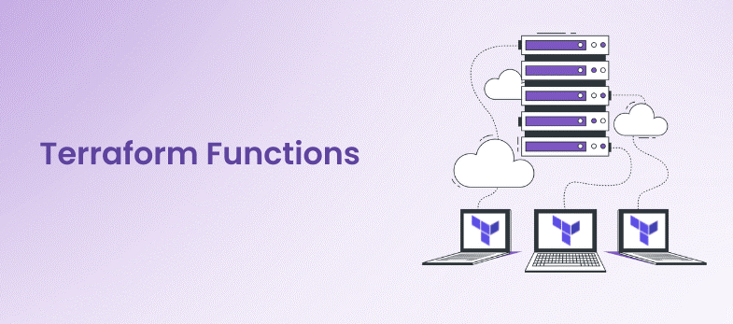
Terraform – Expressions/Functions
Expressions refer to or compute values within a configuration. The simplest expressions are just literal values, like "hello" or 5, but the Terraform language also allows more complex expressions such as references to data exported by resources, arithmetic, conditional evaluation, and a number of built-in functions.
Expressions can be used in a number of places in the Terraform language, but some contexts limit which expression constructs are allowed, such as requiring a literal value of a particular type or forbidding references to resource attributes. Each language feature's documentation describes any restrictions it places on expressions.
You can experiment with the behavior of Terraform's expressions from the Terraform expression console, by running the terraform console command.
https://developer.hashicorp.com/terraform/language/expressions
The Terraform language includes a number of built-in functions that you can call from within expressions to transform and combine values. The general syntax for function calls is a function name followed by comma-separated arguments in parentheses
The Terraform language does not support user-defined functions, and so only the functions built in to the language are available for use. The documentation includes a page for all of the available built-in functions.
https://developer.hashicorp.com/terraform/language/functions

Slide 18
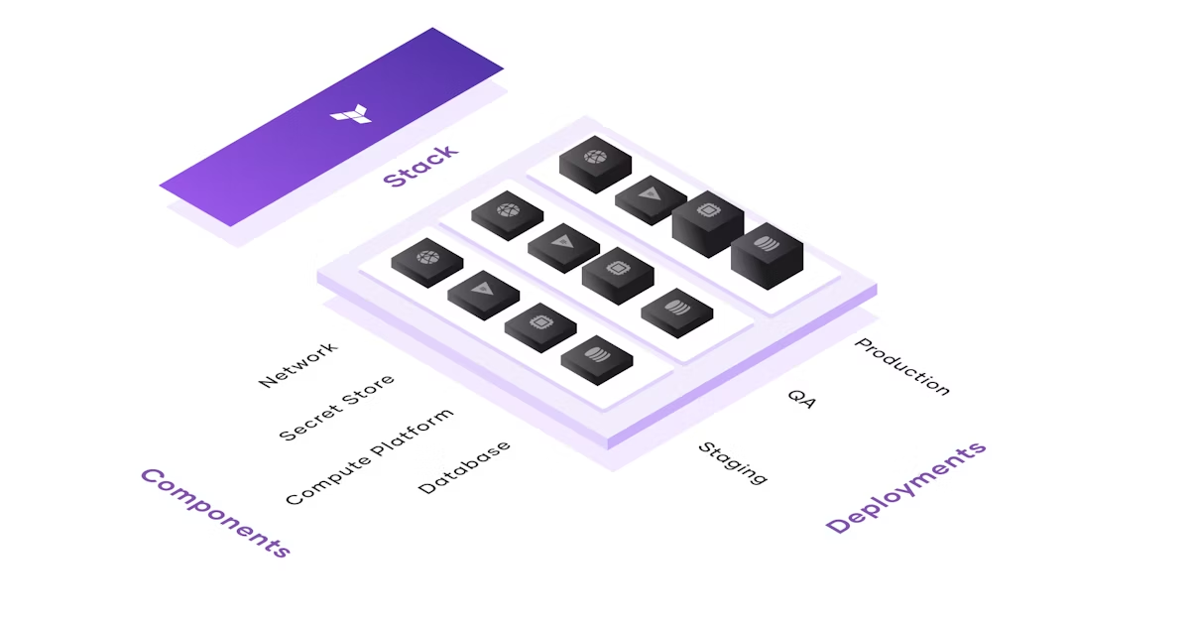
Terraform – Demo
DEMO

Slide 19
Ansible
Ansible is an open-source IT engine that automates application deployment, cloud provisioning, intra-service orchestration, and other IT tools. It is an automation and orchestration tool popular for the following reasons:
Simple to Install.
Free and open source.
Lightweight and consistent.
OpenSSH security features make it very secure.

Slide 20
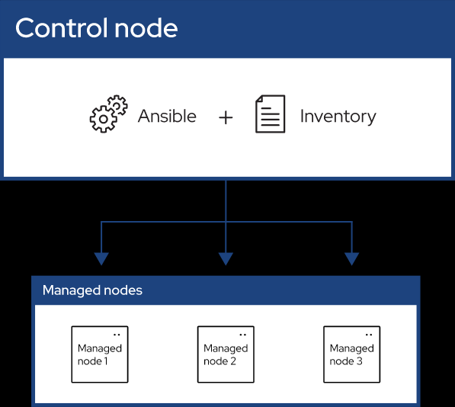
What Is Ansible?
Ansible can be used to deploy the software on different servers at a time without human interaction. Ansible can also be used to configure the servers and create user accounts. Ansible is an agent-less software which means there is no need to install the software in the nodes which means you need to do the SSH to connect the nodes to perform the required operations on the servers.
Ansible playbooks can be written very easily they will be like plain english and Ansible is developed using Python language. There is no need for any knowledge of programming. A single ansible control node can manage thousands of the nodes.

Slide 21
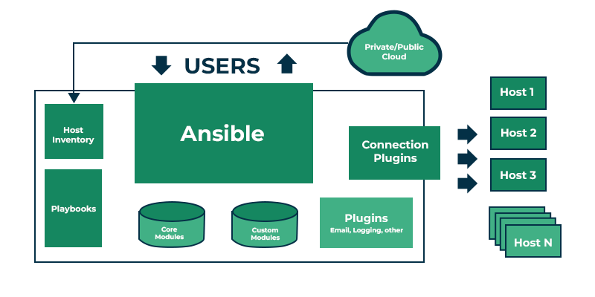
Ansible Architecture
Control node: Commands and Playbooks can run by invoking /usr/bin/ansible or /usr/bin/ansible-playbook, from any control node. You can use any computer that has Python installed on it as a control node. However, one can not use a computer with Windows OS as a control node. One can have multiple control nodes.
Managed nodes: Also sometimes called “hosts”, Managed nodes are the network devices (and/or servers) you manage with Ansible.
Inventory: Also sometimes called “hostfile”, Inventory is the list of Managed nodes use to organize them. It is also used for creating and nesting groups for easier scaling.
Modules: These are the units of code executed by Ansible. Each module can be used for a specific purpose. One can invoke a single module with a task, or invoke several different modules in a playbook.
Tasks: The units of action in Ansible. One can execute a single task once with an ad-hoc command.
https://docs.ansible.com/ansible/latest/getting_started/basic_concepts.html

Slide 22
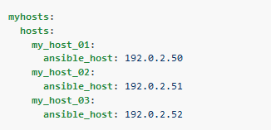
Ansible - Building an inventory
Inventories organize managed nodes in centralized files that provide Ansible with system information and network locations. Using an inventory file, Ansible can manage a large number of hosts with a single command.
To complete the following steps, you will need the IP address or fully qualified domain name (FQDN) of at least one host system. For demonstration purposes, the host could be running locally in a container or a virtual machine. You must also ensure that your public SSH key is added to the authorized_keys file on each host.
https://docs.ansible.com/ansible/latest/getting_started/get_started_inventory.html#

Slide 23
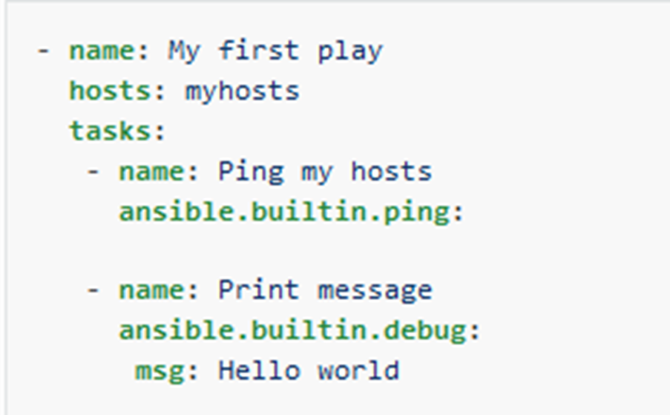
Ansible - Building an inventory
Playbooks are automation blueprints, in YAML format, that Ansible uses to deploy and configure managed nodes.
Playbook
A list of plays that define the order in which Ansible performs operations, from top to bottom, to achieve an overall goal.
Play
An ordered list of tasks that maps to managed nodes in an inventory.
Task
A reference to a single module that defines the operations that Ansible performs.
Module
A unit of code or binary that Ansible runs on managed nodes. Ansible modules are grouped in collections with a Fully Qualified Collection Name (FQCN) for each module.
https://docs.ansible.com/ansible/latest/getting_started/get_started_playbook.html

Slide 24
Ansible Roles
Ansible material can be arranged and reused using Ansible roles. They usually include a collection of variables, handlers, tasks, and templates used to carry out a particular activity, like setting up an application or installing and configuring a web server.Ansible playbooks can be made more modular and reusable by using roles. To deploy many web apps, you could, for instance, build a role for installing and configuring the Apache web server and then utilise that role repeatedly in different playbooks.Sharing Ansible material with other people is another way to use roles. To make your roles available for usage in other people’s playbooks, you can publish them to Ansible Galaxy, a public repository for Ansible roles.

Slide 25

Ansible - Demo
DEMO

