Slide 1
Step 6. Version Control Systems

Slide 2
Agenda
VCS
Git

Slide 3
Version Control Systems

Slide 4
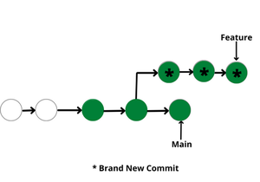
What is it?
Version control systems are a category of software tools that helps in recording changes made to files by keeping a track of modifications done in the code.
Use of Version Control System:
A repository: It can be thought of as a database of changes. It contains all the edits and historical versions (snapshots) of the project.
Copy of Work (sometimes called as checkout): It is the personal copy of all the files in a project. You can edit to this copy, without affecting the work of others and you can finally commit your changes to a repository when you are done making your changes.
Working in a group: Consider yourself working in a company where you are asked to work on some live project. You can’t change the main code as it is in production, and any change may cause inconvenience to the user, also you are working in a team so you need to collaborate with your team to and adapt their changes. Version control helps you with the, merging different requests to main repository without making any undesirable changes. You may test the functionalities without putting it live, and you don’t need to download and set up each time, just pull the changes and do the changes, test it and merge it back. It may be visualized as.
https://www.geeksforgeeks.org/version-control-systems/?ref=lbp

Slide 5
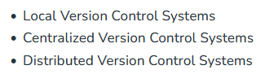
Types of Version Control Systems
Local Version Control Systems: It is one of the simplest forms and has a database that kept all the changes to files under revision control. RCS is one of the most common VCS tools. It keeps patch sets (differences between files) in a special format on disk. By adding up all the patches it can then re-create what any file looked like at any point in time.
https://www.geeksforgeeks.org/version-control-systems/?ref=lbp

Slide 6
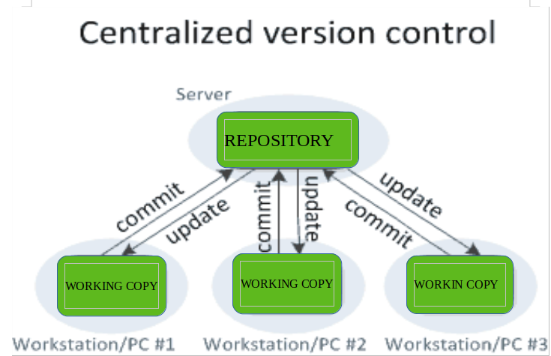
Centralized Version Control Systems
Centralized version control systems contain just one repository globally and every user need to commit for reflecting one’s changes in the repository. It is possible for others to see your changes by updating.
Two things are required to make your changes visible to others which are:
You commit
They update
The benefit of CVCS (Centralized Version Control Systems) makes collaboration amongst developers along with providing an insight to a certain extent on what everyone else is doing on the project. It allows administrators to fine-grained control over who can do what.
It has some downsides as well which led to the development of DVS. The most obvious is the single point of failure that the centralized repository represents if it goes down during that period collaboration and saving versioned changes is not possible. What if the hard disk of the central database becomes corrupted, and proper backups haven’t been kept? You lose absolutely everything.

Slide 7
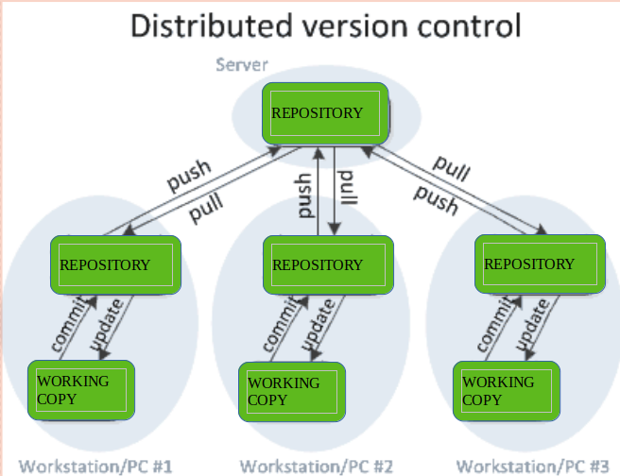
Distributed Version Control Systems
Distributed version control systems contain multiple repositories. Each user has their own repository and working copy. Just committing your changes will not give others access to your changes. This is because commit will reflect those changes in your local repository and you need to push them in order to make them visible on the central repository. Similarly, When you update, you do not get others’ changes unless you have first pulled those changes into your repository.
To make your changes visible to others, 4 things are required:
You commit
You push
They pull
They update
The most popular distributed version control systems are Git, and Mercurial. They help us overcome the problem of single point of failure.
Purpose of Version Control:
Multiple people can work simultaneously on a single project. Everyone works on and edits their own copy of the files and it is up to them when they wish to share the changes made by them with the rest of the team.
It also enables one person to use multiple computers to work on a project, so it is valuable even if you are working by yourself.
It integrates the work that is done simultaneously by different members of the team. In some rare cases, when conflicting edits are made by two people to the same line of a file, then human assistance is requested by the version control system in deciding what should be done.
Version control provides access to the historical versions of a project. This is insurance against computer crashes or data loss. If any mistake is made, you can easily roll back to a previous version. It is also possible to undo specific edits that too without losing the work done in the meanwhile. It can be easily known when, why, and by whom any part of a file was edited.

Slide 8
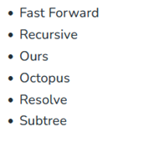
Merge Strategies
Merge in Git allows you to join two or more development work created using git branch into a single branch. It incorporates the changes from named commits and diverges them into the current branch. Before making a merge option make sure the receiving branch and the merging branch are up-to-date with the latest remote changes.
What are Merge Strategies?
Git provides various methods to merge different commits into a base commit. These methods are called Merge Strategies. These base commits are combined to form merge commits. A merge commit is just like the regular commit except that it has two parent commits. Out of multiple strategies for the merging process, the git will automatically choose one if not specified explicitly. This automatic selection of the merge strategy is based on the branches provided for merging.
There are various types of merge strategies :
Fast Forward
Recursive
Ours
Octopus
Resolve
Subtree
Git merge will combine multiple sequences of commits into one unified history. In the most frequent use cases, git merge is used to combine two branches. Any of the upgiven strategies can be used to perform the merging process according to the needs of the project. The most commonly used strategies are Fast Forward Merge and Recursive Merge.
https://www.geeksforgeeks.org/merge-strategies-in-git/?ref=lbp

Slide 9
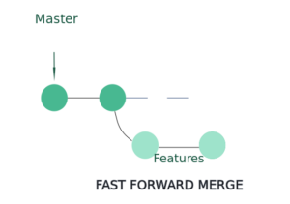
Fast Forward Merge
In this most commonly used merge strategy, history is just one straight line. When you create a branch, make some commits in that branch, the time you’re ready to merge, there is no new merge on the master. That way master’s pointer is just moved straight forward and history is one straight line.

Slide 10
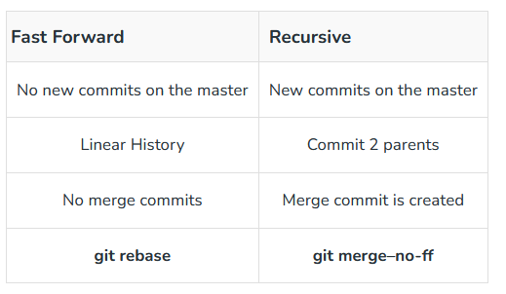
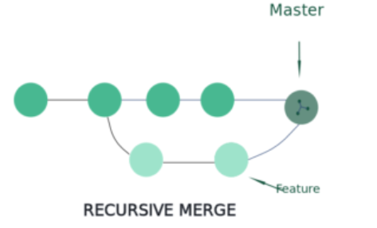
Fast Forward Merge
In Recursive merge, after you branch and make some commits, there are some new original commits on the ‘master‘. So, when it’s time to merge, git recurses over the branch and creates a new merge commit. The merge commit continues to have two parents.

Slide 11
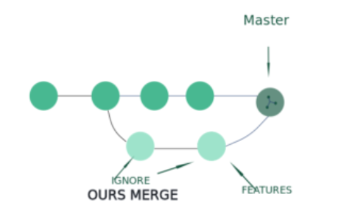
Ours Merge
This merge strategy resolves any number of heads, but the resulting tree of the merge is always that of the current branch head, effectively ignoring all changes from all other branches. It is meant to be used to supersede the old development history of side branches.

Slide 12
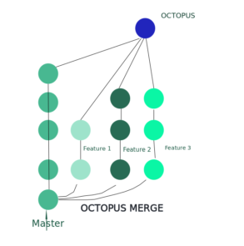
Octopus Merge
Octopus Merge strategy resolves cases with more than two heads but refuses to do a complex merge that needs manual resolution. It is primarily meant to be used for bundling topic branch heads together. This is the default merge strategy when pulling or merging more than one branch.

Slide 13
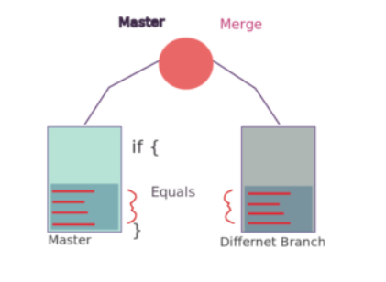
Resolve Merge
This strategy can only resolve two heads (i.e. the current branch and another branch you pulled from) using a 3-way merge algorithm. It tries to carefully detect criss-cross merge ambiguities and is considered generally safe and fast.

Slide 14
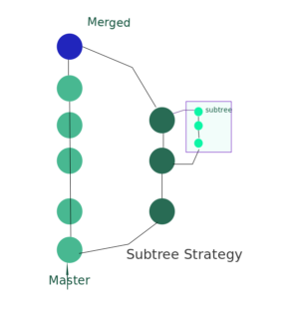
Subtree Merge
This is a modified recursive strategy. When merging trees A and B, if B corresponds to a subtree of A, B is first adjusted to match the tree structure of A, instead of reading the trees at the same level. This adjustment is also done to the common ancestor tree.

Slide 15
Git

Slide 16

What is Git?
Git is a powerful and popular version control system that enables effective tracking of changes in source code. It was developed by Linus Torvalds in 2005 for Linux kernel development and It is used for keeping track of code changes and collaborating with others on code. It uses a decentralized model where each developer has their own copy of the repository and works immediately on the project. Git manages the projects with repositories and can clone a project to operate locally on it. With staging and committing it track changes and control. You can pull the latest code of the project to the local copy, and push local updates to the main projects.

Slide 17
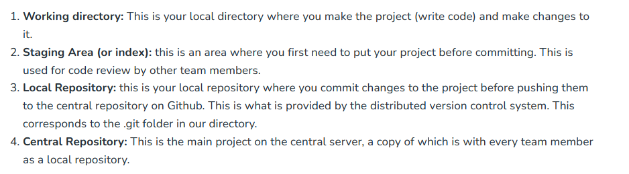
Introduction: Git Repository Structure
It consists of 4 parts:
Working directory: This is your local directory where you make the project (write code) and make changes to it.
Staging Area (or index): this is an area where you first need to put your project before committing. This is used for code review by other team members.
Local Repository: this is your local repository where you commit changes to the project before pushing them to the central repository on Github. This is what is provided by the distributed version control system. This corresponds to the .git folder in our directory.
Central Repository: This is the main project on the central server, a copy of which is with every team member as a local repository.

Slide 18
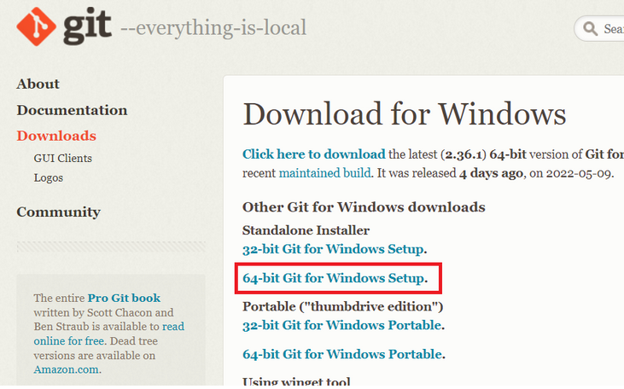

Git: Install and config
Git is a free and open-source version control system. It is used in software development. Git allows software developers to see the changes they made on the code, it gives them the ability to undo things if necessary and also helps a team of people to work together on a project.
Git can be downloaded as a software package on Windows, Mac, Linux platforms. After installing we need to configure the git. After configuration, we can only use it. git config command helps users to do so.
https://www.geeksforgeeks.org/how-to-set-up-git-using-git-config/?ref=lbp

Slide 19
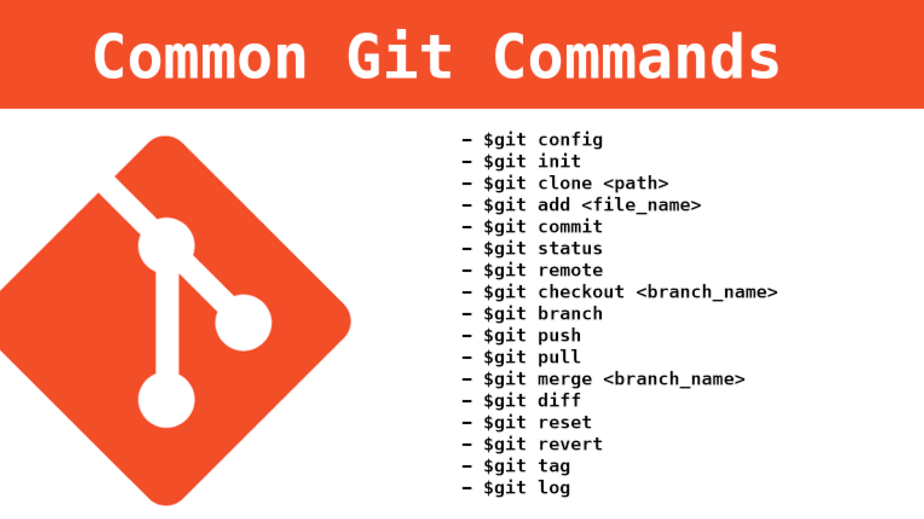
Git: Basic commands
Git init
The main purpose of the git init command is to initialize the new working environment or a new git repository to work on a new project. Before performing the git init command git will not track the files that are in the system it will start to track only when you initialize the git init command form there you can commit the files and push them to the remote repository.
https://www.geeksforgeeks.org/what-is-git-init/?ref=lbp
The git clone command is used to create a copy of a specific repository or branch within a repository. When you clone a repo you get a copy of the entire history of the repo. The command used for cloning any repository is:
git clone <repository-link>
https://www.geeksforgeeks.org/what-is-git-clone/?ref=lbp
For this, you have to use the command git add <filename>. This will add a specific file i.e., you choose from your working tree to the staging area. If you want to add all the files to the staging area then use git add. The dot(.) operator will take all the files and add them to the staging area.
git add . : Staged new and modified files without deleting.
git add -a : Staged all files to the staging area.
git add -u : Staged modified and deleted files.
https://www.geeksforgeeks.org/what-is-git-add/?ref=lbp
The git commit command is used to move files from the staging area to your local repository. This command is run after git add and it can be seen as a checkpoint. After executing the git commit, your staging area will be empty
https://www.geeksforgeeks.org/what-is-git-commit/?ref=lbp
The git status command is used to show the status of the git repository. This command displays the state of the local directory and the staging area.
https://www.geeksforgeeks.org/git-status/?ref=lbp

Slide 20
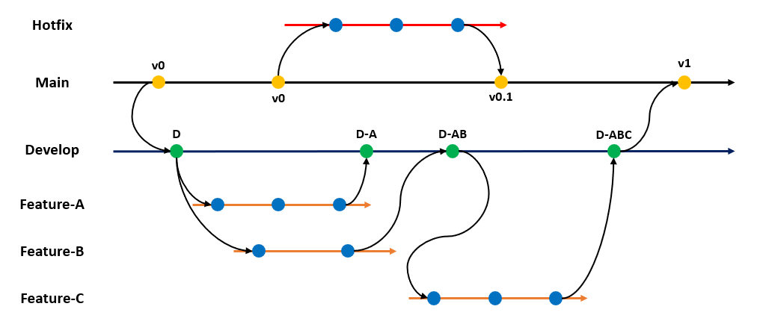
Git: Branching
Branching in Git is a helpful feature for software developers working on a big team project. It allows the team members to work on different aspects of the software by creating a branch from the main branch. The main branch is not affected by the changes in the created branch until it is merged into the main branch. Once, work is complete for the branch, it can be merged into the main branch to incorporate the changes. It can be used for better management of files related to the software. It also helps us try or experiment with adding some new features to the code; if it works well, it can be merged with the main code in the main branch. In this article, we will learn how to create a new branch in Git and push the code to it.
https://www.geeksforgeeks.org/how-to-create-a-new-branch-in-git-and-push-the-code/?ref=lbp

Slide 21
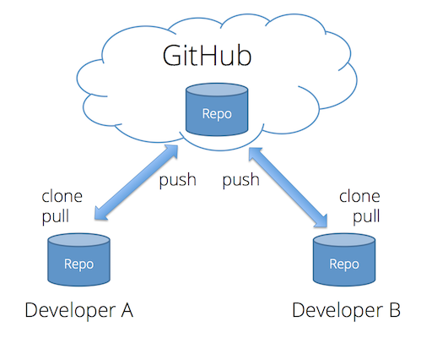
Git: Remote Repositories
Git relies on the basis of distributed development of software where more than one developer may have access to the source code of a specific application and can modify changes to it which may be seen by other developers. This is done by connecting the online repository with the developer’s local repository by remote access. Git provides a command ‘remote‘ to do the above-mentioned task.
git remote
Git ‘remote‘ command helps you to manage the set of repository whose branches you track. This command is used to perform the sync operations required to keep the local repository updated as per the central repository and also to update the changes made by the developer in the local repository on the central repository. These changes are pushed or fetched to/from the central repository with the use of push and pull commands.
Working with remote repositories is made easier with the use of some sub-commands under git remote command.
https://www.geeksforgeeks.org/handling-repositories-with-git-remote/?ref=lbp

Slide 22
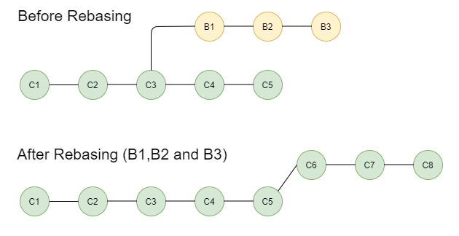
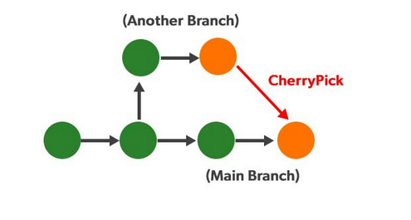
Git: Advanced
Rebasing in Git is a process of integrating a series of commits on top of another base tip. It takes all the commits of a branch and appends them to the commits of a new branch
The main aim of rebasing is to maintain a progressively straight and cleaner project history. Rebasing gives rise to a perfectly linear project history that can follow the end commit of the feature all the way to the beginning of the project without even forking. This makes it easier to navigate your project.
You can integrate the feature branch into the main branch in two ways. the first one is by merging directly into a main branch or first rebasing and then merging. The below diagram shows If you rebase the feature branch first it will facilitate a fast-forward merge. Integrating upstream updates into your local repository is frequently done by rebasing. Git merge causes an unnecessary merging to commit each time you want to see how the project has advanced when you pull in upstream modifications.
https://www.geeksforgeeks.org/rebasing-of-branches-in-git/?ref=lbp
git cherry-pick in git means choosing a commit from one branch and applying it to another branch. This is in contrast with other ways such as merge and rebases which normally apply many commits into another branch.
git cherry-pick is just like rebasing, an advanced concept and also a powerful command. It is mainly used if you don’t want to merge the whole branch and you want some of the commits.
Suppose a developer fails to recognize which branch he is currently on, and by mistake, he commits to another branch instead of committing to the main branch. Now to fix it, he has to first run git show, then save the commit, check out the main branch, apply a patch there, and commit with the same commit message. But all this can be done automatically by using just one command i.e. cherry-pick.
https://www.geeksforgeeks.org/git-cherry-pick/?ref=lbp

Slide 23
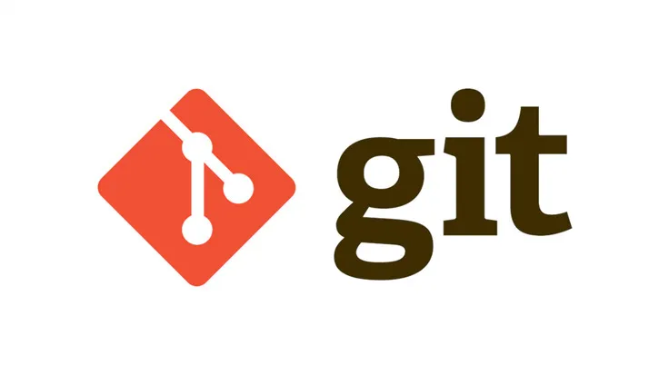
Git: Best practice: commit
Version control or source control is the practice of keeping track of changes that you had made to software code. Version control systems are the tools that help software teams manage changes to their source code. Version control software keeps track of every modification that you made to the code in a special kind of database. Version control software is the most important part of modern software developer practices. There are many version control software available in the market but the most commonly used version control software is Git.
In Git, we use the commit command to save changes to our repository after staging. In other words, git commit creates a commit, which is like a snapshot of your entire repository at a specific time. When you make a commit you have to add a commit message to it so that it can help you to identify a specific commit whenever there is a need of it in the future.
https://www.geeksforgeeks.org/how-to-write-good-commit-messages-in-github/?ref=lbp

Slide 24
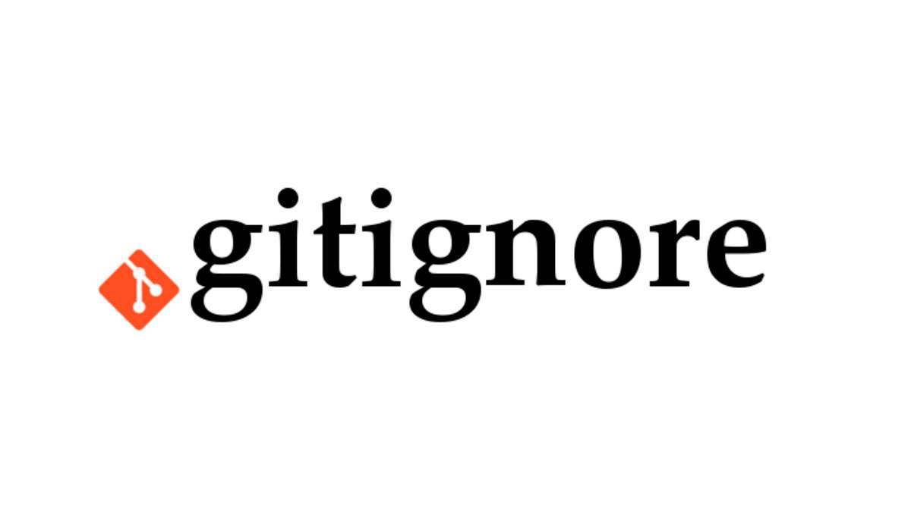
Git: Best practice: git-ignore
Gitignore
.gitignore file is used in a git repository to ignore the files and directories which are unnecessary to project this will be ignored by the git once the changes as been committed to the Remote repository. The type of files which will gets ignored are the mainly temporary files and the files which should not be versioned.
gitignore File (.gitignore)
When the git commits are pushed to to the remote repository to want to ignore some files then we will use .gitignore file is a text file that specifies which files and directories Git should ignore. Which will reduce the size of the repository.
https://www.geeksforgeeks.org/what-is-git-ignore-and-how-to-use-it/?ref=lbp

