Slide 1
Step 10. Monitoring

Slide 2
Agenda
Azure Monitoring
AWS Monitoring

Slide 3
Azure Monitoring
https://learn.microsoft.com/en-us/azure/azure-monitor/overview

Slide 4
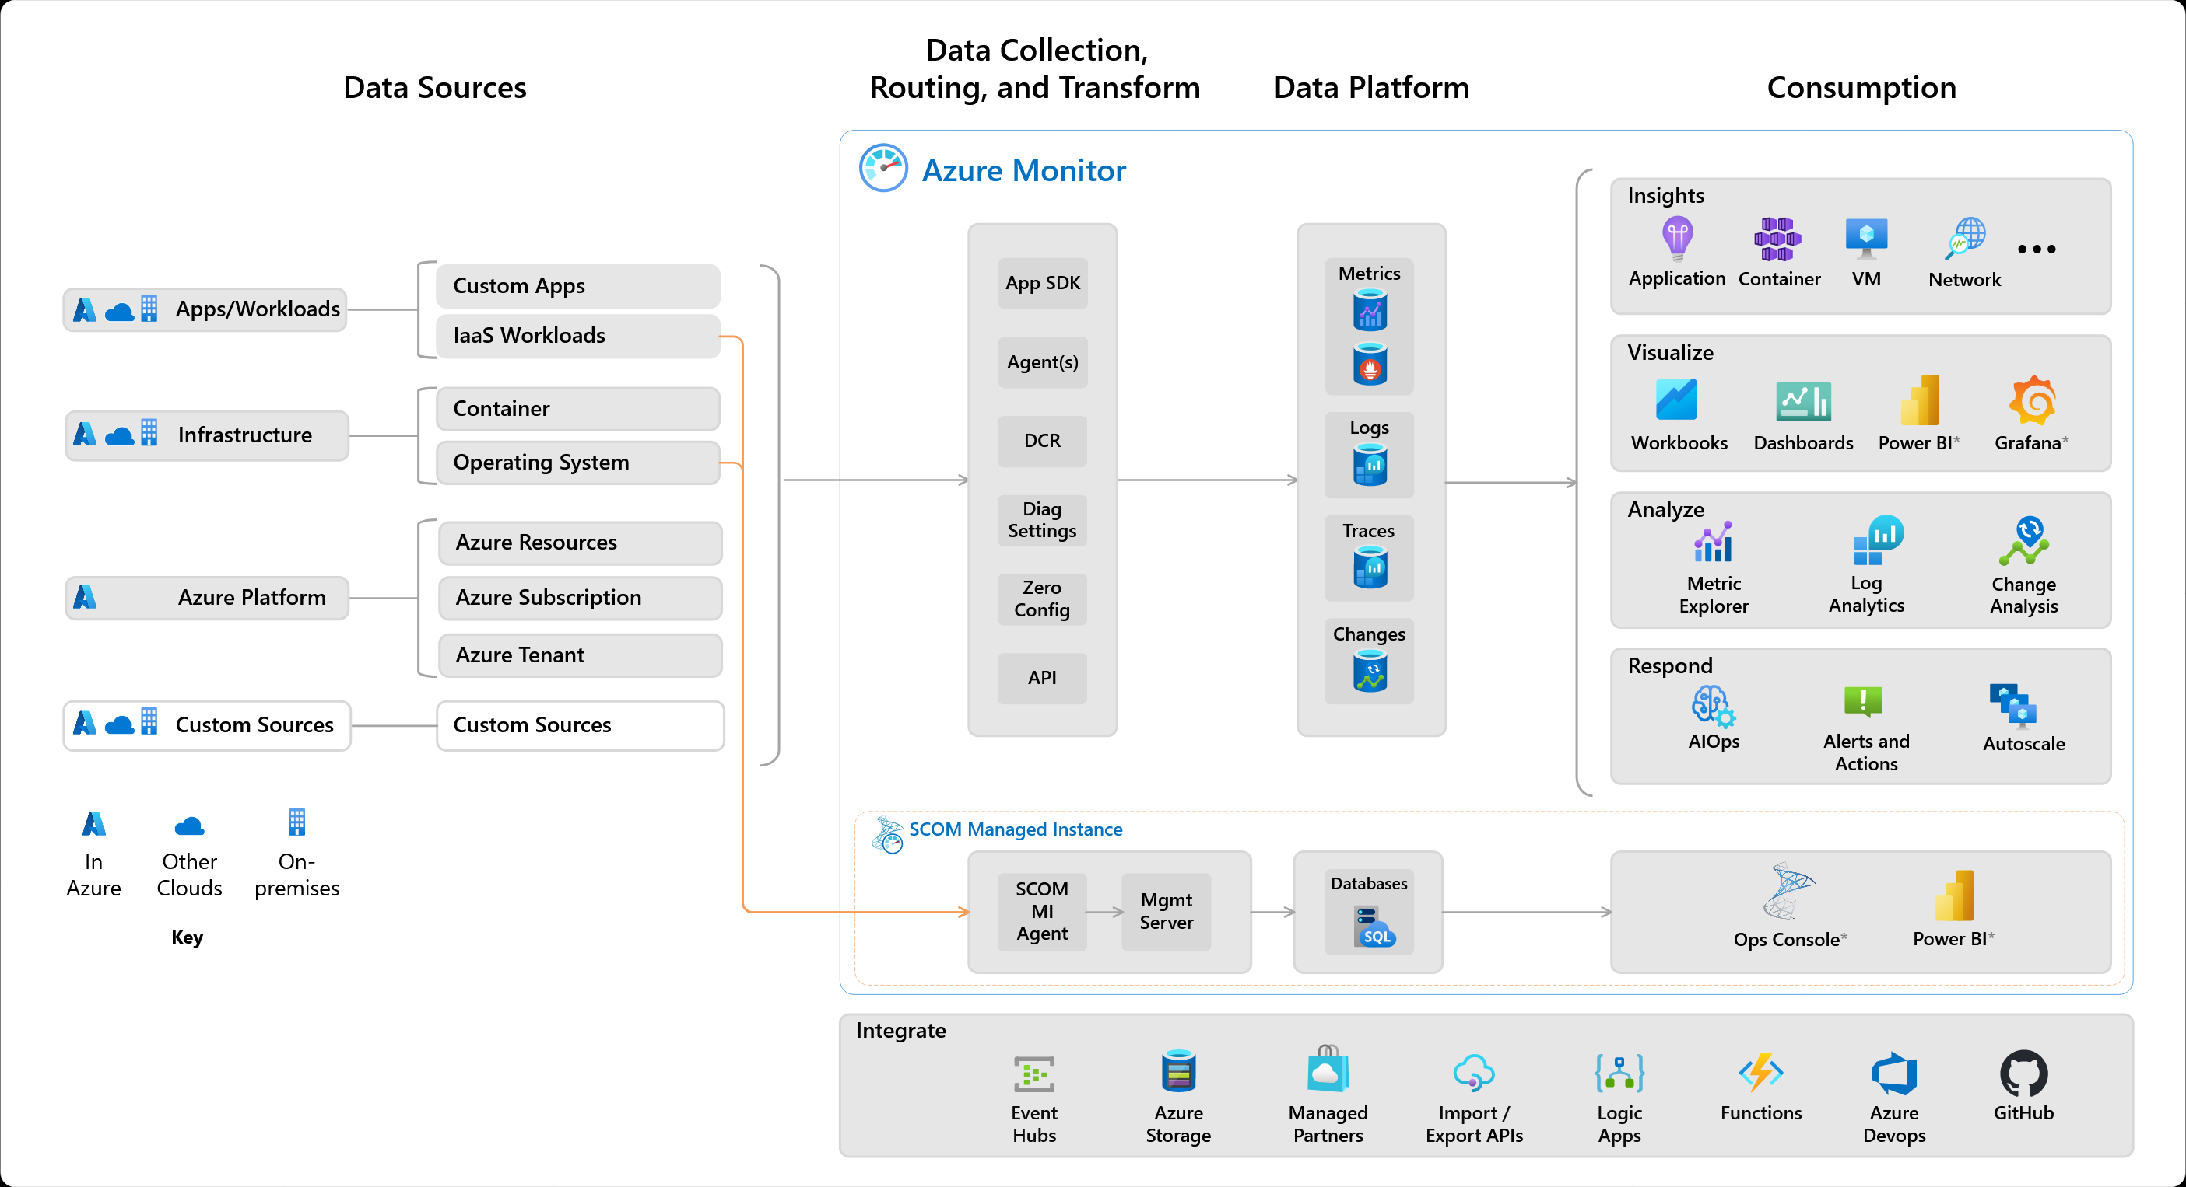
High level architecture
Azure Monitor is a comprehensive monitoring solution for collecting, analyzing, and responding to monitoring data from your cloud and on-premises environments. You can use Azure Monitor to maximize the availability and performance of your applications and services. It helps you understand how your applications are performing and allows you to manually and programmatically respond to system events.
Azure Monitor can monitor these types of resources in Azure, other clouds, or on-premises:
Applications
Virtual machines
Guest operating systems
Containers including Prometheus metrics
Databases
Security events in combination with Azure Sentinel
Networking events and health in combination with Network Watcher
Custom sources that use the APIs to get data into Azure Monitor
You can also export monitoring data from Azure Monitor into other systems so you can:
Integrate with other third-party and open-source monitoring and visualization tools
Integrate with ticketing and other ITSM systems

Slide 5
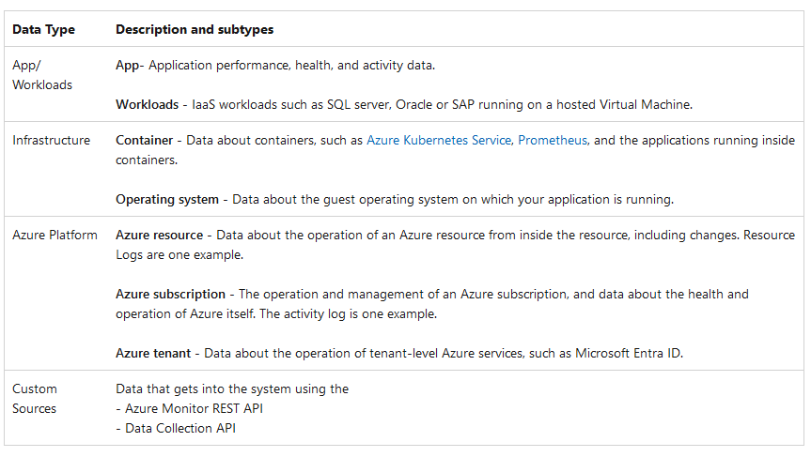
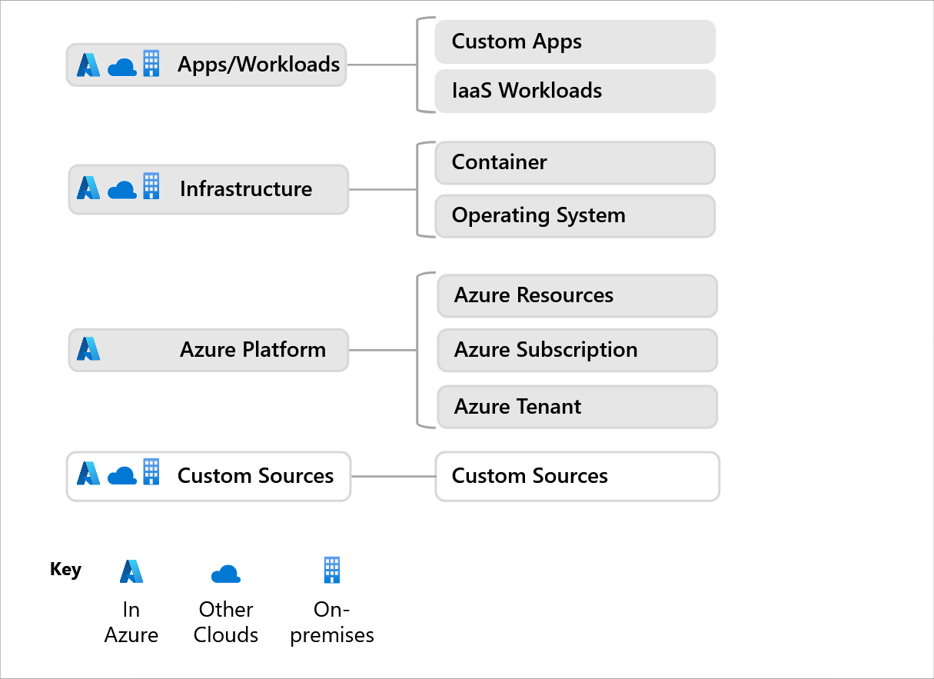
Data sources

Slide 6
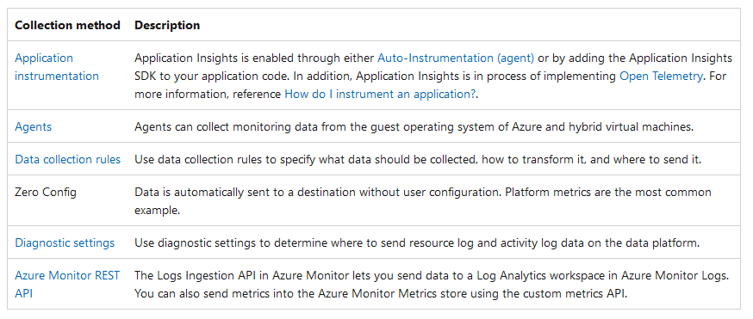
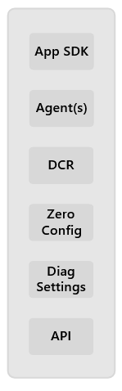
Data collection and routing

Slide 7
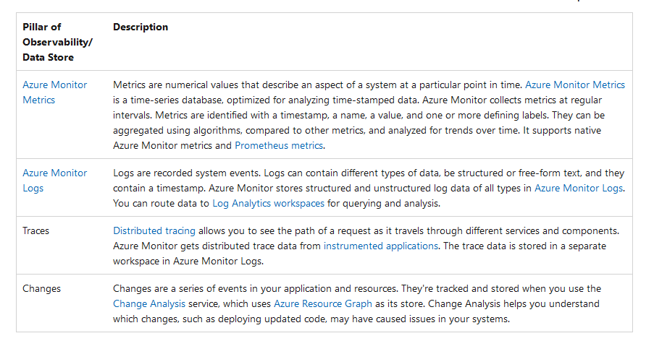
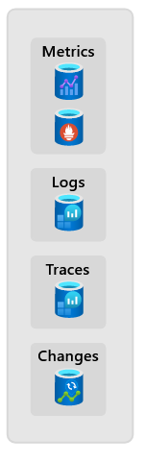
Data platform

Slide 8
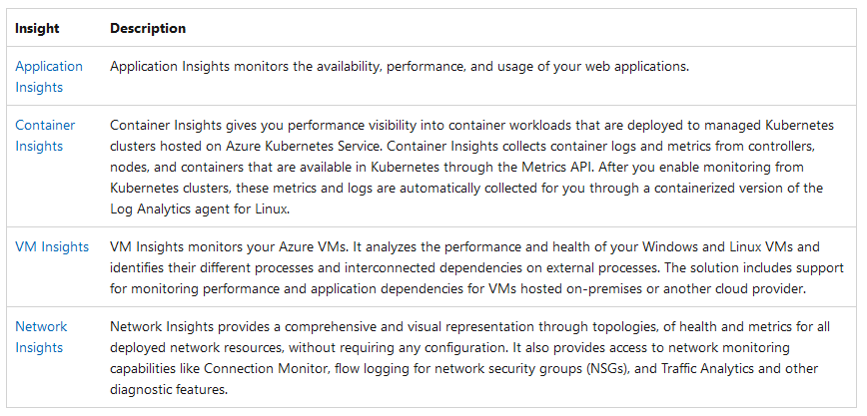
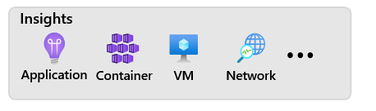
Consumption: Insights

Slide 9
Consumption: Insights

Slide 10
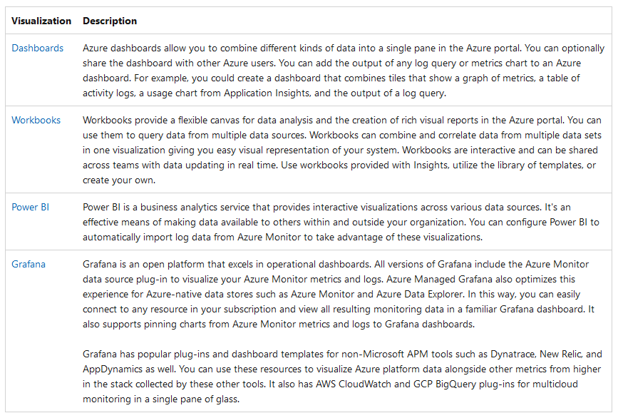
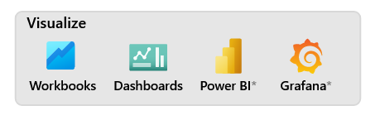
Consumption: Visualize

Slide 11
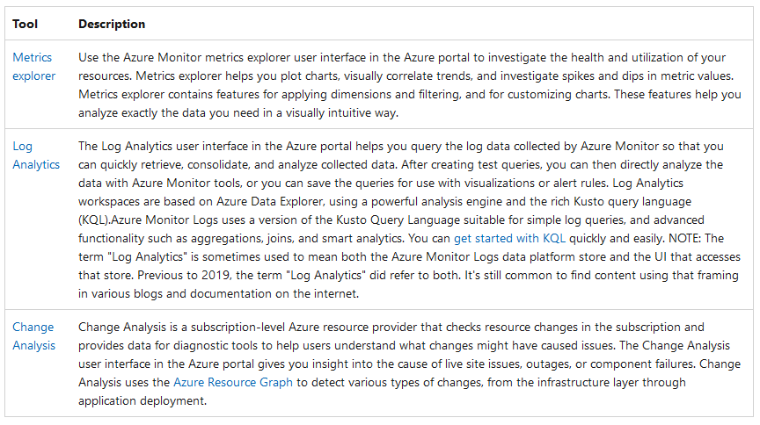
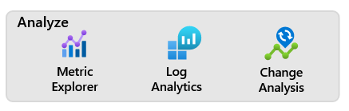
Consumption: Analyze

Slide 12
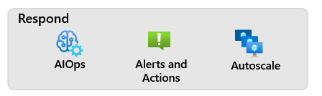
Consumption: Respond
Artificial Intelligence for IT Operations (AIOps) can improve service quality and reliability by using machine learning to process and automatically act on data you collect from applications, services, and IT resources into Azure Monitor. It automates data-driven tasks, predicts capacity usage, identifies performance issues, and detects anomalies across applications, services, and IT resources. These features simplify IT monitoring and operations without requiring machine learning expertise.
Azure Monitor Alerts notify you of critical conditions and can take corrective action. Alert rules can be based on metric or log data.
Metric alert rules provide near-real-time alerts based on collected metrics.
Log alerts rules based on logs allow for complex logic across data from multiple sources.
Autoscale allows you to dynamically control the number of resources running to handle the load on your application. You can create rules that use Azure Monitor metrics to determine when to automatically add resources when the load increases or remove resources that are sitting idle. You can specify a minimum and maximum number of instances, and the logic for when to increase or decrease resources to save money and to increase performance.

Slide 13
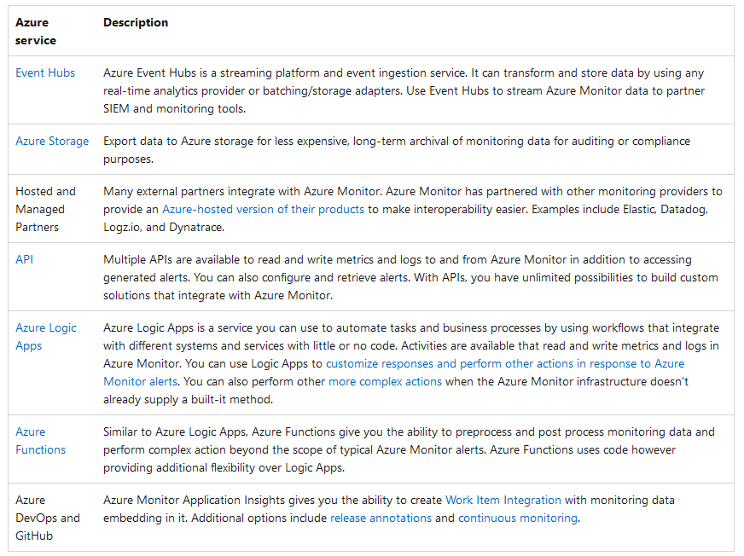
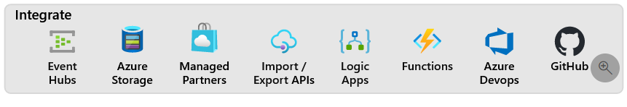
Integrate

Slide 14
AWS Monitoring
1. Event History
Your AWS account has Cloud Trail activated by default, and you have immediate access to the Cloud Trail Event history. A viewable, searchable, printable, and immutable record of the last 90 days’ worth of management events in an AWS Region is available in the Event history. The AWS Management Console, AWS Command Line Interface, and AWS SDKs and APIs are all used to perform the activities that these events record. The AWS Region where the event occurred is documented in the Event history. The Event history can be seen for free on Cloud Trail.
2. Cloud Trail Lake
A managed data lake called AWS Cloud Trail Lake is used to record, store, access, and analyze user and API activity on AWS for audit and security reasons. Existing events in row-based json format are converted to Apache ORC format by Cloud Trail Lake. A columnar storage format called ORC is designed for quick data retrieval. Event data stores, which are immutable collections of events based on criteria you choose by using sophisticated event selectors, aggregate events into immutable collections.
The event data can be kept in an event data storage for a maximum of seven years (2557 days). Using AWS Organizations, you may construct an event data store for a single AWS account or for a number of AWS accounts. Any Cloud Trail logs that you currently have can be imported into an existing or new event data store from your S3 buckets. With Lake dashboards, you can also see the top Cloud Trail event trends. See Creating an event data storage and Working with AWS Cloud Trail Lake for further details.
3. Trails
In addition to delivering and storing events in an Amazon S3 bucket, Trails can also deliver events to Amazon Cloud Watch Logs and Amazon Event Bridge. These occurrences can be entered into your security monitoring programs. You may also search and examine your Cloud Trail logs using custom third-party programs or programs like Amazon Athena.
Using AWS Organizations, you can build trails for a single AWS account or for a number of AWS accounts. Your management events can be analyzed for unusual behavior in API call volumes and error rates by logging Insights events. See Creating a trail for your AWS account for further details.
https://www.geeksforgeeks.org/aws-cloudtrail/

Slide 15
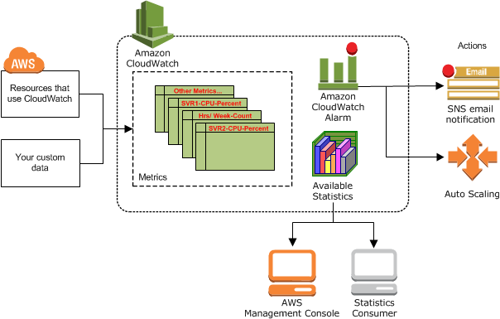
AWS CloudWatch
Amazon CloudWatch monitors your Amazon Web Services (AWS) resources and the applications you run on AWS in real time. You can use CloudWatch to collect and track metrics, which are variables you can measure for your resources and applications.
The CloudWatch home page automatically displays metrics about every AWS service you use. You can additionally create custom dashboards to display metrics about your custom applications, and display custom collections of metrics that you choose.
You can create alarms that watch metrics and send notifications or automatically make changes to the resources you are monitoring when a threshold is breached. For example, you can monitor the CPU usage and disk reads and writes of your Amazon EC2 instances and then use that data to determine whether you should launch additional instances to handle increased load. You can also use this data to stop under-used instances to save money.
With CloudWatch, you gain system-wide visibility into resource utilization, application performance, and operational health.
https://docs.aws.amazon.com/AmazonCloudWatch/latest/monitoring/WhatIsCloudWatch.html

Slide 16
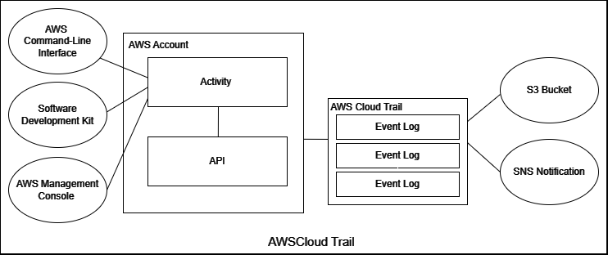
AWS CloudTrail
Your Amazon Web Services (AWS) account’s activity is tracked and recorded by the AWS CloudTrail service. It offers thorough logs of all API calls and operations made on your AWS resources. This is how AWS CloudTrail functions:
Data Collection : Activity in your AWS account is regularly monitored by CloudTrail. An API call is created whenever an AWS service or resource is used or updated.
Log Storage : You can define an Amazon S3 bucket where these log entries will be gathered and stored. For your CloudTrail logs, you may set the bucket’s location and retention time.
Access Control : Policies set forth by AWS Identity and Access Management (IAM) govern who has access to CloudTrail logs. Who is permitted to read, write, or administer CloudTrail logs can be specified.
Alerting and Notifications : You can configure in-the-moment alerts based on particular occurrences or trends in your CloudTrail logs using CloudWatch Alarms. This enables you to react rapidly to operational or security incidents.
Log Generation : Each time an API is called, CloudTrail creates a log entry with information on the caller, the action taken, the resource used, and the timestamp.
https://www.geeksforgeeks.org/aws-cloudtrail/

