Slide 1
Step 9. OS Administer

Slide 2
Agenda
Kubernetes

Slide 3
Linux OS

Slide 4
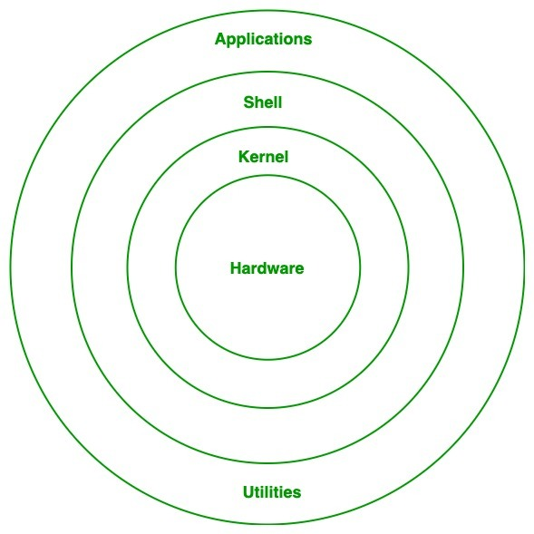
Architecture of Linux

Slide 5
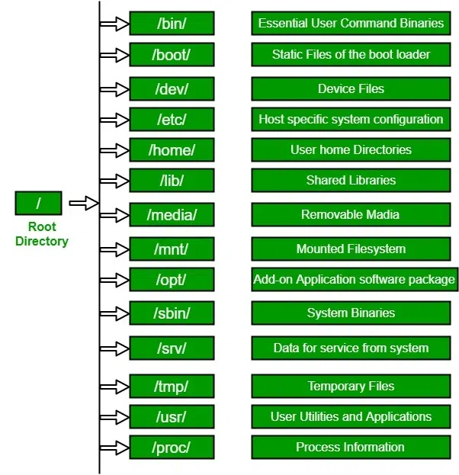
Linux File Hierarchy Structure

Slide 6
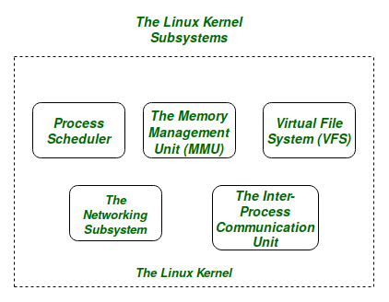
Linux Kernel

Slide 7
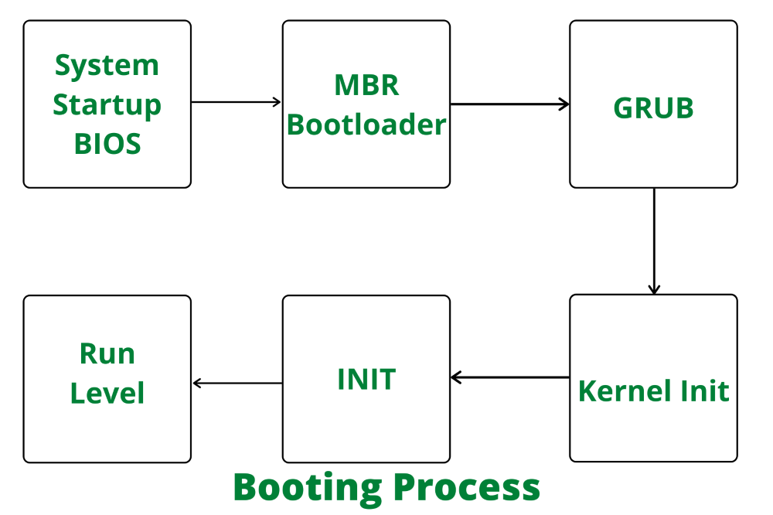
Stages of Linux Boot Process

Slide 8
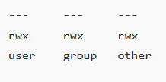
Linux Permissions

Slide 9

Linux Shells

Slide 10
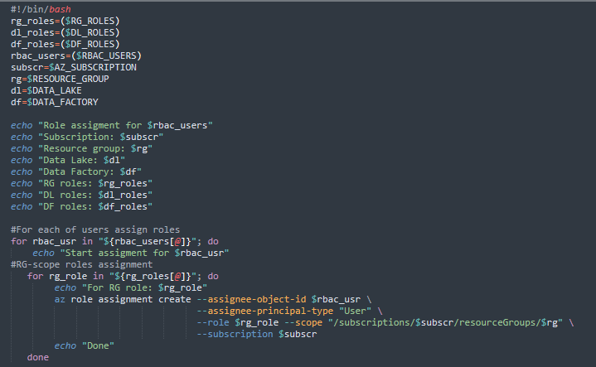
Linux Shells

Slide 11
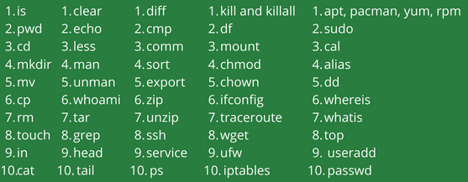
Basic Linux Command

