Slide 1
Step 9. OS Administer

Slide 2
Agenda
Linux OS
Windows OS

Slide 3
Linux OS

Slide 4
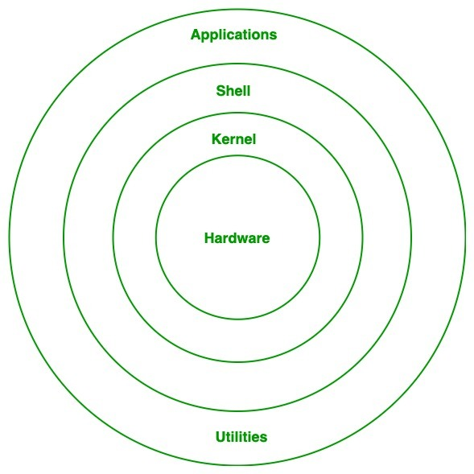
Architecture of Linux

Slide 5
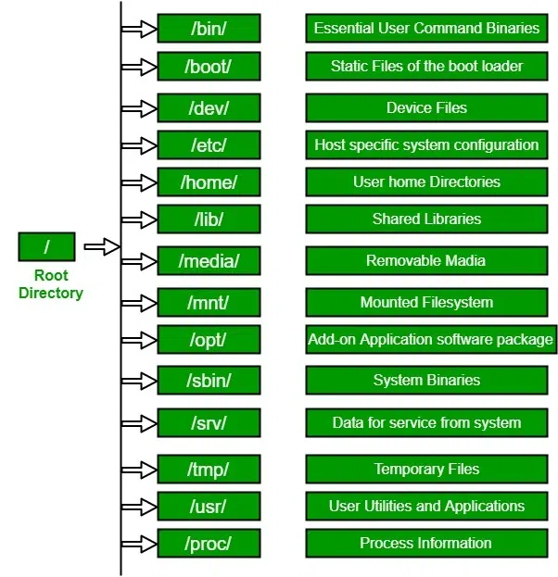
Linux File Hierarchy Structure

Slide 6
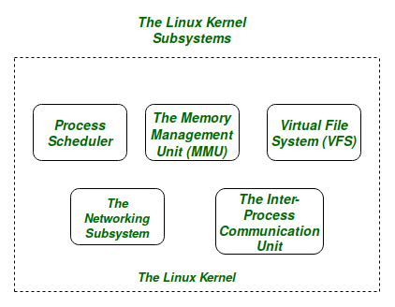
Linux Kernel

Slide 7
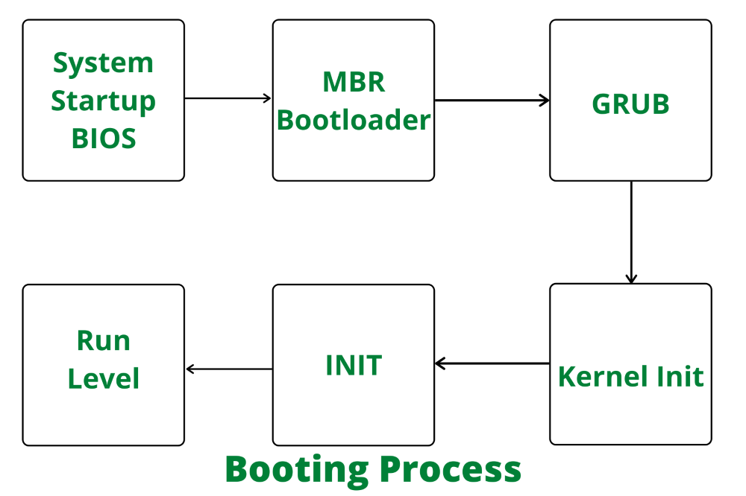
Stages of Linux Boot Process

Slide 8
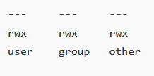
Linux Permissions

Slide 9

Linux Shells

Slide 10
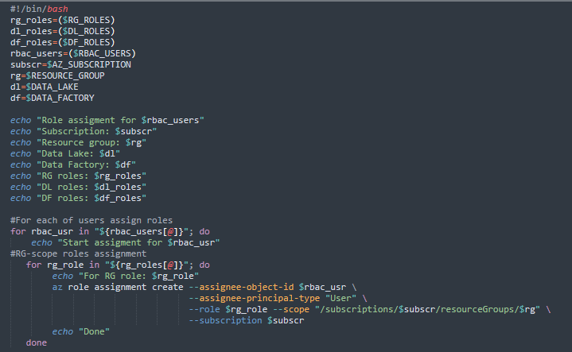
Linux Shells Scripts

Slide 11
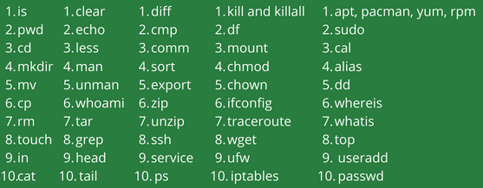
Basic Linux Command

Slide 12
Windows OS

Slide 13
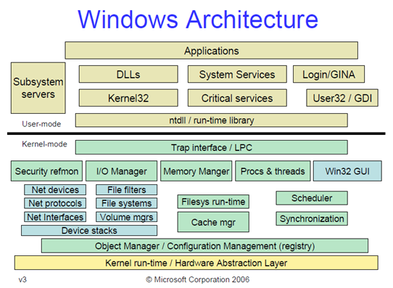
Architecture of Windows

Slide 14
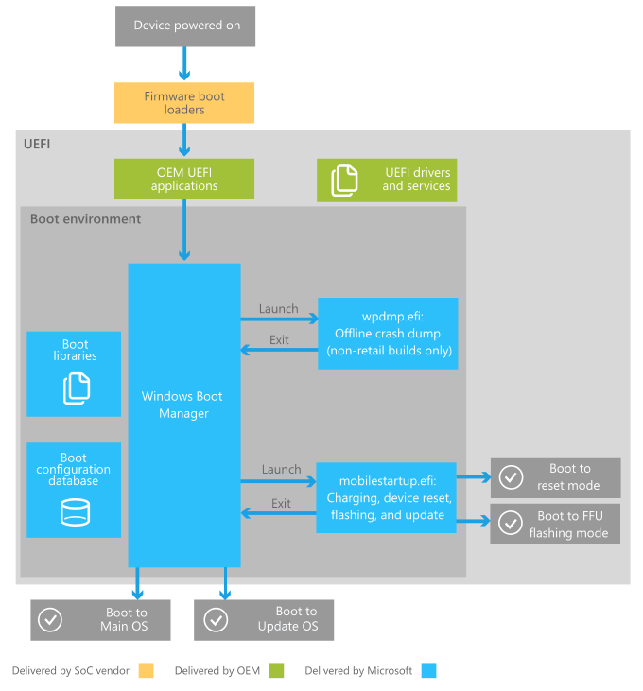
Stages of Windows Boot Process

Slide 15
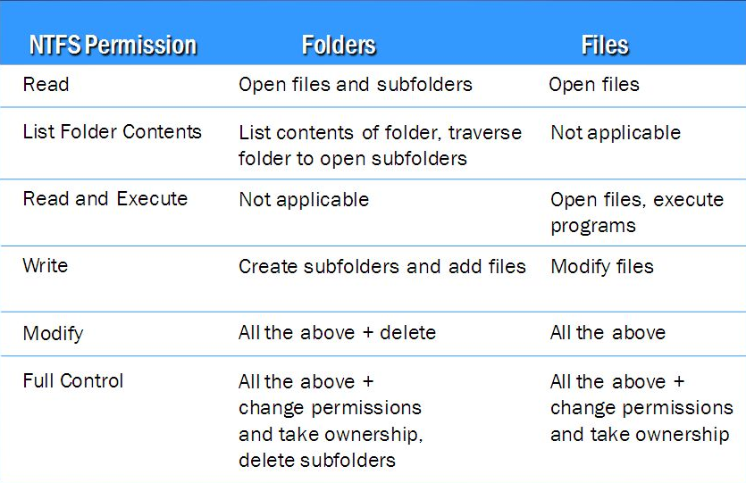
NTFS Permissions

Slide 16


Windows Shells

Slide 17
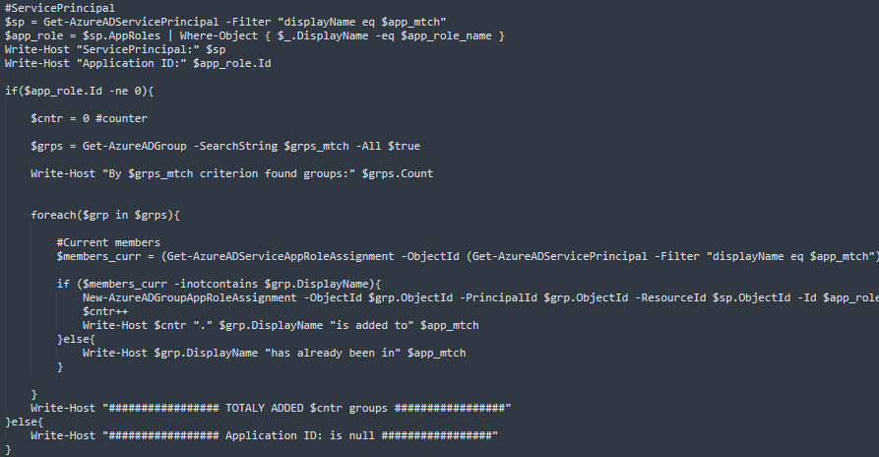
Windows Shells Scripts

Slide 18
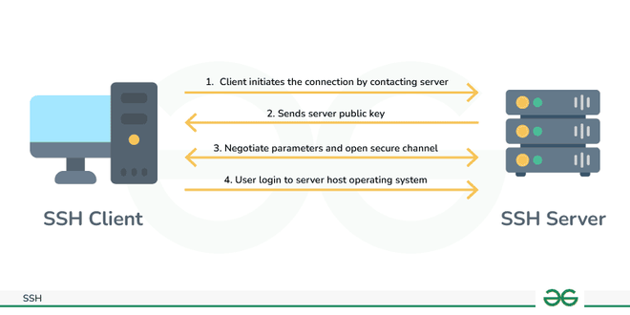
SSH

Slide 19
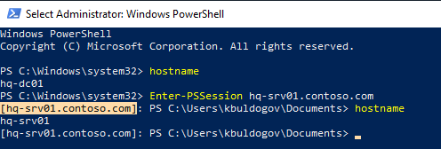
Enter-PSSession

