Slide 1
Step 9. OS Administer

Slide 2
Agenda
Kubernetes

Slide 3
Linux OS

Slide 4
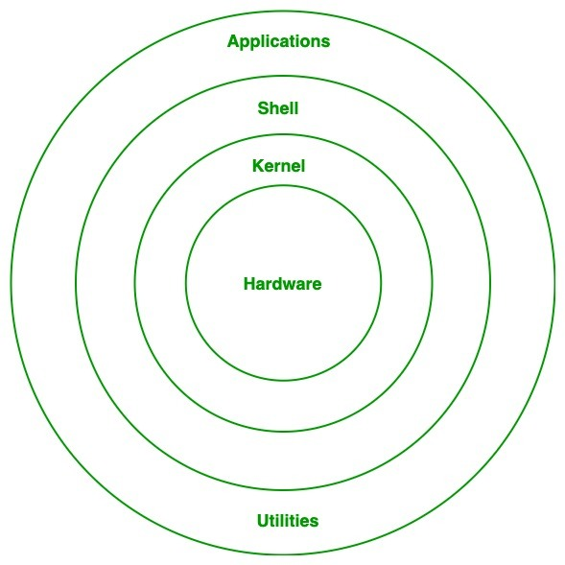
Architecture of Linux
Kernel: Kernel is the core of the Linux based operating system. It virtualizes the common hardware resources of the computer to provide each process with its virtual resources. This makes the process seem as if it is the sole process running on the machine. The kernel is also responsible for preventing and mitigating conflicts between different processes. Different types of the kernel are:
Monolithic Kernel
Hybrid kernels
Exo kernels
Micro kernels
System Library:Linux uses system libraries, also known as shared libraries, to implement various functionalities of the operating system. These libraries contain pre-written code that applications can use to perform specific tasks. By using these libraries, developers can save time and effort, as they don’t need to write the same code repeatedly. System libraries act as an interface between applications and the kernel, providing a standardized and efficient way for applications to interact with the underlying system.
Shell:The shell is the user interface of the Linux Operating System. It allows users to interact with the system by entering commands, which the shell interprets and executes. The shell serves as a bridge between the user and the kernel, forwarding the user’s requests to the kernel for processing. It provides a convenient way for users to perform various tasks, such as running programs, managing files, and configuring the system.
Hardware Layer: The hardware layer encompasses all the physical components of the computer, such as RAM (Random Access Memory), HDD (Hard Disk Drive), CPU (Central Processing Unit), and input/output devices. This layer is responsible for interacting with the Linux Operating System and providing the necessary resources for the system and applications to function properly. The Linux kernel and system libraries enable communication and control over these hardware components, ensuring that they work harmoniously together.
System Utility: System utilities are essential tools and programs provided by the Linux Operating System to manage and configure various aspects of the system. These utilities perform tasks such as installing software, configuring network settings, monitoring system performance, managing users and permissions, and much more. System utilities simplify system administration tasks, making it easier for users to maintain their Linux systems efficiently.
https://www.geeksforgeeks.org/videos/linux-architecture/

Slide 5
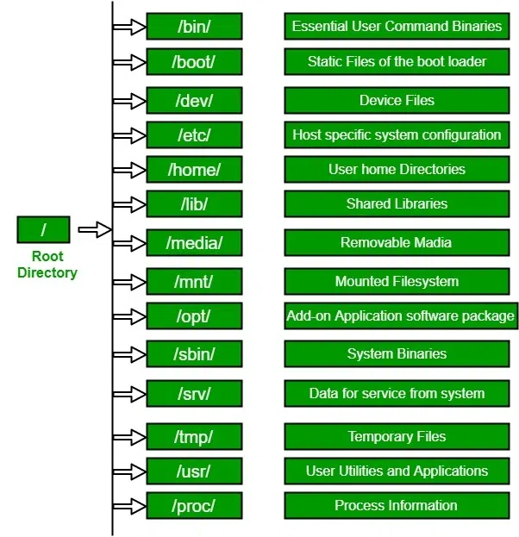
Linux File Hierarchy Structure
The Linux File Hierarchy Structure or the Filesystem Hierarchy Standard (FHS) defines the directory structure and directory contents in Unix-like operating systems. It is maintained by the Linux Foundation.
In the FHS, all files and directories appear under the root directory /, even if they are stored on different physical or virtual devices.
Some of these directories only exist on a particular system if certain subsystems, such as the X Window System, are installed.
Most of these directories exist in all UNIX operating systems and are generally used in much the same way; however, the descriptions here are those used specifically for the FHS and are not considered authoritative for platforms other than Linux.
https://www.geeksforgeeks.org/linux-file-hierarchy-structure/?ref=lbp
https://www.geeksforgeeks.org/linux-directory-structure/?ref=lbp

Slide 6
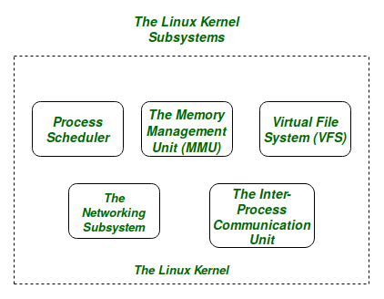
Linux Kernel
Figure: The Linux Kernel for the purpose of this article we will only be focusing on the 1st three important subsystems of the Linux Kernel. The basic functioning of each of the 1st three subsystems is elaborated below:
The Process Scheduler: This kernel subsystem is responsible for fairly distributing the CPU time among all the processes running on the system simultaneously.
The Memory Management Unit: This kernel sub-unit is responsible for proper distribution of the memory resources among the various processes running on the system. The MMU does more than just simply provide separate virtual address spaces for each of the processes.
The Virtual File System: This subsystem is responsible for providing a unified interface to access stored data across different filesystems and physical storage media.
https://www.geeksforgeeks.org/the-linux-kernel/?ref=lbp

Slide 7
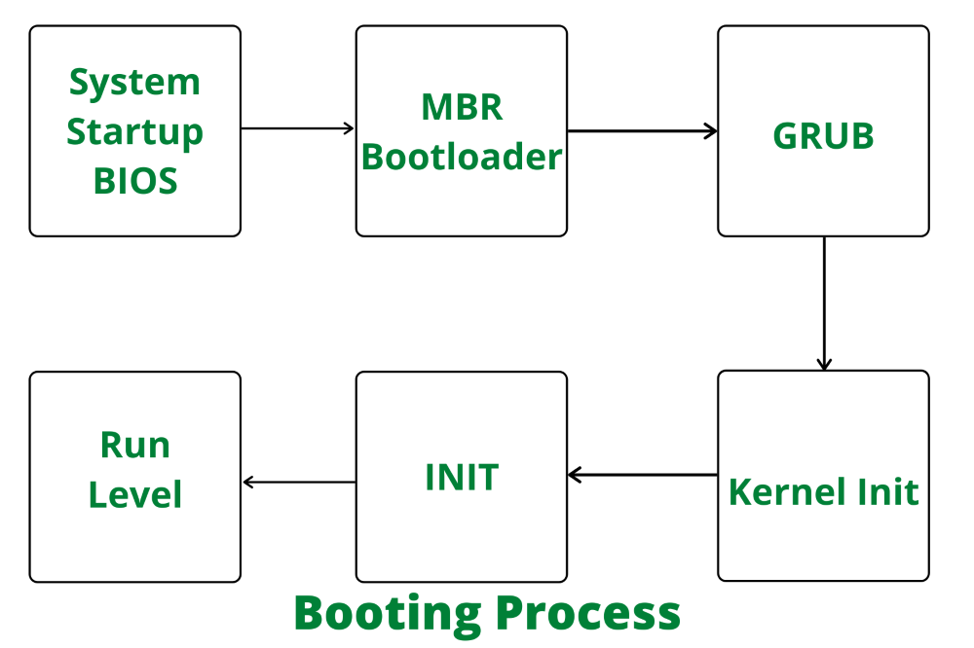
Stages of Linux Boot Process
Stages of Linux Boot Process:
The machine’s BIOS (Basic Input/Output System) or boot microcode hundreds and runs a boot loader.
Boot loader finds the kernel image on the disk and loads it into memory, to start the system.
The kernel initializes the devices and their drivers.
The kernel mounts the basis filesystem.
The kernel starts a program referred to as init with a method ID zero
init sets the remainder of the system processes in motion.
For some purpose, init starts a method permitting you to log in, typically at the top or close to the top of the boot sequence.

Slide 8
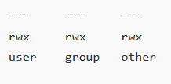
Linux Permissions
Owners: These permissions apply exclusively to the individuals who own the files or directories.
Groups: Permissions can be assigned to a specific group of users, impacting only those within that particular group.
All Users: These permissions apply universally to all users on the system, presenting the highest security risk. Assigning permissions to all users should be done cautiously to prevent potential security vulnerabilities.
https://www.geeksforgeeks.org/permissions-in-linux/?ref=header_search

Slide 9

Linux Shells
A shell is a special user program that provides an interface for the user to use operating system services. Shell accepts human-readable commands from users and converts them into something which the kernel can understand. It is a command language interpreter that executes commands read from input devices such as keyboards or from files. The shell gets started when the user logs in or starts the terminal.
https://www.geeksforgeeks.org/introduction-linux-shell-shell-scripting/
https://www.geeksforgeeks.org/different-shells-in-linux/?ref=lbp

Slide 10
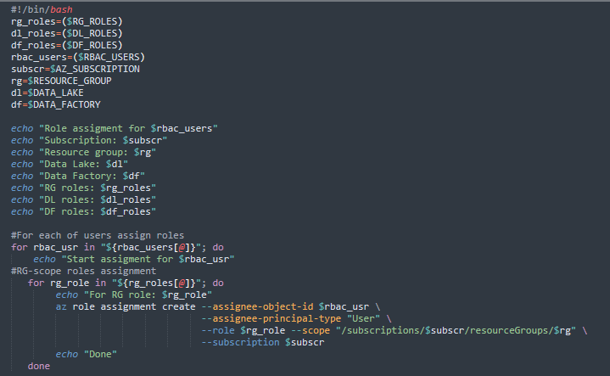
Linux Shells Scripts
There are many Shells available in Linux, such as The bourne shell(sh), The Korn Shell(ksh), and GNU Bourne-Again Shell(bash). Scripts written for the sh shell are called shell scripts, and they can be interpreted by both, the ksh and bash shells. ksh and Bash are improved versions of the original sh shell and they have more features than sh. Bash is generally the default shell in most of the Linux Distributions and scripts written specifically for bash shell are called bash scripts.
You can specify which shell the script will use, even if the script is executed from another shell terminal. To do this, add “#!” on top of the script file, followed by the absolute path of the shell of choice. To specify bash as an interpreter, Add the following line on top of the shell script.

Slide 11
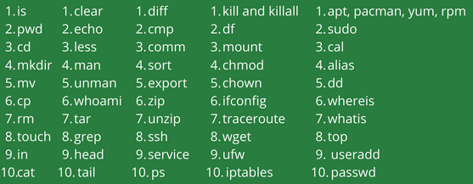
Basic Linux Command

Slide 12
Windows OS

Slide 13
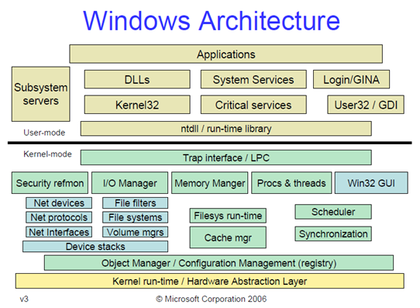
Architecture of Windows
The architecture of Windows NT, a line of operating systems produced and sold by Microsoft, is a layered design that consists of two main components, user mode and kernel mode. It is a preemptive, reentrant multitasking operating system, which has been designed to work with uniprocessor and symmetrical multiprocessor (SMP)-based computers. To process input/output (I/O) requests, it uses packet-driven I/O, which utilizes I/O request packets (IRPs) and asynchronous I/O. Starting with Windows XP, Microsoft began making 64-bit versions of Windows available; before this, there were only 32-bit versions of these operating systems.
Programs and subsystems in user mode are limited in terms of what system resources they have access to, while the kernel mode has unrestricted access to the system memory and external devices. Kernel mode in Windows NT has full access to the hardware and system resources of the computer. The Windows NT kernel is a hybrid kernel; the architecture comprises a simple kernel, hardware abstraction layer (HAL), drivers, and a range of services (collectively named Executive), which all exist in kernel mode.[1]
https://en.wikipedia.org/wiki/Architecture_of_Windows_NT

Slide 14
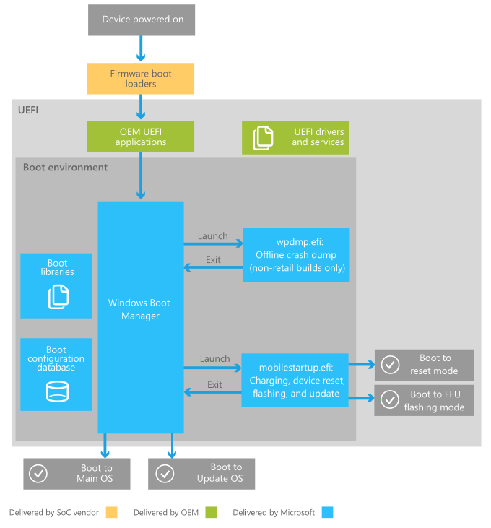
Stages of Windows Boot Process
The device is powered on and runs the SoC-specific firmware boot loaders, which initialize the hardware on the device and provide emergency flashing functionality.
The firmware boot loaders boot the UEFI environment and hands over control to UEFI applications written by the SoC vendor, Microsoft, and OEMs. These applications can utilize UEFI drivers and services.
The UEFI environment launches the Windows Boot Manager, which determines whether to boot to Full Flash Update (FFU) image flashing or device reset mode, to the update OS, or to the main OS.
https://learn.microsoft.com/en-us/windows-hardware/drivers/bringup/boot-and-uefi

Slide 15
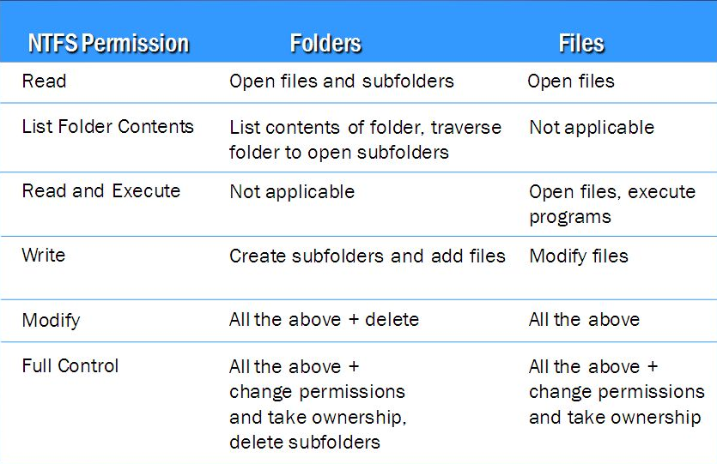
NTFS Permissions

Slide 16
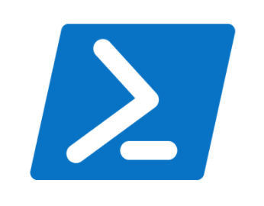
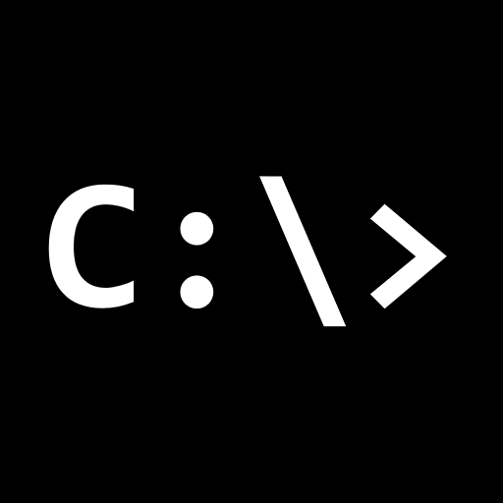
Windows shells
Windows has two command-line shells: the Command shell and PowerShell. Each shell is a software program that provides direct communication between you and the operating system or application, providing an environment to automate IT operations.
The Command shell was the first shell built into Windows to automate routine tasks, like user account management or nightly backups, with batch (.bat) files. With Windows Script Host, you could run more sophisticated scripts in the Command shell. For more information, see cscript or wscript. You can perform operations more efficiently by using scripts than you can by using the user interface. Scripts accept all commands that are available at the command line.
PowerShell was designed to extend the capabilities of the Command shell to run PowerShell commands called cmdlets. Cmdlets are similar to Windows Commands but provide a more extensible scripting language. You can run both Windows Commands and PowerShell cmdlets in PowerShell, but the Command shell can only run Windows Commands and not PowerShell cmdlets.
https://learn.microsoft.com/en-us/windows-server/administration/windows-commands/windows-commands

Slide 17
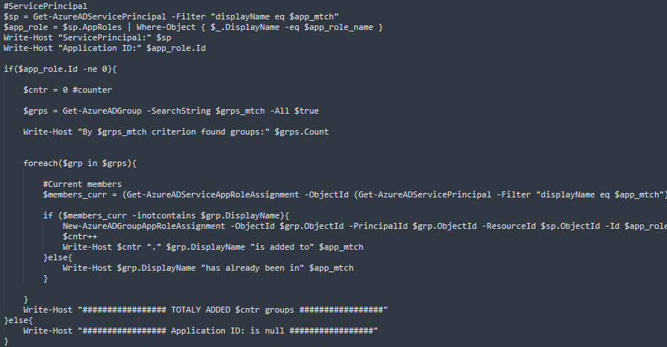
Windows Shells Scripts

Slide 18
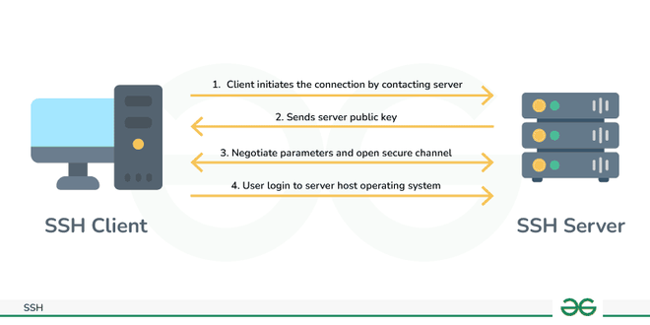
SSH
The SSH(Secure Shell) is an access credential that is used in the SSH Protocol. In other words, it is a cryptographic network protocol that is used for transferring encrypted data over the network. The port number of SSH is 22(Twenty-Two). It allows you to connect to a server, or multiple servers, without having to remember or enter your password for each system that is to log remotely from one system to another. It always comes in key pairs:
Public key – Everyone can see it, no need to protect it. (for encryption function).
Private key – Stays in computer, must be protected. (for decryption function).
Key pairs can be of the following types:
User Key – If the public key and private key remain with the user.
Host Key – If public key and private key are on a remote system.
Session key – Used when a large amount of data is to be transmitted.
https://www.geeksforgeeks.org/introduction-to-sshsecure-shell-keys/

Slide 19
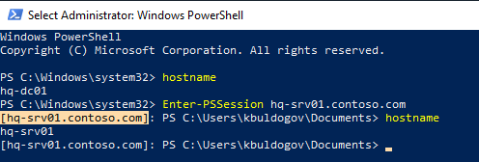
Powershell Remoting
Using the WS-Management protocol, Windows PowerShell remoting lets you run any Windows PowerShell command on one or more remote computers. You can establish persistent connections, start interactive sessions, and run scripts on remote computers.
PowerShell Remoting uses Windows Remote Management (WinRM) to allow users to run PowerShell commands on remote computers. WinRM is the Microsoft implementation of the Web Services for Management (WS-Management) protocol. You can find more information about using PowerShell Remoting at Running Remote Commands.
PowerShell Remoting isn't the same as using the ComputerName parameter of a cmdlet to run it on a remote computer, which uses Remote Procedure Call (RPC) as its underlying protocol.
PowerShell Remoting (and WinRM) listen on the following ports:
HTTP: 5985
HTTPS: 5986
By default, PowerShell Remoting only allows connections from members of the Administrators group. Sessions are launched under the user's context, so all operating system access controls applied to individual users and groups continue to apply to them while connected over PowerShell Remoting.
https://learn.microsoft.com/en-us/powershell/scripting/learn/remoting/winrmsecurity?view=powershell-7.4

