Slide 1
Step 3. Cloud Platforms

Slide 2
Agenda
Cloud Computing
AWS
Azure

Slide 3
Cloud Computing

Slide 4
What Is Cloud Computing?
Cloud Computing means storing and accessing the data and programs on remote servers that are hosted on the internet instead of the computer’s hard drive or local server. Cloud computing is also referred to as Internet-based computing, it is a technology where the resource is provided as a service through the Internet to the user. The data that is stored can be files, images, documents, or any other storable document.
The following are some of the Operations that can be performed with Cloud Computing
Storage, backup, and recovery of data
Delivery of software on demand
Development of new applications and services
Streaming videos and audio

Slide 5
Types of Cloud Computing
The following are the types of Cloud Computing:
Infrastructure as a Service (IaaS)
Platform as a Service (PaaS)
Software as a Service (SaaS)
Infrastructure as a Service ( IaaS )
Flexibility and Control: IaaS comes up with providing virtualized computing resources such as VMs, Storage, and networks facilitating users with control over the Operating system and applications.
Reducing Expenses of Hardware: IaaS provides business cost savings with the elimination of physical infrastructure investments making it cost-effective.
Scalability of Resources: The cloud provides in scaling of hardware resources up or down as per demand facilitating optimal performance with cost efficiency.
Platform as a Service ( PaaS )
Simplifying the Development: Platform as a Service offers application development by keeping the underlying Infrastructure as an Abstraction. It helps the developers to completely focus on application logic ( Code ) and background operations are completely managed by the AWS platform.
Enhancing Efficiency and Productivity: PaaS lowers the Management of Infrastructure complexity, speeding up the Execution time and bringing the updates quickly to market by streamlining the development process.
Automation of Scaling: Management of resource scaling, guaranteeing the program’s workload efficiency is ensured by PaaS.
SaaS (software as a service)
Collaboration And Accessibility: Software as a Service (SaaS) helps users to easily access applications without having the requirement of local installations. It is fully managed by the AWS Software working as a service over the internet encouraging effortless cooperation and ease of access.
Automation of Updates: SaaS providers manage the handling of software maintenance with automatic latest updates ensuring users gain experience with the latest features and security patches.
Cost Efficiency: SaaS acts as a cost-effective solution by reducing the overhead of IT support by eliminating the need for individual software licenses.
Function as a Service (FaaS)
Event-Driven Execution: FaaS helps in the maintenance of servers and infrastructure making users worry about it. FaaS facilitates the developers to run code as a response to the events.
Cost Efficiency: FaaS facilitates cost efficiency by coming up with the principle “Pay as per you Run” for the computing resources used.
Scalability and Agility: Serverless Architectures scale effortlessly in handing the workloads promoting agility in development and deployment.
To know more about the Types of Cloud Computing Difference please read this article – IaaS vs PaaS vs SaaS

Slide 6
Types of Cloud
Public cloud
Private cloud
Hybrid cloud
Community cloud
Multicloud

Slide 7
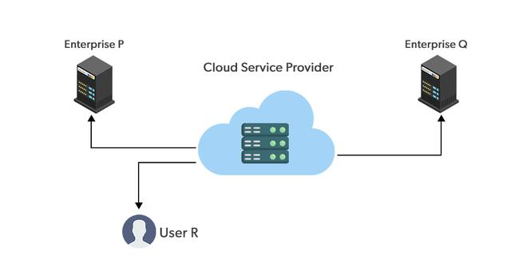
Public Cloud
Public clouds are managed by third parties which provide cloud services over the internet to the public, these services are available as pay-as-you-go billing models.
They offer solutions for minimizing IT infrastructure costs and become a good option for handling peak loads on the local infrastructure. Public clouds are the go-to option for small enterprises, which can start their businesses without large upfront investments by completely relying on public infrastructure for their IT needs.
The fundamental characteristics of public clouds are multitenancy. A public cloud is meant to serve multiple users, not a single customer. A user requires a virtual computing environment that is separated, and most likely isolated, from other users.
Public cloud
Advantages of using a Public cloud are:
High Scalability
Cost Reduction
Reliability and flexibility
Disaster Recovery
Disadvantages of using a Public cloud are:
Loss of control over data
Data security and privacy
Limited Visibility
Unpredictable cost

Slide 8
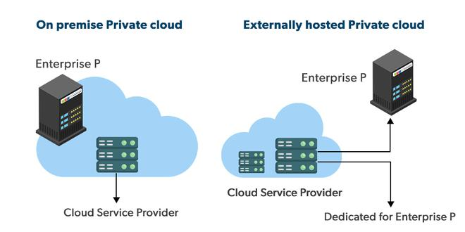
Private cloud
Private clouds are distributed systems that work on private infrastructure and provide the users with dynamic provisioning of computing resources. Instead of a pay-as-you-go model in private clouds, there could be other schemes that manage the usage of the cloud and proportionally billing of the different departments or sections of an enterprise. Private cloud providers are HP Data Centers, Ubuntu, Elastic-Private cloud, Microsoft, etc.
Private Cloud
The advantages of using a private cloud are as follows:
Customer information protection: In the private cloud security concerns are less since customer data and other sensitive information do not flow out of private infrastructure.
Infrastructure ensuring SLAs: Private cloud provides specific operations such as appropriate clustering, data replication, system monitoring, and maintenance, disaster recovery, and other uptime services.
Compliance with standard procedures and operations: Specific procedures have to be put in place when deploying and executing applications according to third-party compliance standards. This is not possible in the case of the public cloud.
Disadvantages of using a private cloud are:
The restricted area of operations: Private cloud is accessible within a particular area. So the area of accessibility is restricted.
Expertise requires: In the private cloud security concerns are less since customer data and other sensitive information do not flow out of private infrastructure. Hence skilled people are required to manage & operate cloud services.

Slide 9
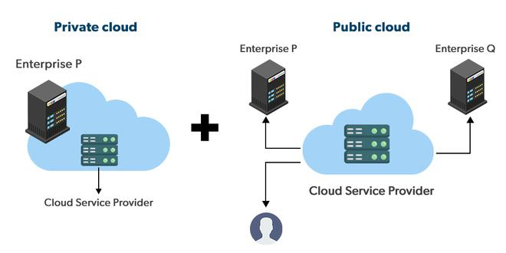
Hybrid cloud
A hybrid cloud is a heterogeneous distributed system formed by combining facilities of the public cloud and private cloud. For this reason, they are also called heterogeneous clouds.
A major drawback of private deployments is the inability to scale on-demand and efficiently address peak loads. Here public clouds are needed. Hence, a hybrid cloud takes advantage of both public and private clouds.
Hybrid Cloud
Advantages of using a Hybrid cloud are:
1) Cost: Available at a cheap cost than other clouds because it is formed by a distributed system.
2) Speed: It is efficiently fast with lower cost, It reduces the latency of the data transfer process.
3) Security: Most important thing is security. A hybrid cloud is totally safe and secure because it works on the distributed system network.
Disadvantages of using a Hybrid cloud are:
It’s possible that businesses lack the internal knowledge necessary to create such a hybrid environment. Managing security may also be more challenging. Different access levels and security considerations may apply in each environment.
Managing a hybrid cloud may be more difficult. With all of the alternatives and choices available today, not to mention the new PaaS components and technologies that will be released every day going forward, public cloud and migration to public cloud are already complicated enough. It could just feel like a step too far to include hybrid.

Slide 10
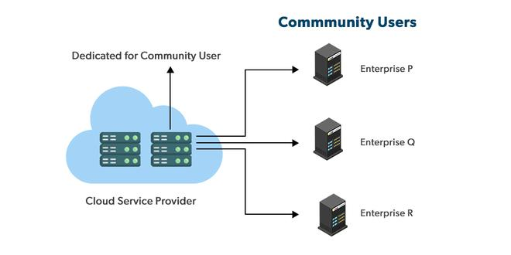
Community cloud
Community clouds are distributed systems created by integrating the services of different clouds to address the specific needs of an industry, a community, or a business sector. But sharing responsibilities among the organizations is difficult.
In the community cloud, the infrastructure is shared between organizations that have shared concerns or tasks. An organization or a third party may manage the cloud.
Community Cloud
Advantages of using Community cloud are:
Because the entire cloud is shared by numerous enterprises or a community, community clouds are cost-effective.
Because it works with every user, the community cloud is adaptable and scalable. Users can alter the documents according to their needs and requirements.
Public cloud is less secure than the community cloud, which is more secure than private cloud.
Thanks to community clouds, we may share cloud resources, infrastructure, and other capabilities between different enterprises.
Disadvantages of using Community cloud are:
Not all businesses should choose community cloud.
gradual adoption of data
It’s challenging for corporations to share duties.

Slide 11
Multicloud
Multicloud is the use of multiple cloud computing services from different providers, which allows organizations to use the best-suited services for their specific needs and avoid vendor lock-in.
This allows organizations to take advantage of the different features and capabilities offered by different cloud providers.
Advantages of using multi-cloud:
Flexibility: Using multiple cloud providers allows organizations to choose the best-suited services for their specific needs, and avoid vendor lock-in.
Cost-effectiveness: Organizations can take advantage of the cost savings and pricing benefits offered by different cloud providers for different services.
Improved performance: By distributing workloads across multiple cloud providers, organizations can improve the performance and availability of their applications and services.
Increased security: Organizations can increase the security of their data and applications by spreading them across multiple cloud providers and implementing different security strategies for each.
Disadvantages of using multi-cloud:
Complexity: Managing multiple cloud providers and services can be complex and require specialized knowledge and expertise.
Increased costs: The cost of managing multiple cloud providers and services can be higher than using a single provider.
Compatibility issues: Different cloud providers may use different technologies and standards, which can cause compatibility issues and require additional resources to resolve.
Limited interoperability: Different cloud providers may not be able to interoperate seamlessly, which can limit the ability to move data and applications between them.

Slide 12
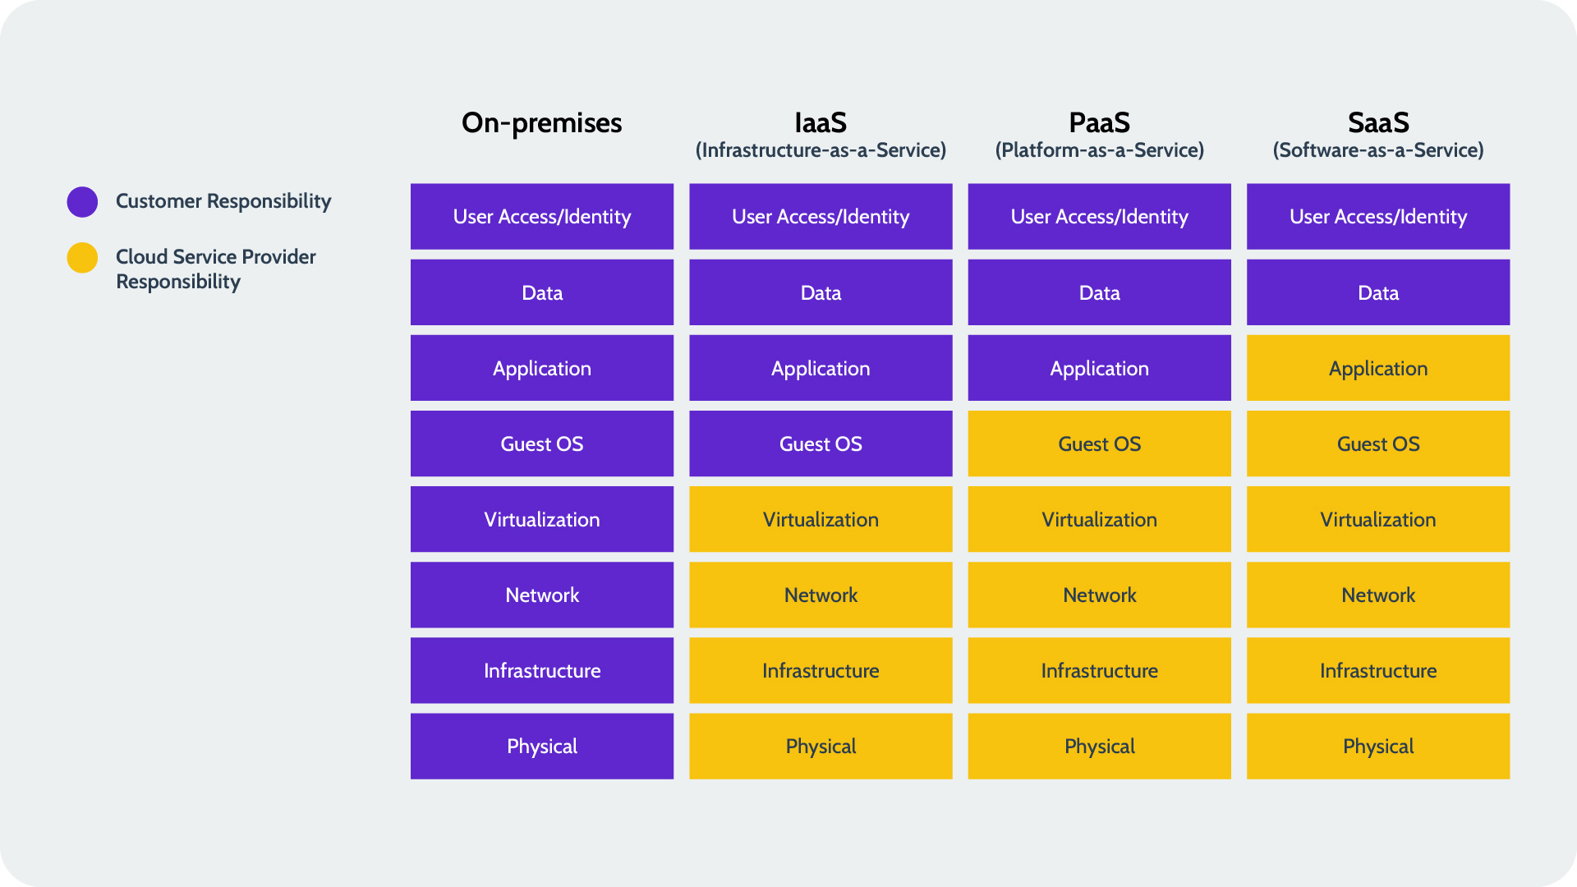
Shared Responsibility Model in Cloud

Slide 13
Amazon Web Services (AWS)
Amazon Web Services (AWS) is a leading top platform in providing the web services of various domains. AWS follows the trends of digital IT and comes up needy services with optimized performances covering a wide range of services from Compute to Storage. It covers a wider range of customers of different domains to expand their business operations. This Article covers the fundamentals of AWS and its scope of IT business.

Slide 14
AWS Fundamentals
In the Journey of AWS, understanding the key concepts such as Regions, Availability Zones, Global Network Infrastructure, etc is crucial. The fundamentals of AWS keep on maintaining the applications reliable and scalable with services globally with coming to a strategic deployment of resources for optimal performance and resilience. The following are the some of the main fundamentals of AWS:
Regions: AWS provide the services with respective division of regions. The regions are divided based on geographical areas/locations and will establish data centers. Based on need and traffic of users, the scale of data centers is depended to facilitate users with low-latencies of servcies.
Availability Zones (AZ): To prevent the Data centers for the Natural Calamities or any other disasters. The Datacenters are established as sub sections with isolated locations to enhance fault tolerance and disaster recovery management.
Global Network Infrastructure: AWS ensures the reliability and scalability of services through setting up its own AWS Network Infrastructure globally. It helps in better management of data transmissions for optimized performance and security reliance.

Slide 15
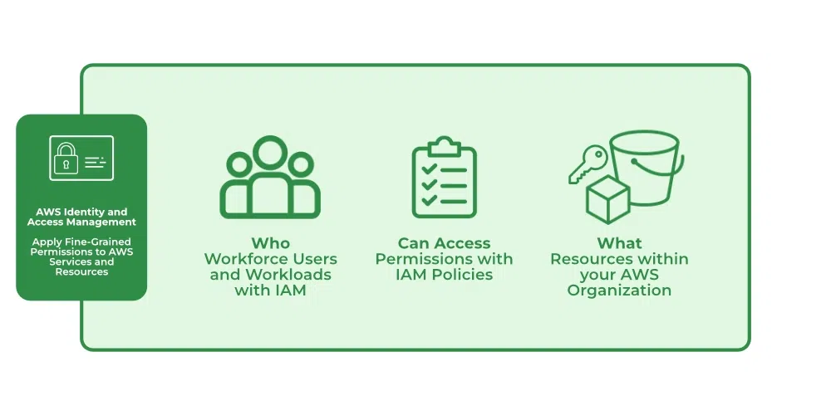
Identity and Access Management
Identity and Access Management (IAM) manages Amazon Web Services (AWS) users and their access to AWS accounts and services. It controls the level of access a user can have over an AWS account & set users, grant permission, and allows a user to use different features of an AWS account. Identity and access management is mainly used to manage users, groups, roles, and Access policies The account we created to sign in to Amazon web services is known as the root account and it holds all the administrative rights and has access to all parts of the account. The new user created an AWS account, by default they have no access to any services in the account & it is done with the help of IAM that the root account holder can implement access policies and grant permission to the user to access certain services.
How IAM Works?
IAM verifies that a user or service has the necessary authorization to access a particular service in the AWS cloud. We can also use IAM to grant the right level of access to specific users, groups, or services. For example, we can use IAM to enable an EC2 instance to access S3 buckets by requesting fine-grained permissions.
IAM Work Flow
https://www.geeksforgeeks.org/identity-and-access-management-iam-in-amazon-web-services-aws/?ref=lbp

Slide 16
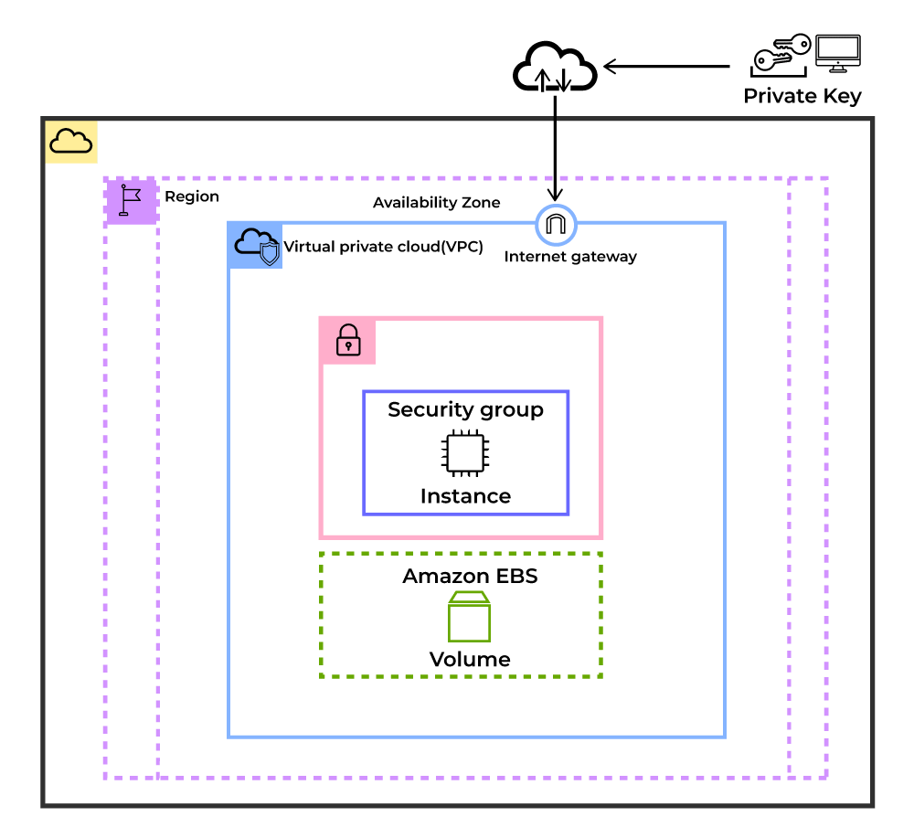
Compute Services (EC2)
EC2 stands for Elastic Compute Cloud. EC2 is an on-demand computing service on the AWS cloud platform. Under computing, it includes all the services a computing device can offer to you along with the flexibility of a virtual environment. It also allows the user to configure their instances as per their requirements i.e. allocate the RAM, ROM, and storage according to the need of the current task. Even the user can dismantle the virtual device once its task is completed and it is no more required. For providing, all these scalable resources AWS charges some bill amount at the end of every month, the bill amount is entirely dependent on your usage. EC2 allows you to rent virtual computers. The provision of servers on AWS Cloud is one of the easiest ways in EC2. EC2 has resizable capacity. EC2 offers security, reliability, high performance, and cost-effective infrastructure so as to meet the demanding business needs.
https://www.geeksforgeeks.org/what-is-elastic-compute-cloud-ec2/?ref=lbp

Slide 17
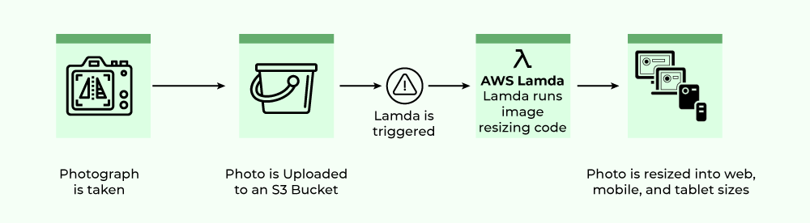
Compute Services (Lambda Function)
AWS lambda are server-less compute functions are fully managed by the AWS where developers can run there code without worrying about servers.AWS lambda functions will allow you to run the code with out provisioning or managing servers.
Once you upload the source code file into AWS lambda in the form of ZIP file then AWS lambda will automatically run the code without you provision the servers and also it will automatically scaling your functions up or down based on demand.
AWS lambda are mostly used for the event-driven application for the data processing Amazon S3 buckets, or responding to HTTP requests.
Examples of AWS Lambdas:
Process data from Amazon S3 buckets.
Respond to HTTP requests.
Build serverless applications.
https://www.geeksforgeeks.org/introduction-to-aws-lambda/?ref=lbp

Slide 18
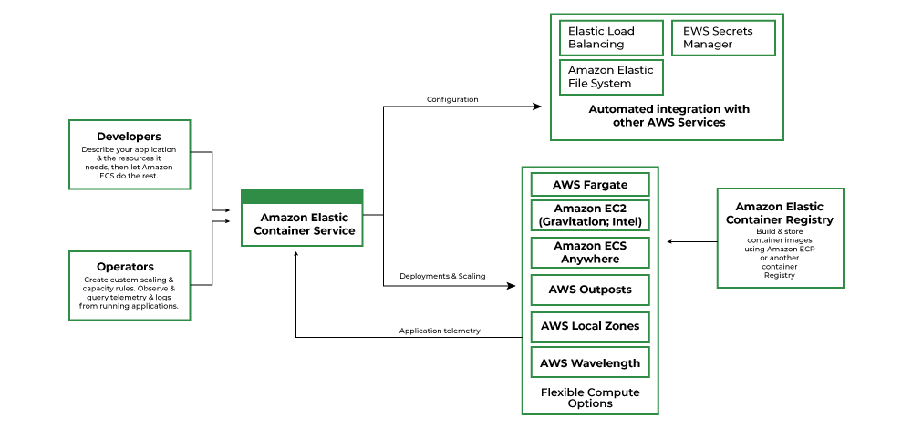
Compute Services (Container Service)
Amazon Elastic Container Service (ECS), also known as Amazon EC2 Container Service, is a managed service that allows users to run Docker-based applications packaged as containers across a cluster of EC2 instances. Running simple containers on a single EC2 instance is simple but running these applications on a cluster of instances and managing the cluster is being administratively heavy process. With ECS, Fargate launch type, the load, and responsibility of managing the EC2 cluster is transferred over to the AWS and you can focus on application development rather than management of your cluster architecture.AWS Fargate is the AWS service that allows ECS to run containers without having to manage and provision the resources required for running these applications.
https://www.geeksforgeeks.org/introduction-to-amazon-elastic-container-service-ecs/?ref=lbp

Slide 19
Simple Storage Service (AWS S3)
Amazon S3 is a Simple Storage Service in AWS that stores files of different types like Photos, Audio, and Videos as Objects providing more scalability and security to. It allows the users to store and retrieve any amount of data at any point in time from anywhere on the web. It facilitates features such as extremely high availability, security, and simple connection to other AWS Services.
Amazon S3 is used for various purposes in the Cloud because of its robust features with scaling and Securing of data. It helps people with all kinds of use cases from fields such as Mobile/Web applications, Big data, Machine Learning and many more. The following are a few Wide Usage of Amazon S3 service.
Data Storage: Amazon s3 acts as the best option for scaling both small and large storage applications. It helps in storing and retrieving the data-intensitive applications as per needs in ideal time.
Backup and Recovery: Many Organizations are using Amazon S3 to backup their critical data and maintain the data durability and availability for recovery needs.
Hosting Static Websites: Amazon S3 facilitates in storing HTML, CSS and other web content from Users/developers allowing them for hosting Static Websites benefiting with low-latency access and cost-effectiveness. To know more detailing refer this Article – How to host static websites using Amazon S3
Data Archiving: Amazon S3 Glacier service integration helps as a cost-effective solution for long-term data storing which are less frequently accessed applications.
Big Data Analytics: Amazon S3 is often considered as data lake because of its capacity to store large amounts of both structured and unstructured data offering seamless integration with other AWS Analytics and AWS Machine Learning Services.
https://www.geeksforgeeks.org/introduction-to-aws-simple-storage-service-aws-s3/?ref=lbp

Slide 20
Elastic Block Store(EBS)
Elastic Block Storage (EBS): From the aforementioned list, EBS is a block type durable and persistent storage that can be attached to EC2-instances for additional storage. Unlike EC-2 instance storage volumes which are suitable for holding temporary data EBS volumes are highly suitable for essential and long term data. EBS volumes are specific to availability zones and can only be attached to instances within the same availability zone.
EBS can be created from the EC2 dashboard in the console as well as in Step 4 of the EC2 launch. Just note that when creating EBS with EC2, the EBS volumes are created in the same availability zone as EC2, however when provisioned independently users can choose the AZ in which EBS is required.
https://www.geeksforgeeks.org/introduction-to-aws-elastic-block-storeebs/?ref=lbp

Slide 21
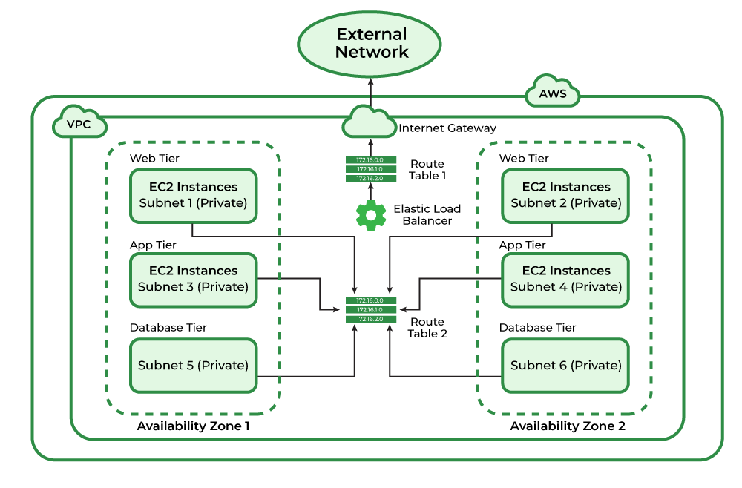
Amazon Virtual Private Cloud
Amazon VPC can be referred to as the private cloud inside the cloud. It is a logical grouping of servers in a specified network. The servers that you are going to deploy in the Virtual Private Cloud(VPC) will be completely isolated from the other servers that are deployed in the Amazon Web Services. You can have complete control of the IP address to the virtual machines and route tables and gateways to the VPC. With the help of security groups and network access control lists, you can protect your application more.
The basic architecture of a properly functioning VPC consists of many distinct services such as Gateway, Load Balancer, Subnets, etc. Altogether, these resources are clubbed under a VPC to create an isolated virtual environment. Along with these services, there are also security checks on multiple levels.
It is initially divided into subnets, connected with each other via route tables along with a load balancer.
https://www.geeksforgeeks.org/amazon-vpc-introduction-to-amazon-virtual-cloud/?ref=lbp

Slide 22
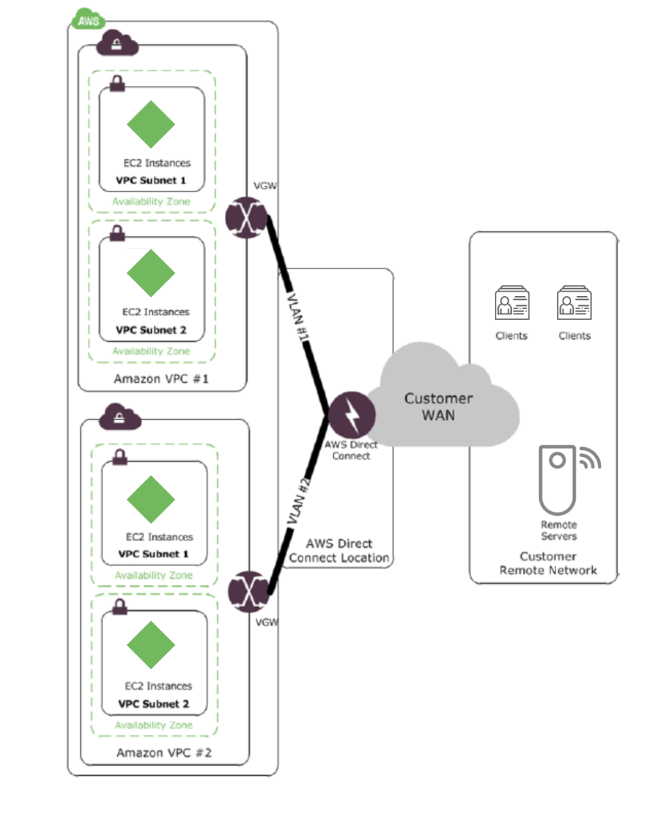
Direct Connect Service
AWS direct connect facilitates the installation of dedicated network connections from your premises to your Amazon VPC or between Amazon VPCs. It provides users with an efficient method of connecting. Its use can efficiently cut network costs. It can give a more consistent network experience and boost bandwidth throughput than other VPC-to-VPC connecting methods. Because traffic can take advantage of 1 Gbps or 10 Gbps fiber links physically connecting to the AWS network in each area, AWS Direct Connect can enable exceptionally efficient routing.
Furthermore, this solution provides the most control and management options for routing on your local and remote networks, as well as the capability to reuse AWS Direct Connect connections.
A physical AWS Direct Connect connection can be divided into many logical connections, one for each VPC. As shown in the diagram below, you can then use these logical connections to route traffic between VPCs. In addition to intra-region routing, you can use your current WAN providers to connect AWS Direct Connect locations in other regions and use AWS Direct Connect to route traffic across regions through your WAN backbone network.
https://www.geeksforgeeks.org/amazon-vpc-working-with-direct-connect-service/?ref=lbp

Slide 23
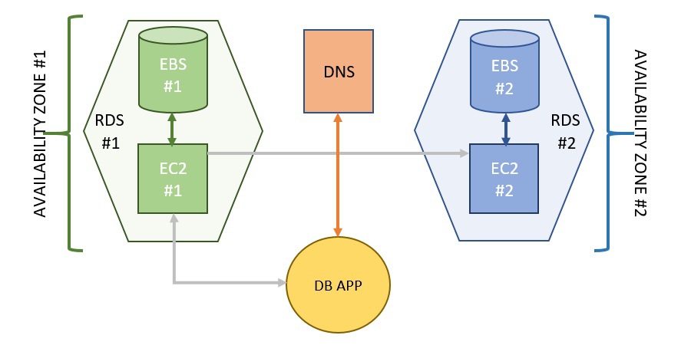
Amazon Relational Database Service (Amazon RDS)
Amazon Web Services offers Amazon RDS a service where it is managed completely by AWS and also it offers wide range data base engines like the following:
MySQL.
PostgreSQL.
Oracle.
SQL Server.
The backup of the data and the infrastructure will be taken care of by the AWS scaling and balancing the load the security is very high the data will be encrypted at rest can control the accesses to the data with the help of (Identity Access Management)IAM. The DR(Disaster Recovery) will automatically take by the AWS automatically by the AWS
How Amazon RDS Works?
Traditionally, database management used to be a very scattered service, from the webserver to the application server and then finally to the database. For the maintenance of such a vast system a team was required, to shrink this workforce, AWS came across an amazing all-in-one service, RDS. The whole architecture of RDS includes every aspect of the traditional management system, all in place. Thus, it includes everything from EC2 (Elastic Compute Cloud) to DNS (Domain Name System). Every part of the RDS architecture has its own separate set of features completely different from each other.
https://www.geeksforgeeks.org/amazon-rds-introduction-to-amazon-relational-database-system/?ref=lbp

Slide 24
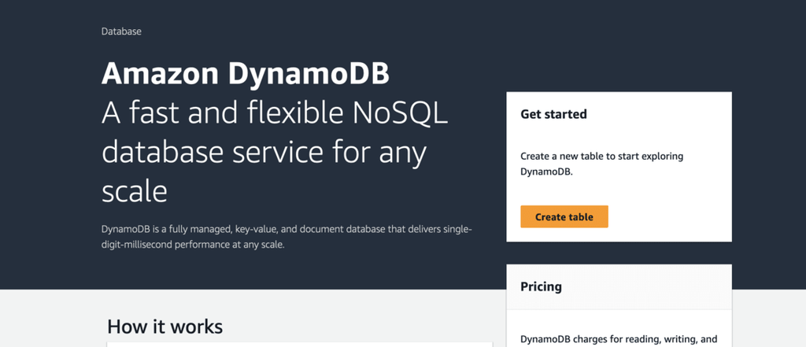
AWS DynamoDB
DynamoDB allows users to create databases capable of storing and retrieving any amount of data and comes in handy while serving any amount of traffic. It dynamically manages each customer’s request and provides high performance by automatically distributing data and traffic over servers. It is a fully managed NoSQL database service that is fast, predictable in terms of performance, and seamlessly scalable. It relieves the user from the administrative burdens of operating and scaling a distributed database as the user doesn’t have to worry about hardware provisioning, patching Software, or cluster scaling.
https://www.geeksforgeeks.org/aws-dynamodb-creating-a-table/?ref=lbp

Slide 25
Amazon Aurora
The Amazon Aurora is a relational database service offered from amazon cloud. This is one of the widely used services for the data storage, for low latency and value-based data storage and processing. Amazon Aurora is a MySQL and PostgreSQL-compatible relational database fabricated for the cloud, that consolidates the performance and accessibility of traditional databases with the simplicity and reliability of commercial databases at 1/10th the cost. It works with a clustered approach with data replication in the AWS accessibility zone for efficient data availability.
The Amazon Aurora is packed with high-performance subsystems. It is MySQL and PostgreSQL engines which take advantage of fast distributed storage. Aurora provides speed and throughput up to 5 times of MySQL and 3 times of PostgreSQL with the existing system. It bolsters, high storage capacity, which can scale up to 64 Terabytes of database size for enterprise implementation. Amazon Aurora is completely managed by Amazon Relational Database Service (RDS), which automates tedious administration undertakings like hardware provisioning, database arrangement, fixing, and reinforcements.
Amazon Aurora is built on top of an innovative distributed architecture that separates the storage and compute layers of the database engine. The storage layer is distributed across multiple replicas, while the compute layer runs on instances that are separate from the storage layer. This architecture allows for automatic scaling of storage and compute resources independently and also provides better fault tolerance and availability.
https://www.geeksforgeeks.org/amazon-aurora/?ref=lbp

Slide 26
CloudWatch
Amazon CloudWatch is a service used for monitoring and observing resources in real-time, built for DevOps engineers, developers, site reliability engineers (SREs), and IT managers. CloudWatch provides users with data and actionable insights to monitor their respective applications, stimulate system-wide performance changes, and optimize resource utilization. CloudWatch collects monitoring and operational data in the form of logs, metrics, and events, providing its users with an aggregated view of AWS resources, applications, and services that run on AWS. The CloudWatch can also be used to detect anomalous behavior in the environments, set warnings and alarms, visualize logs and metrics side by side, take automated actions, and troubleshoot issues.
https://www.geeksforgeeks.org/introduction-to-amazon-cloudwatch/?ref=lbp

Slide 27
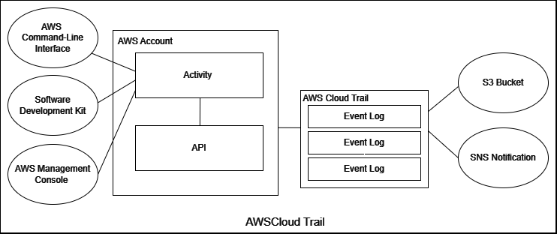
CloudTrail
AWS With the help of the tool called Cloud Trail, offered by Amazon Web Services (AWS), you may keep track of and document activities that take place inside your AWS infrastructure. It gives you a thorough event history of every activity users, services, and resources took while using your AWS account. By recording and archiving event logs, Cloud Trail assists with security, compliance, operational auditing, and troubleshooting.
When you create Cloud Trail, it is already operational in your AWS account and doesn’t need to be manually set up. A Cloud Trail event is created each time something happens in your AWS account.
https://www.geeksforgeeks.org/aws-cloudtrail/?ref=lbp

Slide 28
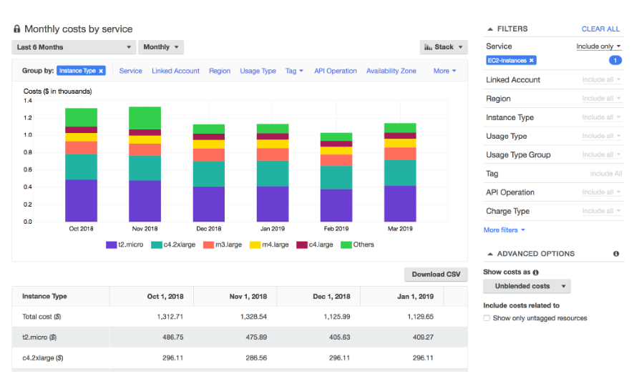
Cost Explorer & Cost Management
AWS Cost Explorer will help you to visualize, understand, and manage your AWS costs and usage over time. Use Cost explorer to find your higher spending first and start from there. There has been a lot of product updates that will help with costs. AWS released cost categories where you can group your cost together and deal with some of the misspelled tags. There’s hourly data available in cost Explorer which can show resource IDs tag policies and can import tags across multiple attributes accounts.
By using the cost explorer you will be able to review charges and usage associated with individual accounts or AWS Organisations spend. You can create custom reports that will analyze the cost and usage data, but it is for a high level. You can get, your total cost and usage across all accounts, or monthly or hourly, or at the resource level. Most importantly, you can forecast usage up to twelve months based on the previous usage and get recommendations for what reserved instances to purchase.
https://www.geeksforgeeks.org/amazon-web-services-introduction-to-aws-cost-explorer-cost-management/?ref=lbp

Slide 29
Microsoft Azure
Azure is Microsoft’s cloud platform, just like Google has its Google Cloud and Amazon has its Amazon Web Service or AWS.000. Generally, it is a platform through which we can use Microsoft’s resources. For example, to set up a huge server, we will require huge investment, effort, physical space, and so on. In such situations, Microsoft Azure comes to our rescue. It will provide us with virtual machines, fast processing of data, analytical and monitoring tools, and so on to make our work simpler. The pricing of Azure is also simpler and cost-effective. Popularly termed as “Pay As You Go”, which means how much you use, pay only for that.
https://www.geeksforgeeks.org/introduction-microsoft-azure-cloud-computing-service/?ref=lbp

Slide 30
Azure Fundamentals
It is a private and public cloud platform that helps developers and IT professionals to build deploy and manage the application. It uses the technology known as virtualization. Virtualization separates the tight coupling between the hardware and the operating system using an abstraction layer called a hypervisor. Hypervisor emulates all the functions of a computer in the virtual machine, it can run multiple virtual machines at the same time and each virtual machine can run any operating system such as Windows or Linux. Azure takes this virtualization technique and repeats it on a massive scale in the data center owned by Microsoft. Each data center has many racks filled with servers and each server includes a hypervisor to run multiple virtual machines. The network switch provides connectivity to all those servers.
Azure will provide the Microsoft Azure is a cloud computing platform which offers
Infrastructure as a service (IaaS).
Platform as a service (PaaS).
Software as a service (SaaS).

Slide 31
Azure Identity - Microsoft Entra

Slide 32
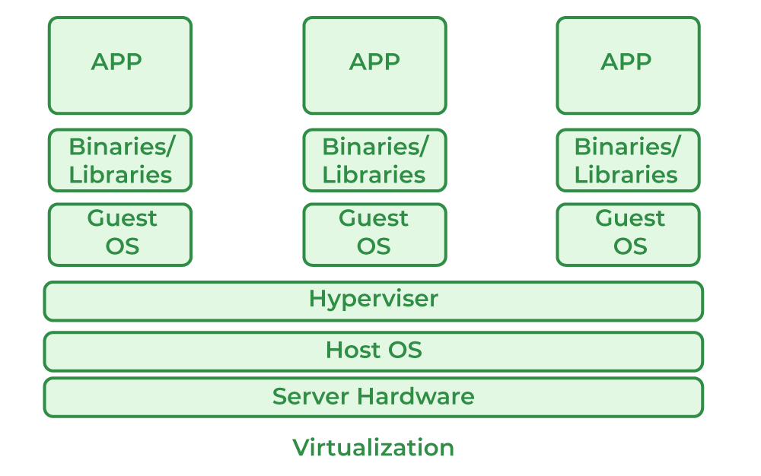
Azure Compute - VM
A virtual machine is like a physical computer but it is actually a digital version of it. Actually, it is not so much different from physical computers because they have also memory, CPU, as well as they have disks to store our data or various files and one more interesting thing is that they can also connect to the internet. So we can say that a VM is actually the software-defined computer that exists only as a code but is present on physical servers.
https://www.geeksforgeeks.org/what-are-azure-virtual-machines/

Slide 33
Azure Compute – Function App
Azure Functions is a serverless computing service provided by Microsoft Azure to help us run tasks on a schedule like processing data, working with the Internet of Things (IoT), and integrating systems. We can also use them to develop server-less applications, simple APIs, and microservices. This helps us be efficient by just writing code to solve our current problem.
There are many more integration and automation services that can be used to automate the process and define inputs, conditions, actions, and output.
https://www.geeksforgeeks.org/what-is-microsoft-azure-functions/

Slide 34
Azure Compute – Azure Container Instances
Azure Container Instances (ACI) is a fully managed service for deploying and running containerized applications in Azure. It allows you to specify the exact number of CPU cores and amount of memory that your container needs, and it automatically allocates the resources to your container when it is deployed. ACI is designed to be easy to use and requires no upfront investment in infrastructure. It is well-suited for development and testing scenarios, as well as for deploying small, bursty workloads that start and stop quickly. ACI integrates with other Azure services such as Azure Functions and Azure Monitor, and it supports a wide range of container orchestration platforms including Docker, Kubernetes, and Azure Batch.
https://www.geeksforgeeks.org/introduction-to-azure-container-instances/

Slide 35
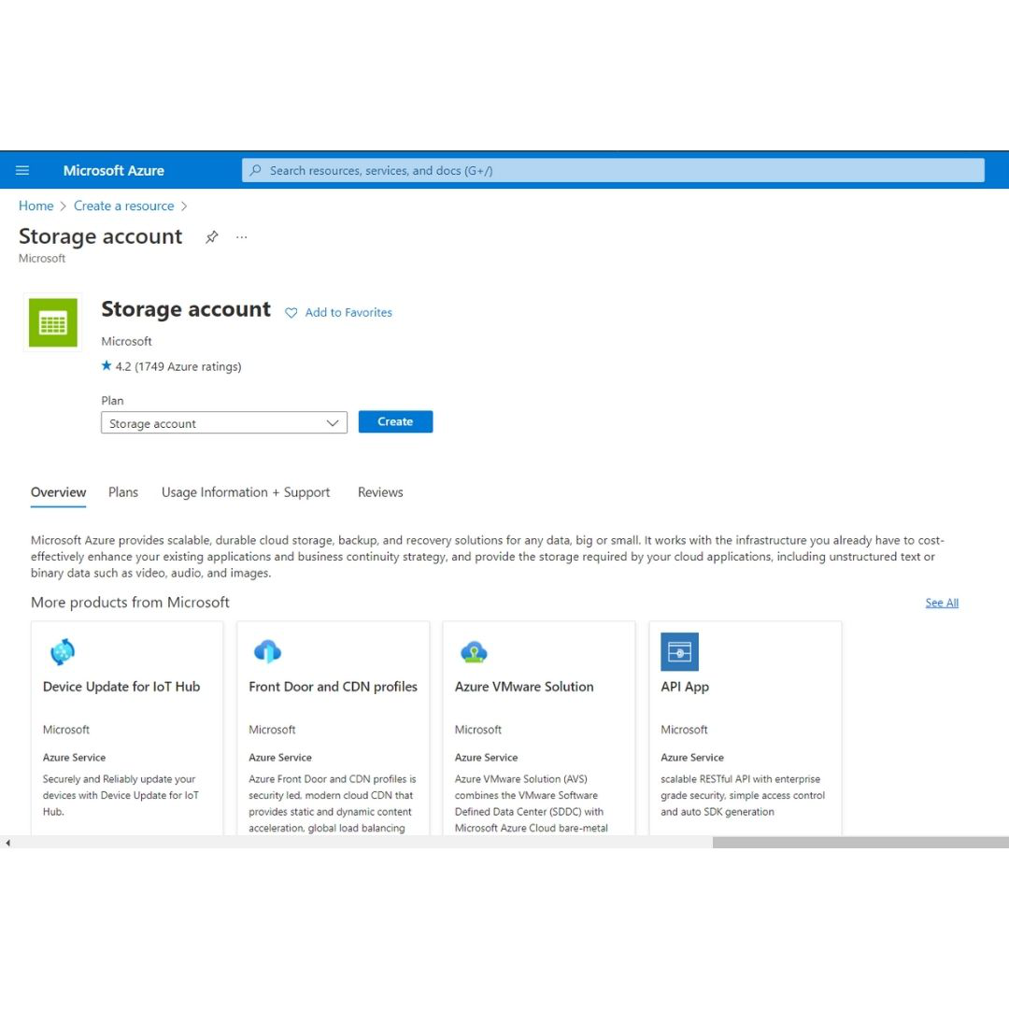
Azure – Storage Accounts
Azure Storage Account is a storage account that is a resource that acts as a container that groups all the data services from Azure storage (Azure blobs, Azure files, Azure Queues, and Azure Tables). This helps us manage all of them as a group. The policies we specify while creating the storage account or making changes after the creation applies to all the services inside the account. Deleting a storage account deletes all the storage services deployed and the data stored inside it.
https://www.geeksforgeeks.org/microsoft-azure-storage-accounts/?ref=lbp

Slide 36
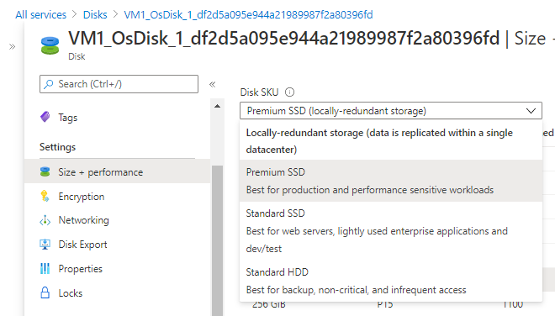
Azure- Disk Storage
Azure Disk Storage is the only shared cloud block storage that supports both Windows and Linux-based clustered or high-availability applications via Azure shared disks.
There are two types of Disks in Azure :
Managed Disks
Unmanaged Disks.
Managed Disks
Simplest option
Lower management overhead as Azure manages the storage accounts.
Only LRS replication mode is currently available
To know how to host a Static Website with Azure Storage
Unmanaged Disks
DIY option
Management overhead (20000 IOPS per storage account limit)
Supports all replication modes (LRS, ZRS, GRS, RA-GRS)
https://www.geeksforgeeks.org/microsoft-azure-disk-storage-in-microsoft-azure/?ref=lbp

Slide 37
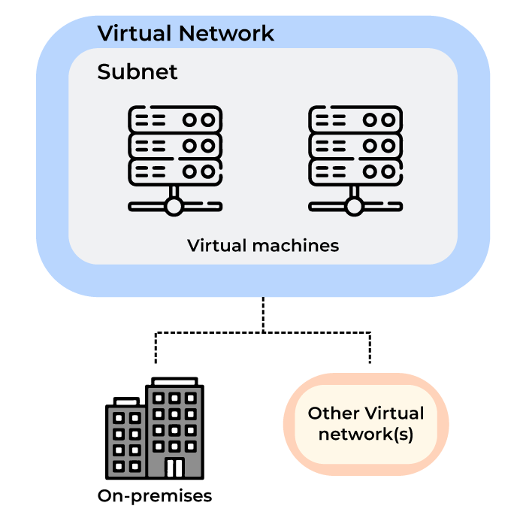
Azure – Virtual Network
It is a representation of the on-premises network on the cloud. It helps us logically isolate the Azure cloud network dedicated to our subscription. It helps us to manage and provision virtual private networks in Azure, link the virtual networks with other virtual networks in Azure, or with on-premises IT infrastructure and networks that help us create hybrid or cross-premises solutions.
Each virtual network we create has its own Classless Inter-Domain Routing (CIDR) block and can be linked with other virtual and on-premises networks of the CIDR blocks that do not overlap. We also have control of DNS server settings and segmentation of the virtual networks into the subnets.
https://www.geeksforgeeks.org/microsoft-azure-virtual-network/?ref=lbp

Slide 38
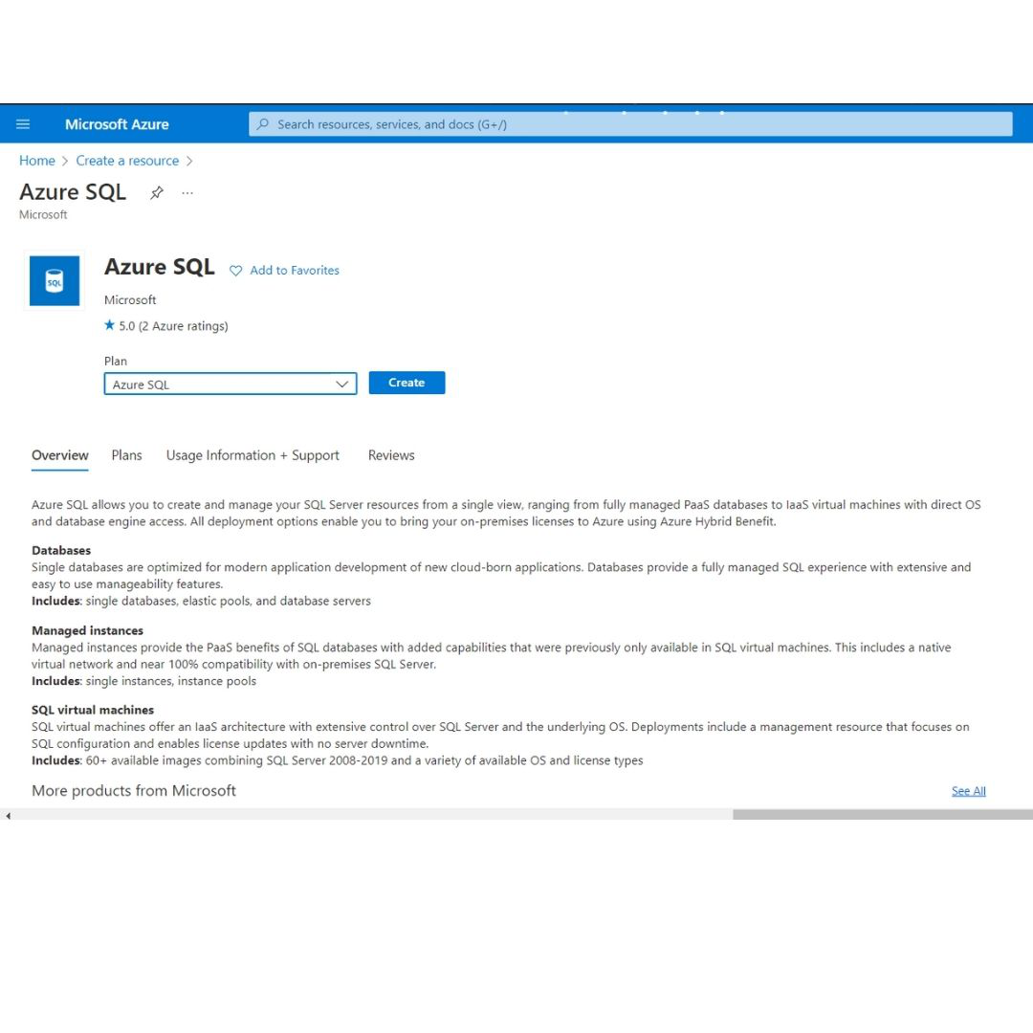
Azure SQL Database
Azure SQL Database is a relational database(RDBMS) service provided by Microsoft Azure that is widely used by developers when creating new applications in the cloud. It is managed completely by Microsoft and is a highly scalable platform-as-a-service (PaaS) designed especially for cloud applications. Here, we create a managed database server in the cloud and use the server to deploy our database. The server is a logical construct that acts as the central administration point for pooled databases or multiple logins, auditing rules, threat detection policy, and failover groups.
The databases are available as Single databases and elastic pools.
https://www.geeksforgeeks.org/microsoft-azure-azure-sql-database/?ref=lbp

Slide 39
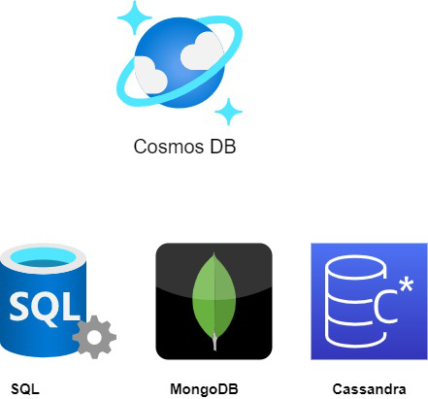
Azure Cosmos DB
CosmosDB is a NoSQL database by Azure. In this article, We’ll discuss high-level horizontal scaling, replication, partitioning, and database schema. And then we’ll dive into some of the data models that Cosmos DB supports. So, let’s get started.
Applications used to be relatively simple. We would have an app, an API layer, and a slow drip of data dropping into our database. Now occasionally, we may have needed to surface that data and lookup device information in a catalog or look up an appointment on a calendar. But often the data sat in the database until it was called on however many days, months, or even years later.
In the age of big data, where data sets have now grown from a few gigabytes to tens of gigabytes and even petabytes for some of our most demanding applications. Data is pouring into our databases and applications are demanding that data be surfaced quickly and frequently to fulfill user expectations of a personalized and fast application experience.
Now, Azure Cosmos DB has boomed as the answer to the big data demands of cloud-native applications. Because non-relational or NoSQL databases like Azure Cosmos DB scale horizontally rather than vertically, we can essentially uncap the throughput and volume of data in our database. Rather than upgrading hardware on a single node to serve requests faster, Cosmos DB distributes that work across multiple nodes so requests can be served concurrently. Scaling out verse scaling up is the biggest difference between relational databases and non-relational databases like Cosmos DB.
https://www.geeksforgeeks.org/introduction-to-azure-cosmos-db/?ref=lbp

Slide 40
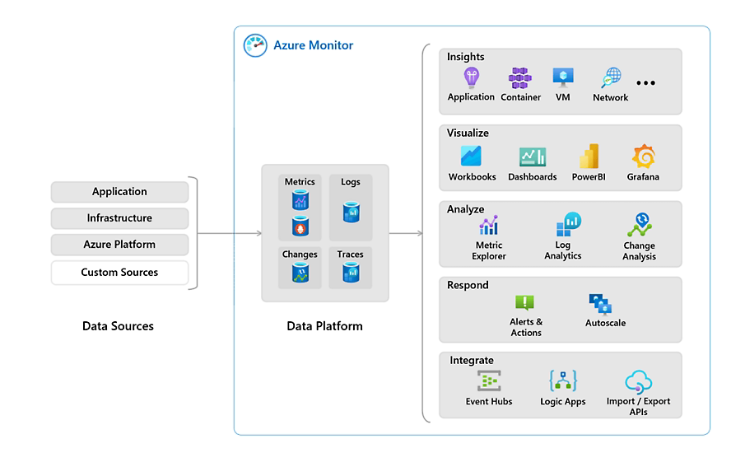
Azure Monitor
Azure Monitor is a comprehensive monitoring solution for collecting, analyzing, and responding to monitoring data from your cloud and on-premises environments. You can use Azure Monitor to maximize the availability and performance of your applications and services. It helps you understand how your applications are performing and allows you to manually and programmatically respond to system events.
Azure Monitor collects and aggregates the data from every layer and component of your system across multiple Azure and non-Azure subscriptions and tenants. It stores it in a common data platform for consumption by a common set of tools that can correlate, analyze, visualize, and/or respond to the data. You can also integrate other Microsoft and non-Microsoft tools.
https://learn.microsoft.com/en-us/azure/azure-monitor/overview

Slide 41
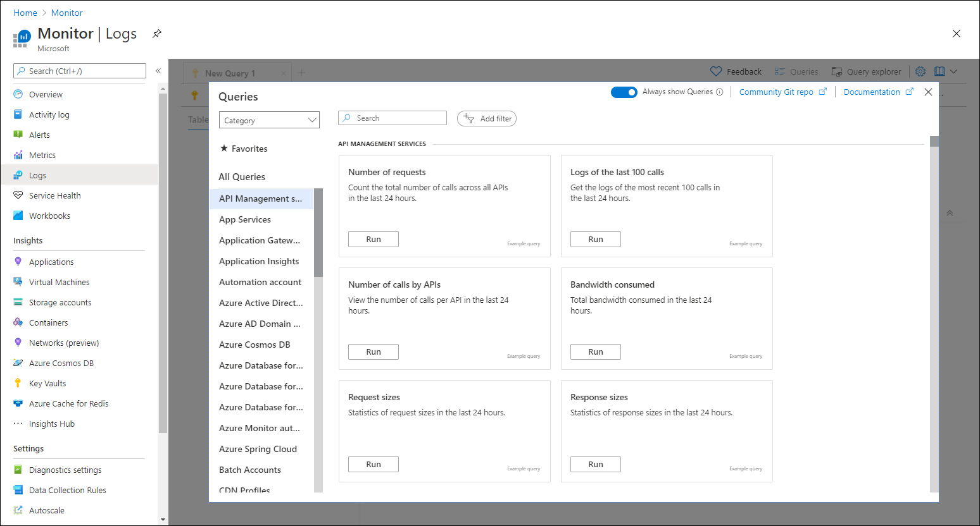
Azure Monitor - Log Analytics
Log Analytics is a tool in the Azure portal that's used to edit and run log queries against data in the Azure Monitor Logs store.
You might write a simple query that returns a set of records and then use features of Log Analytics to sort, filter, and analyze them. Or you might write a more advanced query to perform statistical analysis and visualize the results in a chart to identify a particular trend.
Whether you work with the results of your queries interactively or use them with other Azure Monitor features, such as log query alerts or workbooks, Log Analytics is the tool that you'll use to write and test them.
https://learn.microsoft.com/en-us/azure/azure-monitor/logs/log-analytics-overview

Slide 42
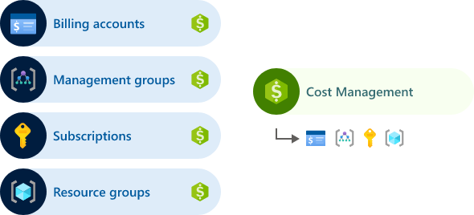
Cost Management and Billing
Microsoft Cost Management is a suite of tools that help organizations monitor, allocate, and optimize the cost of their Microsoft Cloud workloads. Cost Management is available to anyone with access to a billing or resource management scope. The availability includes anyone from the cloud finance team with access to the billing account. And, to DevOps teams managing resources in subscriptions and resource groups.
Billing is where you can manage your accounts, invoices, and payments. Billing is available to anyone with access to a billing account or other billing scope, like billing profiles and invoice sections. The cloud finance team and organizational leaders are typically included.
Together, Cost Management and Billing are your gateway to the Microsoft Commerce system that's available to everyone throughout the journey. From initial sign-up and billing account management, to the purchase and management of Microsoft and third-party Marketplace offers, to financial operations (FinOps) tools.
https://learn.microsoft.com/en-us/azure/cost-management-billing/cost-management-billing-overview#how-cost-management-and-billing-relate

