Slide 1
Step 4. Cloud Platforms

Slide 2
Agenda
Cloud Computing
AWS
Azure

Slide 3
Cloud Computing

Slide 4
What Is Cloud Computing?

Slide 5
Types of Cloud Computing

Slide 6
Types of Cloud

Slide 7
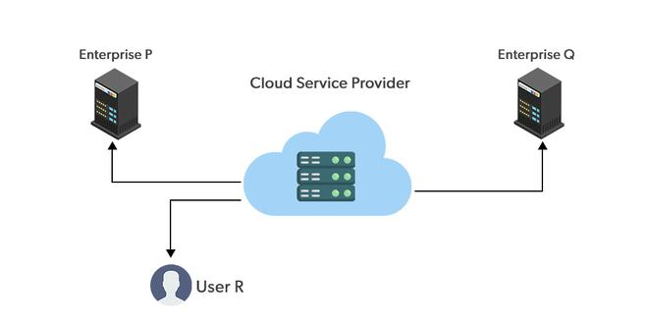
Public Cloud

Slide 8
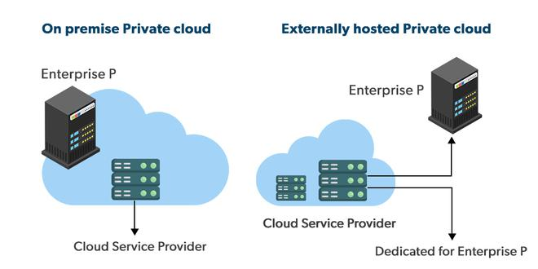
Private cloud

Slide 9
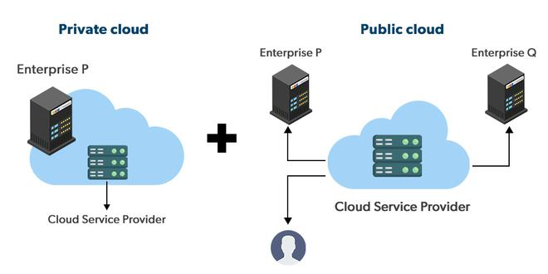
Hybrid cloud

Slide 10
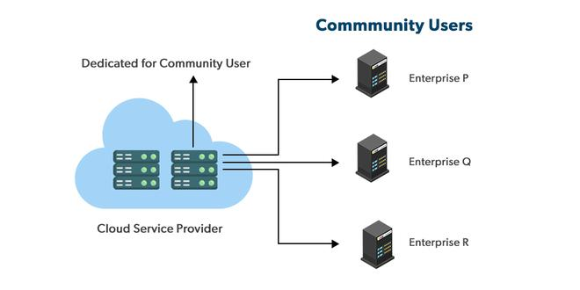
Community cloud

Slide 11
Multicloud

Slide 12
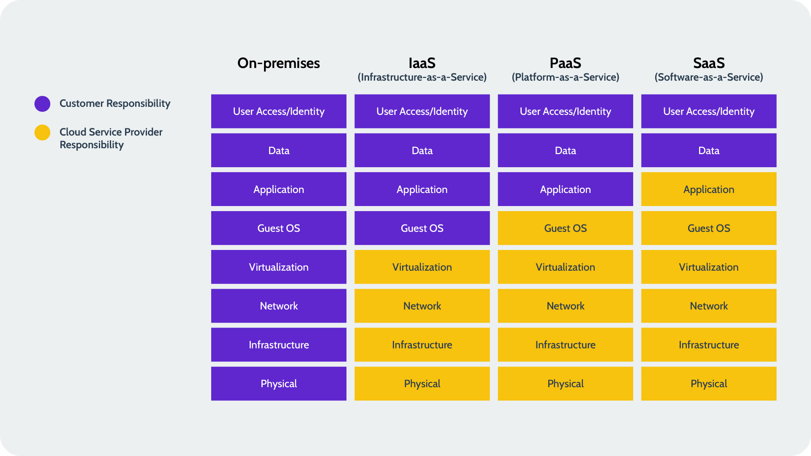
Shared Responsibility Model in Cloud

Slide 13
Amazon Web Services (AWS)

Slide 14
AWS Fundamentals

Slide 15
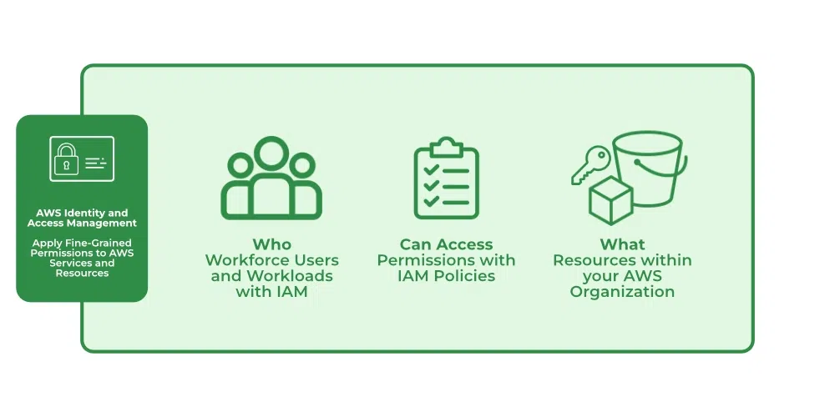
Identity and Access Management

Slide 16
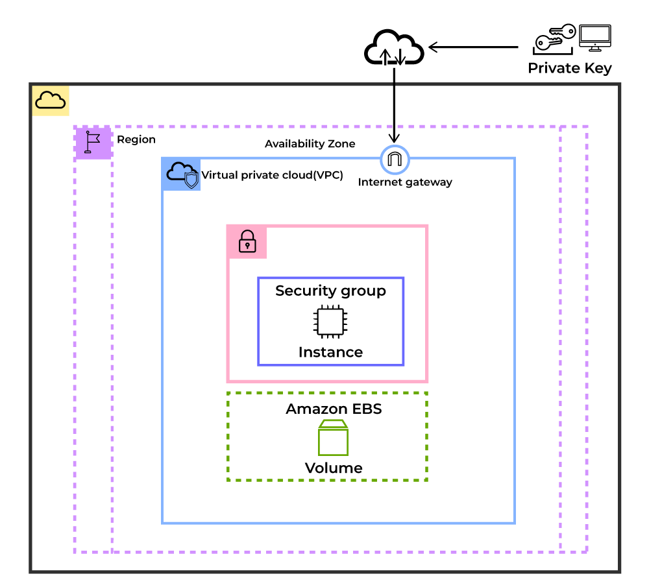
Compute Services (EC2)

Slide 17
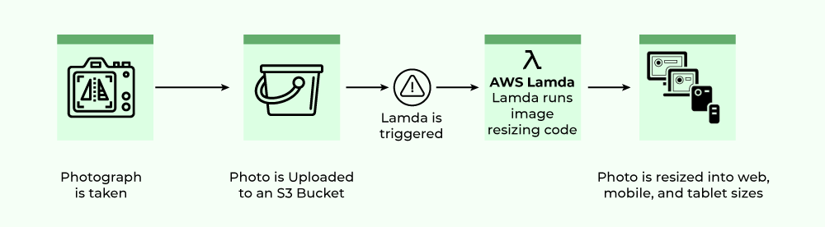
Compute Services (Lambda Function)

Slide 18
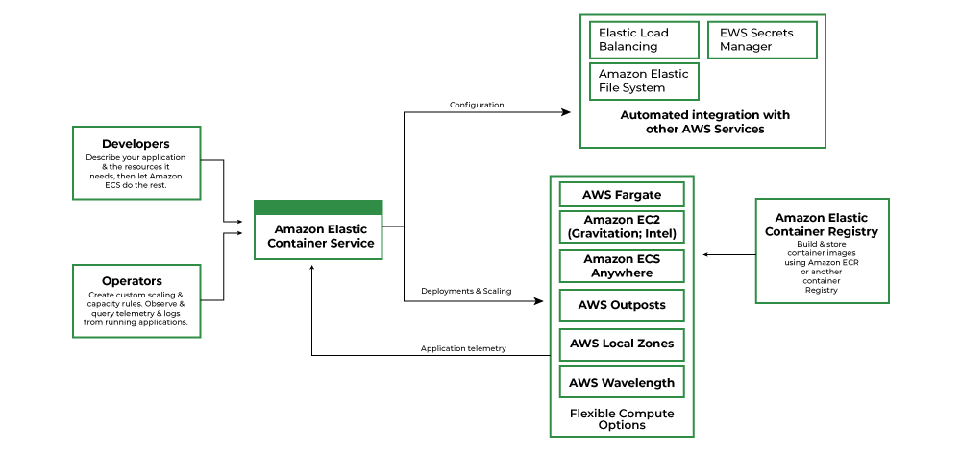
Compute Services (Container Service)

Slide 19
Simple Storage Service (AWS S3)

Slide 20
Elastic Block Store(EBS)

Slide 21
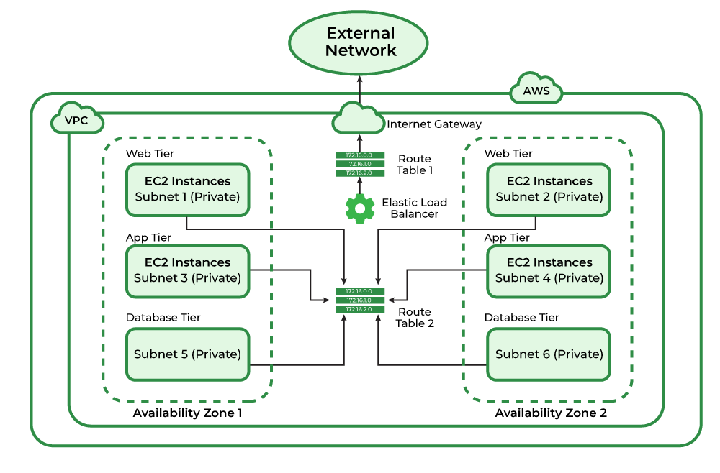
Amazon Virtual Private Cloud

Slide 22
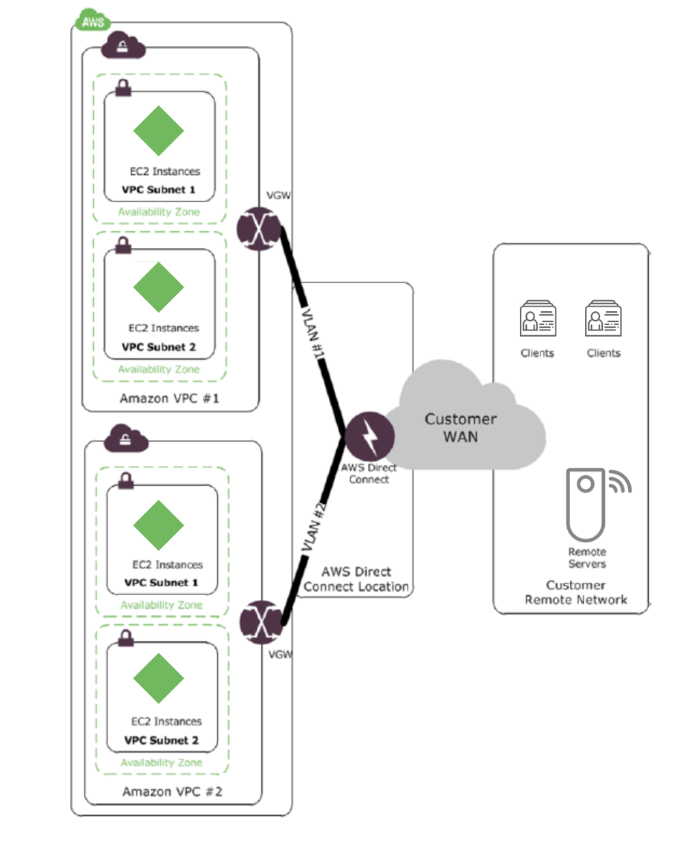
Direct Connect Service

Slide 23
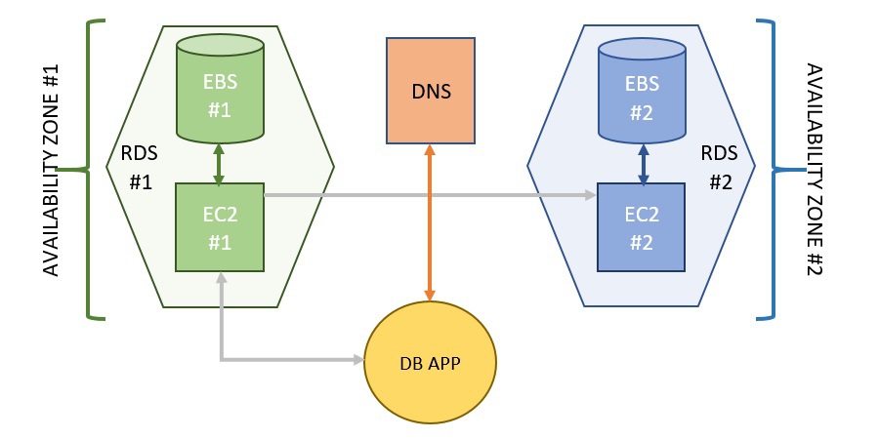
Amazon Relational Database Service (Amazon RDS)

Slide 24
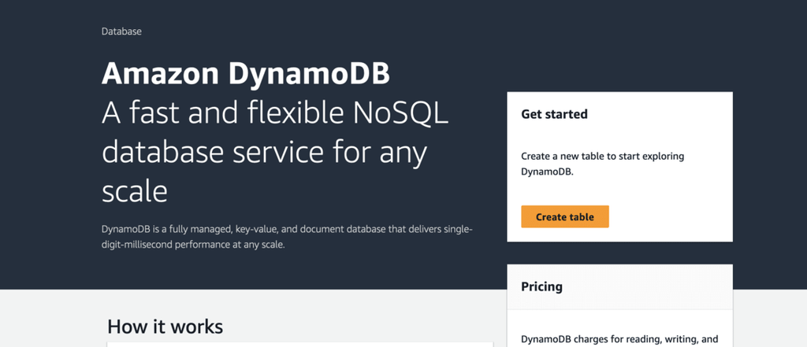
AWS DynamoDB

Slide 25
Amazon Aurora

Slide 26
CloudWatch

Slide 27
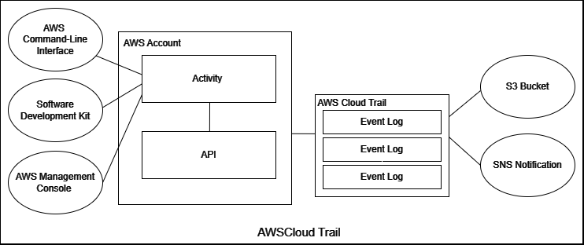
CloudTrail

Slide 28
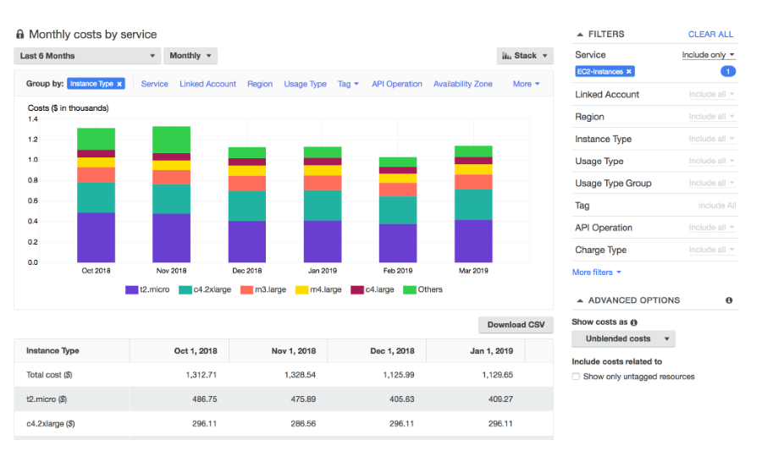
Cost Explorer & Cost Management

Slide 29
Microsoft Azure

Slide 30
Azure Fundamentals

Slide 31
Azure Identity - Microsoft Entra

Slide 32
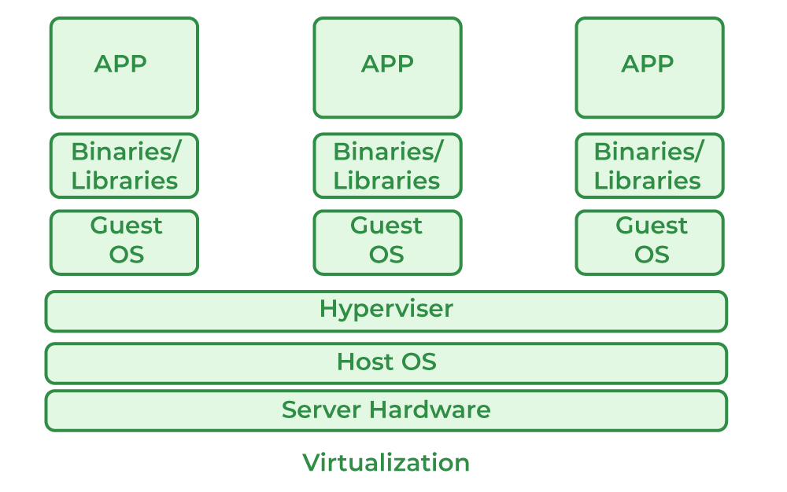
Azure Compute – Azure VM

Slide 33
Azure Compute – Function App

Slide 34
Azure Compute – Azure Container Instances

Slide 35
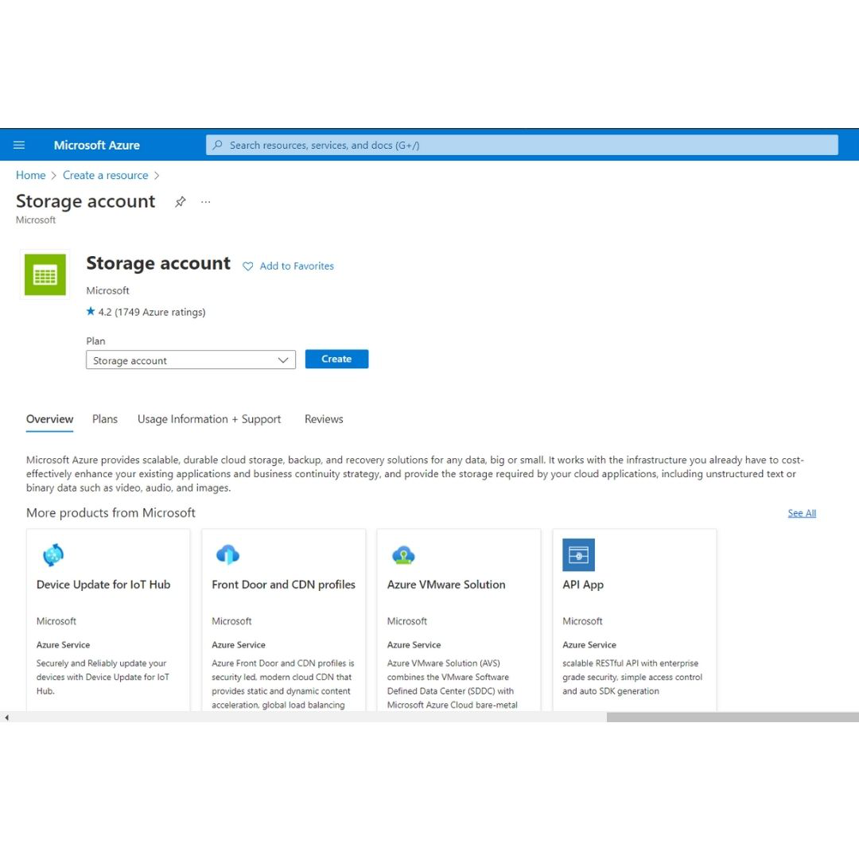
Azure – Storage Accounts

Slide 36
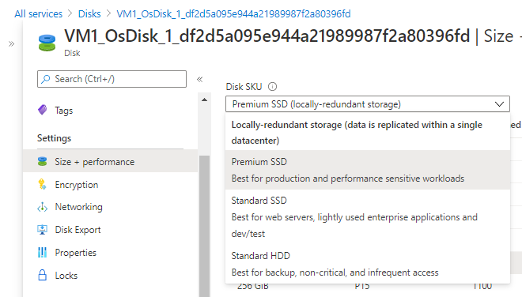
Azure - Disk Storage

Slide 37
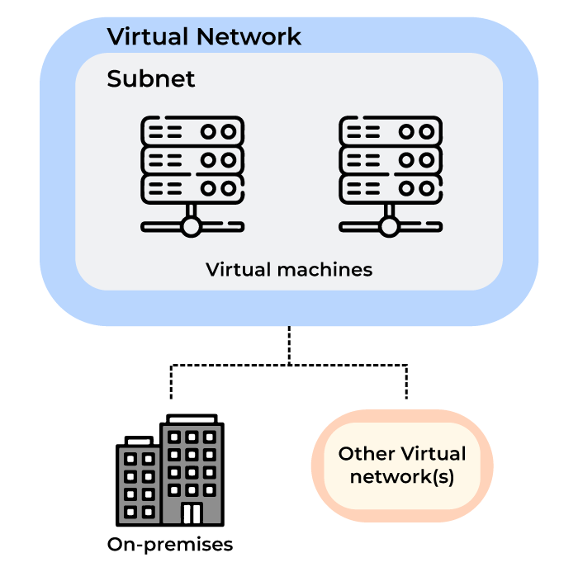
Azure – Virtual Network

Slide 38
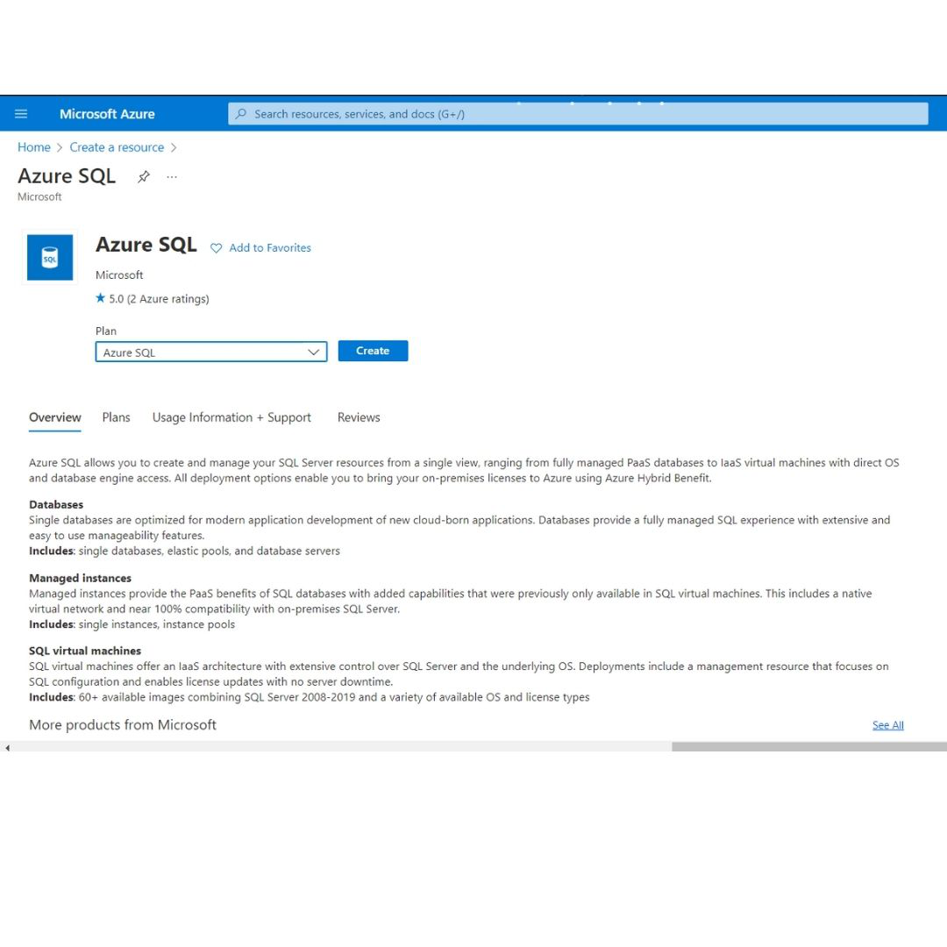
Azure SQL Database

Slide 39
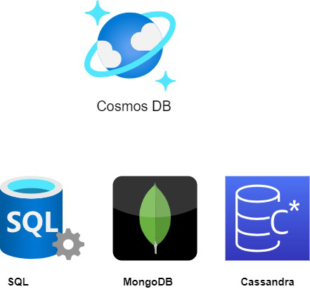
Azure Cosmos DB

Slide 40
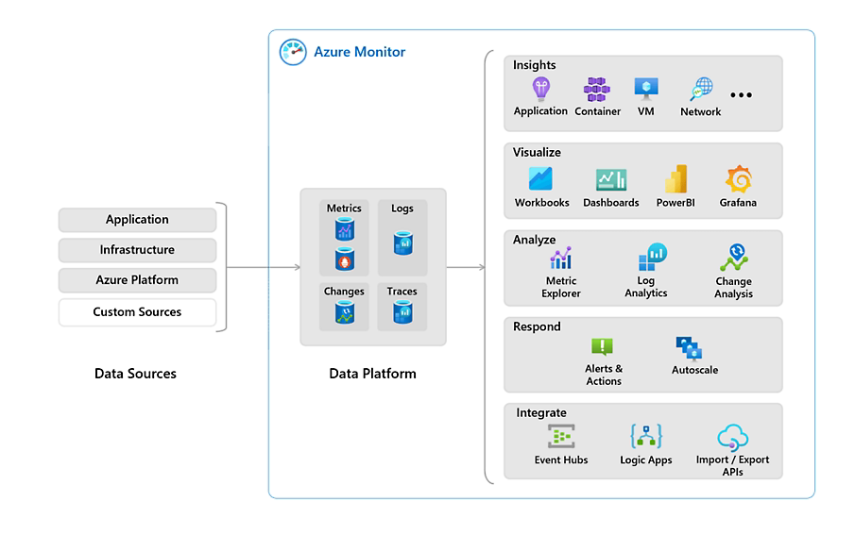
Azure Monitor

Slide 41
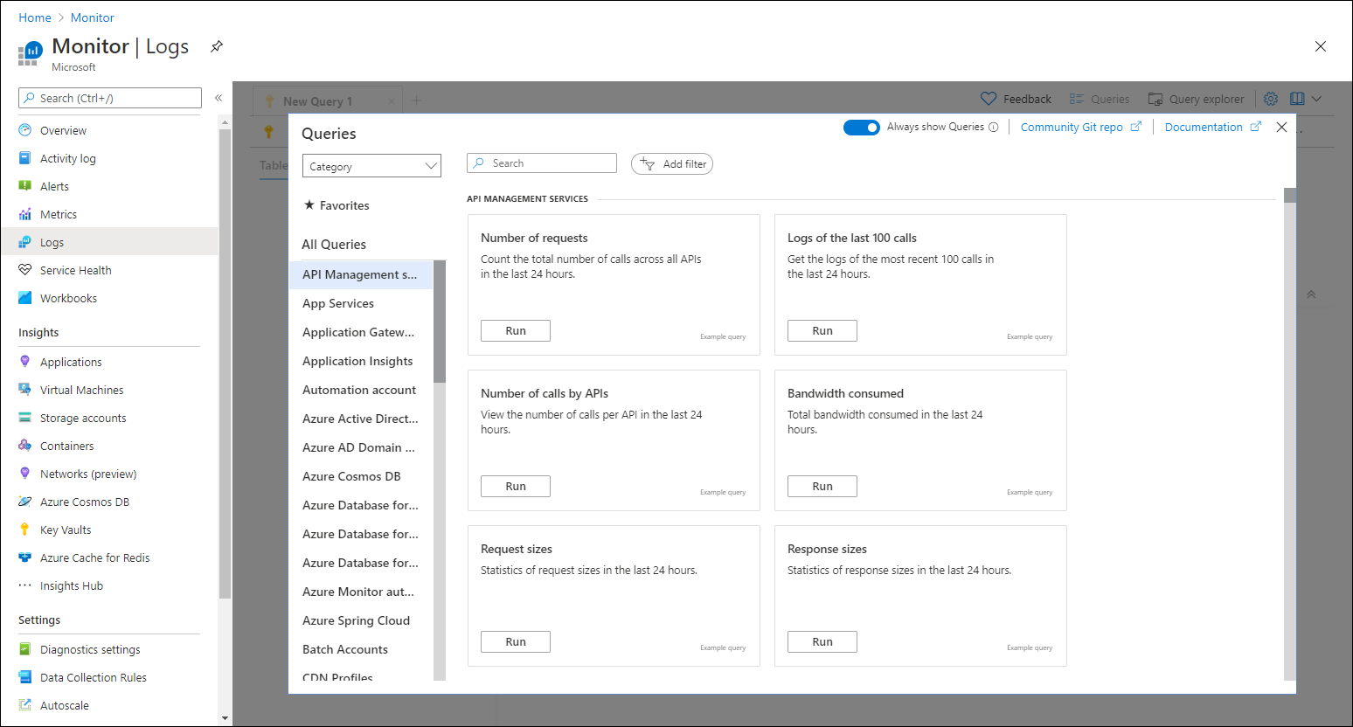
Azure Monitor - Log Analytics

Slide 42
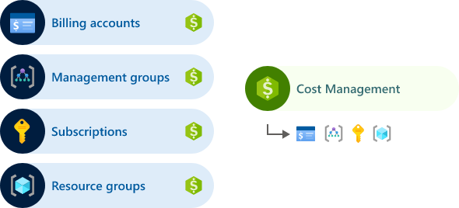
Cost Management and Billing

