Slide 1
Step 5. Infrastructure as a Code

Slide 2
Agenda
Cloud Computing
AWS
Azure

Slide 3
Terraform

Slide 4
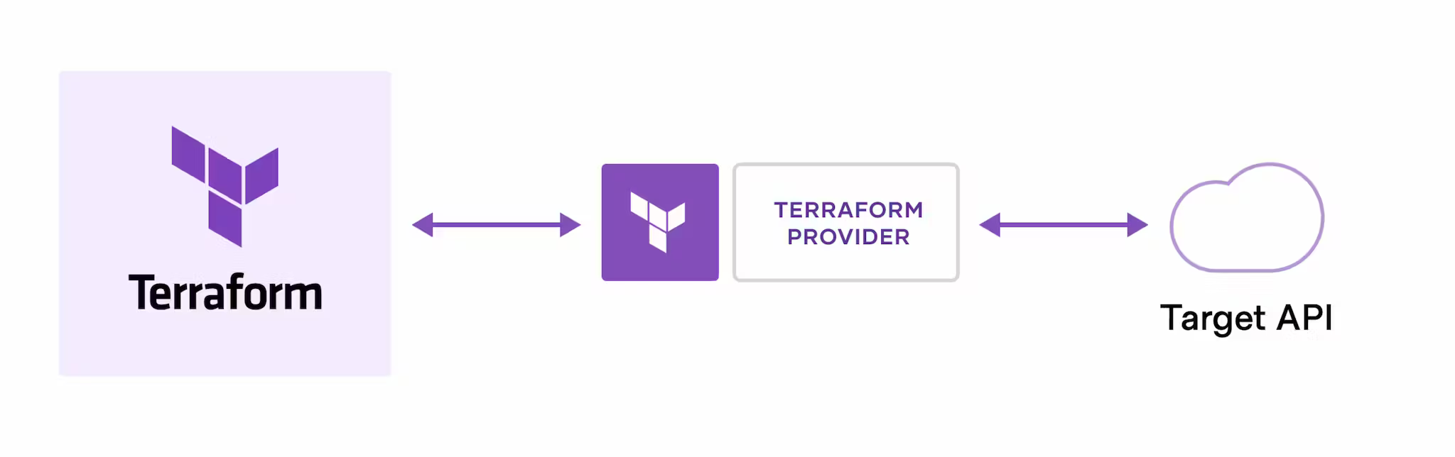
How does Terraform work?

Slide 5
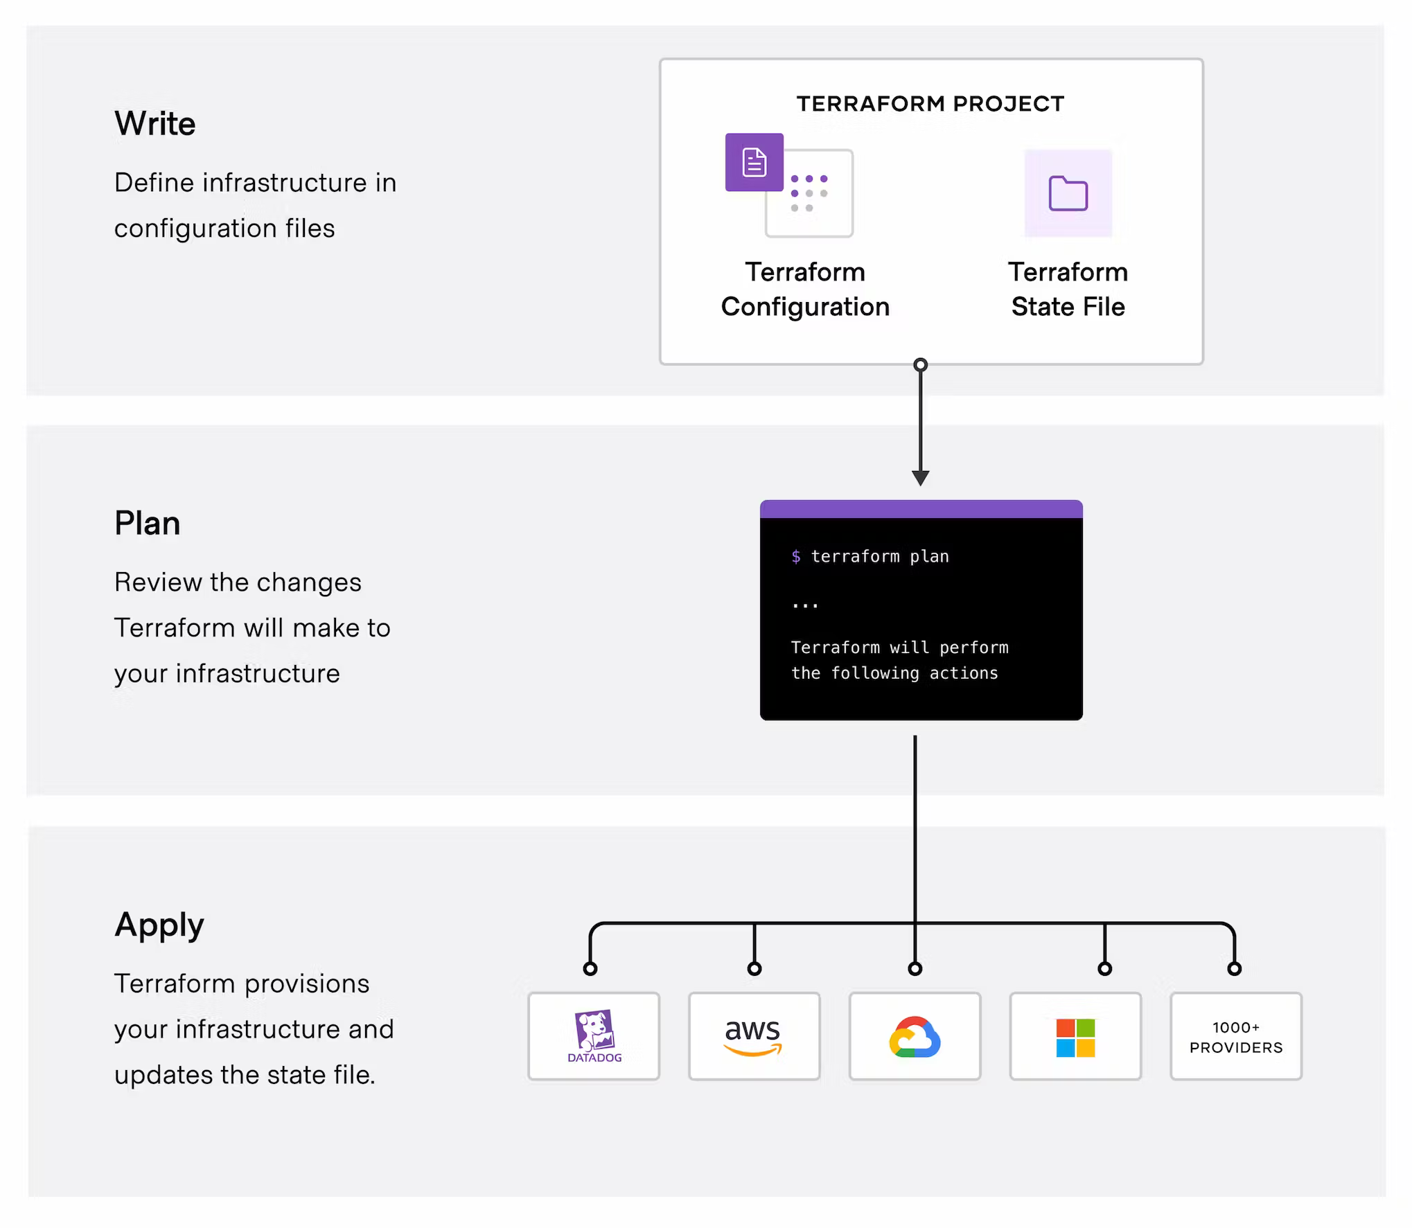
Terraform workflow

Slide 6
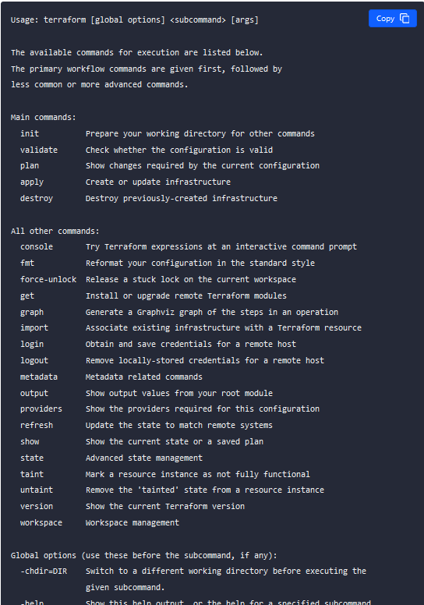
Terraform - Basic CLI Features

Slide 7
Terraform - Initializing Working Directories

Slide 8
Provisioning Infrastructure with Terraform

Slide 9
Manipulating Terraform State

Slide 10
Terraform - Inspecting Infrastructure

Slide 11
Terraform – Elements: Resources

Slide 12
Terraform – Elements: Data Sources

Slide 13
Terraform – Elements: Providers

Slide 14
Terraform – Elements: Variables and Outputs

Slide 15
Terraform – Modules

Slide 16
Terraform – Import

Slide 17
Terraform – Expressions/Functions

Slide 18
Terraform – Demo

