Slide 1
Step 2. CI/CD

Slide 2
Agenda
CI/CD

Slide 3
CI/CD

Slide 4
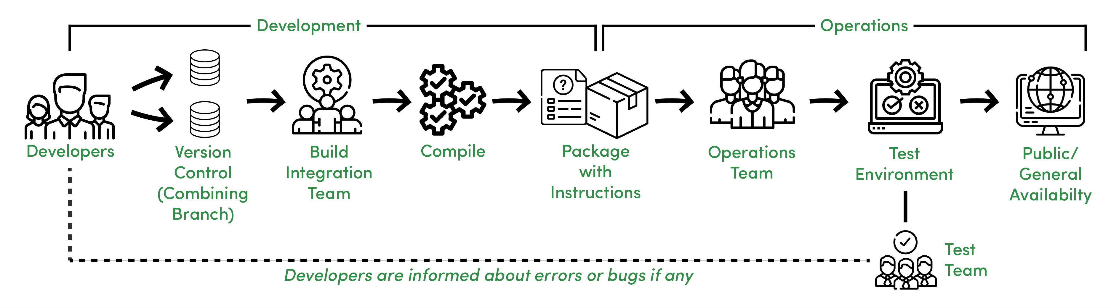
What is CI/CD?

Slide 5
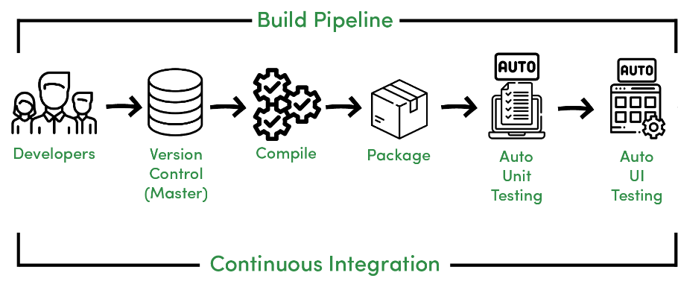
Continuous Integration

Slide 6
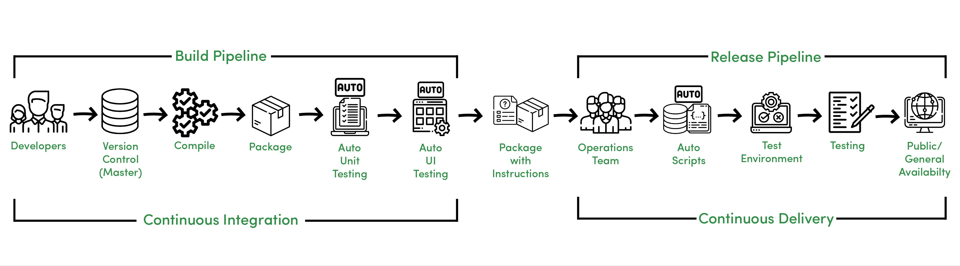
Continuous Delivery

Slide 7
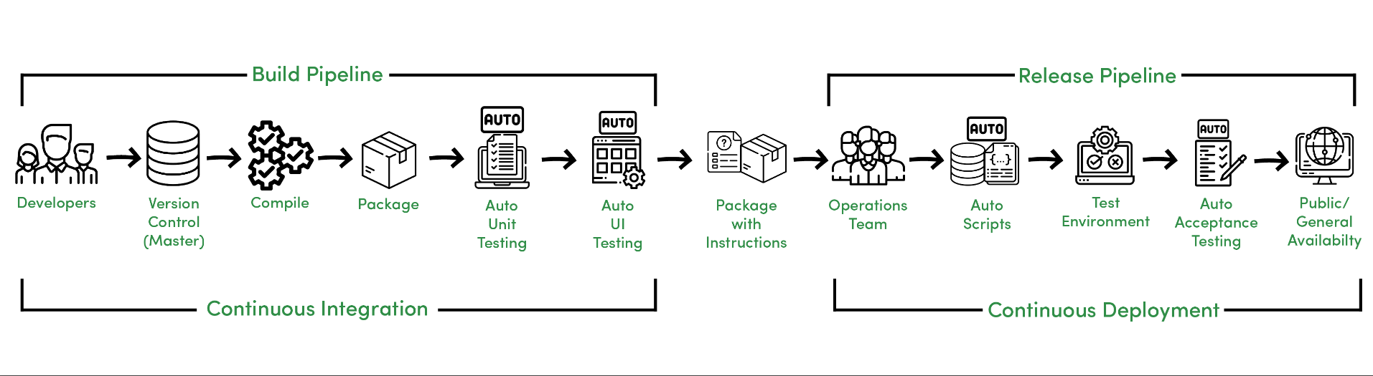
Continuous Deployment

Slide 8
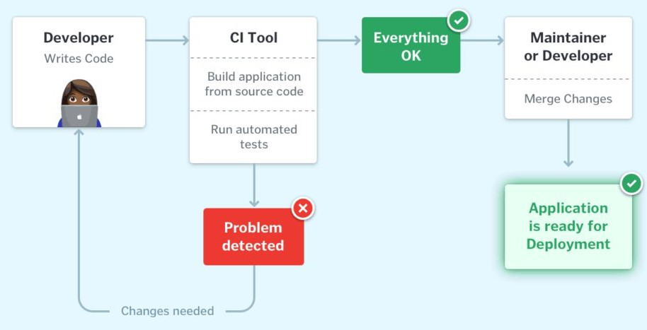
CI Workflow

Slide 9
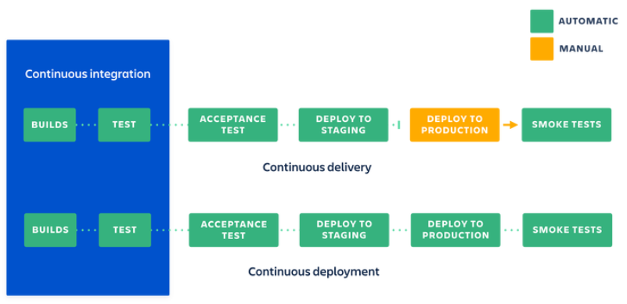
CI and CD Workflow

