Slide 2
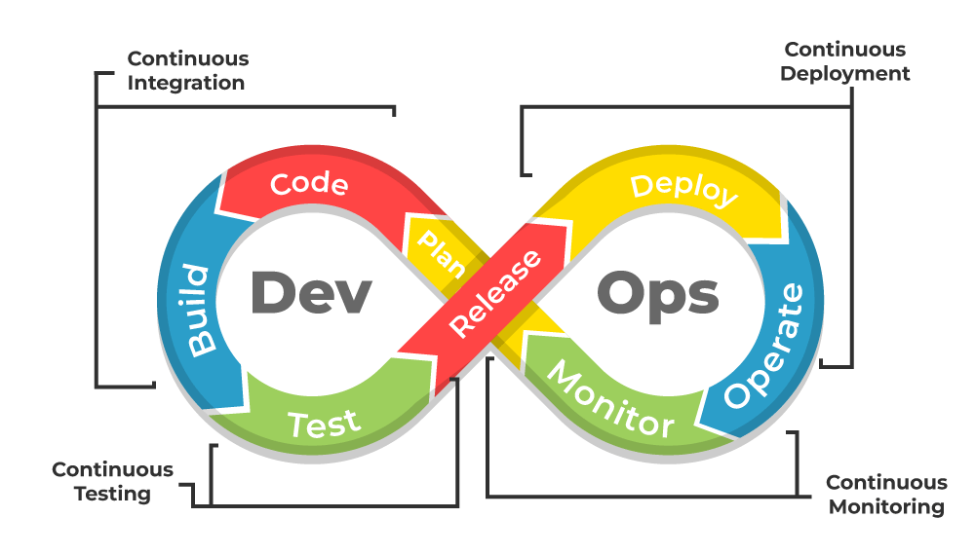
What’s DevOps?

Slide 3
What’s DevOps?

Slide 4
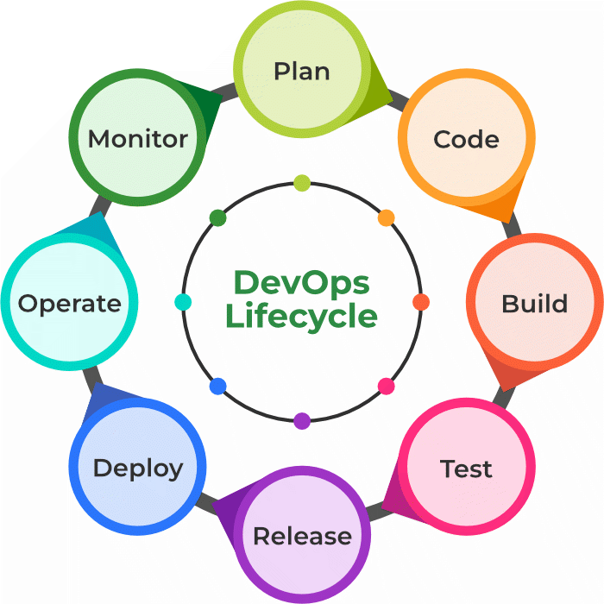
DevOps Lifecycle

Slide 5
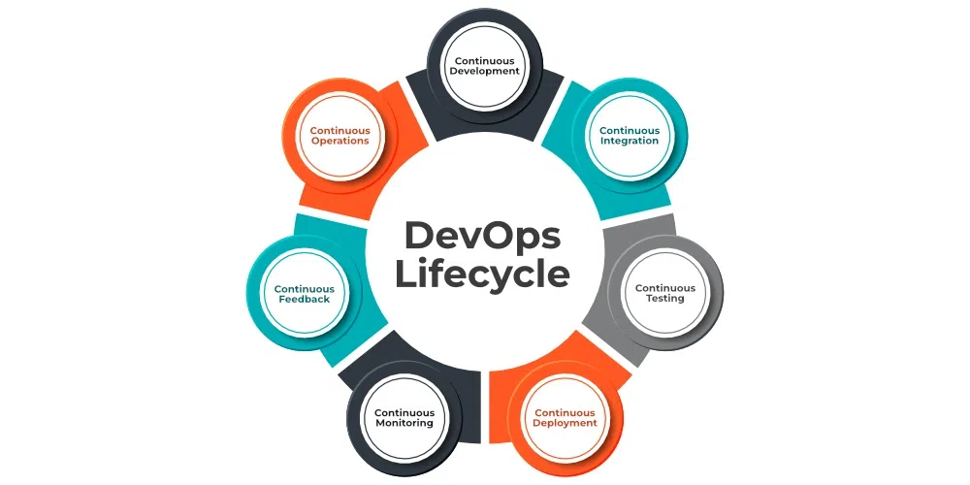
DevOps Lifecycle

Slide 6
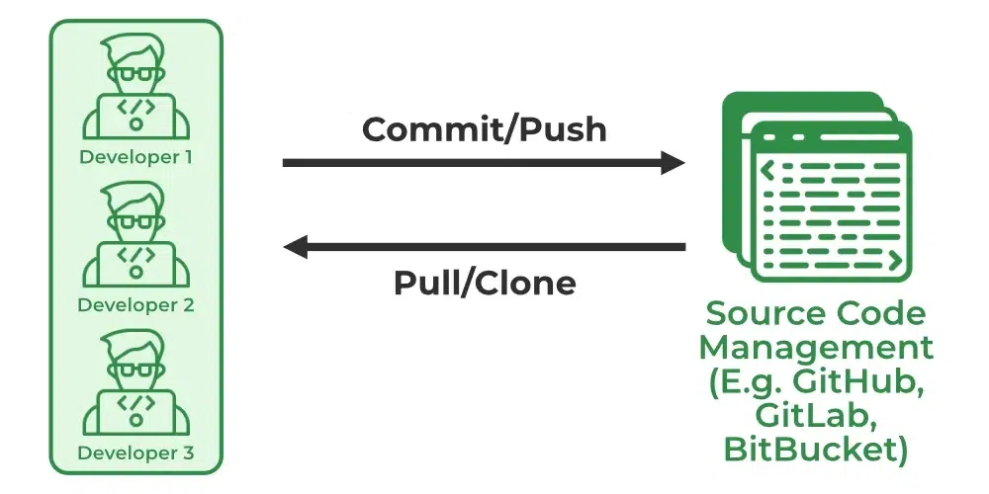
Continuous Development

Slide 7
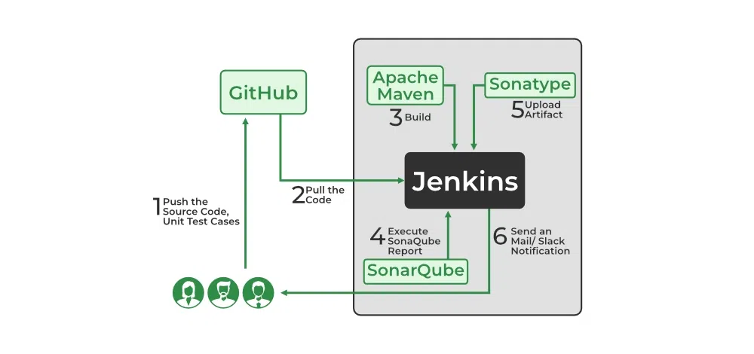
Continuous Integration

Slide 8
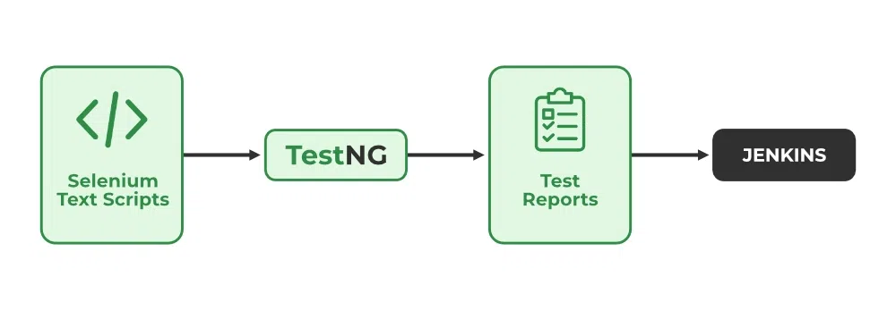
Continuous Testing

Slide 9
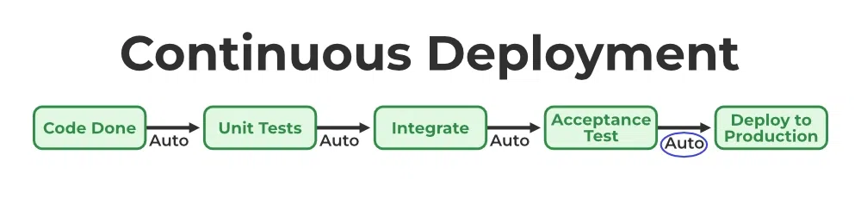
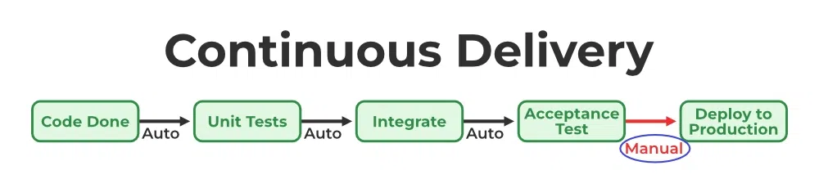
Continuous Deployment/ Continuous Delivery

Slide 10
Continuous Monitoring

Slide 11
Continuous Feedback

Slide 12
Continuous Operations

