Slide 1
Step 7. Containerization

Slide 2
Agenda
Containers
Docker

Slide 3
Containerization

Slide 4
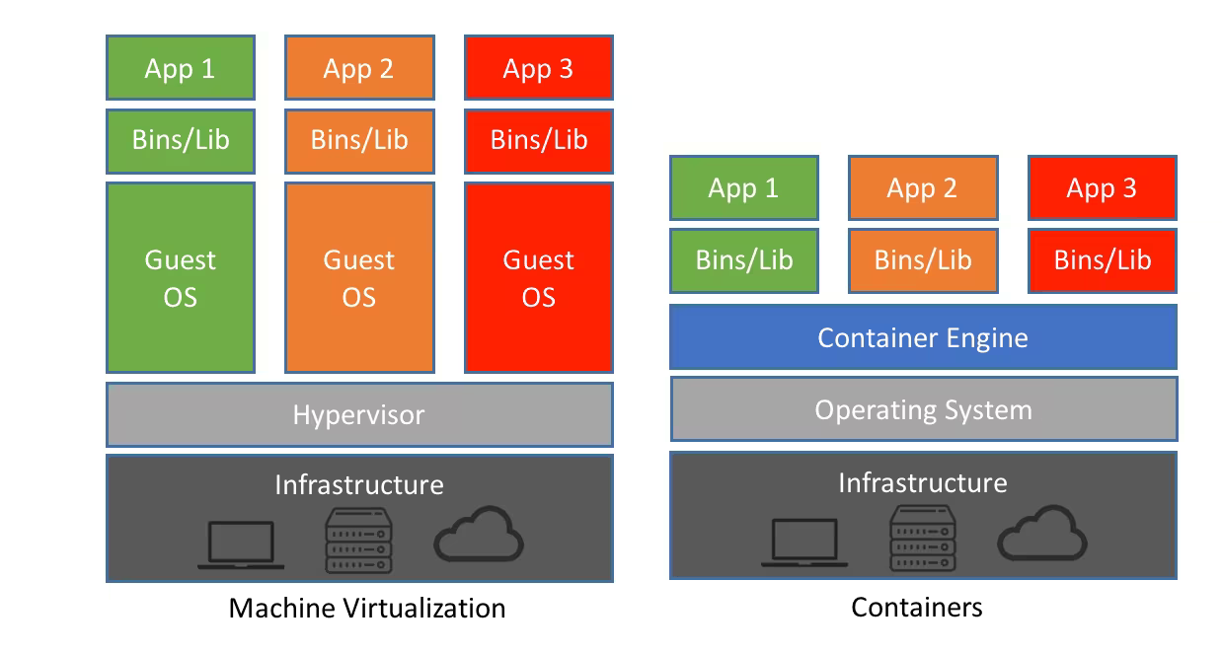
Virtualization vs. Containerization
What is Virtualization?
Virtualization is the process of partitioning a physical server into multiple virtual servers. The process of partitioning is carried out using a software called 'hypervisor'. After partitioning, the virtual servers act and perform just as a physical server. Essentially, it means using the same hardware set-up more efficiently, thereby freeing the resources for other tasks or retiring the resources altogether.
What is Containerization?
When code is developed in a specific computing environment and transferred to a different environment, there is a high possibility of the code to result in bugs and errors due to missing dependencies, libraries, or any configuration setting files.
Containerization is the process of bundling the application code along with the libraries, configuration files, and dependencies required for the application to run cross-platform.

Slide 5
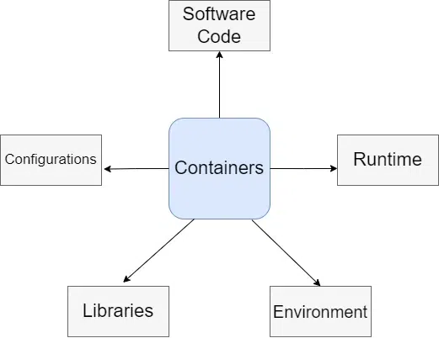
What is a Container?
The Docker official docs say that a container image is a lightweight Standalone executable package of software that includes everything needed to run an application. You can think of a container as a box that contains the underlying OS dependencies.

Slide 6
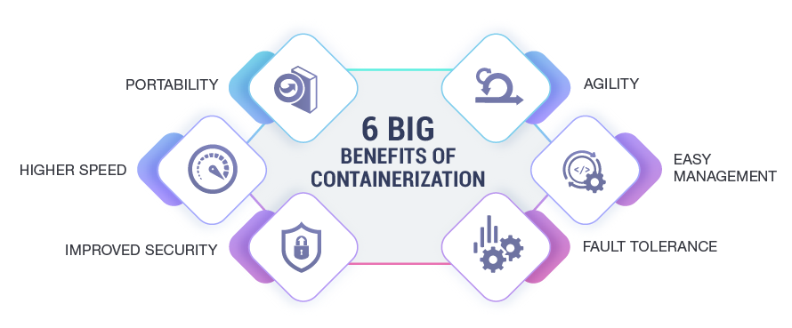
Benefits of using containers
1. Containers are portable
2. Bringing our local environment as close as possible to the production environment
3. No need to manually install all the dependencies
4. Containers are scalable
5. Containerization enables Isolation

Slide 7
Docker

Slide 8
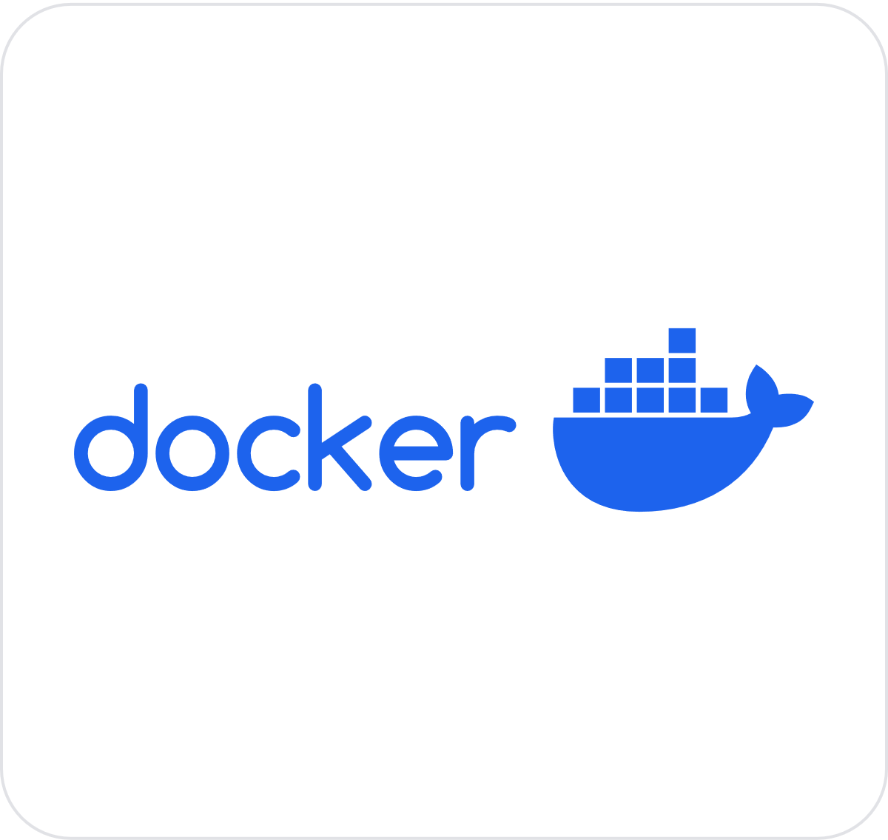
What is Docker?
Docker is an open-source containerization platform by which you can pack your application and all its dependencies into a standardized unit called a container. Containers are light in weight which makes them portable and they are isolated from the underlying infrastructure and from each other container. You can run the docker image as a docker container in any machine where docker is installed without depending on the operating system.
Docker is popular because of the following:
Portability.
Reproducibility.
Efficiency.
Scalability

Slide 9
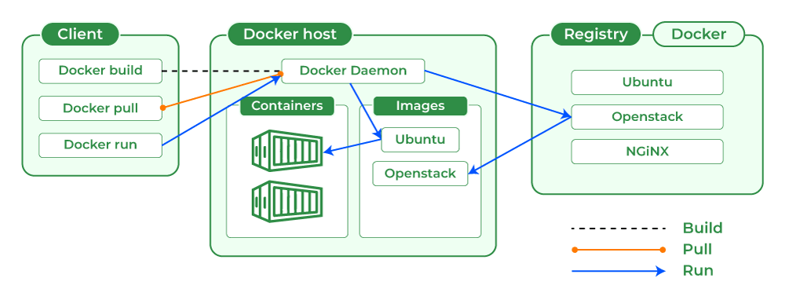
How Docker Works
Docker makes use of a client-server architecture. The Docker client talks with the docker daemon which helps in building, running, and distributing the docker containers. The Docker client runs with the daemon on the same system or we can connect the Docker client with the Docker daemon remotely. With the help of REST API over a UNIX socket or a network, the docker client and daemon interact with each other.
What is Docker Daemon?
Docker daemon manages all the services by communicating with other daemons. It manages docker objects such as images, containers, networks, and volumes with the help of the API requests of Docker.
Docker Client
With the help of the docker client, the docker users can interact with the docker. The docker command uses the Docker API. The Docker client can communicate with multiple daemons. When a docker client runs any docker command on the docker terminal then the terminal sends instructions to the daemon. The Docker daemon gets those instructions from the docker client withinside the shape of the command and REST API’s request.
The main objective of the docker client is to provide a way to direct the pull of images from the docker registry and run them on the docker host. The common commands which are used by clients are docker build, docker pull, and docker run.
Docker Host
A Docker host is a type of machine that is responsible for running more than one container. It comprises the Docker daemon, Images, Containers, Networks, and Storage.
Docker Registry
All the docker images are stored in the docker registry. There is a public registry which is known as a docker hub that can be used by anyone. We can run our private registry also. With the help of docker run or docker pull commands, we can pull the required images from our configured registry. Images are pushed into configured registry with the help of the docker push command.
Docker Objects
Whenever we are using a docker, we are creating and use images, containers, volumes, networks, and other objects. Now, we are going to discuss docker objects:-
Docker Images
An image contains instructions for creating a docker container. It is just a read-only template. It is used to store and ship applications. Images are an important part of the docker experience as they enable collaboration between developers in any way which is not possible earlier.
Docker Containers
Containers are created from docker images as they are ready applications. With the help of Docker API or CLI, we can start, stop, delete, or move a container. A container can access only those resources which are defined in the image unless additional access is defined during the building of an image in the container.
Docker Storage
We can store data within the writable layer of the container but it requires a storage driver. Storage driver controls and manages the images and containers on our docker host.
https://www.geeksforgeeks.org/architecture-of-docker/

Slide 10
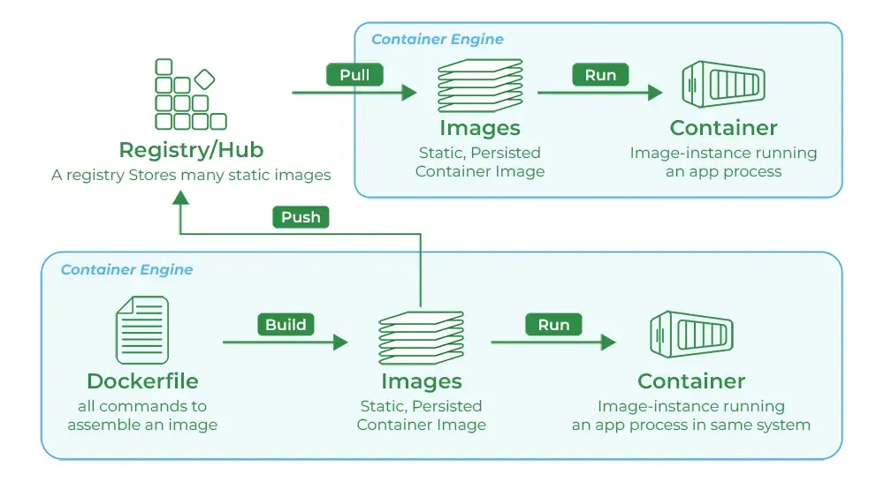
What is Docker Registry?
A Docker registry is a system for storing and distributing Docker images with specific names. There may be several versions of the same image, each with its own set of tags. A Docker registry is separated into Docker repositories, each of which holds all image modifications. The registry may be used by Docker users to fetch images locally and to push new images to the registry (given adequate access permissions when applicable). The registry is a server-side application that stores and distributes Docker images. It is stateless and extremely scalable.
Uses of Docker Registry
Our images can be stored in the Docker registry.
We can automate the development.
With the help of a private docker registry, we can secure our image.
Different Types of Docker Registries
DockerHub
Amazon Elastic Container Registry (ECR)
Google Container Registry (GCR)
Azure Container Registry (ACR)
https://www.geeksforgeeks.org/what-is-docker-registry/?ref=lbp

Slide 11
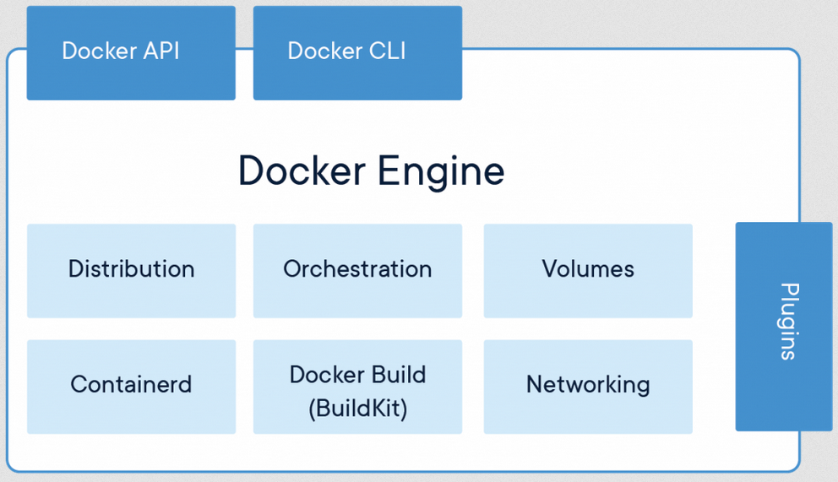
Docker Engine
The software that hosts the containers is named Docker Engine. Docker Engine is a client-server based application. The docker engine has 3 main components:
Server: It is responsible for creating and managing Docker images, containers, networks, and volumes on the Docker. It is referred to as a daemon process.
REST API: It specifies how the applications can interact with the Server and instructs it what to do.
Client: The Client is a docker command-line interface (CLI), that allows us to interact with Docker using the docker commands.

Slide 12
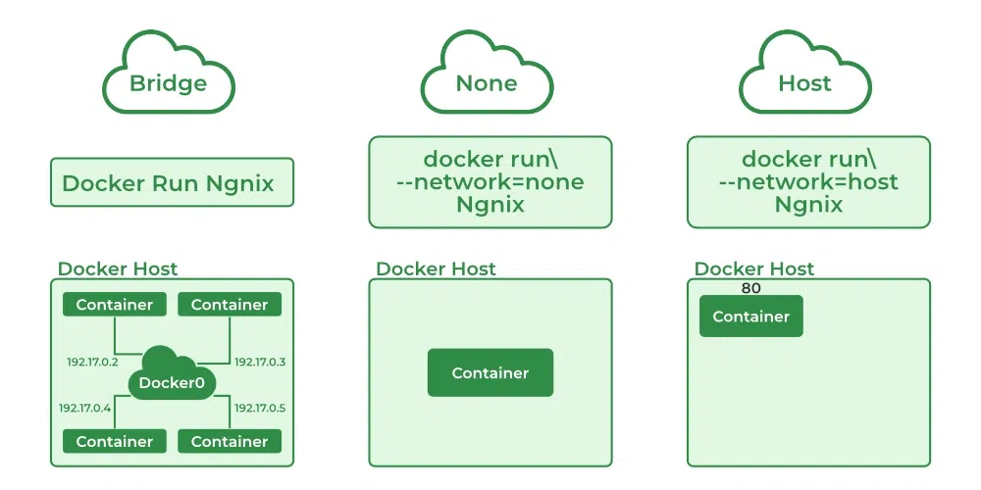
Docker Networking
Docker Networking allows you to create a Network of Docker Containers managed by a master node called the manager. Containers inside the Docker Network can talk to each other by sharing packets of information. In this article, we will discuss some basic commands that would help you get started with Docker Networking.
Types of Network Drivers
bridge: If you build a container without specifying the kind of driver, the container will only be created in the bridge network, which is the default network.
host: Containers will not have any IP address they will be directly created in the system network which will remove isolation between the docker host and containers.
none: IP addresses won’t be assigned to containers. These containments are not accessible to us from the outside or from any other container.
overlay: overlay network will enable the connection between multiple Docker demons and make different Docker swarm services communicate with each other.
ipvlan: Users have complete control over both IPv4 and IPv6 addressing by using the IPvlan driver.
macvlan: macvlan driver makes it possible to assign MAC addresses to a container.
https://www.geeksforgeeks.org/basics-of-docker-networking/?ref=lbp

Slide 13
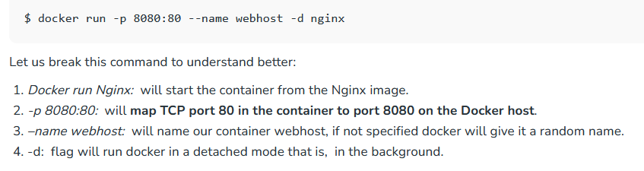

Docker Networking – Port Expose
Docker is a set of platform-as-a-service products that use OS-level virtualization to deliver software in packages called containers. These containers may need to talk to each other or to services outside docker, for this we not only need to run the image but also expose the container’s port and make it accessible by other services or containers which are on a different network.
https://www.geeksforgeeks.org/docker-managing-ports/?ref=lbp

Slide 14
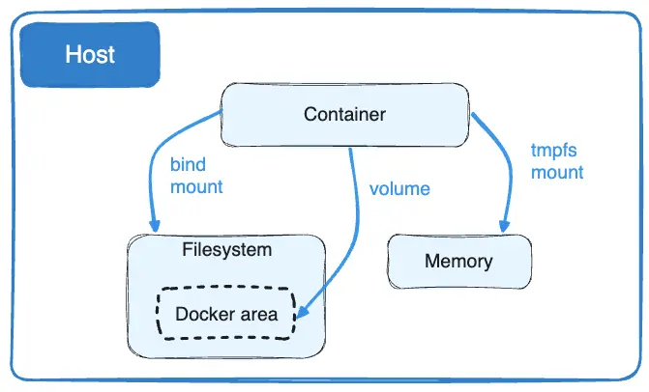
Data Storage in Docker
Docker images are built-in form of layers and docker containers store all the data being used, on the container writable layer which is only persisted till the lifespan of the container i.e. it is no longer accessible once the container is removed. This also makes it difficult to get the data out of the container if it is required by some other processes.
To persist the data irrespective of the container’s lifecycle so that the files are available in the host filesystem even if the container is no longer available, Docker provides two options:
1. Docker Volume
Volumes are the directories or files that exist on the host filesystem and are mounted to the containers for persisting data generated or modified by them. They are stored in the part of the host filesystem managed specifically by Docker and it should not be modified by non-Docker processes. Volumes are the most preferred way to store container data as they provide efficient performance and are isolated from the other functionalities of the Docker host.
2. Bind Mounts
This is also a mechanism provided by Docker to store container data on localhost, but the directory or file mounted using bind mounts can be accessed by non-Docker processes as well and it relies on the host machine’s filesystem having a specific directory structure available because it uses absolute path for binding.
Bind mounts have limited functionality and can’t be managed directly through Docker CLI, thus making it less preferable in comparison to volumes. Moreover, it allows the container to modify the host filesystem i.e. it can create, modify or delete important file directories which can impact security and non-Docker processes as well.
3. tmpfs mounts
When using Docker in Linux, you can also create storage volume for containers using tmpfs mount. But contrary to bind mounts and volumes, this type of mount is temporary and persists on host memory.
Once the container is stopped, the tmpfs mount is removed and files stored using it won’t be available anymore. This type of mount has very limited use and can only be used by Linux users. Moreover, it does not allow sharing of mounted data among containers.
4.) Named pipes
https://www.geeksforgeeks.org/data-storage-in-docker/?ref=lbp

Slide 15
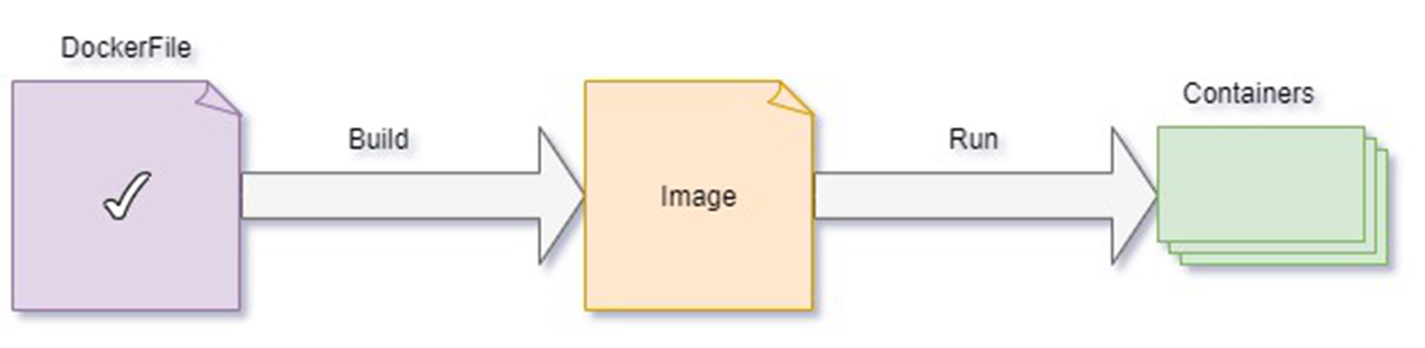
What is Docker Image?
Docker images are built using the Dockerfile which consists of a set of instructions that are required to containerize an application. The docker image includes the following to run a piece of software. A docker image is a platform-independent image that can be built in the Windows environment and it can be pushed to the docker hub and pulled by others with different OS environments like Linux.
Application ode.
Runtime.
Libraries
Environmentaltools.
Docker image is very light in weight so can be portable to different platforms very easily
Structure Of Docker Image
The layers of software that make up a Docker image make it easier to configure the dependencies needed to execute the container.
Base Image: The basic image will be the starting point for the majority of Dockerfiles, and it can be made from scratch.
Parent Image: The parent image is the image that our image is based on. We can refer to the parent image in the Dockerfile using the FROM command, and each declaration after that affects the parent image.
Layers: Docker images have numerous layers. To create a sequence of intermediary images, each layer is created on top of the one before it.
Docker Registry: Refer to this page on the Docker Registry for further information.
https://www.geeksforgeeks.org/what-is-docker-image/?ref=lbp

Slide 16
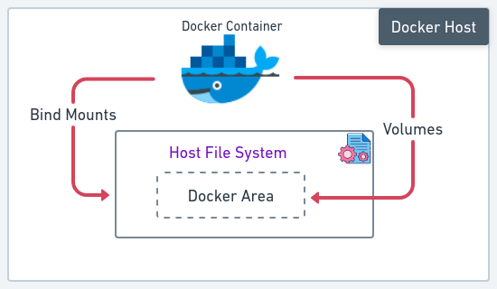
What is Docker Container?
Docker Container
A byproduct of containerization is the container. It is fundamentally pretty similar to a virtual machine, but much smaller and focused on sustaining just one programme as opposed to a fully-fledged OS with numerous software tools. An alternate method for creating virtual computers is containerization. Developers construct software clones of computers where their applications are launched and executed rather than employing hardware virtualization.
Hosting of Docker Containers
The hosts that DevOps experts or developers deal with are similar to any other hosts, including those that support Docker containers. But it’s crucial to pick the host that will provide you with a dependable, complete platform for your project from among the available hosts.
Docker Hosts
A Docker host is a piece of hardware that supports Docker containers and the operating system; in essence, this is the server. A machine that is located someplace in the hosting company’s data centre and operates round-the-clock to maintain your website or web application.
The Docker engine isolates its containers from one another and shares a portion of the host’s computational resources with them, much like a hypervisor. It does not execute unique guest operating systems for each of its containers, in contrast to a hypervisor. The Docker host kernel is shared by all containers. As a result, workloads in containers are unable to leverage capabilities that the Docker host kernel does not support.
https://www.geeksforgeeks.org/docker-containers-hosts/?ref=ml_lbp

Slide 17
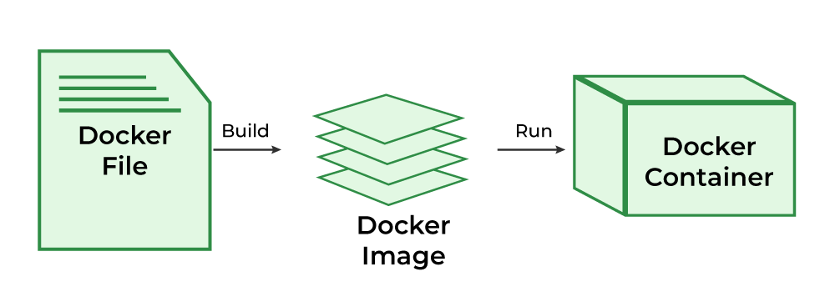
What is Dockerfile?
The Dockerfile uses DSL (Domain Specific Language) and contains instructions for generating a Docker image. Dockerfile will define the processes to quickly produce an image. While creating your application, you should create a Dockerfile in order since the Docker daemon runs all of the instructions from top to bottom.
A Dockerfile is a script that uses the Docker platform to generate containers automatically. It is essentially a text document that contains all the instructions that a user may use to create an image from the command line. The Docker platform is a Linux-based platform that allows developers to create and execute containers, self-contained programs, and systems that are independent of the underlying infrastructure. Docker, which is based on the Linux kernel’s resource isolation capabilities, allows developers and system administrators to transfer programs across multiple systems and machines by executing them within containers.
Docker containers may operate on any Linux host thanks to Dockerfiles. Docker images are used to construct container environments for applications, and they may be produced manually or automatically using Dockerfiles. Docker containers can execute Linux and Windows apps. Developers may use Dockerfiles to construct an automated container build that steps through a series of command-line instructions. Docker containerization is essentially virtualization at the operating system level. Without the startup overhead of virtual machines, several independent containers can run within a single Linux instance.
Dockerfiles provide business applications with more flexibility and mobility. Dockerfiles are used by IT companies to bundle programs and their dependencies in a virtual container that may operate on bare metal, in public or private clouds, or on-premises. Numerous apps, worker tasks, and other activities can operate independently on a single physical computer or across multiple virtual machines using containers. Kubernetes is an open-source solution for automating the management and orchestration of Dockerfile-based containerized applications.
https://www.geeksforgeeks.org/what-is-dockerfile-syntax/?ref=header_search

Slide 18
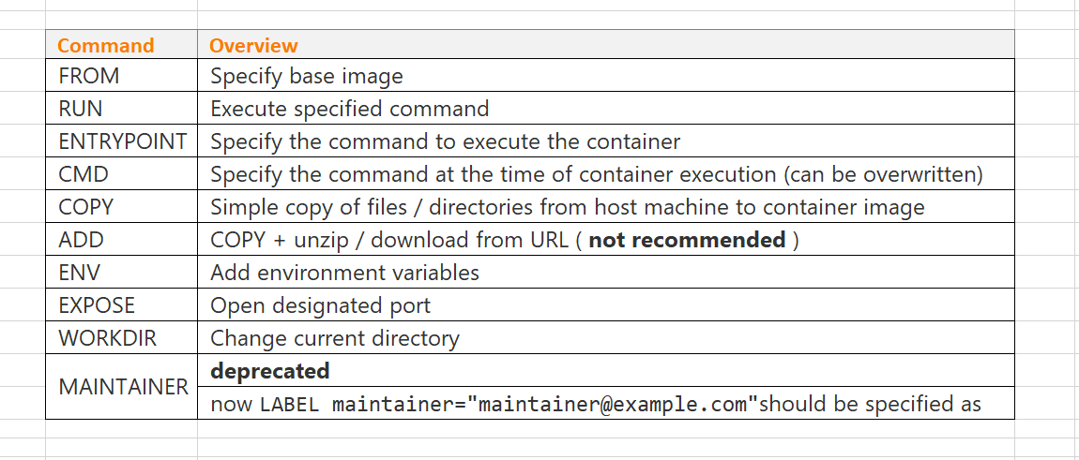
Dockerfile Syntax
1. FROM
A FROM statement defines which image to download and start from. It must be the first command in your Dockerfile. A Dockerfile can have multiple FROM statements which means the Dockerfile produces more than one image.
2. MAINTAINER
This statement is a kind of documentation, which defines the author who is creating this Dockerfile or who should you contact if it has bugs.
3. RUN
The RUN statement defines running a command through the shell, waiting for it to finish, and saving the result. It tells what process will be running inside the container at the run time.
4. ADD
If we define to add some files, ADD statement is used. It basically gives instructions to copy new files, directories, or remote file URLs and then adds them to the filesystem of the image.
To sum up it can add local files, contents of tar archives as well as URLs.
5. ENV
ENV statement sets the environment variables both during the build and when running the result. It can be used in the Dockerfile and any scripts it calls. It can be used in the Dockerfile as well as any scripts that the Dockerfile calls. These are also persistent with the container and can be referred to at any moment.
6. ENTRYPOINT
It specifies the starting of the expression to use when starting your container. Simply ENTRYPOINT specifies the start of the command to run. If your container acts as a command-line program, you can use ENTRYPOINT.
7. CMD
CMD specifies the whole command to run. We can say CMD is the default argument passed into the ENTRYPOINT. The main purpose of the CMD command is to launch the software required in a container.
Note: If you have both ENVIRONMENT and CMD, they are combined together.
8. EXPOSE
EXPOSE statement maps a port into the container. The ports can be TCP or UDP but by default, it is TCP.
9. VOLUME
The VOLUME statement defines shared volumes or ephemeral volumes depending upon whether you have one or two arguments.
10. WORKDIR
As the name suggests, WORKDIR sets the directory that the container starts in. Its main purpose is to set the working directory for all future Dockerfile commands.
11. USER
It sets which user’s container will run as. This can be useful if you have shared network directories involved that assume a fixed username or a fixed user number.
12. ARG
A variable that can be provided at build time is defined by an ARG Instruction. Once it has been specified in the Dockerfile, you can specify it using the –build-arg switch when creating the image. The Dockerfile supports multiple ARG instructions. The only instruction in the Dockerfile that can come before the FROM instruction is ARG.
https://www.geeksforgeeks.org/what-is-dockerfile-syntax

Slide 19
Dockerignore
If you are a Docker Developer, you might have noticed that when you build a Docker Image either using a dockerfile or directly pull an image from the Docker registry, the size of the image can be considerably large depending upon your Docker Build Context.
Since Docker is a client-server application, we know that the Docker Client is the actual Command Line Interface that we used to access the Docker Containers and the Docker Server is actually called the Docker Daemon which helps you in maintaining the Containers. When we are trying to build a Docker Image, we need to send some files to the Docker Daemon or the server so that those files can be used and included inside the Docker Container that we are trying to build. This set of files and directories is called the Docker Build Context.
It’s obvious that the larger the size of the files and folders inside the Docker build context, the larger is the size of the Docker Image. Now, inside the folder where you keep your dockerfile and through which you are trying to build the Image, there might contain some files and folders that are although a part of the project and you don’t want to include those files in the Docker Build Context.
https://www.geeksforgeeks.org/how-to-use-a-dockerignore-file/?ref=header_search

Slide 20
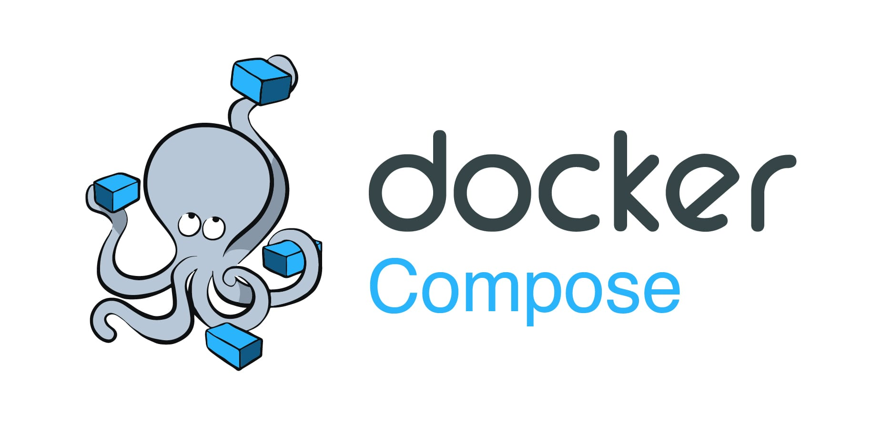
Docker Compose
Docker Compose will execute a YAML-based multi-container application. The YAML file consists of all configurations needed to deploy containers Docker Compose, which is integrated with Docker Swarm, and provides directions for building and deploying containers. With Docker Compose, each container is constructed to run on a single host.
As discussed earlier, a real-world application has a separate container for each of its services. And we know that each container needs to have a Dockerfile. It means we will have to write maybe hundreds of docker files and then manage everything about the containers individually, That’s cumbersome.
Hence we use docker-compose, which is a tool that helps in the definition and running of multi-container applications. With the help of Docker Compose you can start and stop the services by using its YAML file.
Docker-compose allows us to start and stop all of the services with just a few simple commands and a single YAML file for each configuration.
In contrast to utilizing a prebuilt image from Docker Hub, which you may configure with the docker-compose.yaml file, if you are using a custom image, you will need to declare its configurations in a separate Dockerfile.
These are the features that docker-compose support:
All the services are isolated running on a single host.
Containers are recreated only when there is some change.
The volume data is not reset when creating new containers, volumes are preserved.
Movement of variables and composition within environments.
It creates a virtual network for easy interaction within the environments.
https://www.geeksforgeeks.org/docker-compose/?ref=lbp

Slide 21
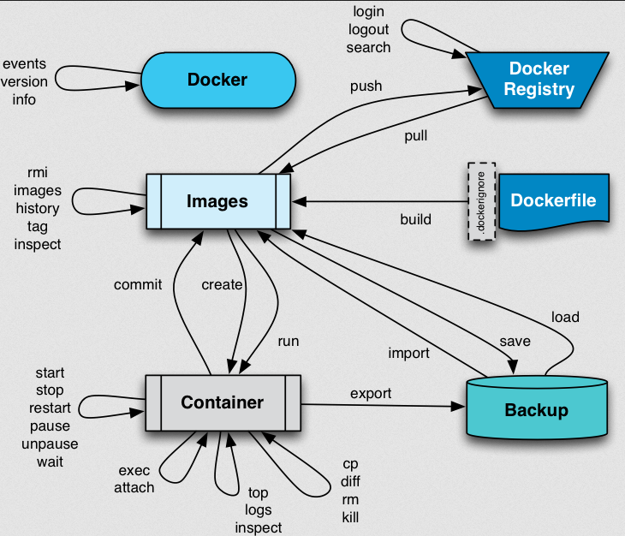
Docker Compose
Docker Run command
This command is used to run a container from an image. The docker run command is a combination of the docker create and docker start commands. It creates a new container from the image specified and starts that container. if the docker image is not present, then the docker run pulls that.
Docker Pull
This command allows you to pull any image which is present in the official registry of docker, Docker hub. By default, it pulls the latest image, but you can also mention the version of the image.
Docker PS
This command (by default) shows us a list of all the running containers. We can use various flags with it.
-a flag: shows us all the containers, stopped or running.
-l flag: shows us the latest container.
-q flag: shows only the Id of the containers.
Docker exec
This command allows us to run new commands in a running container. This command only works until the container is running, after the container restarts, this command does not restart.
Some important flags:
-d flag: for running the commands in the background.
-i flag: it will keep STDIN open even when not attached.
-e flag: sets the environment variables
Docker Commit command
After running the containers by using the current image you can make the updates to the containers by interacting with the containers from that containers you can create an image by using the following commands.
https://www.geeksforgeeks.org/docker-instruction-commands/?ref=lbp

