Slide 1
Software Development Life Cycle (SDLC)

Slide 2
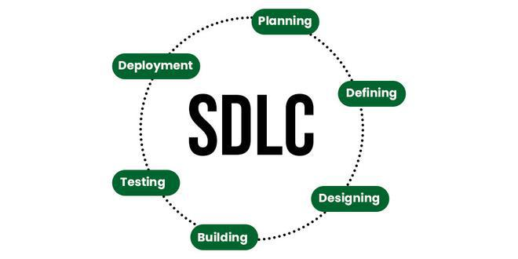
Software Development Life Cycle (SDLC)

Slide 3
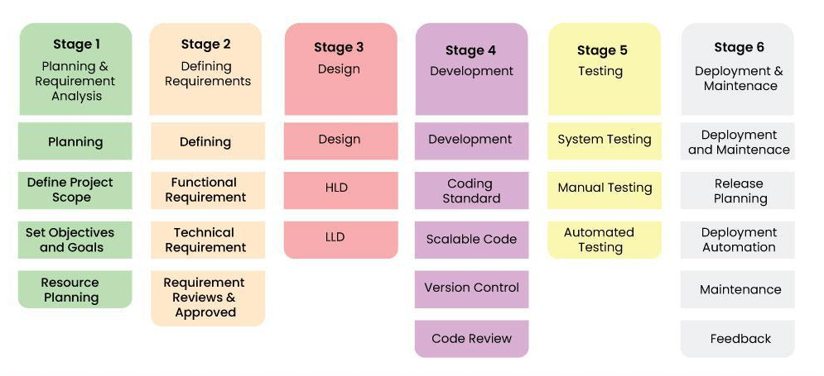
Stages of SDLC

Slide 4
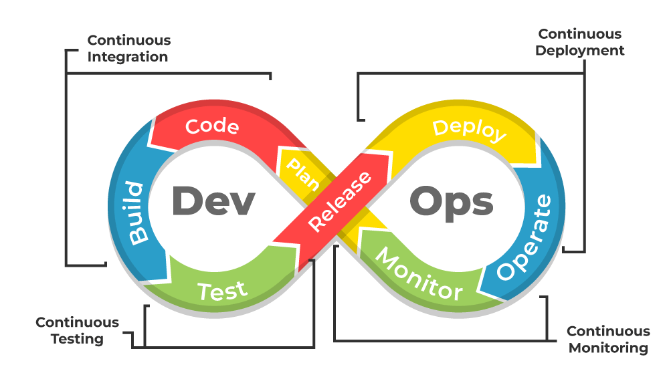
What’s DevOps?

Slide 5
What’s DevOps?

Slide 6
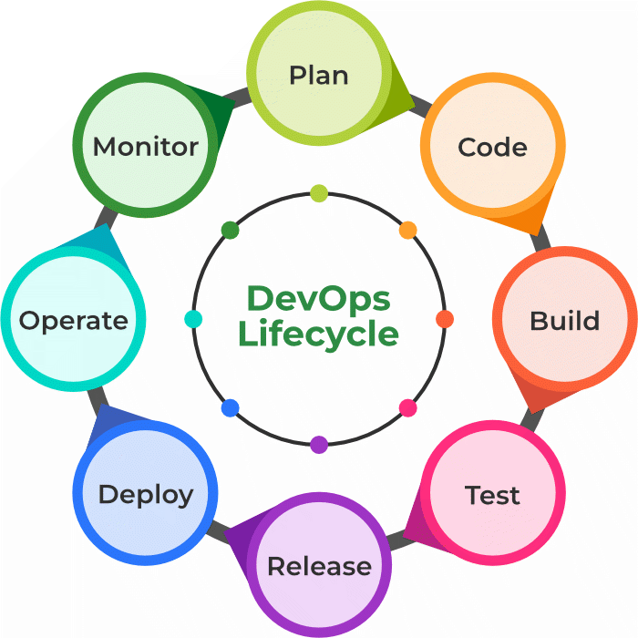
DevOps Lifecycle

Slide 7
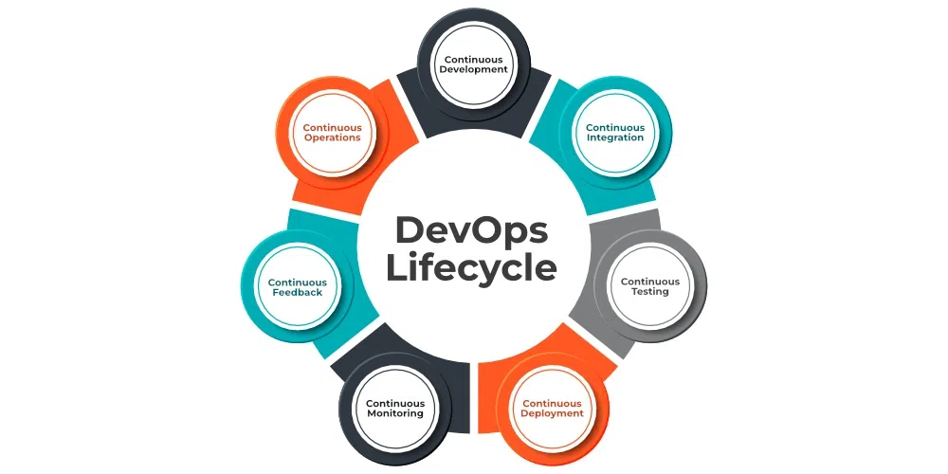
DevOps Lifecycle

Slide 8
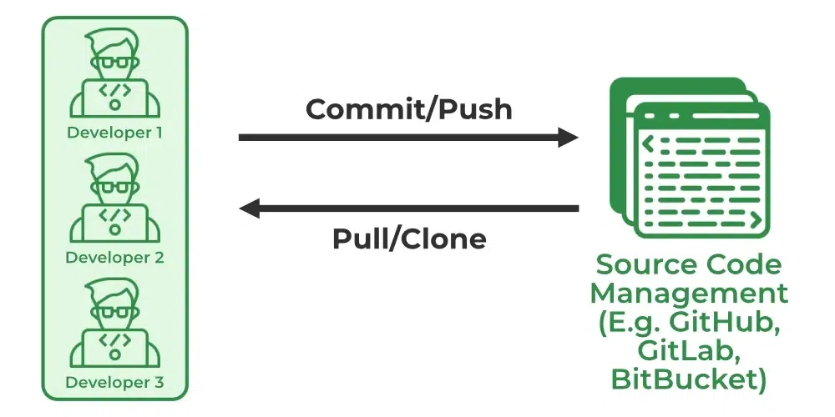
Continuous Development

Slide 9
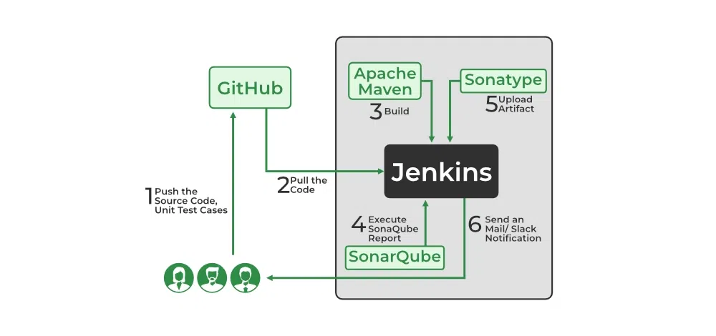
Continuous Integration

Slide 10
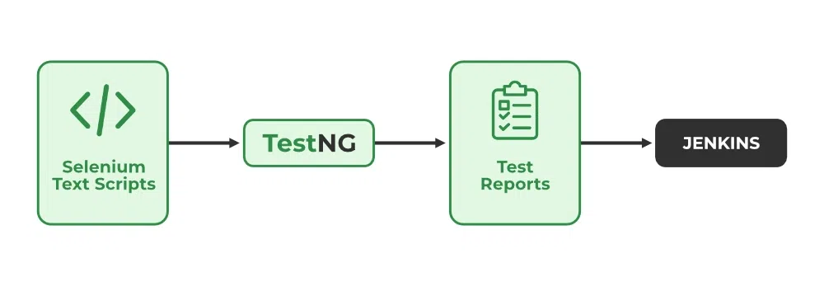
Continuous Testing

Slide 11
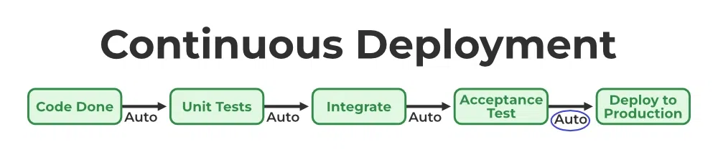
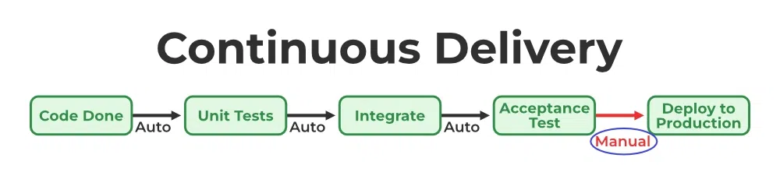
Continuous Deployment/ Continuous Delivery

Slide 12
Continuous Monitoring

Slide 13
Continuous Feedback

Slide 14
Continuous Operations

