Slide 2
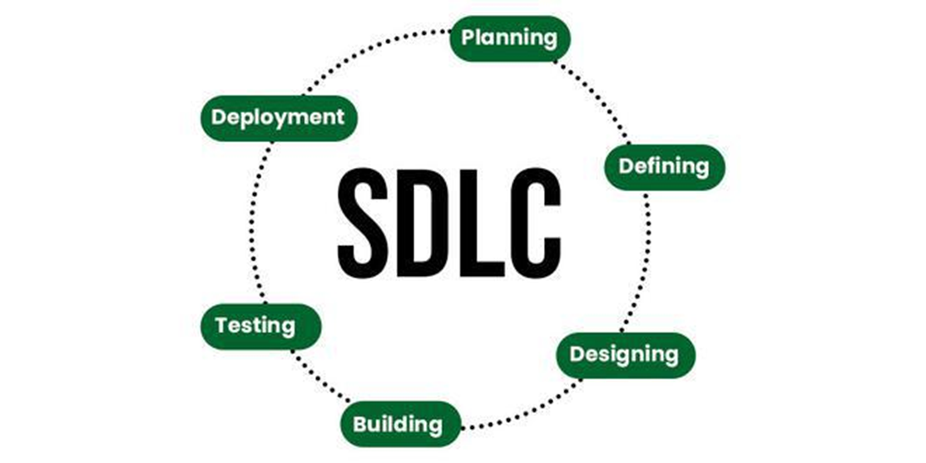
Software Development Life Cycle (SDLC)
SDLC is a process followed for software building within a software organization. SDLC consists of a precise plan that describes how to develop, maintain, replace, and enhance specific software. The life cycle defines a method for improving the quality of software and the all-around development process.

Slide 3
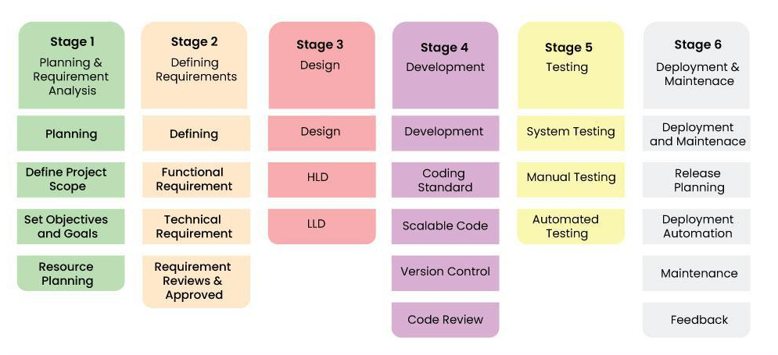
Stages of SDLC
SDLC specifies the task(s) to be performed at various stages by a software engineer or developer. It ensures that the end product is able to meet the customer’s expectations and fits within the overall budget. Hence, it’s vital for a software developer to have prior knowledge of this software development process.

Slide 4
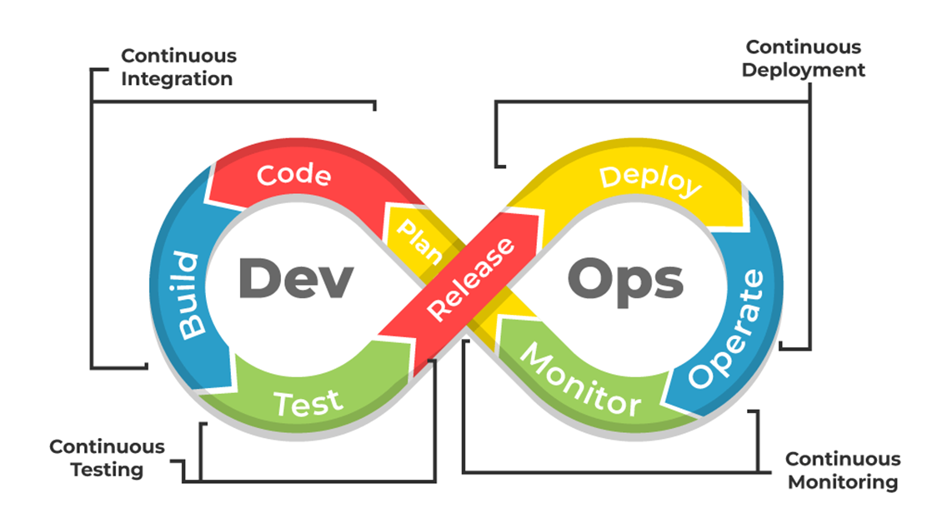
What’s DevOps?
DevOps is a software development approach emphasizing collaboration, automation, and continuous delivery to provide high-quality products to customers quickly and efficiently. DevOps breaks down silos between development and operations teams to enable seamless communication, faster time-to-market, and improved customer satisfaction. It allows a team to handle the complete application lifecycle, from development to testing, operations, and deployment. It shows cooperation between Development and Operations groups to deploy code to production quickly in an automated and repeatable manner.
Every phase of the software development lifecycle, including planning, coding, testing, deployment, and monitoring, is heavily automated in DevOps. This improves productivity, ensures consistency, and lowers error rates in the development process. A culture of continuous improvement is also promoted by DevOps, where feedback loops are incorporated into the procedure to facilitate quicker iteration and better decision-making. Organizations can increase their agility, lower costs, and speed up innovation by adopting DevOps.

Slide 5

What’s DevOps?
Why DevOps?
The goal of DevOps is to increase an organization’s speed when it comes to delivering applications and services. Many companies have successfully implemented DevOps to enhance their user experience including Amazon, Netflix, etc.
Facebook’s mobile app which is updated every two weeks effectively tells users you can have what you want and you can have it. Now ever wondered how Facebook was able to do social smoothing? It’s the DevOps philosophy that helps Facebook ensure that apps aren’t outdated and that users get the best experience on Facebook. Facebook accomplishes this true code ownership model that makes its developers responsible that includes testing and supporting through production and delivery for each kernel of code. They write and update their true policies like this but Facebook has developed a DevOps culture and has successfully accelerated its development lifecycle.
Industries have started to gear up for digital transformation by shifting their means to weeks and months instead of years while maintaining high quality as a result. The solution to all this is- DevOps

Slide 6
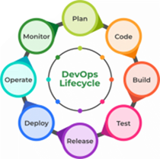
DevOps Lifecycle
Plan: Determining the commercial needs and gathering the opinions of end-user by professionals in this level of the DevOps lifecycle.
Code: At this level, the code for the same is developed and in order to simplify the design, the team of developers uses tools and extensions that take care of security problems.
Build: After the coding part, programmers use various tools for the submission of the code to the common code source.
Test: This level is very important to assure software integrity. Various sorts of tests are done such as user acceptability testing, safety testing, speed testing, and many more.
Release: At this level, everything is ready to be deployed in the operational environment.
Deploy: In this level, Infrastructure-as-Code assists in creating the operational infrastructure and subsequently publishes the build using various DevOps lifecycle tools.
Operate: At this level, the available version is ready for users to use. Here, the department looks after the server configuration and deployment.
Monitor: The observation is done at this level that depends on the data which is gathered from consumer behavior, the efficiency of applications, and from various other sources.

Slide 7
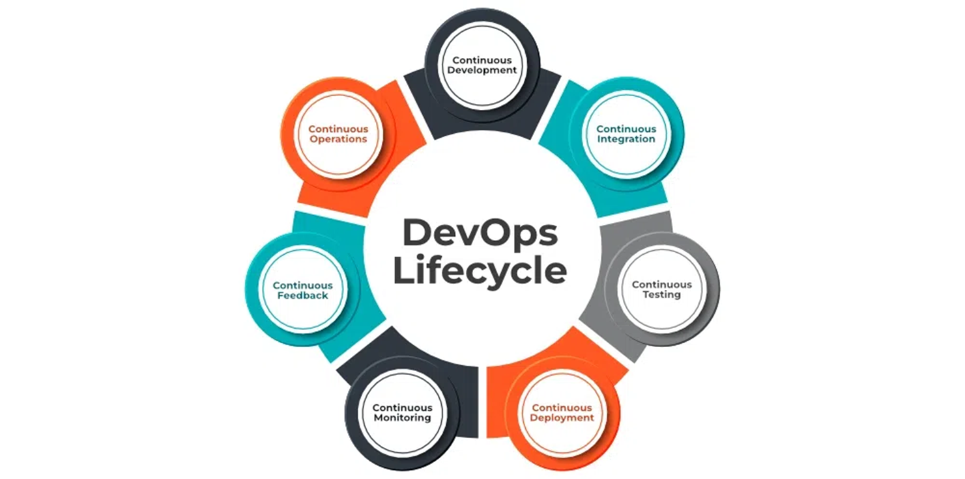
DevOps Lifecycle
7 Cs of DevOps
Continuous Development
Continuous Integration
Continuous Testing
Continuous Deployment/Continuous Delivery
Continuous Monitoring
Continuous Feedback
Continuous Operations

Slide 8
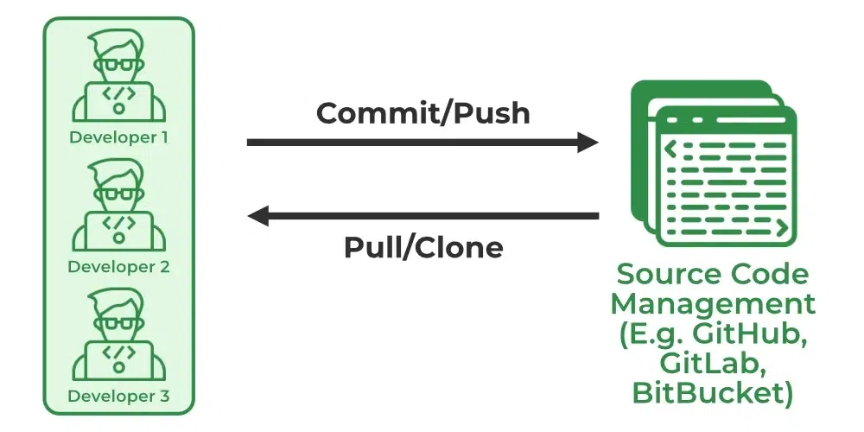
Continuous Development
In Continuous Development code is written in small, continuous bits rather than all at once, Continuous Development is important in DevOps because this improves efficiency every time a piece of code is created, it is tested, built, and deployed into production. Continuous Development raises the standard of the code and streamlines the process of repairing flaws, vulnerabilities, and defects. It facilitates developers’ ability to concentrate on creating high-quality code.

Slide 9
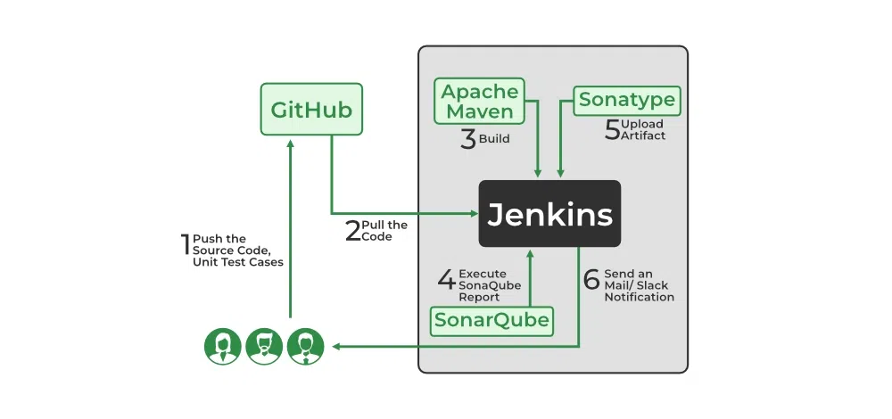
Continuous Integration
Continuous Integration can be explained mainly in 4 stages in DevOps. They are as follows:
Getting the SourceCode from SCM
Building the code
Code quality review
Storing the build artifacts
The stages mentioned above are the flow of Continuous Integration and we can use any of the tools that suit our requirement in each stage and of the most popular tools are GitHub for source code management(SCM) when the developer develops the code on his local machine he pushes it to the remote repository which is GitHub from here who is having the access can Pull, clone and can make required changes to the code. From there by using Maven we can build them into the required package (war, jar, ear) and can test the Junit cases.SonarQube performs code quality reviews where it will measure the quality of source code and generates a report in the form of HTML or PDF format. Nexus for storing the build artifacts will help us to store the artifacts that are build by using Maven and this whole process is achieved by using a Continuous Integration tool Jenkins.

Slide 10
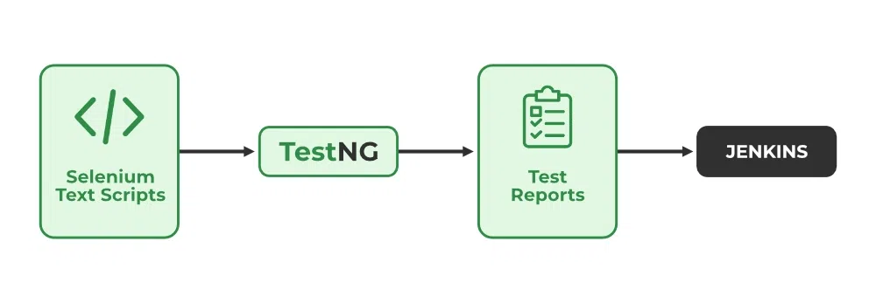
Continuous Testing
Any firm can deploy continuous testing with the use of the agile and DevOps methodologies. Depending on our needs, we can perform continuous testing using automation testing tools such as Testsigma, Selenium, LambdaTest, etc. With these tools, we can test our code and prevent problems and code smells, as well as test more quickly and intelligently. With the aid of a continuous integration platform like Jenkins, the entire process can be automated, which is another added benefit.

Slide 11
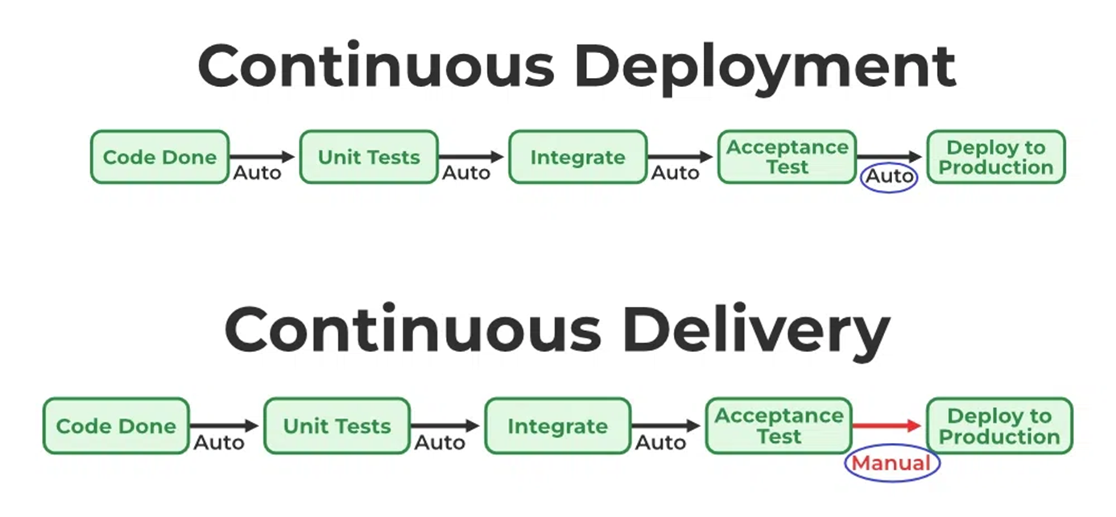
Continuous Deployment/ Continuous Delivery
Continuous Deployment: Continuous Deployment is the process of automatically deploying an application into the production environment when it has completed testing and the build stages. Here, we’ll automate everything from obtaining the application’s source code to deploying it
Continuous Delivery: Continuous Delivery is the process of deploying an application into production servers manually when it has completed testing and the build stages. Here, we’ll automate the continuous integration processes, however, manual involvement is still required for deploying it to the production environment.

Slide 12
Continuous Monitoring
DevOps lifecycle is incomplete if there was no Continuous Monitoring. Continuous Monitoring can be achieved with the help of Prometheus and Grafana we can continuously monitor and can get notified before anything goes wrong with the help of Prometheus we can gather many performance measures, including CPU and memory utilization, network traffic, application response times, error rates, and others. Grafana makes it possible to visually represent and keep track of data from time series, such as CPU and memory utilization.

Slide 13
Continuous Feedback
Once the application is released into the market the end users will use the application and they will give us feedback about the performance of the application and any glitches affecting the user experience after getting multiple feedback from the end users’ the DevOps team will analyze the feedbacks given by end users and they will reach out to the developer team tries to rectify the mistakes they are performed in that piece of code by this we can reduce the errors or bugs that which we are currently developing and can produce much more effective results for the end users also we reduce any unnecessary steps to deploy the application. Continuous Feedback can increase the performance of the application and reduce bugs in the code making it smooth for end users to use the application.

Slide 14
Continuous Operations
We will sustain the higher application uptime by implementing continuous operation, which will assist us to cut down on the maintenance downtime that will negatively impact end users’ experiences. More output, lower manufacturing costs, and better quality control are benefits of continuous operations.

