Slide 1
Step 1. Model

Slide 2
Agenda
SDLC
DevOps
Agile
DevSecOps

Slide 3
Software Development Life Cycle (SDLC)

Slide 4
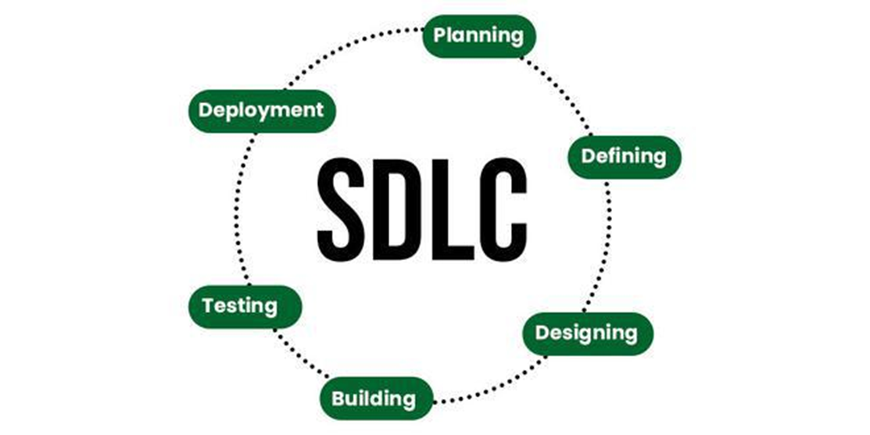
Software Development Life Cycle (SDLC)
SDLC is a process followed for software building within a software organization. SDLC consists of a precise plan that describes how to develop, maintain, replace, and enhance specific software. The life cycle defines a method for improving the quality of software and the all-around development process.

Slide 5
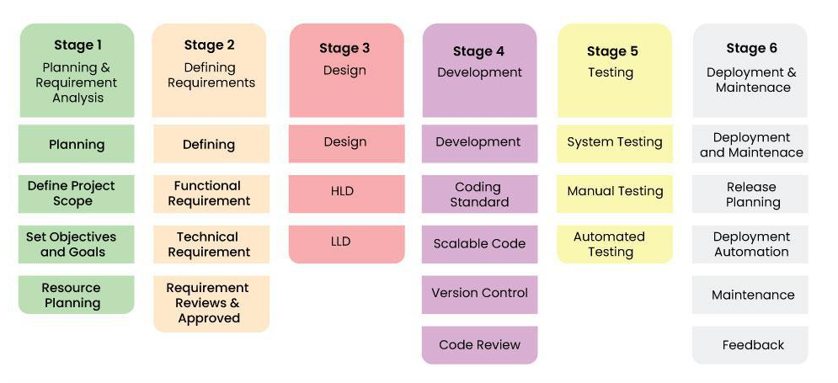
Stages of SDLC
SDLC specifies the task(s) to be performed at various stages by a software engineer or developer. It ensures that the end product is able to meet the customer’s expectations and fits within the overall budget. Hence, it’s vital for a software developer to have prior knowledge of this software development process.

Slide 6
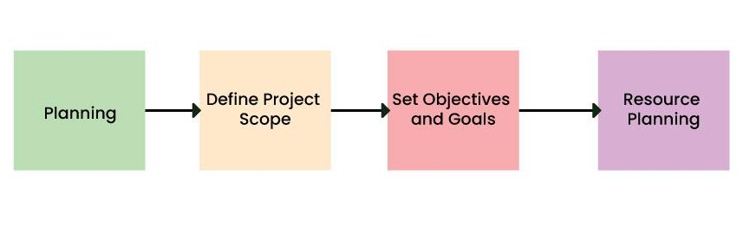
Stage-1: Planning and Requirement Analysis
Planning is a crucial step in everything, just as in software development. In this same stage, requirement analysis is also performed by the developers of the organization. This is attained from customer inputs, and sales department/market surveys.
The information from this analysis forms the building blocks of a basic project. The quality of the project is a result of planning. Thus, in this stage, the basic project is designed with all the available information

Slide 7
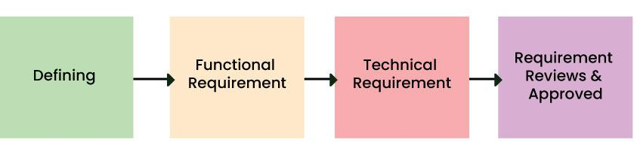
Stage-2: Defining Requirements
In this stage, all the requirements for the target software are specified. These requirements get approval from customers, market analysts, and stakeholders.
This is fulfilled by utilizing SRS (Software Requirement Specification). This is a sort of document that specifies all those things that need to be defined and created during the entire project cycle.

Slide 8
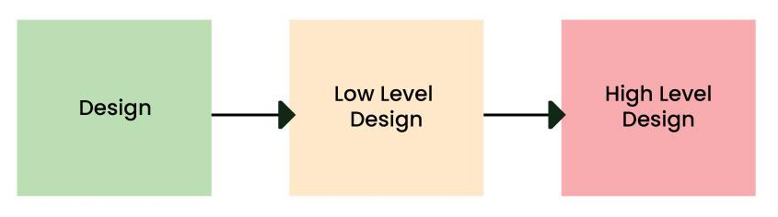
Stage-3: Designing Architecture
SRS is a reference for software designers to come up with the best architecture for the software. Hence, with the requirements defined in SRS, multiple designs for the product architecture are present in the Design Document Specification (DDS).
This DDS is assessed by market analysts and stakeholders. After evaluating all the possible factors, the most practical and logical design is chosen for development.

Slide 9
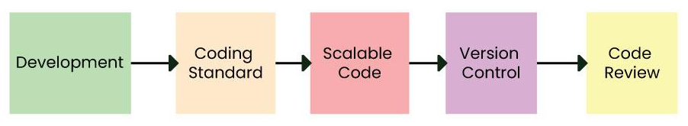
Stage-4: Developing Product
At this stage, the fundamental development of the product starts. For this, developers use a specific programming code as per the design in the DDS. Hence, it is important for the coders to follow the protocols set by the association. Conventional programming tools like compilers, interpreters, debuggers, etc. are also put into use at this stage. Some popular languages like C/C++, Python, Java, etc. are put into use as per the software regulations.

Slide 10
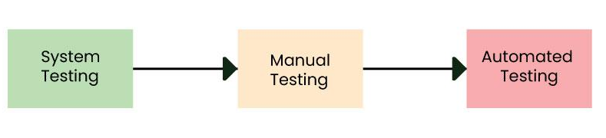
Stage-5: Product Testing and Integration
After the development of the product, testing of the software is necessary to ensure its smooth execution. Although, minimal testing is conducted at every stage of SDLC. Therefore, at this stage, all the probable flaws are tracked, fixed, and retested. This ensures that the product confronts the quality requirements of SRS.
Documentation, Training, and Support: Software documentation is an essential part of the software development life cycle. A well-written document acts as a tool and means to information repository necessary to know about software processes, functions, and maintenance. Documentation also provides information about how to use the product. Training in an attempt to improve the current or future employee performance by increasing an employee’s ability to work through learning, usually by changing his attitude and developing his skills and understanding.

Slide 11
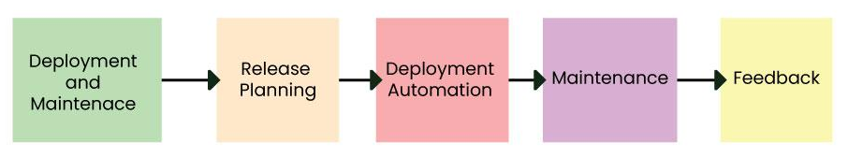
Stage 6: Deployment and Maintenance of Products
After detailed testing, the conclusive product is released in phases as per the organization’s strategy. Then it is tested in a real industrial environment. It is important to ensure its smooth performance. If it performs well, the organization sends out the product as a whole. After retrieving beneficial feedback, the company releases it as it is or with auxiliary improvements to make it further helpful for the customers. However, this alone is not enough. Therefore, along with the deployment, the product’s supervision.
6

Slide 12
SDLC Models
SDLC Models or Software Development Life Cycle (SDLC) models are frameworks that guide the development process of software applications from initiation to deployment. Various SDLC models in software engineering exist, each with its approach to the phases of development.

Slide 13
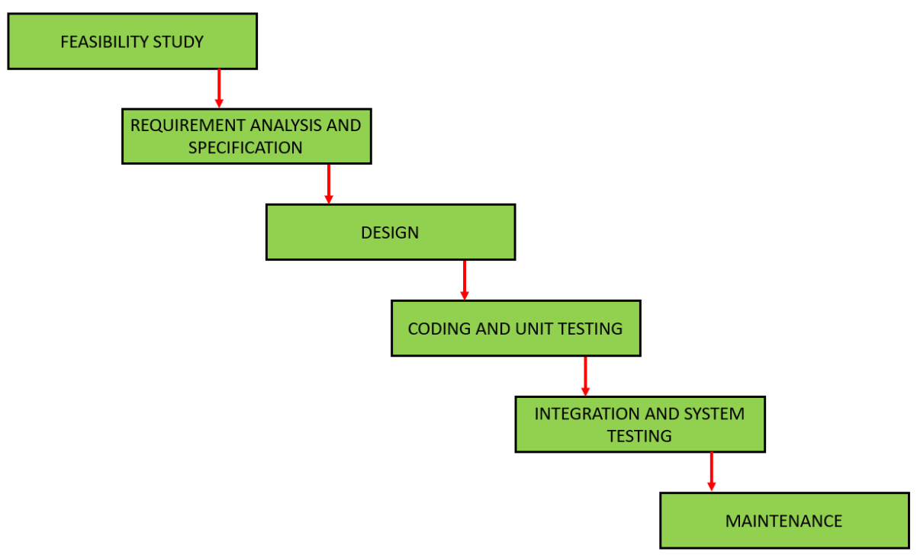
Waterfall SDLC Models
The Waterfall models is one of the oldest and most straightforward approaches to software development. In this blog, we will explore the key aspects of the Waterfall Models, its phases, advantages, disadvantages, and instances where it is most suitable.
The Waterfall models follows a linear and sequential approach to software development. Each phase in the development process must be completed before moving on to the next one, resembling the downward flow of a waterfall. The models is highly structured, making it easy to understand and use
Requirement analysis: In this phase, Client’s requirements are collected and documented. Requirements of both the system and software are documented and reviewed with the customer.
Software design: Planning and defining the system architecture with consideration of requirement specification document. This phase includes translation of requirements into a representation of a software that can be assessed for quality before coding begins.
Implementation: The design must be translated into machine readable form in this phase. It includes the actual coding part and developing the software based on specifications.
Testing: Verification of the developed software is done in this phase to ensure it meets the specified requirements and functions correctly.
Deployment: After the verification and testing, this developed software is deployed to the customer. Also it provides ongoing support, updates, and addressing issues post-deployment to ensure the software functions smoothly.
Maintenance: The final phase of the Waterfall models is maintenance, which involves fixing any issues that arise after the software has been deployed and ensuring that it continues to meet the requirements over time.
Advantages of the Waterfall SDLC Models:
Simplicity: The linear and sequential nature of the Waterfall models makes it easy to understand and implement.
Clear Documentation: Each phase has its own set of documentation, making it easier to track progress and manage the project.
Stable Requirements: Well-suited for projects with stable and well-defined requirements at the beginning.
Predictability: Due to its structured nature, the Waterfall models allows for better predictability in terms of timelines and deliverables.
Disadvantages of the Waterfall SDLC Models:
Rigidity: The models is highly inflexible once a phase is completed, making it challenging to accommodate changes.
Late Testing: Testing is performed after the implementation phase, which means that defects might not be discovered until late in the process.
Limited Client Involvement: Clients are involved mainly in the initial phase, and significant changes cannot be easily accommodated later in the development process.
No Prototyping: The models lacks the provision for creating prototypes, which could be a disadvantage in projects where user feedback is crucial.
When to Use the Waterfall SDLC Models:
Well-Defined Requirements: When project requirements are clear, stable, and unlikely to change significantly.
Small to Medium-Sized Projects: For smaller projects with straightforward objectives and limited complexity.
Mission-Critical Systems: In scenarios where it is crucial to have a well-documented and predictable development process, especially for mission-critical systems.

Slide 14
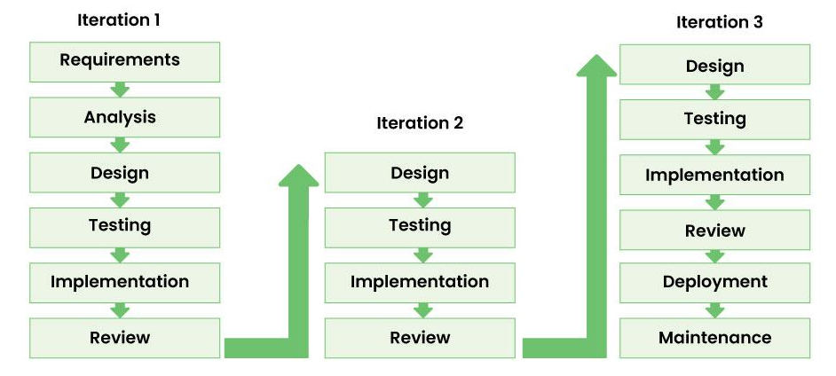
Iterative SDLC Models
Key Principles:
Incremental Progress: The Iterative models emphasizes incremental development, breaking down the project into manageable parts. This allows for quicker delivery of functional components and facilitates early user feedback.
Flexibility and Adaptability: One of the models’s strengths is its adaptability to changing requirements. Developers can easily incorporate new features or modifications during any iteration without disrupting the entire development process.
Continuous Evaluation: Regular assessment and evaluation occur after each iteration, enabling developers to identify and rectify issues early in the development cycle. This continuous feedback loop ensures that the final product aligns with user expectations.
Risk Management: Risks are addressed proactively throughout the development process. By identifying potential issues early on, the team can mitigate risks and make informed decisions, reducing the likelihood of project setbacks.
Benefits of Iterative SDLC:
Faster Time-to-Market: Incremental development allows for the release of functional components at the end of each iteration, resulting in a faster time-to-market compared to traditional SDLC models.
Enhanced Flexibility: The ability to adapt to changing requirements makes the Iterative models suitable for projects with evolving needs, ensuring that the final product meets user expectations.
Improved Quality: Continuous evaluation and testing in each iteration contribute to higher software quality. Bugs and issues are identified and addressed early, preventing them from accumulating in later stages.
Increased Stakeholder Engagement: Stakeholders are involved throughout the development process, providing valuable feedback after each iteration. This ensures that the final product aligns with user expectations and business goals.
Best Practices for Implementing Iterative SDLC:
Clear Project Scope: Define a clear and well-understood project scope to guide each iteration. This ensures that the development team and stakeholders are aligned on the project’s goals.
Effective Communication: Open and transparent communication is crucial. Regular team meetings, stakeholder updates, and documentation help maintain a shared understanding of project progress and requirements.
Automated Testing: Implement automated testing to streamline the testing process in each iteration. This ensures that the software remains stable and functional as new features are added.
Version Control: Utilize version control systems to manage code changes and track project history. This helps in maintaining a stable codebase and enables easier collaboration among team members.
The Iterative SDLC models offers a dynamic and adaptive approach to software development, aligning with the industry’s demand for flexibility and efficiency. By embracing incremental progress, continuous evaluation, and stakeholder engagement, development teams can deliver high-quality software that meets evolving user requirements. As organizations navigate the complex landscape of software development, the Iterative SDLC models stands as a valuable methodology for achieving success in a rapidly changing environment.

Slide 15
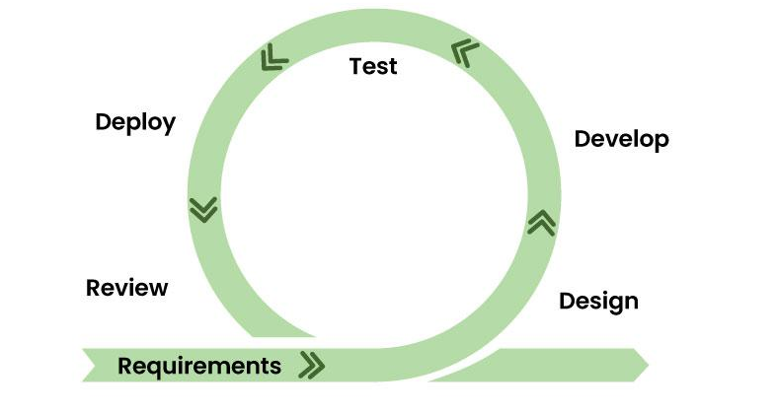
Agile SDLC Models
Agile is not a specific methodology but rather a set of principles and values outlined in the Agile Manifesto. The Agile Manifesto prioritizes individuals and interactions, working solutions, customer collaboration, and responding to change over rigid processes and documentation. Several Agile methodologies, including Scrum, Kanban, and Extreme Programming (XP), have been developed to implement these principles.
Key Principles of Agile SDLC Models:
Iterative and Incremental Development: Agile promotes iterative development cycles, with each iteration producing a potentially shippable increment of the software. This allows for rapid adaptation to changing requirements.
Customer Collaboration: Regular and close collaboration with customers and stakeholders is integral to Agile. Their feedback is sought throughout the development process, ensuring that the product meets their expectations.
Adaptability to Change: Agile embraces change, even late in the development process. It recognizes that requirements are likely to evolve, and the methodology is designed to accommodate these changes efficiently.
Cross-Functional Teams: Agile encourages the formation of cross-functional teams comprising individuals with diverse skills. This promotes collaboration and enables the team to collectively take ownership of the entire development process.
Advantages of the Agile SDLC Models:
Flexibility and Adaptability: Agile’s iterative nature allows teams to adapt quickly to changing requirements. This flexibility is particularly valuable in dynamic and fast-paced environments.
Customer Satisfaction: Continuous customer involvement ensures that the delivered product aligns closely with customer expectations. This customer-centric approach enhances satisfaction and reduces the risk of delivering a product that does not meet user needs.
Early and Predictable Delivery: Agile’s iterative cycles result in regular and predictable product deliveries. This allows stakeholders to see tangible progress at the end of each iteration.
Improved Quality: Continuous testing and integration throughout the development process contribute to higher software quality. Bugs and issues are identified and addressed early, reducing the risk of defects in the final product.
Best Practices for Agile SDLC Models:
Effective Communication: Foster open and transparent communication within the team and with stakeholders. Regular meetings, stand-ups, and collaborative tools are essential for keeping everyone informed.
Prioritization and Planning: Prioritize features and tasks based on customer value. Regular planning sessions, such as Sprint Planning in Scrum, help the team focus on high-priority items.
Continuous Integration and Testing: Implement continuous integration practices to ensure that code changes are integrated and tested frequently. This minimizes integration issues and helps maintain a stable codebase.
Retrospectives for Continuous Improvement: Conduct regular retrospectives to reflect on what went well, what could be improved, and how the team can enhance its processes. Continuous improvement is a core principle of Agile.

Slide 16
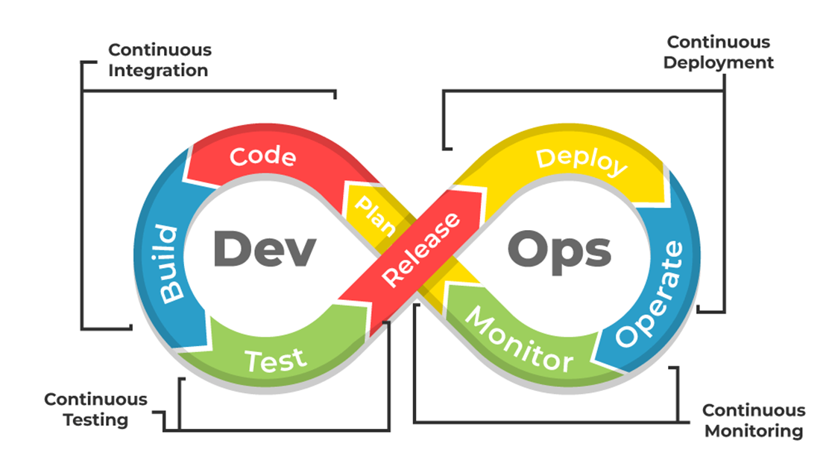
DevOps SDLC Models
DevOps, comprises of “development” and “operations,” represents a cultural and organizational shift in how software is developed, tested, and deployed. It emphasizes collaboration and communication between software developers and IT operations, promoting automation and continuous delivery. DevOps is not just a set of practices; it is a cultural mindset that seeks to improve collaboration and efficiency across the entire software development lifecycle.
Key Principles of DevOps SDLC Models:
Collaboration: DevOps encourages close collaboration and communication between development and operations teams. Silos are dismantled, and teams work together to achieve common goals.
Automation: Automation is a fundamental principle of DevOps. By automating repetitive tasks, such as testing and deployment, teams can increase efficiency, reduce errors, and accelerate the delivery pipeline.
Continuous Integration and Continuous Delivery (CI/CD): DevOps promotes the practice of continuous integration, where code changes are regularly integrated into a shared repository, and continuous delivery, where software can be deployed to production at any time.
Infrastructure as Code (IaC): Infrastructure as Code is the practice of managing and provisioning infrastructure through code and automation tools. This allows for consistent and repeatable infrastructure deployments.
Advantages of the DevOps SDLC Models
Increased Collaboration: DevOps breaks down traditional barriers between development and operations, fostering a culture of collaboration. Shared goals and responsibilities lead to improved communication and efficiency.
Faster Time-to-Market: Automation and continuous delivery practices in DevOps result in shorter development cycles and faster deployment of features and updates, reducing time-to-market.
Improved Reliability: Automated testing and deployment processes enhance the reliability of software releases. DevOps practices contribute to the detection and resolution of issues early in the development lifecycle.
Scalability and Flexibility: DevOps enables organizations to scale their infrastructure and applications efficiently. Automation allows for the rapid provisioning and scaling of resources based on demand.
Best Practices for DevOps SDLC Models:
Cultural Transformation: DevOps is not just about tools; it requires a cultural shift. Encourage a collaborative and transparent culture where teams work together to achieve shared objectives.
Automation Tools: Invest in and leverage automation tools for various aspects of the development and operations lifecycle, including continuous integration, testing, deployment, and monitoring.
Continuous Monitoring: Implement robust monitoring practices to gain insights into application and infrastructure performance. Continuous monitoring helps detect and address issues proactively.
Feedback Loops: Establish feedback loops throughout the development and operations processes. This includes feedback on code quality, application performance, and user satisfaction.

Slide 17
DevOps

Slide 18
What’s DevOps?
DevOps is a software development approach emphasizing collaboration, automation, and continuous delivery to provide high-quality products to customers quickly and efficiently. DevOps breaks down silos between development and operations teams to enable seamless communication, faster time-to-market, and improved customer satisfaction. It allows a team to handle the complete application lifecycle, from development to testing, operations, and deployment. It shows cooperation between Development and Operations groups to deploy code to production quickly in an automated and repeatable manner.
Every phase of the software development lifecycle, including planning, coding, testing, deployment, and monitoring, is heavily automated in DevOps. This improves productivity, ensures consistency, and lowers error rates in the development process. A culture of continuous improvement is also promoted by DevOps, where feedback loops are incorporated into the procedure to facilitate quicker iteration and better decision-making. Organizations can increase their agility, lower costs, and speed up innovation by adopting DevOps.

Slide 19

What’s DevOps?
Why DevOps?
The goal of DevOps is to increase an organization’s speed when it comes to delivering applications and services. Many companies have successfully implemented DevOps to enhance their user experience including Amazon, Netflix, etc.
Facebook’s mobile app which is updated every two weeks effectively tells users you can have what you want and you can have it. Now ever wondered how Facebook was able to do social smoothing? It’s the DevOps philosophy that helps Facebook ensure that apps aren’t outdated and that users get the best experience on Facebook. Facebook accomplishes this true code ownership model that makes its developers responsible that includes testing and supporting through production and delivery for each kernel of code. They write and update their true policies like this but Facebook has developed a DevOps culture and has successfully accelerated its development lifecycle.
Industries have started to gear up for digital transformation by shifting their means to weeks and months instead of years while maintaining high quality as a result. The solution to all this is- DevOps

Slide 20
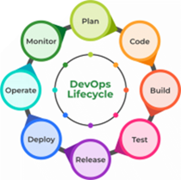
DevOps Lifecycle
Plan: Determining the commercial needs and gathering the opinions of end-user by professionals in this level of the DevOps lifecycle.
Code: At this level, the code for the same is developed and in order to simplify the design, the team of developers uses tools and extensions that take care of security problems.
Build: After the coding part, programmers use various tools for the submission of the code to the common code source.
Test: This level is very important to assure software integrity. Various sorts of tests are done such as user acceptability testing, safety testing, speed testing, and many more.
Release: At this level, everything is ready to be deployed in the operational environment.
Deploy: In this level, Infrastructure-as-Code assists in creating the operational infrastructure and subsequently publishes the build using various DevOps lifecycle tools.
Operate: At this level, the available version is ready for users to use. Here, the department looks after the server configuration and deployment.
Monitor: The observation is done at this level that depends on the data which is gathered from consumer behavior, the efficiency of applications, and from various other sources.

Slide 21
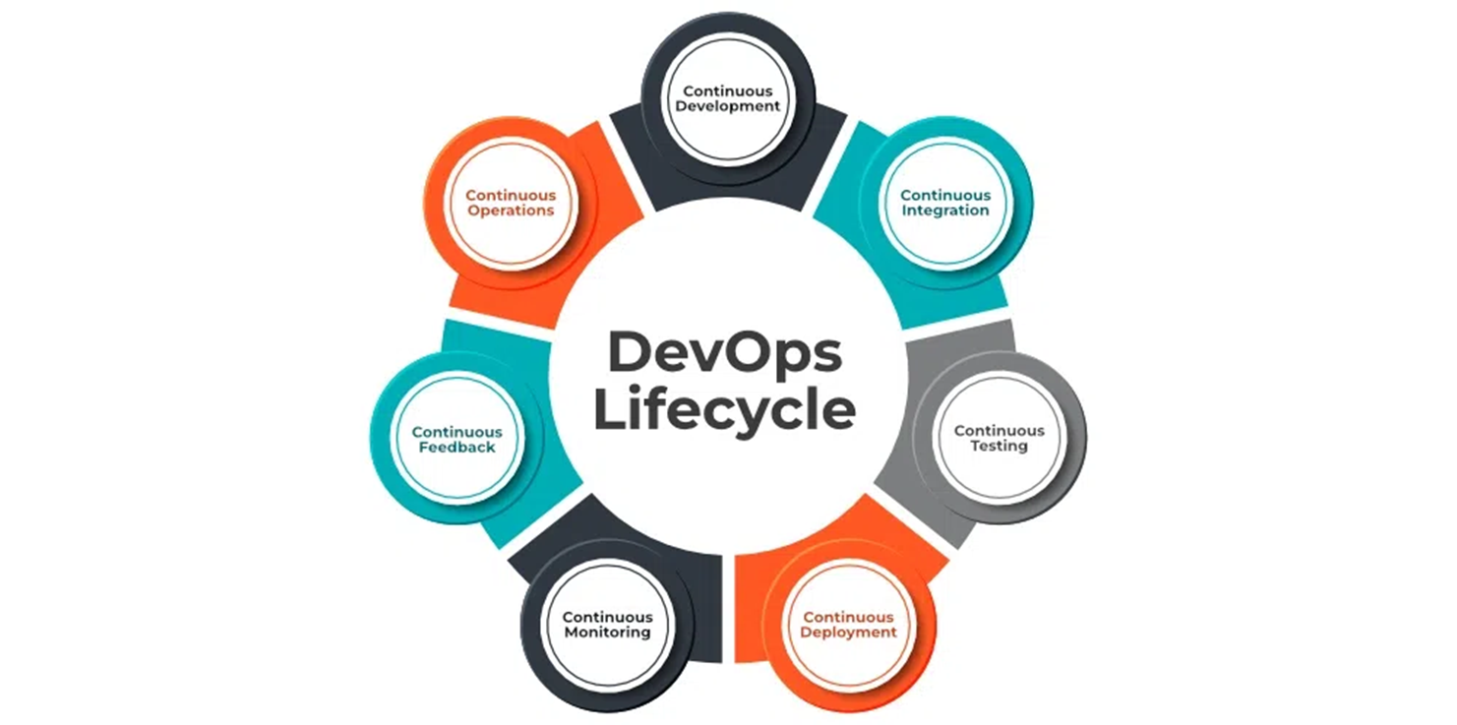
DevOps Lifecycle
7 Cs of DevOps
Continuous Development
Continuous Integration
Continuous Testing
Continuous Deployment/Continuous Delivery
Continuous Monitoring
Continuous Feedback
Continuous Operations

Slide 22
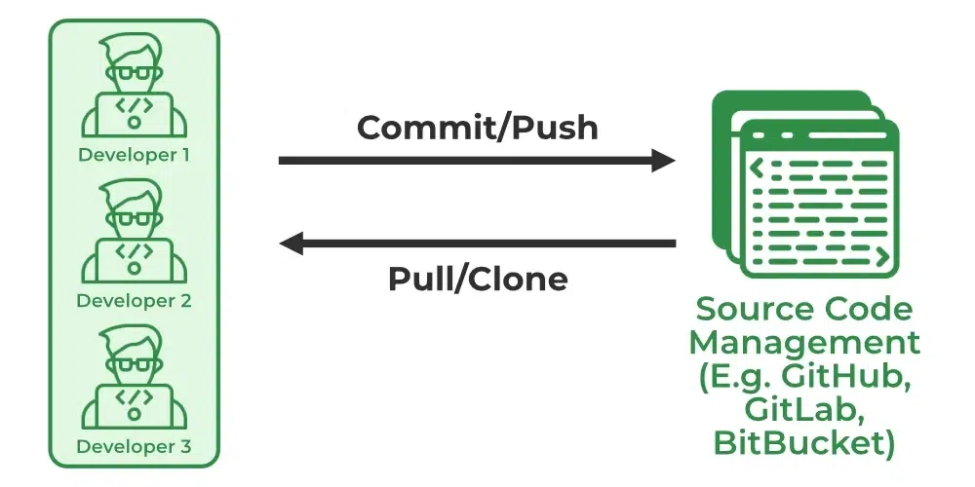
Continuous Development
In Continuous Development code is written in small, continuous bits rather than all at once, Continuous Development is important in DevOps because this improves efficiency every time a piece of code is created, it is tested, built, and deployed into production. Continuous Development raises the standard of the code and streamlines the process of repairing flaws, vulnerabilities, and defects. It facilitates developers’ ability to concentrate on creating high-quality code.

Slide 23
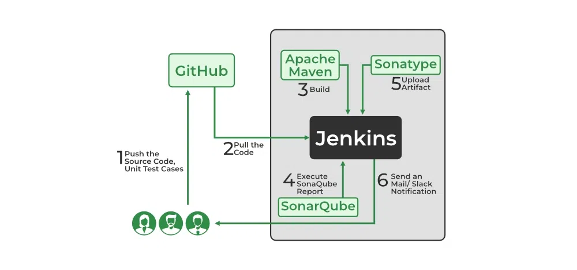
Continuous Integration
Continuous Integration can be explained mainly in 4 stages in DevOps. They are as follows:
Getting the SourceCode from SCM
Building the code
Code quality review
Storing the build artifacts
The stages mentioned above are the flow of Continuous Integration and we can use any of the tools that suit our requirement in each stage and of the most popular tools are GitHub for source code management(SCM) when the developer develops the code on his local machine he pushes it to the remote repository which is GitHub from here who is having the access can Pull, clone and can make required changes to the code. From there by using Maven we can build them into the required package (war, jar, ear) and can test the Junit cases.SonarQube performs code quality reviews where it will measure the quality of source code and generates a report in the form of HTML or PDF format. Nexus for storing the build artifacts will help us to store the artifacts that are build by using Maven and this whole process is achieved by using a Continuous Integration tool Jenkins.

Slide 24
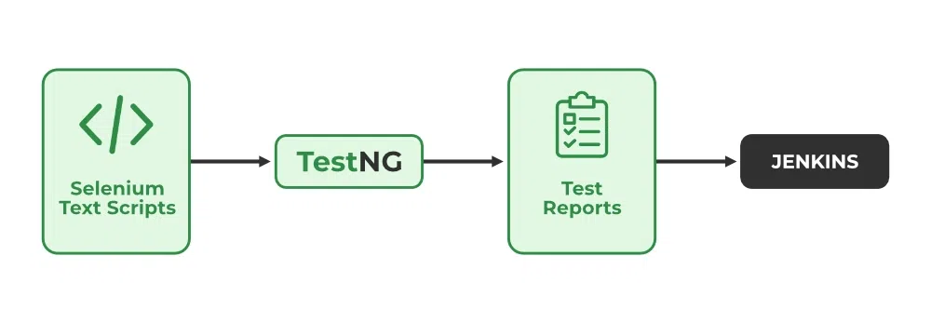
Continuous Testing
Any firm can deploy continuous testing with the use of the agile and DevOps methodologies. Depending on our needs, we can perform continuous testing using automation testing tools such as Testsigma, Selenium, LambdaTest, etc. With these tools, we can test our code and prevent problems and code smells, as well as test more quickly and intelligently. With the aid of a continuous integration platform like Jenkins, the entire process can be automated, which is another added benefit.

Slide 25
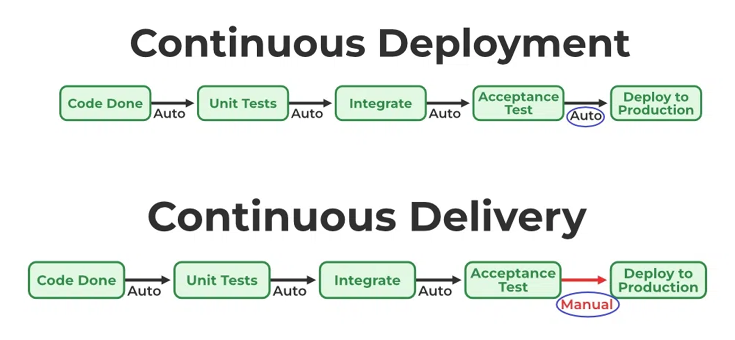
Continuous Deployment/ Continuous Delivery
Continuous Deployment: Continuous Deployment is the process of automatically deploying an application into the production environment when it has completed testing and the build stages. Here, we’ll automate everything from obtaining the application’s source code to deploying it
Continuous Delivery: Continuous Delivery is the process of deploying an application into production servers manually when it has completed testing and the build stages. Here, we’ll automate the continuous integration processes, however, manual involvement is still required for deploying it to the production environment.

Slide 26
Continuous Monitoring
DevOps lifecycle is incomplete if there was no Continuous Monitoring. Continuous Monitoring can be achieved with the help of Prometheus and Grafana we can continuously monitor and can get notified before anything goes wrong with the help of Prometheus we can gather many performance measures, including CPU and memory utilization, network traffic, application response times, error rates, and others. Grafana makes it possible to visually represent and keep track of data from time series, such as CPU and memory utilization.

Slide 27
Continuous Feedback
Once the application is released into the market the end users will use the application and they will give us feedback about the performance of the application and any glitches affecting the user experience after getting multiple feedback from the end users’ the DevOps team will analyze the feedbacks given by end users and they will reach out to the developer team tries to rectify the mistakes they are performed in that piece of code by this we can reduce the errors or bugs that which we are currently developing and can produce much more effective results for the end users also we reduce any unnecessary steps to deploy the application. Continuous Feedback can increase the performance of the application and reduce bugs in the code making it smooth for end users to use the application.

Slide 28
Continuous Operations
We will sustain the higher application uptime by implementing continuous operation, which will assist us to cut down on the maintenance downtime that will negatively impact end users’ experiences. More output, lower manufacturing costs, and better quality control are benefits of continuous operations.

Slide 29
Agile
Agile Software Development is a software development methodology that values flexibility, collaboration, and customer satisfaction. It is based on the Agile Manifesto, a set of principles for software development that prioritize individuals and interactions, working software, customer collaboration, and responding to change.
Agile Software Development is an iterative and incremental approach to software development that emphasizes the importance of delivering a working product quickly and frequently. It involves close collaboration between the development team and the customer to ensure that the product meets their needs and expectations.

Slide 30
Why Agile are used?
Technology in this current era is progressing faster than ever, forcing global software companies to work in a fast-paced changing environment. Because these businesses are operating in an ever-changing environment, it is impossible to gather a complete and exhaustive set of software requirements. Without these requirements, it becomes practically hard for any conventional software model to work. The conventional software models such as the Waterfall Model that depend on completely specifying the requirements, designing, and testing the system are not geared towards rapid software development. As a consequence, a conventional software development model fails to deliver the required product. This is where agile software development comes to the rescue. It was specially designed to curate the needs of the rapidly changing environment by embracing the idea of incremental development and developing the actual final product. Let’s now read about the on which the Agile has laid its foundation:

Slide 31
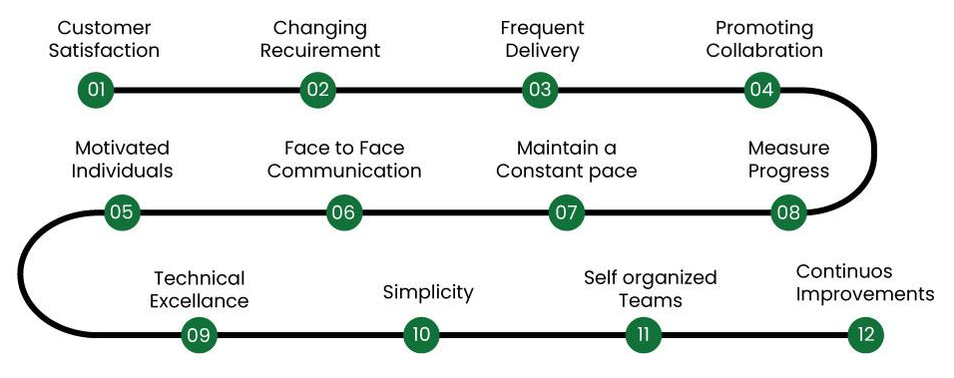
Principles of Agile
Ensuring customer satisfaction through the early delivery of software.
Being open to changing requirements in the stages of the development.
Frequently delivering working software with a main focus on preference for timeframes.
Promoting collaboration between business stakeholders and developers as an element.
Structuring the projects around individuals. Providing them with the necessary environment and support.
Prioritizing face to face communication whenever needed.
Considering working software as the measure of the progress.
Fostering development by allowing teams to maintain a pace indefinitely.
Placing attention on excellence and good design practices.
Recognizing the simplicity as crucial factor aiming to maximize productivity by minimizing the work.
Encouraging self organizing teams as the approach to design and build systems.
Regularly reflecting on how to enhance effectiveness and to make adjustments accordingly.

Slide 32
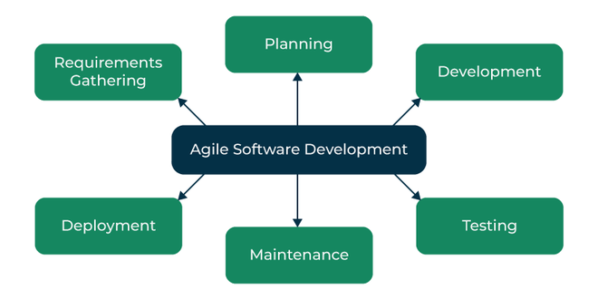
The Agile Software Development Process
Requirements Gathering: The customer’s requirements for the software are gathered and prioritized.
Planning: The development team creates a plan for delivering the software, including the features that will be delivered in each iteration.
Development: The development team works to build the software, using frequent and rapid iterations.
Testing: The software is thoroughly tested to ensure that it meets the customer’s requirements and is of high quality.
Deployment: The software is deployed and put into use.
Maintenance: The software is maintained to ensure that it continues to meet the customer’s needs and expectations.
Agile Software Development is widely used by software development teams and is considered to be a flexible and adaptable approach to software development that is well-suited to changing requirements and the fast pace of software development.
Agile is a time-bound, iterative approach to software delivery that builds software incrementally from the start of the project, instead of trying to deliver all at once.

Slide 33
Practices of Agile Software Development
Scrum: Scrum is a framework for agile software development that involves iterative cycles called sprints, daily stand-up meetings, and a product backlog that is prioritized by the customer.
Kanban: Kanban is a visual system that helps teams manage their work and improve their processes. It involves using a board with columns to represent different stages of the development process, and cards or sticky notes to represent work items.
Continuous Integration: Continuous Integration is the practice of frequently merging code changes into a shared repository, which helps to identify and resolve conflicts early in the development process.
Test-Driven Development: Test-Driven Development (TDD) is a development practice that involves writing automated tests before writing the code. This helps to ensure that the code meets the requirements and reduces the likelihood of defects.
Pair Programming: Pair programming involves two developers working together on the same code. This helps to improve code quality, share knowledge, and reduce the likelihood of defects.

Slide 34
SCRUM
Scrum is the type of Agile framework. It is a framework within which people can address complex adaptive problem while productivity and creativity of delivering product is at highest possible values. Scrum uses Iterative process. Silent features of Scrum are:
Scrum is light-weighted framework
Scrum emphasizes self-organization
Scrum is simple to understand
Scrum framework help the team to work together

Slide 35
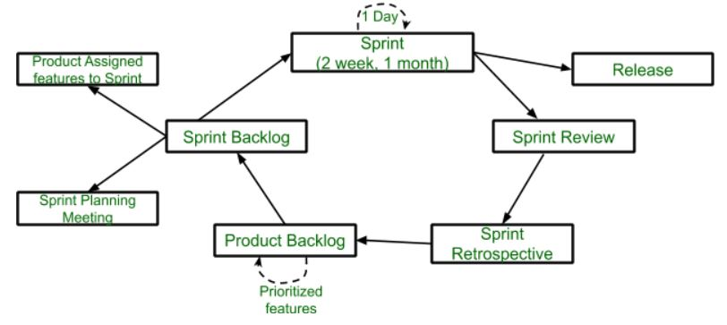
Lifecycle of Scrum
Sprint: A Sprint is a time box of one month or less. A new Sprint starts immediately after the completion of the previous Sprint. Release: When the product is completed, it goes to the Release stage. Sprint Review: If the product still has some non-achievable features, it will be checked in this stage and then passed to the Sprint Retrospective stage. Sprint Retrospective: In this stage quality or status of the product is checked. Product Backlog: According to the prioritize features the product is organized. Sprint Backlog: Sprint Backlog is divided into two parts Product assigned features to sprint and Sprint planning meeting.
Advantage of using Scrum framework:
Scrum framework is fast moving and money efficient.
Scrum framework works by dividing the large product into small sub-products. It’s like a divide and conquer strategy
In Scrum customer satisfaction is very important.
Scrum is adaptive in nature because it have short sprint.
As Scrum framework rely on constant feedback therefore the quality of product increases in less amount of time
Disadvantage of using Scrum framework:
Scrum framework do not allow changes into their sprint.
Scrum framework is not fully described model. If you wanna adopt it you need to fill in the framework with your own details like Extreme Programming(XP), Kanban, DSDM.
It can be difficult for the Scrum to plan, structure and organize a project that lacks a clear definition.
The daily Scrum meetings and frequent reviews require substantial resources.

Slide 36
Kanban
The main aim of Kanban is to reduce WIP (Work-In-Progress), or inventory, between processes by ensuring the upstream process creates parts as long as its downstream process needs it. The goal of the Kanban execution is to ensure work items move to the next steps quickly to realize business value faster.
The Kanban method is an approach to evolutionary and incremental systems and process change for organizations. A work-in-progress limited pull system is used as the central mechanism to uncover system operation (or process) complications and encourage collaboration to improve the system continuously.

Slide 37
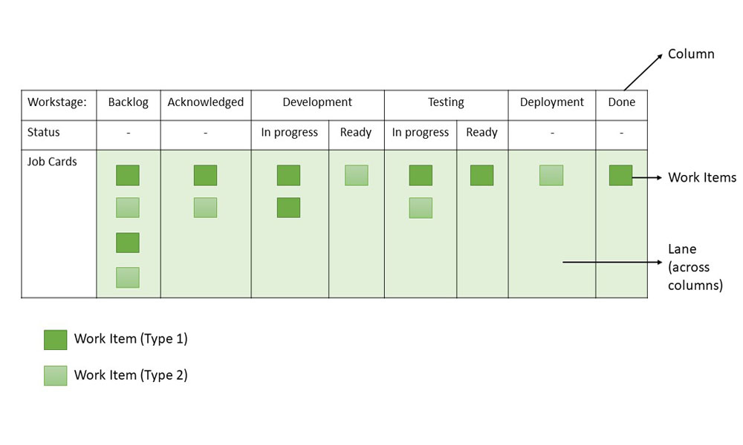
Kanban Board/Card
It is critical to understand the visualization of workflow stages in the task execution pipeline. Kanban board provides a simple way to understand the process. It can be explained as follows:
Every request received is put on the Kanban board.
A column on the board represents a stage (these stages are termed as the Work stage) during the lifecycle of bugs/ tickets. For instance, the Kanban board can have 4 stages- Received/ Acknowledged, In-progress, UAT & Done.
The received stage could be called a “Backlog” also.
The team could decide the names for the phases based on the terminology used by their respective teams.
Kanban board could be a simple whiteboard on which sticky notes could be used with ticket details or an electronic Kanban board could be used.
ALM tools like Rally/ Jira could be configured to use the Kanban board.
The board can give a signal in case the bugs/ tickets are stuck in one stage for a long.
For electronic boards, one can configure the Kanban board in a way that tickets/ user stories along with the time stamp are visible.
For whiteboards that are maintained manually, the team can enter the date/ time.

Slide 38
Principles of Kanban
Kanban is based on four key principles which are mentioned below:
Start with the existing process: It is a change management method that starts with the existing process. Changes are done in the system in incremental and evolutionary ways. Unlike Scrum, there’s no specific process or roles defined in Kanban.
Agree to continue evolutionary and incremental changes: After starting with the existing process, the team must agree on continuous, incremental, and evolutionary changes. The changes should be small and incremental. Rapid and substantial changes may be effective but they will be subjected to larger resistance as well by the Team.
Admire current roles, processes, responsibilities & titles: Though Kanban suggests continuous incremental changes in the process, it respects current roles, responsibilities, and job titles. This helps the team to gain confidence as they get started with Kanban.
Leadership at all levels: Kanban does not expect leadership from a specific set, rather the actions of leadership at all levels in the organization, are very much encouraged.

Slide 39
Kanban Practices
The following are the six core Kanban practices:
Limit WIP: Limiting Work-In-Process (WIP) implies that a pull system is executed on either parts or the whole workflow. It (PULL system) will act as one of the key stimuli for incremental, continuous, and evolutionary changes to the system. Limit WIP assigns explicit limits to the number of items that may be in progress at each workflow state.
Visualize: Visualizing the workflow and making it visible is important so as to know how work proceeds. Without understanding the flow of work, incorporating the right changes is difficult. Usually, a card wall with columns and cards is used to visualize the flow of work. Different states or steps within the workflow are represented by the columns on the card wall.
Manage flow: Flow of work through every state within the workflow should be observed, measured, and informed. By managing the flow vigorously, the incremental, continuous, and evolutionary modifications to the system can be assessed to have negative or positive effects on the system.
Improve Collaboratively, Evolve Experimentally: Kanban encourages small incremental, continuous, and evolutionary changes. Whenever teams have a common understanding of concepts about work, process, workflow, and risk, they are more likely to be able to form a shared understanding of a problem and suggest enhancement actions that could achieve a consensus.
Implement Feedback Loops: Early feedback from clients and the pull system are important in Kanban. If we get feedback from different stakeholders and processes, it will help to eliminate risk and optimize the delivery process.
Make Policies Explicit: Until the mechanism of a process is not made clear, it is difficult to hold a debate and discuss ways to improve it. Without a clear understanding of how work is truly done and how things actually work, any conversation of complications tends to be anecdotal, emotional, and subjective. With a clear understanding, it is possible to hold a more rational, empirical, objective discussion of issues. It is more likely to facilitate consensus around improvement suggestions.

Slide 40
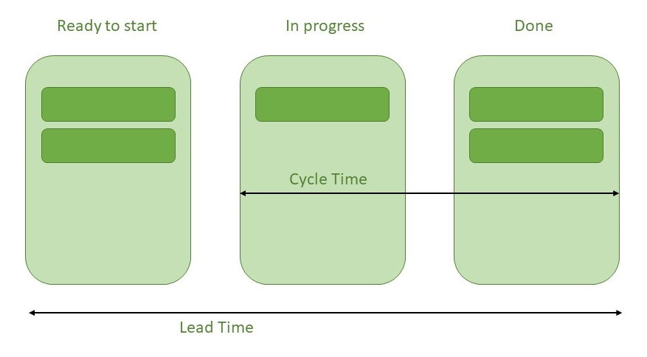
Lead Time and Cycle Time
Lead Time: The time span between the time a task enters the work system and the time it is completed is known as lead time. Lead time is the time it takes for an input to pass through all of the operations and arrive at the finish line. In Kanban terminology, the overall time it takes for a delegated task to reach the right-most column.
Cycle Time: The cycle time displays how much time the team spends working on a prioritized task. Cycle time begins when any team member begins working on the task and transfers it to the ‘in progress’ column, and it continues until the task is completed.
Cycle Time and Lead Time Relationship: The most important, though often overlooked, the distinction between cycle time and lead time is their measurement units.
Cycle time is measured in amount of time per unit/process/task
Lead time is measured in elapsed time (weeks, hours, seconds)
Little’s Law gives the best description of the link between Cycle time and Lead time-
Cycle time x WIP = Lead time (Work-In-Progress)

Slide 41
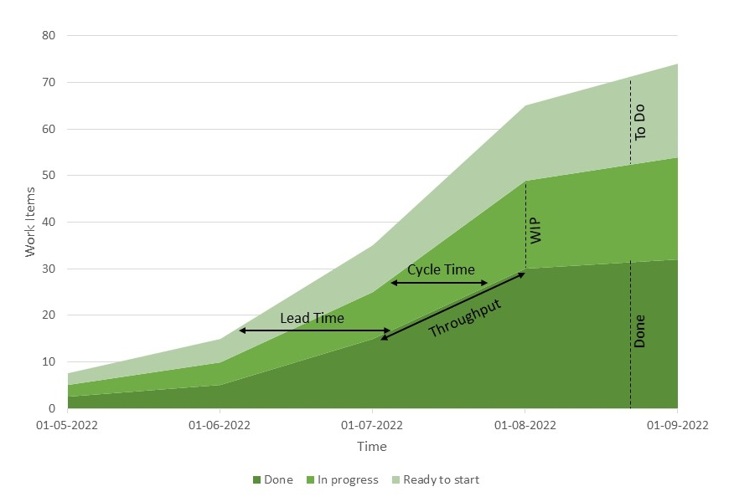
Cumulative Flow Diagram
In Kanban, a cumulative flow diagram (CFD) is an advanced analysis tool. It allows teams to see how their workflow efforts and overall project progress are being visualized. Teams can use the cumulative flow diagram to track how stable their workflow is, anticipate bottlenecks so they can alter their workflow accordingly, and make processes more predictable.
The following are three crucial parameters to look for in the CFD:
Cycle time: The overall time taken by your team to accomplish each assignment from start to finish.
Work in progress: This is the number of tasks that your team is currently working on.
Throughput: The number of tasks your team can finish in a particular period.

Slide 42
DevSecOps
DevSecOps methodology is an extension of the DevOps model that helps development teams to integrate security objectives very early into the lifecycle of the software development process giving developers the team confidence to carry out several security tasks independently to protect code from advanced threat potentials and vulnerabilities. In this article, we will discuss the lifecycle and timeline of the DevSecOpps domain and its importance in the IT Industry and Operations.

Slide 43
What is DevSecOps?
DevSecOps stands for Development, Security, and Operations. It is a software development approach that emphasises on integration of security and operations in the software development process. It involves the collaboration of the developing team, testing team, security professionals, and operations team. The goal of DevSecOps is to build and maintain secure software by creating and adapting a continuous environment of security into the software development process.
DevSecOps helps organizations quickly identify and solve potential security vulnerabilities for the development team that relies on an agile and rapid software development lifecycle model. It accelerates modern software prototyping and agile framework development while addressing security issues during the development phase only, being an effective methodology that increases software quality and ensures fast delivery.

Slide 44
Where is DevSecOps Used?
In present times, DevSec Ops is widely integrated into the software building and development cycle that leads to early product release. It is also used in altering security practices throughout the development of IT operations. DevSecOps makes sure that security does not slow down the software process instead it saves the developers and testers from the overtime of debugging security issues in software that is hard to debug and solve in later stages of maintenance.
It boosts the delivery system of applications in organizations and increases the efficiency of applications. It is mostly seen as a methodology change applied while building the software application. It is also used in integrating security into the already planned and prototyped software development lifecycle.

Slide 45
What are the Principles of DevSecOps?
DevSecOps is a collaborative integration of development, security, and operations in a software development environment following certain principles for efficient and effective deployment.
Security Testing: DevSecOps automates security testing in collaboration with unit testing or integration testing to analyze and debug quality for security vulnerabilities and threats. Such a principle improves the quality of software products after every build and prototype release integrating into the CI/CD pipeline.
Promoting Culture and Communication: Organisations hiring DevSecOps professionals make it easy for the developer’s team and testers’ team to communicate and work together parallel practicing security practices and building qualitative software hand-in-hand.
Shift Left Security: Every software product is configured using the shift left strategy in the SDLC model, optimizing cost, security and market for business goals. It enables the team to early identify security and risk exposure promoting a secure build.
Continuous Quality Improvement: Security threats and risks are continuously evolving in present times, exposing the quality of software products to vulnerabilities and delaying the end delivery of products. The principle of continuous quality improvement helps the development team build a robust prototype during the SDLC phases.
Some of the Major Principles of DevOps are:
Reliable Software Delivery
Automated Testing compliance
Quality improvement
Rapid Delivery

Slide 46
What are the Benefits of DevSecOps?
There are several benefits of incorporating the DevSecOps model in software applications:
Uniform Security: DevSecOps involves automated security verification checks on the code to identify potential errors and threats to create no hassle with deployment schedules.
Automated auto-verification: DevSecOps is an automated task following the installation of security tools that identify vulnerabilities without any manual and direct contact with the operations team or maintainable team. It is a vital ongoing background check on the software development process.
No code redundancy and repetition: DevSecOps provides best practices and tools for code refinement, suggesting good code standards and code syntax to provide a qualitative end product.
Advanced Threat Analysis: The DevSecOps continuous monitoring eliminates advanced threats and bugs solving the flow of debugging for developers.
Software Cost Saving Potential: The organisations benefit from the integration of DevSecOps professionals with the development team saving the software cost and attaining the major business goal.

Slide 47
How DevSecOps Works?
DevSecOps is the secure integration of code through CI/CD tools. It follows a flowchart of pipeline timeline, covering software security checks throughout :
1. Code
The entire workflow starts from the root code to ensure static code analysis and code reviews are implemented in the coding phase for the syntax prone to security threats.
2. Commit
The commit made to the git repository needs to be passed through the right level of security by working in a private repository instead of the public repository to prevent any threat exposure. The CI pipeline starts after the Commit phase.
3. Build and Test
This is a combined phase of static code analysis identifying vulnerabilities, performing integration tests and performance tests along with infrastructure scans. This pipeline interval is called as CI pipeline.
4. Staging and Production
This phase of the pipeline is called a CD part of the pipeline and includes a review in staging and production with a parallel passive penetration test, and SSL scan to ensure the production-ready code is well protected.

Slide 48
What are the Challenges in Implementing DevSecOps?
There are several challenges faced by the DevSecOps team while collaborating with the development team:
Compatibility Issues: While DevSecOps methodology contains a certain set of tools and equipment to protect data and code from security vulnerabilities or threats, it raises security issues as well if not compatible with the ongoing software SDLC. The issue may emerge across the development team to make their code compatible with security concerns.
Complexity Issue: Heavy deployment, continuous infrastructure security check, data security, and code reassurance heavily leverage the development team and increases the level of complexity while building and delivering software product.
Speed and Security Issue: DevSecOps is all about high and fast delivery with security and operations integration but sometimes too many security concerns hamper the positive impact of development and deployment.
Skills Issue: Developers still lack the security skills that need to be carried out while implementing DevSecOps tools and practices. The developer must enrol in some self-paced course or online training by organisations to implement security practices while coding efficiently.

