Slide 1
Step 3. Deployment Automatization

Slide 2
Agenda
CI/CD

Slide 3
GitHub DevOps

Slide 4
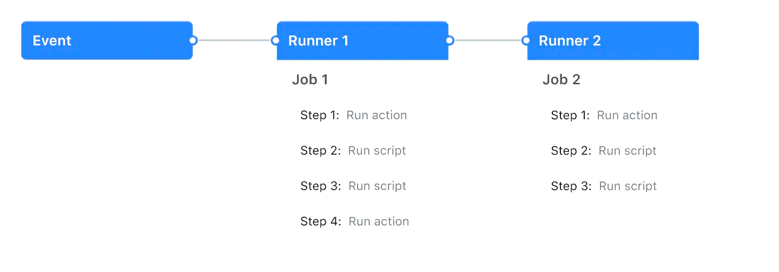
GitHub Actions
GitHub Actions is a continuous integration and continuous delivery (CI/CD) platform that allows you to automate your build, test, and deployment pipeline. You can create workflows that build and test every pull request to your repository, or deploy merged pull requests to production.
GitHub Actions goes beyond just DevOps and lets you run workflows when other events happen in your repository. For example, you can run a workflow to automatically add the appropriate labels whenever someone creates a new issue in your repository.
GitHub provides Linux, Windows, and macOS virtual machines to run your workflows, or you can host your own self-hosted runners in your own data center or cloud infrastructure.
You can configure a GitHub Actions workflow to be triggered when an event occurs in your repository, such as a pull request being opened or an issue being created. Your workflow contains one or more jobs which can run in sequential order or in parallel. Each job will run inside its own virtual machine runner, or inside a container, and has one or more steps that either run a script that you define or run an action, which is a reusable extension that can simplify your workflow.

Slide 5
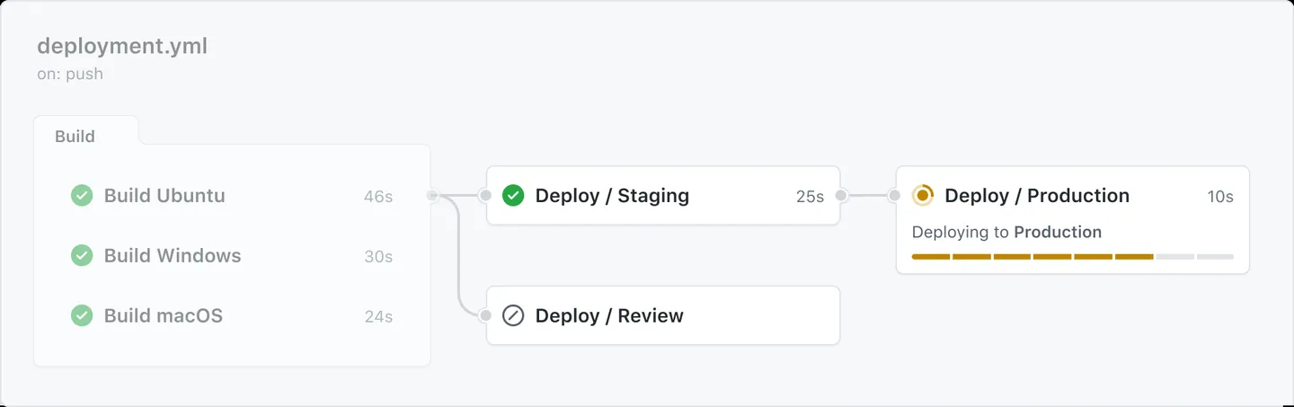
GitHub Actions (workflows)
A workflow is a configurable automated process that will run one or more jobs. Workflows are defined by a YAML file checked in to your repository and will run when triggered by an event in your repository, or they can be triggered manually, or at a defined schedule.
Workflows are defined in the .github/workflows directory in a repository, and a repository can have multiple workflows, each of which can perform a different set of tasks. For example, you can have one workflow to build and test pull requests, another workflow to deploy your application every time a release is created, and still another workflow that adds a label every time someone opens a new issue.

Slide 6
GitHub Actions (events)
An event is a specific activity in a repository that triggers a workflow run. For example, activity can originate from GitHub when someone creates a pull request, opens an issue, or pushes a commit to a repository. You can also trigger a workflow to run on a schedule, by posting to a REST API, or manually.

Slide 7
GitHub Actions (jobs)
A job is a set of steps in a workflow that is executed on the same runner. Each step is either a shell script that will be executed, or an action that will be run. Steps are executed in order and are dependent on each other. Since each step is executed on the same runner, you can share data from one step to another. For example, you can have a step that builds your application followed by a step that tests the application that was built.
You can configure a job's dependencies with other jobs; by default, jobs have no dependencies and run in parallel with each other. When a job takes a dependency on another job, it will wait for the dependent job to complete before it can run. For example, you may have multiple build jobs for different architectures that have no dependencies, and a packaging job that is dependent on those jobs. The build jobs will run in parallel, and when they have all completed successfully, the packaging job will run.

Slide 8
GitHub Actions (actions)
An action is a custom application for the GitHub Actions platform that performs a complex but frequently repeated task. Use an action to help reduce the amount of repetitive code that you write in your workflow files. An action can pull your git repository from GitHub, set up the correct toolchain for your build environment, or set up the authentication to your cloud provider.
You can write your own actions, or you can find actions to use in your workflows in the GitHub Marketplace.

Slide 9
GitHub Actions (runners)
A runner is a server that runs your workflows when they're triggered. Each runner can run a single job at a time. GitHub provides Ubuntu Linux, Microsoft Windows, and macOS runners to run your workflows; each workflow run executes in a fresh, newly-provisioned virtual machine. GitHub also offers larger runners, which are available in larger configurations. For more information, see "About larger runners." If you need a different operating system or require a specific hardware configuration, you can host your own runners.

Slide 10
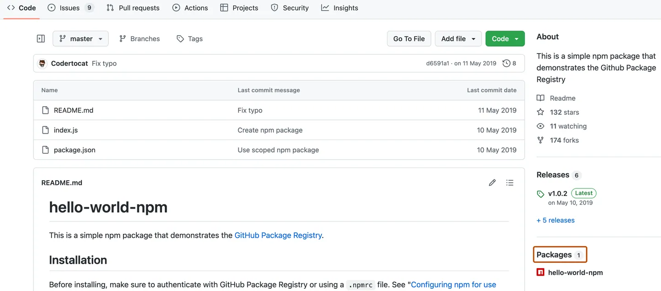
GitHub Packages
GitHub Packages is a platform for hosting and managing packages, including containers and other dependencies. GitHub Packages combines your source code and packages in one place to provide integrated permissions management and billing, so you can centralize your software development on GitHub.
You can integrate GitHub Packages with GitHub APIs, GitHub Actions, and webhooks to create an end-to-end DevOps workflow that includes your code, CI, and deployment solutions.
GitHub Packages offers different package registries for commonly used package managers, such as npm, RubyGems, Apache Maven, Gradle, Docker, and NuGet. GitHub's Container registry is optimized for containers and supports Docker and OCI images.

Slide 11
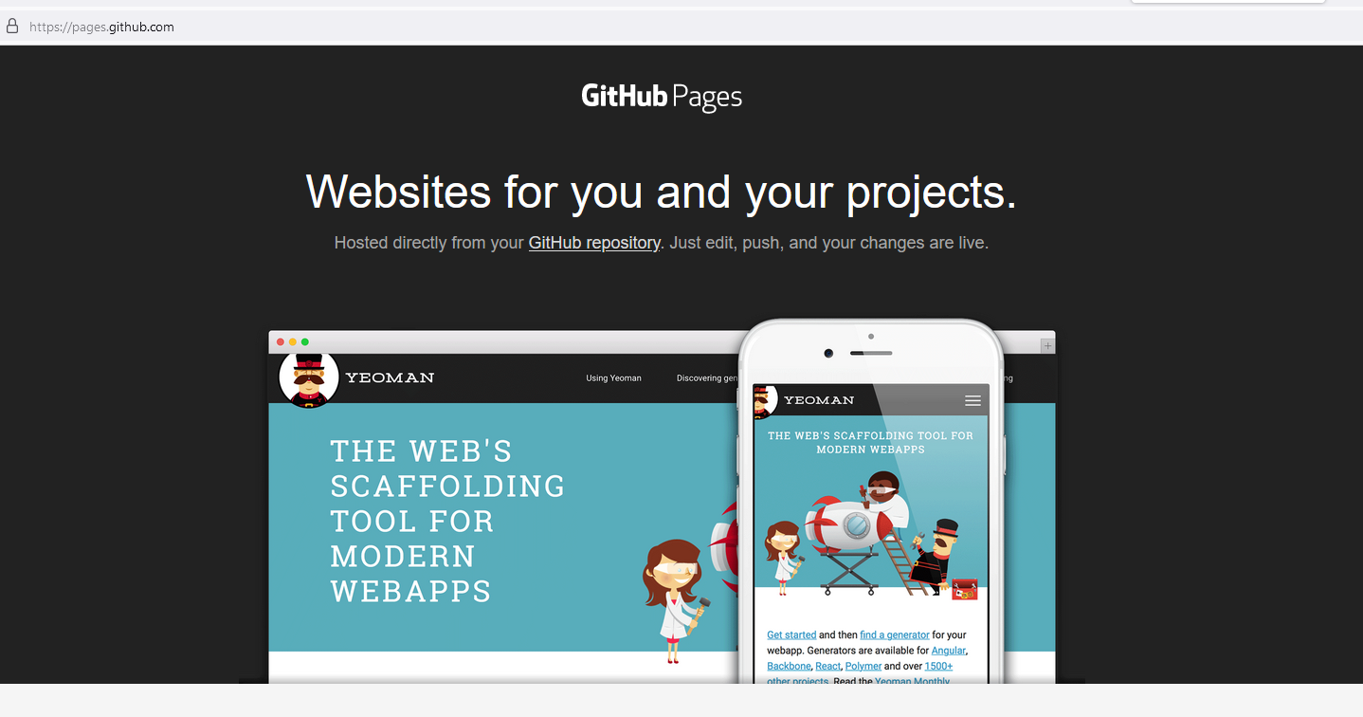
GitHub Pages
GitHub Pages is a static site hosting service that takes HTML, CSS, and JavaScript files straight from a repository on GitHub, optionally runs the files through a build process, and publishes a website. You can see examples of GitHub Pages sites in the GitHub Pages examples collection.
You can host your site on GitHub's github.io domain or your own custom domain. For more information, see "Configuring a custom domain for your GitHub Pages site."
You can create GitHub Pages sites that are publicly available on the internet. Organizations that use GitHub Enterprise Cloud can also publish sites privately by managing access control for the site. For more information, see "Changing the visibility of your GitHub Pages site" in the GitHub Enterprise Cloud documentation.
To get started, see "Creating a GitHub Pages site."
Organization owners can disable the publication of GitHub Pages sites from the organization's repositories. For more information, see "Managing the publication of GitHub Pages sites for your organization."

Slide 12
Azure DevOps
Azure DevOps is a Software as a service (SaaS) provided by Microsoft Azure that will reduce human efforts and automates the deployment and testing of an application. You can use no.of services to deploy the application or complete the software development life cycle in a fast and efficient manner. previously Azure DevOps is also called Microsoft visual studio team services (VSTS).

Slide 13
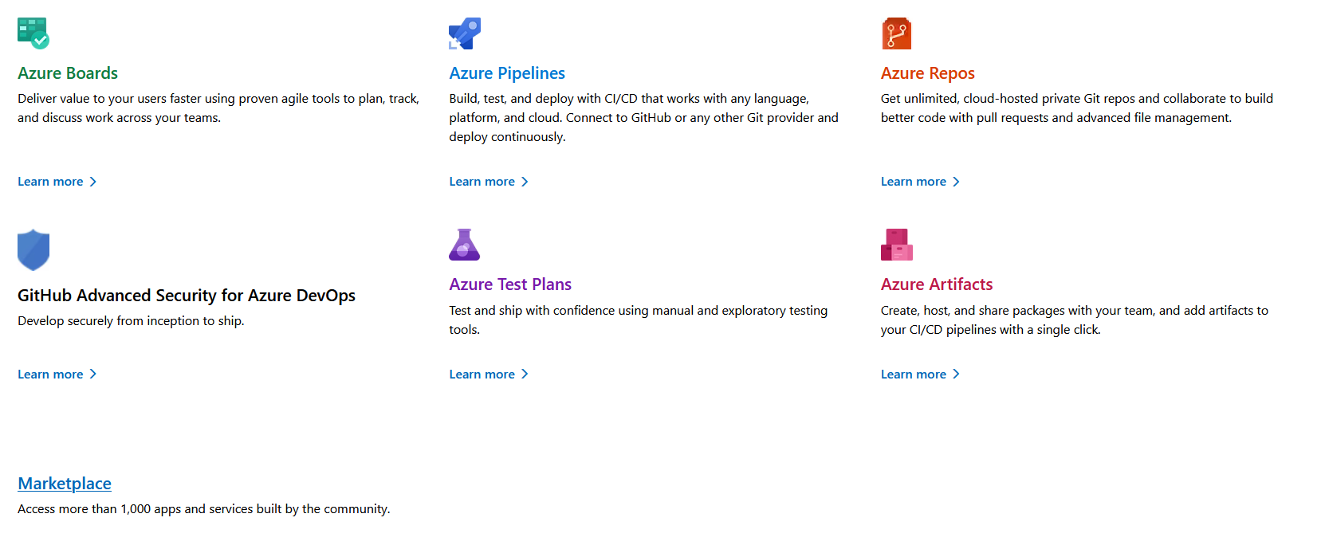
Azure DevOps Services
Azure DevOps is a Software as a service (SaaS) it uses certain services to complete the software development lifecycle in an efficient manner with less amount of time following are some service which is used by Azure DevOps.
Azure Test Plans
Azure Boards
Azure Repos
Azure Pipeline
Azure Artifacts

Slide 14
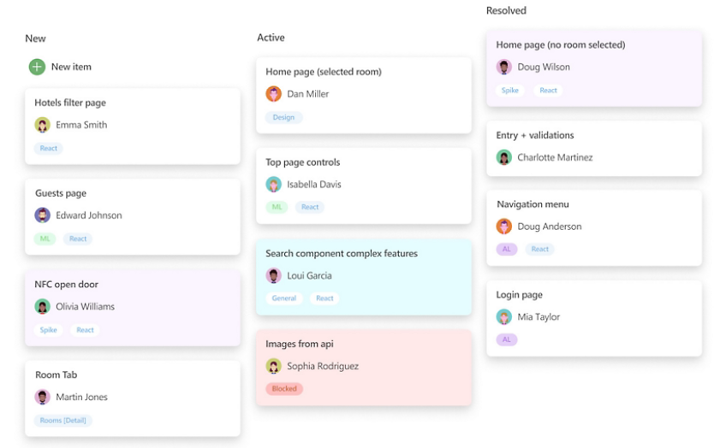
Azure Boards
Azure Boards is a tool that helps teams plan, track, visualize, and discuss the work that needs to be done. It offers four different processes to choose from:
CMMI
Scrum
Agile
Basic

Slide 15
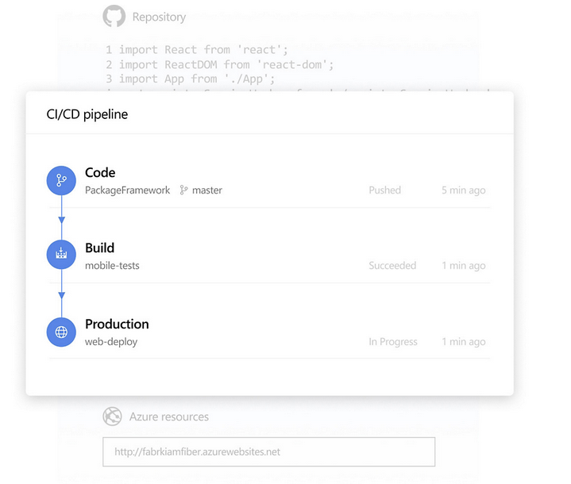
Azure Boards
Azure Pipelines is a cloud service that can be used to automatically build, test, and deploy any code project. It is a cloud-agnostic CI/CD platform with support for containers or Kubernetes and works with any language or project type.

Slide 16
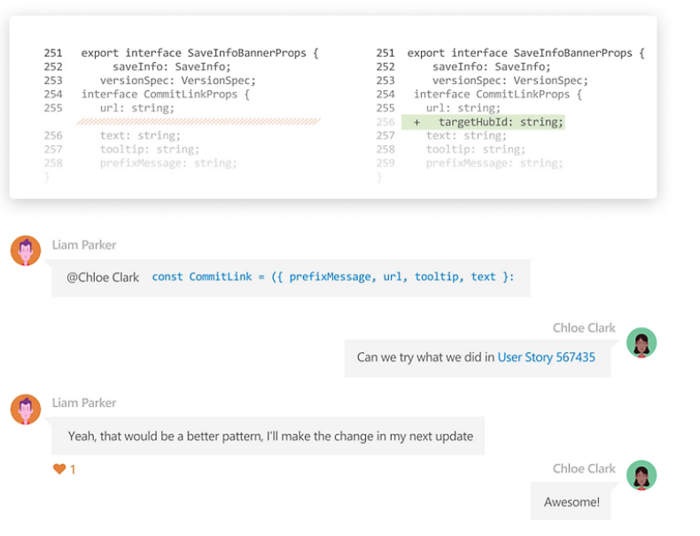
Azure Repos
Azure Repos provides unlimited, cloud-hosted private, and public Git repos.

Slide 17
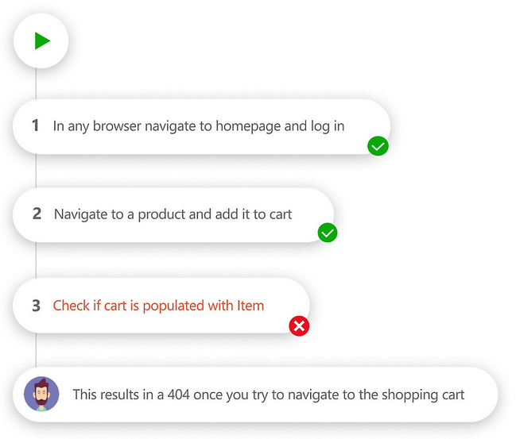
Azure Test Plans
Azure Test Plans provides manual and exploratory testing solutions. Azure DevOps is also compatible with various third-party tools.
Azure DevOps is flexible, platform-agnostic, and cloud-agnostic. This means that you don’t have to use all the services provided by Azure and Azure DevOps for your needs. You can choose the best services according to your requirements without any trouble. Azure DevOps is not platform dependent i.e. it doesn’t matter whether you are using Windows/Linux/Mac or whether you use .NET, C/C++, Python, or any other language for your development, Azure DevOps is compatible with almost all platforms, and languages. The story does not end here, it also does not matter whether you deploy your software to Azure, AWS, or GCP, continuous delivery is supported by all these cloud services.

Slide 18
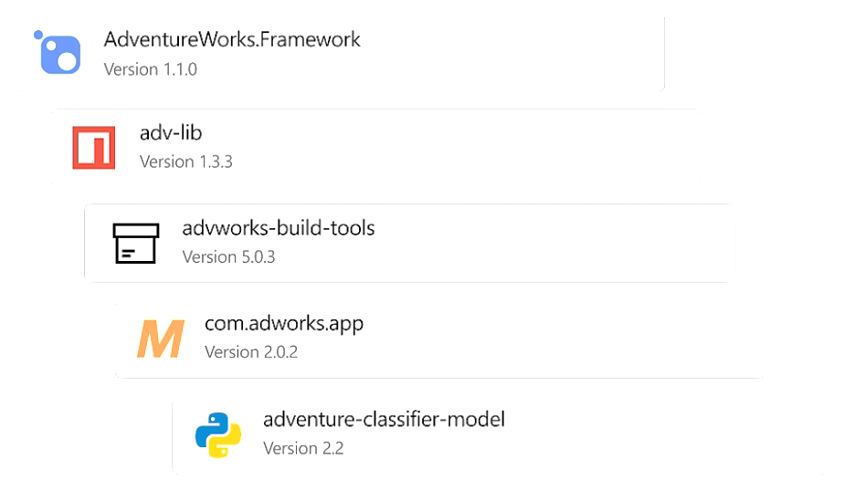
Azure Artifacts
Azure Artifacts lets you create, host, and share packages. It also provides integrated package management with support for Maven, npm, Python, and NuGet package feeds from public or private sources.

Slide 19
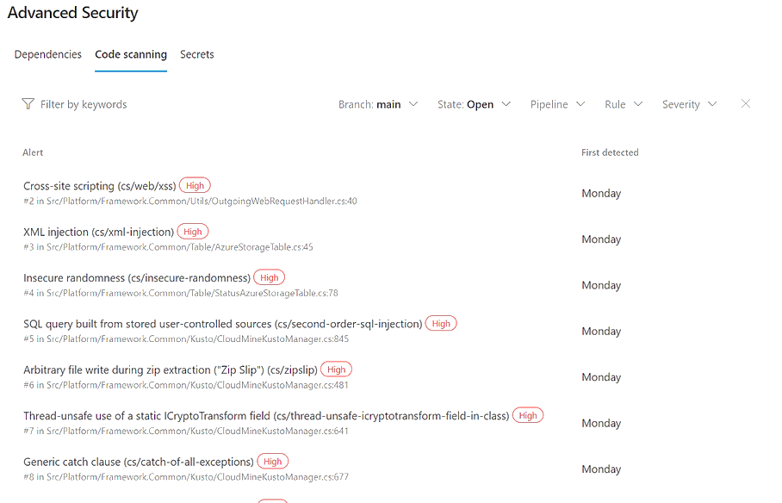
Azure Advanced Security
GitHub Advanced Security is an application security (AppSec) testing service that’s embedded in the developer workflow. It empowers developer, security, and operations (DevSecOps) teams to prioritize innovation and enhance developer productivity without sacrificing security.

Slide 20
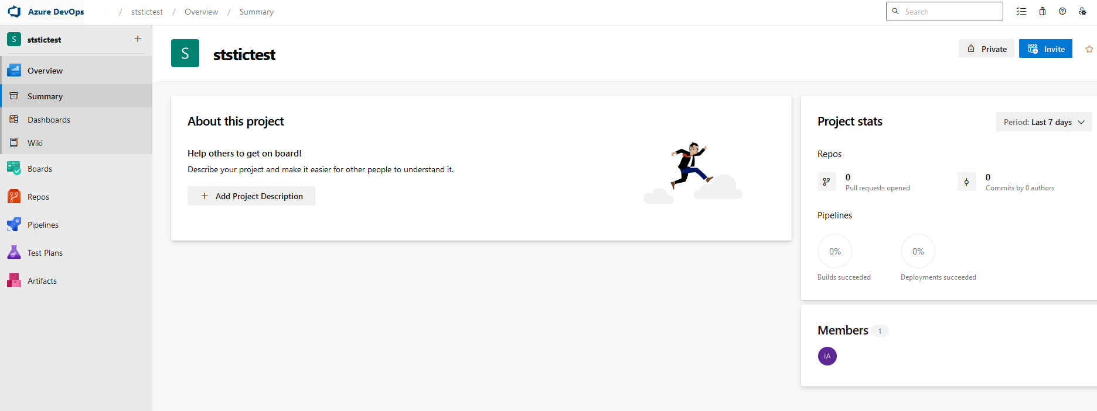
Azure DevOps (getting started)
Step 1: Set up a Microsoft Azure DevOps account. by clicking on My Azure DevOps Organizationnization.
Follow the instructions after completion of that you can start using the Azure DevOps.
Step 2: Create an organization with the name of your company or if it is a personal project give the name of the organization according to your interest. The organization represents the no.of projects that you are going to deal with.
After clicking on create a new organization you can give the name of the organization as shown below.
Step 3: Setup the Azure Repos which is a version control tool by which you push or pull the code depending upon your need the version control that is used in Azure Repo is the most commonly used Repo which is GIT.
Step 4: Set up the pipeline for automating the continuous integration and continuous deployment by using pipelines. Pipeline plays a major role in DevOps and Azure DevOps which will reduce human efforts. You can set up your pipeline by clicking on create pipeline as shown in the following image.
Step 4: Set up the Azure test plans to perform the automated or manual testing on the source code or you can also integrate some automation tools with the Azure test plan as shown in the following figure.

Slide 21
Azure Pipeline (in use)
DEMO

