Slide 1
Step 6. Version Control Systems

Slide 2
Agenda
Terraform
Ansible

Slide 3
Version Control Systems

Slide 4
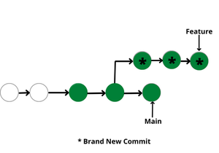
What is it?

Slide 5
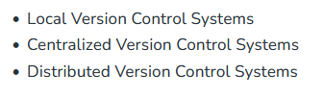
Types of Version Control Systems

Slide 6
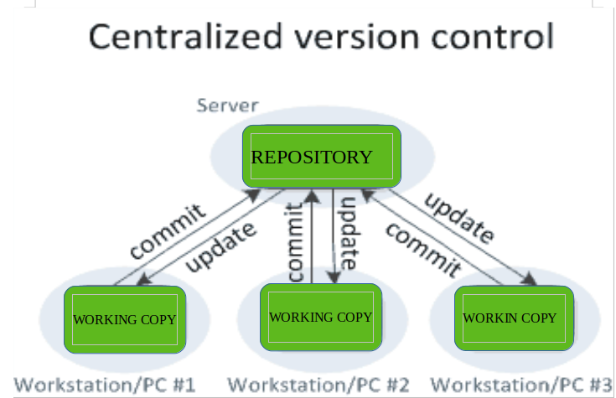
Centralized Version Control Systems

Slide 7
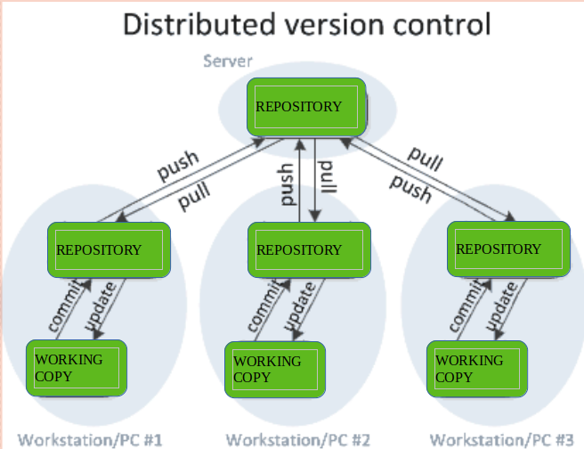
Distributed Version Control Systems

Slide 8
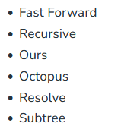
Merge Strategies

Slide 9
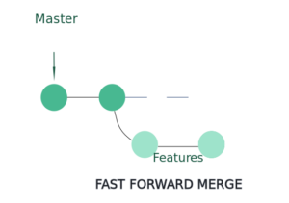
Fast Forward Merge

Slide 10
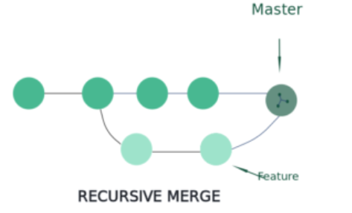
Fast Forward Merge

Slide 11
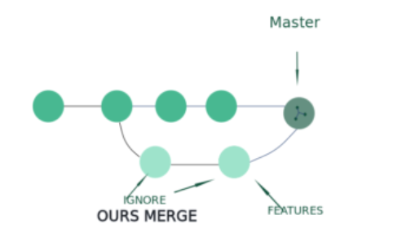
Ours Merge

Slide 12
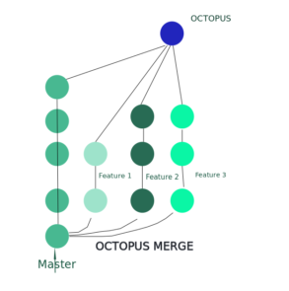
Octopus Merge

Slide 13
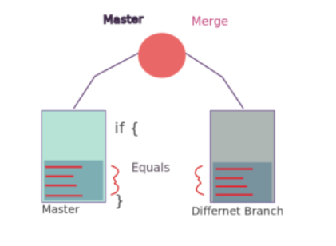
Resolve Merge

Slide 14
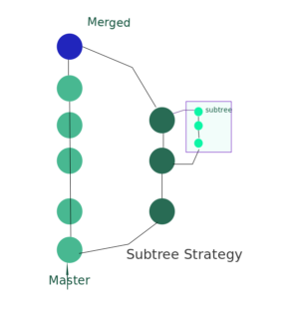
Subtree Merge

Slide 15
Git

Slide 16
What is it?

