Slide 1
Step 6. Version Control Systems

Slide 2
Agenda
Terraform
Ansible

Slide 3
Version Control Systems

Slide 4
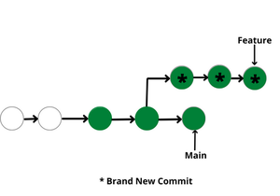
What is it?
Version control systems are a category of software tools that helps in recording changes made to files by keeping a track of modifications done in the code.
Use of Version Control System:
A repository: It can be thought of as a database of changes. It contains all the edits and historical versions (snapshots) of the project.
Copy of Work (sometimes called as checkout): It is the personal copy of all the files in a project. You can edit to this copy, without affecting the work of others and you can finally commit your changes to a repository when you are done making your changes.
Working in a group: Consider yourself working in a company where you are asked to work on some live project. You can’t change the main code as it is in production, and any change may cause inconvenience to the user, also you are working in a team so you need to collaborate with your team to and adapt their changes. Version control helps you with the, merging different requests to main repository without making any undesirable changes. You may test the functionalities without putting it live, and you don’t need to download and set up each time, just pull the changes and do the changes, test it and merge it back. It may be visualized as.
https://www.geeksforgeeks.org/version-control-systems/?ref=lbp

Slide 5
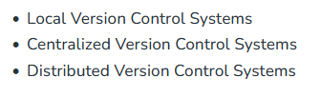
Types of Version Control Systems
Local Version Control Systems: It is one of the simplest forms and has a database that kept all the changes to files under revision control. RCS is one of the most common VCS tools. It keeps patch sets (differences between files) in a special format on disk. By adding up all the patches it can then re-create what any file looked like at any point in time.
https://www.geeksforgeeks.org/version-control-systems/?ref=lbp

Slide 6
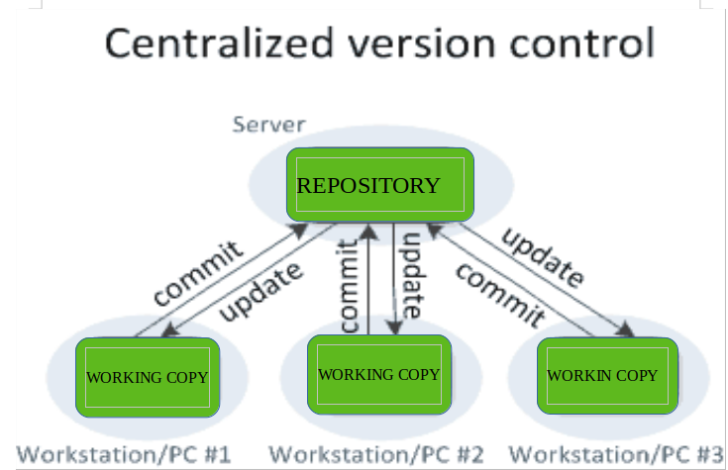
Centralized Version Control Systems
Centralized version control systems contain just one repository globally and every user need to commit for reflecting one’s changes in the repository. It is possible for others to see your changes by updating.
Two things are required to make your changes visible to others which are:
You commit
They update
The benefit of CVCS (Centralized Version Control Systems) makes collaboration amongst developers along with providing an insight to a certain extent on what everyone else is doing on the project. It allows administrators to fine-grained control over who can do what.
It has some downsides as well which led to the development of DVS. The most obvious is the single point of failure that the centralized repository represents if it goes down during that period collaboration and saving versioned changes is not possible. What if the hard disk of the central database becomes corrupted, and proper backups haven’t been kept? You lose absolutely everything.

Slide 7
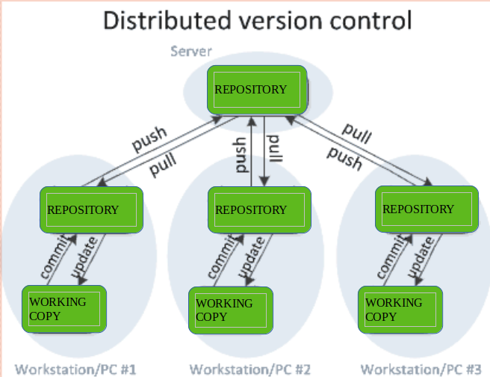
Distributed Version Control Systems
Distributed version control systems contain multiple repositories. Each user has their own repository and working copy. Just committing your changes will not give others access to your changes. This is because commit will reflect those changes in your local repository and you need to push them in order to make them visible on the central repository. Similarly, When you update, you do not get others’ changes unless you have first pulled those changes into your repository.
To make your changes visible to others, 4 things are required:
You commit
You push
They pull
They update
The most popular distributed version control systems are Git, and Mercurial. They help us overcome the problem of single point of failure.
Purpose of Version Control:
Multiple people can work simultaneously on a single project. Everyone works on and edits their own copy of the files and it is up to them when they wish to share the changes made by them with the rest of the team.
It also enables one person to use multiple computers to work on a project, so it is valuable even if you are working by yourself.
It integrates the work that is done simultaneously by different members of the team. In some rare cases, when conflicting edits are made by two people to the same line of a file, then human assistance is requested by the version control system in deciding what should be done.
Version control provides access to the historical versions of a project. This is insurance against computer crashes or data loss. If any mistake is made, you can easily roll back to a previous version. It is also possible to undo specific edits that too without losing the work done in the meanwhile. It can be easily known when, why, and by whom any part of a file was edited.

Slide 8
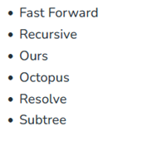
Merge Strategies
Merge in Git allows you to join two or more development work created using git branch into a single branch. It incorporates the changes from named commits and diverges them into the current branch. Before making a merge option make sure the receiving branch and the merging branch are up-to-date with the latest remote changes.
What are Merge Strategies?
Git provides various methods to merge different commits into a base commit. These methods are called Merge Strategies. These base commits are combined to form merge commits. A merge commit is just like the regular commit except that it has two parent commits. Out of multiple strategies for the merging process, the git will automatically choose one if not specified explicitly. This automatic selection of the merge strategy is based on the branches provided for merging.
There are various types of merge strategies :
Fast Forward
Recursive
Ours
Octopus
Resolve
Subtree
Git merge will combine multiple sequences of commits into one unified history. In the most frequent use cases, git merge is used to combine two branches. Any of the upgiven strategies can be used to perform the merging process according to the needs of the project. The most commonly used strategies are Fast Forward Merge and Recursive Merge.
https://www.geeksforgeeks.org/merge-strategies-in-git/?ref=lbp

Slide 9
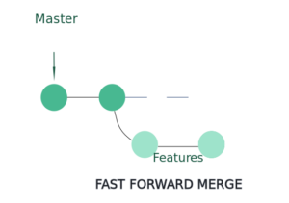
Fast Forward Merge
In this most commonly used merge strategy, history is just one straight line. When you create a branch, make some commits in that branch, the time you’re ready to merge, there is no new merge on the master. That way master’s pointer is just moved straight forward and history is one straight line.

Slide 10
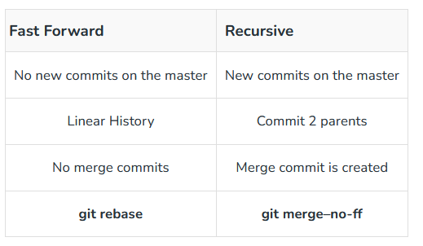
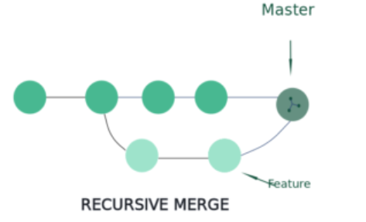
Fast Forward Merge
In Recursive merge, after you branch and make some commits, there are some new original commits on the ‘master‘. So, when it’s time to merge, git recurses over the branch and creates a new merge commit. The merge commit continues to have two parents.

Slide 11
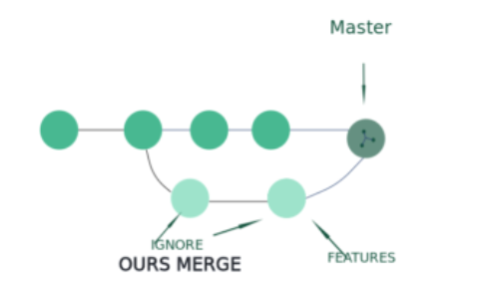
Ours Merge
This merge strategy resolves any number of heads, but the resulting tree of the merge is always that of the current branch head, effectively ignoring all changes from all other branches. It is meant to be used to supersede the old development history of side branches.

Slide 12
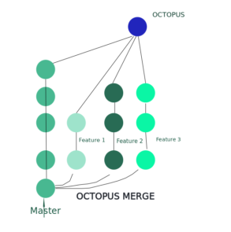
Octopus Merge
Octopus Merge strategy resolves cases with more than two heads but refuses to do a complex merge that needs manual resolution. It is primarily meant to be used for bundling topic branch heads together. This is the default merge strategy when pulling or merging more than one branch.

Slide 13
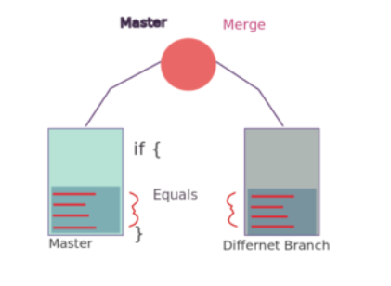
Resolve Merge
This strategy can only resolve two heads (i.e. the current branch and another branch you pulled from) using a 3-way merge algorithm. It tries to carefully detect criss-cross merge ambiguities and is considered generally safe and fast.

Slide 14
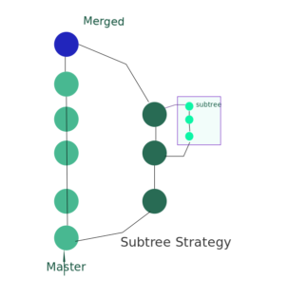
Subtree Merge
This is a modified recursive strategy. When merging trees A and B, if B corresponds to a subtree of A, B is first adjusted to match the tree structure of A, instead of reading the trees at the same level. This adjustment is also done to the common ancestor tree.

Slide 15
Git

