Slide 1


STREETHACK
HACKATHON
21-22APR’18
Organised by

Slide 2

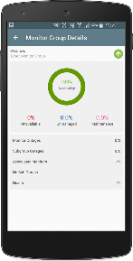



THE PROBLEM
For this,
We need
uncontrolled electricity consumption = resources wastage
Sensors Monitoring App
Predictive ML Model Backend server for real-time sync
Must deploy a system to monitor energy consumption and guide user to get most efficient solution to reduce it.

Slide 3
The Solution
In, short,
Gather data.
Visualise it.
Compare and make decisions.
Step2:We have data but now what? We need to intergrate and work upon this data
Step1:We need to gather data! But how?
Sensors and Electricity meters
This is where our ML model and app comes in

Slide 4
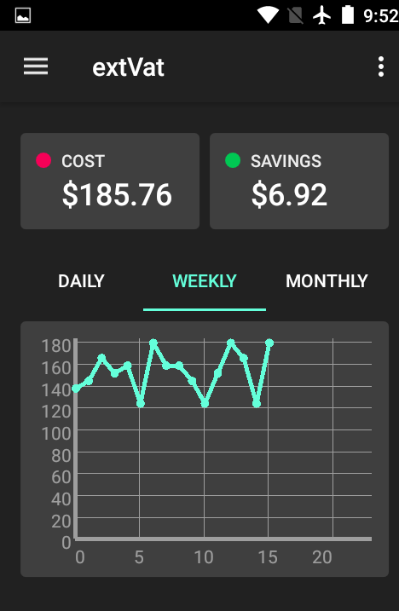
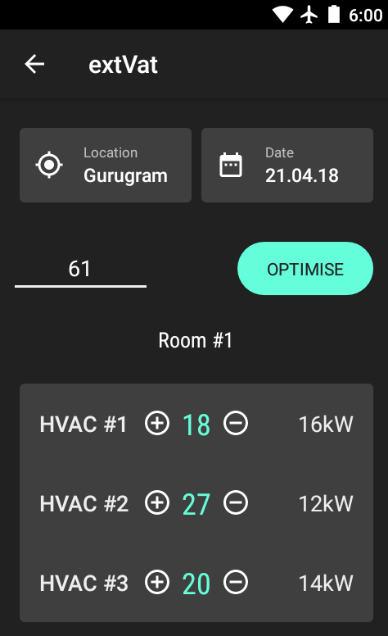
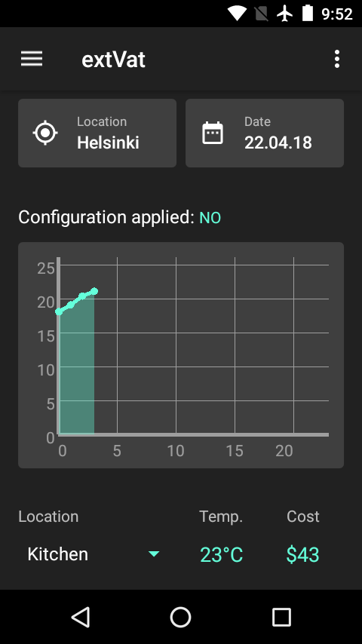
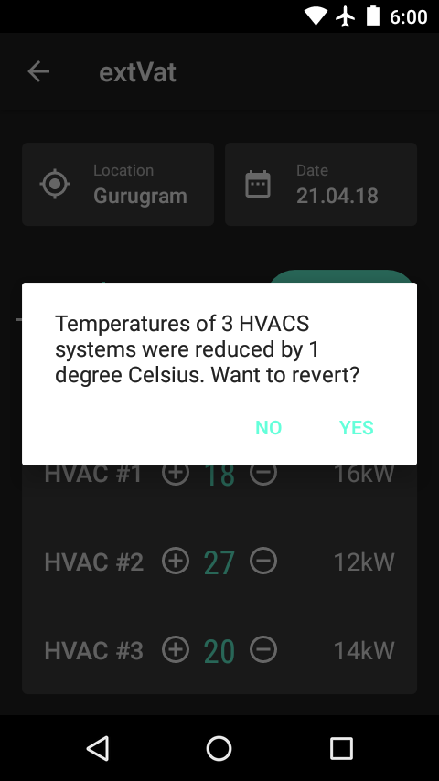
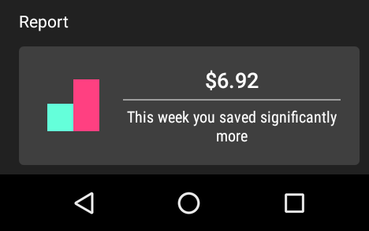
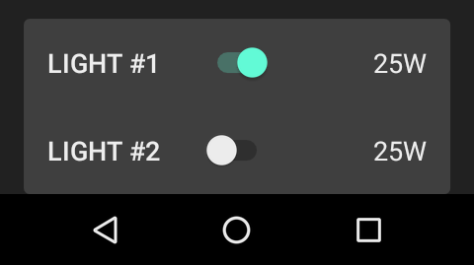
Brief Demo
Home
History
Admin Panel

Slide 5
What’s next?
-building architecture based optimization.
-integrated single centralized system for all appliances.
-additions of user based scheduling system.

Slide 6
Team extVAT
Abhishek Nigam
Prabhnoor Singh
Ojasvi Sharma
Prafull Mishra
Bhrigu Kansra

