Slide 1
Intro to AI with .NET, OpenAI, and Semantic Kernel

Slide 2
Generative AI
Notes:
Well, that demo had a lot of moving parts in it, let’s break it down into a few smaller pieces to learn just how it did what it did.
Underpinning all of it though was Generative AI, so before we go into the .NET aspect of it, let’s have a look at just how Generative AI works.

Slide 3


Large Language Models (LLMs)
“Once
upon a time,
GPT 3.5
GPT 4
“In a quaint village
nestled between rolling hills and meandering streams,
there existed […]. ”
N-token Prompt
M-token Completion
Notes:
First, let’s define a Large Language Model, commonly abbreviated as LLMs. LLMs are a type of generative AI model that can generate and understand natural language by learning statistical patterns of natural language from huge volumes of text – books, articles, web pages, and social media - basically anything that is text.
An LLM works by estimating the probability of a word, or token or a sequence of tokens, given some previous tokens or context. They can also generate whole sequences of tokens, such as a paragraph or a story through an expanding window pattern.
LLMs repeatedly predict the next token using context and its prior predictions until a stop condition is met.
Phrased another way, you can think of these models as being training on a large chunk of the Internet, so their parameters represent something like a 100x compression of all the knowledge contained on the Internet into a ~140GB file. By optimizing the model on the next-word prediction task as part of self-supervised training loop – meaning hiding parts of input text and asking the model to predict the missing parts - the model learns about the world just to predict that next word.
[Ready the audience/vibe: joke] Learning about the world just to predict the next word in a sentence sounds like a lot of work, right?
You interact with these models by inputting a prompt, which is a series of words or tokens. LLMs make predictions based on your prompt and output a completion, which is a series of words or tokens again.

Slide 4
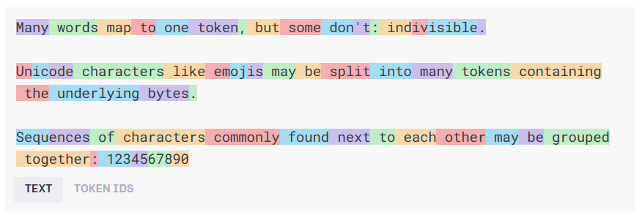
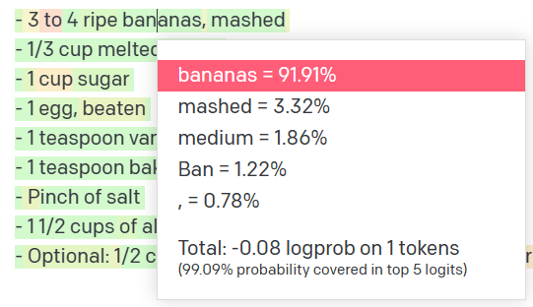
How language models work
Natural
language input
Pre-processing
Tokens
Natural
language output
Model
Get results
Decoding + Post-processing
Probability distribution
Notes:
The language model receives raw text, then tokenizes the text, tokens are chunks of text depicted by the different colored boxes in the image above, and these tokens are then transformed into integers that are fed to the model.
The model is a transformer architecture-based neural network, which we don’t have time to dive into here, but essentially the goal of this model is to predict the next word in a sequence, which leads to the model sampling a probability distribution that results in the final text/token output.
General idea:
Text -> token
Token (are numbers)
Numbers go into the model
Model samples a probability distribution, then outputs natural language (a single token)

Slide 5
How language models work
0.01
0.005
0.003
0.013
0.077
…
0.006
do
say
try
anthrop
buy
zux
We
need
to
stop
n tokens in
1 tokens out
p
Notes:
Do I get the same result twice?
The answer is no. What is actually returns is a probability distributions of possible tokens
It assigns a possibility to each token returned
And then you sample from that distribution
2 methods of measurement that you can adjust to affect output
Temperature - You will often see from a scale of 0 to 1 and controls creativity or randomness. Lowering the temperature will create more deterministic results whereas increasing it will increase randomness.
p_top value – You will also see on a scale from 0 to 1, but this essentially limits the distribution to whatever specified. 0.1 will limit the sampling to the top 10
% of likely values (deterministic & focused) whereas setting it to 0.5 will allow the model to sample from a broader set of possibilities (more creative). What you need will depend on your usecase.
0.1 = top 10% values (deterministic & focused)
0.5 = 50% (creative writing)

Slide 6
Prompt Engineering

Slide 7
Prompt engineering
You can create your model prompt using different styles:
Instruction
e.g., “Translate the following code from Python to C# […]”
Completion
e.g., “Machine Learning is a field of artificial intelligence that”
Question
e.g., “What is Artificial Intelligence?”
TIP – Imaging you are speaking to an untrained intern
Avoid assumptions
Break down problems
Provide details
Notes:
My key recommendation for you with prompt engineering is write your prompt imaging you are speaking to an untrained intern. Make sure to avoid assumptions, break down problems into multiple parts, and provide clear and concise detailed instructions.

Slide 8

System prompt vs user prompt
System prompt
You are an AI assistant that helps people find information and responds in rhyme. If the user asks you a question you don't know the answer to, say so.
User prompt
What can you tell about me, John Doe?
Assistant
Dear John, I'm sorry to say,
But I don't have info on you today.
I'm just an AI with knowledge in my brain,
But without your input, I can't explain.
So please tell me more about what you seek,
And I'll do my best to give you an answer unique.
Notes:
In the latest models like GPT 3.5 and GPT 4 we have a system prompt
The system prompt is typically not visible to the user but is fed into the models context before the user prompt to help steer the model in a specific direction.
Tell the model how to behave steer the model
Talk about finetuning > system message combined with examples get very far
First for a brief look at the interface that developers use to build with GPT-4 and 3.5 turbo.
Delightful interface that works for all scenarios, like summarization, content generation as well as chat.
New system message field. More steerable. Nuanced instructions.
Examples go into the User and Assistant field.

Slide 9

Common use cases
Content generation
Summarization
Code generation
Semantic search
Chat
Notes:
This list is by no means exhaustive, but here are the most common text generation use cases I encounter when working with startups.
Startups are building on top of models like ChatGPT-4 Turbo for:
Creating diverse texts for websites, social media marketing, and product descriptions.
Summarizing company documents to generate product manuals, legal briefs, and regulatory filings.
Assisting engineers write code to build and debug new applications.
Helping end-users find the most relevant e-commerce products.
And developing chatbots for customer support, sales, and personal assistance.

Slide 10
Prompt engineering for text generation
Defining assistant persona, its tone and style, and the chat history
1
Providing examples, context and data (meta-grounding)
2
Providing guardrails and mitigating fabrications
3
Notes:
There are 3 key approaches to prompt engineering for text generation that we will see in our upcoming demo:
1. Defining assistant persona, its tone and style, and the chat history. E.g. ‘you are an assistant helping with employee handbook questions; be precise and short in your answers’
2. Providing examples, context and data (meta-grounding) -> E.g. providing examples in your system prompt or augmenting your model with retrieval augmented generation (RAG) with external data.
3. Providing guardrails and mitigating fabrications. E.g. ‘Use only the data provided to answer user’s question, if the answer cannot be retrieved from this data source, please reply you don’t have an answer’

Slide 11
GenAI Features: Embeddings
[-0.006655829958617687, 0.0026128944009542465, 0.008792596869170666, -0.02446001023054123, -0.008540431968867779, 0.022071078419685364, -0.010703742504119873, 0.003311325330287218, -0.011632772162556648, -0.02187200076878071, ...]
“Today we are going to learn about Azure AI Studio”
Text Embedding Ada
Notes:
Computers ultimately speak numbers and need to convert text to into a numerical form to understand relationships between words and concepts.
Embedding models transform text into an array of numbers which is the representation of the original text into the semantic space.
The OpenAI ADA model is a large multimodal model, commonly abbreviated as LMM, that can understand both text and images.
It can generate embeddings or vectors of numbers, to encode both the meaning and context of your input prompt.
For example, ADA will take your prompt “Today we are going to learn about Azure AI Studio” and generates a length 10 numerical vector shown on the screen, which captures the meaning of each of those 10 words and concepts like “today” and “Azure AI Studio”.
This is useful for tasks such as semantic search and sentence similarity.

Slide 12
Retrieval Augmented Generation
User Question
Workflow
Query My Data
Retriever over Knowledge Base
Add Results to Prompt
Query Model
Large Language Model
Send Results
Notes:
Adding knowledge that we retrieve from data source into the prompt we call "Retrieval Augmented Generation"
Retrieval-augmented generation (RAG) allows for incorporating data directly into prompts without retraining models.
RAG is efficient and cost-effective due to its relatively quick process and inexpensive indexing.
Internal tests show that RAG is effective at adding knowledge to AI experiences.
Both RAG and fine-tuning are complementary technologies, not mutually exclusive.

Slide 13
Thank you

