Slide 1
Chaos engineering

Slide 2
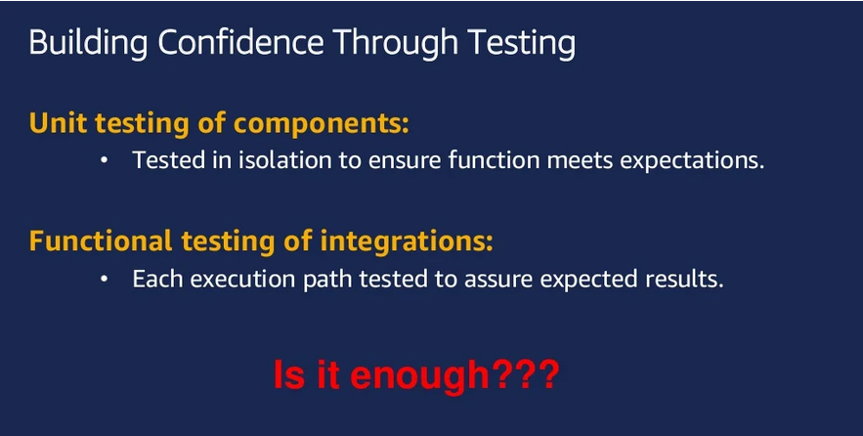

Slide 3
People
Whoops!
I wonder why it did that?
Let’s reboot it.
Now it’s really hosed
Unexpected application behavior often causes people to intervene and make the situation worse

Slide 4
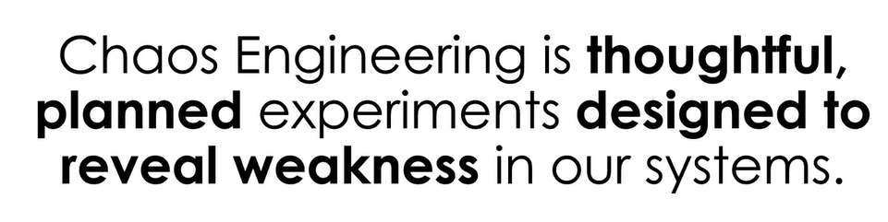

Slide 5
People Training
!
A fire drill is a boring routine where we make everyone take the stairs and assemble in the parking lot

Slide 6
People Training
Fire drills save lives in the event of a real fire, because people are trained how to react

Slide 7
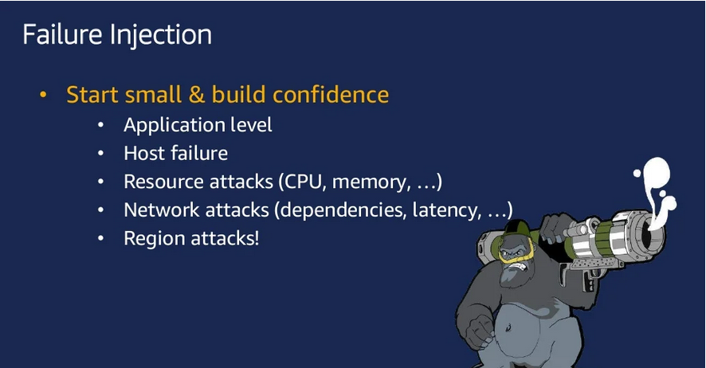
Think of a vaccine or a flu shot, where you inject yourself with a small amount of a potentially harmful foreign body in order to build resistance and prevent illness. Chaos Engineering is a tool we use to build such an immunity in our technical systems by injecting harm (like latency, CPU failure, or network black holes) in order to find and mitigate potential weaknesses.

Slide 8
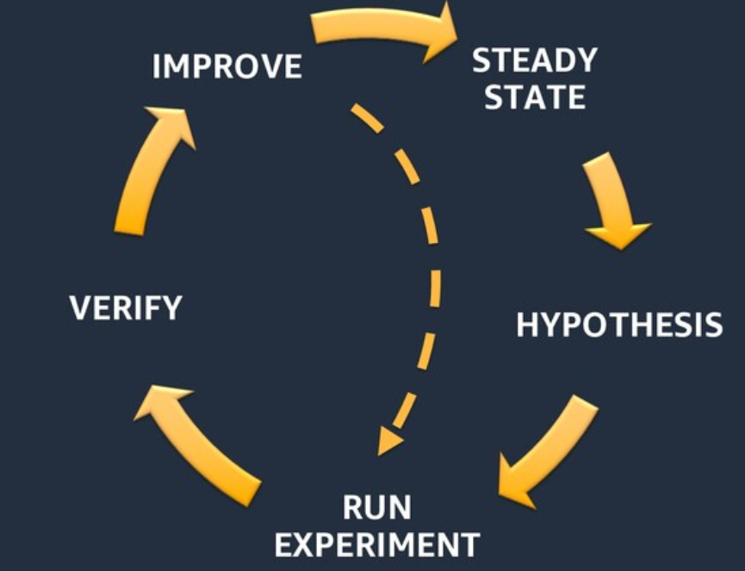
Steady state is nothing but normal working condition of the system where we need to take a note of the SLA, response time, throughput, error rate and baseline performance numbers/response time etc..
After you define the steady state, we need to prepare with a set of hypothesis (some assumptions which may true or may not true, we need to prove or disprove)
To prove/dis-prove the hypothesis we need to run a set of tests based on the hypothesis.

Slide 9
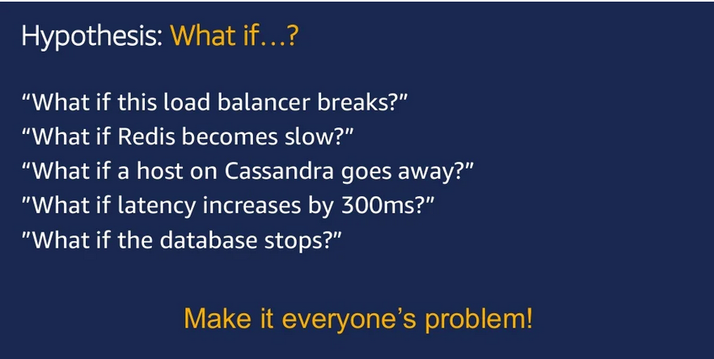

Slide 10
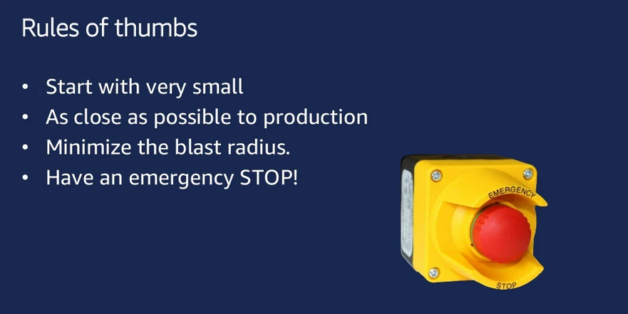

Slide 11
People
Who runs the “fire drill” for I.T.?
Application
Switching
Infrastructure

Slide 12
People
Application
Chaos Engineering Team
Switching
Infrastructure

Slide 13
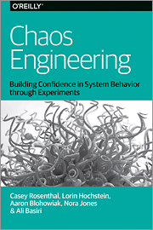
People
Application
Chaos Engineering Team
Switching
Infrastructure

Slide 14
People
Application
Tools
Chaos Engineering Team
Switching
Infrastructure

Slide 15


Tools
Game days
People
Simian Army
Application
chaostoolkit
Chaos Engineering Team
Switching
ChAP
Gremlin
Infrastructure

Slide 16
People
Application
Tools
Chaos Engineering Team
Switching
Security Red Team
Infrastructure

Slide 17
People
Application
Tools
Tools
Chaos Engineering Team
Switching
Security Red Team
Infrastructure

Slide 18
Tools
People
Safestack AVA
Application
Metasploit
Tools
Chaosslingr
Chaos Engineering Team
Switching
Security Red Team
AttackIQ
Infrastructure
SafeBreach

Slide 19
Chaos
Architecture
People
Application
Four layers
Two teams
An attitude— Break it to make it better
Tools
Tools
Chaos Engineering Team
Switching
Security Red Team
Infrastructure

Slide 20
Break it to make it safer

Slide 21
Gremlin
Break things on purpose
Break it to make it safer
It provides a library of attacks to simulate real outages.

Slide 22
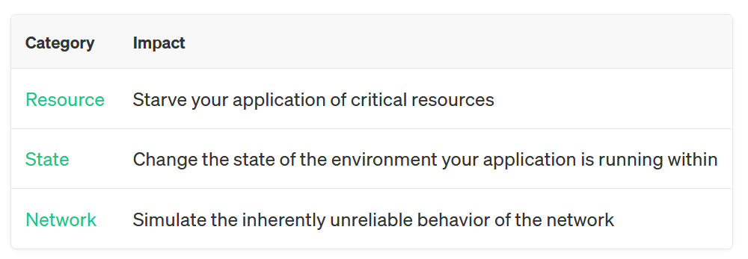
Gremlin
Categories of attack
Break it to make it safer

Slide 23
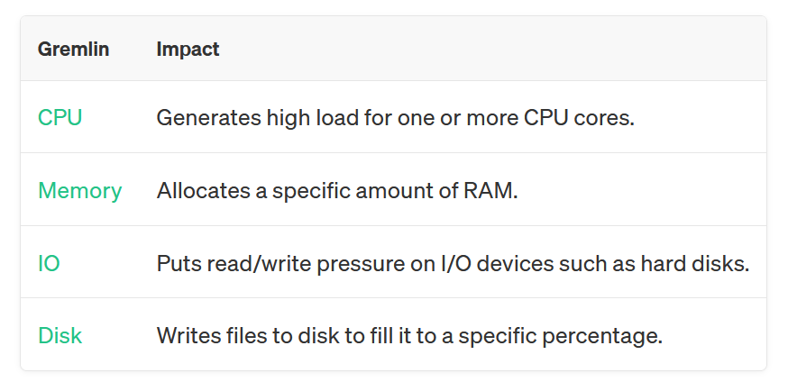
Resource Gremlins
Break it to make it safer

Slide 24
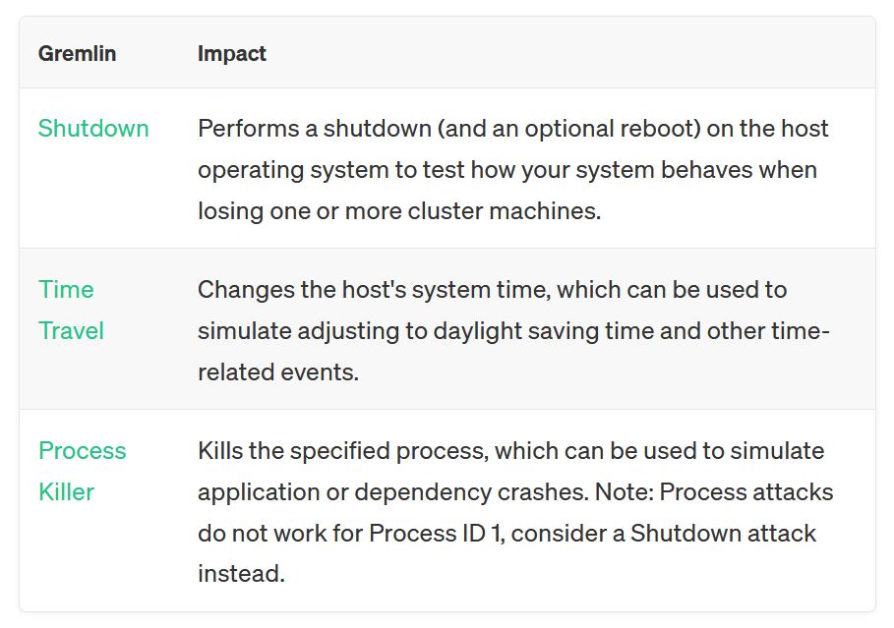
State Gremlins
Break it to make it safer

Slide 25
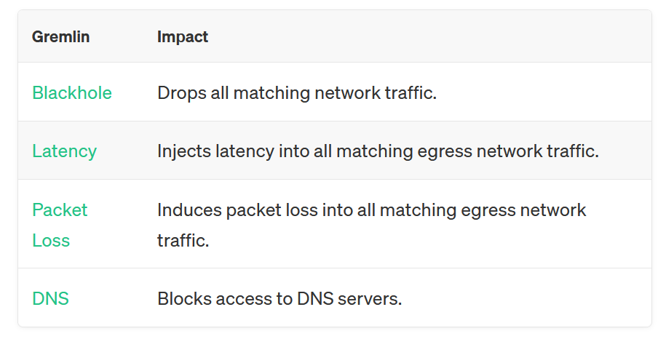
Network Gremlins
Break it to make it safer

Slide 26
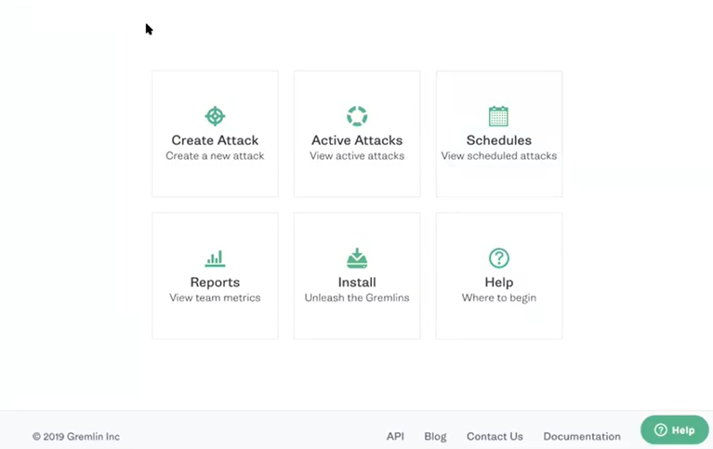

Slide 27
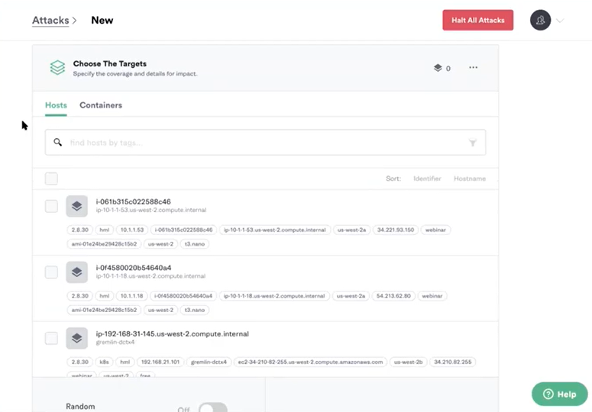

Slide 28
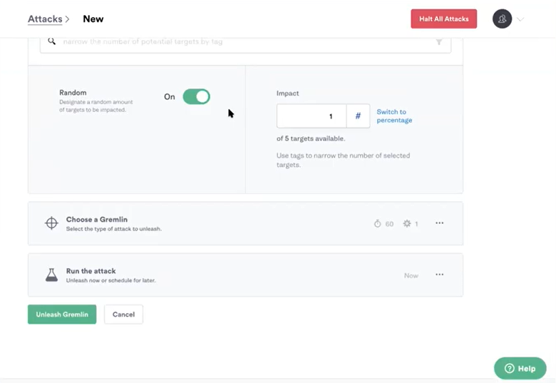

Slide 29
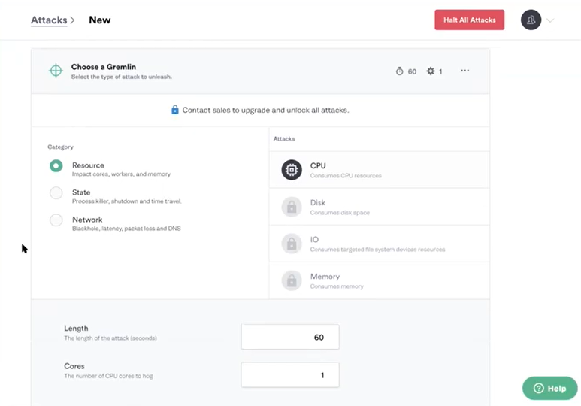

Slide 30
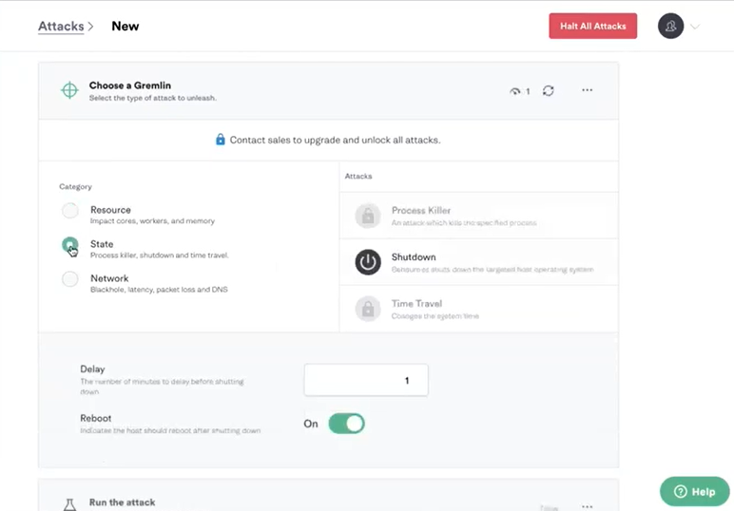

Slide 31
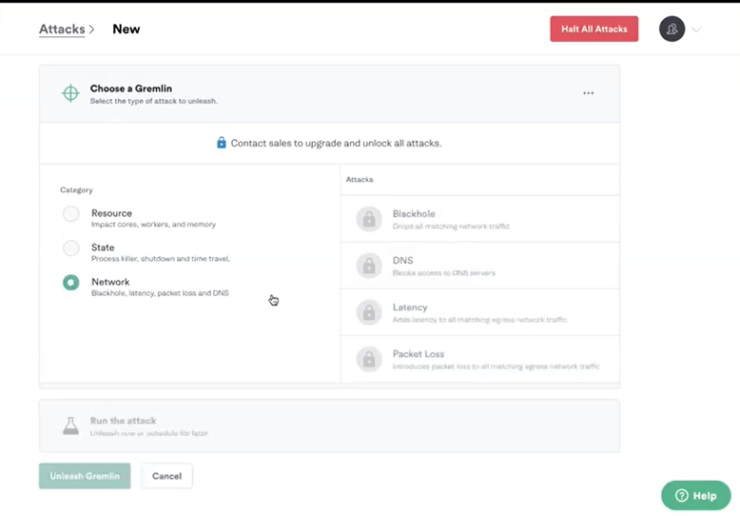

Slide 32
