Slide 1
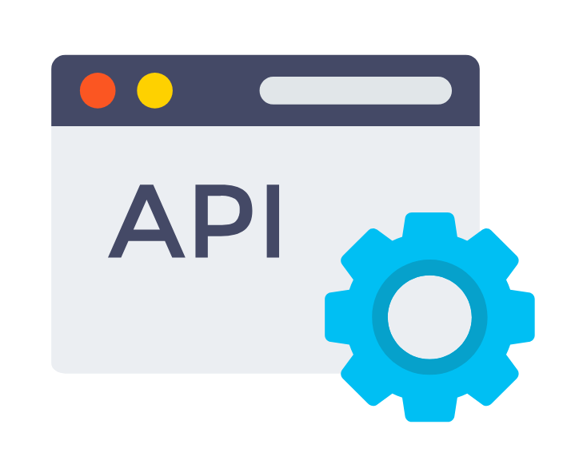
Application Programming Interface

Slide 2
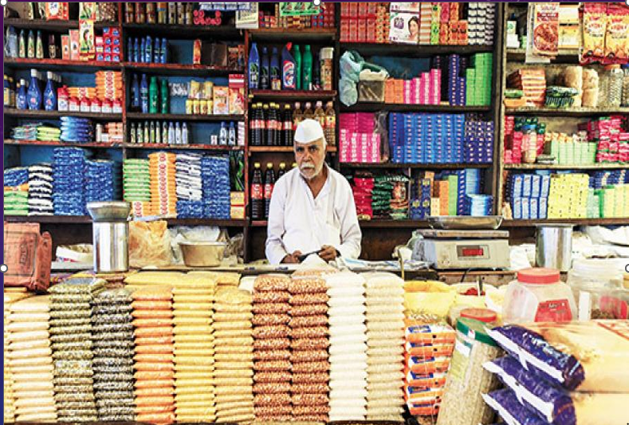
What is an API ??

Slide 3
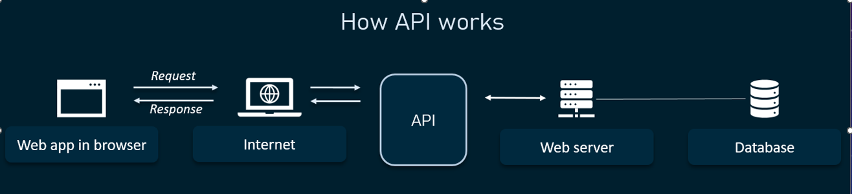

Slide 4
API Examples
Adhaar-Based Verifications
Travel Bookings
Booking Cab’s from Google Maps
Weather App and many more

Slide 5
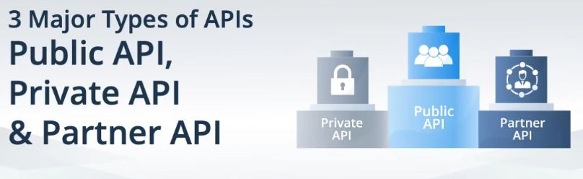
Private APIs are APIs that are private and only used by your team, department, company, or organization.
Public APIs also known as public APIs are publicly available APIs that are available for anyone to use.
Partner APIs are private and shared only with specific, integration partners outside of your organization.

Slide 6
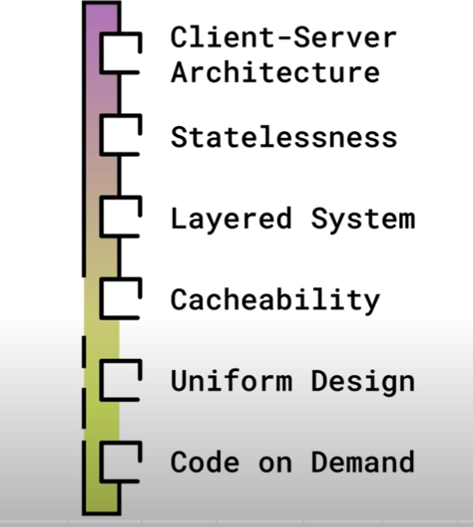
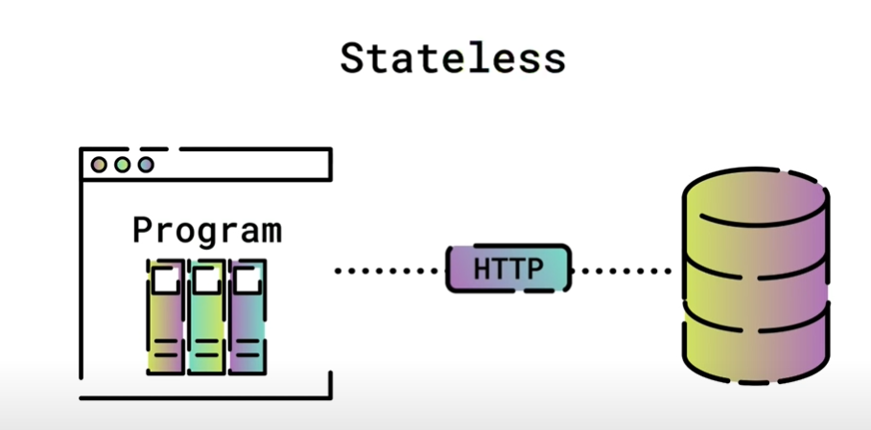
Rest API – Representational state transfer

Slide 7
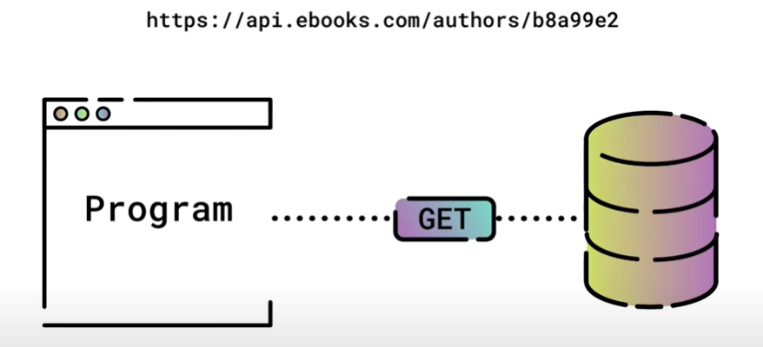
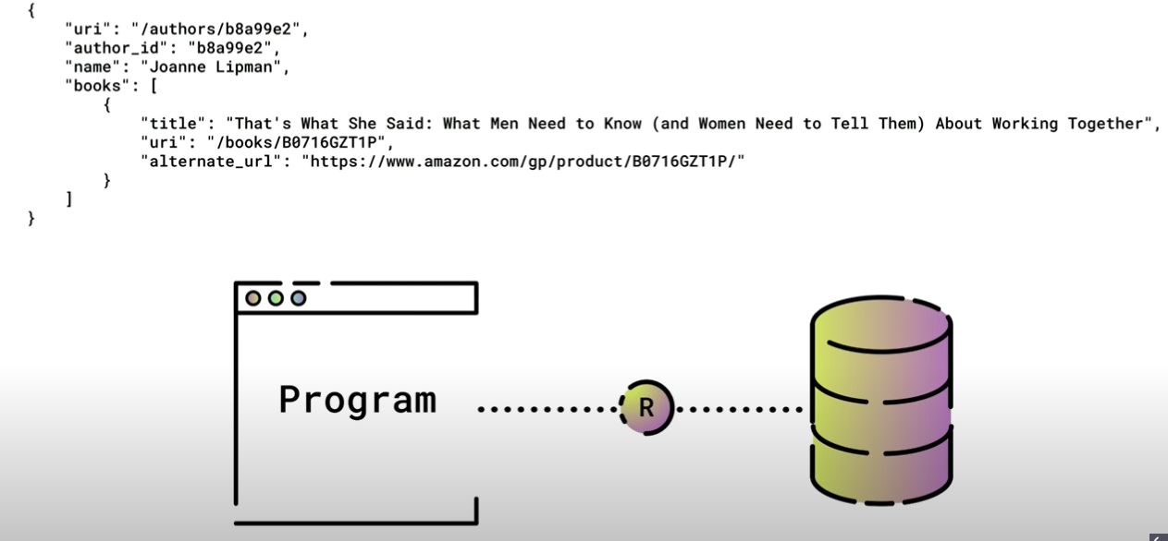
URL --→
Header
Parameters
Authorization Key

Slide 8
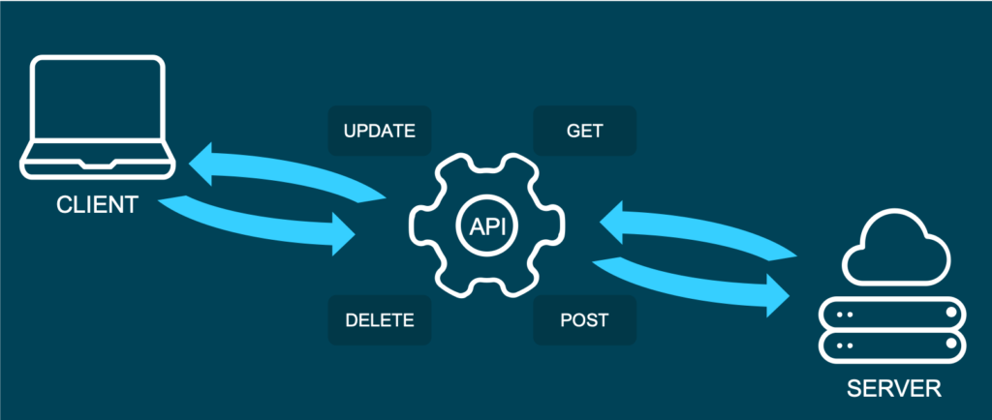

Slide 9
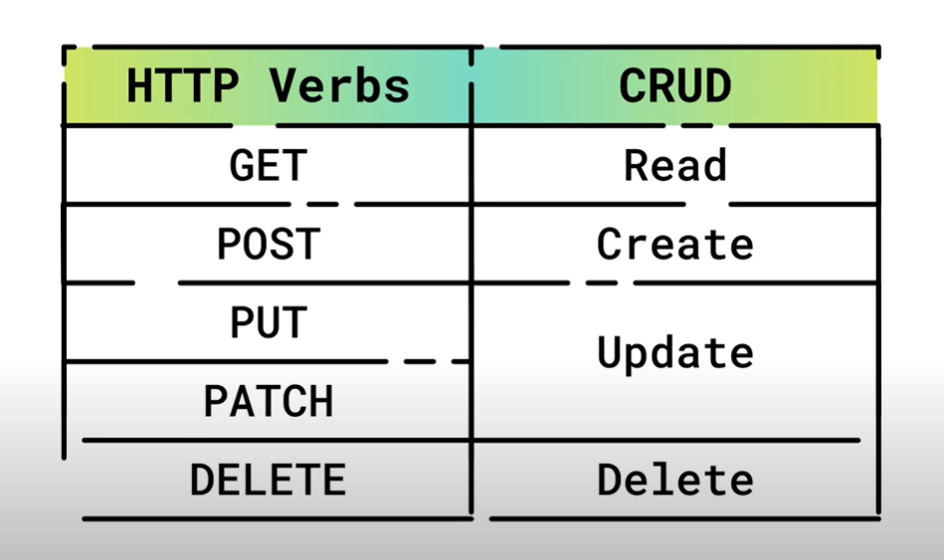
Api methods

Slide 10
Let’s Try out some API’s
List news about the Musician – https://rapidapi.com/
List the top 10 song’s of artists from a music app – https://developer.spotify.com
List Comments from the Youtube channel – https://developers.google.com/youtube
Send SMS to friends to check out the Latest Album - https://www.twilio.com/

Slide 11
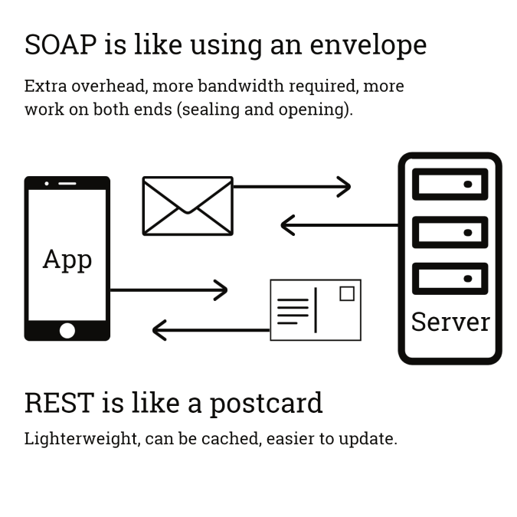

Slide 12
THANK YOU

