Slide 1
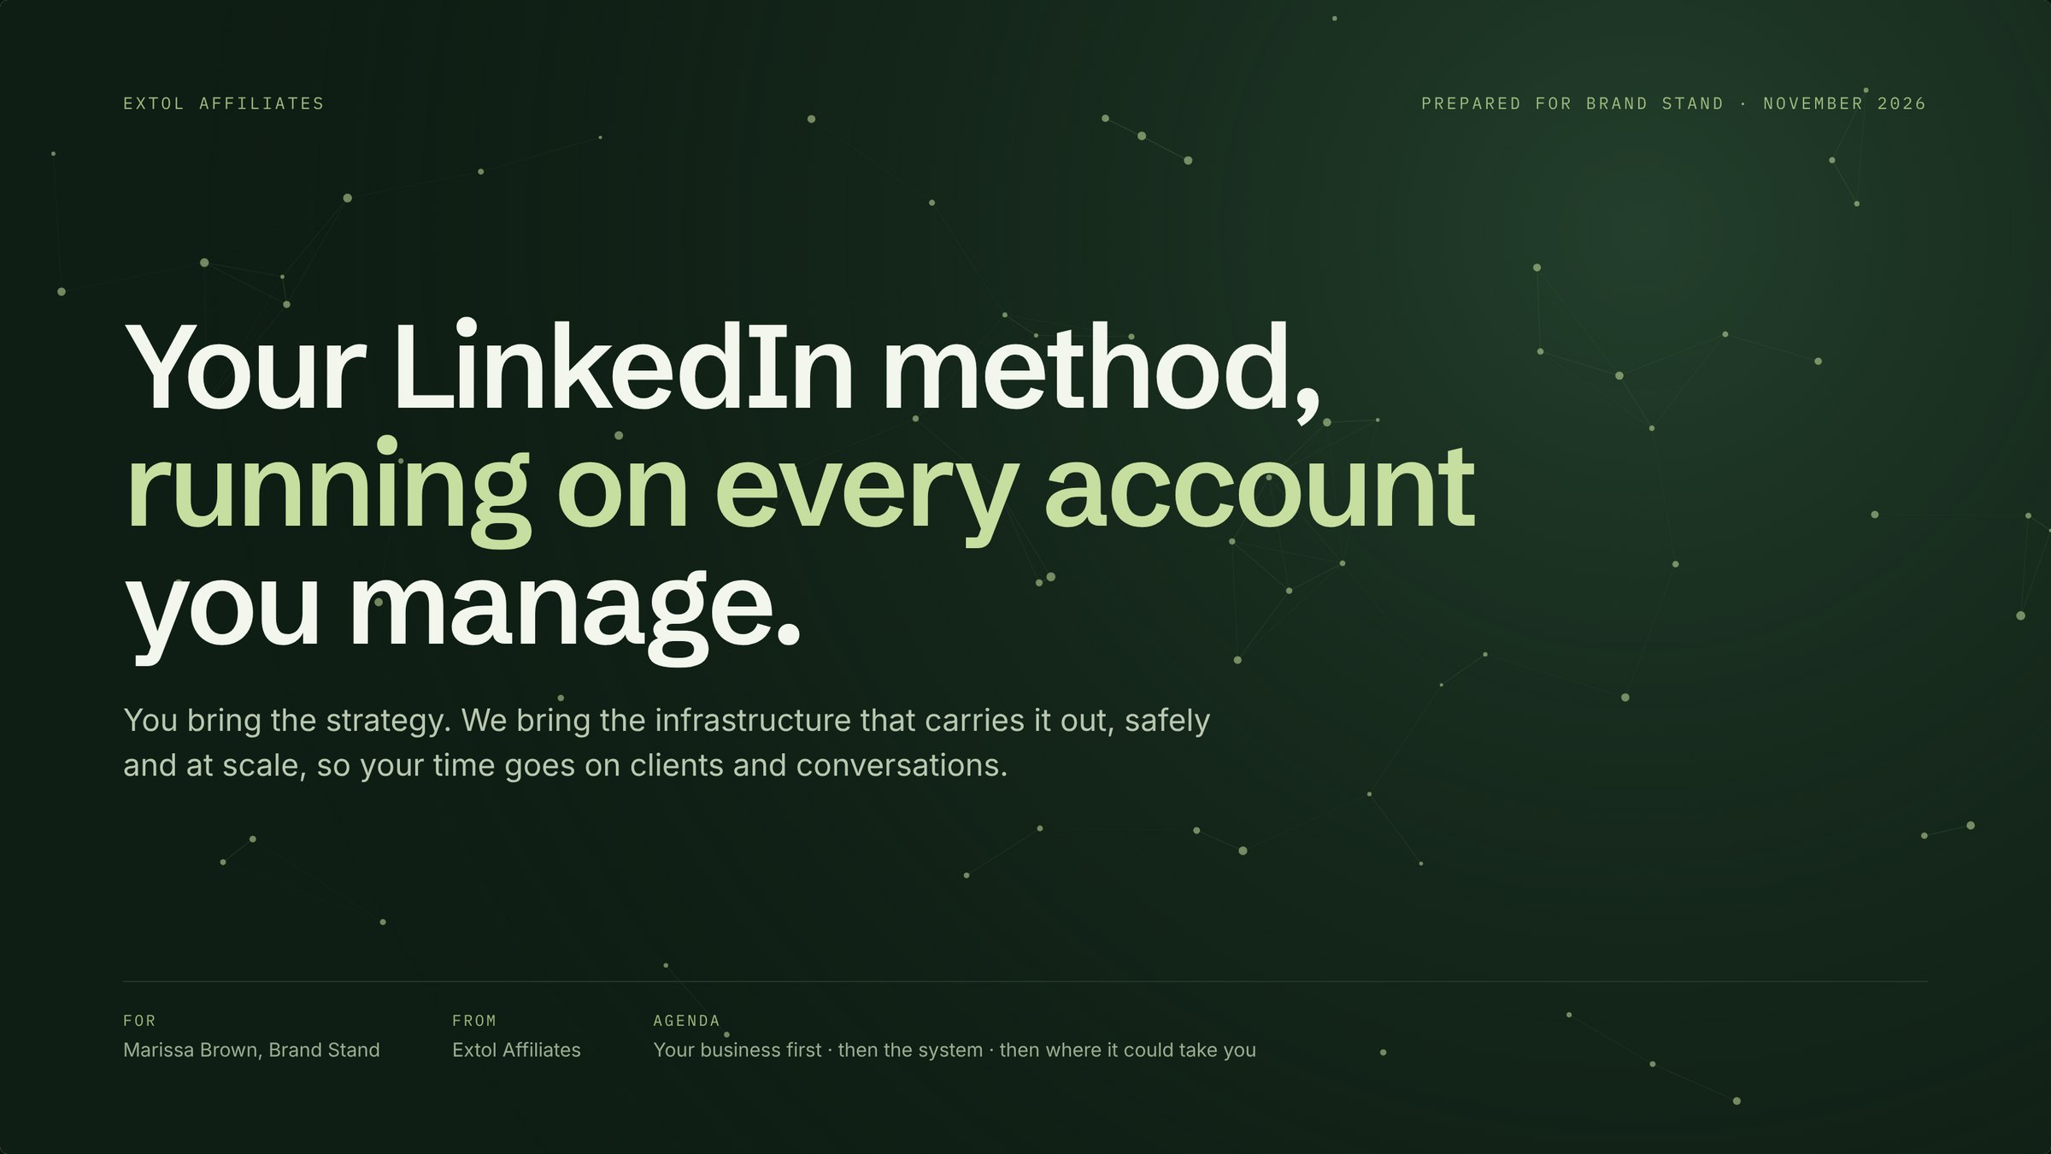
Notes:
Set the frame: you know LinkedIn better than we do. Today is about your business first, then the system we would run for you.

Slide 2
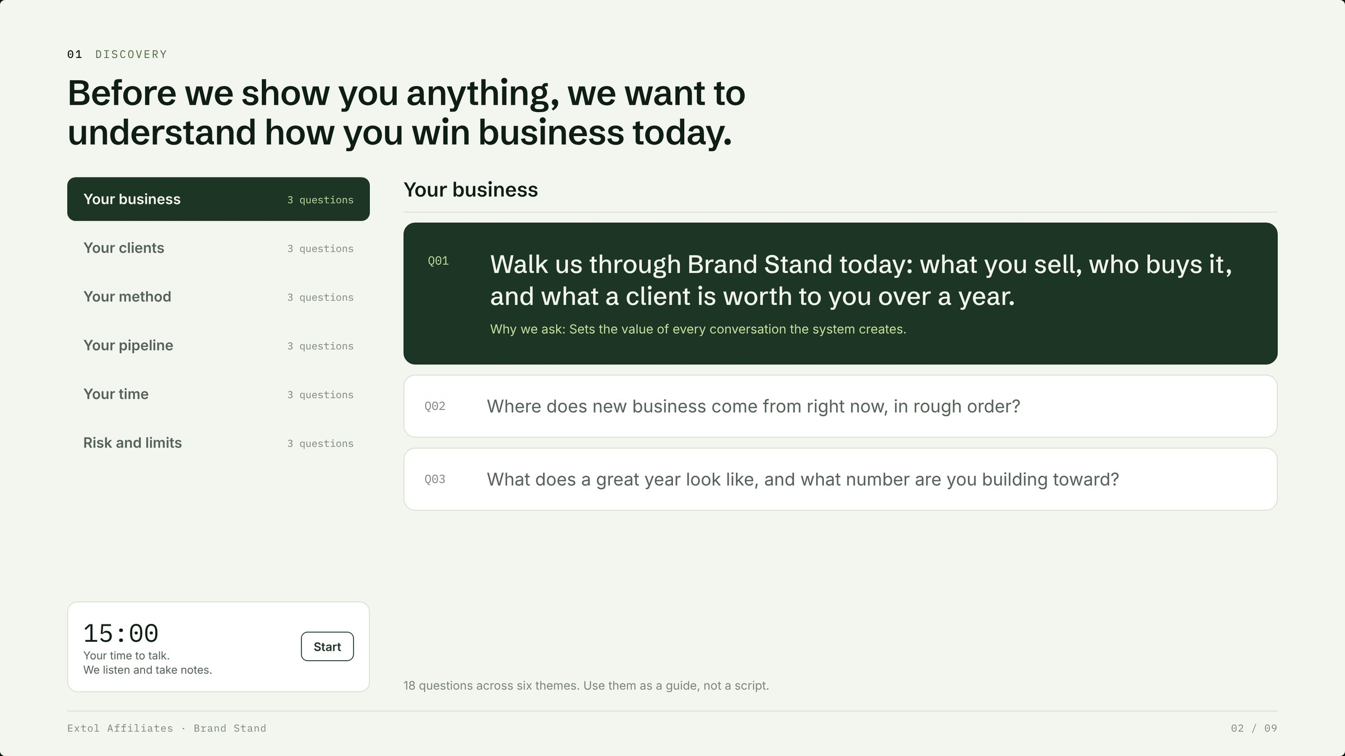
Notes:
Give her the floor for 15 minutes. Use the six themes as a guide, not a script. Write her answers down in her words, especially the revenue goal and hours per week.

Slide 3
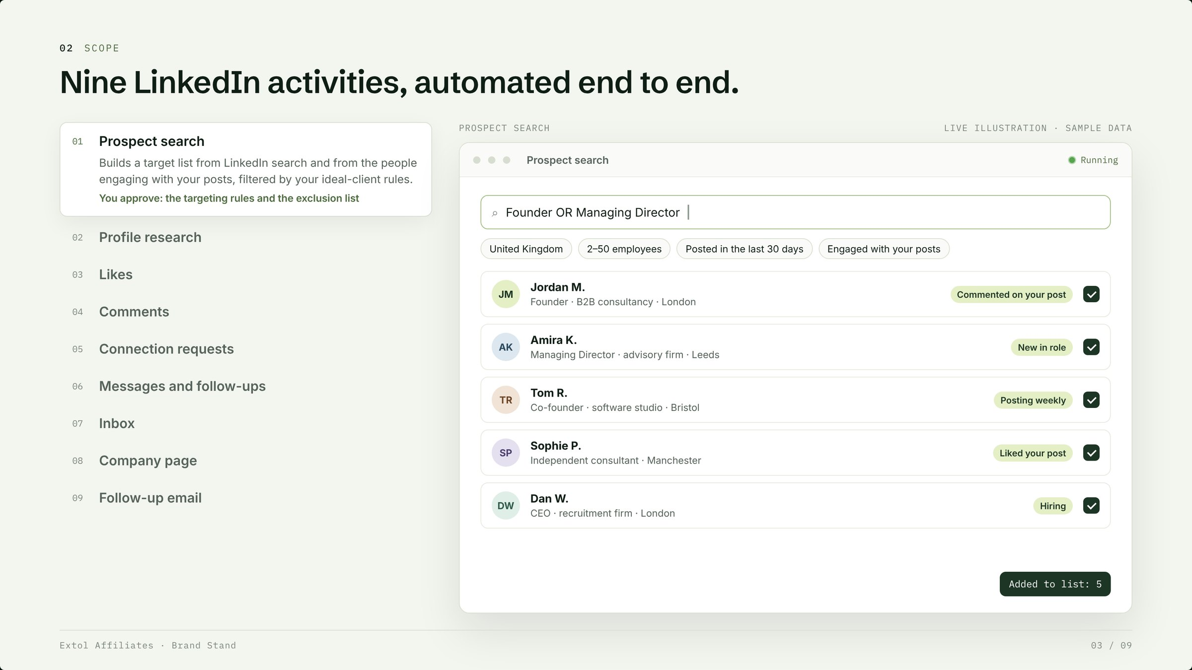
Notes:
Nine activities the system runs end to end. Walk through prospect search as the example: rules in, a qualified list out.

Slide 4
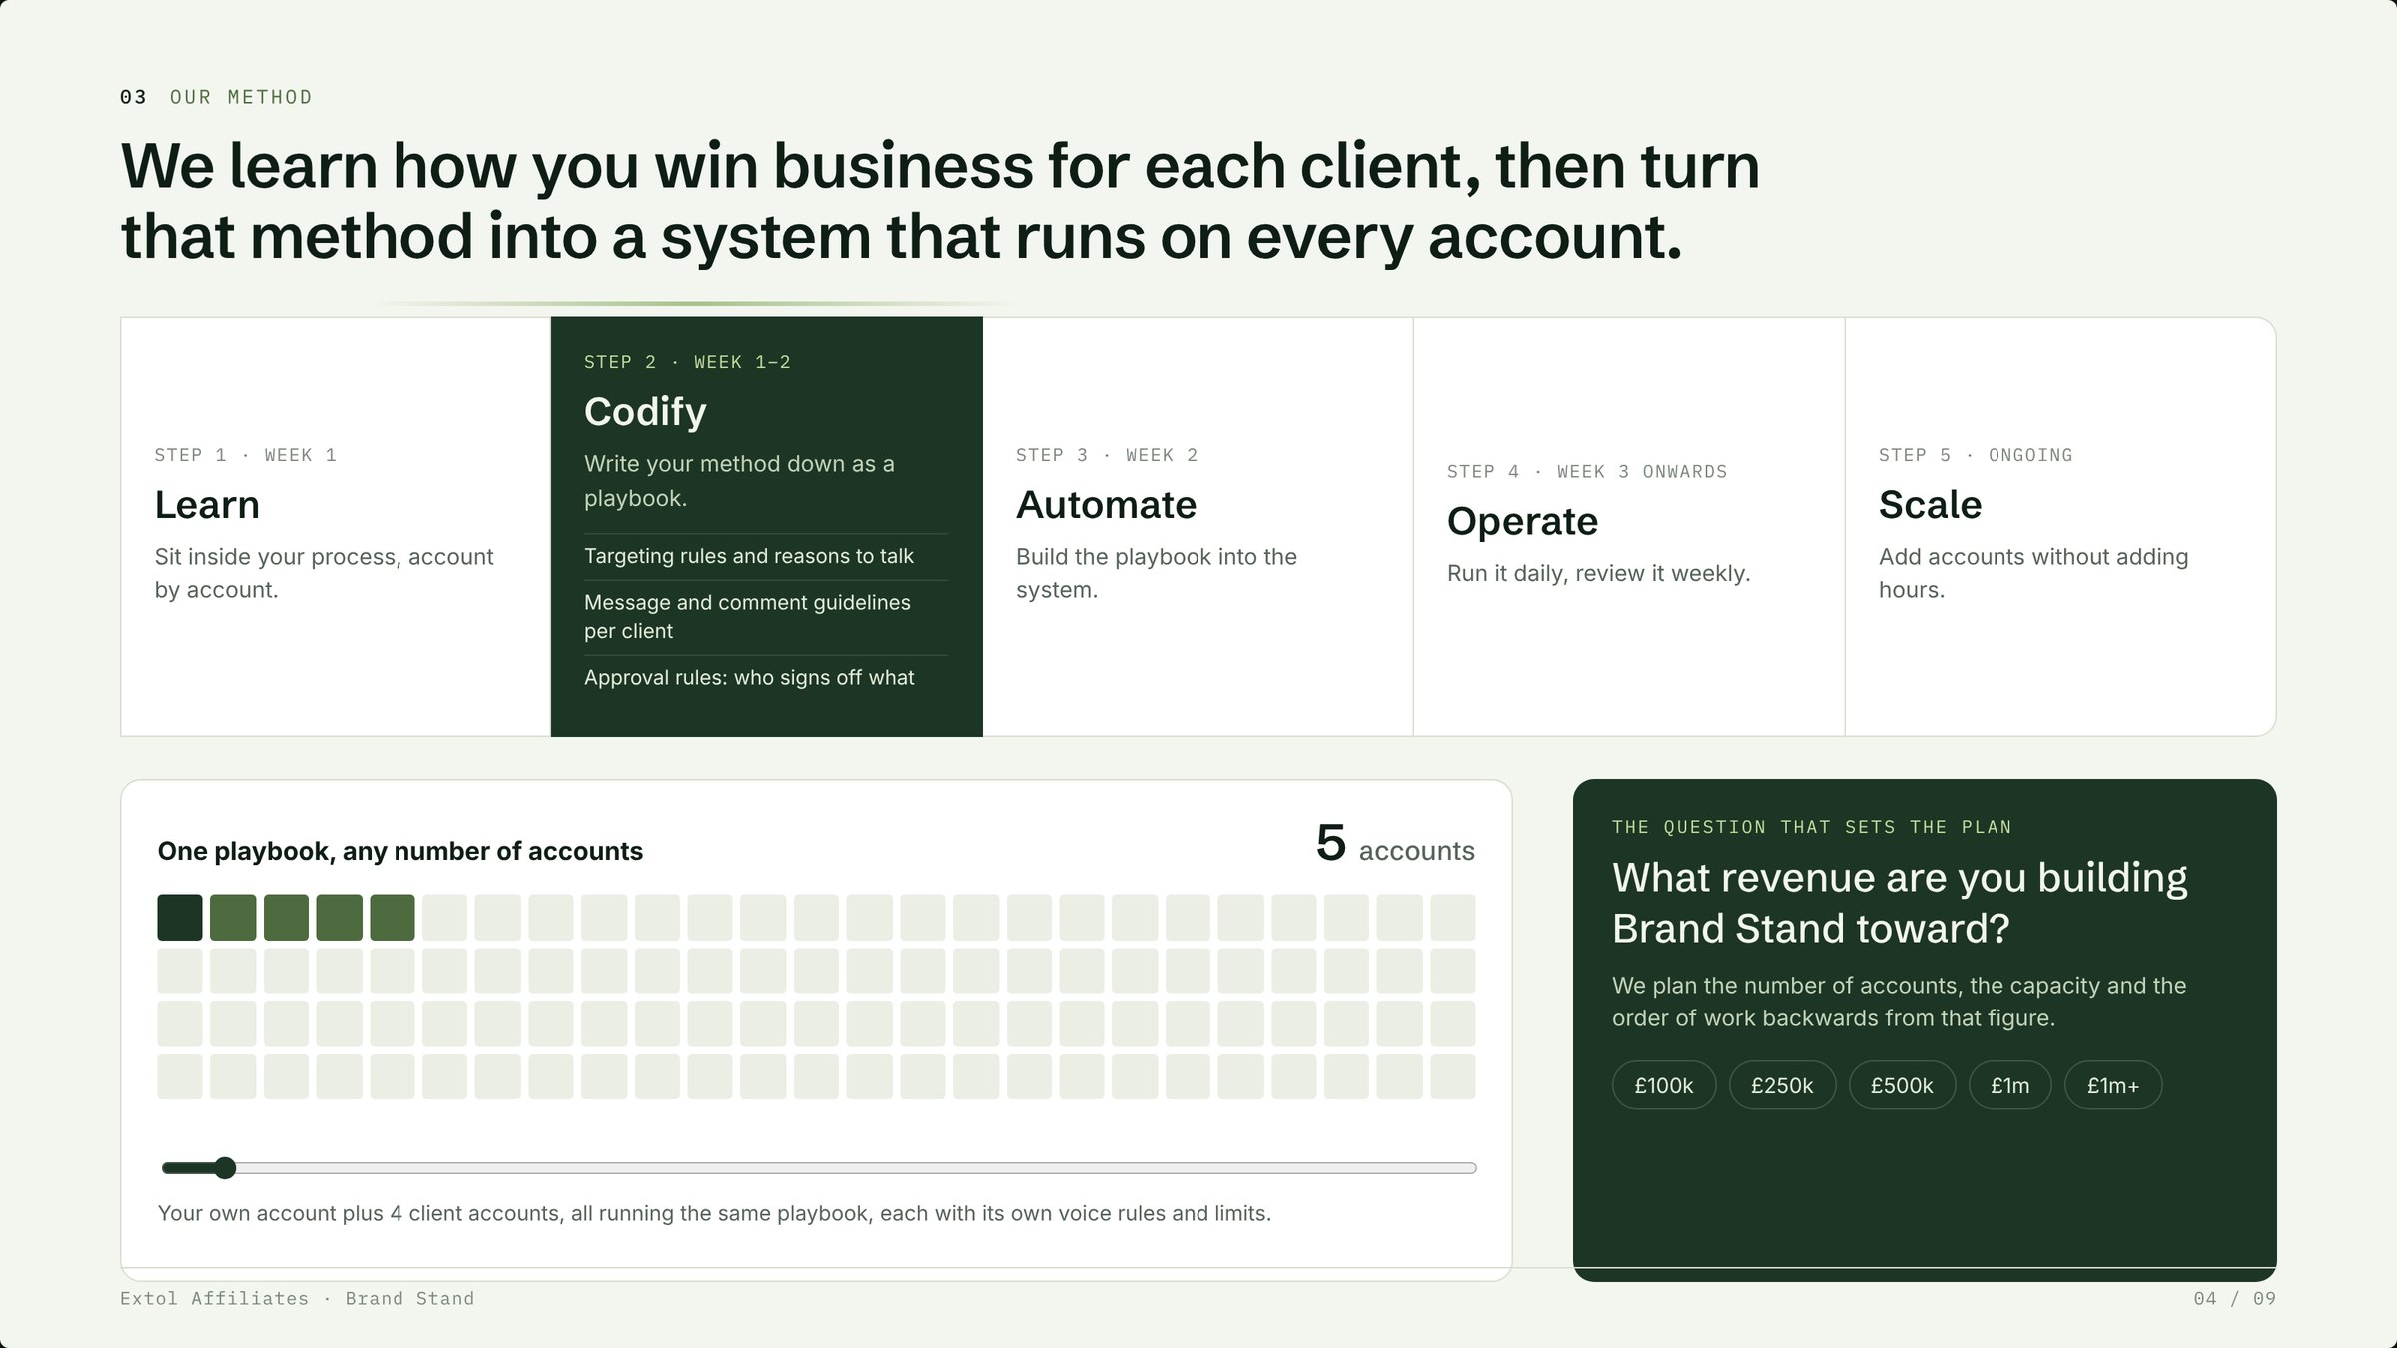
Notes:
Our method: learn her process account by account, write it down as a playbook, automate it, run it, then scale it. Ask the revenue question and plan back from her number.

Slide 5
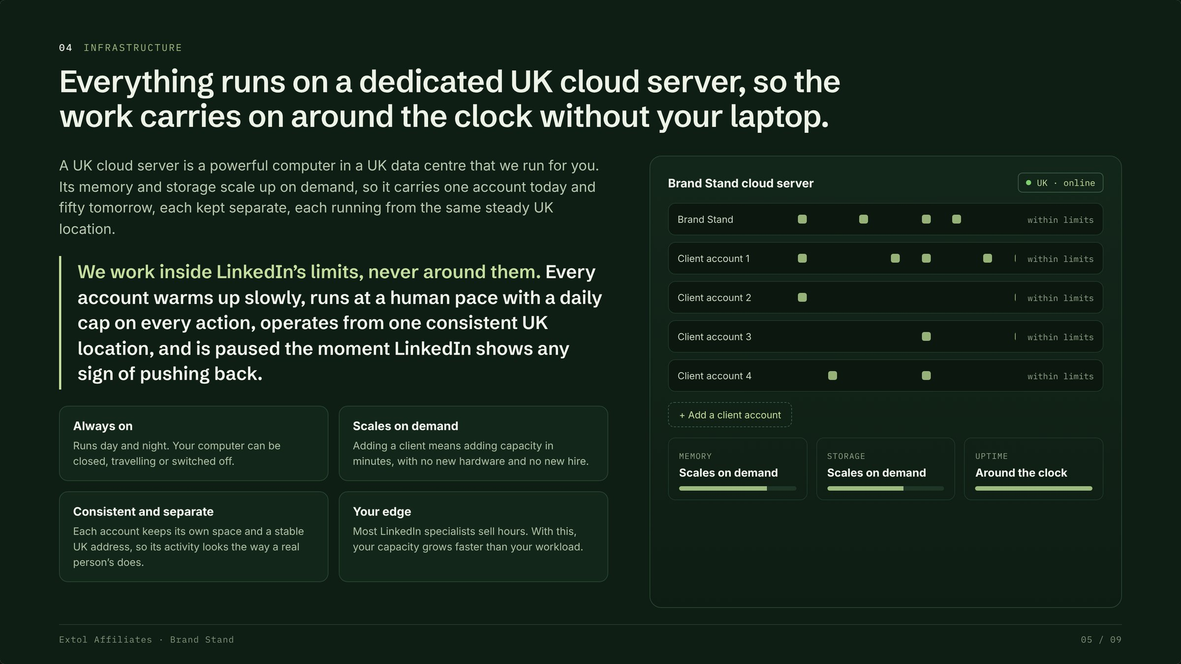
Notes:
The UK cloud server runs everything around the clock. Read the safety statement out loud: we work inside LinkedIn's limits, never around them.

Slide 6
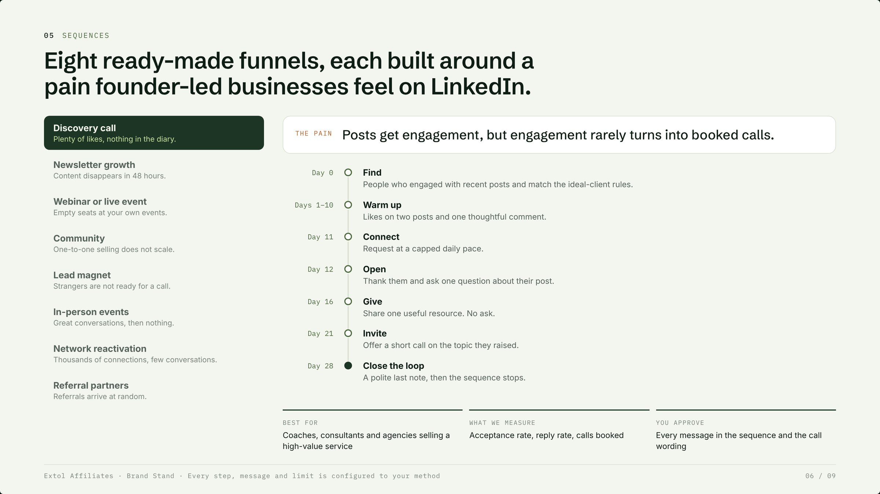
Notes:
Eight ready-made funnels, each built around a real pain. Ask which pain sounds most like her clients.

Slide 7
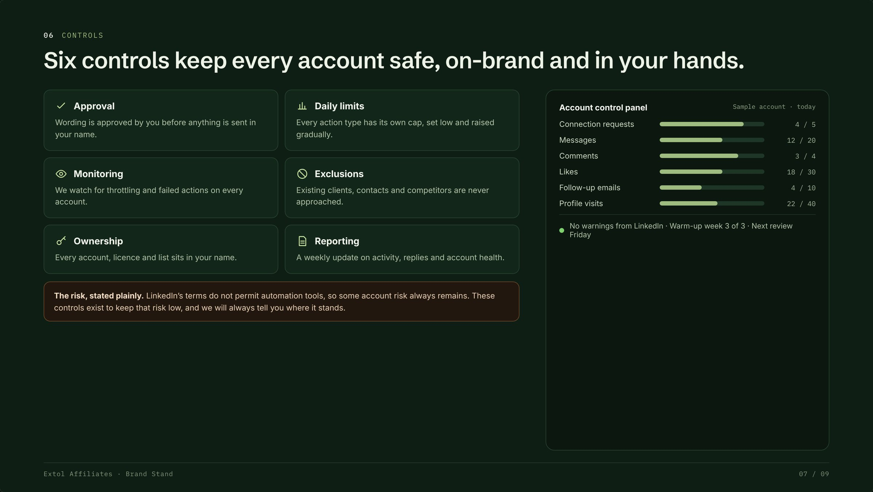
Notes:
Six controls keep accounts safe and on-brand. State the risk plainly and say we will always tell her where it stands.

Slide 8
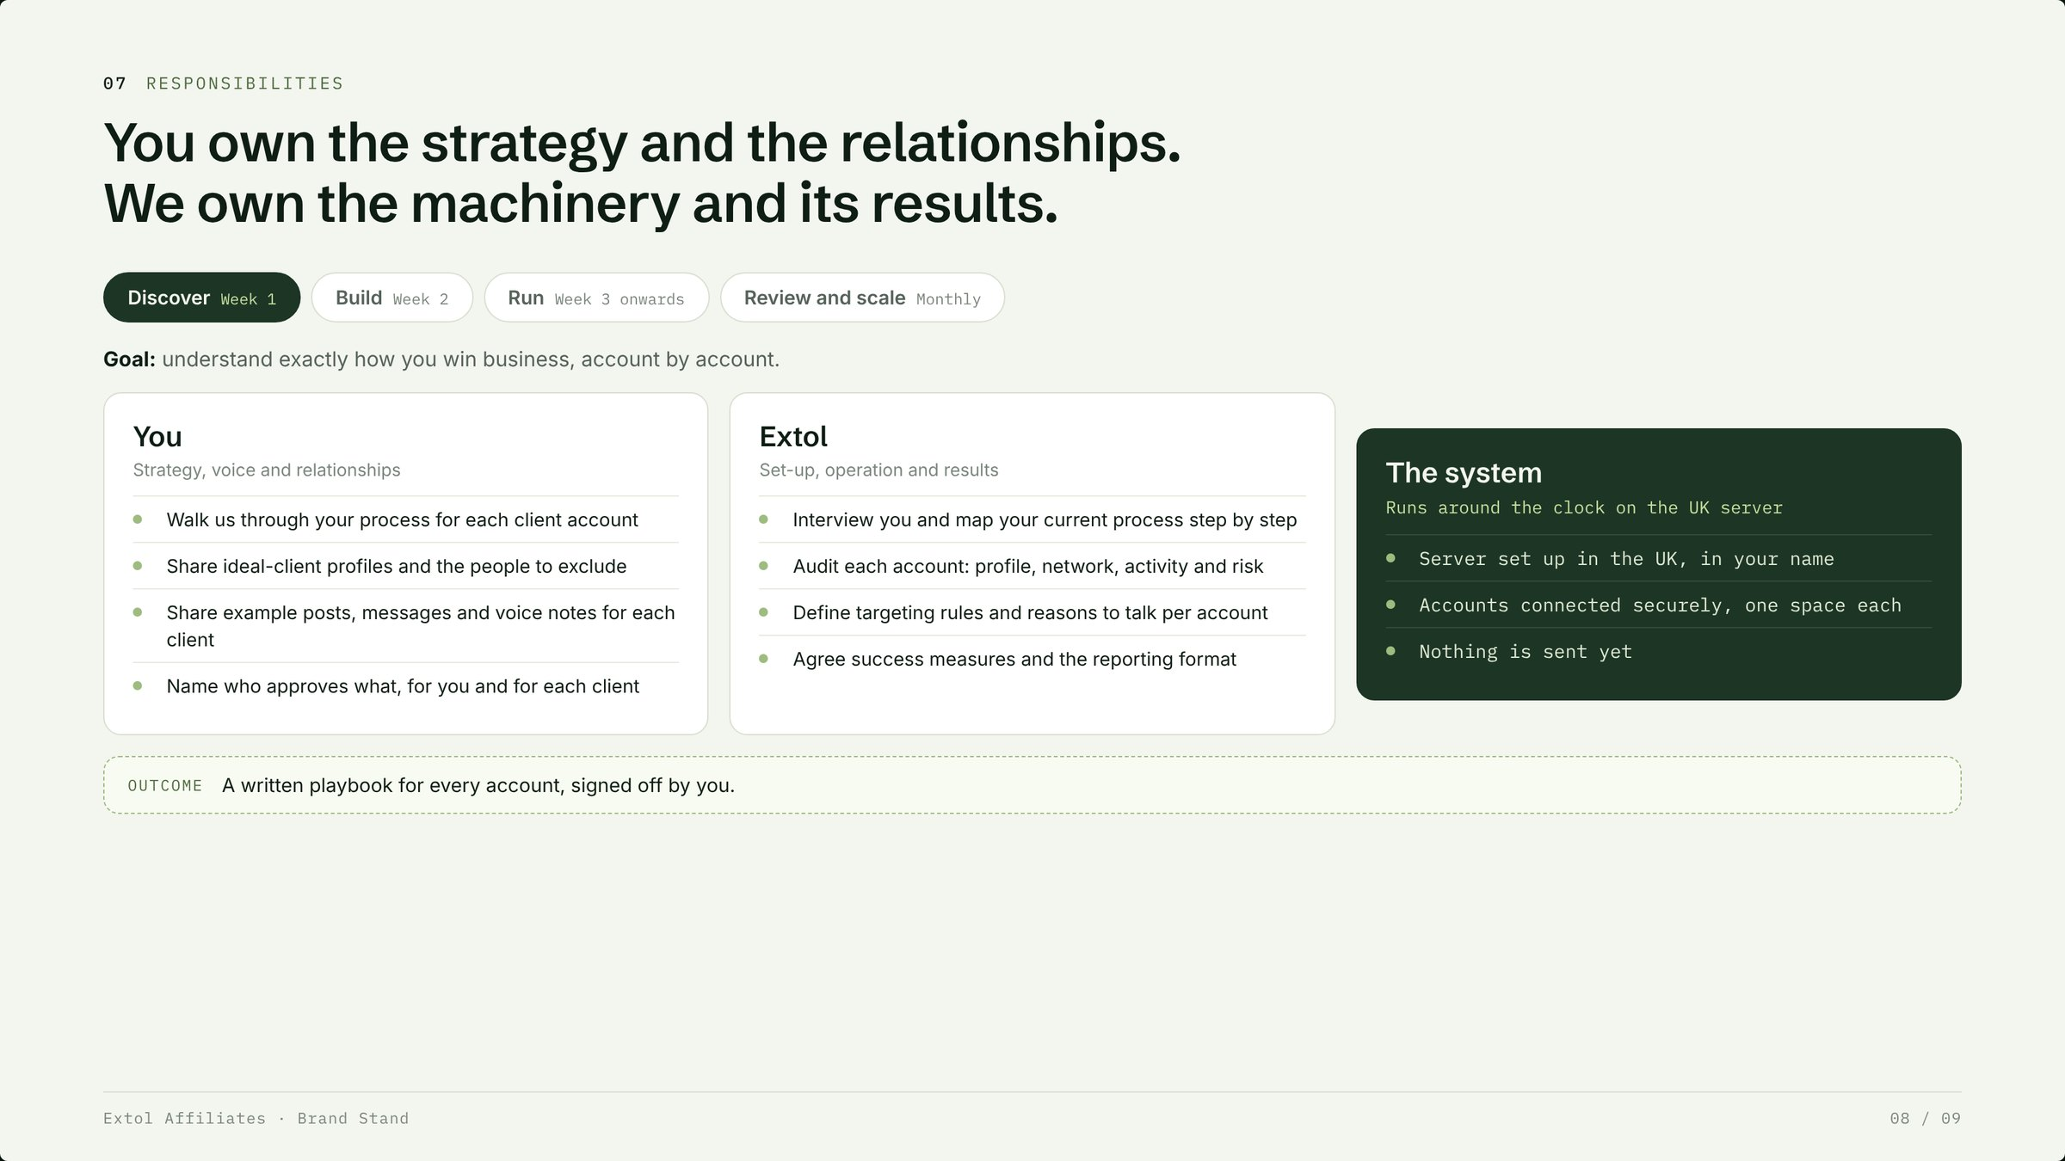
Notes:
Clear split of work across four phases. She owns strategy, voice and relationships; Extol owns set-up, operation and results.

Slide 9
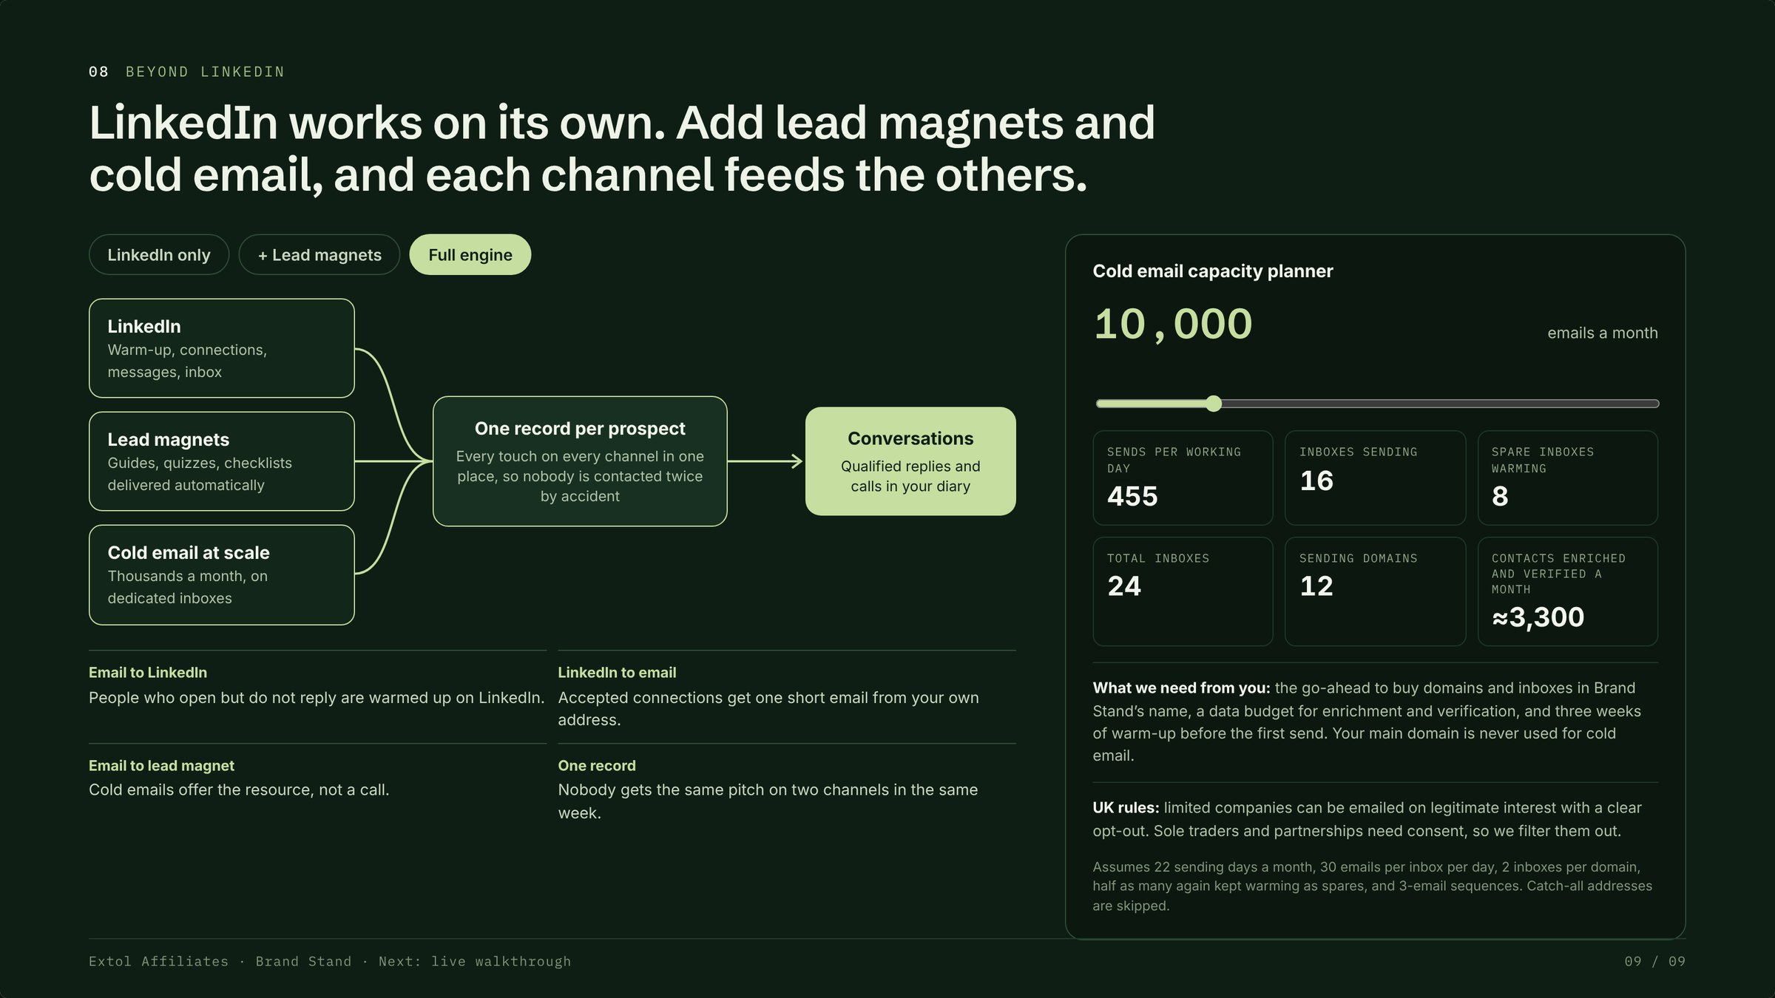
Notes:
LinkedIn works on its own. Lead magnets and cold email make each channel feed the others. Then move to the live walkthrough.

