Slide 1
Extra-P GPR Measurement Point Selection Strategy Evaluation Results
Case-Studies: Relearn, Lulesh, MiniFE, Kripke, FASTEST, Quicksilver

Slide 2
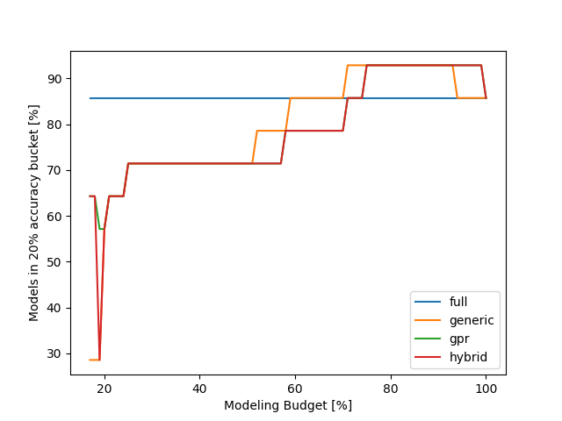
Relearn results
Can be explained by overfitting, less points can lead to a better preditiction on the evaluation point
Using only a minimal budget the gpr and hybrid approach are better than the generic strategy

Slide 3
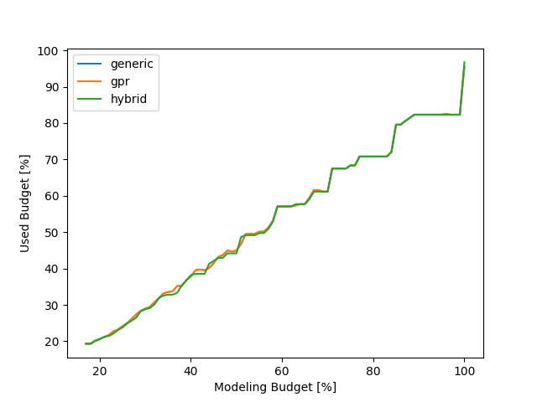
Relearn results
This plot basically shows how well the different strategies use the available modeling budget
???
Maybe I should change this plot to show the difference better…

Slide 4
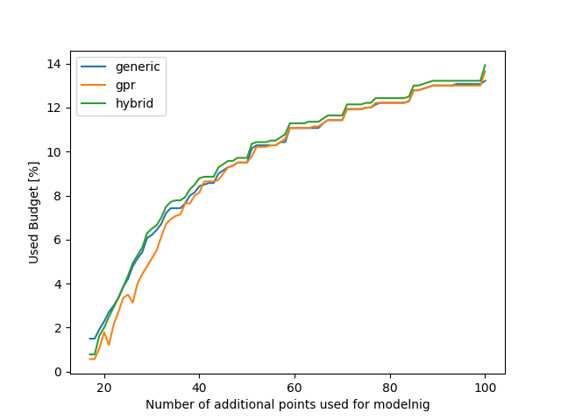
Relearn results
We can get the same accuracy for our models but need to measure less configurations with the GPR strategy…

Slide 5
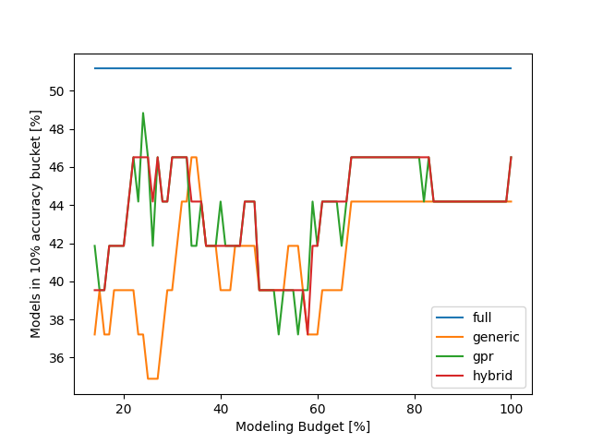
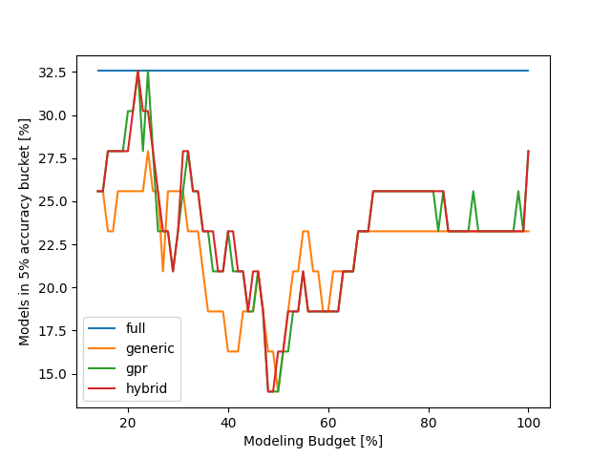
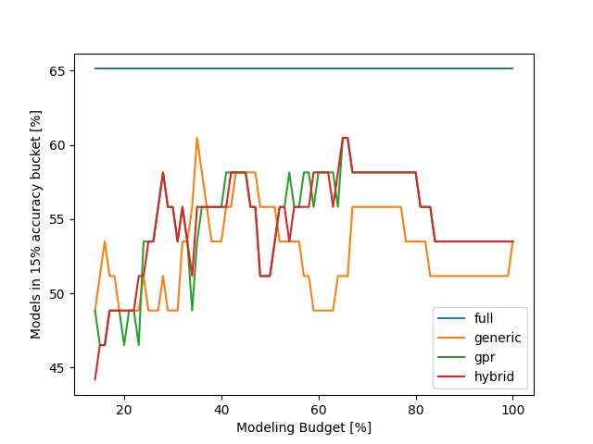
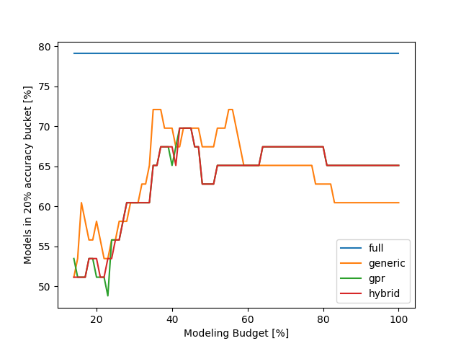
LULESH results - accuracy

Slide 6
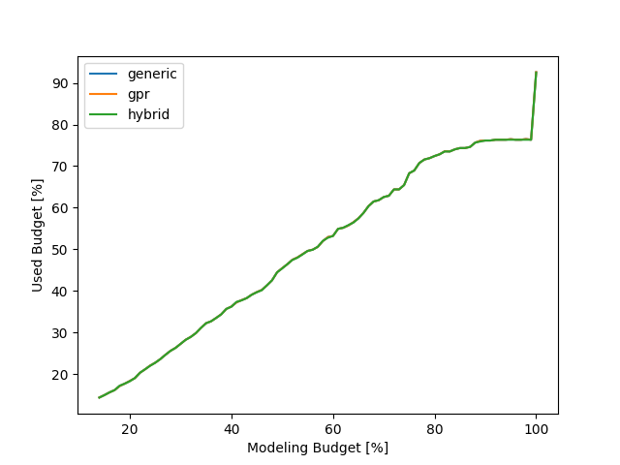
LULESH results - cost

Slide 7
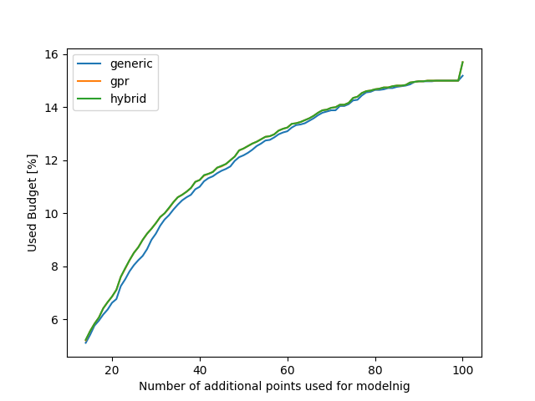
LULESH results – additional points

Slide 8
MiniFE results

Slide 9
MiniFE results

Slide 10
MiniFE results

Slide 11
Kripke results

Slide 12
Kripke results

Slide 13
Kripke results

Slide 14
FASTEST results

Slide 15
FASTEST results

Slide 16
FASTEST results

Slide 17
Quicksilver results

Slide 18
Quicksilver results

Slide 19
Quicksilver results

