Slide 1
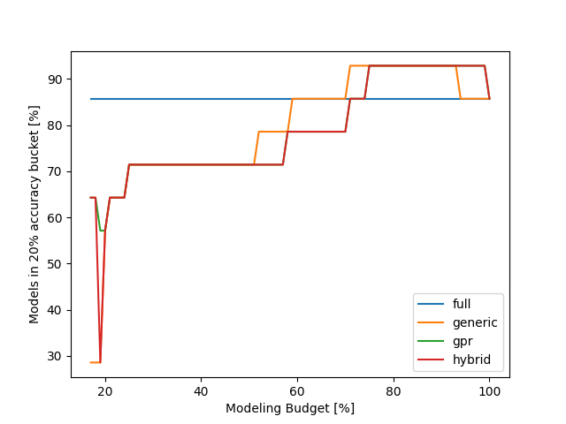
Relearn results
Can be explained by overfitting, less points can lead to a better preditiction on the evaluation point
Using only a minimal budget the gpr and hybrid approach are better than the generic strategy

