Slide 1
Extra-P GPR Measurement Point Selection Strategy Evaluation Results

Slide 2
Questions
Function generation
Which exponents and coefficients to use
Check term contribution or not? For 3+ parameters very time-consuming to find functions where all 3 terms >1% contribution
Parameter values
Function types
Modeler configuration
Number of terms per parameter
Exponents

Slide 3
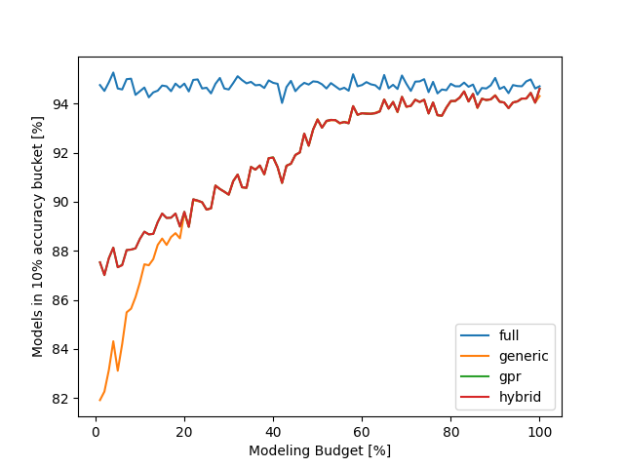
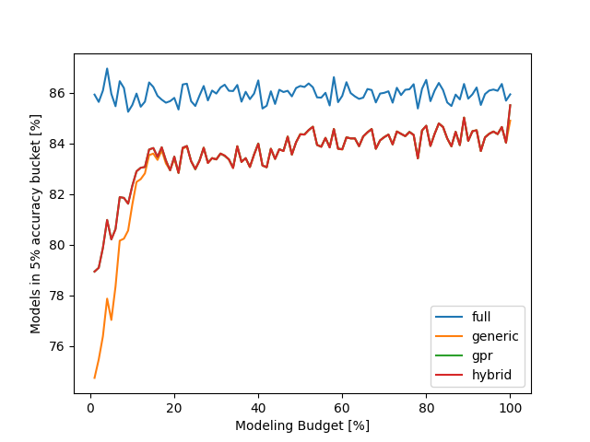
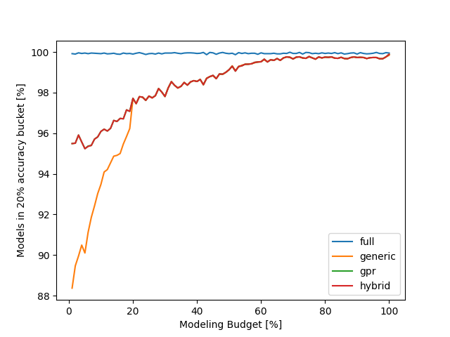
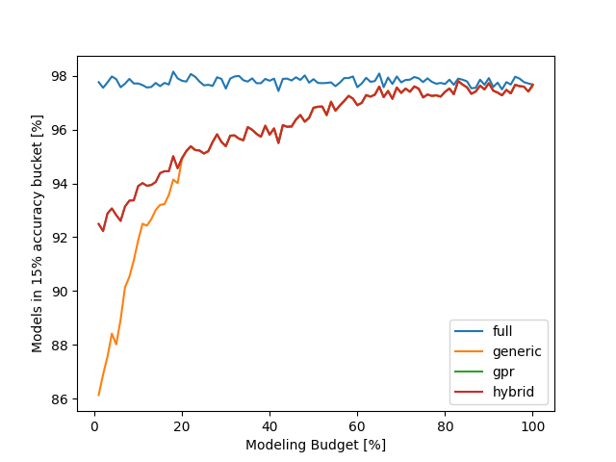
Synthetic Evaluation – 1% noise

Slide 4
Synthetic Evaluation – 2% noise
Text

Slide 5
Synthetic Evaluation – 5% noise
Text

Slide 6
Synthetic Evaluation – 10% noise
Text

Slide 7
Case Studies
Relearn
Lulesh
MiniFE
Kripke
FASTEST
Quicksilver

Slide 8
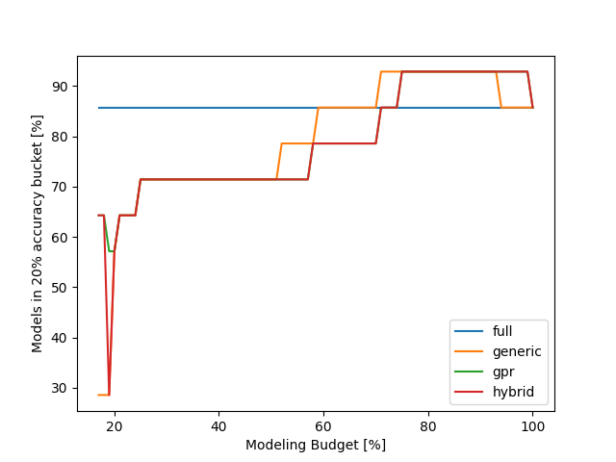
Relearn results
Can be explained by overfitting, less points can lead to a better preditiction on the evaluation point
Using only a minimal budget the gpr and hybrid approach are better than the generic strategy

Slide 9
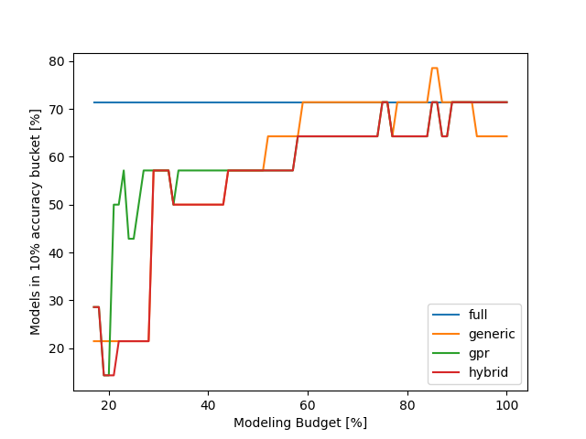
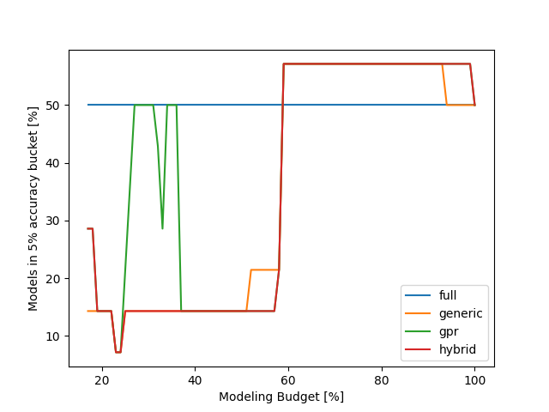
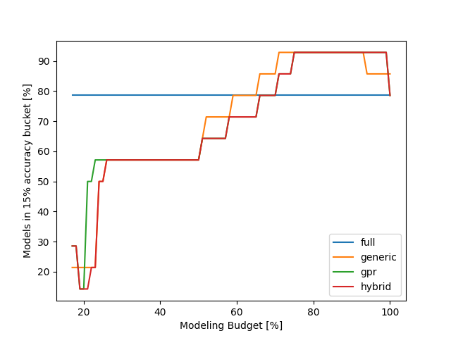
Relearn results

Slide 10
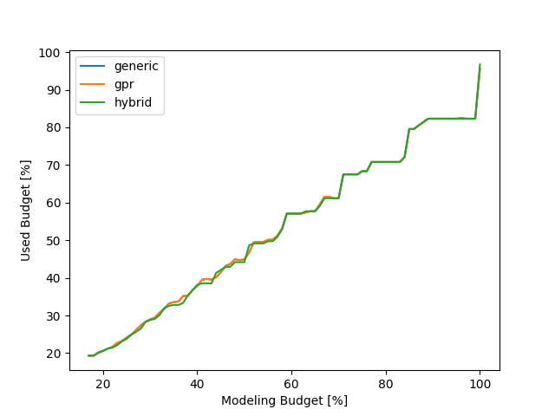
Relearn results
This plot basically shows how well the different strategies use the available modeling budget
???
Maybe I should change this plot to show the difference better…

Slide 11
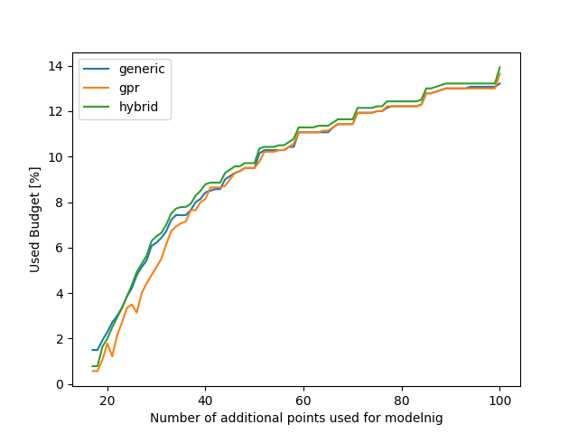
Relearn results
We can get the same accuracy for our models but need to measure less configurations with the GPR strategy…

Slide 12
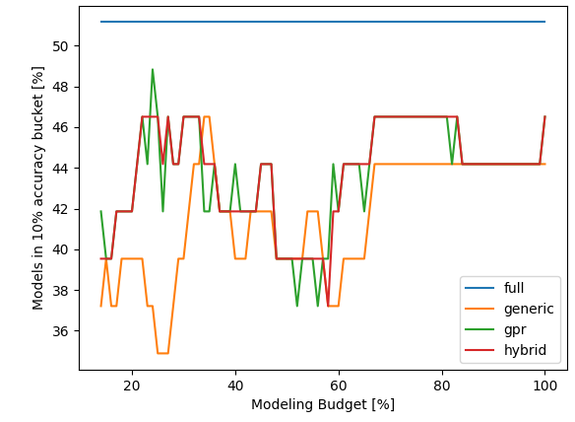
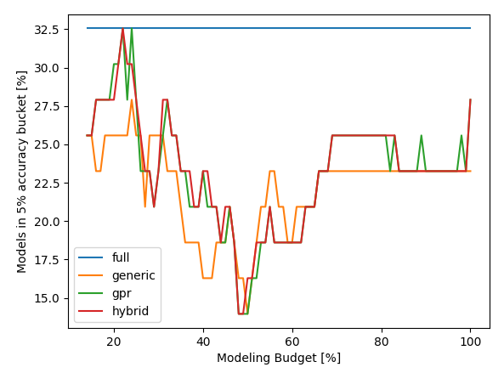
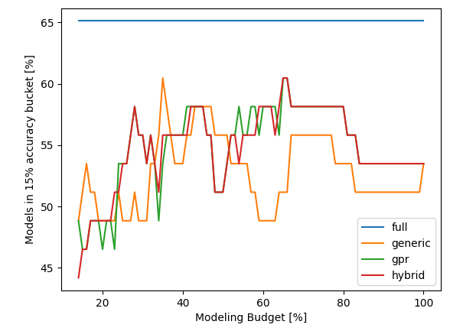
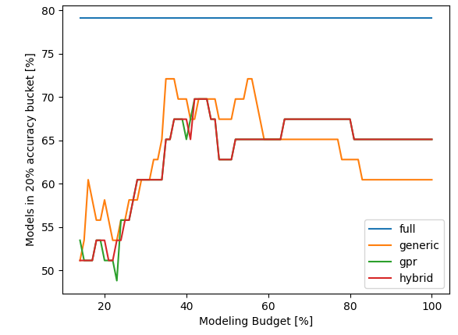
LULESH results - accuracy
Text

Slide 13
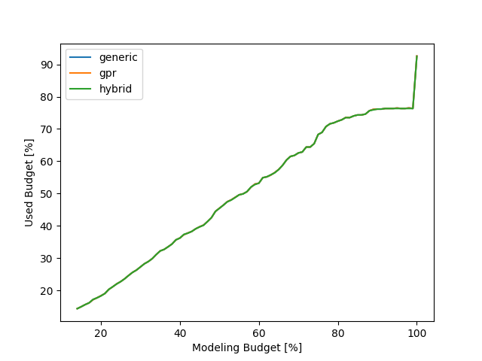
LULESH results - cost

Slide 14
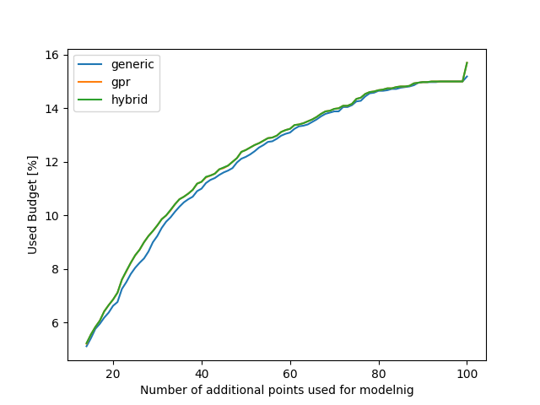
LULESH results – additional points

Slide 15
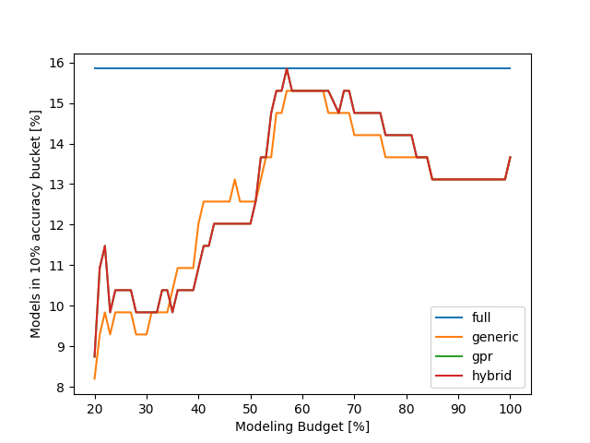
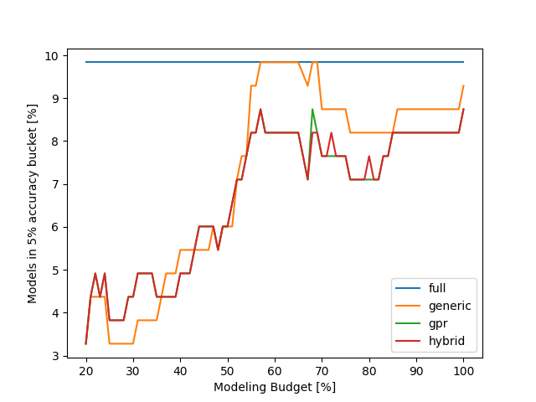
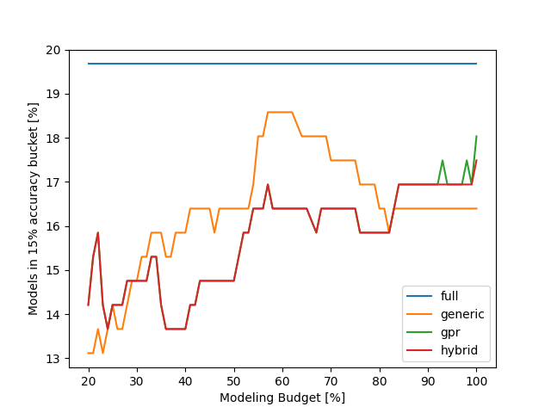
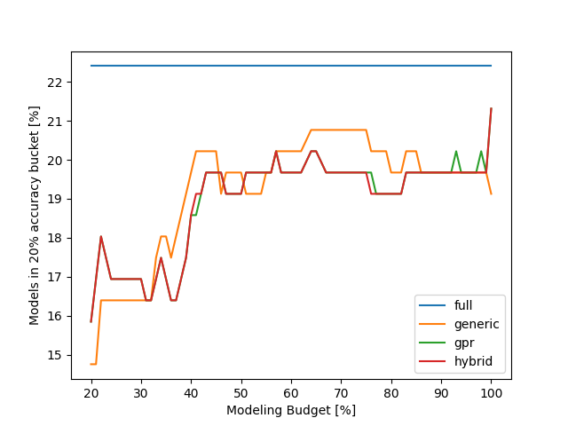
MiniFE results - accuracy

Slide 16
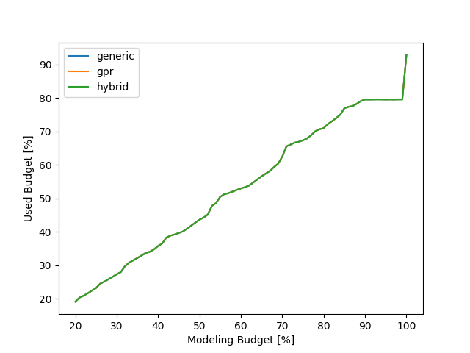
MiniFE results - cost

Slide 17
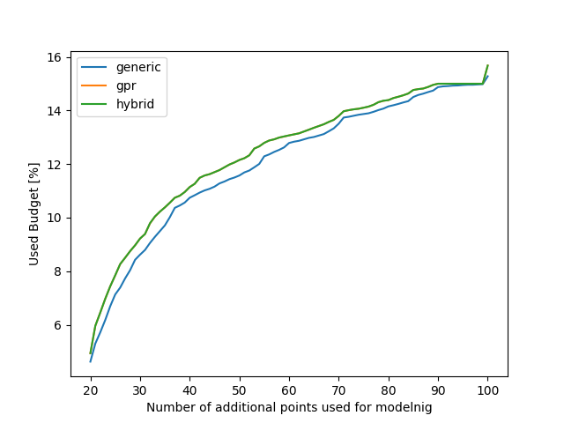
MiniFE results – additional points

Slide 18
Kripke results

Slide 19
Kripke results

Slide 20
Kripke results

Slide 21
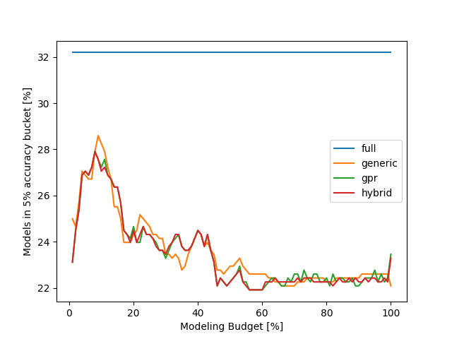
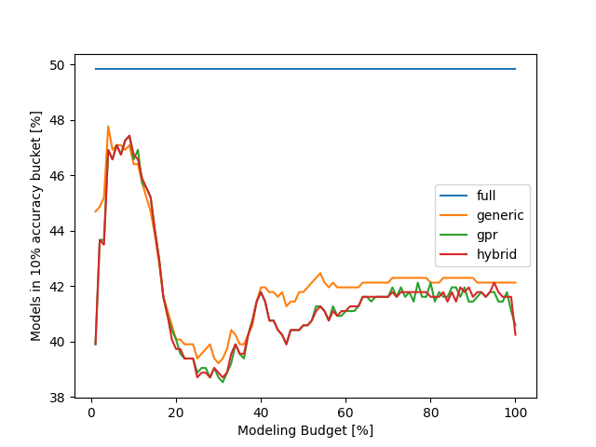
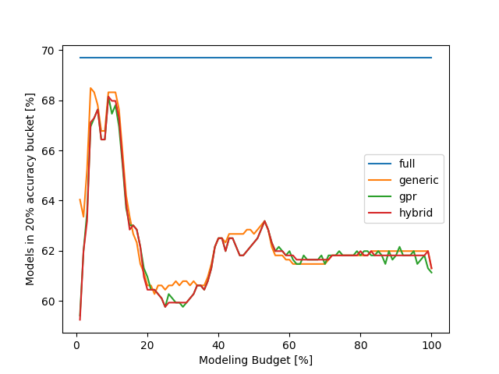
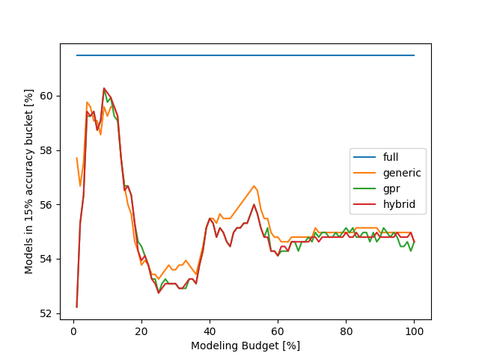
FASTEST results - accuracy

Slide 22
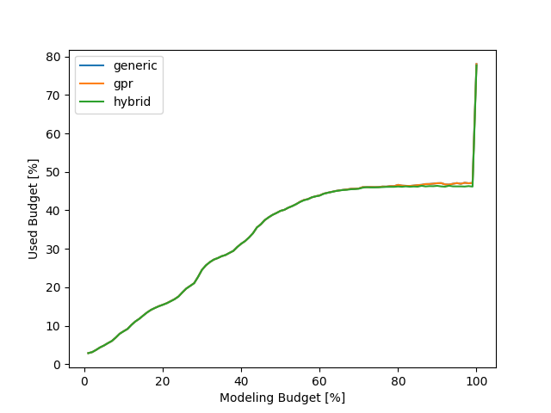
FASTEST results - cost

Slide 23
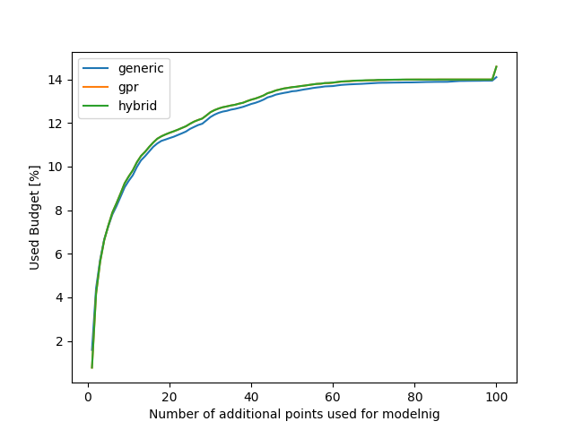
FASTEST results – additional points

Slide 24
Quicksilver results

Slide 25
Quicksilver results

Slide 26
Quicksilver results

