Slide 1
Extra-P GPR Measurement Point Selection Strategy Evaluation Results

Slide 2
Questions
Function generation
Which exponents and coefficients to use
Check term contribution or not? For 3+ parameters very time-consuming to find functions where all 3 terms >1% contribution
Parameter values
Function types
Modeler configuration
Number of terms per parameter
Exponents

Slide 3
Synthetic Evaluation
Text

Slide 4
Case Studies
Relearn
Lulesh
MiniFE
Kripke
FASTEST
Quicksilver

Slide 5
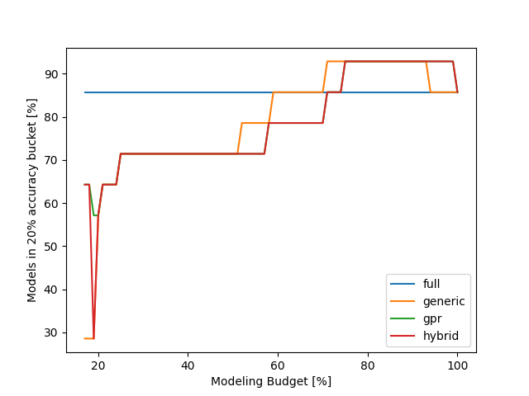
Relearn results
Can be explained by overfitting, less points can lead to a better preditiction on the evaluation point
Using only a minimal budget the gpr and hybrid approach are better than the generic strategy

Slide 6
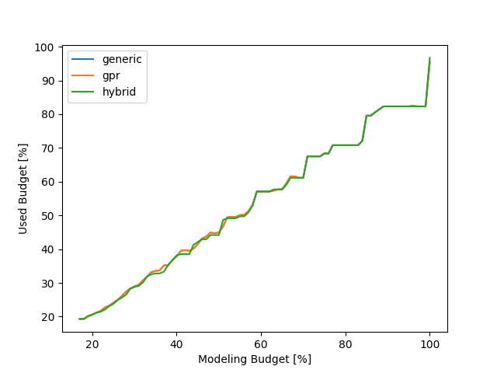
Relearn results
This plot basically shows how well the different strategies use the available modeling budget
???
Maybe I should change this plot to show the difference better…

Slide 7
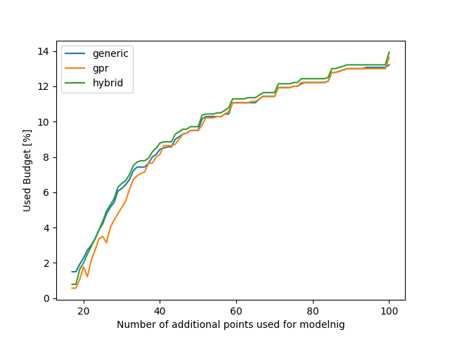
Relearn results
We can get the same accuracy for our models but need to measure less configurations with the GPR strategy…

Slide 8
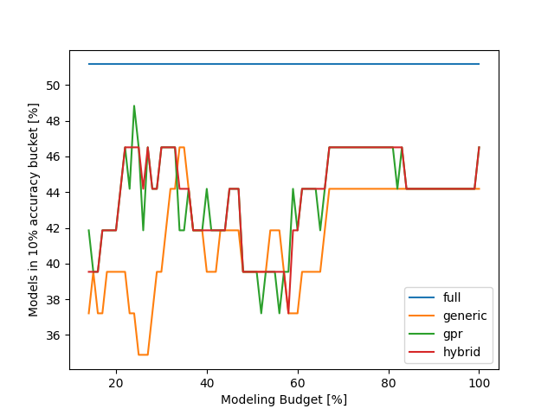
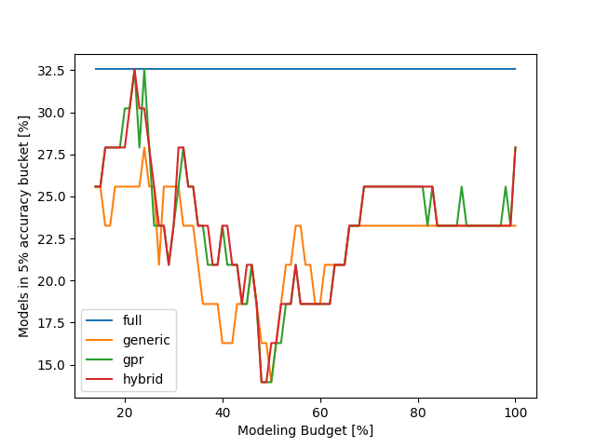
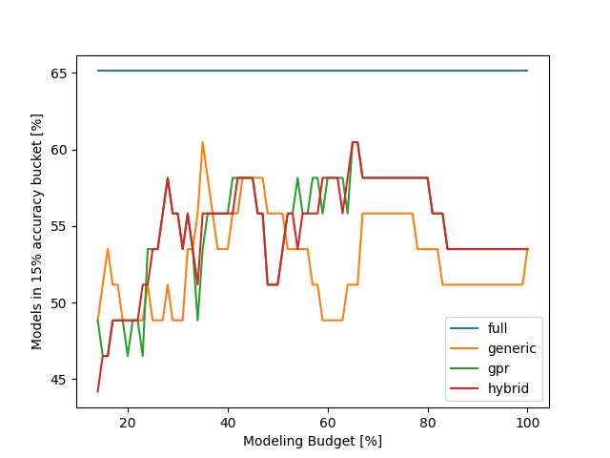
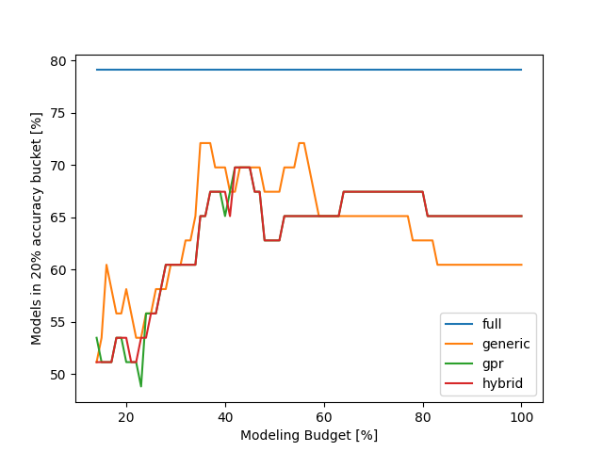
LULESH results - accuracy

Slide 9
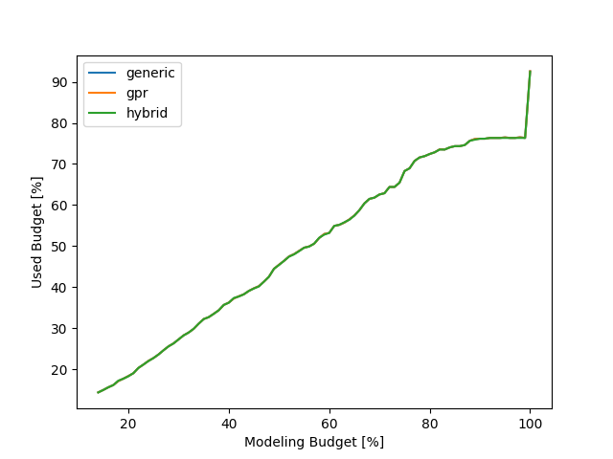
LULESH results - cost

Slide 10
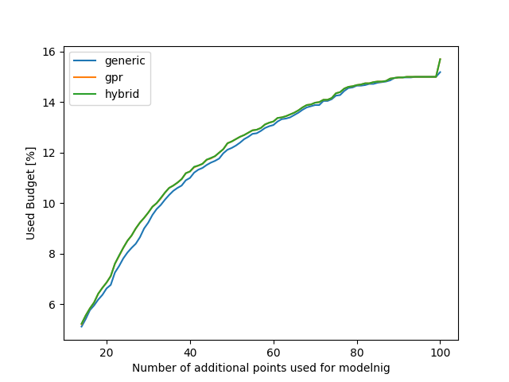
LULESH results – additional points

Slide 11
MiniFE results

Slide 12
MiniFE results

Slide 13
MiniFE results

Slide 14
Kripke results

Slide 15
Kripke results

Slide 16
Kripke results

Slide 17
FASTEST results

Slide 18
FASTEST results

Slide 19
FASTEST results

Slide 20
Quicksilver results

Slide 21
Quicksilver results

Slide 22
Quicksilver results

