Slide 1
RELEARN Analysis Results
CPF, GPR, Hybrid measurement point selection strategy
~1% noise on RELEARN measurements (Lichtenberg cluster)

Slide 2
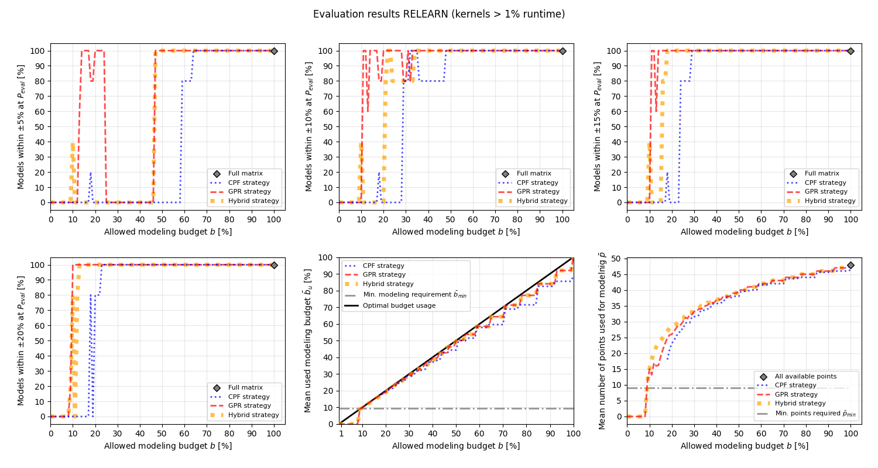

Slide 3
