Slide 1
Extra-P GPR Measurement Point Selection Strategy Evaluation Results

Slide 2
Questions
Function generation
Which exponents and coefficients to use
Check term contribution or not? For 3+ parameters very time-consuming to find functions where all 3 terms >1% contribution
Parameter values
Function types
Modeler configuration
Number of terms per parameter
Exponents

Slide 3
Synthetic Evaluation
Text

Slide 4
Case Studies
Relearn
Lulesh
MiniFE
Kripke
FASTEST
Quicksilver

Slide 5
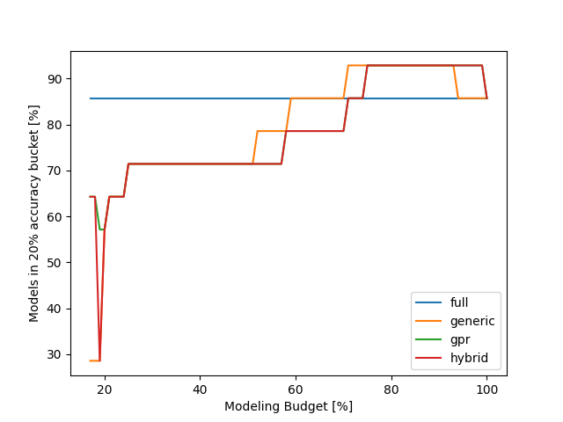
Relearn results
Can be explained by overfitting, less points can lead to a better preditiction on the evaluation point
Using only a minimal budget the gpr and hybrid approach are better than the generic strategy

Slide 6
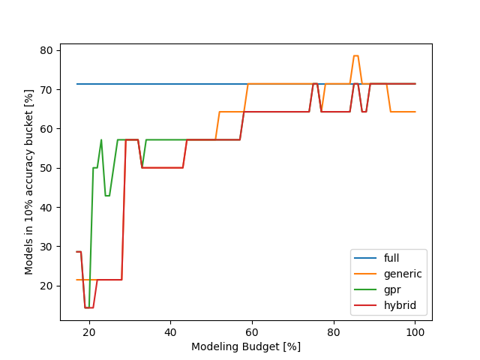
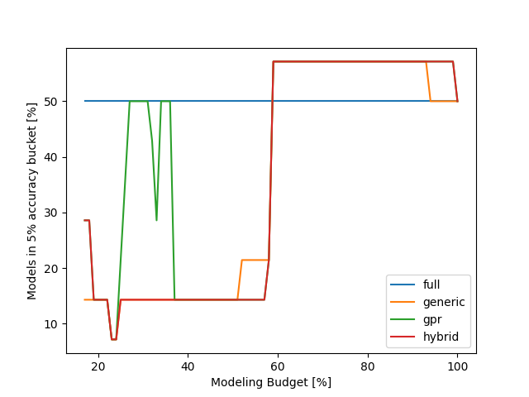
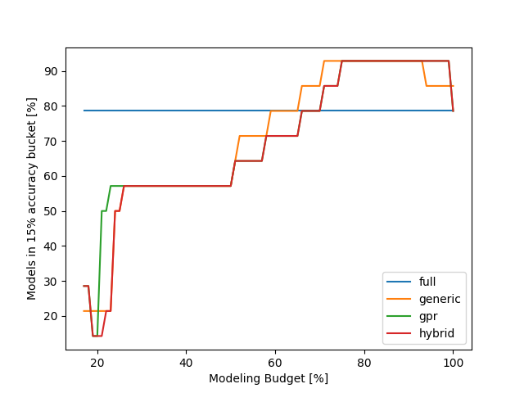
Relearn results

Slide 7
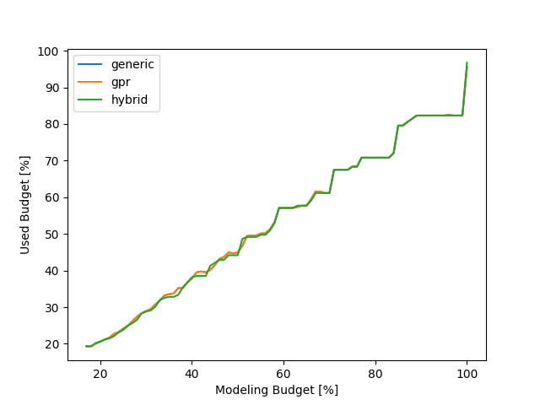
Relearn results
This plot basically shows how well the different strategies use the available modeling budget
???
Maybe I should change this plot to show the difference better…

Slide 8
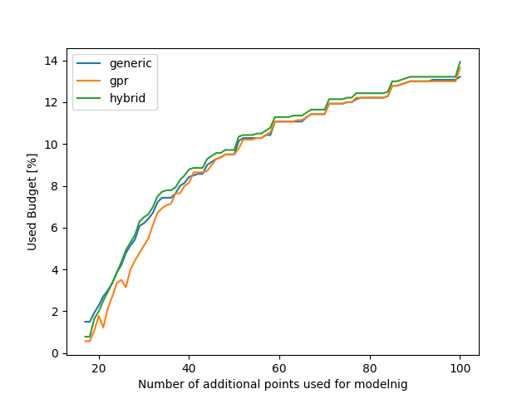
Relearn results
We can get the same accuracy for our models but need to measure less configurations with the GPR strategy…

Slide 9
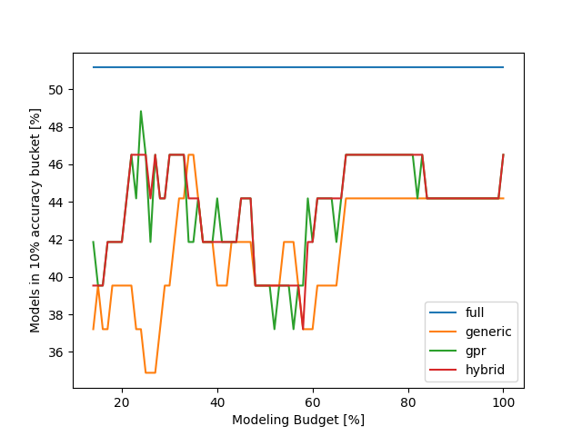
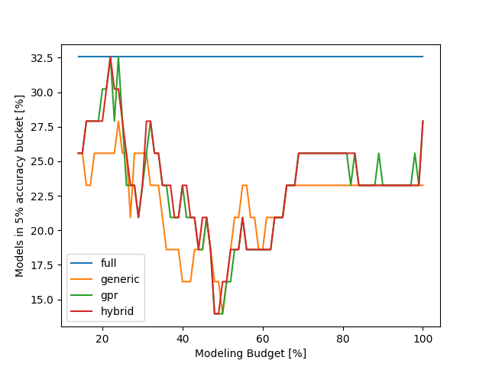
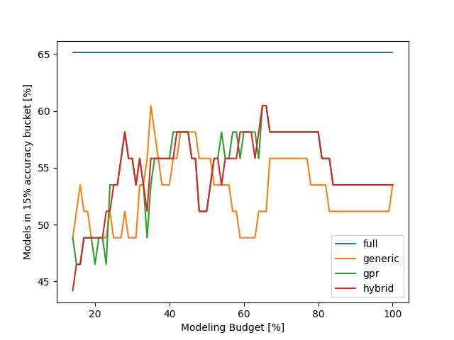
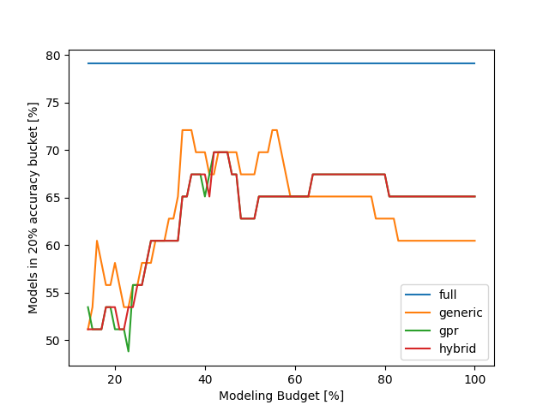
LULESH results - accuracy

Slide 10
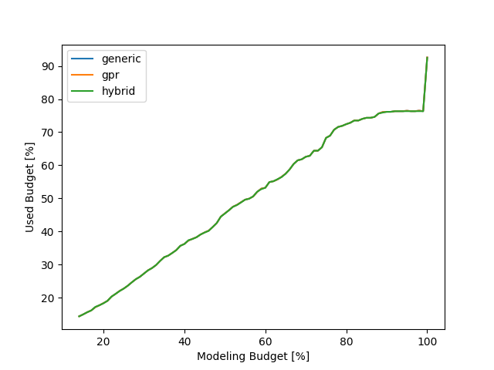
LULESH results - cost

Slide 11
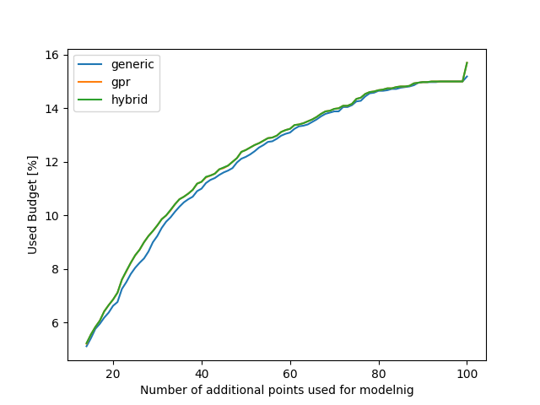
LULESH results – additional points

Slide 12
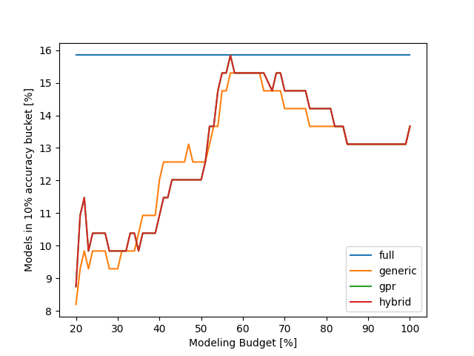
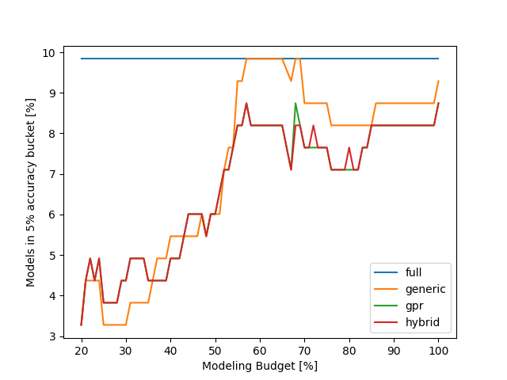
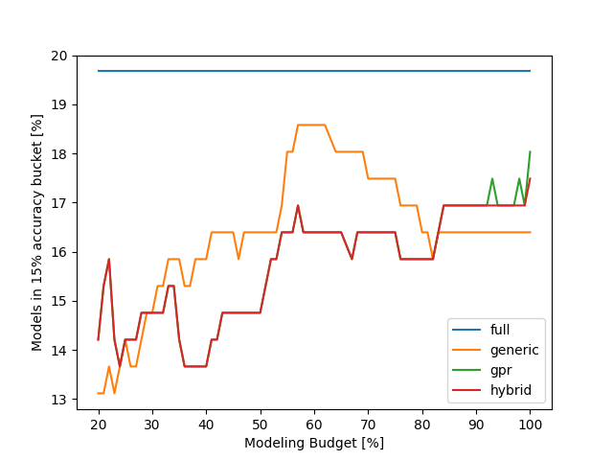
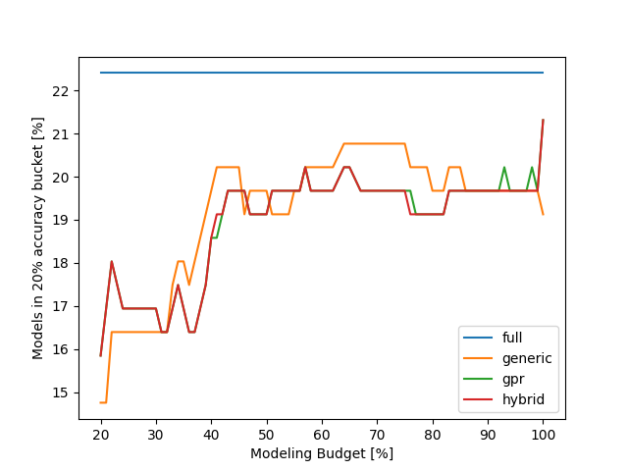
MiniFE results - accuracy

Slide 13
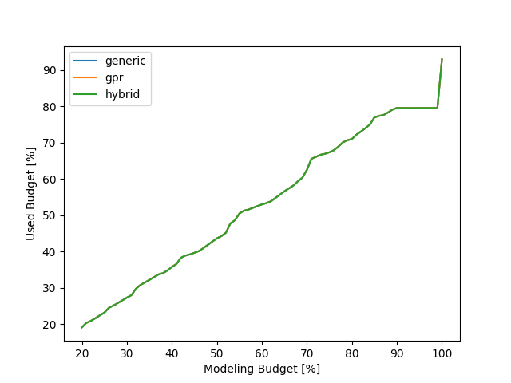
MiniFE results - cost

Slide 14
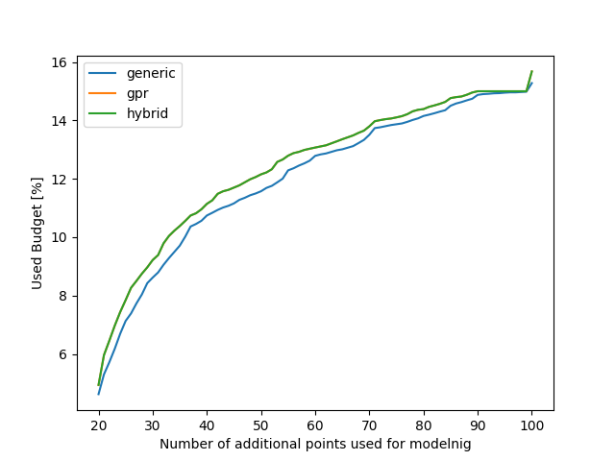
MiniFE results – additional points

Slide 15
Kripke results

Slide 16
Kripke results

Slide 17
Kripke results

Slide 18
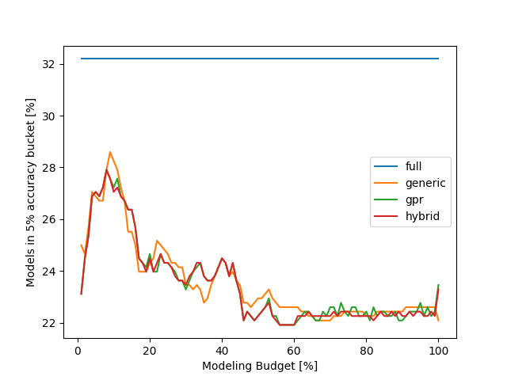
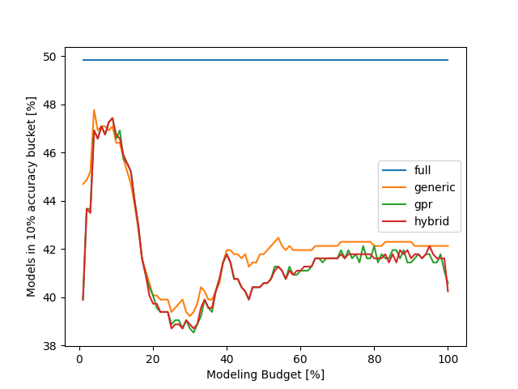
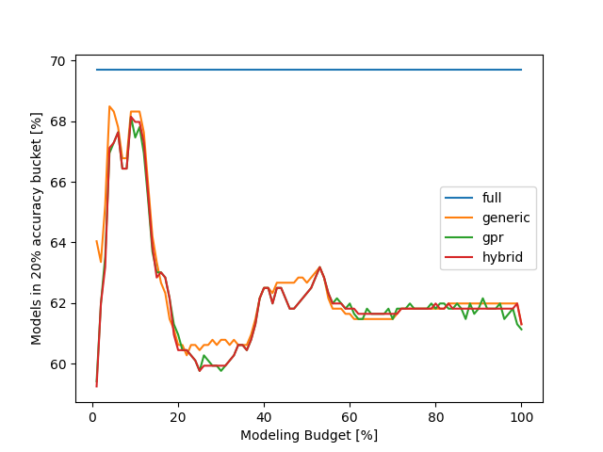
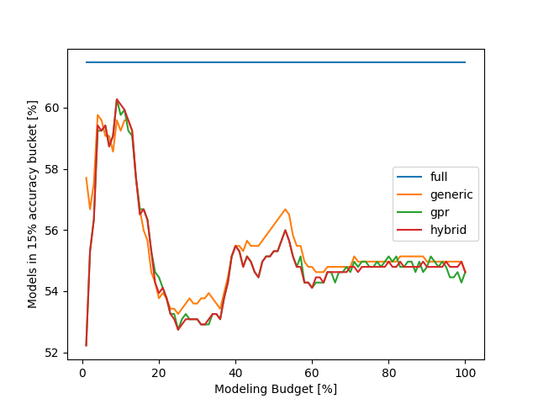
FASTEST results - accuracy

Slide 19
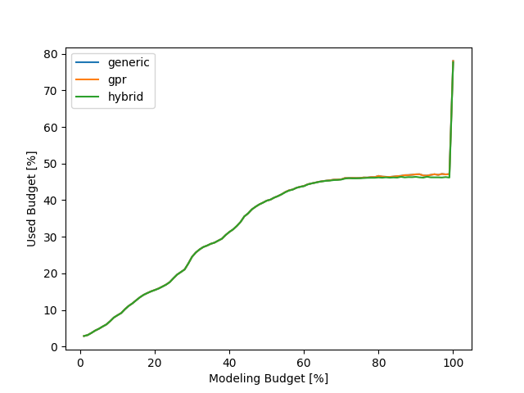
FASTEST results - cost

Slide 20
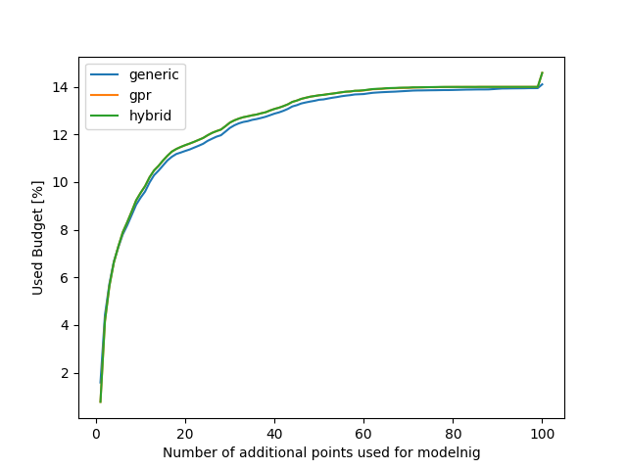
FASTEST results – additional points

Slide 21
Quicksilver results

Slide 22
Quicksilver results

Slide 23
Quicksilver results

