Slide 1
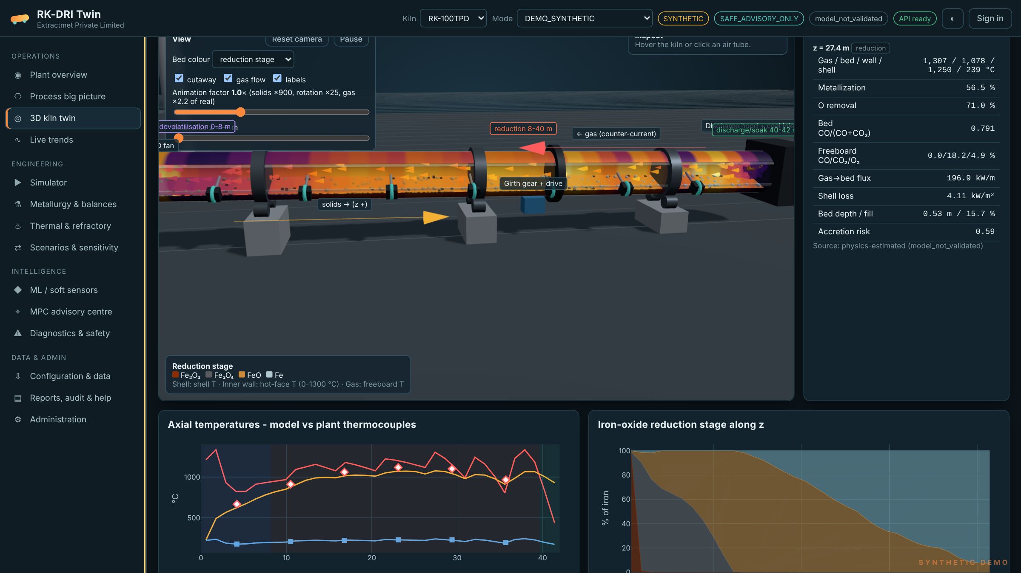
RK-DRI Twin
Digital twin, process simulator and safe advisory control for coal-based rotary-kiln DRI plants
Physics first. Explainable AI. Operator in charge.
Extractmet Private Limited
Deep-tech pyrometallurgy company incubated at IIT Madras Research Park
Notes:
Open with the promise: a calibrated physics model of the customer's kiln that operators can trust, plus advisory recommendations that never touch the PLC without the plant's own approval gateway.

Slide 2
One twin for the whole kiln: from pellet feed to stack
~55 Mt
50-500
10⁻¹⁵
India sponge-iron output, FY25 estimate - the world's largest DRI producer, mostly coal-based kilns
TPD kiln classes configured out of the box (geometry, lining, air tubes, feeds)
relative element-balance closure in every solver audit - results that add up
What it does: simulates metallization, coal use, temperatures, gas and heat losses along the kiln; estimates hidden states from plant sensors; recommends setpoint moves with confidence bands.
How it is different: a conservation-checked first-principles engine underneath every ML and MPC number, and an advisory-only safety boundary by design.
Market figures: Mysteel (FY25 estimate ~55 Mt) and BigMint (H1 FY26 ~29 Mt, +9 % y-o-y). Closure figure: RK-DRI Twin validation report (synthetic configuration).

Slide 3
Kiln operators steer by delayed, partial information
1
Coal is the biggest cost
Specific coal and the feed/injection split are set by experience; small air changes swing heat release and char burn-off.
2
Quality is seen hours late
Metallization comes from lab samples taken after a multi-hour solids transit - decisions lag the process.
3
Accretion and hot spots
Ring formation and refractory hot spots reduce throughput and force shutdowns; warning signs are weak.
4
Energy leaves with the off-gas
Exit-gas sensible heat, unburnt char and shell loss are rarely quantified together.
5
Safety must not be compromised
CO, draft and coal-dust hazards mean any optimisation must respect site interlocks absolutely.

Slide 4
Four layers, one source of truth
Physics core
Counter-current 1-D finite-volume kiln: 23 balanced reactions, pellet reduction kinetics, char gasification, heat transfer, refractory
Operator desk
14 screens: overview, process big picture, 3D kiln, trends, simulator, balances, thermal, scenarios, ML, MPC, diagnostics, data, reports, admin
Browser-based, deploys as two GitHub repos (FastAPI backend + static frontend) on Render or on-premises
Every value labelled measured, physics-estimated, ML-predicted or projected
State estimation
Kalman filter fuses thermocouples, shell scanner, gas analyser and delayed lab results; flags faulty sensors
Machine learning
Soft sensor, bounded physics-residual correction, anomaly and accretion-precursor detection
Advisory MPC
Receding-horizon optimiser: five objectives, actuator limits, safety gates, operator approval

Slide 5
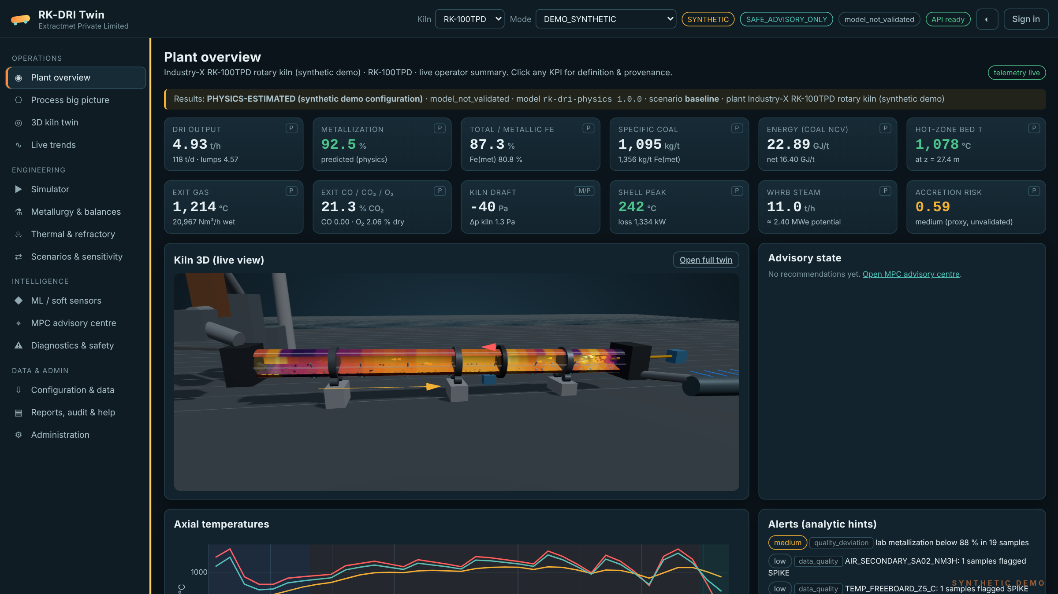
The control-room view: twelve KPIs, live kiln, alerts
Click any KPI
for its definition, provenance and run ID
Live 3D kiln
coloured by backend temperature arrays
Analytic alerts
kept separate from site safety alarms

Slide 6
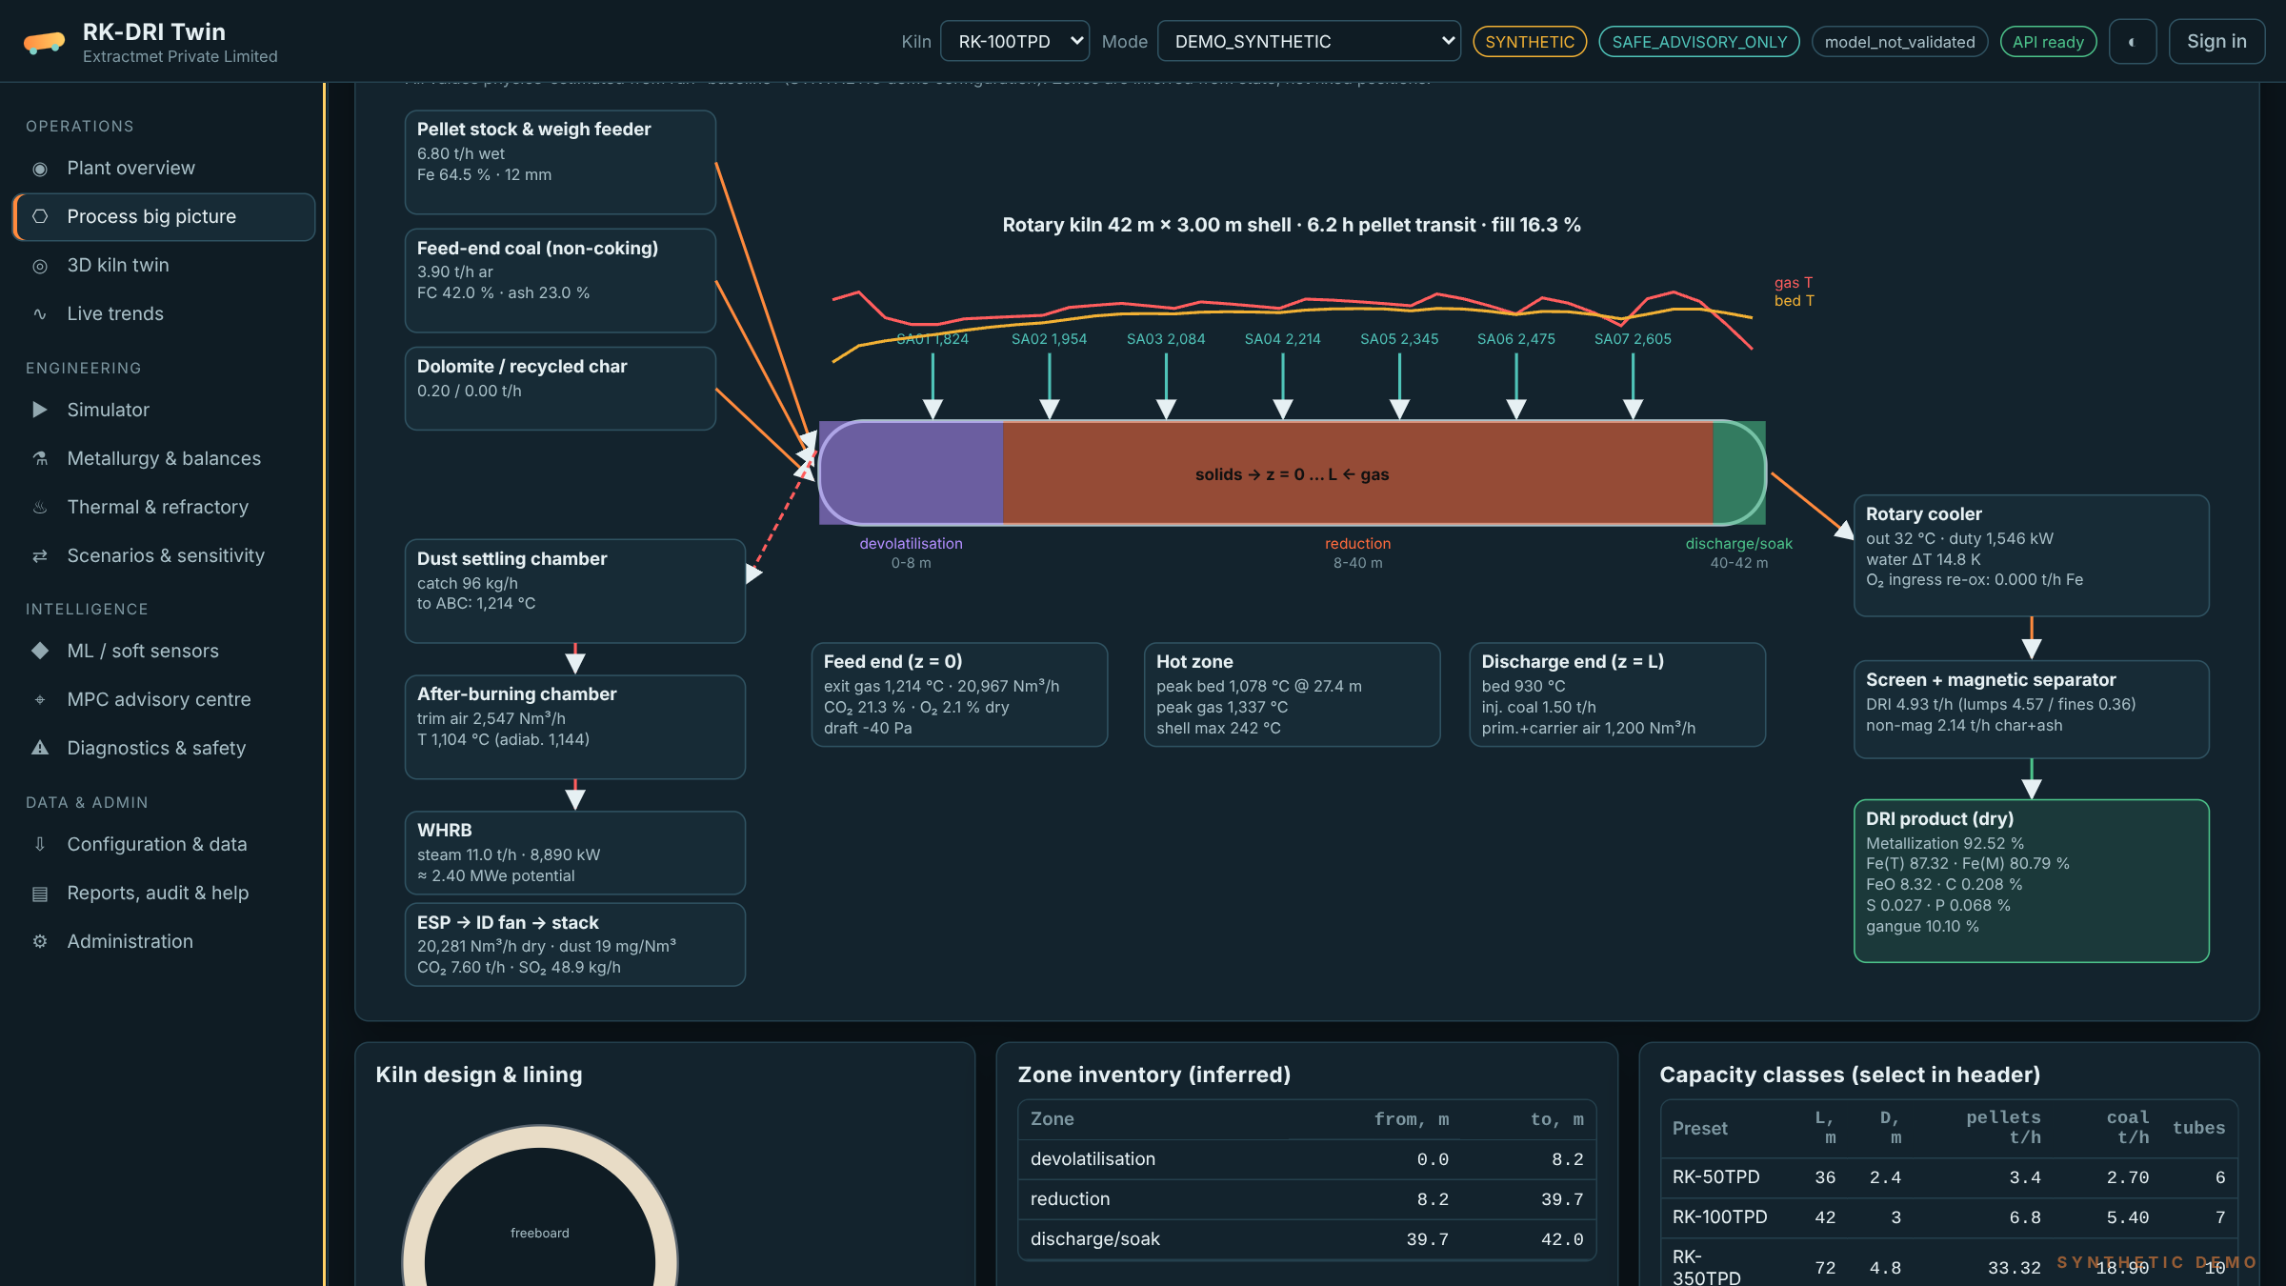
See inside the kiln, then see the whole plant
3D twin: cutaway shell, refractory and bed coloured by temperature or reduction stage; moving pellets and counter-current gas; click air tubes and slices to inspect any point.
Process big picture: bins and feeders, inferred kiln zones, every air tube, cooler, magnetic separation, ABC, WHRB, ESP and stack, all with live run values.

Slide 7
The physics engine models what happens in the kiln
Chemistry and kinetics
Transport, heat and plant
Hematite to magnetite to wustite to iron, by CO and H₂, with equilibrium limits
Three-interface shrinking-core pellet kinetics with film and pore diffusion
Boudouard and steam gasification of char; devolatilisation closed against coal NCV
Drying, dolomite calcination, sulfur release and capture
Freeboard combustion, water-gas shift, bed-surface char burn and re-oxidation
Kramers-Saeman bed transport: depth, fill, velocity, residence time
Gas-bed, gas-wall, wall-bed contact and radiative heat transfer
Multi-layer refractory conduction; shell convection and radiation losses
Cooler, magnetic separation, after-burner, WHRB steam, ESP and emissions
Accretion-risk index and an LHV energy ledger
Audited every step: mass residual 3 × 10⁻⁷, energy 1 × 10⁻¹¹, each element ~10⁻¹⁵ (relative). Unbalanced results are rejected, never normalised.

Slide 8
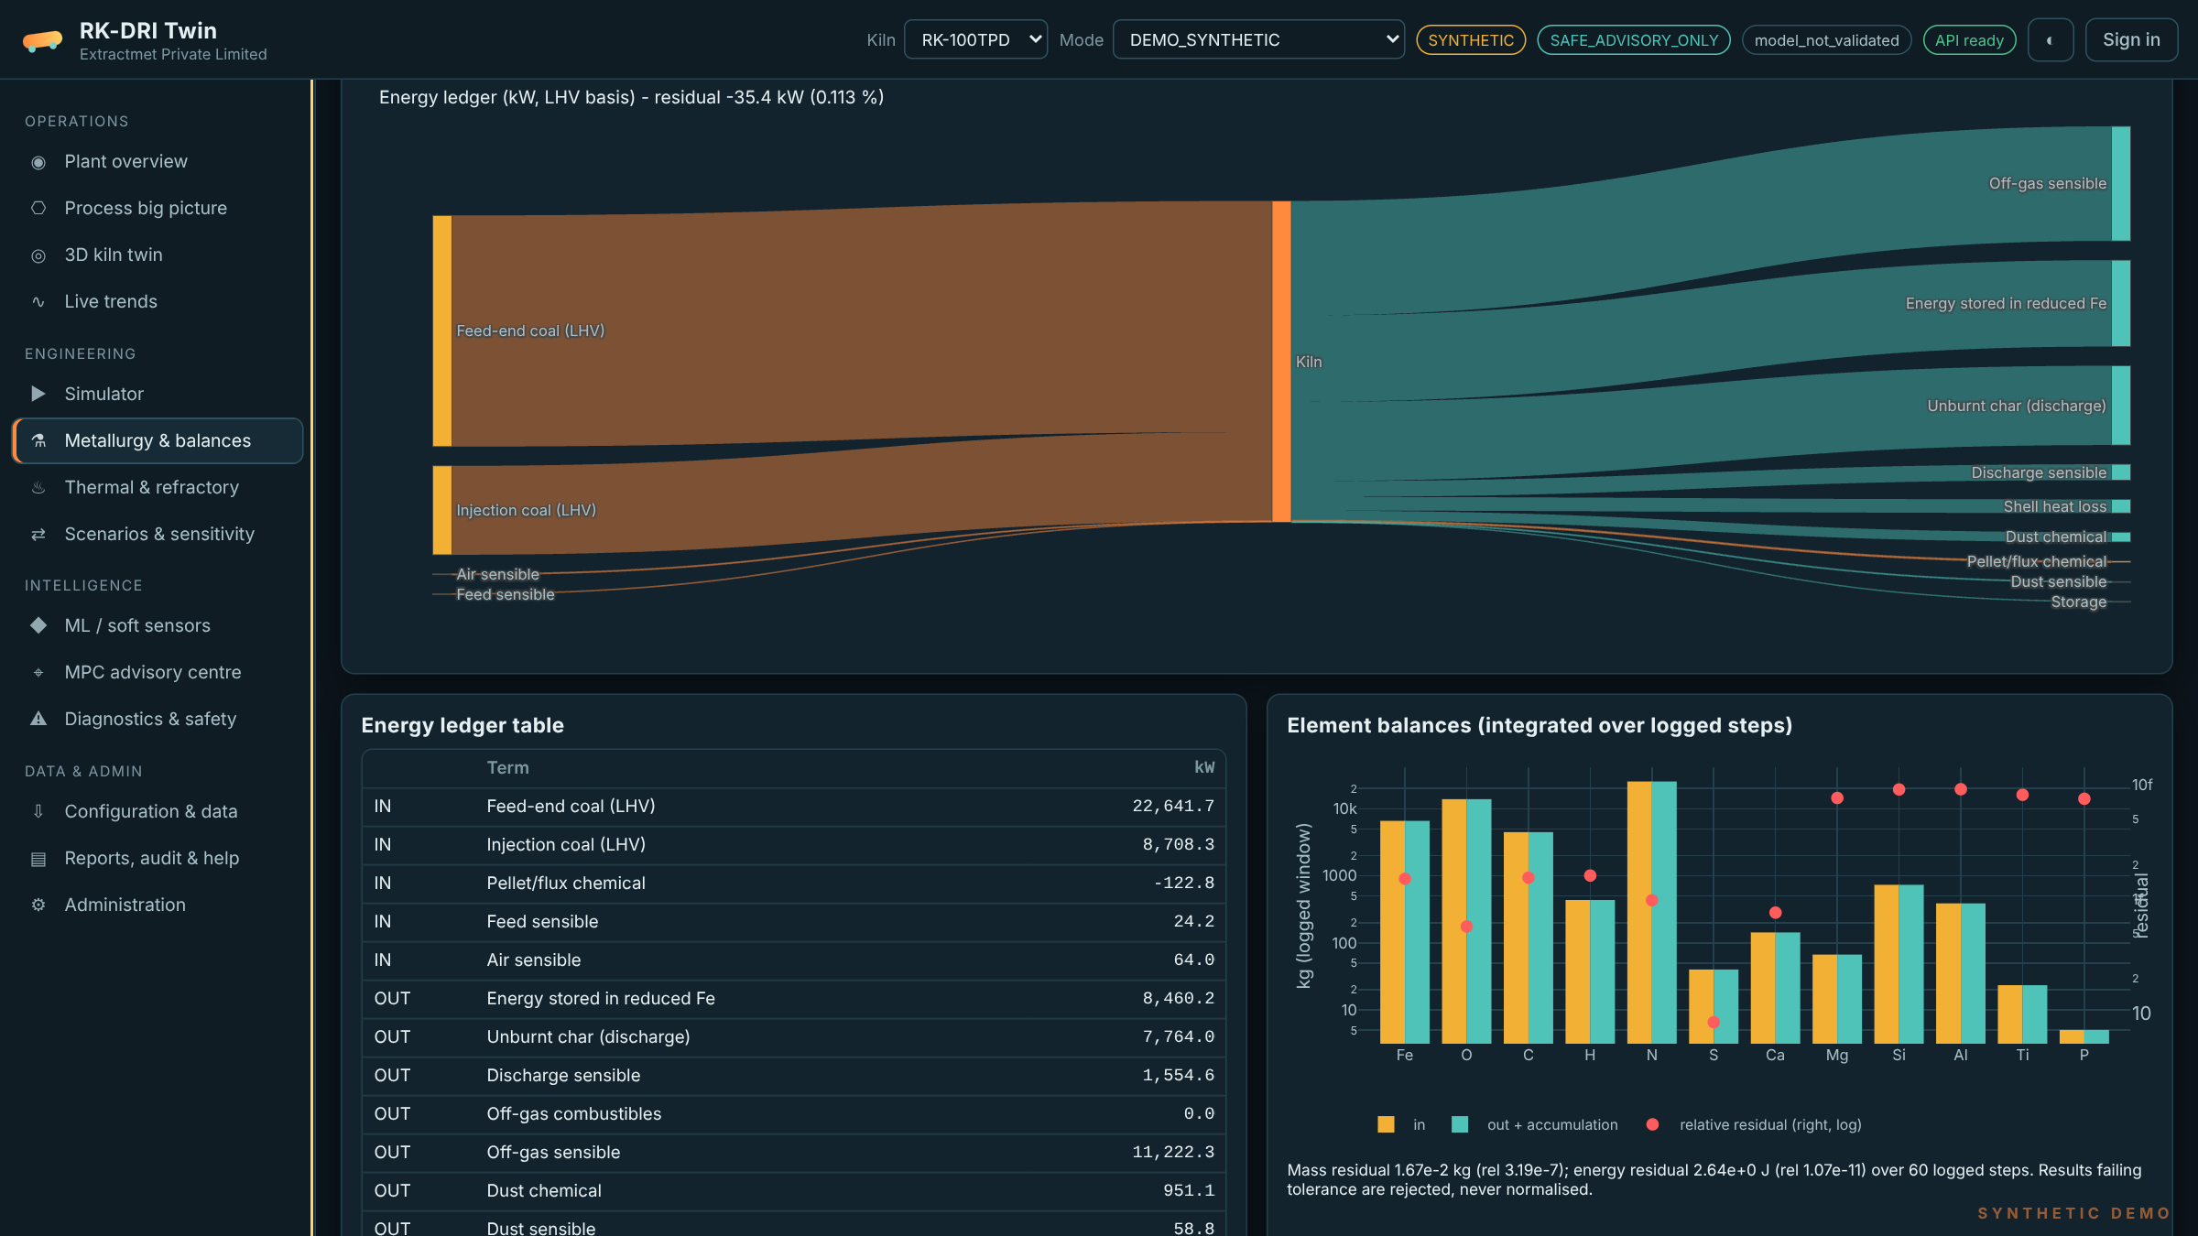
Every tonne and every kilowatt is accounted for
100 TPD demo kiln
Coal LHV in: 31.4 MW
Stored in reduced iron: 8.5 MW
Off-gas sensible: 11.2 MW, recoverable in the WHRB (≈ 11 t/h steam)
Unburnt char at discharge: 7.8 MW
Shell loss: 1.3 MW
Synthetic demonstration configuration; site figures follow calibration.

Slide 9
Ready for any kiln size from 50 to 500 TPD
Kiln class | Length m | Metallization % | DRI t/d (model) | Coal kg/t | Peak bed °C | WHRB steam t/h
RK-50TPD | 36 | 93.5 | 59 | 1,102 | 1,145 | 3.5
RK-100TPD | 42 | 92.5 | 118 | 1,095 | 1,078 | 11.0
RK-350TPD | 72 | 92.5 | 576 | 788 | 1,153 | 29.9
RK-500TPD | 80 | 93.5 | 808 | 802 | 1,169 | 45.8
Read this honestly: these are uncalibrated physics results on synthetic inputs. For the larger kiln geometries the model predicts output above the nameplate class, showing that kinetics and heat-transfer placeholders must be calibrated to each plant. Site calibration is step one of every engagement.

Slide 10
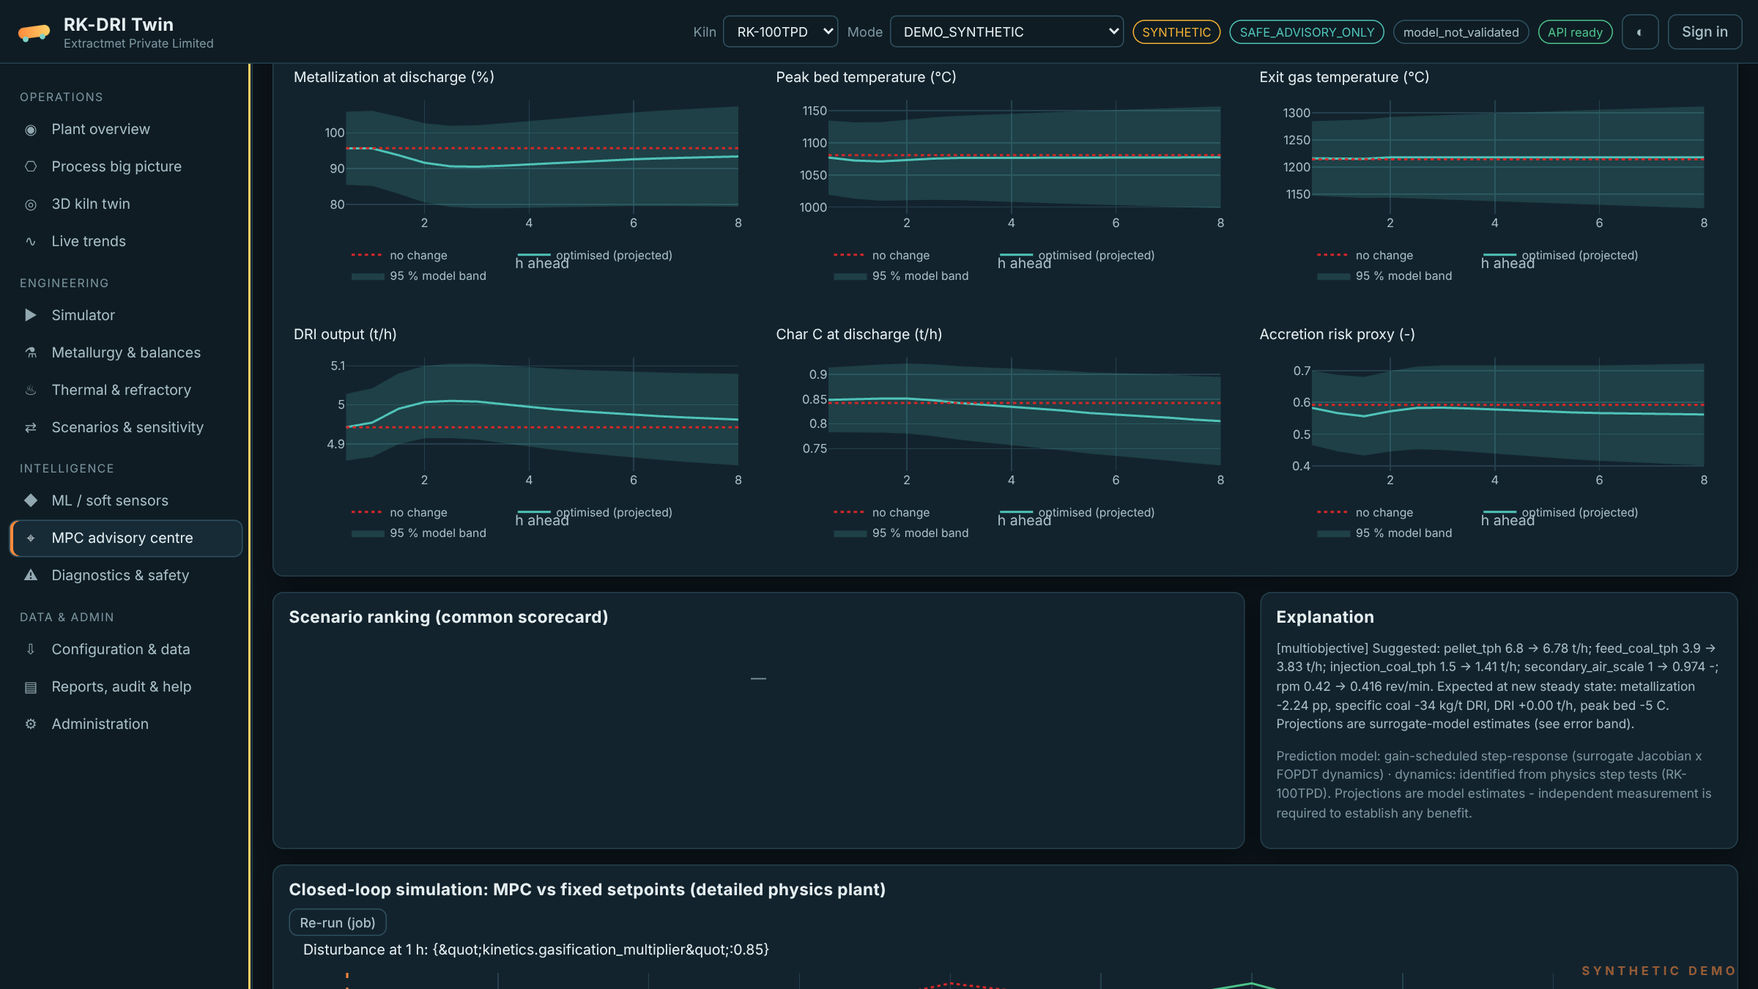
Advice with confidence bands, never blind setpoints
Five objectives: metallization, specific coal, throughput, thermal risk, multi-objective
Hard actuator bounds and ramp rates; process envelopes as soft constraints
Six safety gates: mode, optimiser, envelope, model domain, local model confidence, data freshness
Approve, reject or defer with a mandatory note, all in the audit trail
Advisory only: no button can write to the PLC or DCS.

Slide 11
Safe by architecture: read-only from the plant
PLC / DCS + safety interlocks
Read-only data path
PLC/DCS to historian to DMZ connector; no public OPC UA, no internet-reachable PLC
Plant historian (read-only)
Cloud or on-premises
Render for demos; private or on-prem deployment with SSO, TLS and Postgres for plants
DMZ connector, egress only
Future supervisory link
Only through a separate on-prem approval gateway after management of change and plant sign-off
RK-DRI Twin backend: physics, EKF, ML, MPC
Aligned with
Operator desk: approve / reject advice
NIST SP 800-82 Rev. 3, OPC UA security, Ministry of Steel safety guidelines (SG/32)

Slide 12
Where the value is, and how we prove it at your plant
Coal
Quality
Measurement and verification
Optimise feed/injection split and air distribution against the coal-per-tonne objective
Soft-sensed metallization hours before the lab result
Baseline from your historian before any trial
Shadow mode first: the twin predicts, it does not advise
Acceptance thresholds agreed in the contract before the trial
Benefits measured independently; we publish no generic savings
Uptime
Energy
Early accretion and hot-spot warnings from shell, torque and model residuals
Quantified WHRB potential and losses for every operating point
In our own closed-loop simulation the first MPC tuning did not beat fixed setpoints. That is why site identification and tuning come before any advisory trial.

Slide 13
From demo to trusted advisor in five steps
0
1
2
3
4
Demo
Configure
Calibrate
Shadow
Advisory
Synthetic twin of your kiln class, hosted
Geometry, lining, assays, air tubes, tag map
Historian + lab data; kinetic and heat-transfer fit; blind test
Read-only live feed; predictions and drift tracked
Approved recommendations, M&V, operator training
Gate before supervisory use: plant HAZOP and cybersecurity review, management of change, an independent fail-safe gateway and plant authority sign-off. Until then the twin stays advisory.

Slide 14
Simple commercial packages
Simulator
Shadow + Advisory
Enterprise
Configured twin of one kiln
What-if studies and training
Reports, balances, 3D desk
Cloud hosted
Everything in Simulator
Calibration and blind test
Live read-only data, EKF, ML
Advisory MPC with audit trail
Quarterly model review
Multiple kilns or sites
On-premises deployment
SSO, Postgres, integrations
Custom kinetics and lab programme
Priority support
Licence: annual subscription per kiln plus one-time configuration and calibration. Pricing quoted by Extractmet per site scope.

Slide 15
Why Extractmet
1
Domain depth
2
Proven modelling stack
Founded by a full professor of metallurgical and materials engineering at IIT Madras; decades of iron- and steelmaking modelling
Thermodynamics, heat and mass transfer, zone models and data-driven ML on large plant datasets
3
Twin portfolio
4
Engineering honesty
Blast furnace, MIDREX shaft, electric smelting, EAF, BOF, ladle, induction furnace, sinter, ferrochrome and beneficiation twins
Every result labelled; validation gates published; no unverified savings claims

Slide 16
Next step: a configured twin of your kiln
What we need from you
What you get
Kiln drawings: length, diameter, slope, lining, dam, air-tube positions
Two weeks of historian data and lab results
Pellet and coal assays (proximate, ultimate, NCV, ash fusion)
A process engineer as single point of contact
A configured twin of your kiln class
A calibration plan with acceptance thresholds
A shadow-mode proposal with M&V method
Extractmet Private Limited | IIT Madras Research Park, Chennai

