Slide 1
Introduction

Slide 2
Framework
Core
Integration
Logging
Stage Navigation
Multiplay
Chat
Third party
VContainer
UniRx
UniTask
Vivox
Unity
Addressable Asset System
Netcode for GameObjects

Slide 3
Title screen
Avatar selection screen
Space selection screen
Virtual space
TODO
サンプルアプリができたらスクリーンショットを貼る
TODO
サンプルアプリができたらスクリーンショットを貼る
TODO
サンプルアプリができたらスクリーンショットを貼る
TODO
サンプルアプリができたらスクリーンショットを貼る
TitleScreen
AvatarSelectionScreen
SpaceSelectionScreen
VirtualSpace
Framework
App
App
App
App
CameraControl
CameraControl
CameraControl
CameraControl
Core
InputControl
InputControl
InputControl
InputControl
TitleScreen
NetworkControl
NetworkControl
NetworkControl
Stage
Navigation
PlayerControl
PlayerControl
PlayerControl
AvatarSelectionScreen
LobbyControl
TextChatControl
SpaceSelectionScreen
VoiceChatControl
Stage
ReactionControl
VirtualSpace
Scene

Slide 4
Scene
Third party
subscribe
VContainer
View
call
Presenter
call
Model
subscribe
UniRx

Slide 5
TextChatControl
Framework
Third party
TextChatView
TextChatPresenter
TextChatModel
Integration
<<GameObject>>
TextChatUI
Chat
Vivox

Slide 6
Sample Applicaiton

Slide 7
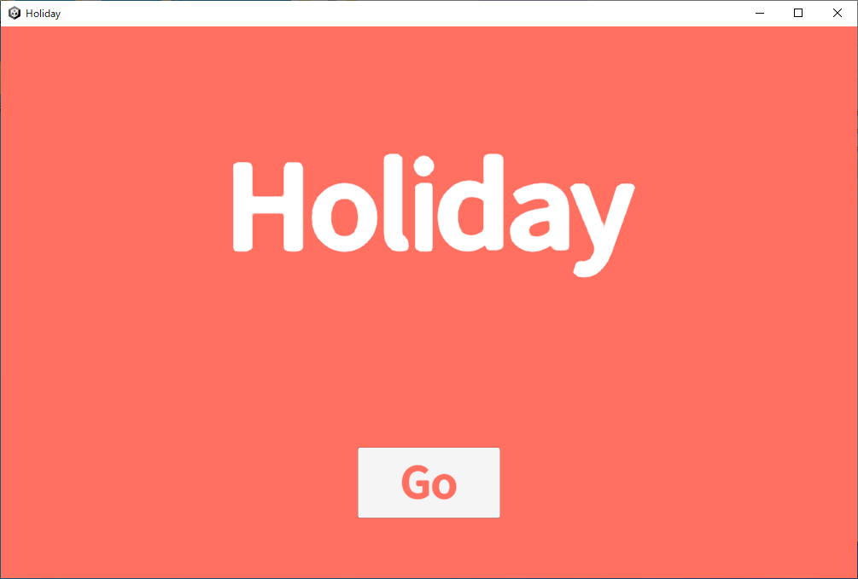
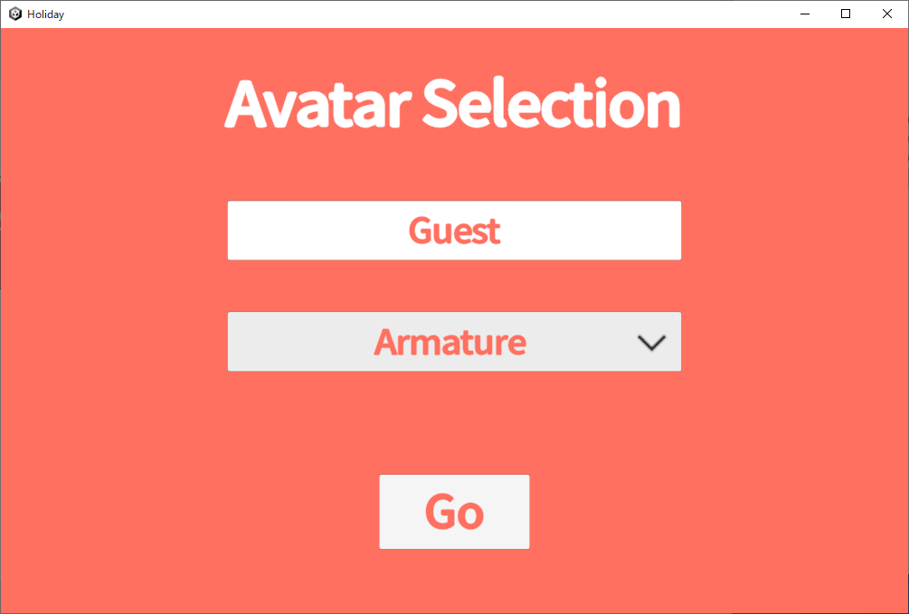
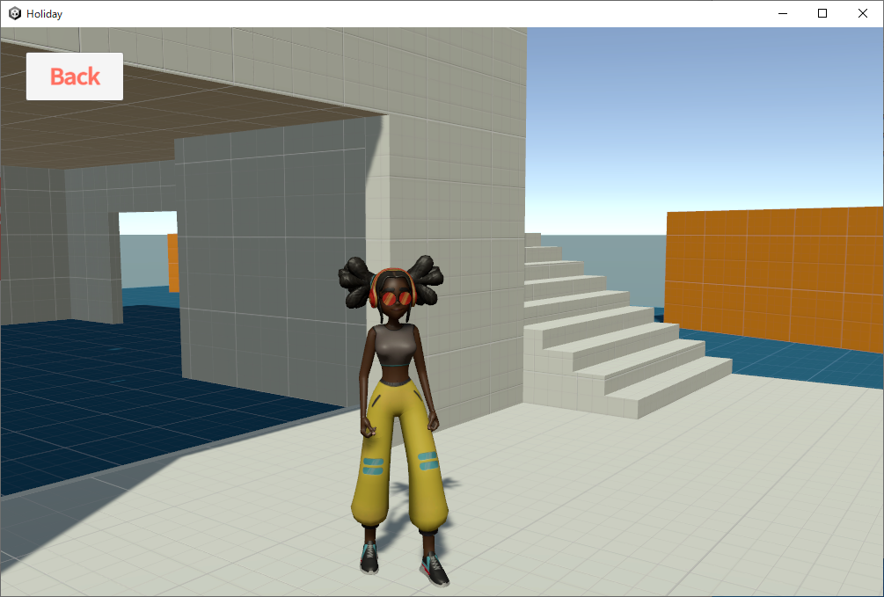

Slide 8
Apple Store
User
download
Google Play
AWS S3
upload
use
setup
Developer
Vivox
(SaaS)
text/voice chat
setup
Holiday
(PC or Mobile)
play, reaction
Multiplay
(AWS EC2)

Slide 9
TitleScreen
AvatarSelectionScreen
VirtualSpace
App
App
App
Entry point
Models
Models
Models
InputControl
InputControl
InputControl
LightControl
LightControl
LightControl
Common scenes
BackgroundScreen
BackgroundScreen
BackgroundScreen
LoadingScreen
LoadingScreen
LoadingScreen
CameraControl
CameraControl
PlayerControl
Scenes by stage
TitleScreen
AvatarSelectionScreen
VirtualSpace
Stage
Scene

Slide 10
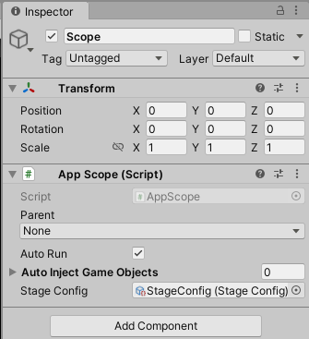
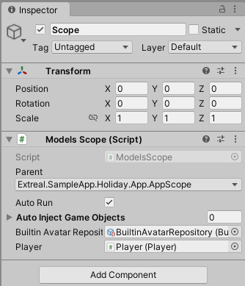
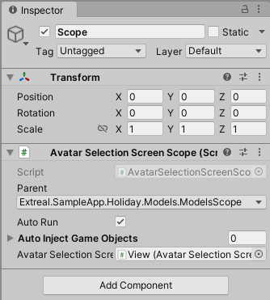
App scene
Models scene
AvatarSelectionScreen scene

Slide 11
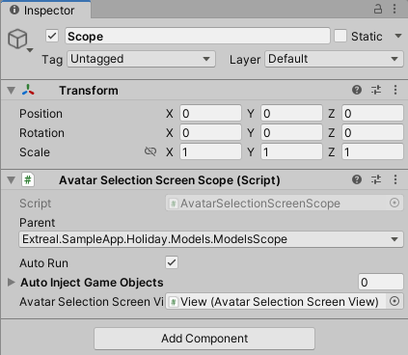
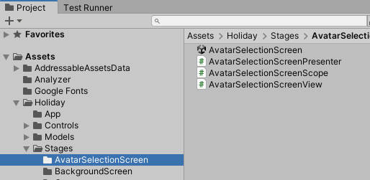
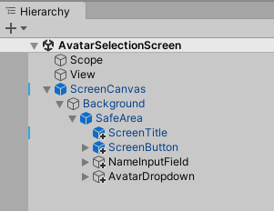
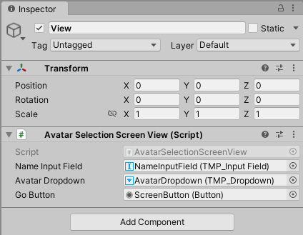

Slide 12
Learning

Slide 13
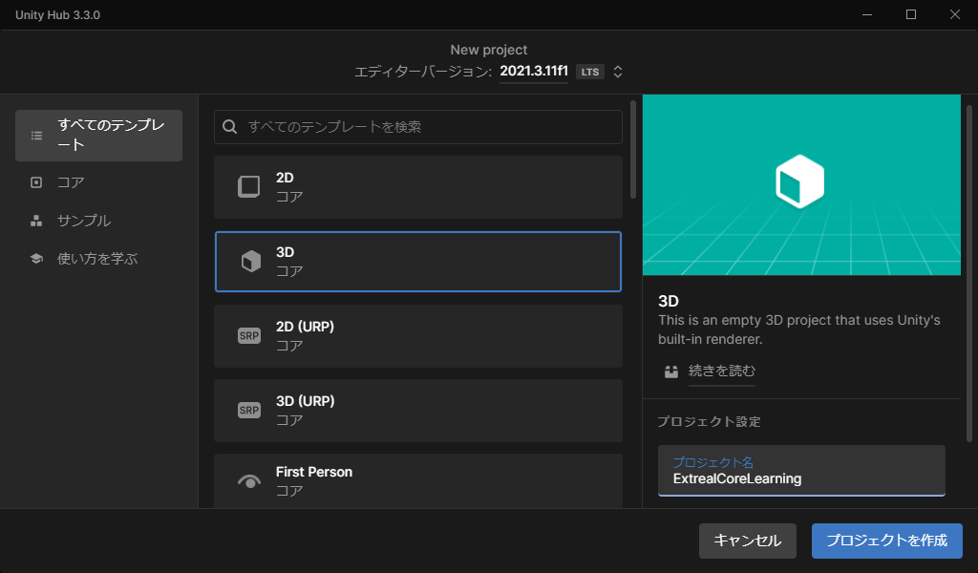

Slide 14
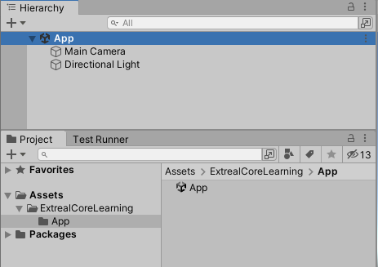

Slide 15
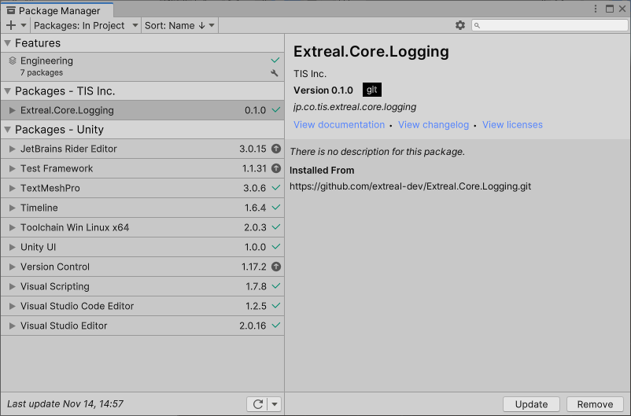

Slide 16
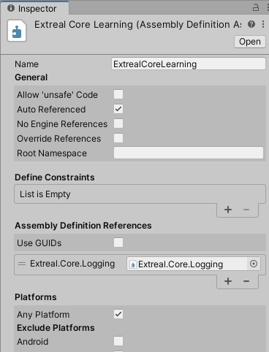
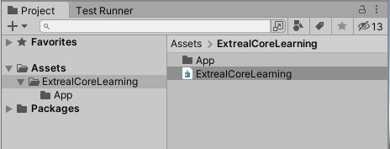

Slide 17
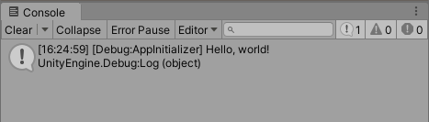

Slide 18
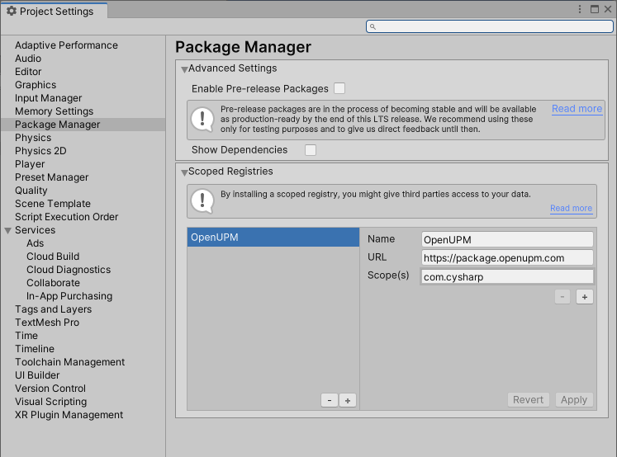

Slide 19
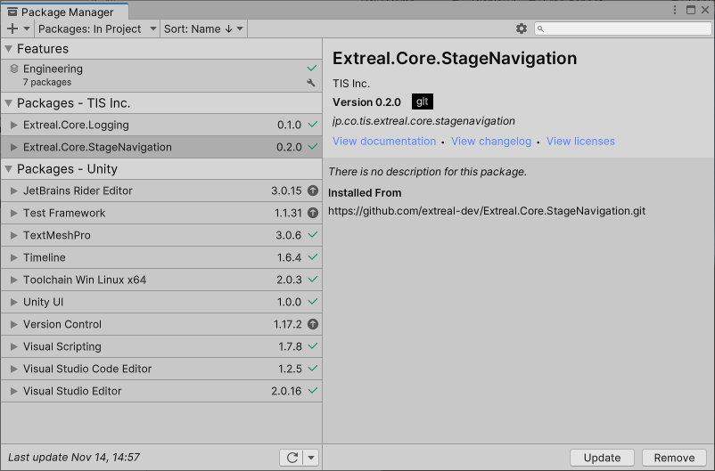
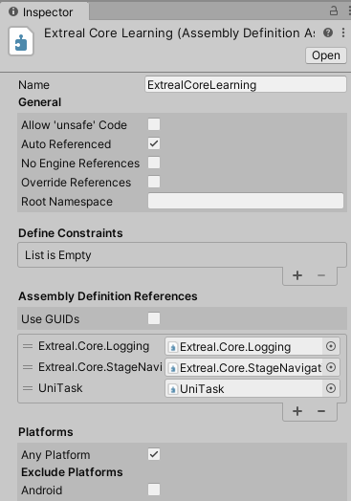

Slide 20
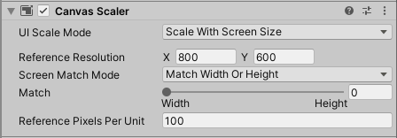

Slide 21
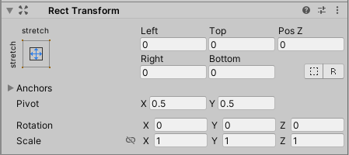
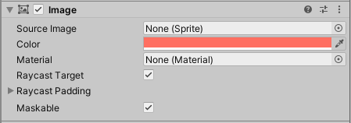

Slide 22
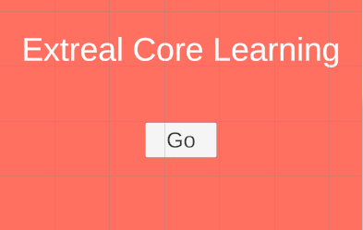

Slide 23
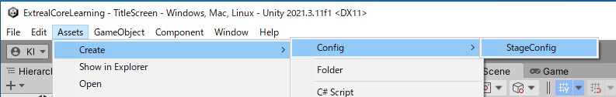
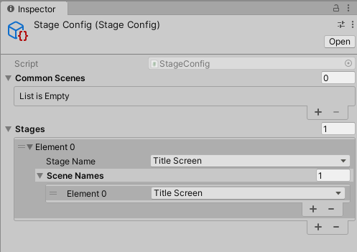
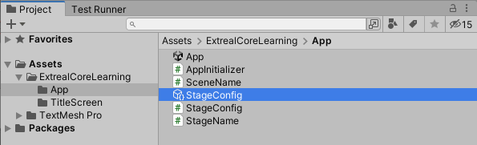

Slide 24
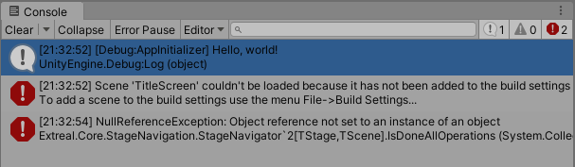

Slide 25
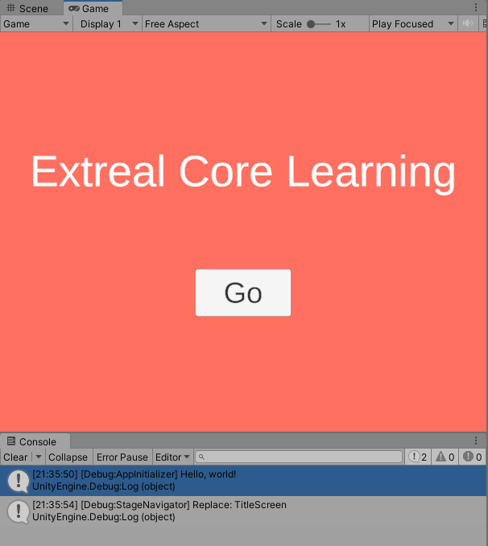

Slide 26
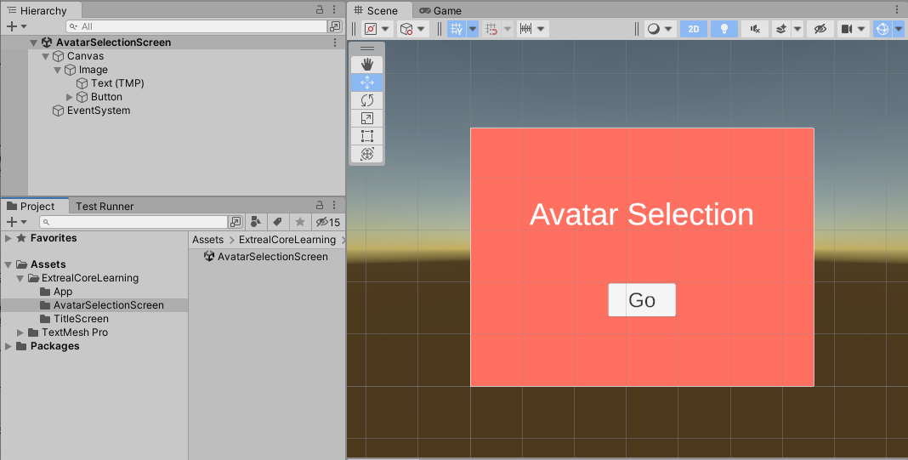

Slide 27
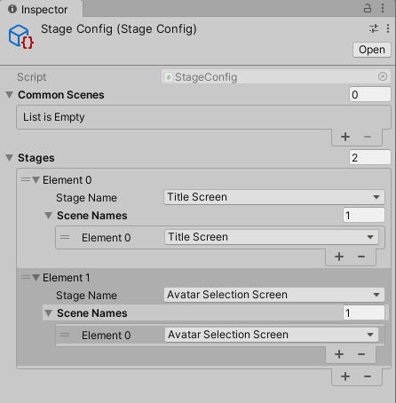

Slide 28
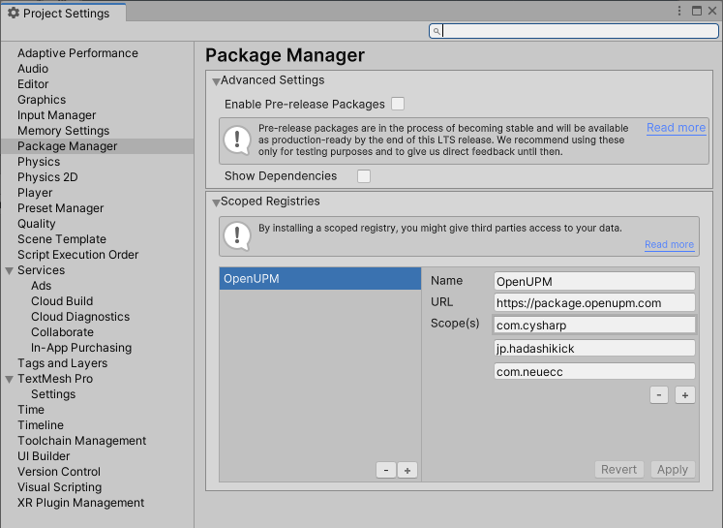

Slide 29
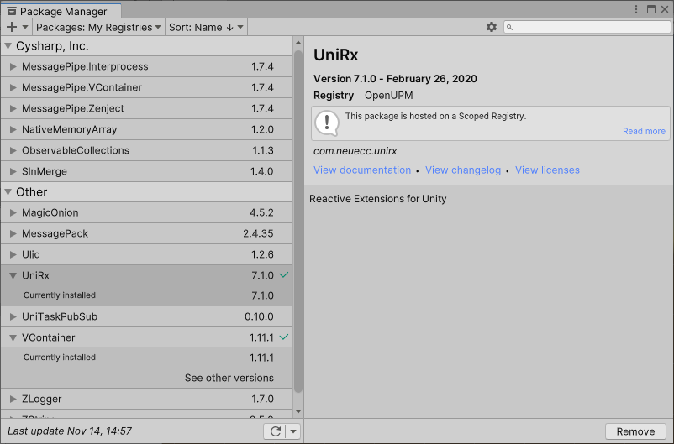
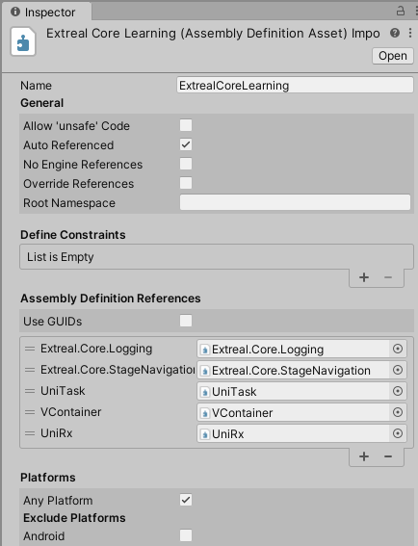

Slide 30
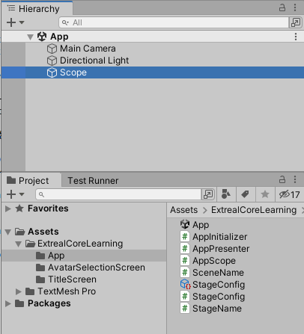
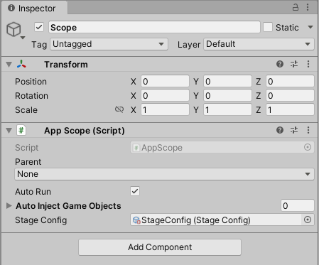

Slide 31
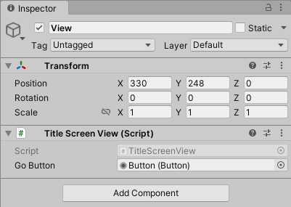
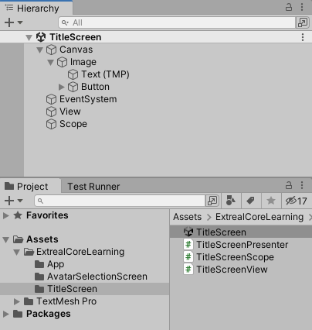
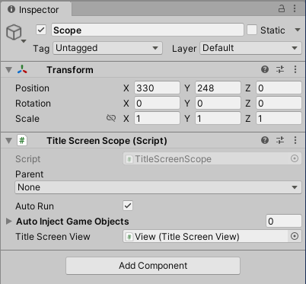

Slide 32
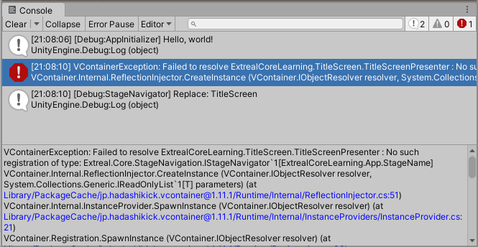

Slide 33
